Slide 1
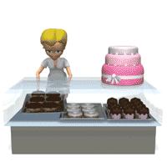
K Bakery Project

Slide 2
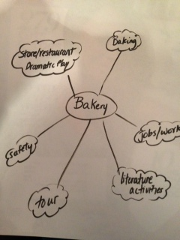
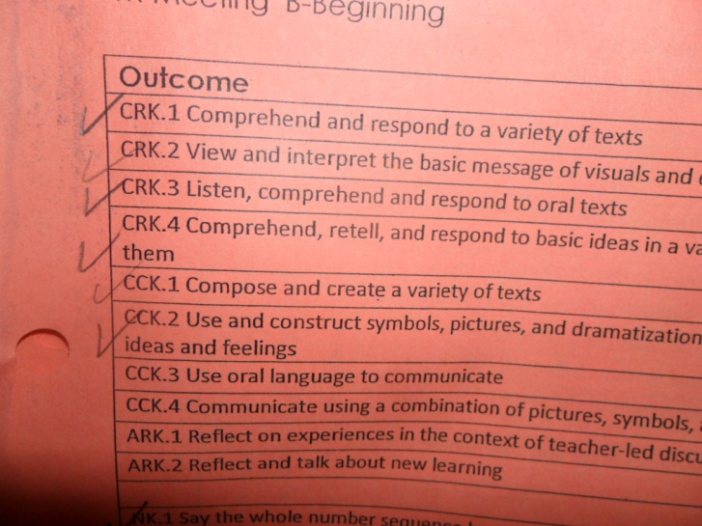
Phase 1
Before I started this project, I briefly brainstormed possible directions that the bakery project could go and checked off outcomes that could be covered!

Slide 3
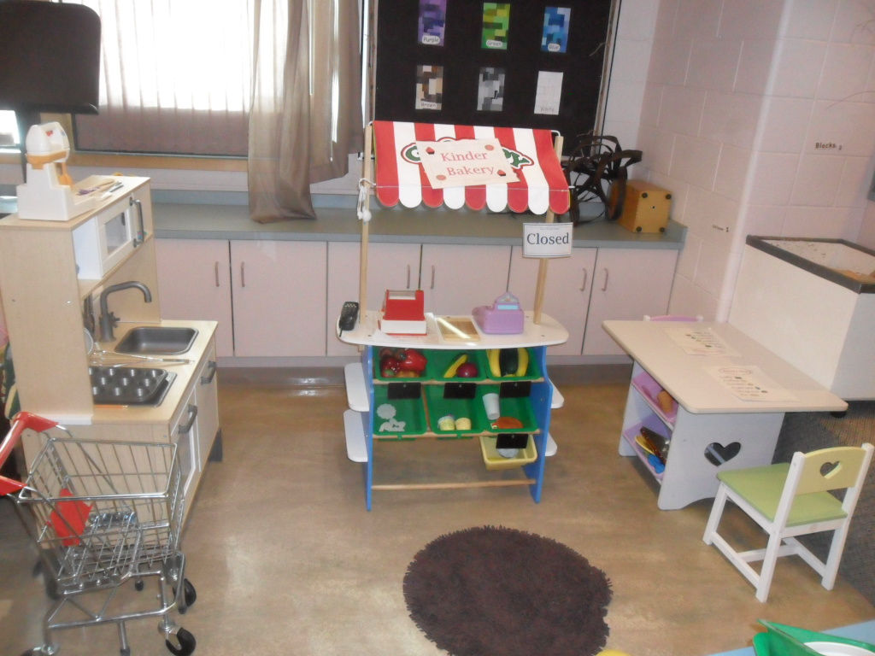
Our Bakery Project took place in a Kindergarten class with 16 students, who come 5 days a week for half a day! I set up a bakery centre one night, and the next day all the students were playing there before the day even started! This project was chosen because students were playing in the kitchen centre everyday during exploration time!
Before:

Slide 4
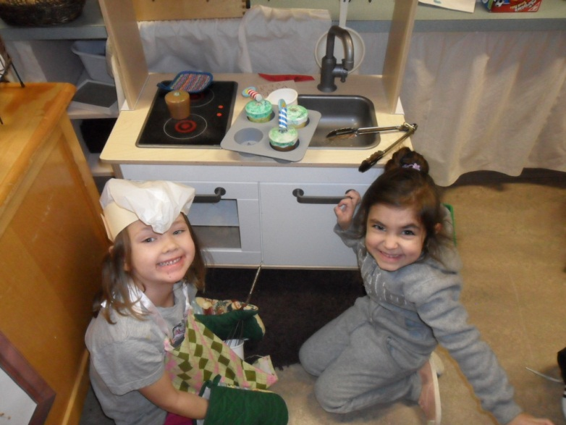
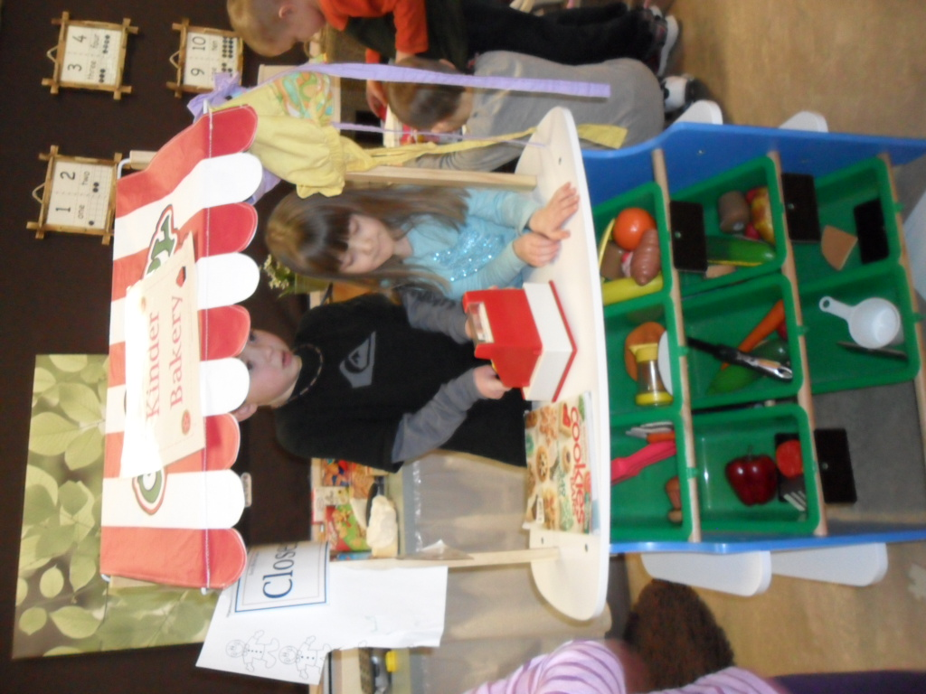
After:

Slide 5
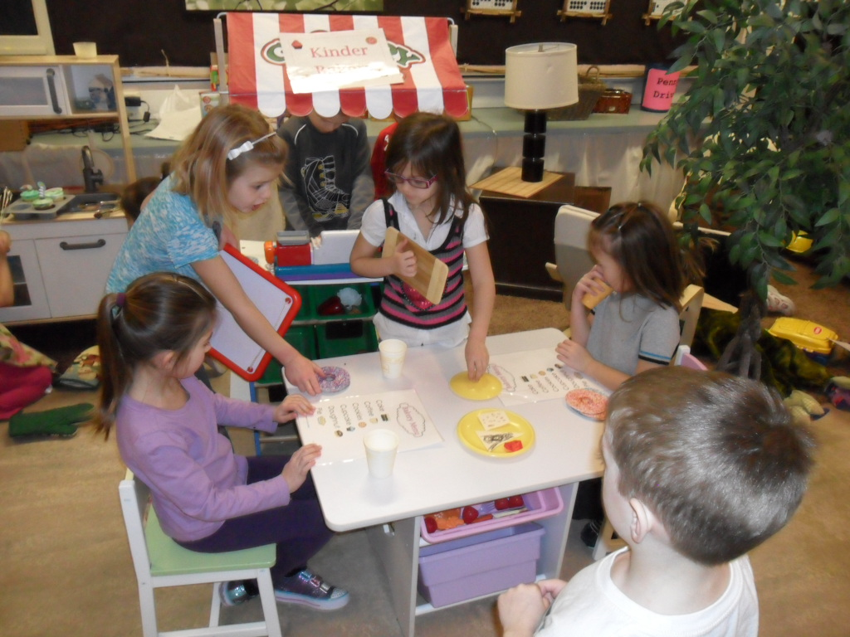
Menus were placed on the tables, the kitchen and bakery were set up with a cash register and phone to answer their customers phone calls! We made bakers hats, students brought aprons to wear and we even got some boxes from Tim Hortons to make the bakery seem realistic!

Slide 6
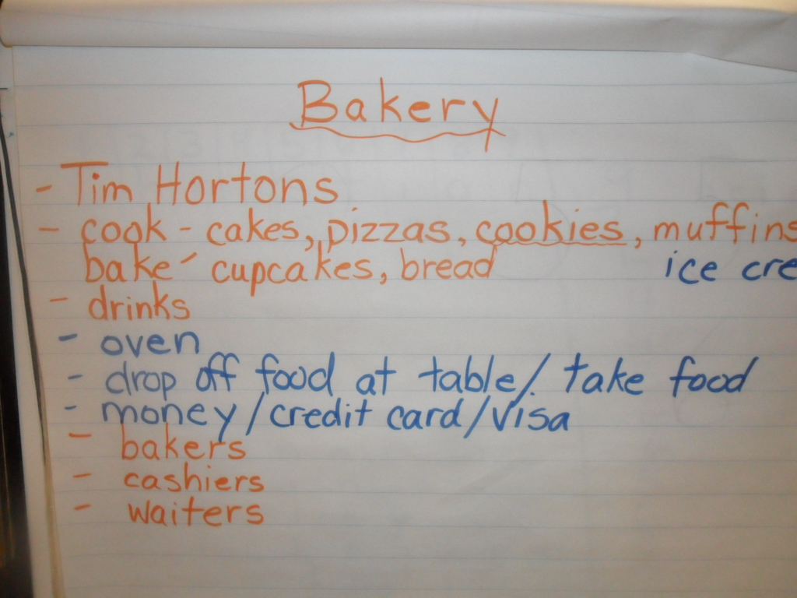
We brainstormed as a class, anything that they could think of that related to a bakery.

Slide 7
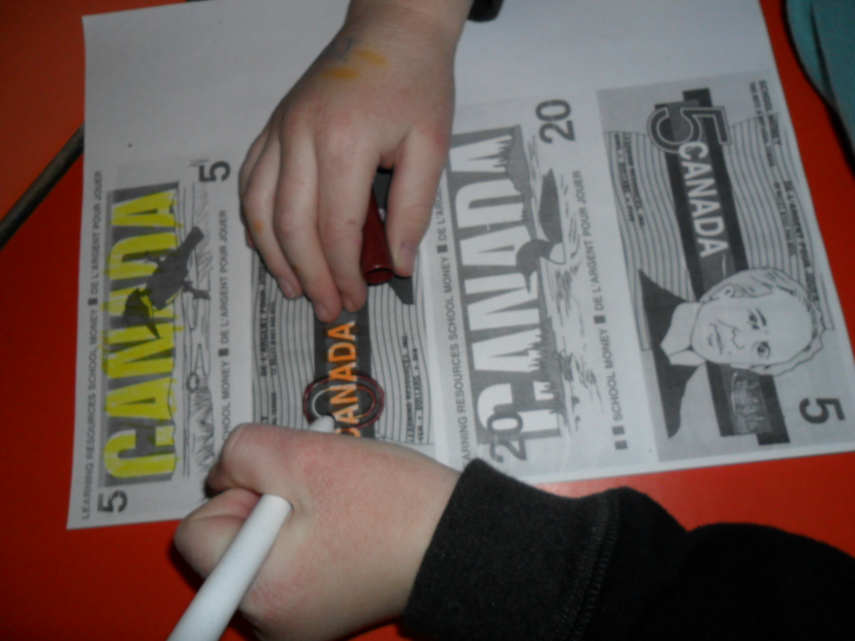
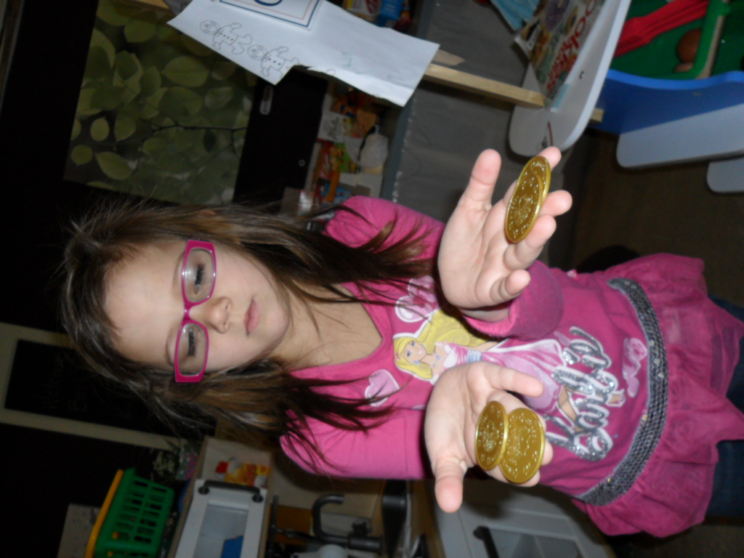
Phase 2
We had students make signs for each person who works in a bakery. We also made money to use which led to many discussions and activities on money and numbers!

Slide 8
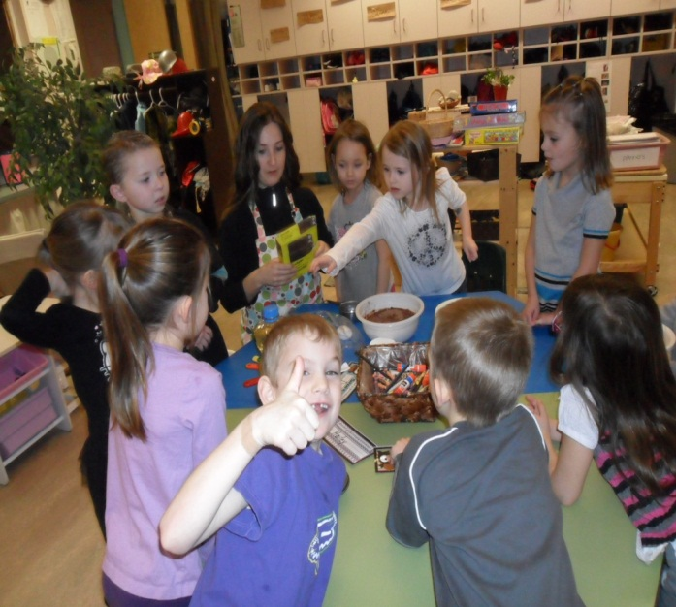
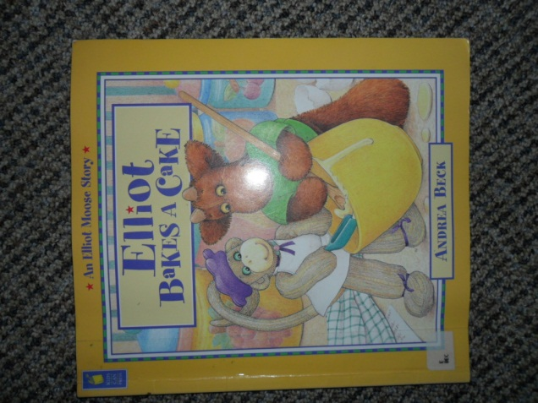
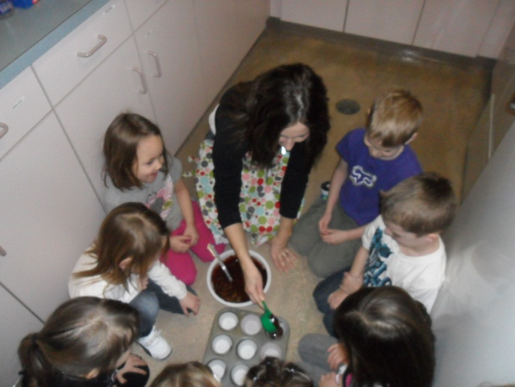
We read the book, “Elliot Bakes A Cake,” and discussed the process of making a cake. We then made our own cupcakes, and boy were they good! The students all had turns using measuring cups, pouring things in and stirring!

Slide 9
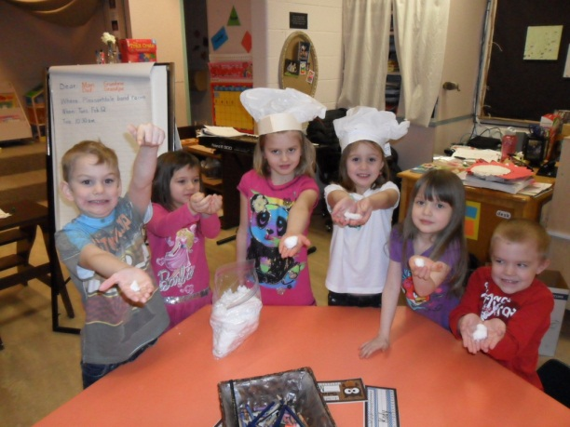
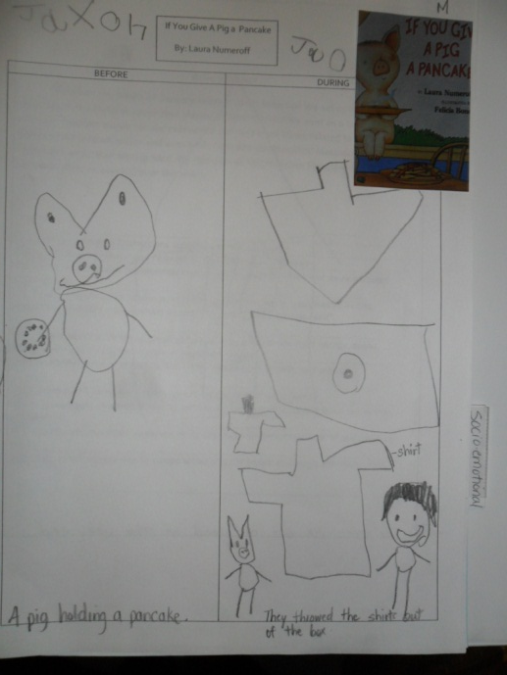
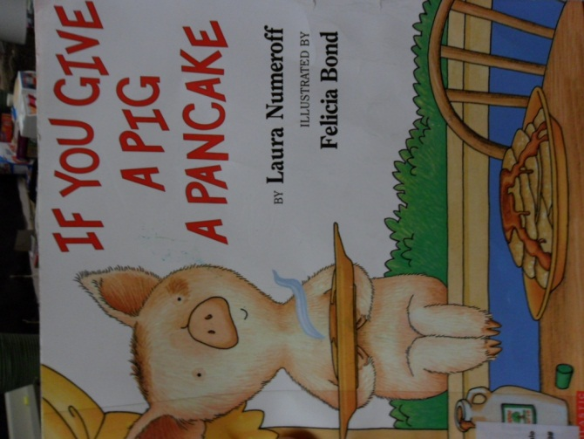
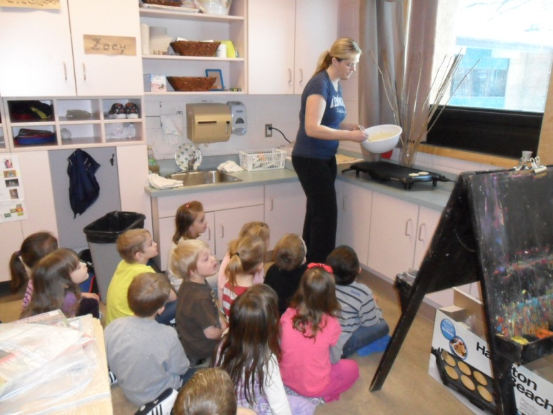
We did some literature activities with , “If You Give A Pig A Pancake”, and then had a parent volunteer come into the class to make pancakes with us!

Slide 10
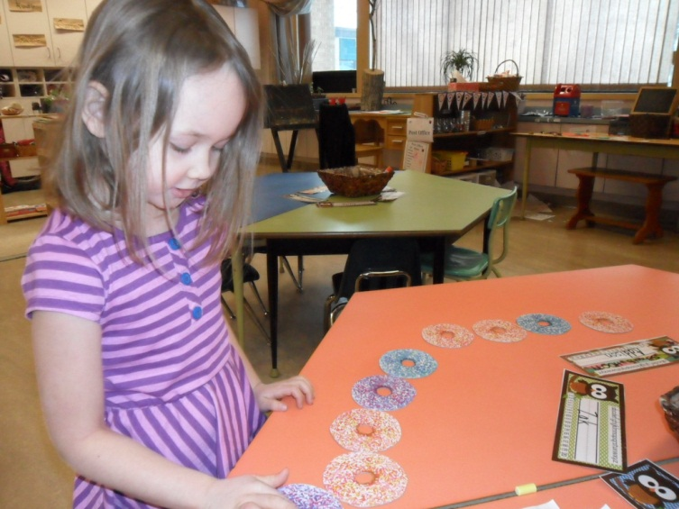
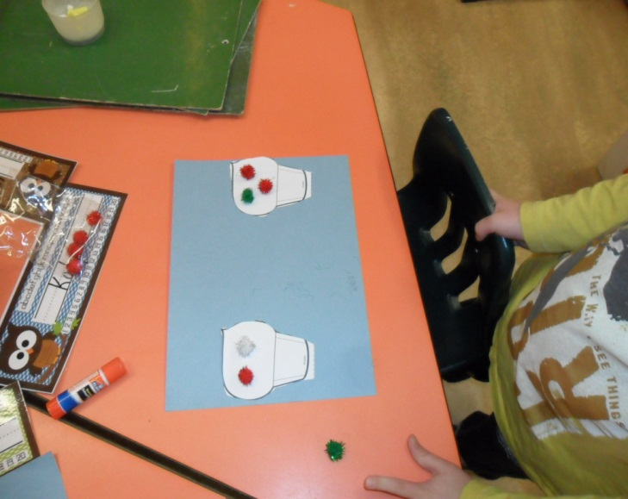
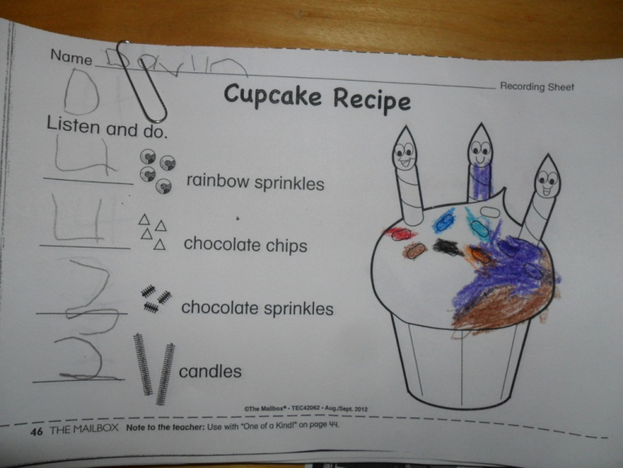
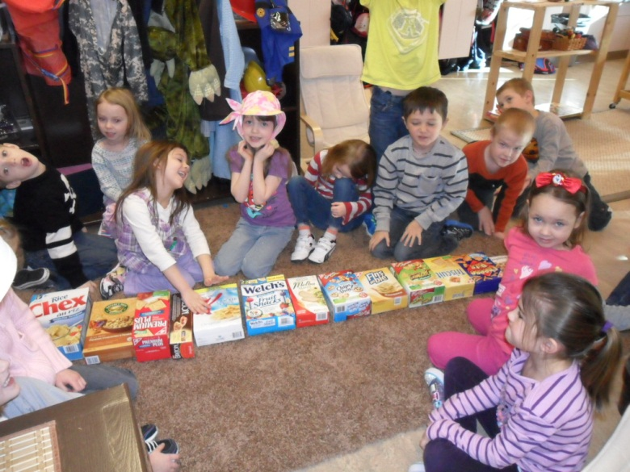
We did a lot of Math activities.
Counting
More/Fewer
Biggest/Smallest

Slide 11
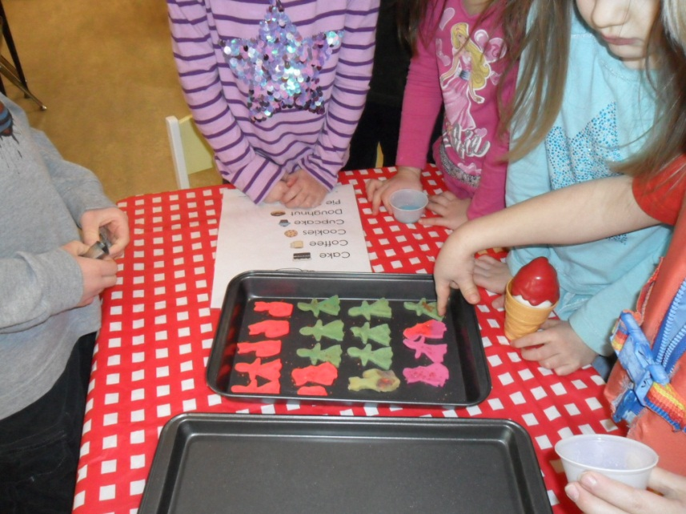
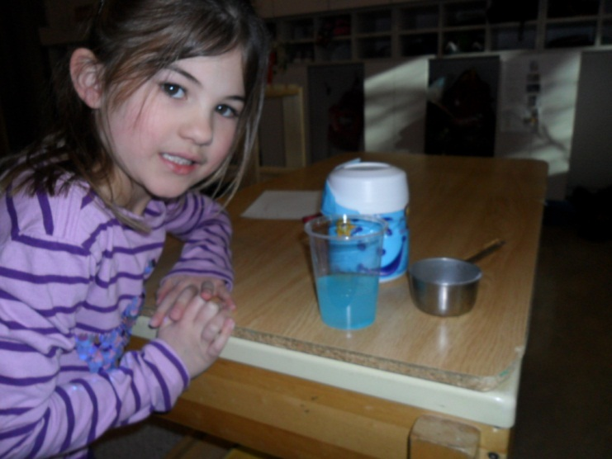
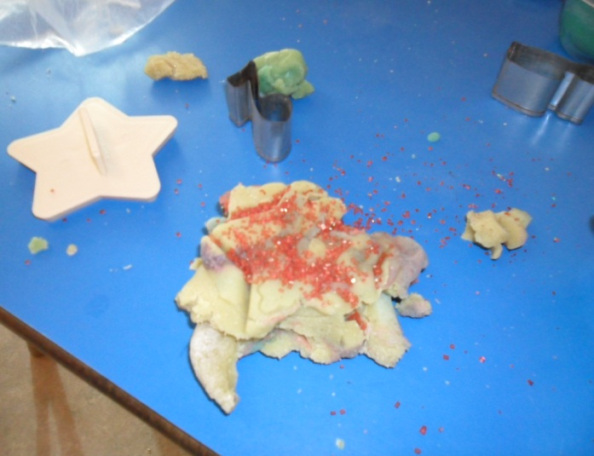
The students had lots of time to explore and have fun pretending to make their own food and drinks!

Slide 12
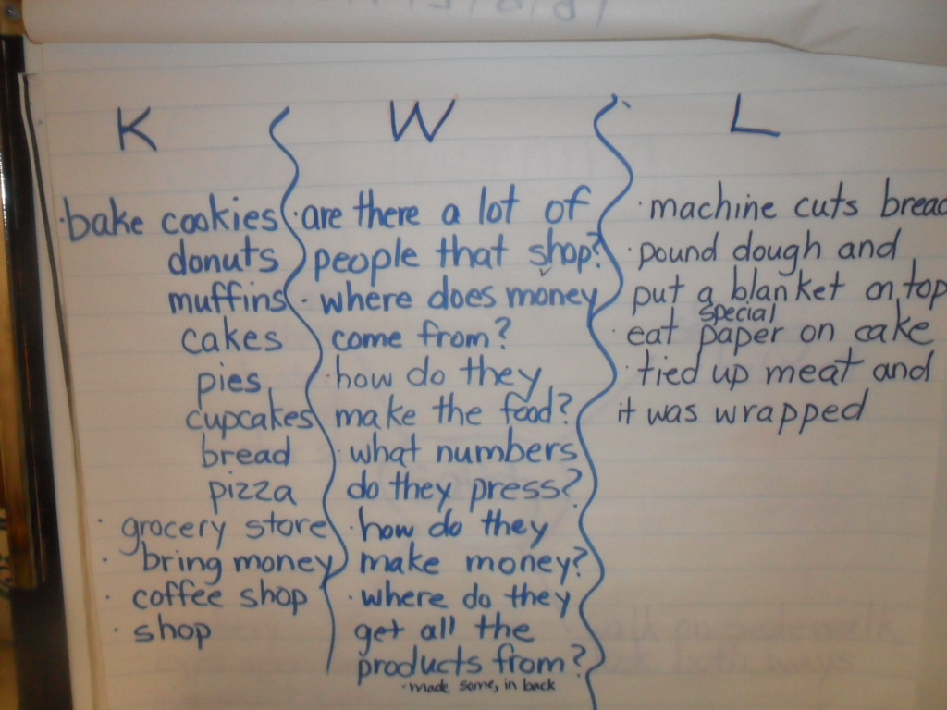
We did a KWL chart as a class before we went on a tour of Sobey’s! This is what they knew and wanted to learn from the bakery tour. We then filled out some things that they learned after the tour as well!

Slide 13
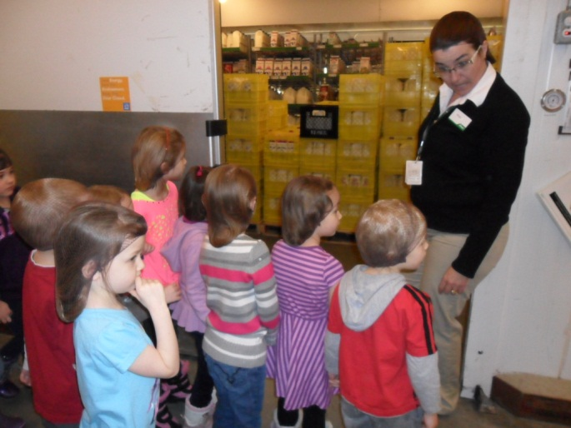
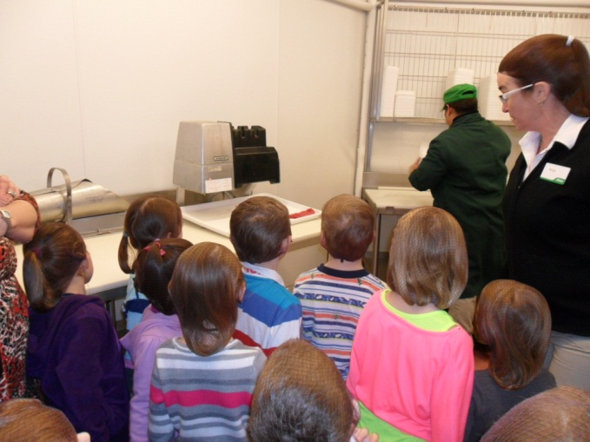
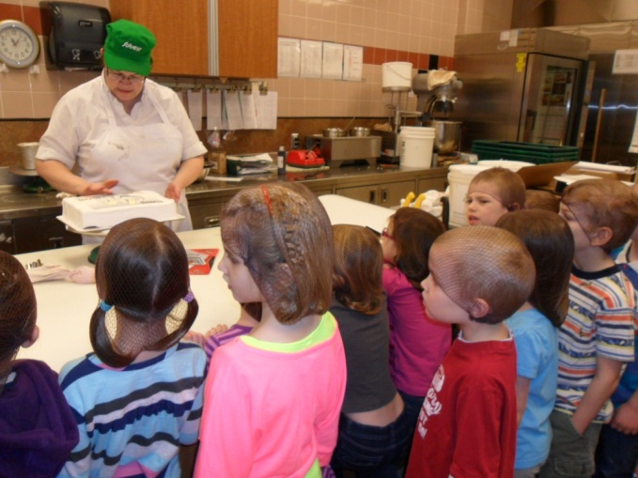
Here is our tour of Sobey’s. Not only were we able to tour the bakery, but we got a tour of the whole store! Students had many questions before going and had many of them answered this day. We also talked about what foods were healthy to eat and how much food the grocery store makes for people! They also taught the children about bakery safety and healthy food handling.

Slide 14
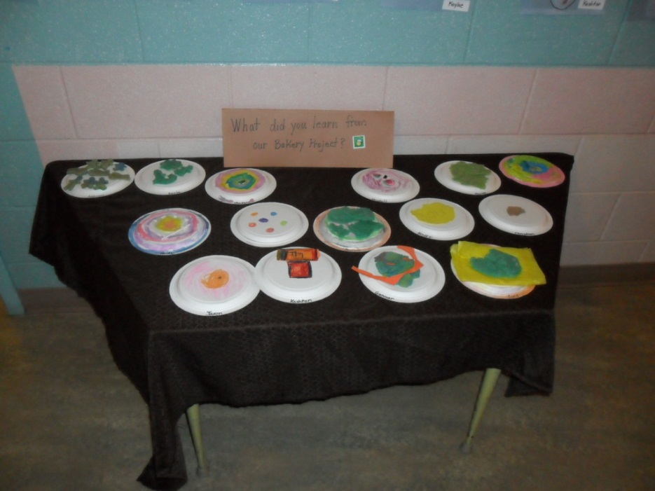
Phase 3
This project lasted for 6 weeks! The students seemed to LOVE it! We ended off our project by having each person make something that represented what they learned in the project. We displayed it in the hall for everyone to see!

Slide 15
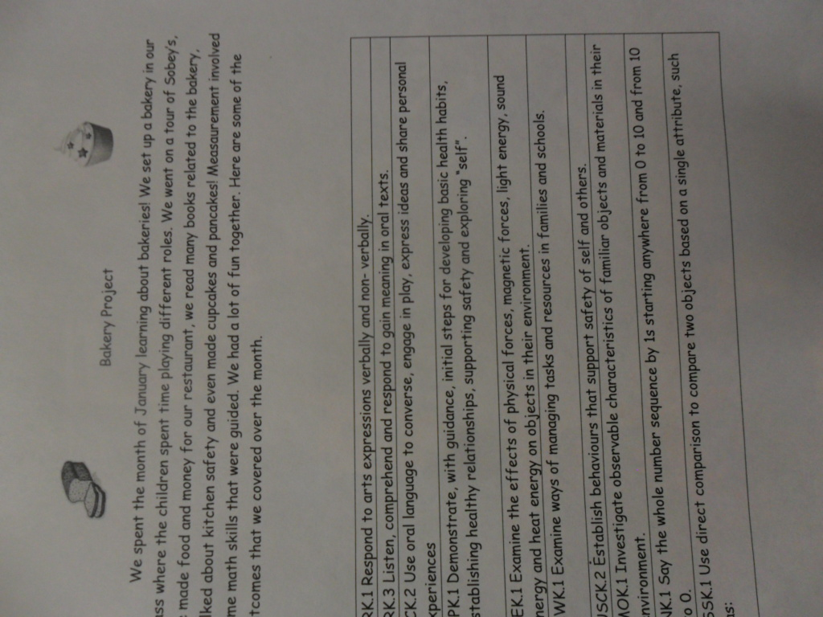
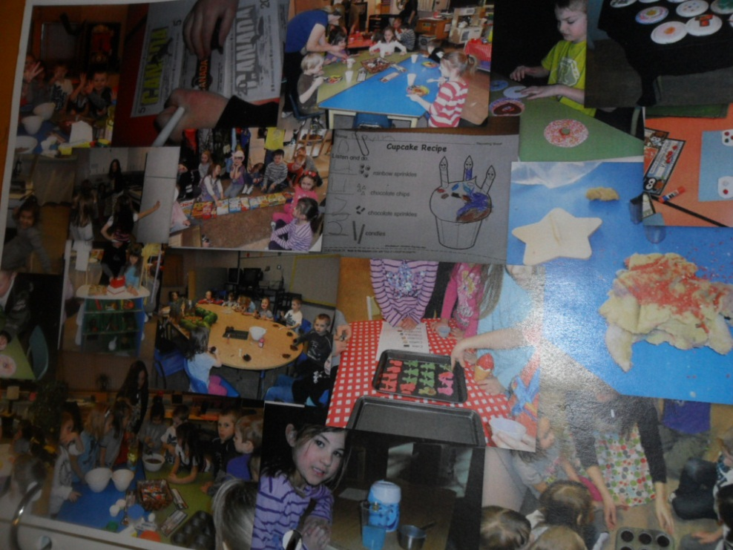
This project was then added into their portfolios to share with their parents!

Slide 16
OUTCOMES
CRK.1Comprehend and respond to a variety of visual, oral, print, and multimedia texts that address identity (e.g., exploring interests), community (e.g., belonging), and social responsibility (e.g., contributing).
CRK.2 View and interpret the basic message of visuals and objects in a variety of texts including models, photographs, dramas, dance creations, and videos.
CRK.3 Listen, comprehend, and respond to gain meaning in oral texts.
CRK.4Comprehend, retell, and respond to basic ideas in stories, poems, songs, and informational texts read to them.
CCK.1Compose and create various visual, multimedia, oral, and written texts that explore and present thoughts, ideas, and experiences.
CCK.2Use and construct symbols, pictures, and dramatizations to communicate feelings and ideas in a variety of ways.
CCK.3Use oral language to converse, engage in play, express ideas, and share personal experiences.

Slide 17
USCK.1 Develop basic habits to establish healthy relationships with self, others, and the environment.
USCK.2 Establish behaviours that support safety of self and others (including safety at school and at home).
NK.1 Say the whole number sequence by 1s starting anywhere from 0 to 10 and from 10 to 0.
NK.5 Compare quantities, 0 to 10, using one-to-one correspondence.
PK.1 Demonstrate an understanding of repeating patterns (two or three elements)
SSK.1 Use direct comparison to compare two objects based on a single attribute, such as: length including height, mass, volume, capacity.
MOK.1 Investigate observable characteristics of familiar objects and materials in their environment.
RWK.1 Examine ways of managing tasks and resources in families and schools.

Slide 18
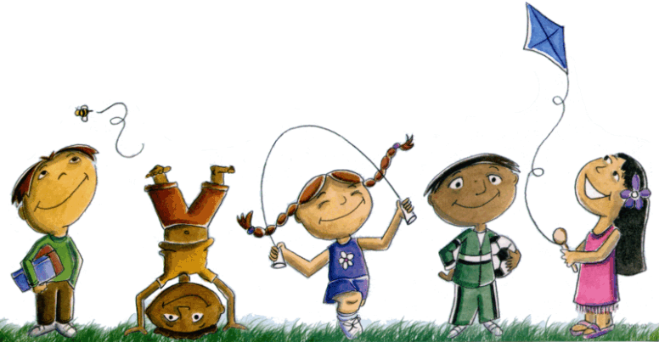
RefLEction
I thought the project went over well! All students kept interest for a long time, and there were many different avenues to take this project, making things easy to plan! This project not only met outcomes, but gave each child an opportunity to experience real life experiences that some may not have normally been able to have.

