Slide 1
Spanish Immersion Preschool
Bati McComas and Maru Aguirre

Slide 2
Going in a trip to the beach
Age group: 3 to 4 years old
Participant: 16 children
Multi-age group half day
Alerces Saskatoon SK

Slide 3
Phase I
Children’s interests
We go on a trip
To the Beach
To the Deep Ocean
We need...
-Luggage, Suitcase
-Sunscreen, swimsuit
-Goggles and flippers -Food for the trip, some cookies
-We go by car or if it is tooo far by airplane
-We have seat belts
-We need a map
-We need to get gas
-The kittens go in the trunk
We need to stop to pee or poo
-Ocean is restful and peaceful
-It’s blue
-Animals play in the ocean all together
-Ocean splash and have waves, they are going in and out.
-Sometimes ocean has dolphins and sharks!
-Sharks just swim, they don’t poop, they eat the man…they just need to go out!- they chew the man

Slide 4
Phase I
Teachers’ web
Trip to the Beach
Social-emotional
Physical
Intellectual
Spiritual
Group conversations
Personal experiences near water
Recall of Family events and family time
Experiencing large and small movements
Pouring different quality of elements
Role play
Large mass of water in nature
Ocean’s flora and fauna
Food chain
Flotation, transparency, straining, absorption
Wind, waves & twists
Our relationship with nature
The power of nature
Pleasure of new discoveries

Slide 5
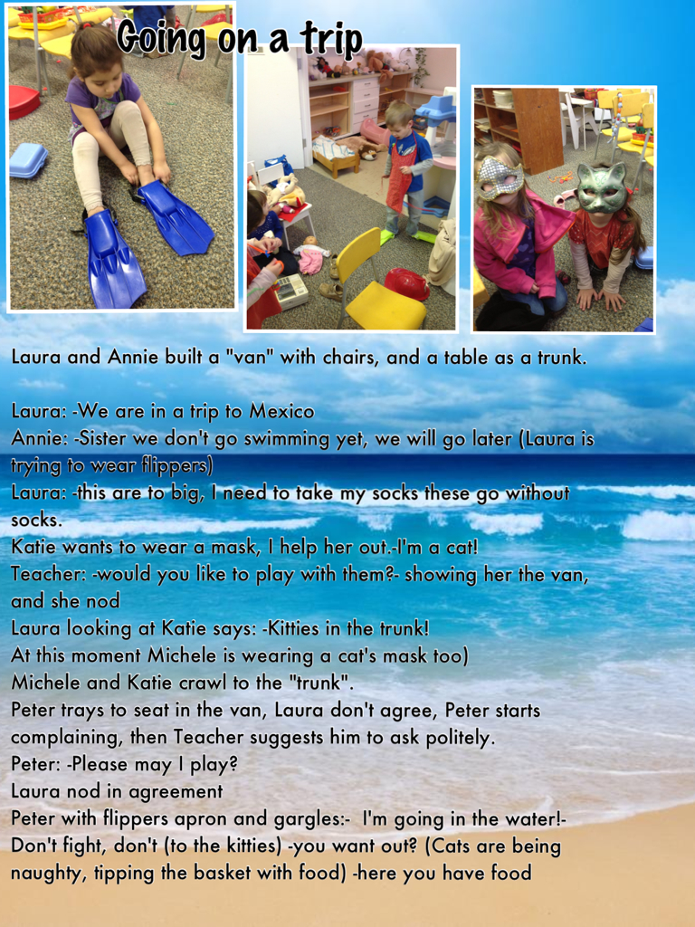
Phase I The Spark!
Laura and Annie built a “van” with chairs and a table. Katie puts on a mask.
Laura: We are on a trip to Mexico
Annie: Sister we don’t go swimming yet, we will go later—Laura is putting on flippers.
Laura: These are too big, I need to take off my socks.
Katie: I am a cat
Teacher: Would you like to play with them?
Katie nods yes.
Laura, looking at Katie: Kitties in the trunk!
Michele who also has a kitty mask on and Laura crawl to the “trunk”.
Peter tries to sit in the van, Laura doesn’t agree and Peter starts complaining. The teacher suggests he asks politely.
Peter: May I play?
Laura nods in agreement.
Peter puts on flippers and an apron, gargles and says: I’m going in the water!

Slide 6
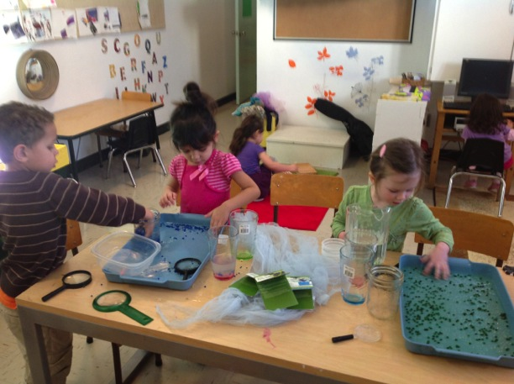
Invitation: “Polymers”
PHASE II

Slide 7
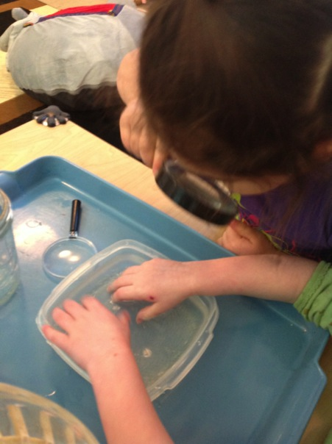
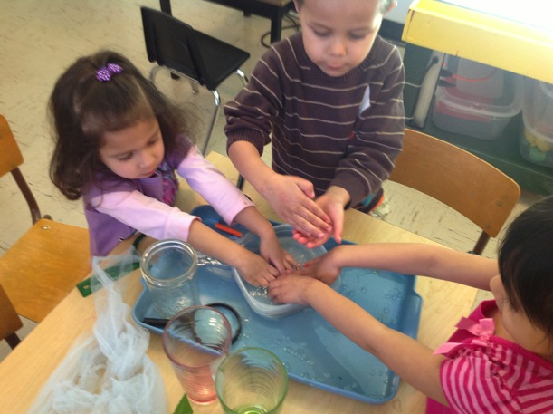
-They are play seeds
-Sparkles
-Oh! No! Beads! I don’t want to make a necklace to my mom.
-Kind of beans?
The children touch them:
-Stick in my fingers
-Is gum sticks everywhere
-Plastic is sticky
-Raining rocks
-Feels like watermelon

Slide 8
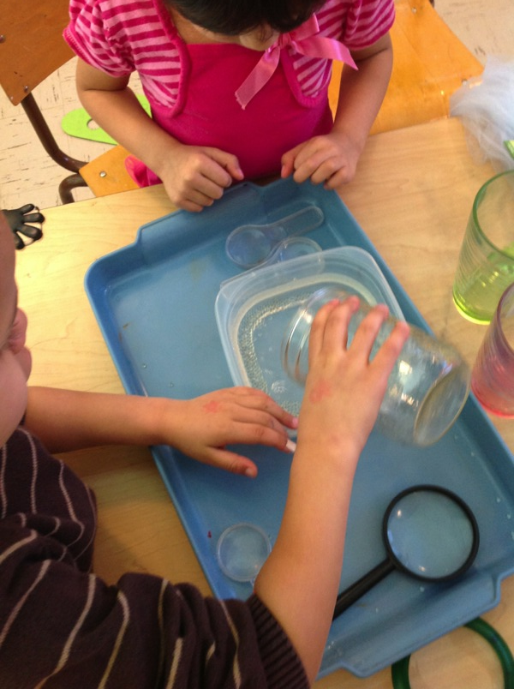
“Seeds need water, we need water”
The water is in a jar on the table, children rinse sticky little balls from their hands and add water.

Slide 9
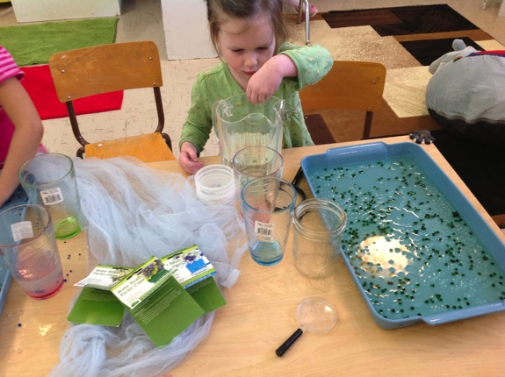
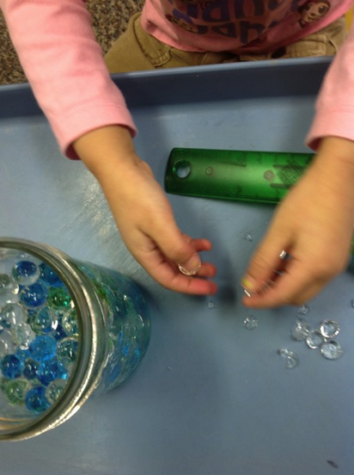
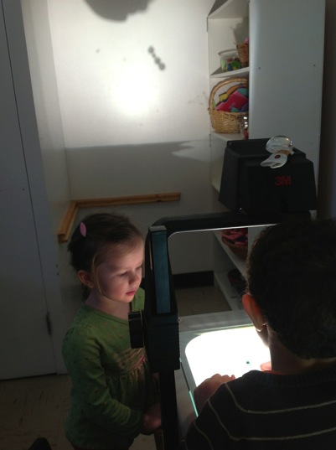
Everybody goes for snack when they return polymers have changed.
The children start squeezing the polymers, and laughing.
Polymers are overflowing, getting out of the container.
“Taste like gummy, I'm not eating for real, I just spit it out.”
At the overhead projector: -“Hey! Big medium small!!”
-“Hey! You can see through!”

Slide 10
Invitation on the water table
This invitation represents a blend between two interests previously observed:
Ocean wild life
Water

Slide 11
Associative play

Slide 12
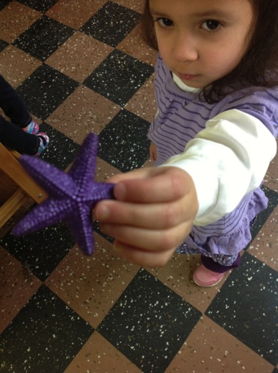
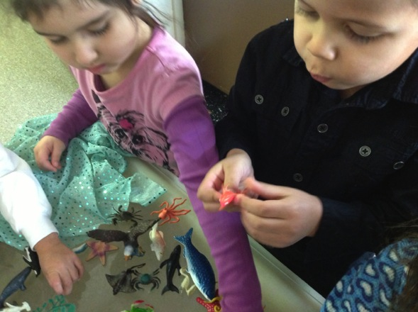
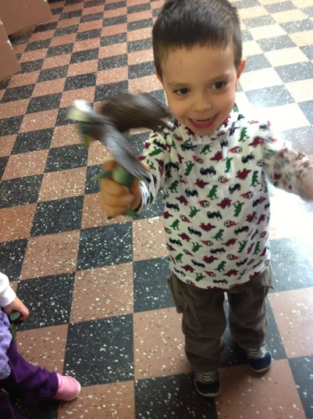
-This is a purple star fish- They just muy pequeños (very little)- talking about shells
-It is a glowing fish in a deep ocean I saw in blue planet
- “Memo” was running fast the shark eats it

Slide 13
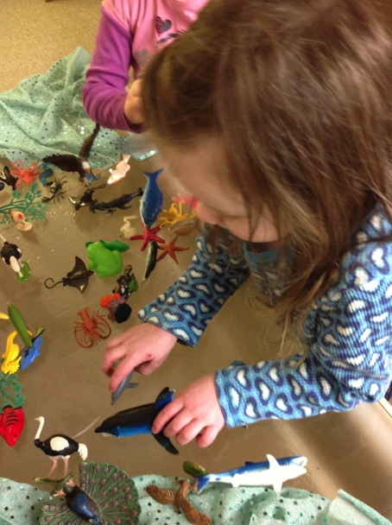
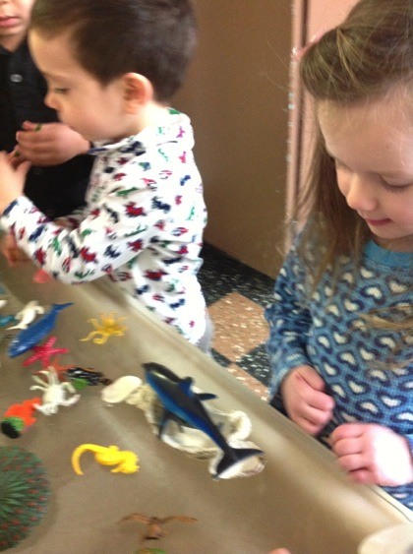
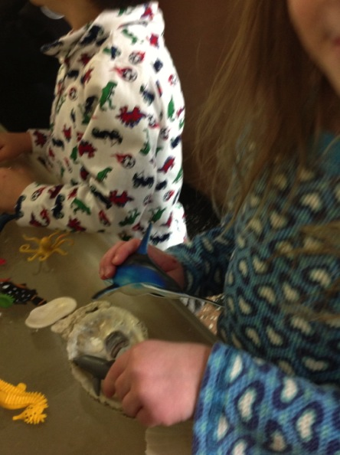
-This is a dolphin and a baby dolphin- placing both dolphins beside each other and hiding the little one under a shell.

Slide 14
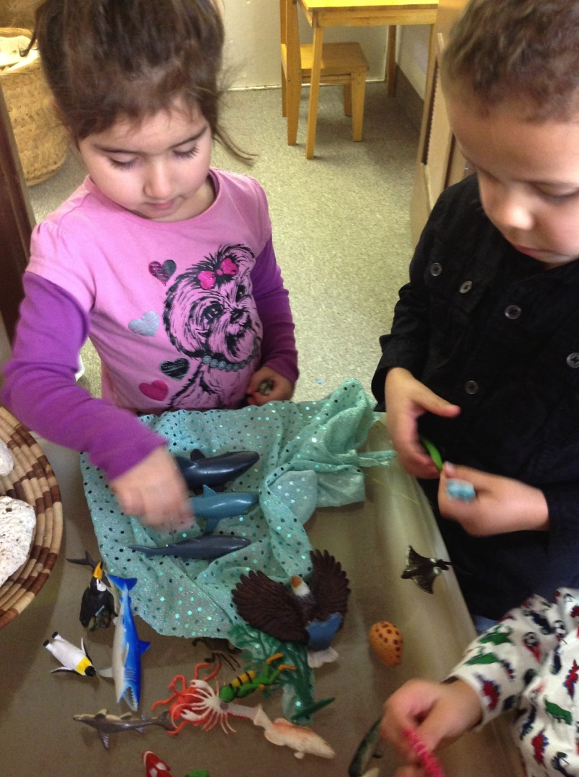
Kaleb talking to Alex: -Villan down there--shark
Laura:-Those are turtles they sure go In water
Kaleb:-And in land too

Slide 15
Children made a discovery…
The children ask the teacher:
-Can we have water and make fishes swim???
-We can make the Ocean!!!
The children were full of excitement and got ready to experience the discovery .

Slide 16
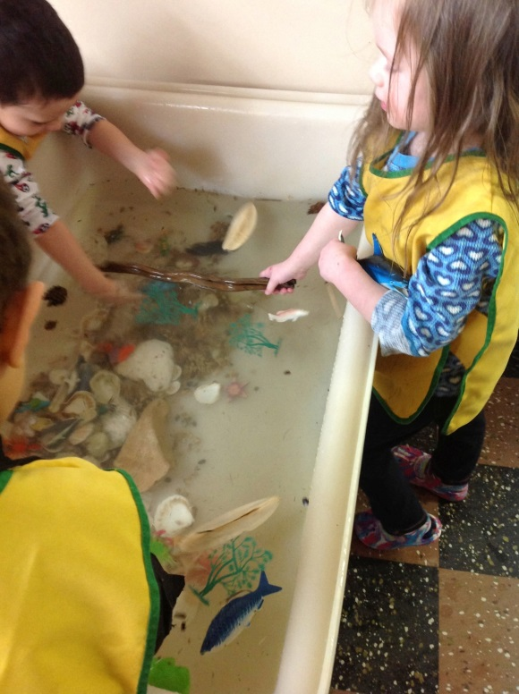
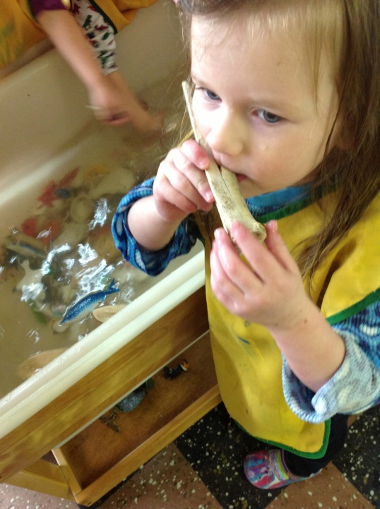
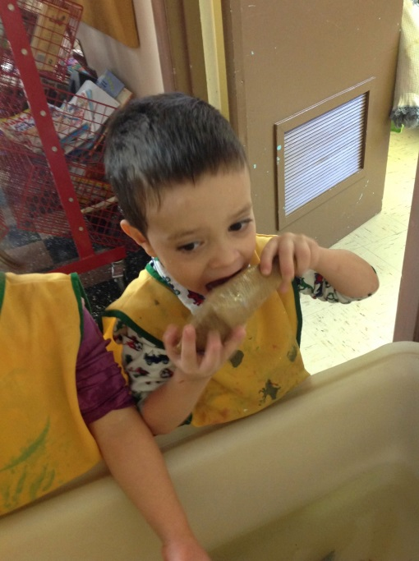
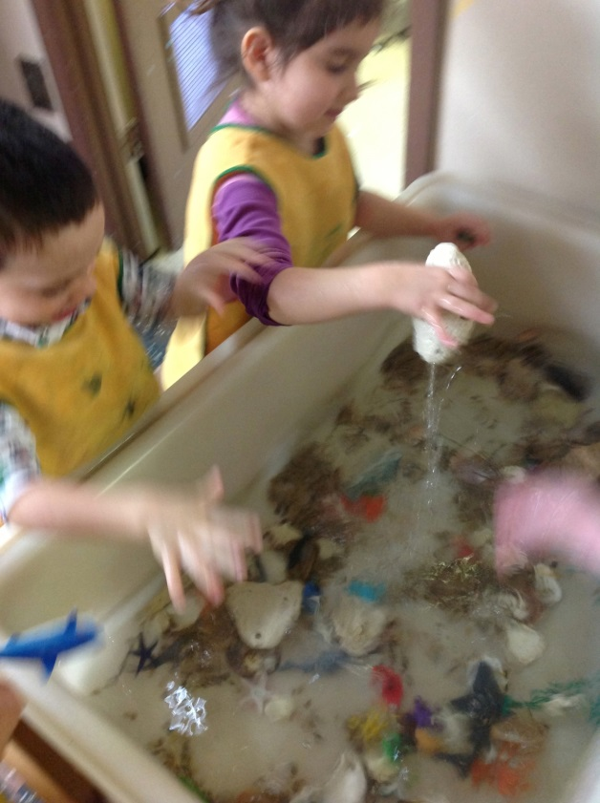
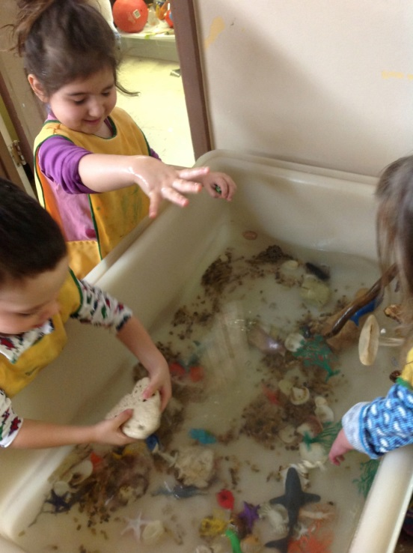
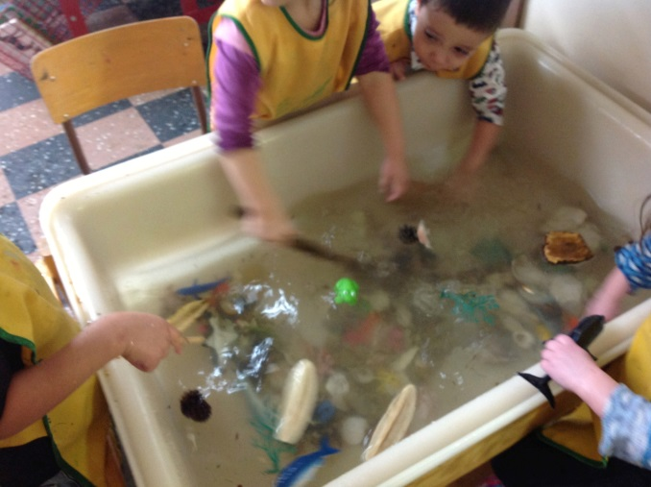
Children experienced…

Slide 17
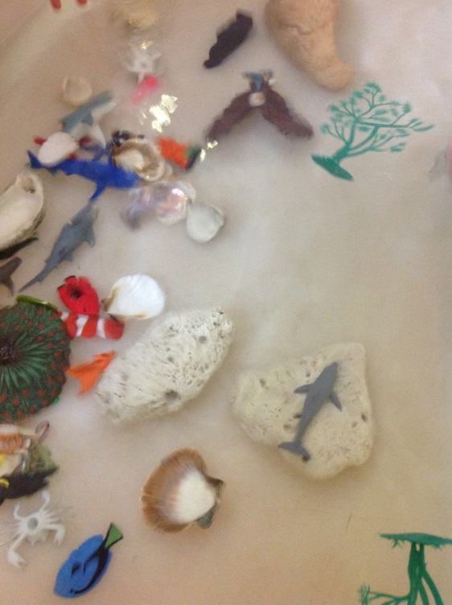
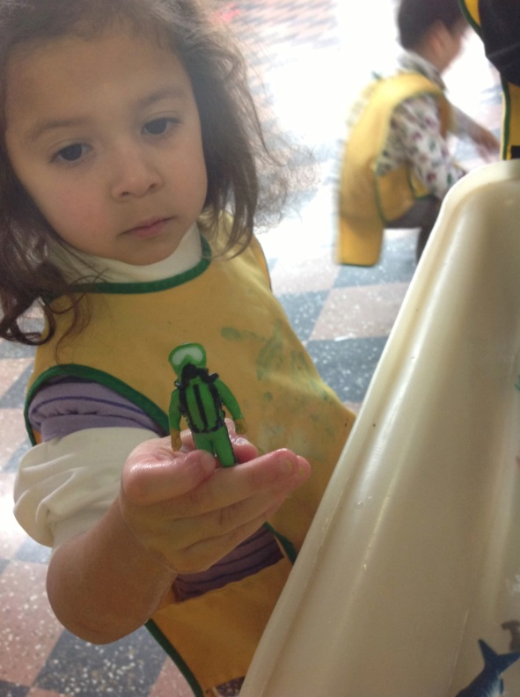
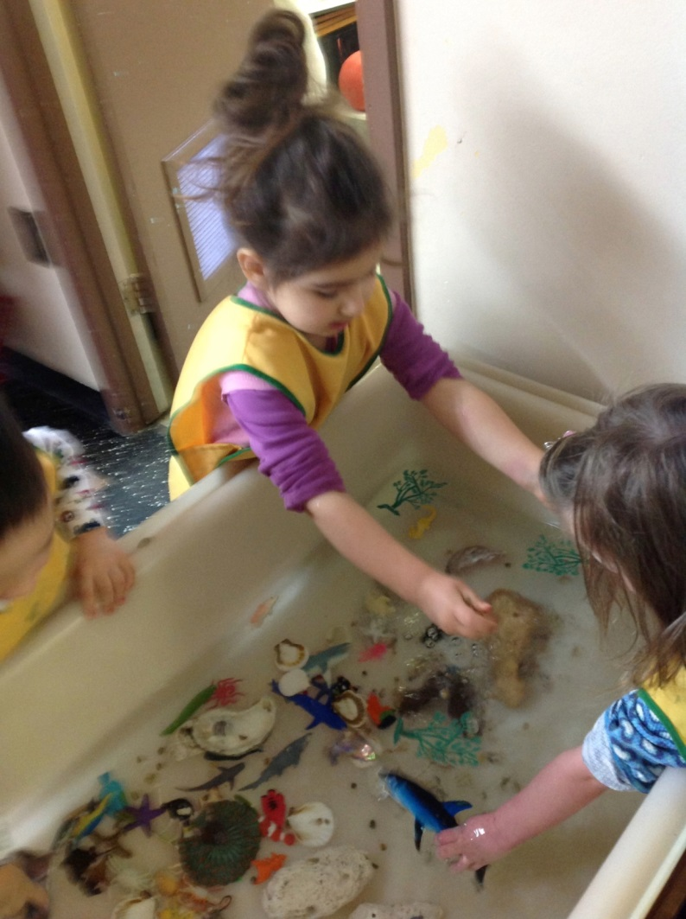
Laughter, ideas, causes and effects
Scuba diving man
Water weight, splashing with big weights
Flotation
Transparency and bleariness
Taste
Air sound throughout a bone

Slide 18
How we experienced the ocean with our bodies?
An invitation with handkerchiefs
Playing under the water.

Slide 19
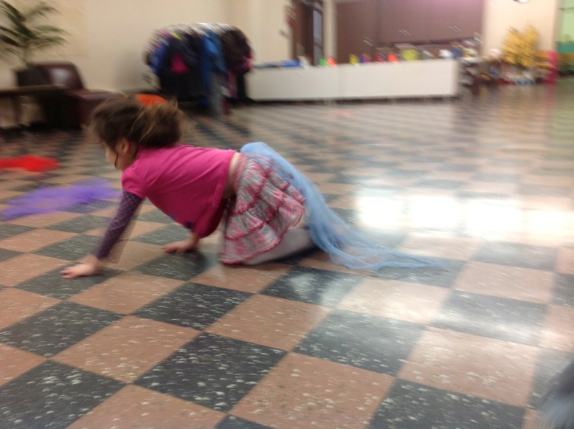
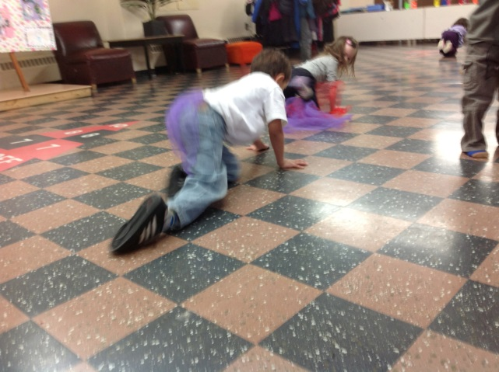
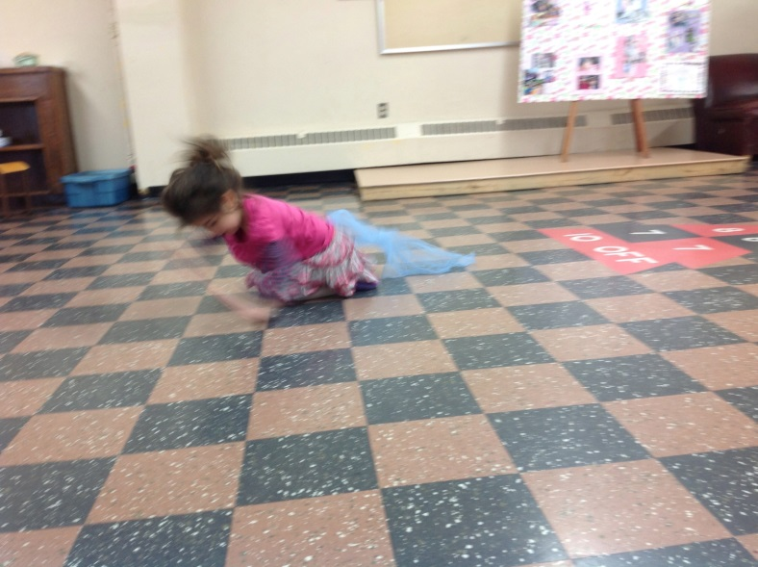
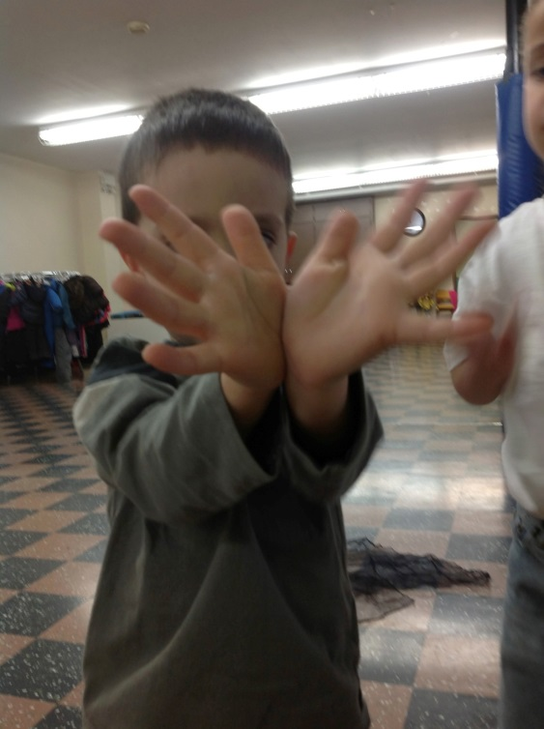
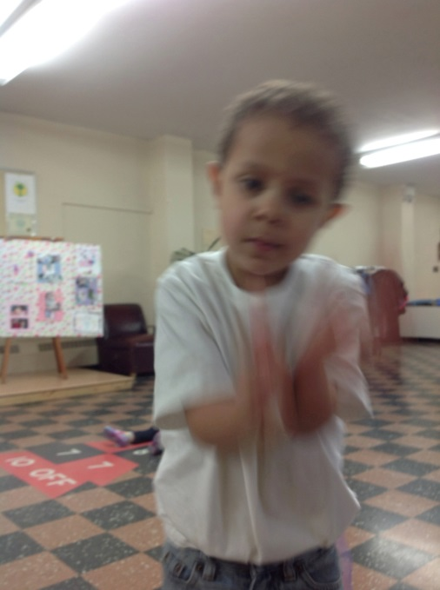
-This is how a whale swims
-This is how a whale’s tail is
-And this is how it moves

Slide 20
Making connections with inquisitive minds

Slide 21
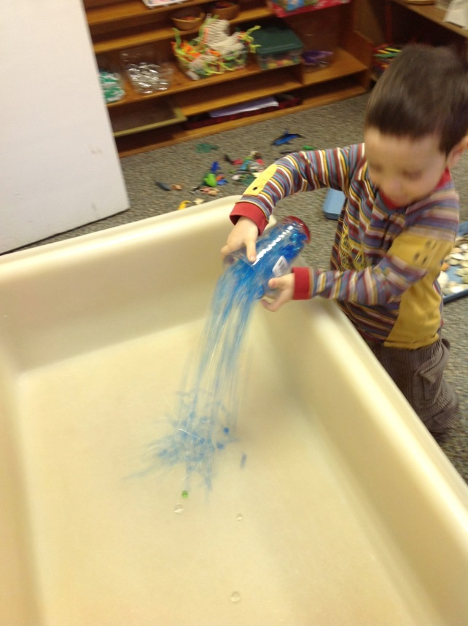
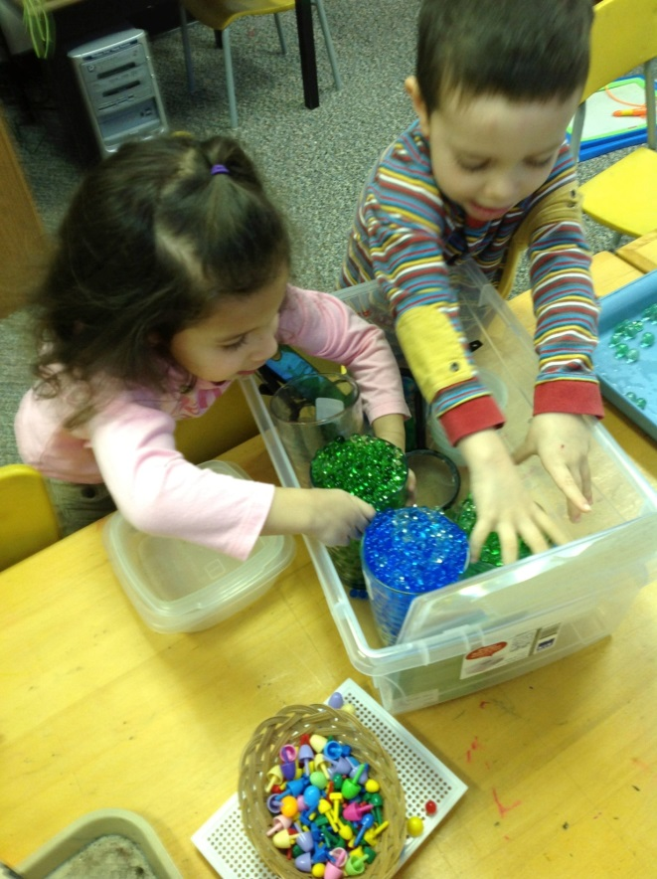
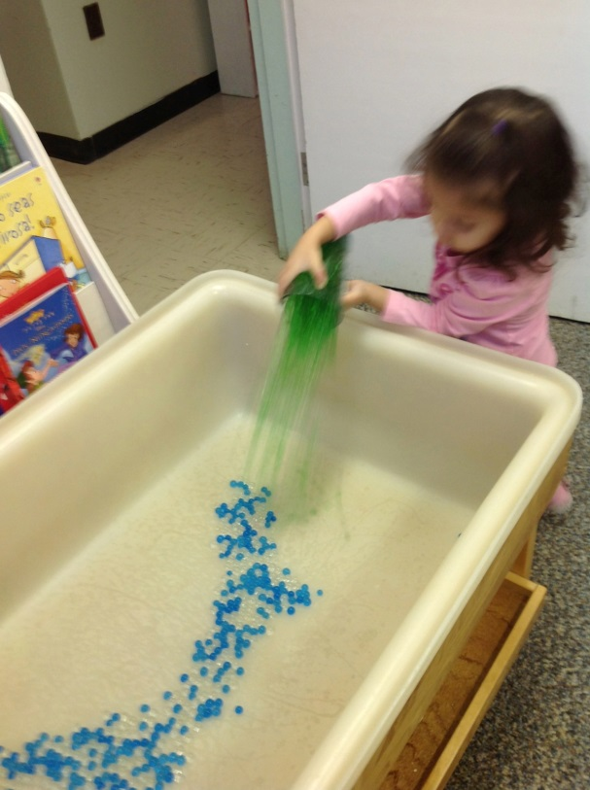
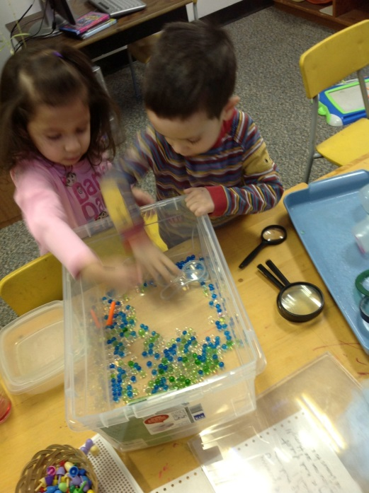
Alex: -it pops (squeezing the polymers)
-they are marbles
Alex & Faith playing together: Alex looks over the water table, he wants to open the container, the teacher helps him, after that gets a container with polymers, and Faith repeats Alex’s actions.

Slide 22
Creativity
Self confidence
and independence guiding big ideas…

Slide 23
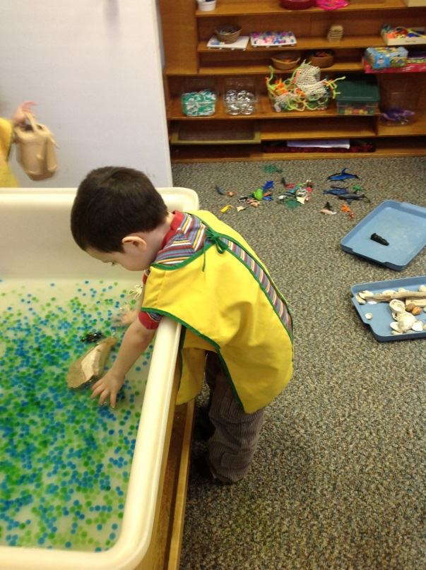
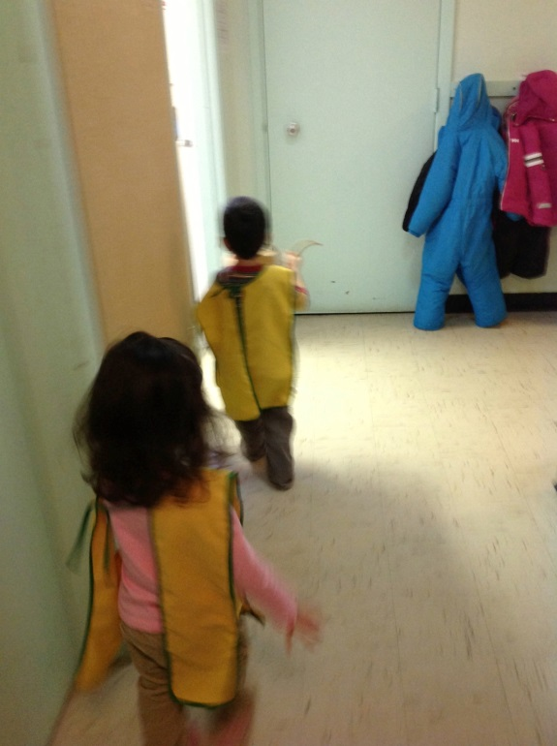
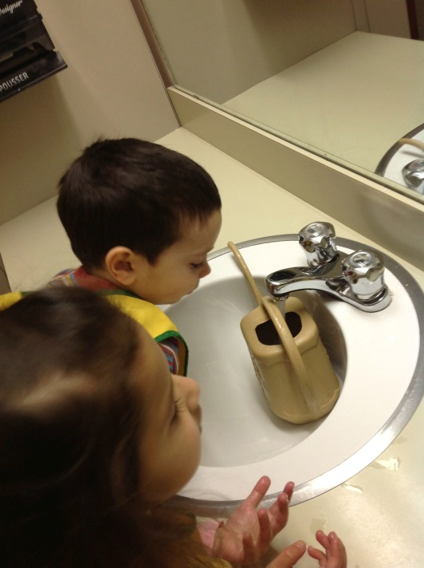
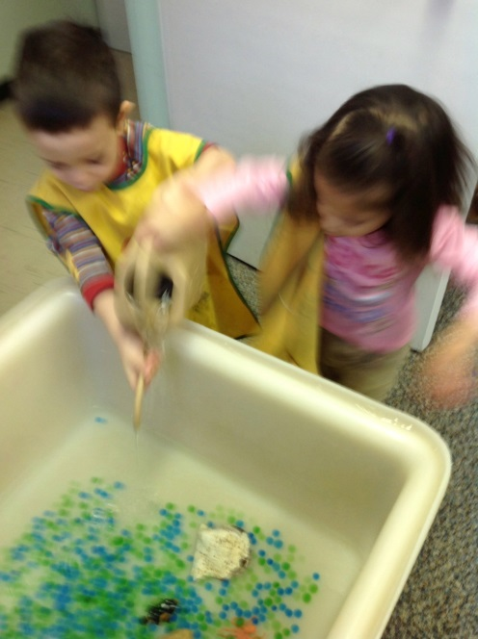
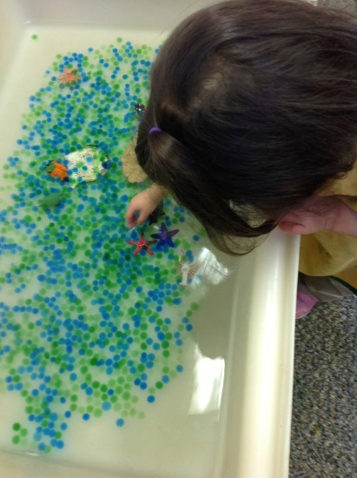
Alex:- I need lost of water make deep...
Teacher: -What does deep mean?
Alex: -deep as the Ocean!, deep as the ocean - He repeats the sentence every time he brings a jar with water - up to the top
Faith: -we not top?! (with concern)
They return to the bathroom for water
Alex: -Deep as the ocean, like that
Faith touches the water: - now fria (cold)!

Slide 24
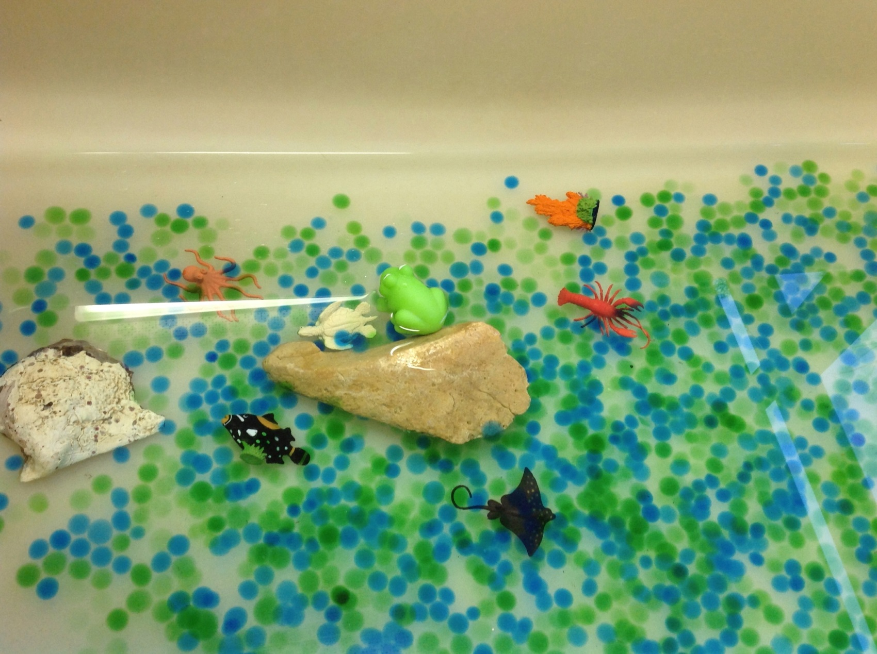
Children’s creation

Slide 25
Meanwhile a trip to the beach
Laura: I'm the mama
Alex: I'm the daddy, we travel like my mom, in the front. I need sun glasses,
Teacher: Why sunglasses?
Laura: Because is sunny there, and makes eyes really sore
Alex: We need a parachute pack with lots of things. (He talks about scuba gear)
Laura: No I packed that ! Don't ! (She is talking about luggage)
Alex: I need one. (He got a little backpack). I like parachute pack. I was jumping in water
Erin: -I'm packing baby stuff. When baby gets dirty we have to change, and need bottle

Slide 26
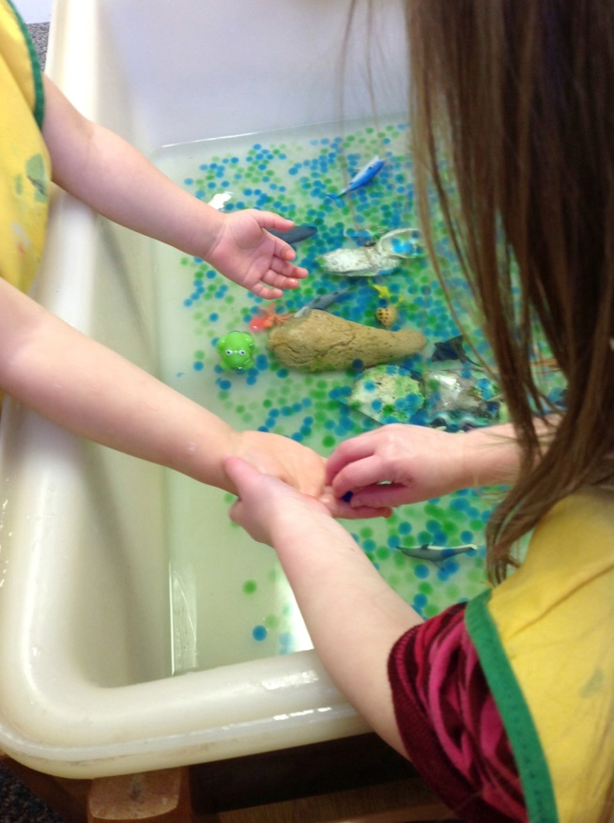
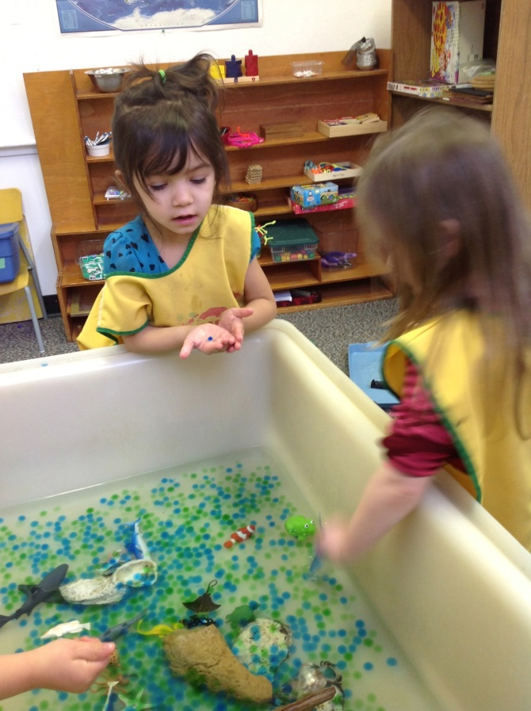
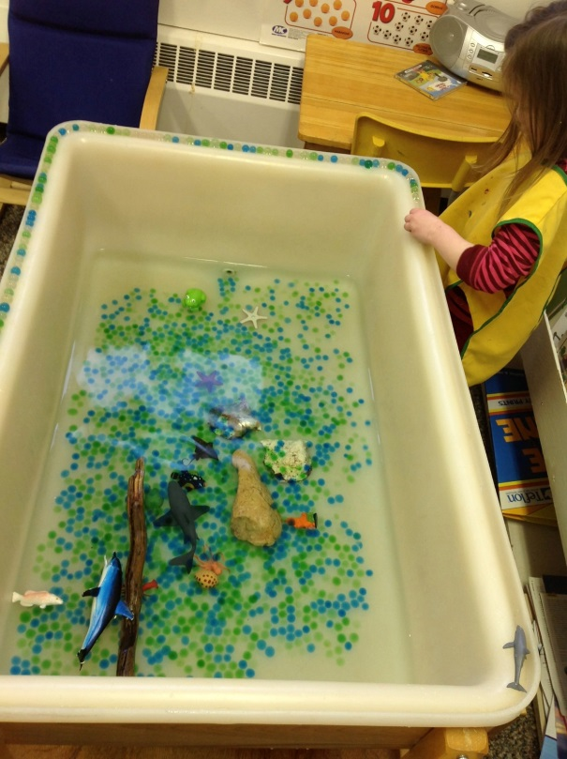
Kate: -There is a baby inside, like Kaedan said yesterday- repeats-There is a baby inside beeeee careful don't squeeze it
Erin: -I got it
Teacher: - Which animals grow from eggs?
Erin: -like a shark
Alex from other side of the room: -baby crocodiles
Laura: -This mmm… is a whale
Erin: -No! Is a shark!
Laura: -It doesn't look like is there, look! (Transparent polymer) it's like a water bubble-Disappear into the water
Erin: -They have babies , they are white fishes, I found many, look how many!- I need does that I can't see
Teacher: - Why can't you see?
Laura: - because is the same color as this ( the water)

Slide 27
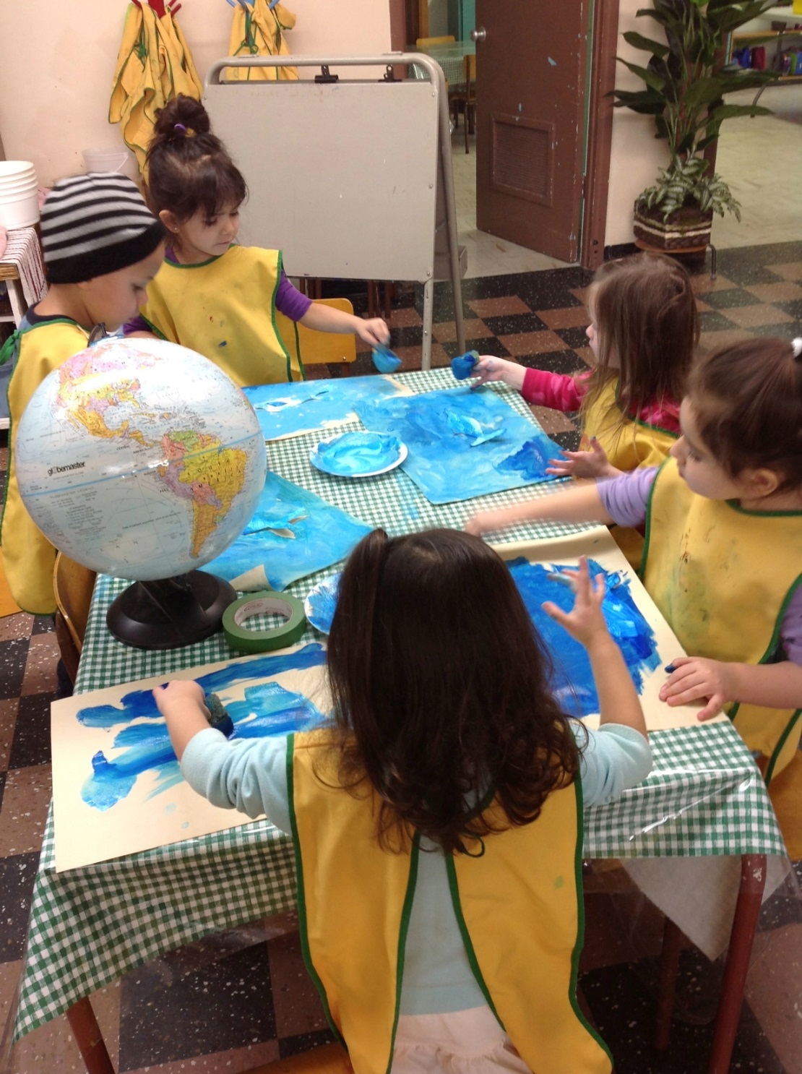
Teacher brings a globe
Kaleb: -the ocean is very big? It never ends! It has lots of fishes
Kate: -it has lots of cities but has more ocean, is more water than city
Laura: -we can drink the ocean water
Kate: -first we need to clean
Laura: -yes the sea weed, it's yucky!
Kaleb: -has rocks too and they need to be clean and then we can drink
Have you seen the ocean?
Laura:- yes it is big and has waves
Kate: -I went to the ocean in Hawaii and there are dolphins
Teacher: -Which other places have lots of water and fish?
Laura:- At mama and papa's lake there are lots of fish, we go fishing at the lake, there are fish to eat, now is winter and we can not go fishing, but we go in Summer
Teacher: -Saskatoon has somewhere like that?
Kaleb: -Yes there is a lake with a bridge on top....(thinking) but I don't know, it says NO fishing
Teacher: -Saskatoon has a lake or a river?
Erin: -It is a river
Kaleb: -No it is a lake!
Teacher: -We will need to visit and see if it is a river or a lake

Slide 28
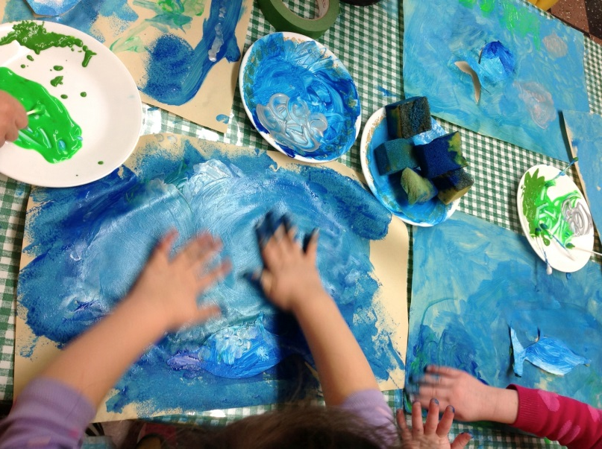
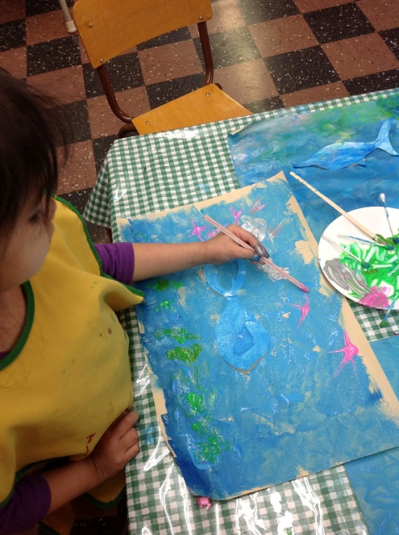
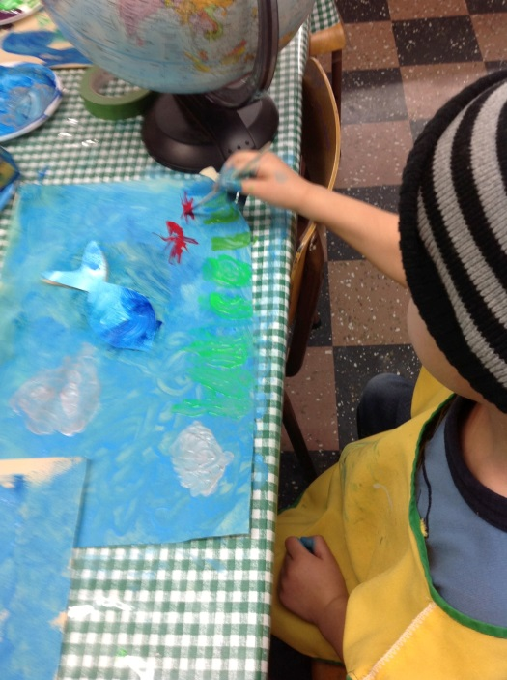
-Mine is a lake the fish live in the bottom of the water, I will put down here ( sticking fish two cm. from the bottom edge of the paper)
-I'm doing little rocks
-I want to do purple flowers
Children decided about tools, colors, details for their design
-I'm doing a big rock
Teacher: -Did you know in the ocean you can find " anemones” ? They have different colors.
-Yes! Anemones! I want red
“I want grey for the rocks”

Slide 29
Research: Books, shells and more

Slide 30
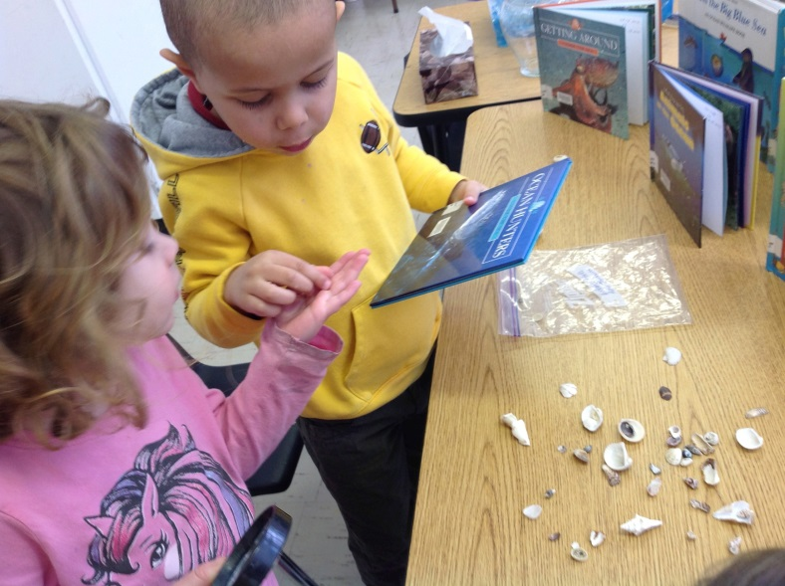
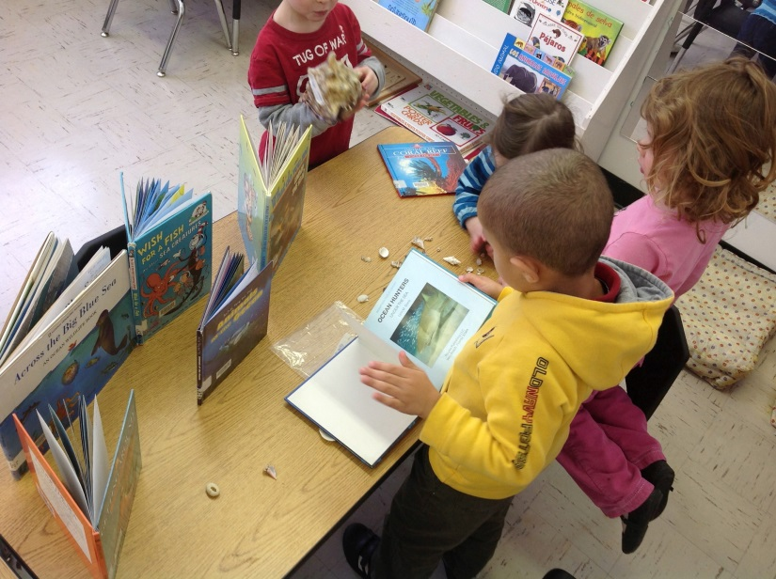
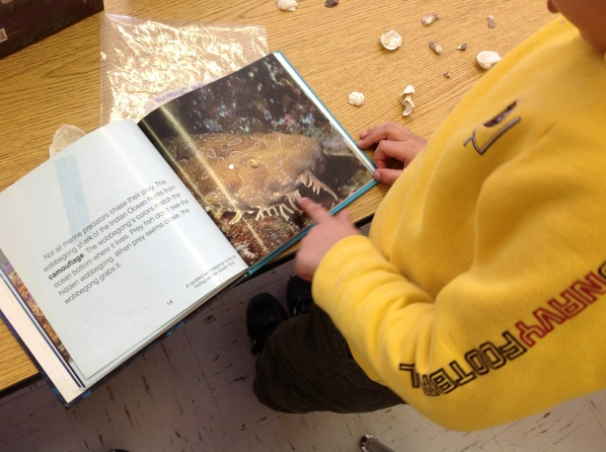
Families contributed with shells from their trips
-This fish is camouflage, look! Is like corals

Slide 31
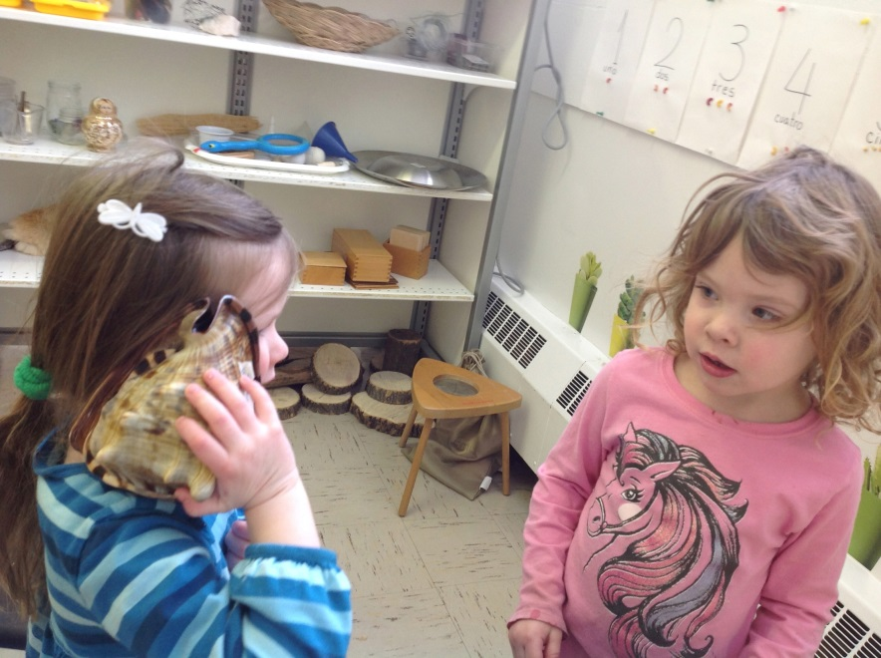
Listening inside big shell Kaedan brought from Jamaica
-“Why you can hear the ocean?
-Because there is water?
-No because it comes from the ocean

Slide 32
Families Participation

Slide 33
Wind & Twist
Kate and Kaleb:
-I'm wind she is tornado
wowwwwww, I'm the tornado water I'm dizzy
Kate:-I’m the wind!
(They turn and move, with extended arms, going up and down with their bodies, swishing and wooing. Suddenly they stop and hide underneath the tables)
Kaleb:-We rest in our den, wind and twist.

Slide 34
Making learning visible
Look! I made jelly fish and a submarine.

Slide 35
Invitation: “Jello”

Slide 36
-I don’t have any idea what color is it?
-“Patarente?” I think
- Transparente
- Oh! I Know! Transparent!
-I know what is this! Is a dessert.
-You can see through this

Slide 37
Experiments
There are a daily variety of available materials and resources, these promote spontaneous use, combination and exploration of multiple possibilities:
-Pouring
-Straining
Notes:
Ash: could I use a basket
Si seguro
Wow it pickup the food and the water comes out
Ka: we can strain all!
This is a pie with tuna
These are fishie gum gums , it will be full decorated
A: this is a pretty one fish tuna
Water is soft and balls are thicker and big
No, the Water is wet
Tuesday January 29 : gelatins packages
Kiley: I want to do this ((holding a box of gelatins, along came Kaedan, and Layla)

Slide 38
Personal experiences & Family participation
Notes:
Showing snorkeling pictures from Mexico
Craft painting and pleasing silhouettes of fishes

Slide 39
Fishing and Counting

Slide 40
Puppets
Language
Literacy

Slide 41
Sharing knowledge
Kittie showing a fish tank manual

Slide 42
Construction
I made a fish!
This was a surprising discovery
Notes:
This construction continue with the children building a pool and fishing rods

Slide 43
Invitation at the Atelier
Notes:
Language and literacy

Slide 44
Senses
Smelling
Feeling

Slide 45
Senses
-Sticky
-Cold
-Smelly
-Is like my shampoo

Slide 46
“We want a Shark”

Slide 47
Cleaning the aquarium
Children discover:
“Water drains through the funnel but not the rocks”

Slide 48
Field trip to Pet Store
PHASE III
Looking for a shark

Slide 49
Beach Day!

Slide 50
Ocean, sun and pina coladas

Slide 51
So much fun!!!

Slide 52
“It’s like a real beach day!”

Slide 53
Expert visit

Slide 54
Teachers’ reflections
Children are driven by a great sense of natural interest of learning, is one of the strong roads to follow and really engage them in a constant spiral of growing knowledge.
This project unfolded because it was directly related to the children’s personal experiences.
This was a meaningful project for us, because it was part of our culture and background.

Slide 55
What did children learn?

Slide 56
Ocean
Sea
Lake
River
Swimming
Diving
Fishing
Beach day
Fishes
Fish eggs
Mammals
(Whales & Dolphins)
Jellyfish
Going in a trip to the ocean
Plants in the water
Seaweed
Anemones
Coral
Rocks
Shells
Flotation
Transparency
Straining
Suck the water (absorption)
Temperature
They filled up and grew (expansion)
Wind, waves and twist
(mesa de agua)
Soft and hard

Slide 57
Notes:
The project still on with a coming up expert: Scuba diving presentation

