Slide 1
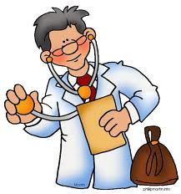
The Doctor Project

Slide 2
General Information
This is a Kindergarten class consisting of 2 forms. The project was mainly focused on one form of 16, 5 and 6 year old children. This form attends every second day in a full day setting. The project took place at an elementary school for approximately 6 weeks and was headed by teachers Connie Parenteau and Janessa Sholter.

Slide 3
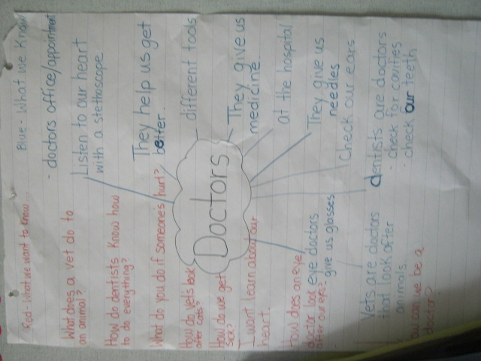
Beginning the Project

Slide 4
This project was chosen based on the students interest in different kinds of doctors. There wasn’t a focusing event to start the process so we began with a concept/topical web. Children were asked to voice what they knew about doctors it didn’t matter what type. We represented the things they already knew on the web as well as questions they wanted to explore and materials each kind of doctor would use.
Our expectations were that the students would guide their own learning while at the same time directing us to incorporate different outcomes based on their interests.

Slide 5
Possible Outcomes to Explore
Language Arts
CRK.1 Comprehend and respond to a variety of visual, oral, print, and multimedia texts that address identity (e.g., exploring interests), community (e.g., belonging), and social responsibility (e.g., contributing).
CRK.2 View and interpret the basic message of visuals and objects in a variety of texts
CRK.3 Listen, comprehend, and respond to gain meaning in oral texts.
including models, photographs, dramas, dance creations, and videos.
CRK.4 Comprehend, retell, and respond to basic ideas in stories, poems, songs, and informational texts read to them.
CCK.1 Compose and create various visual, multimedia, oral, and written texts that explore and present thoughts, ideas, and experiences.
CCK.2 Use and construct symbols, pictures, and dramatizations to communicate feelings and ideas in a variety of ways.
CCK.3 Use oral language to converse, engage in play, express ideas, and share personal experiences.
CCK.4 Create messages using a combination of pictures, symbols, and letters.
Math
NK.3 Relate a numeral, 0 to 10, to its respective quantity. [C, R, V]
NK.4 Represent the partitioning of whole numbers (1 to 10) concretely and pictorially. [C, CN, ME, R, V]
NK.5 Compare quantities, 0 to 10, using one-to-one correspondence.
Health
USCK.1 Develop basic habits to establish healthy relationships with self, others, and the environment.
USCK.2 Establish behaviours that support safety of self and others (including safety at school and at home).

Slide 6
Phase 2
Let’s Play and Discover!

Slide 7
The Classroom
We set up the room to accommodate appropriate space and to represent different types of doctors. The room was staged with a waiting room, doctors office/hospital room and open areas for their own exploration and creativity. There was a selection of doctor items, real and pretend for them to choose from. We gathered resources from different centers (the hospital, doctors office, dentist and veterinarian) to make the learning experience more realistic.

Slide 8
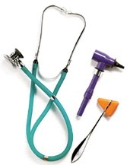
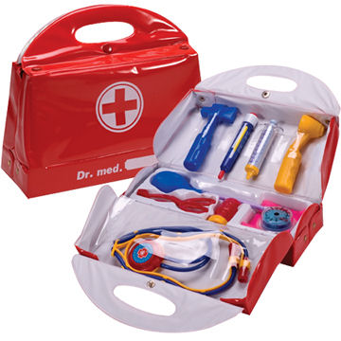
Materials
Some of the students’ favourite items were the selection of dress up materials and real hospital gloves. Putting on a white coat puts the student into a new role.
Items like doctor’s charts and appointment cards help to bring out voluntary writing. Math was focused on when students would ask how much their patient weighed and their height. Or when they took their patients’ blood pressure and temperature.
A selection of books were pulled from the library as well as pictures, charts, movies and posters.

Slide 9
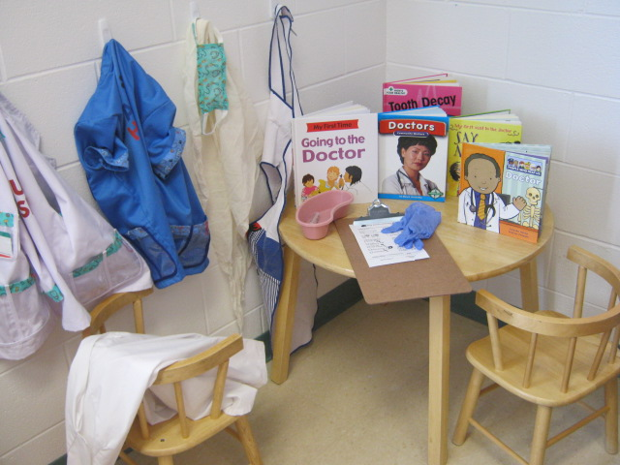
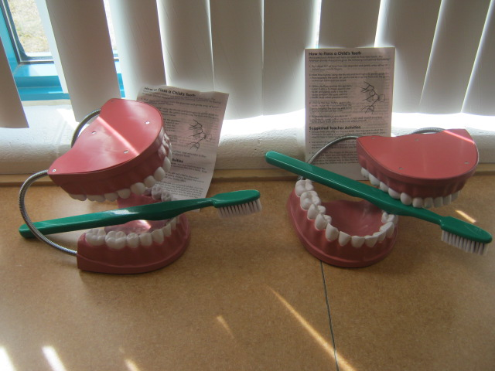

Slide 10
During Play
Students took on the role as doctors, dentists, veterinarians, and patients.
They explored the ones they were interested in the most.
They developed their own style with a waiting rooms and emergency area.
They used previous personal experiences. This guided us to provide additional supports. For example hanging a sheet from the ceiling to give their patients a private area. This changed the flow and style of the room to accommodate their play.

Slide 11
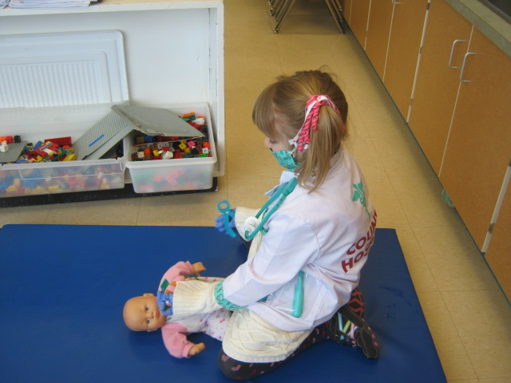
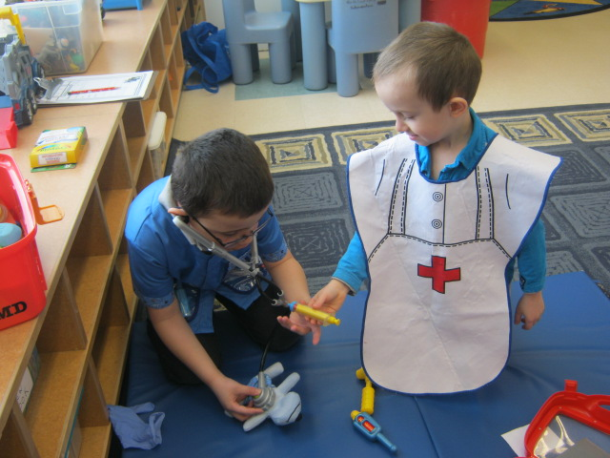
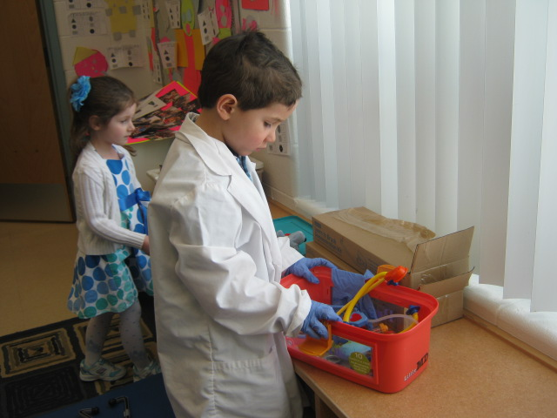
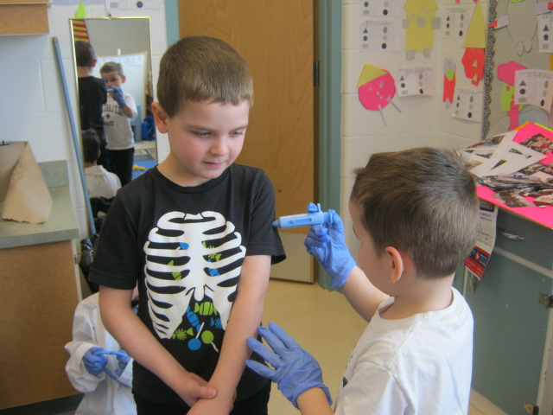

Slide 12
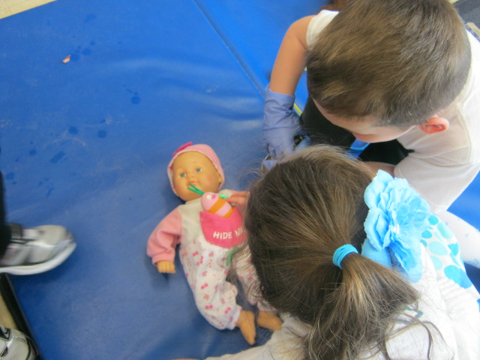
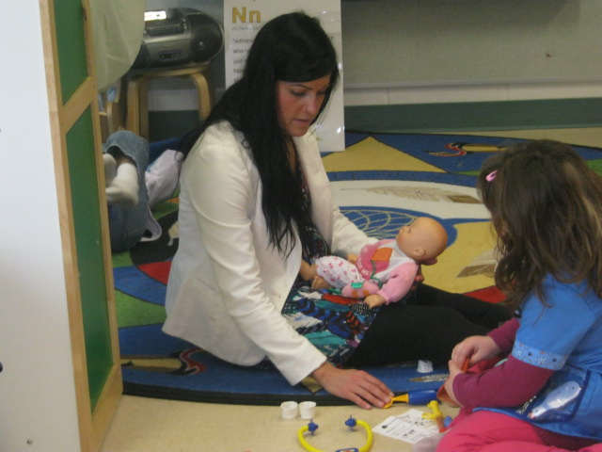
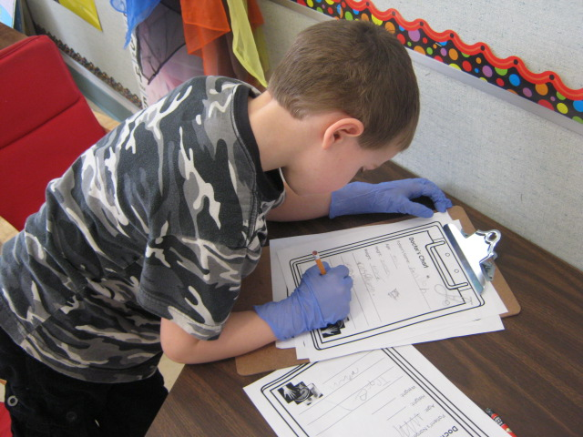
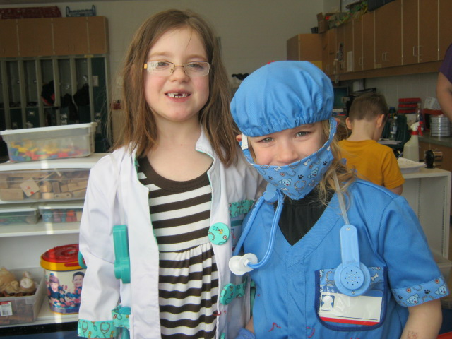

Slide 13
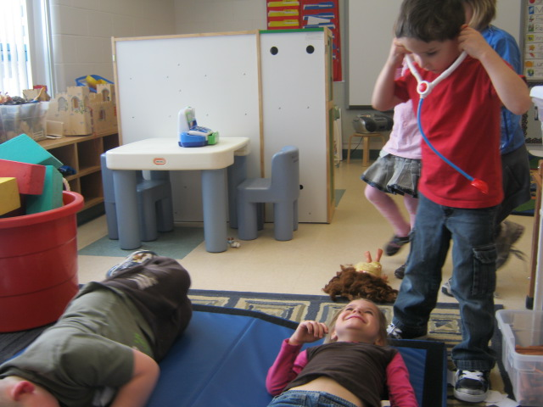
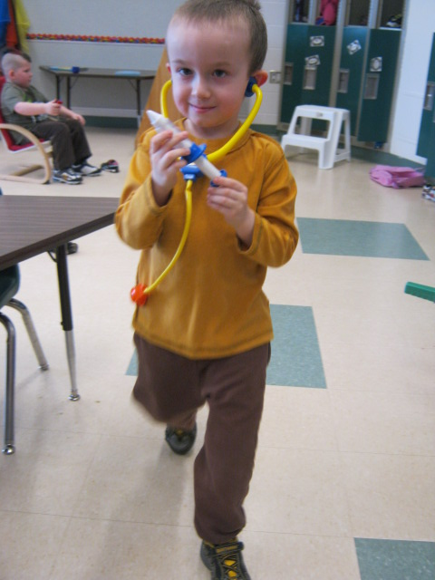
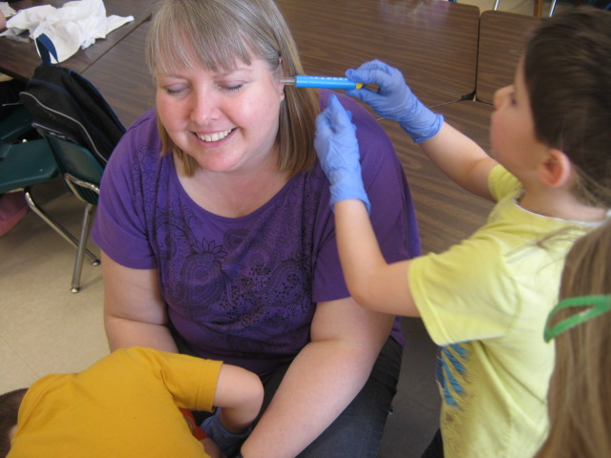
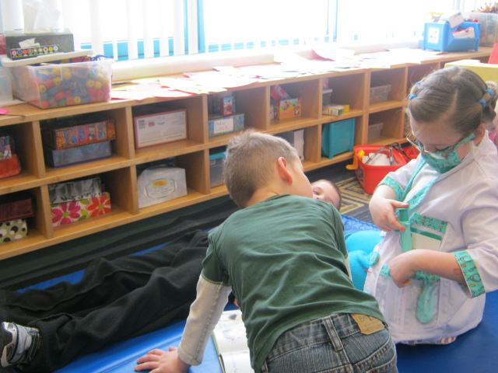
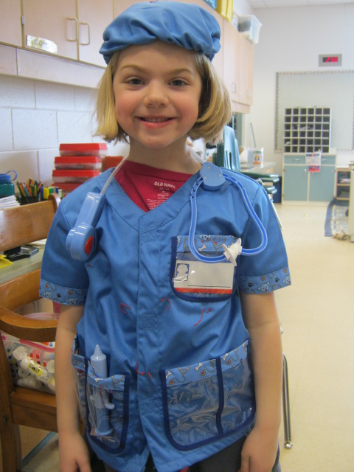

Slide 14

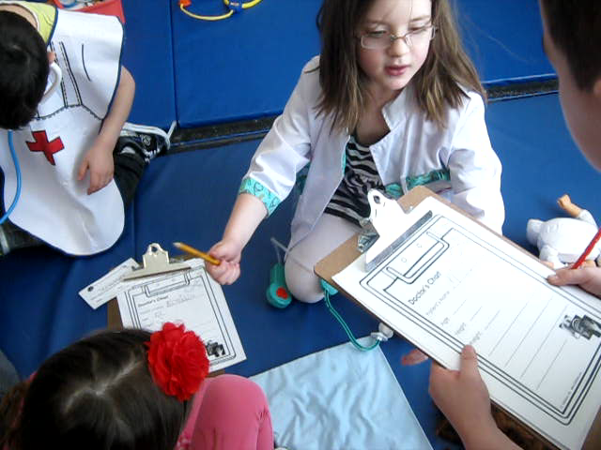
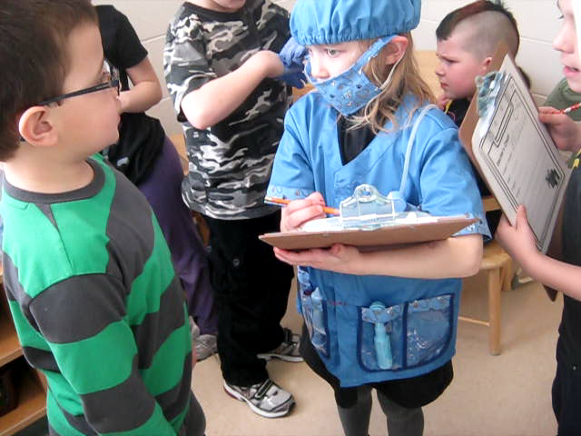
016.AVI
017.AVI
Videos

Slide 15
Some of our interesting conversations:
“Can I take your blood pleasure?”
“The patient is a baby so you don’t have to squeeze very hard for her blood pressure.”
“I wonder what these cups are for..Are they for medicine?”
“If you don’t laugh that you don’t have a funny bone!”
“His head is hot he must have a fever”
“Hold still this is going to hurt but only for a second.”
“Don’t worry we will look after you and baby”.

Slide 16
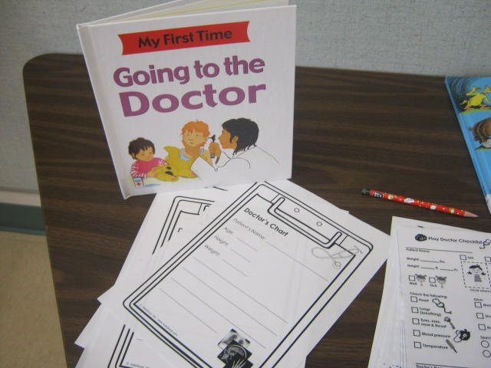
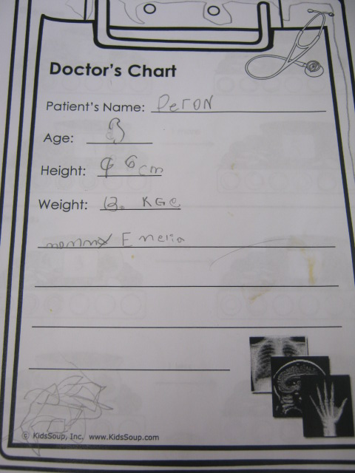
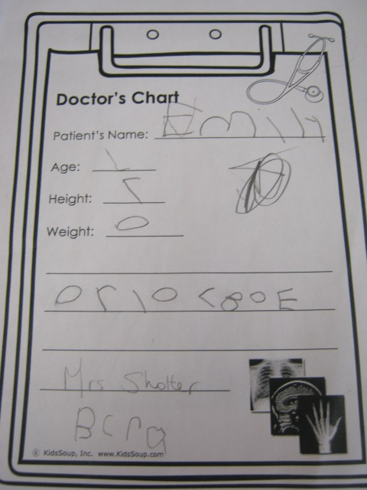
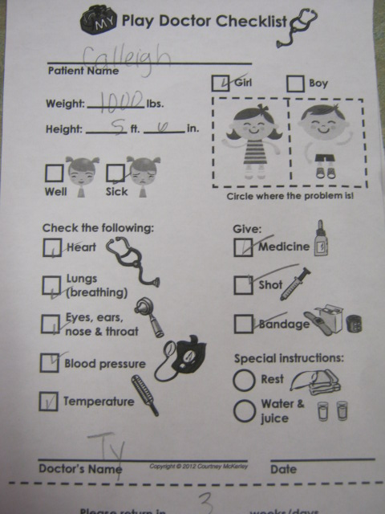

Slide 17
Physical Education Class
In Physical Education class we talked about the importance of exercise and how it helps to keep our heart healthy. We felt our pulses and touched our foreheads to see if we “broke a sweat”.

Slide 18
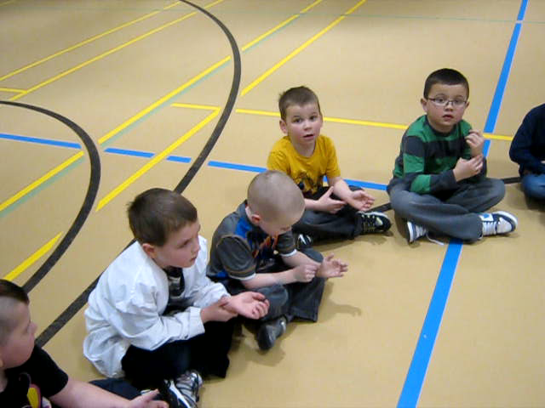
015.AVI
Video

Slide 19
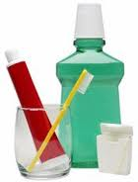
Health Lessons
For Health outcomes we used the SMART board to sort healthy and unhealthy foods. We sorted foods into the food groups. In a more directed lesson we created a plate of healthy food to eat.
We also discussed Dental Health and how to keep our teeth healthy. The Dental Health Nurse came in and did a presentation on making good choices for our teeth. We borrowed a big model of a set of teeth and practiced flossing and brushing it. During free play students used this background information in their play. Their language and vocabulary were challenged. We could overhear a student saying, “Open big I need to see your molars”.

Slide 20
Reflections
Successes and Challenges!

Slide 21
Time
Unfortunately due to unforeseeable circumstances we were unable to fully conclude our project before the presentation. We are in contact with several field sites to explore and investigate at a later date. We also have a guest speaker willing to talk to the class and would like to take the opportunity to welcome the parents into the class and have the students show what they know/teach their families.

Slide 22
Positives!
The most positive things to see come out of this project for me was to see the students voluntary writing. I observed several of my students who dislike classroom writing work voluntary pick up a pencil and chart paper and write.
I loved seeing how motivated and engaged some students acted. They asked questions and completely transformed themselves to the role of a doctor. It was interesting to see students in various roles. I enjoyed seeing some of my more passive students take a leadership role.

Slide 23
Challenges!
A challenge for me was giving up control of an environment. This is also a positive thing because I got to see how a simple mat can be turned into an ambulance. It allowed me to use my inner 5 year old imagination.
Another challenge was managing students who had no interest in the project. By week 2 we had to block of a different corner of the classroom for some students to create a zoo.

