Slide 1
Grocery Store Project Prekindergarten – Half Day Setting Multi-age: 3 and 4 year olds Project length: ~ 6 weeks
Notes:
Grocery Store Project
Prekindergarten
2012
Mid January 2013-March 7

Slide 2
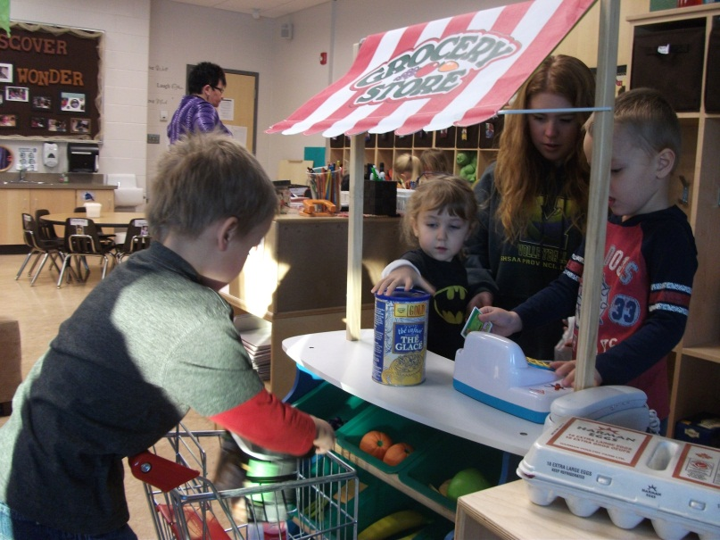
Phase 1 – Beginning The Project
Since the children seemed interested and involved in the dramatic grocery store, a note was sent home inviting families to participate by sending empty product boxes/packages to stock the store shelves.

Slide 3
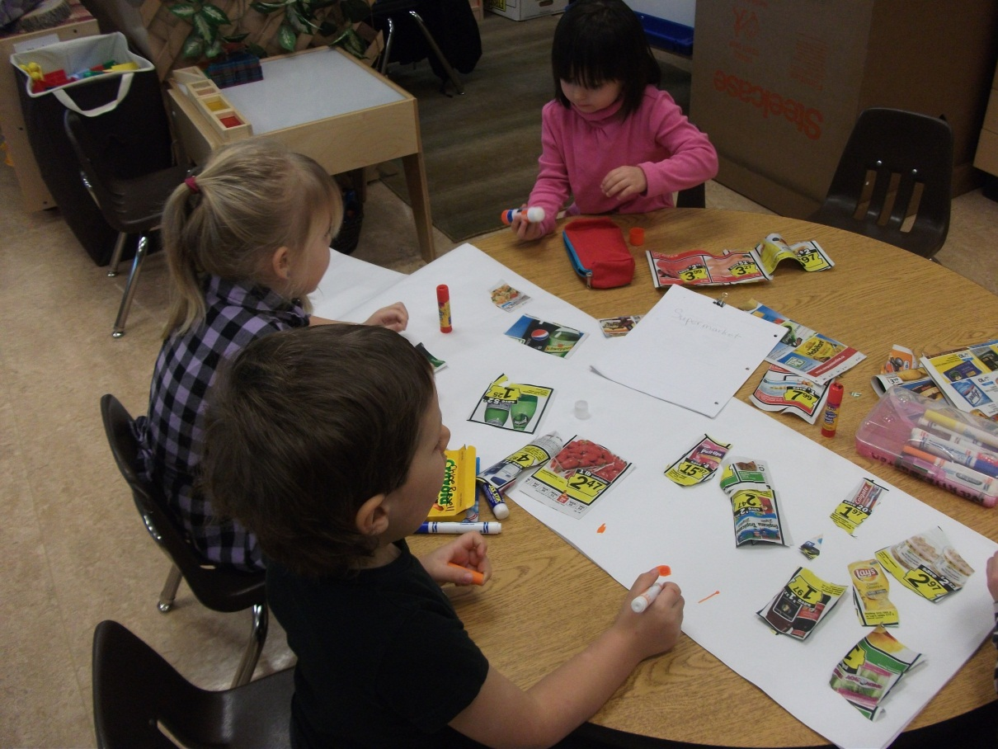
The children looked at photos of grocery stores. They decided to create a sign for their own grocery store.

Slide 4
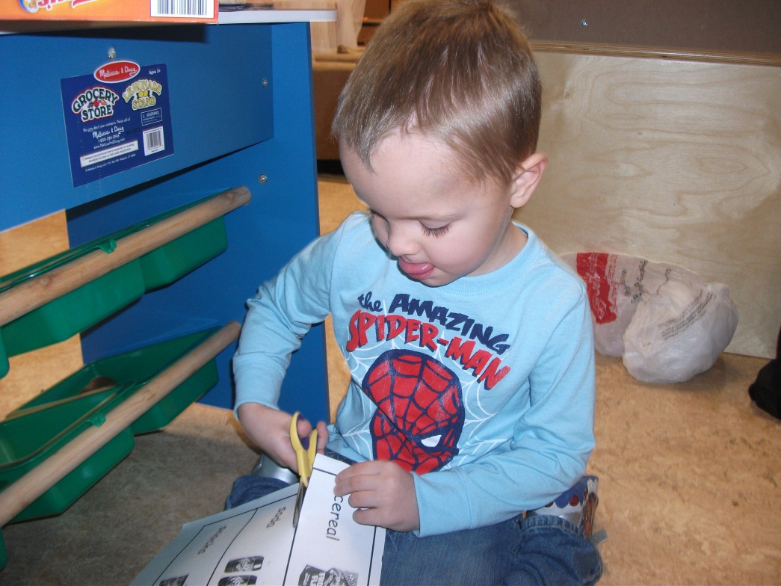
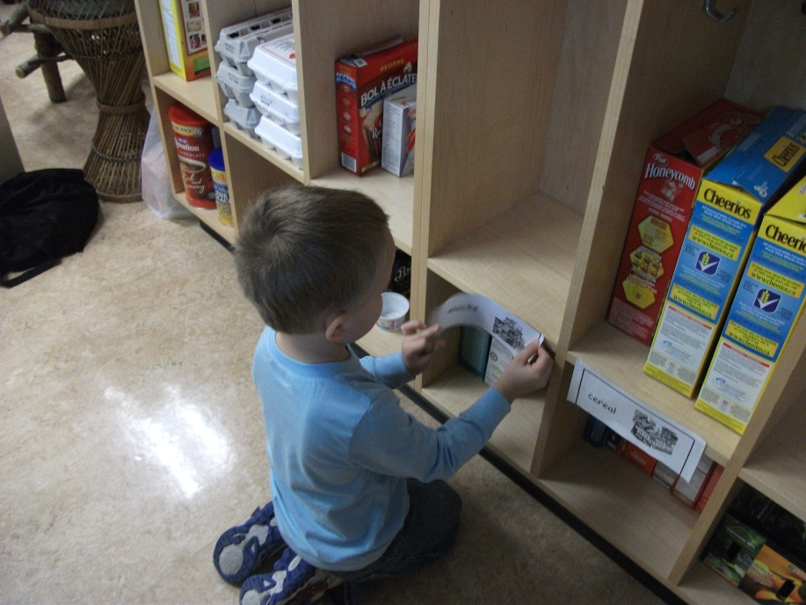
One boy was tidying the shelves and putting like foods together which led to labeling the shelves.

Slide 5
The children had some prior knowledge about grocery stores. “You buy things like apples.” “You put groceries in shopping carts.” My Mom uses a card. You push buttons with it.” “You need to drive the cart slow.”
One little boy shared his grocery experience of tipping over in a cart!
Their experiences and knowledge were recorded and once the “spark” was there we talked about what they wanted to learn about grocery stores.

Slide 6
The children used resources (books, computer) to generate questions.
Some Resources:
At the Supermarket-Rockwell
Supermarket –Doyle
The Supermarket-Hoena
A Busy Day at Mr. Kang’s Grocery Store-Flanagan
Working at a Grocery Store-Marsico
Our Corner Grocery Store-Schwartz
Grocery Store-Leeper
Do The Doors Open by Magic and Other Supermarket Questions – Ripley
Learn 360 Videos:
A Trip to the Bakery
Let’s Go to the Store

Slide 7
The following investigations were the main foci that evolved during the project work:
What kind of food is found at the grocery store
Grocery workers’ jobs (clerk, stocking, manager, etc.)
Where the food is stored

Slide 8
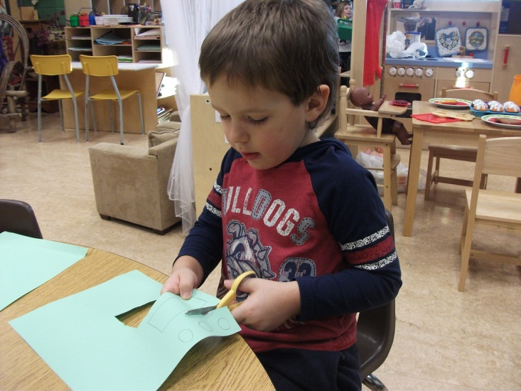
Phase II – Developing The Project
Focus: Operating the Cash Register & Money
The cash register and money were intriguing for the children. They investigated different coins and paper money. One child decided “We can make money. All the people can share the money.”

Slide 9
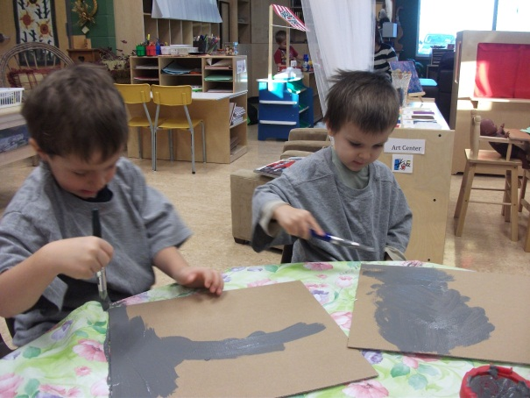
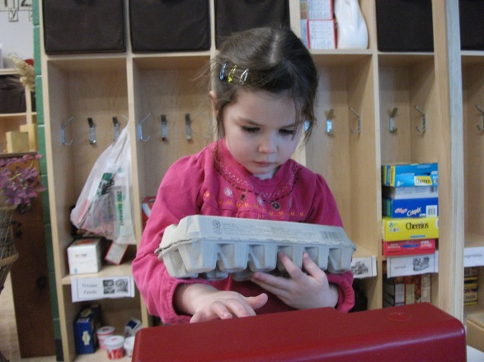
… creating representations of coins – painting, cutting and stamping
…the role of a clerk

Slide 10
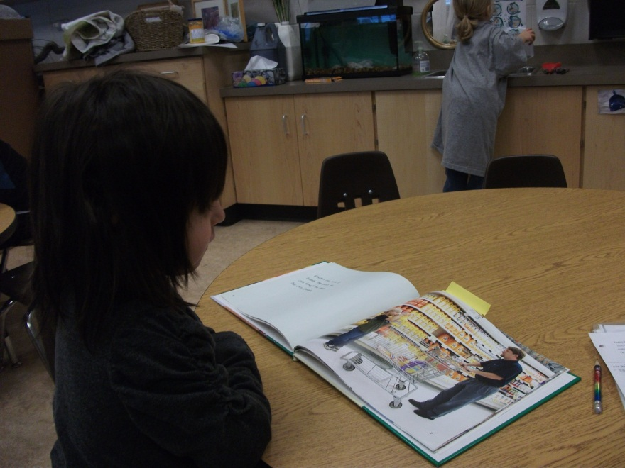
Focus: 1) Food Sections at the Grocery Store
Several resources were used to support learning about the different areas of a grocery store (books: grocery flyers, photos, etc.)
2) Healthy and Unhealthy foods

Slide 11
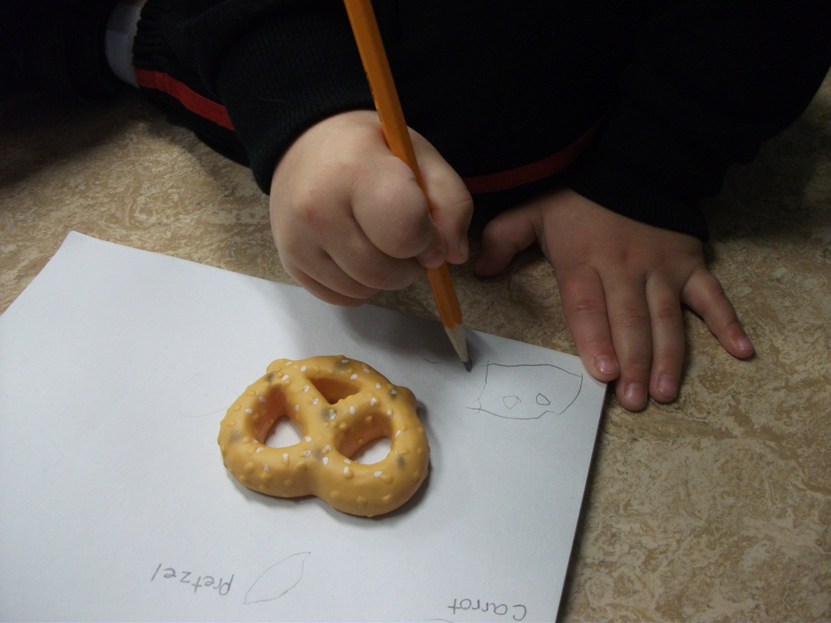
The children did Observational drawings of foods found in the food sections of the store.

Slide 12
Focus: Where the Food is Stored
At a class meeting the children brainstormed items needed to organize the store (shelves, fridges, freezers, cartons, etc.) Some of the children decided they would like to learn more about freezers and create their own. They looked at store freezer photos from the computer. Then the planning began: How many shelves? What controls the temperature? What materials would they need to create their freezer?

Slide 13
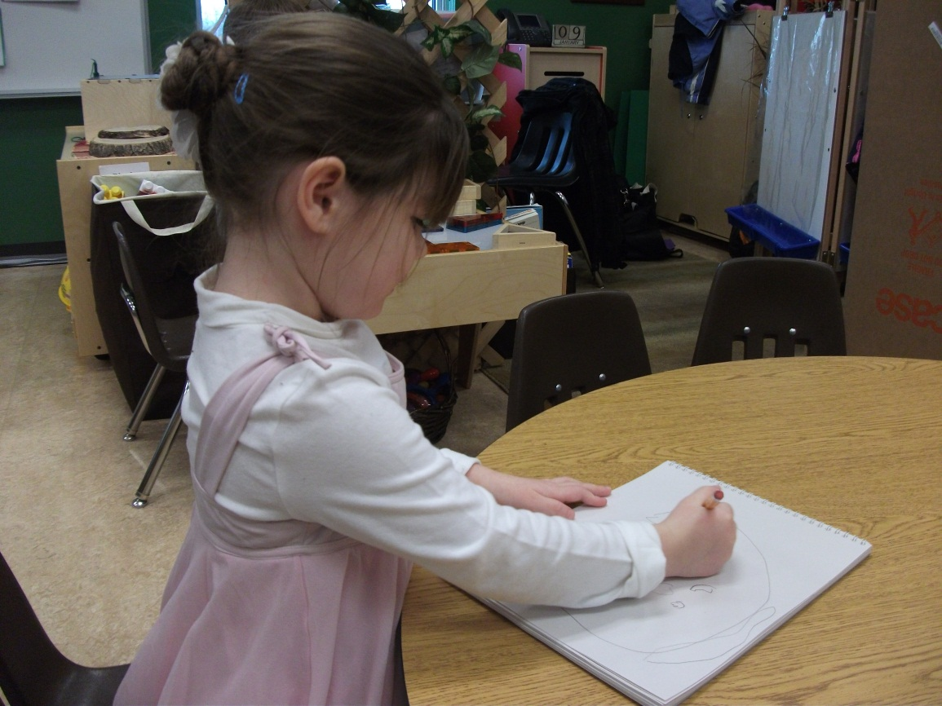
Making a plan for the store freezer.
“It needs to have lots of shelves.”

Slide 14
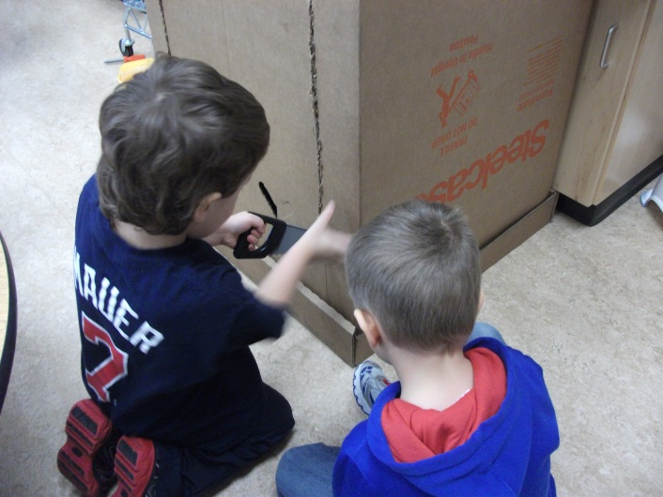
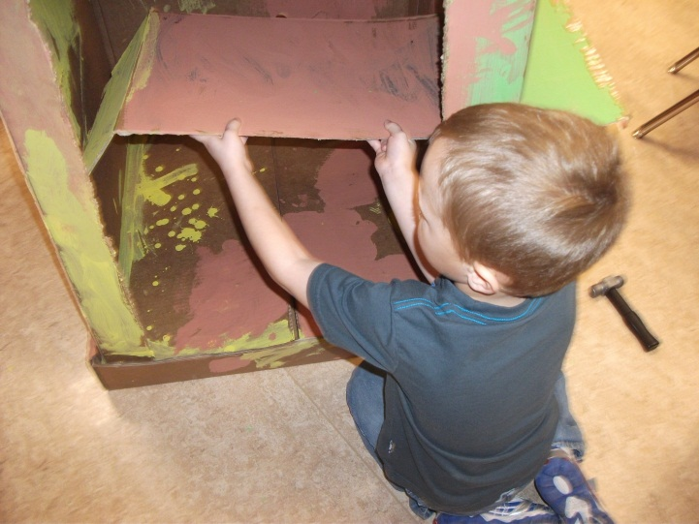
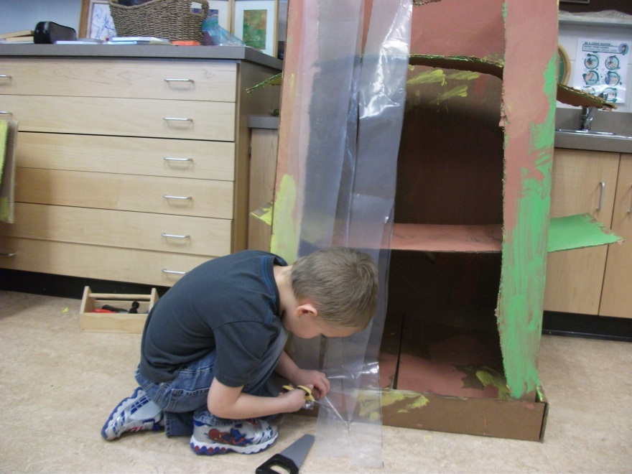
Developing: representational skills, ability to work together and solve problems.

Slide 15
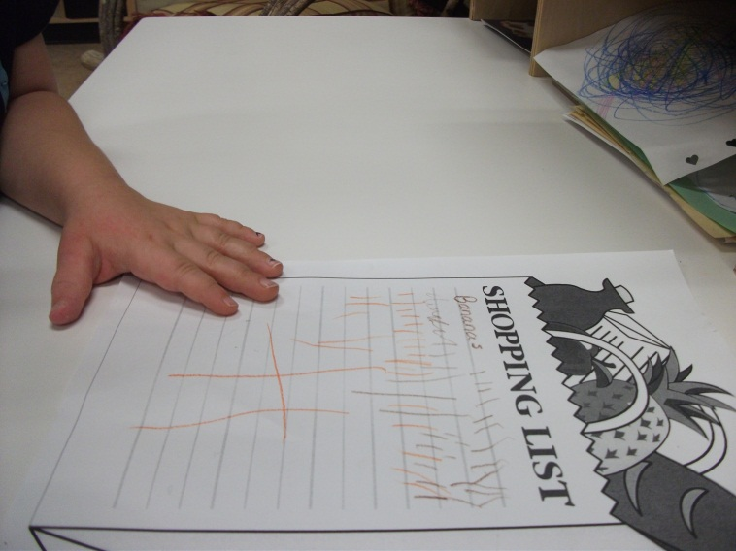
Field Work
Preparation: Expectations, creating a grocery list to buy food items to take back to the school, observational sketch practice

Slide 16
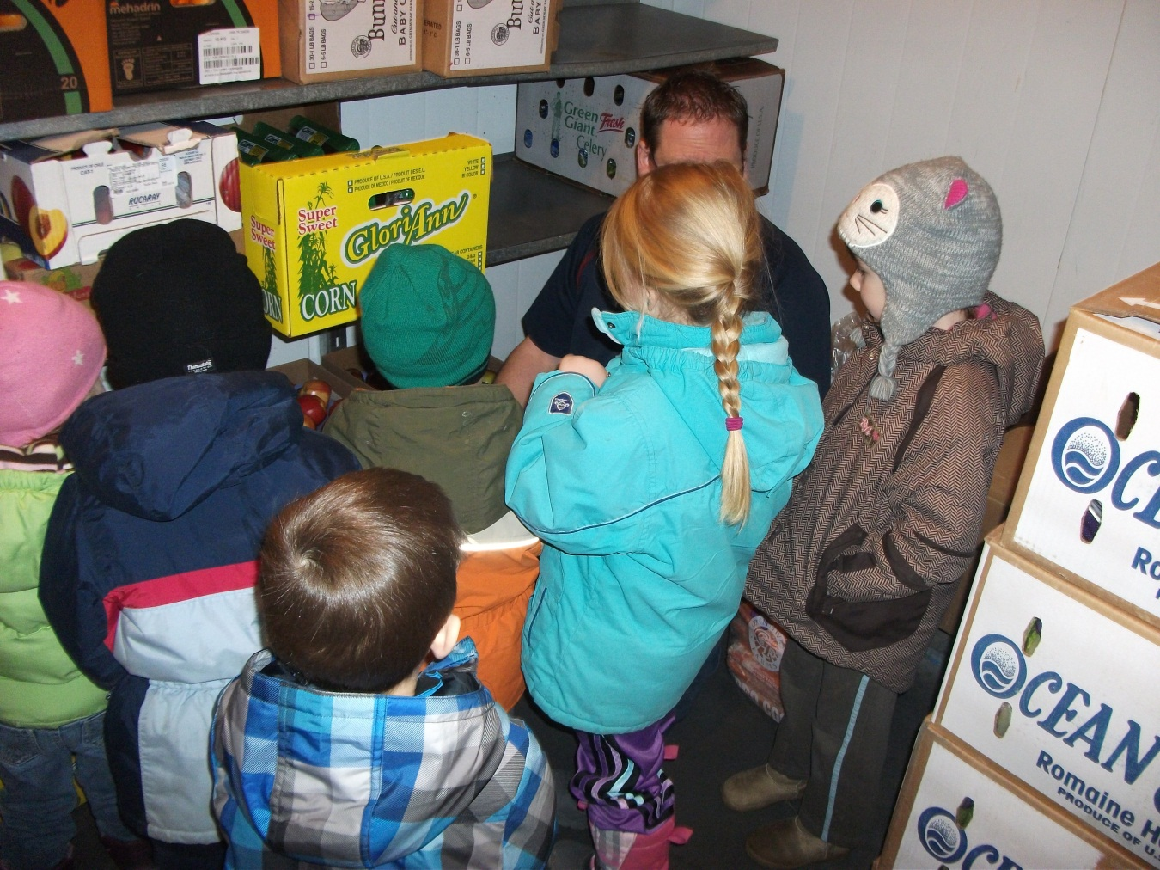
At the local grocery store the children looked at storage freezers/fridges in the warehouse.

Slide 17
As part of the field-site visit the children and parents had assigned tasks to identify fruits and vegetables and do sketching of their findings.

Slide 18
Phase III: Sharing the Project
Prekindergarten shared their learning web with Kindergarten. They opened up the Pre-K grocery store to “sell” Kindergarten the healthy fruits and vegetables they bought at the local grocery store. They had to run the cash registers, and bag the groceries for Kindergarten. Everyone sat down together to enjoy the snack together!

Slide 19
Teacher Reflections
CHALLENGES:
Keeping the focus on the questions we had set out to answer so the project was manageable.
Organizing the fieldwork (ideally the fieldwork could have been done earlier which might have led to more opportunities to explore in the classroom but SK weather was a dictating factor!)

Slide 20
For a first time project “The Grocery Store” was a choice I was happy with since it had familiarity and relevance to the children.
Especially meaningful was the involvement of the families/children with the fieldwork. The preparation for the fieldwork (practice sketching, discussion of expectations etc.) is something I definitely would repeat.

