Slide 1
Rockets: – Pre Kindergarten

Slide 2
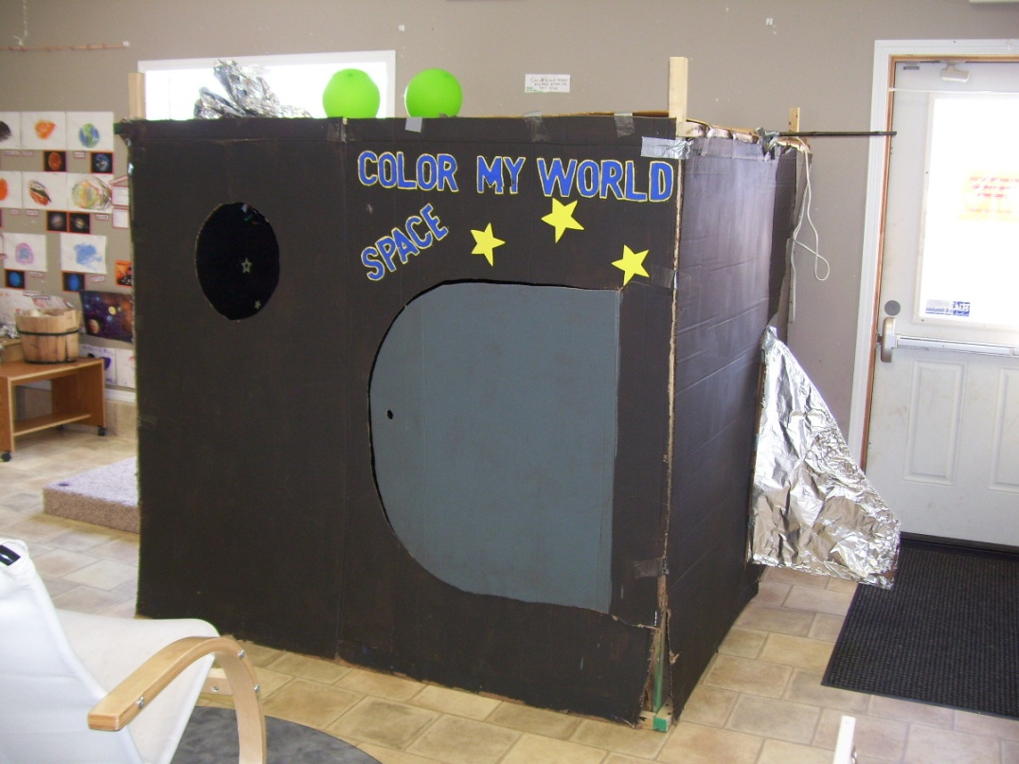
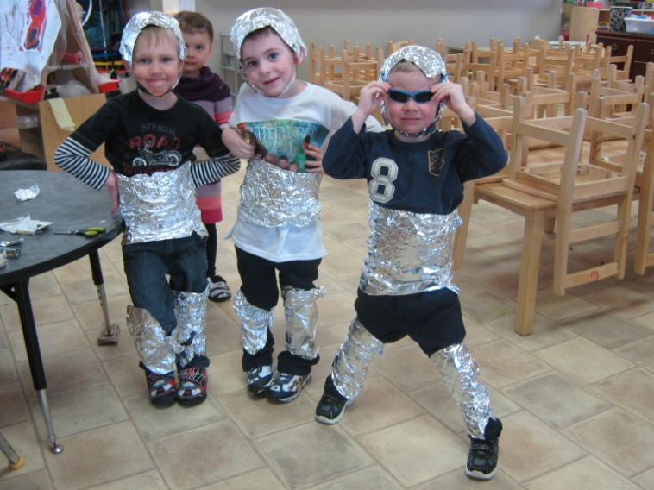
A couple of space men!
The staff built and displayed a rocket ship for the children, this then turned into a project about planets and space and all kinds of different things!
Notes:
The rocket ship after being beat up for three weeks.

Slide 3
What do we need for the rocket ship?
Calder- “We could make planets to hang from the roof so that we can see them from outside of the rocket like we are in space.”
Ryan- “Stars.”
Katryna- “What are the names of all the planets?
Well, this sparked the interest in all of the planets and more and more questions arose out of our discussion.

Slide 4
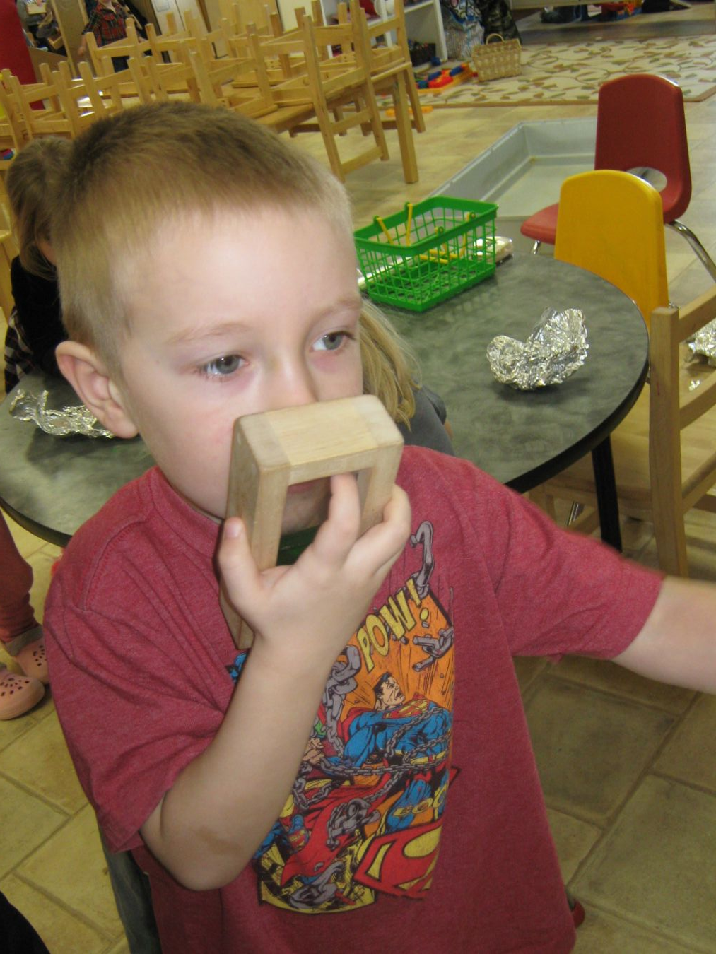
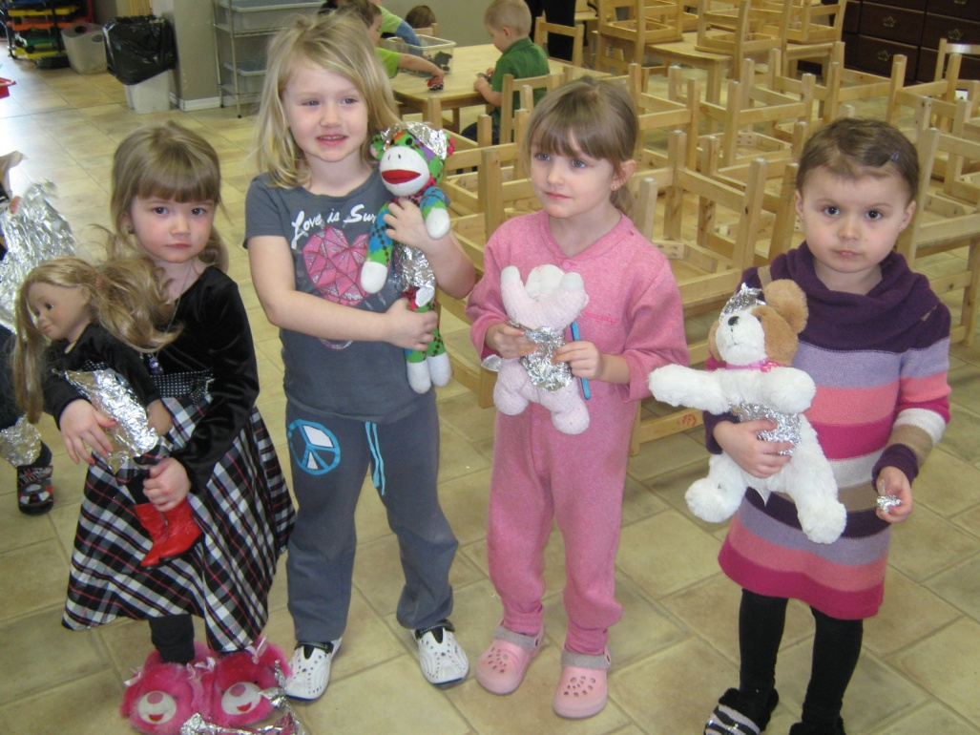
The space men of day care!
They wanted their stuffey’s to have space suits too.
“Come in space command, we are going to blast off in 3...2...1...BLAST OFF!” Seth

Slide 5
Planets was the project
we chose to start!
What do we know? | What do we want to know?
Ryan- “Mars” | Ryan- “Why does Saturn have rings?”
Calder- “They stay in the air, the earth spins around in circles, there is meteor showers, the earth moves around the sun.” | Calder- “How do they stay in the air? How do people make planets? How do the stars stay in the air?”
Katryna- “Jupiter, Mars, and Earth.” | Katryna- “Why is there planets?”
Tyler- “There is no gravity.” | Tyler- “Why are they those colors?”
Landon- “You can blast off to planets.” | Izzy- “Could they tip?” “Can you float on them?”
Izzy- “They float around.” | Falon- “How big are the planets?”
Rylan K- “Astronauts come from the moon.” | Izzy- “How come some have rings and some don’t?”
Izzy- “If you land on the moon and fall off, then you will float.” | Talyn- “Why is the sun so close to the planets?” Has anyone been to the moon before?”

Slide 6
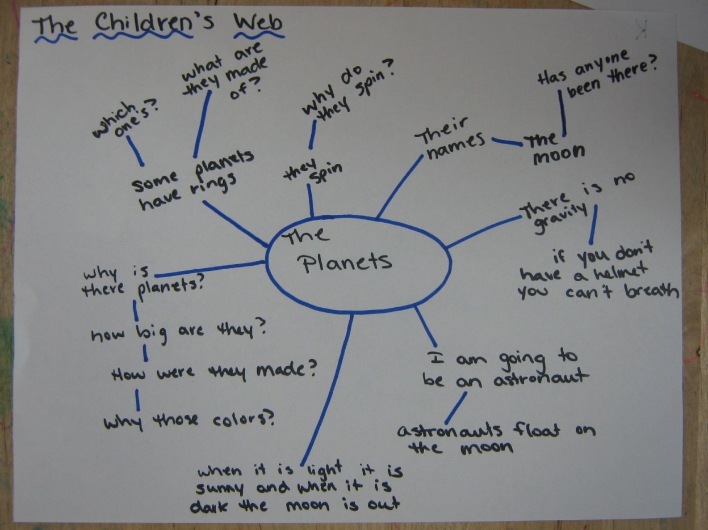
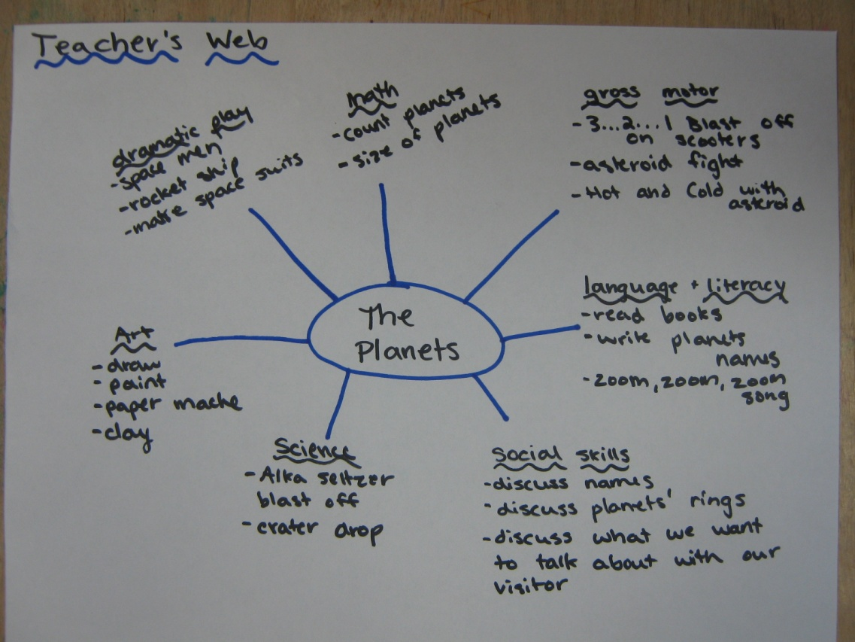
Our topic webs:

Slide 7
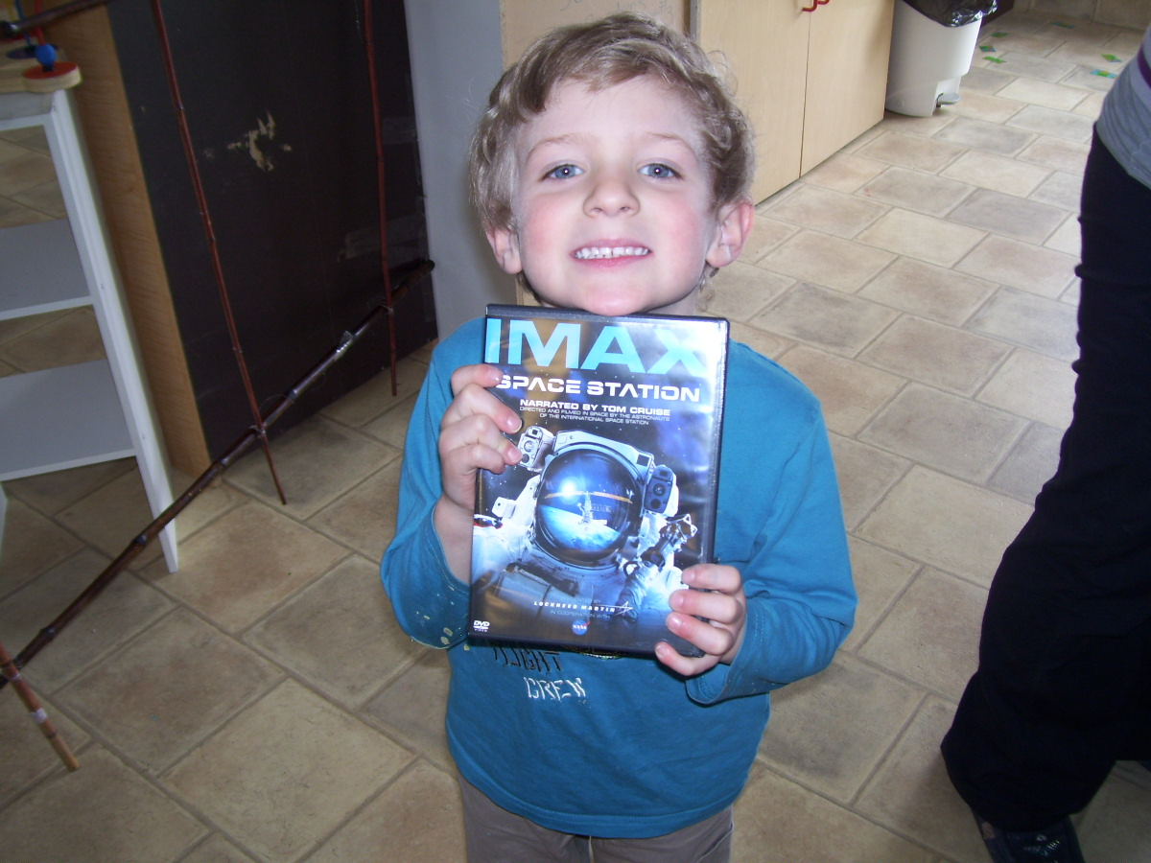
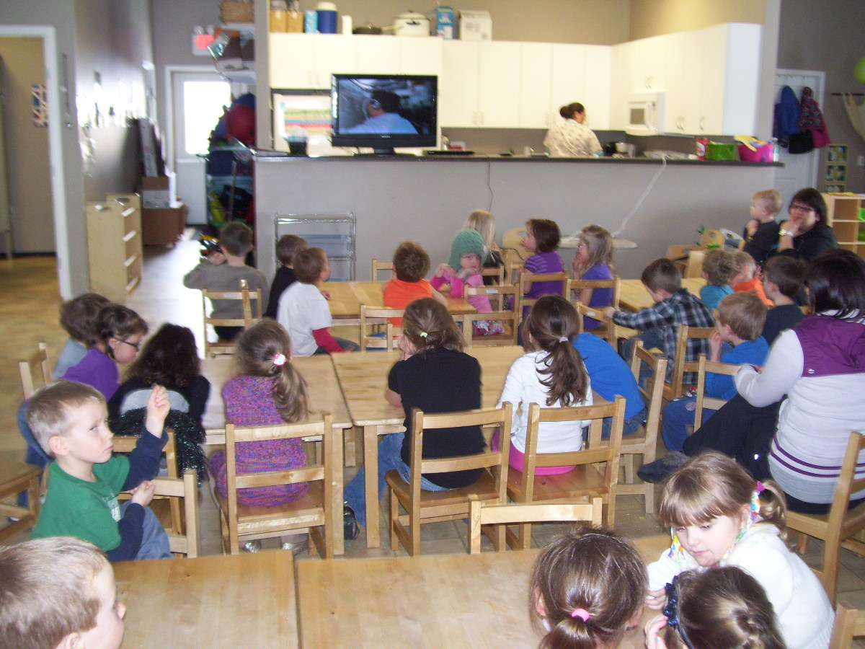
A child brought us a movie to watch that talked
all about rocket ships!

Slide 8
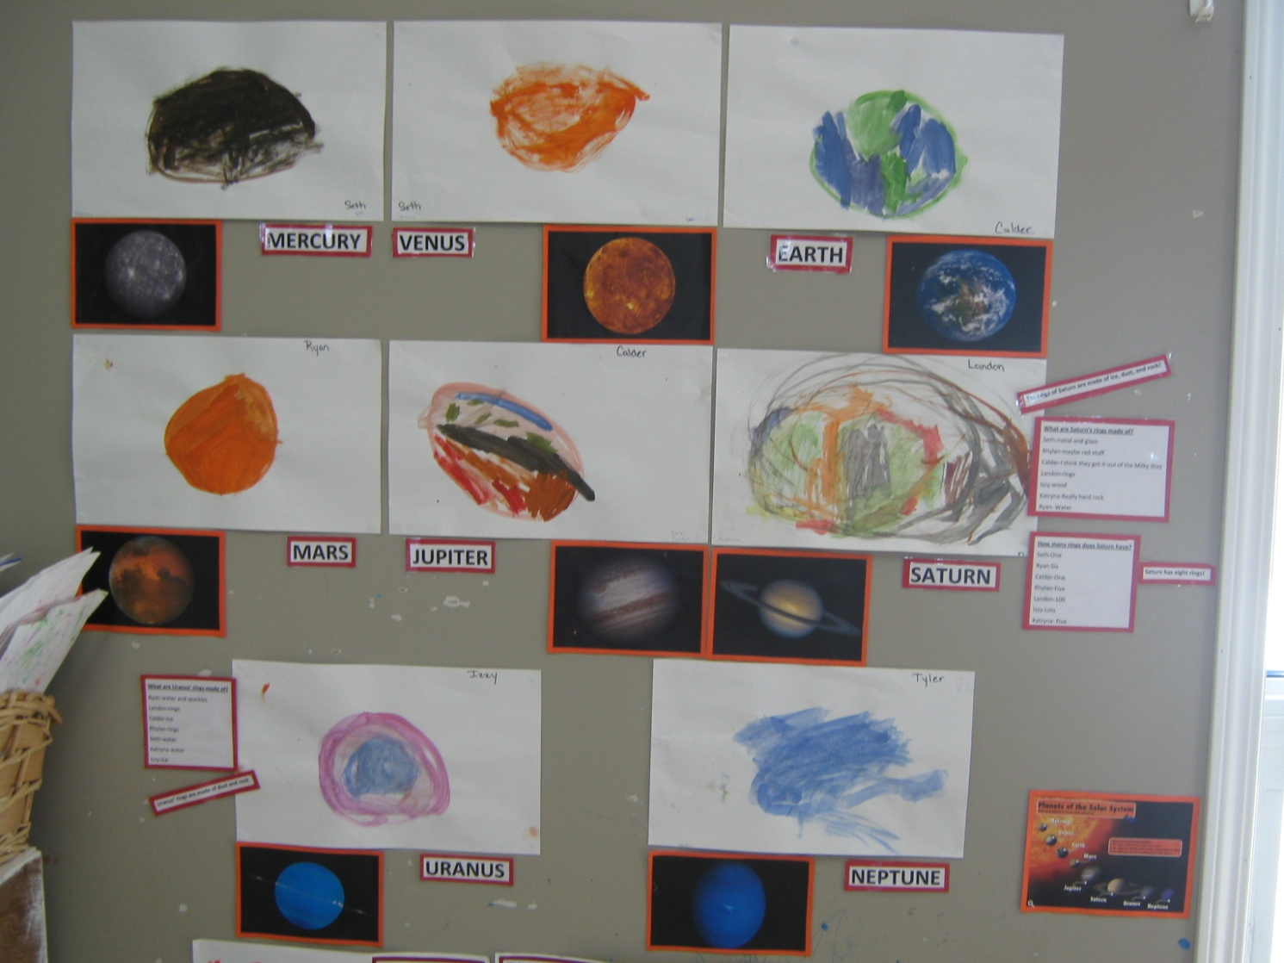
We looked up all of the planets and what they look like...then painted them with water colors!
The children noticed that two of the planets have rings, Saturn and Uranus. Discussion started about those planets.

Slide 9
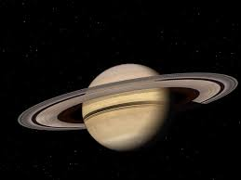
What are Saturn’s rings made of? | How many rings does Saturn have?
Seth- “metal and glass.” | Seth- “one”
Rhylan- “maybe red stuff.” | Ryan- “six”
Calder- “I think they got it out of the milky way.” | Calder- “One”
Landon- “rings.” | Rhylan- “Rhylan”
Izzy- “wood.” | Landon- “100”
Katryna- “really hard rock.” | Izzy- “lots”
Ryan- “water” | Katryna- “five”
We discovered after reading some books that have facts about Saturn in it that Saturn's rings are made of dust, ice, and rock. We also discovered that Saturn has eight rings.
What are Uranus’ rings made of?
Ryan- “Water and sparkles”
Landon- “rings”
Calder- “ice
Rhylan- “rings”
Seth- “water”
Katryna- “water”
Izzy- “ice”
We discovered through books again that Uranus’ rings are made of dust and rock.”

Slide 10
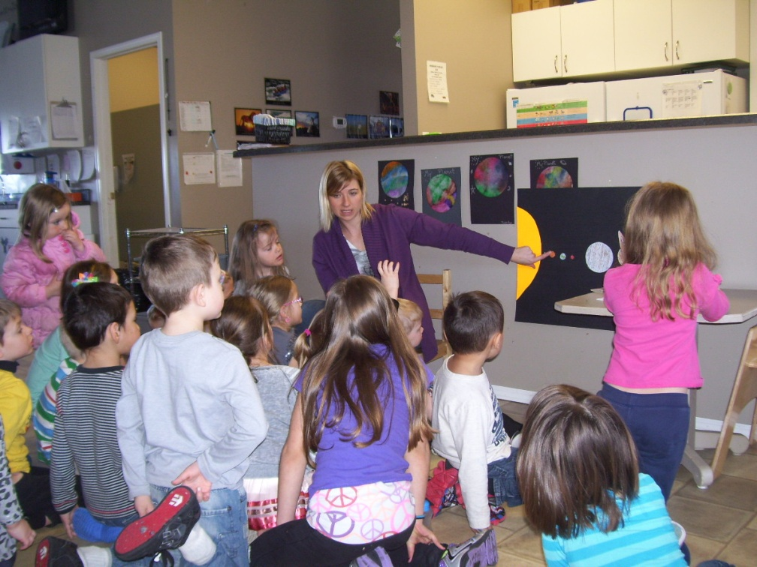
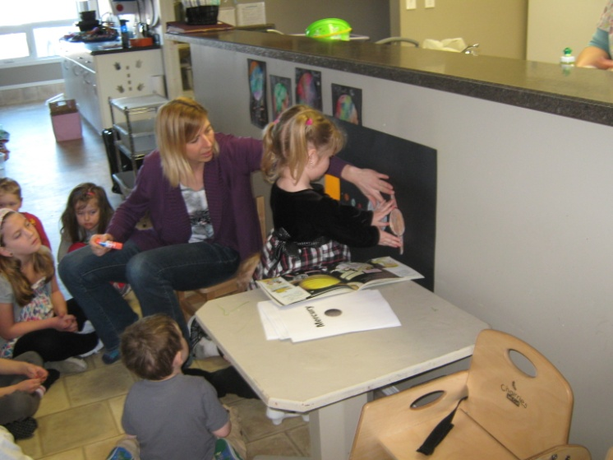
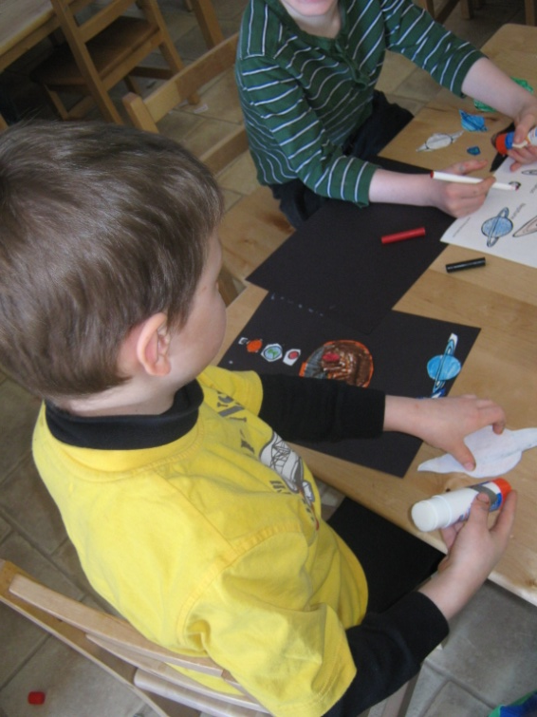
A visit from a child’s mom.
Our mom is a vice principal at one of the local schools. We asked her to come to the center and talk to the children about planets!
Thank you!!

Slide 11
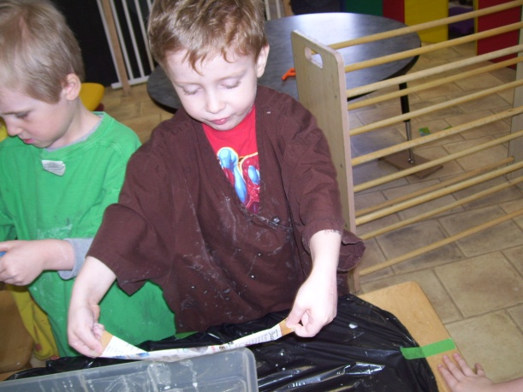
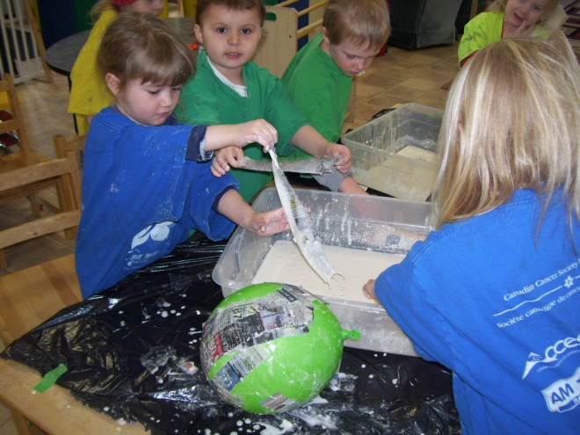
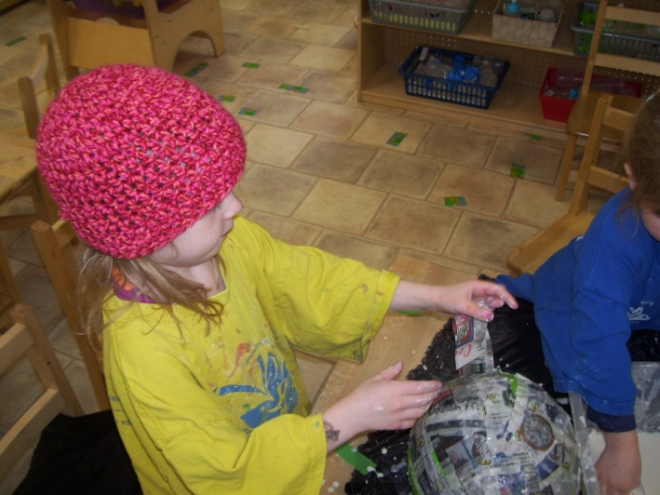
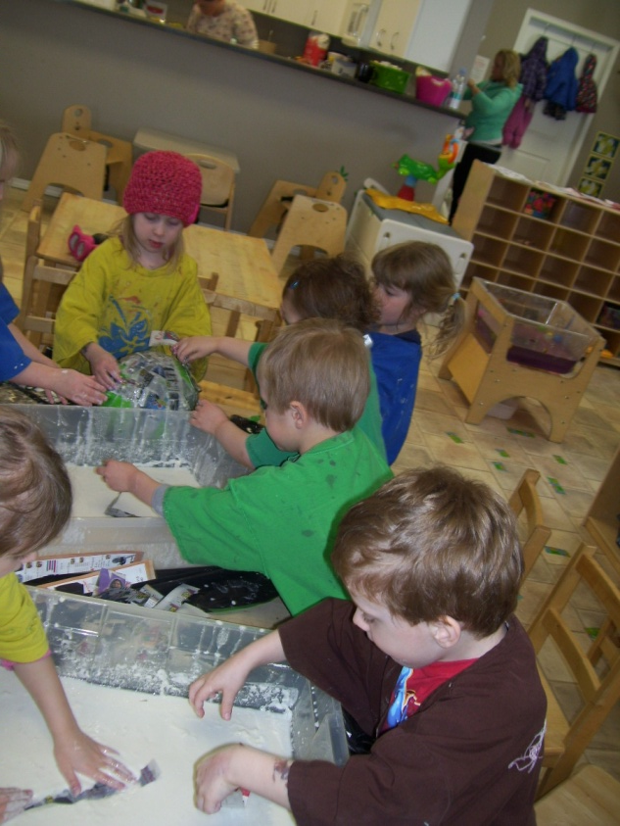
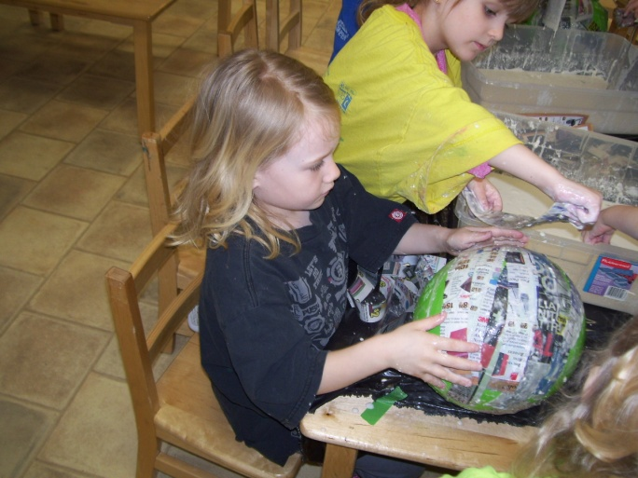
Paper Mache
I sat down with the children and asked them “What should we do next?” Calder instantly shouted at me, “We need to make the planets to hang from the roof!!”
So that is what we began to do.
The paper mache planets are still a work in progress, we are slowly working on them every day and getting closer to finishing them!

Slide 12
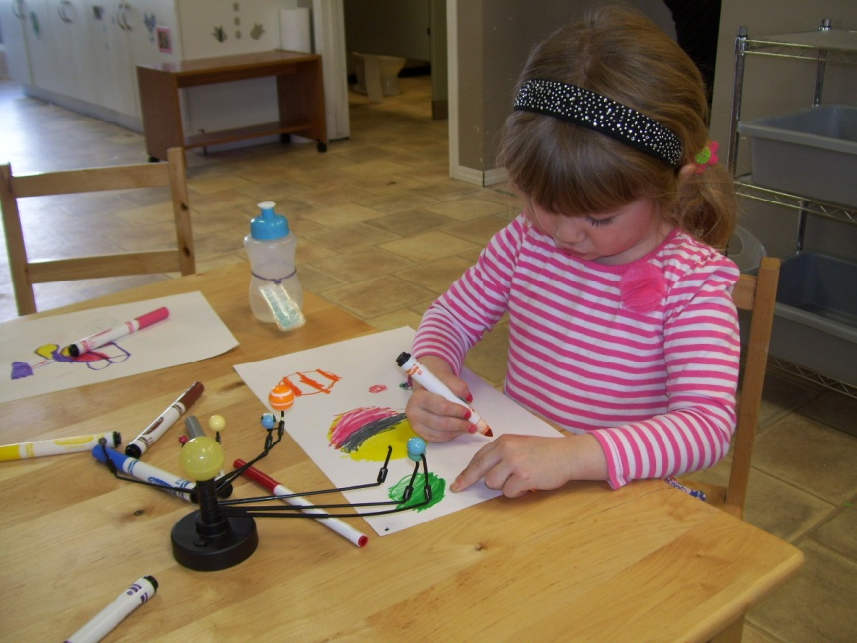
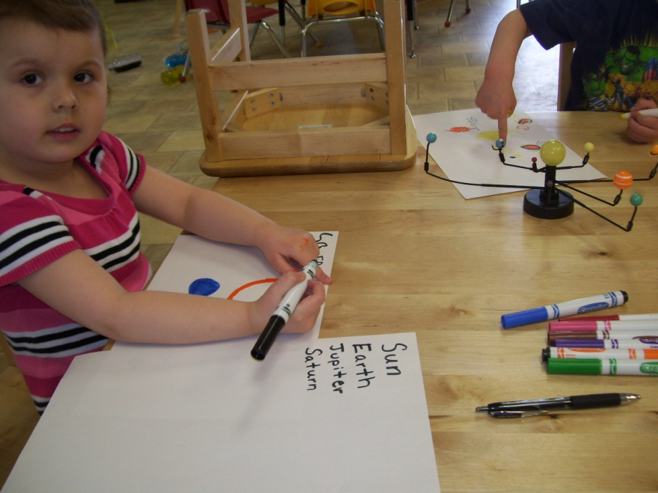
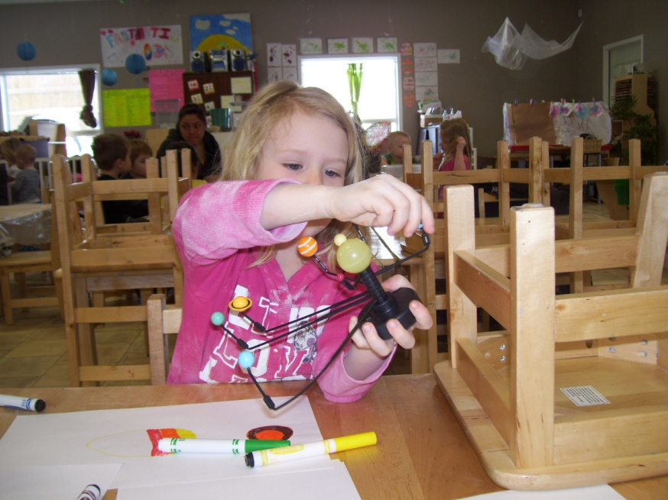
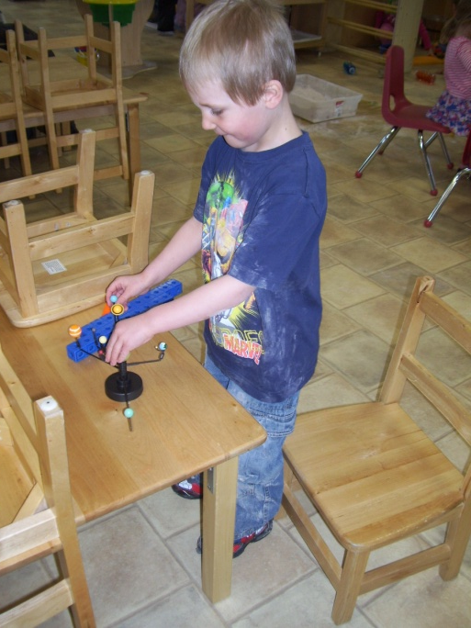
Drawing and Writing
We bought a model Solar System out of the book order and the children wanted to draw the planets, they took it even further because they wanted to write the letters of the planets names!! ☺

Slide 13
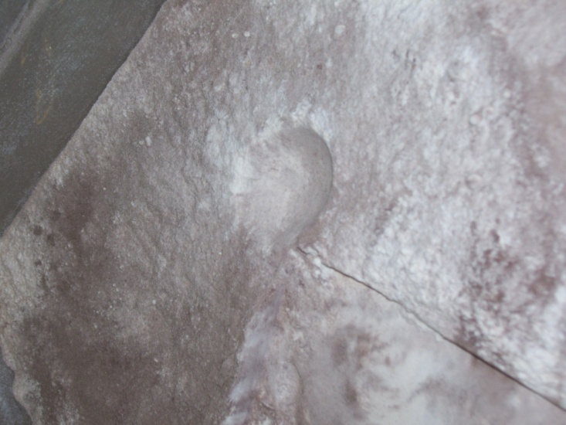
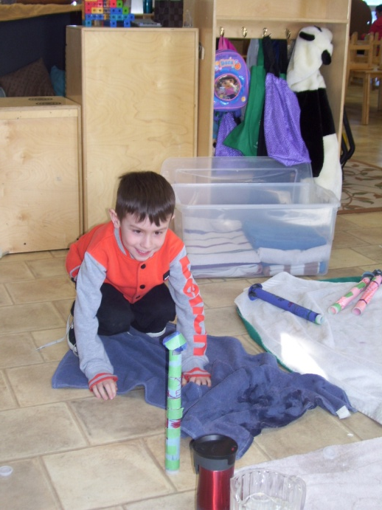
We joined the kindergarten group to do a couple of science experiments that they were doing.
The kindergarten's were doing an experiment on how craters are formed as well as how rockets blast off. We learned all about how when pressure builds up in a tiny space and has no where to go that is when there will be an explosion.
This student is blasting off his rocket that he created, with an alka seltzer tablet and water. It hit the roof!!
A crater formed by a ball.

Slide 14
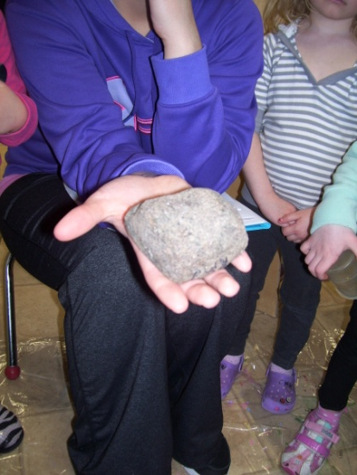
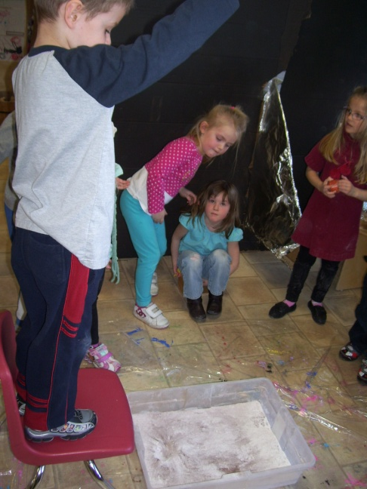
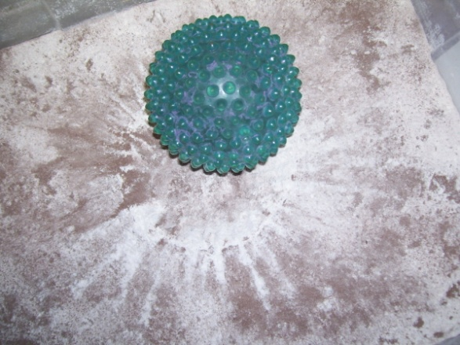
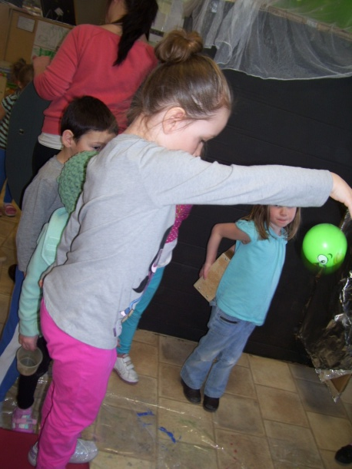
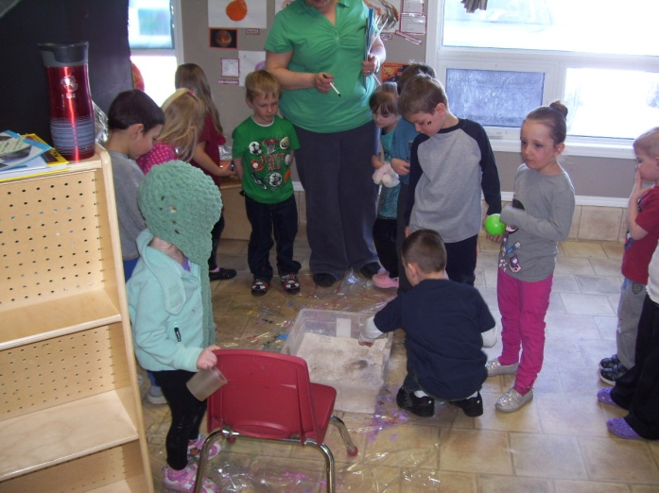
The Crater Experiment
It was determined by the kindergarten’s that different items of sizes and shapes will make different sizes and shapes of craters. We heard a lot of “WOW’s” during this experiment.
Dropping a ball in the flour and chocolate pudding mixture.
“Wow, look at the lines it made!”
“My ball is light so it will not make a big crater.”

Slide 15
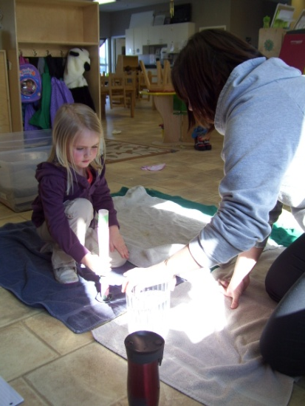
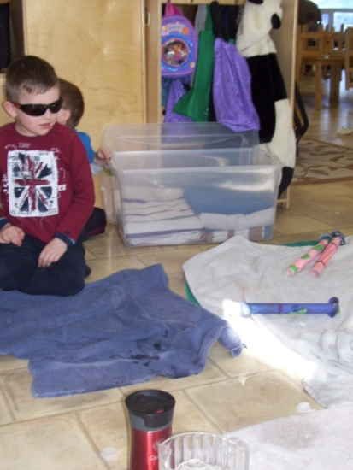
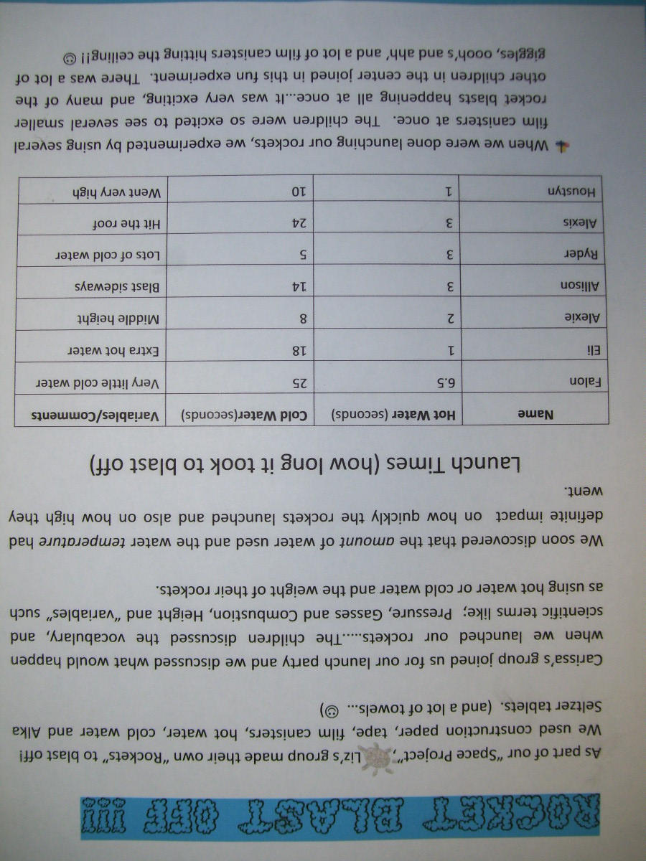
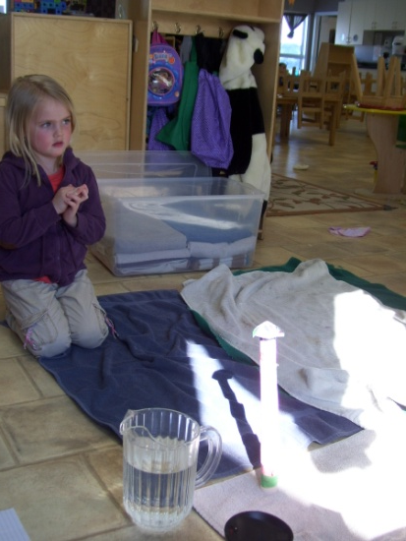
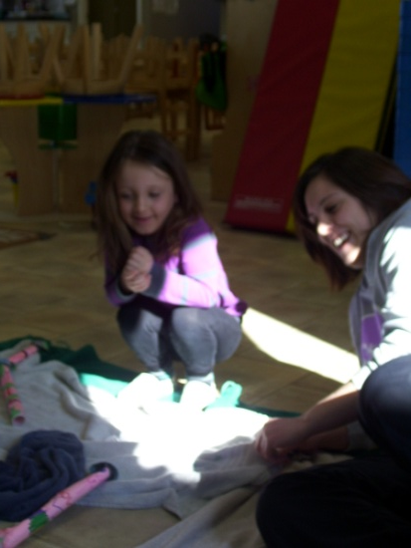
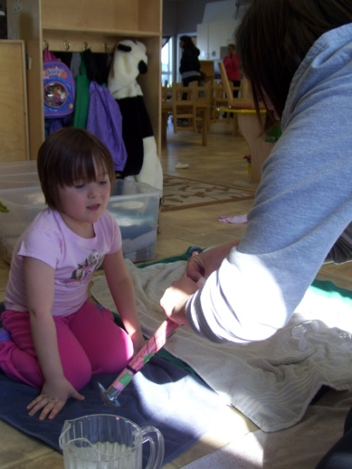
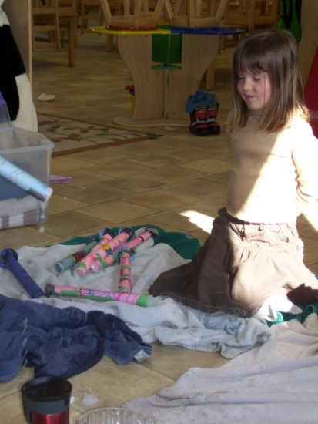

Slide 16
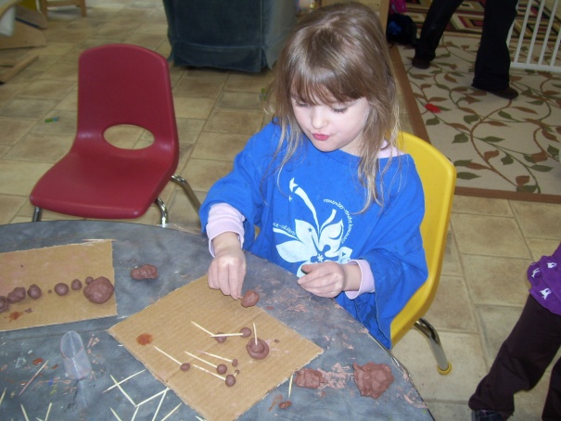
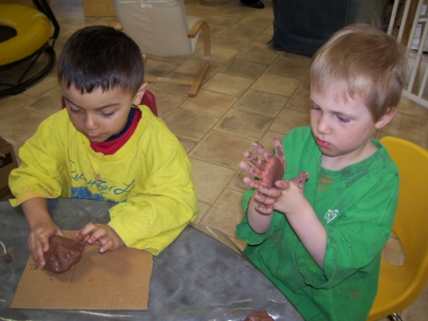
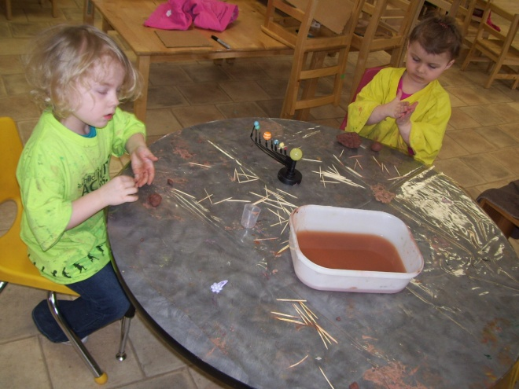
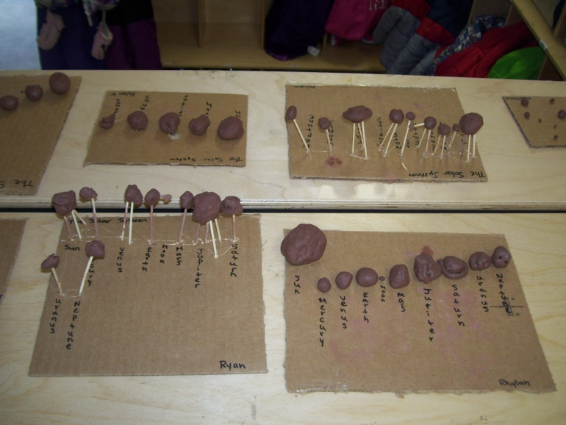
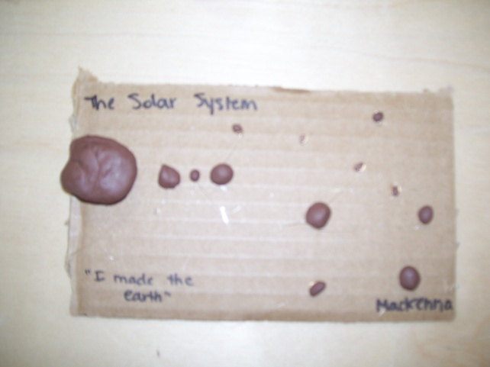
We then went back to working on planets.
The children wanted to work with clay so I gave them the clay and they wanted to make the planets again. They created the solar systems. But we were unsure how we could get them to stand up, they determined that cardboard and toothpicks would hold everything together.
Some of the finished products.

Slide 17
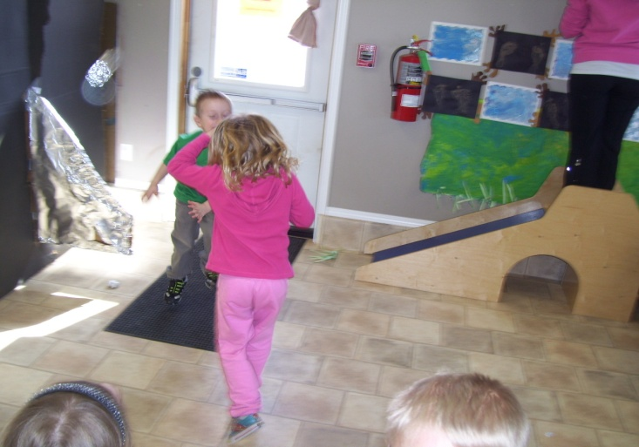
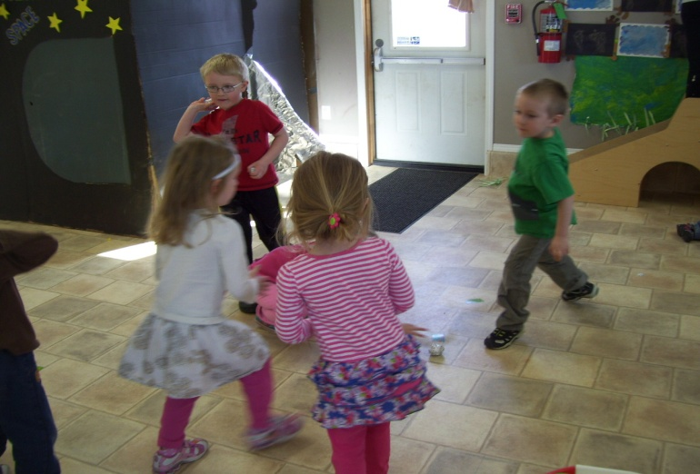
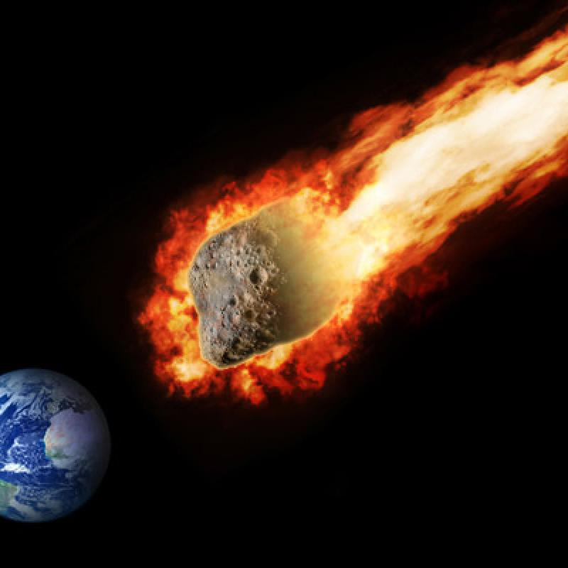
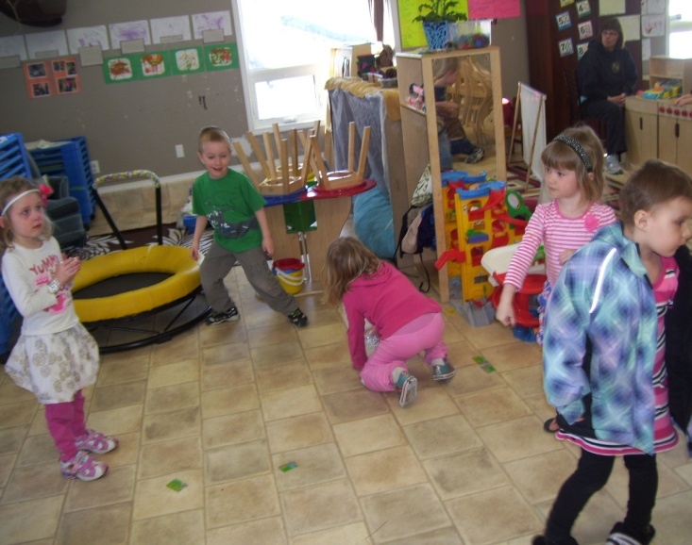
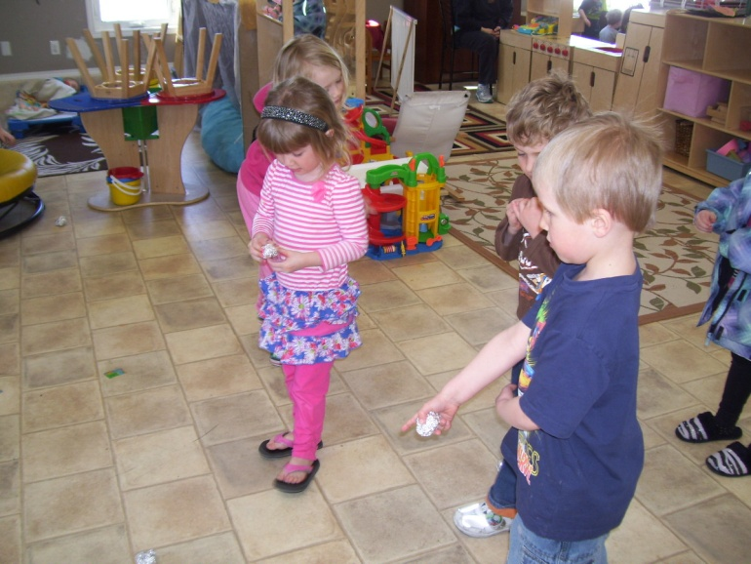
Asteroid Attack
The children made asteroids out of tin foil and started throwing them at each other, then Calder yelled out, “Asteroid Attack.” And so the game began...

Slide 18
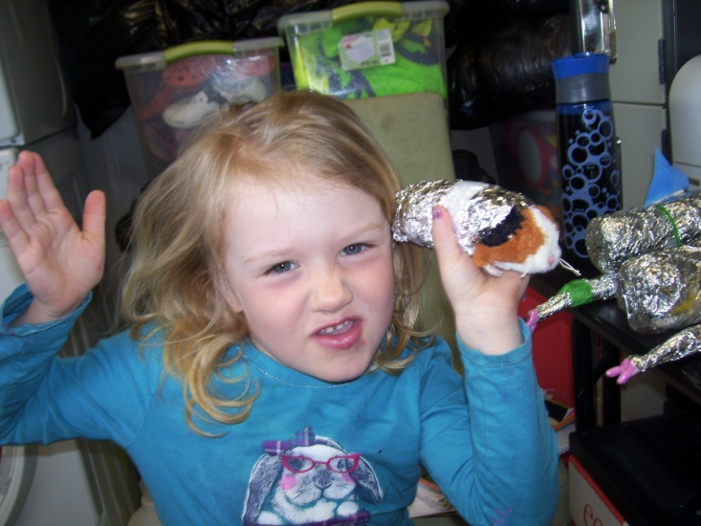
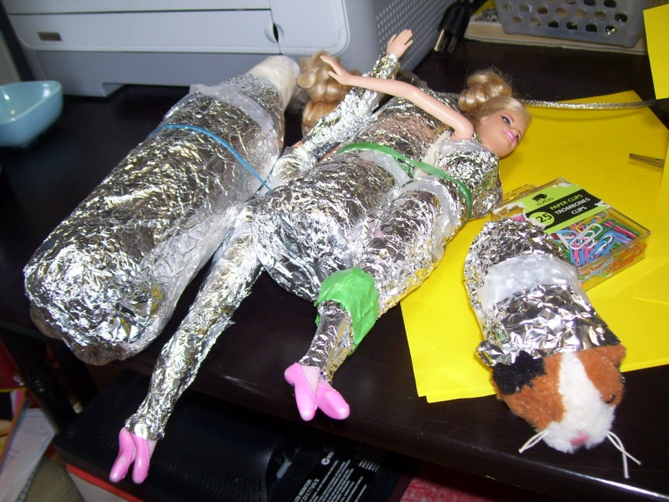
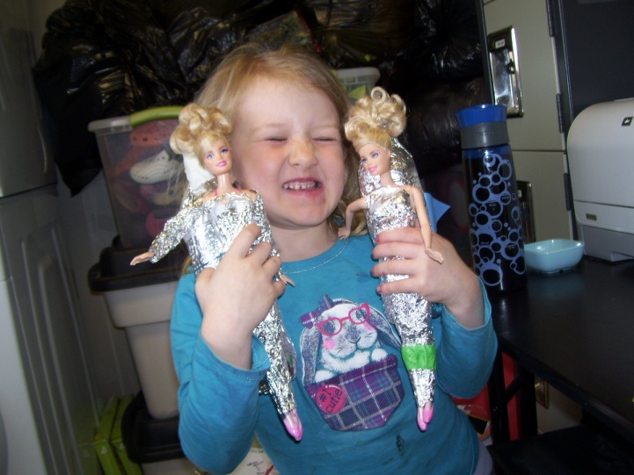
As I was programming one day...
T. came to me and said, “look at what I made Carissa!” “It is space Barbie and guinea pig. I built them, me and Gene made them. The Barbie's have rockets, the guinea pig can fly but he does not have a rocket ship.”

Slide 19
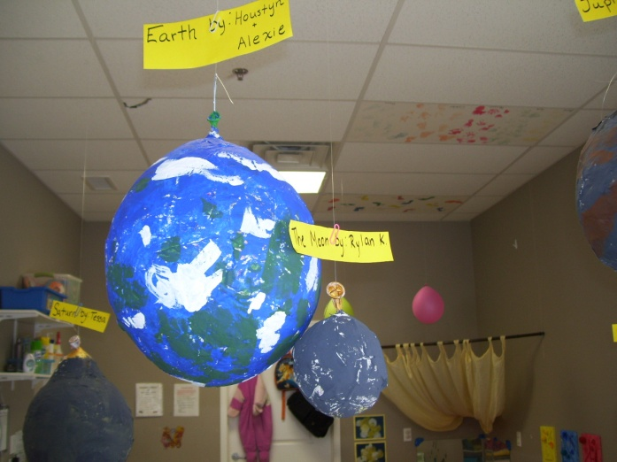
The finished Solar System
We worked very hard as a group and finally completed our Solar System that hangs from the roof.

Slide 20
And that ended our Planet Project!

