Slide 1
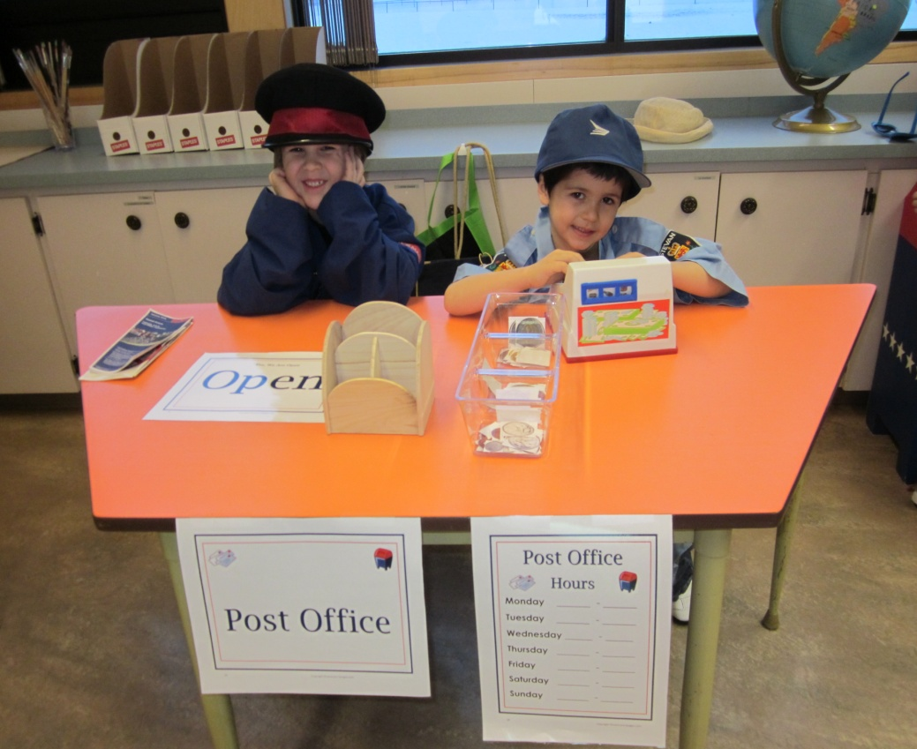
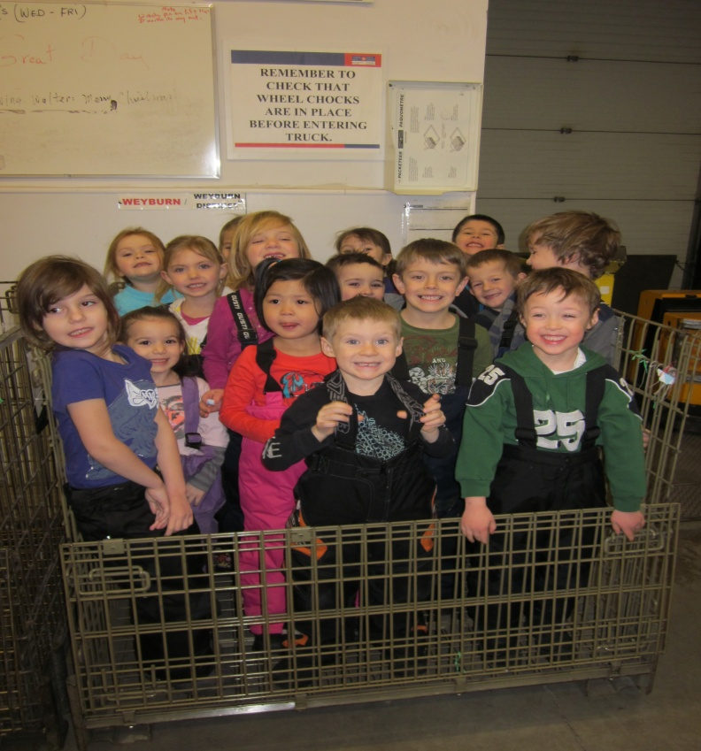
Post Office Project
Submitted by: Sarah Dykstra

Slide 2
The Post Office Project General Information
The Post Office Project was completed by 16 Kindergarten students (ages 5-6). It was completed over a 5 week period in a half-day setting. One teacher was involved in this project and assistance was provided from our Educational Assistant.

Slide 3
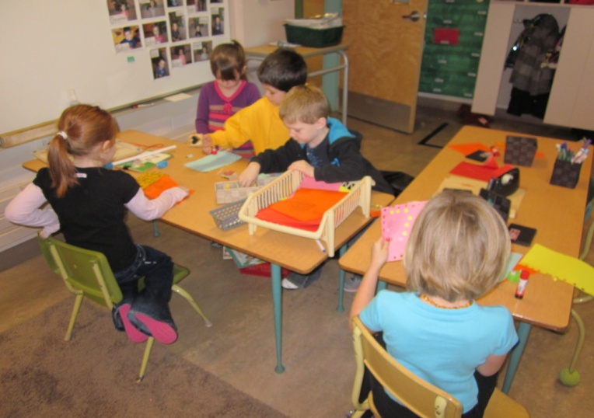
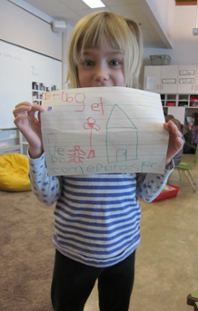
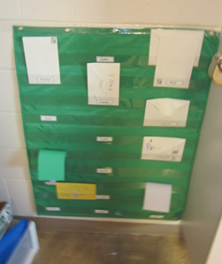
Phase 1:Beginning the Project
The topic of this project was chosen through observation of the children’s play. With the addition of envelopes at the writing centre, students began writing and delivering letters to each other, siblings in older grades, students in the other kindergarten classroom and their parents. This was the focusing event for our project. Our writing centre grew to accommodate the interest my students had in writing and delivering letters.

Slide 4
Phase 1: Curriculum Outcome Web
I created a curriculum outcome web to map out possible avenues that could be explored through this project.

Slide 5
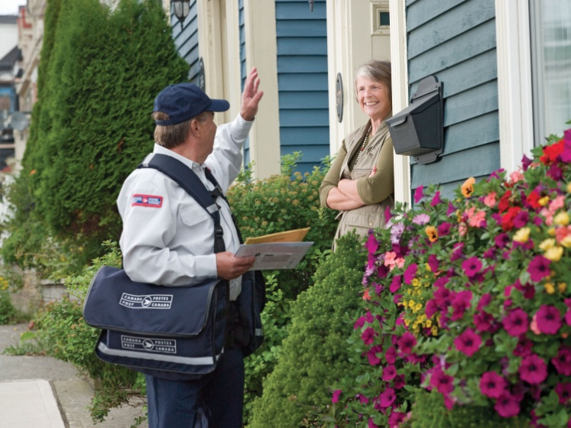
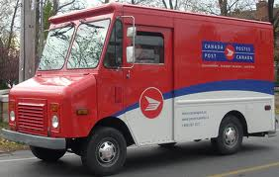
Phase 1: Topic Web
Various pictures were shown to the students before the project started to get them thinking about what they already knew about mail delivery and the post office and what they wanted to learn more about.

Slide 6
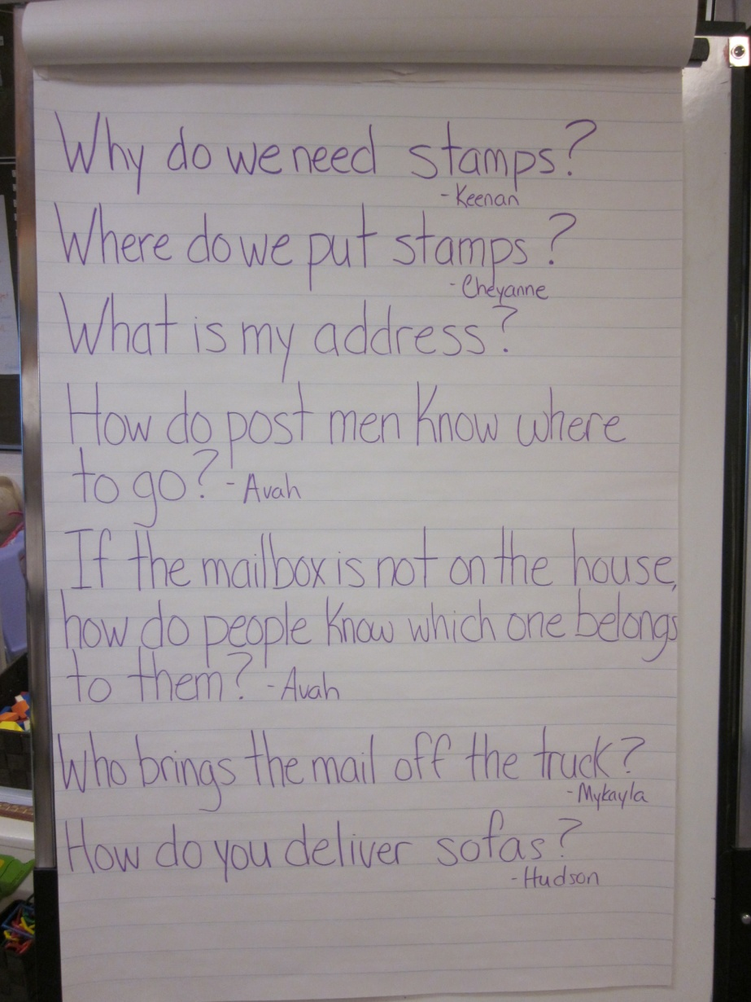
Phase 1: Topic Web

Slide 7
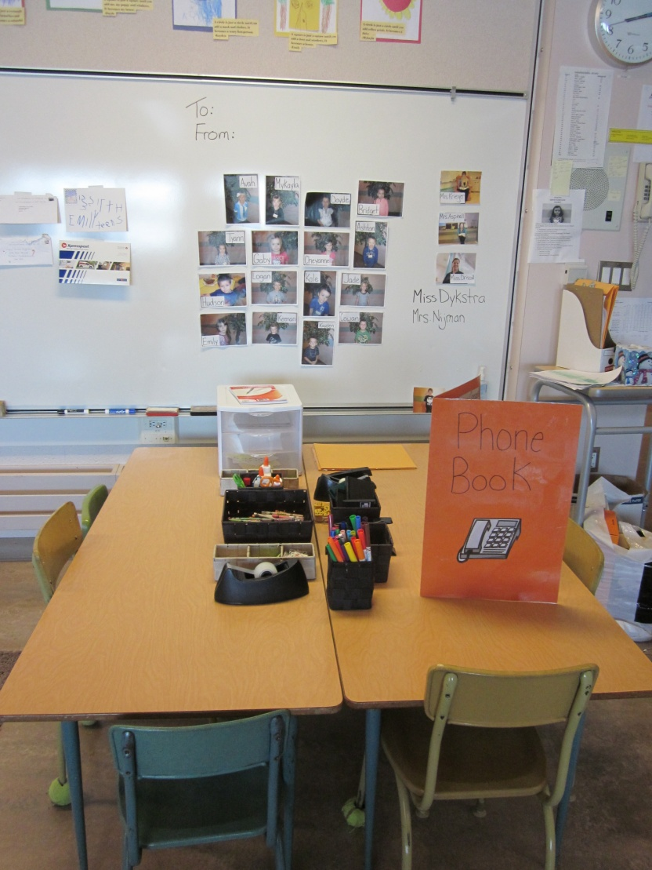
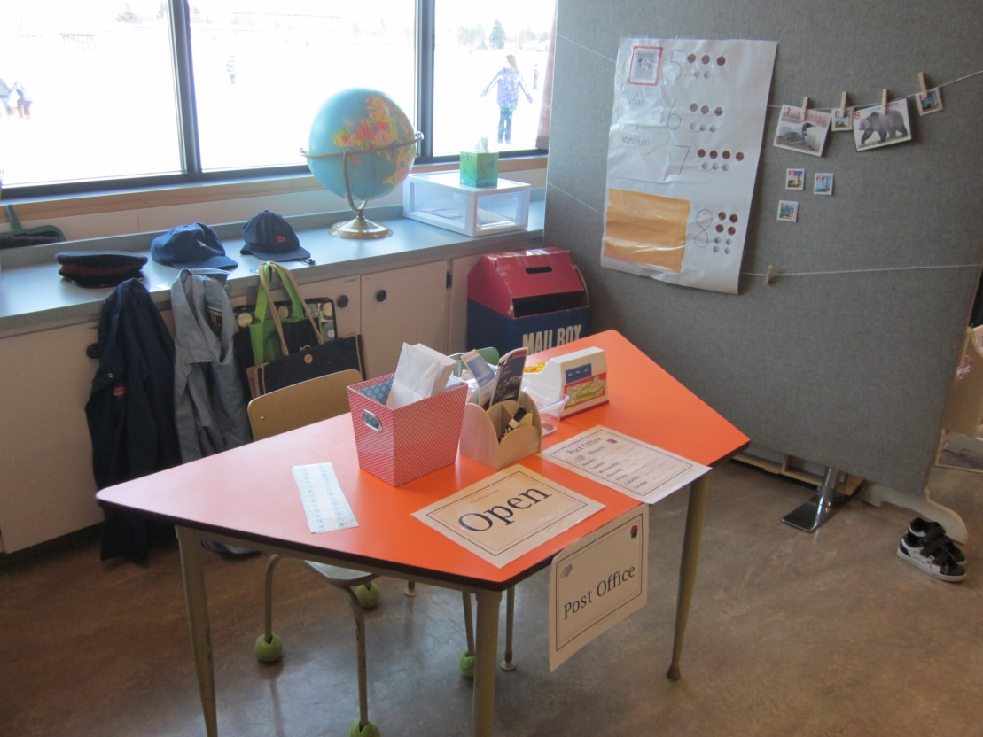
Phase 1: Learning Environment

Slide 8
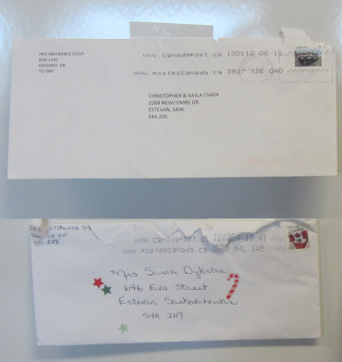
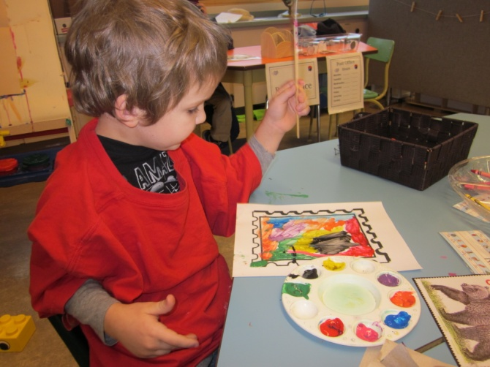
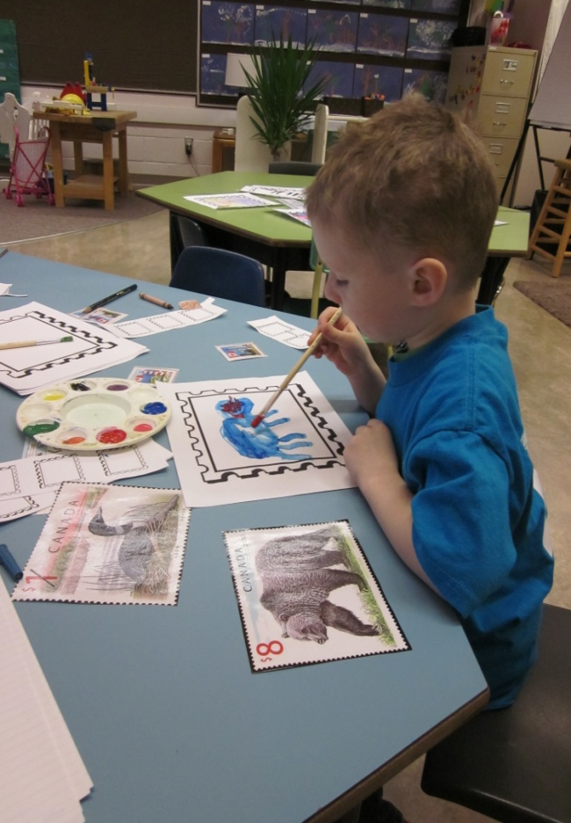
Phase 2: Investigating Why do we need stamps and where do they go?
Parents brought in envelopes and packages that they got in the mail and we examined them. We noticed where stamps were put on the envelopes and the different types of pictures that were on them. I set up an invitation with stamp outlines, paint and stamp books from the post office. Students had fun making there own stamps! When they were done, I shrunk their artwork and put them at the writing centre for them to use on their letters.

Slide 9
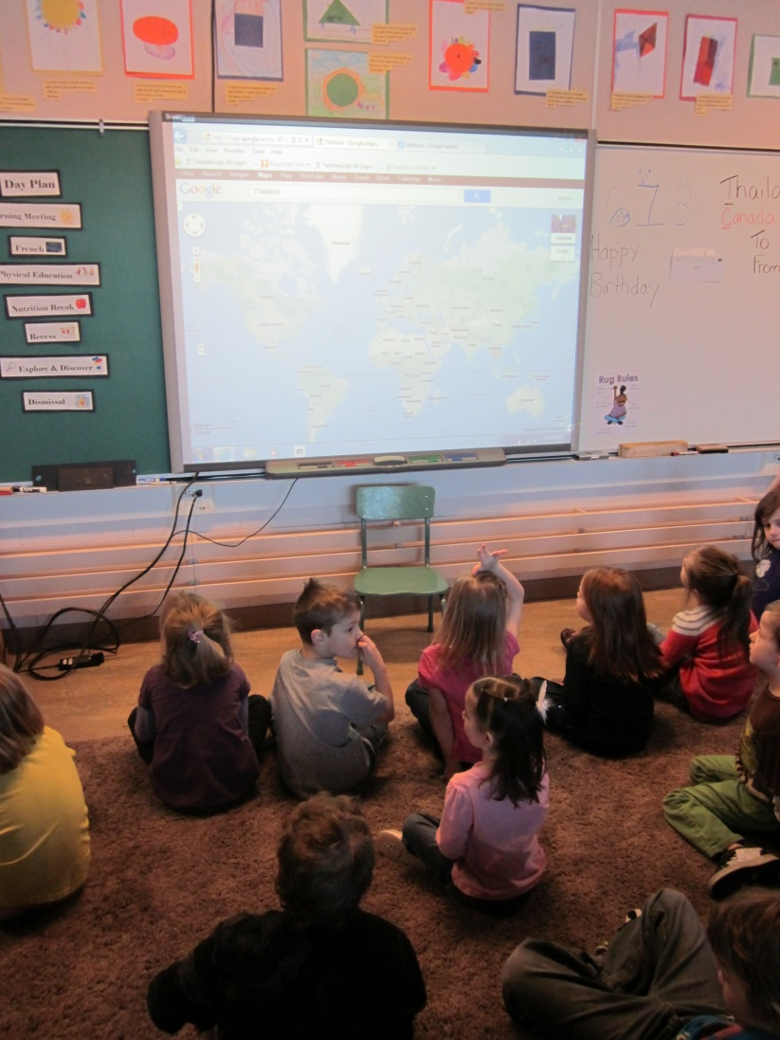
Phase 2: Investigating What is my address?
We looked on Google Maps to see where our mail boxes were and what they looked like. This got us talking about our address. We also talked about how our mail would get delivered to our new student coming to our classroom from overseas.

Slide 10
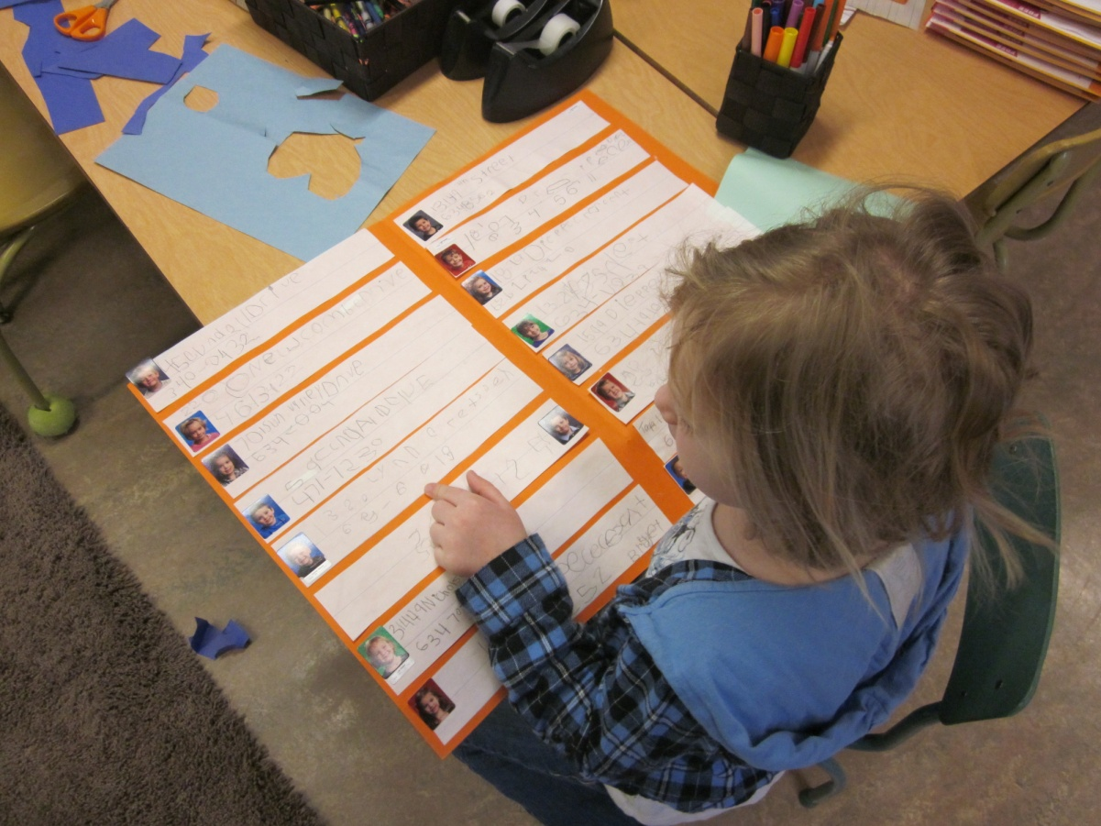
Phase 2: Investigating Where can I find my address?
We made our own phone book so that we could address our letters. This way our mail would get delivered to our friends mailboxes.

Slide 11
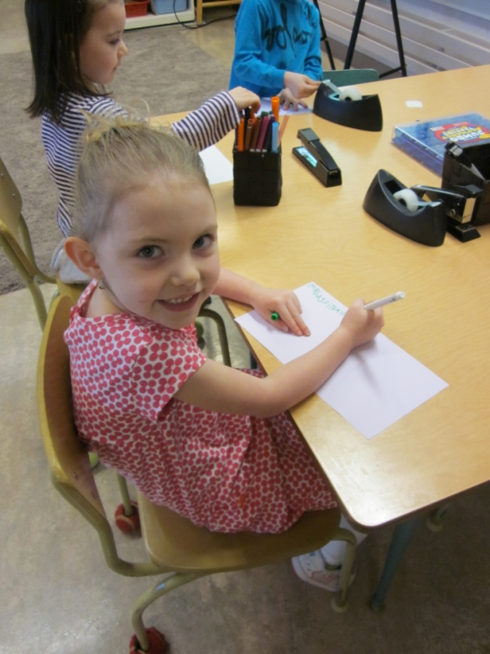
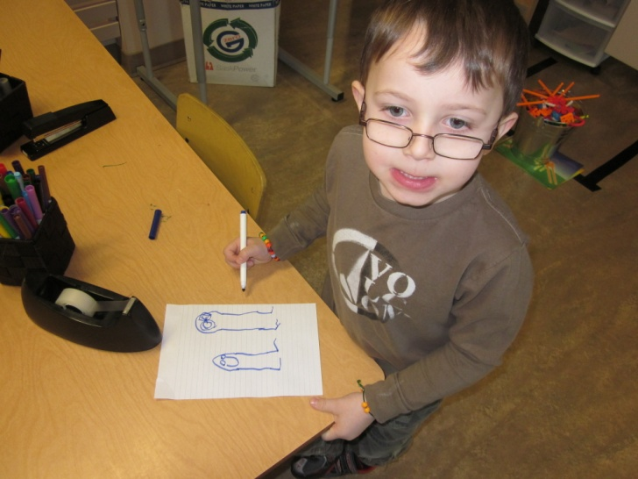
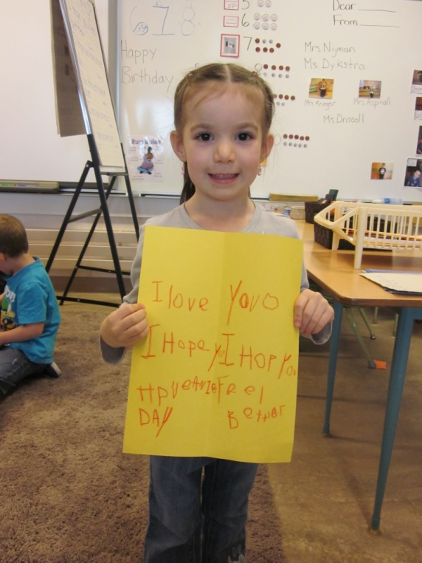
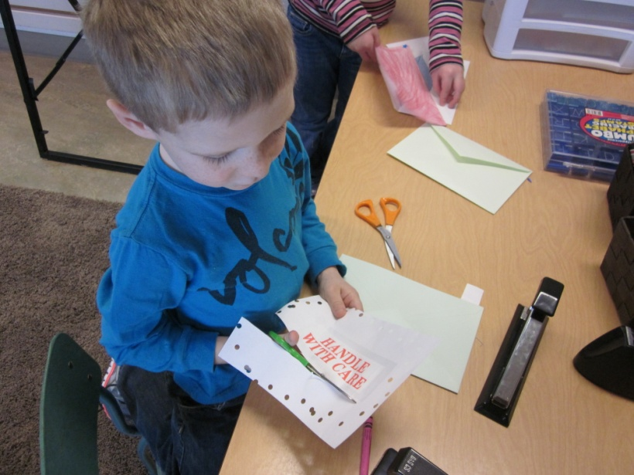
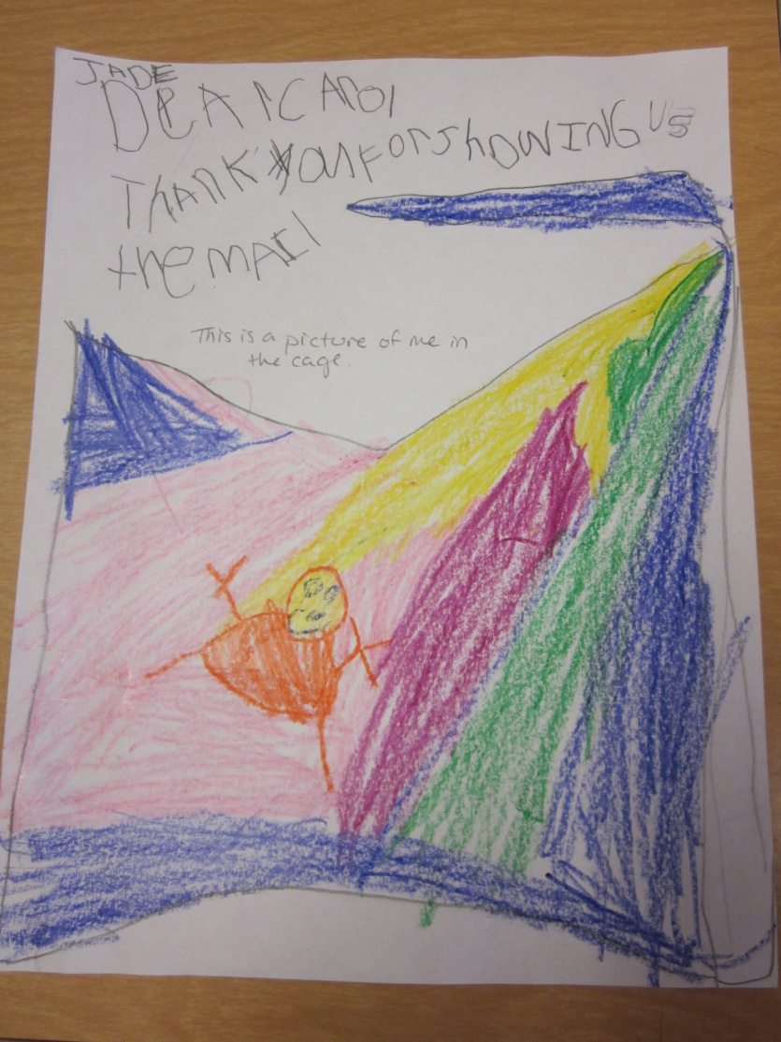
We Wrote Letters...

Slide 12
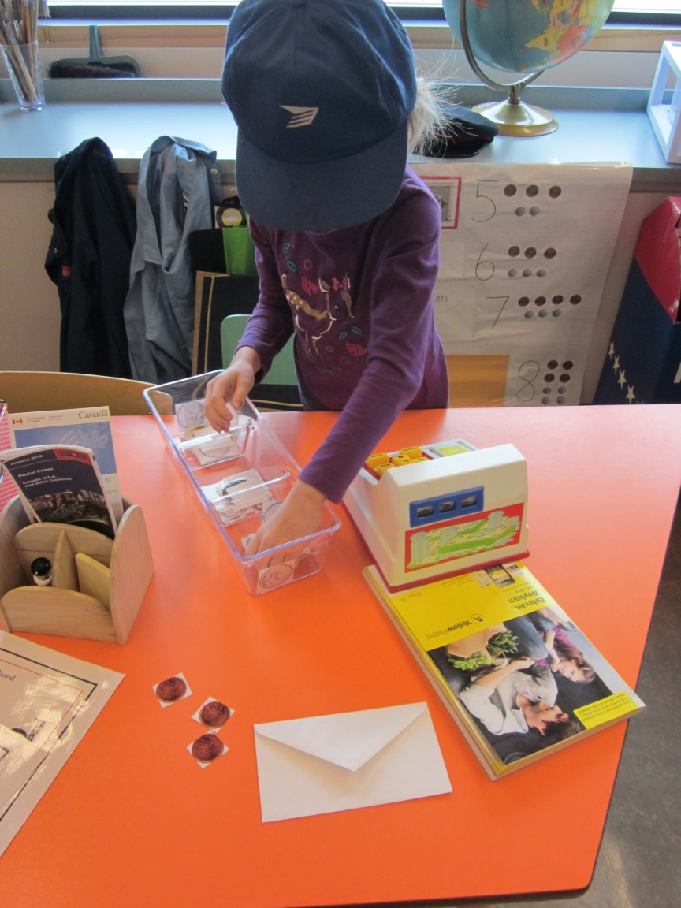
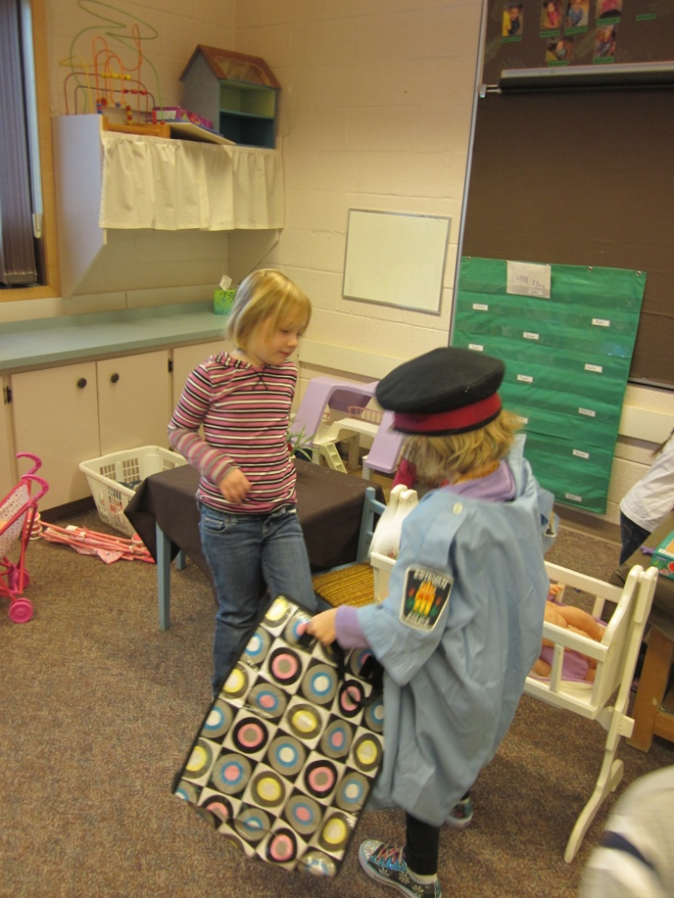
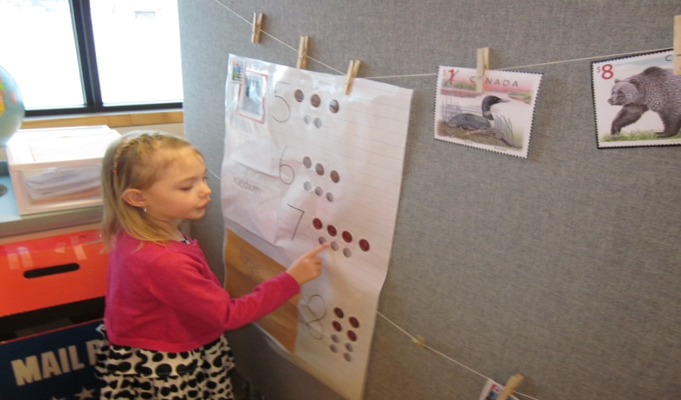
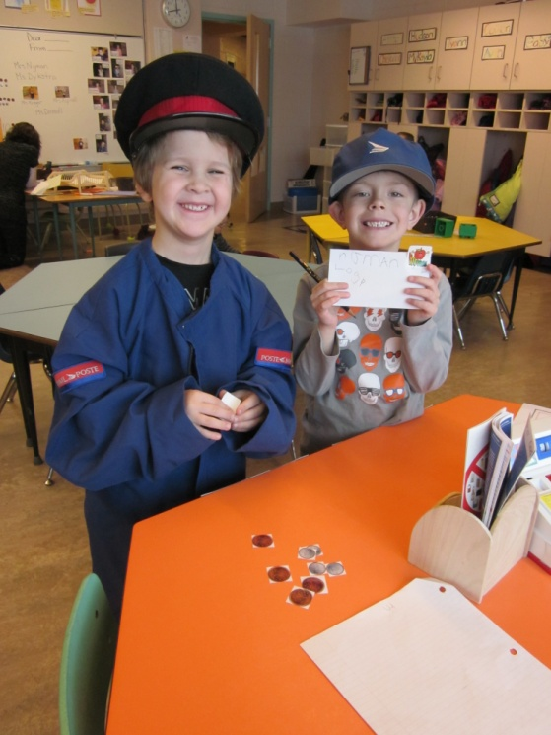
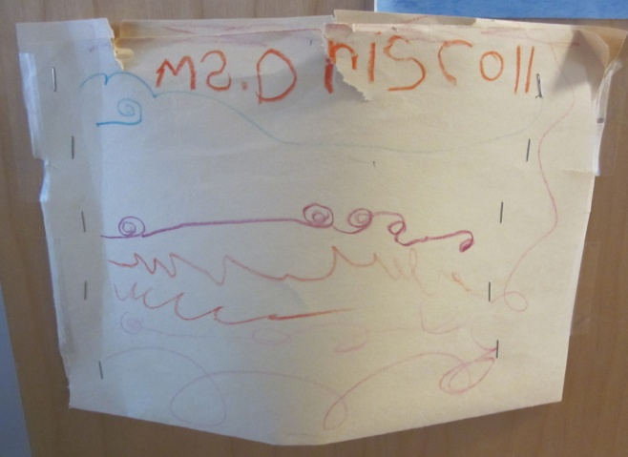
And Delivered Them!

Slide 13
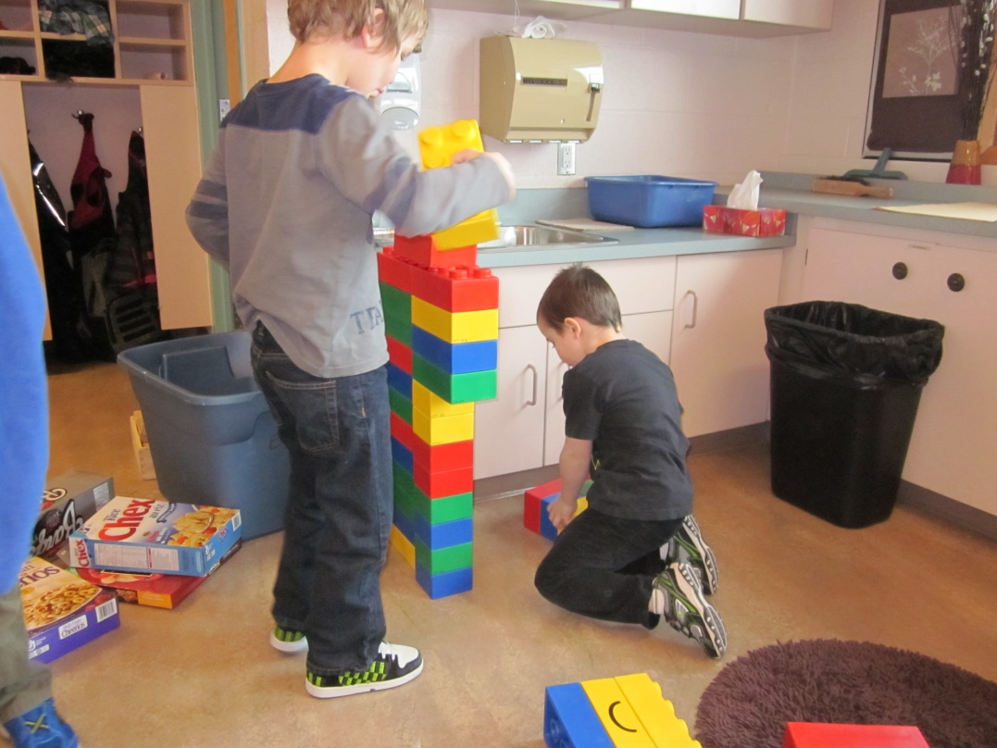
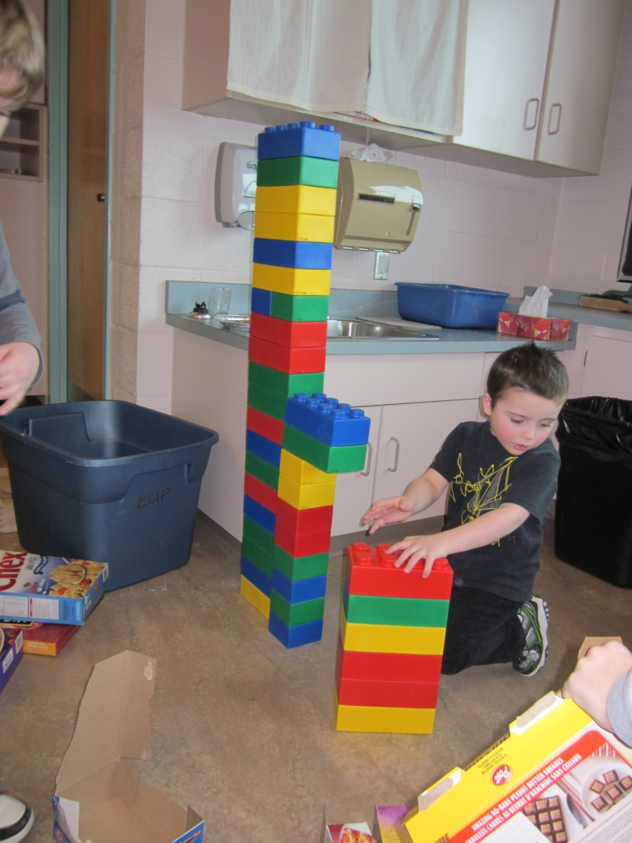
Phase 2: Investigating Post Office Construction
Day 1
On the first day of construction, two students worked together to build a post office. By the end of the morning, they had a big wall built but weren’t quite finished. ..

Slide 14
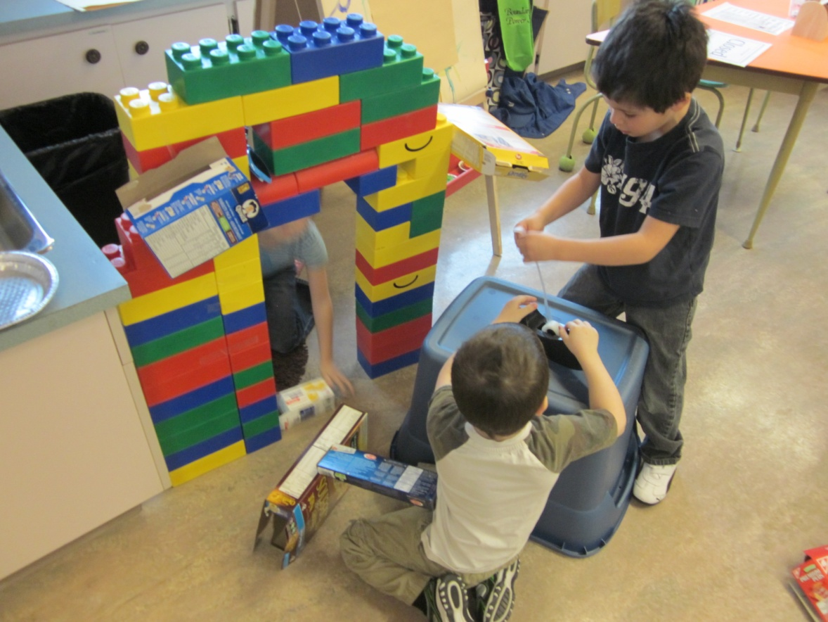
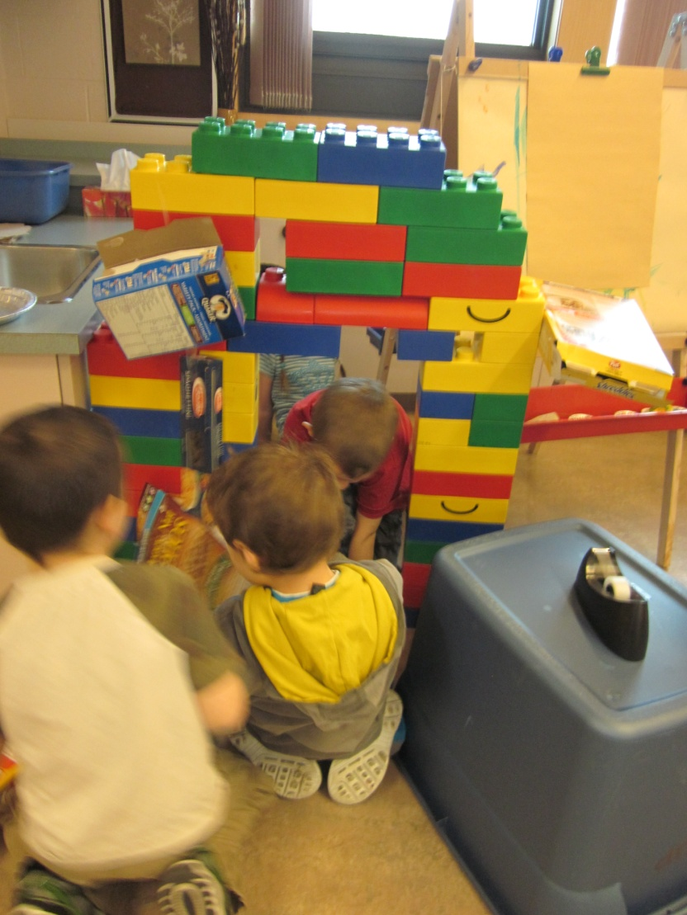
Phase 2: Investigating Post Office Construction
Day 2
On day 2, more students had taken an interest in the post office construction and it began to evolve. The students constructed a post office with a door way, windows and were taping mail boxes all over it.

Slide 15
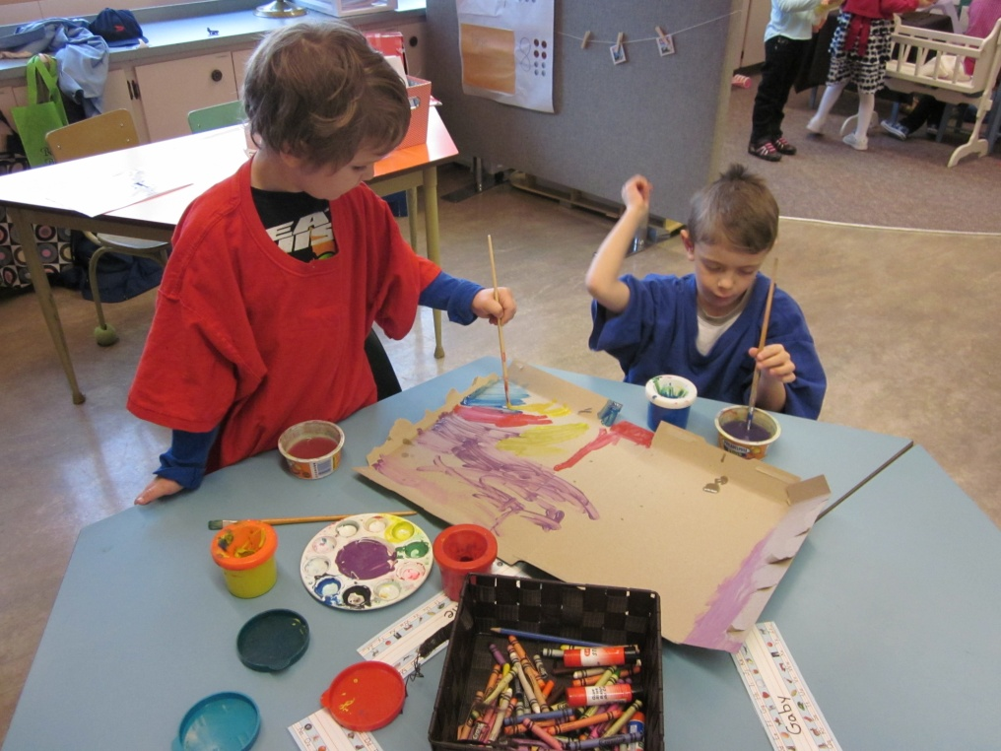
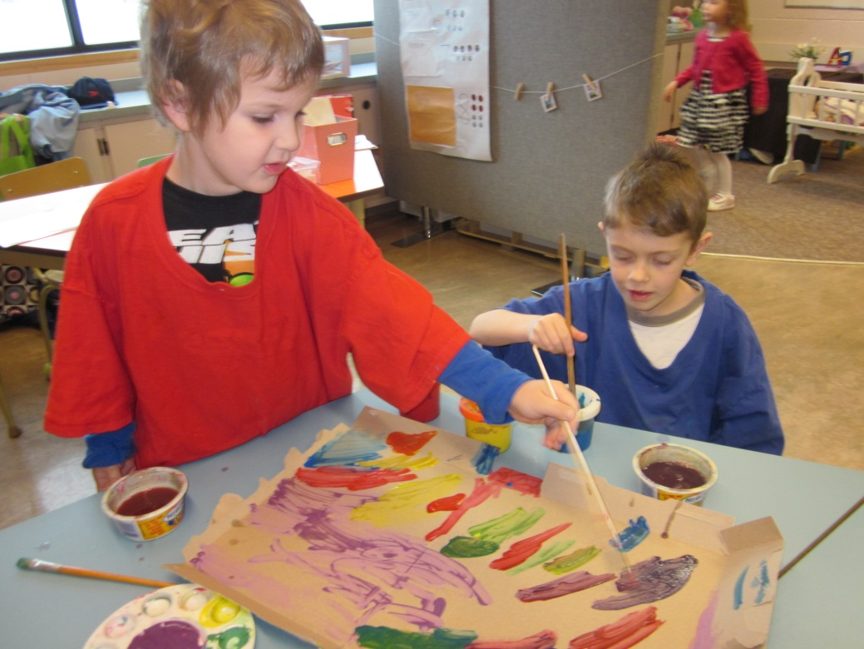
Phase 2: Investigating Post Office Construction
Day 3
These two students decided to build a door for the Post Office. As they were painting they realized that when some of the colours mixed together they made other colours.

Slide 16
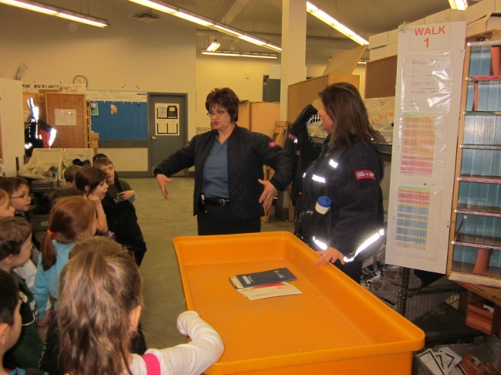
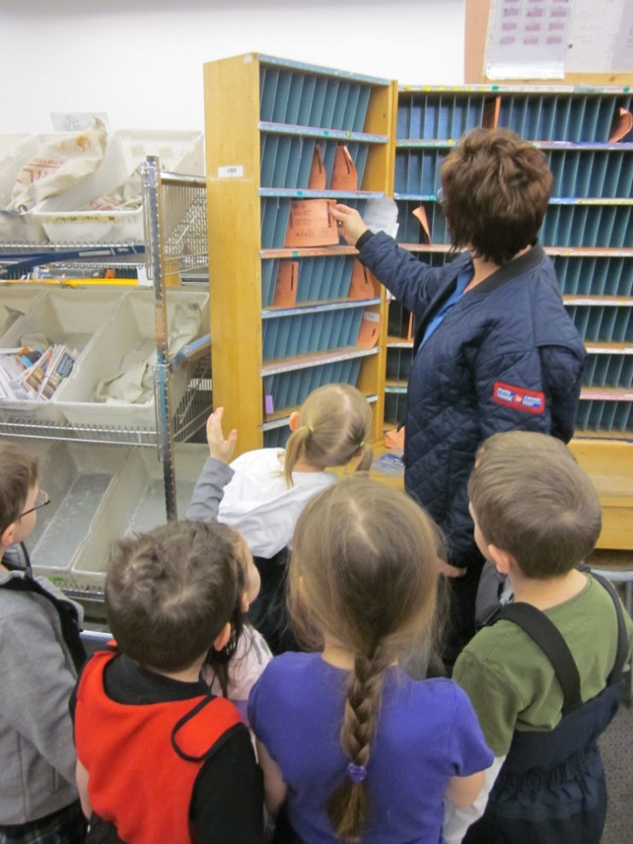
Phase 2: Investigating The Post Office
How do Mail Carriers know where to go?
We met a Mail Carrier and learned that she knows where to go when she delivers mail because she does the same route every day. We also learned that they sometimes use maps to find their way around the city and we got to see a big map of the city.

Slide 17
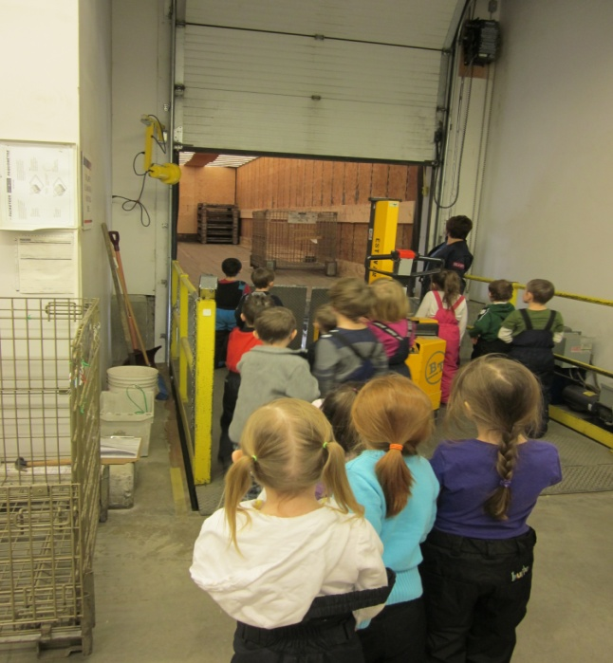
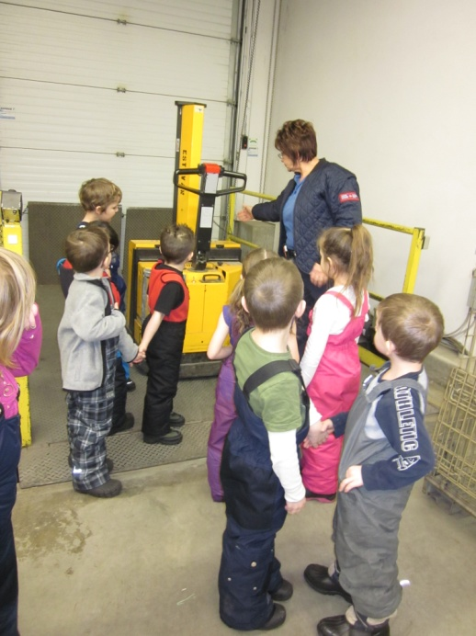
The Post Office
Who takes the mail off of the trucks?
We learned that the yellow machine helps people who work at the Post Office lift the cages of mail off the truck and load them into the garage.

Slide 18
The Post Office
We all got to stand in the mail cage!

Slide 19
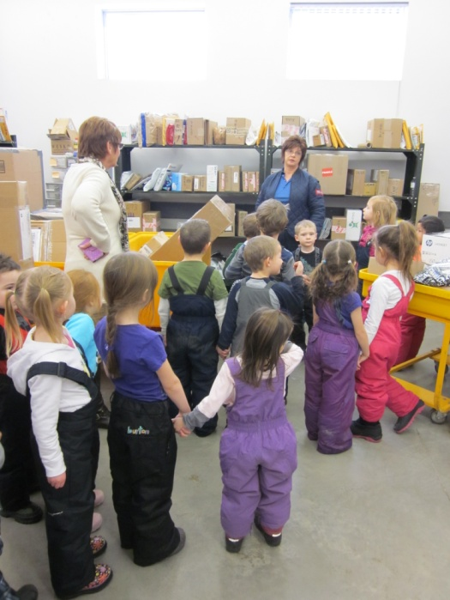
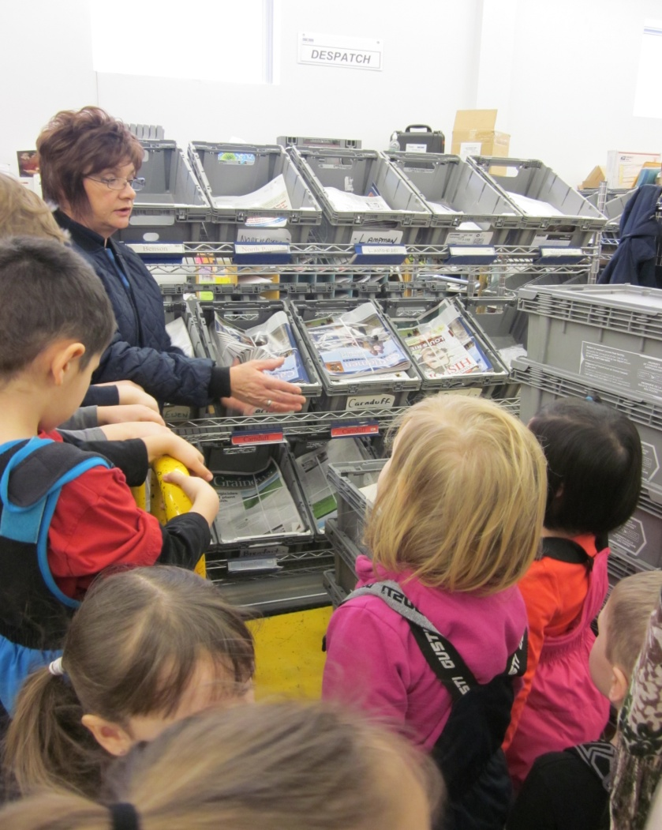
The Post Office
How do Mail Carriers deliver sofas?
We learned that mail carriers deliver packages and magazines to our houses too. Delivery people who work at stores deliver sofas!

Slide 20
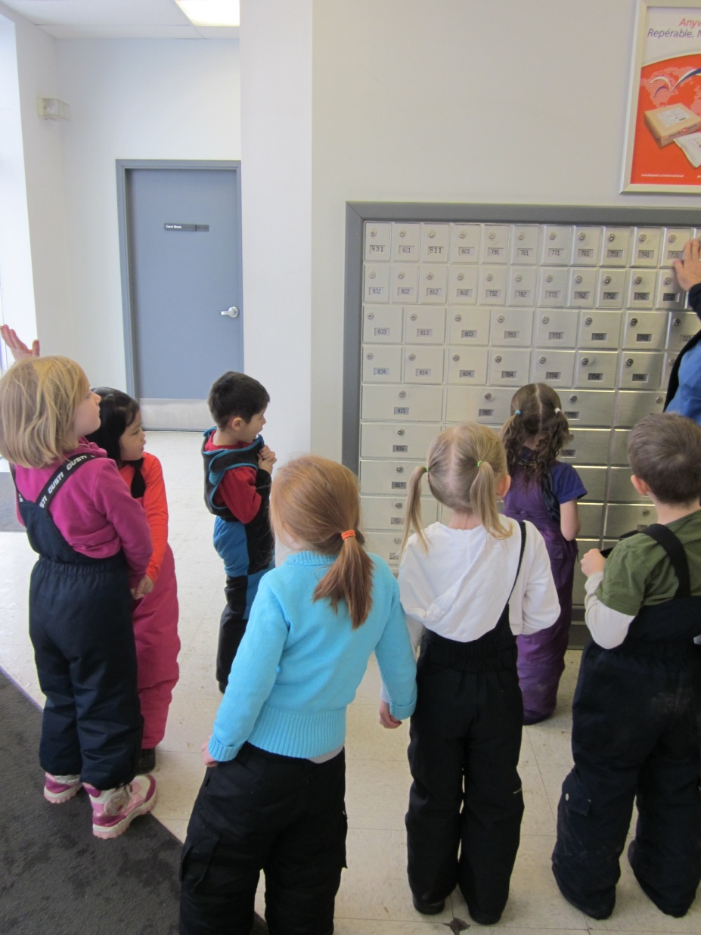
The Post Office
If the mailbox is not on their house, how do people know if it belongs to them?
We learned that some people do not get their mail delivered to their house. Instead they have to go to the post office to get their mail. Each mail box has a number so they know it belongs to them.

Slide 21
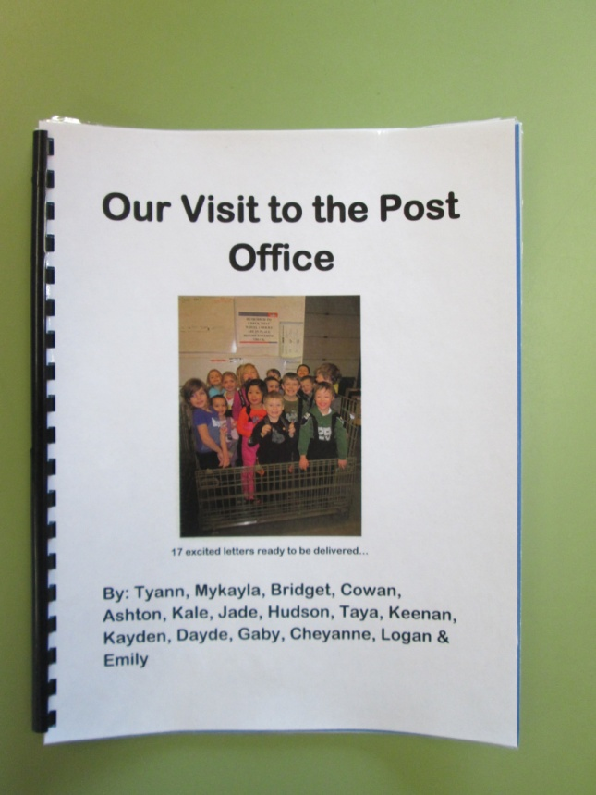
Phase 3: Concluding the Project
To conclude our project we made a book with photographs from our visit to the post office. The children’s thoughts were shared on each page of our book. The book was sent home with each child to share with their families.

Slide 22
Outcomes
SSK.2 Sort 3-D objects using a single attribute
NK.3Relate a numeral, 0 to 10, to its respective quantity
NK.4 Represent the partitioning of whole numbers (1 to 10) concretely and pictorially.
SSK.1Use direct comparison to compare two objects based on a single attribute
MOK.1 Investigate observable characteristics of familiar objects and materials in their environment.
CPK.4 Create art works that express own observations and ideas about the world.
DRK.1 Describe the spatial relationships among people, places, and environments
CPK.2 Explore a variety of drama strategies
CCK.2 Use and construct symbols, pictures, and dramatizations to communicate feelings and ideas in a variety of ways.
CCK.3Use oral language to converse, engage in play, express ideas, and share personal experiences.
CCK.4 Create messages using a combination of pictures, symbols, and letters.
ARK.1 Reflect on viewing, listening, emerging “reading”, representing, speaking, and emerging “writing” experiences in the context of teacher-led discussions.
ARK.2 Reflect and talk about new learning.

Slide 23
Teacher Reflection
Facilitating student learning using the project approach taught me to take a step back, listen to my students and learn along with them. I was amazed to see that students who were not previously interested in the writing centre before our project, spent most of their time writing letters! By setting up the learning environment to encourage my students natural curiosity and providing them with the resources they needed, their learning became hands on and more meaningful. Their interest and questions fueled their learning and made for a very fun and rewarding project!

