Slide 1
ROCKETS
Pre Kindergarten classroom
16 children, ages 3 & 4, half day program
Michelle Barkway – Teacher
Carol Charron – Educational Assistant

Slide 2
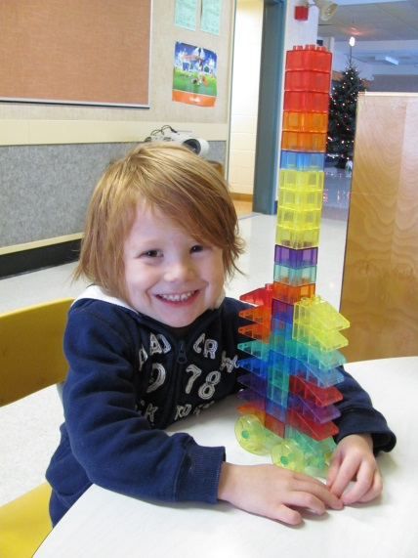
PhasE I – Beginning the project
As we observed the children we noticed that many of them were interested in rockets.
One of the children in the group was with us last year also. Everything he built last year as a 3 year old was a rocket. This year he continues his fascination with rockets and has sparked others’ interests.
Click play to view video.
Then click to advance slide.
December 2012

Slide 3
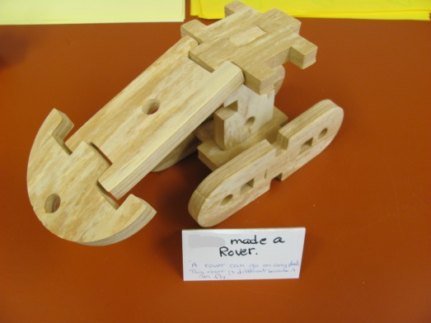
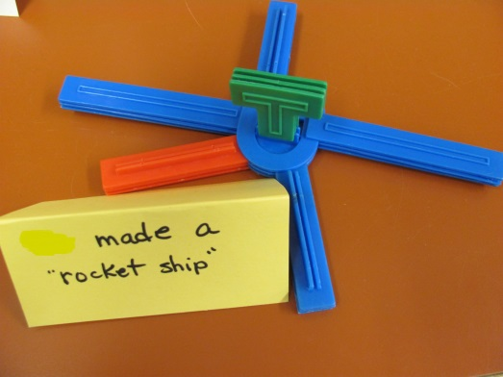
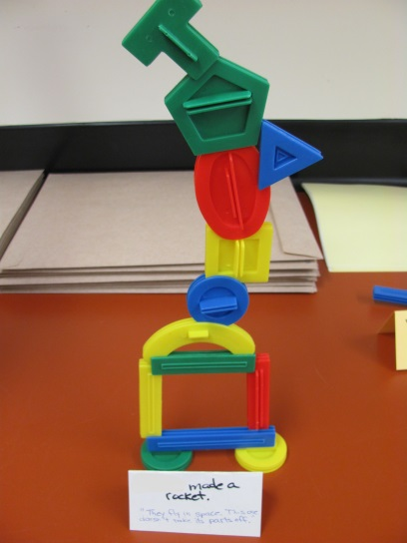
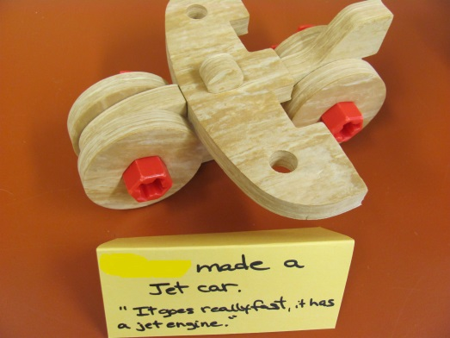
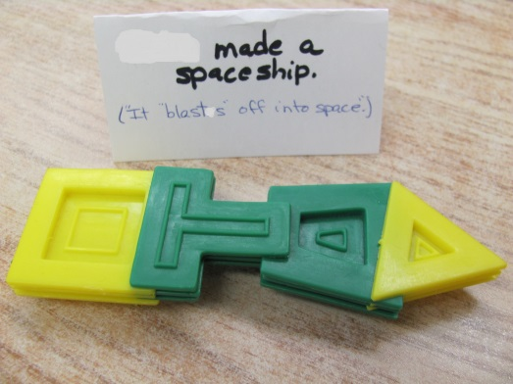
Others began to build rockets and other space vehicles.

Slide 4
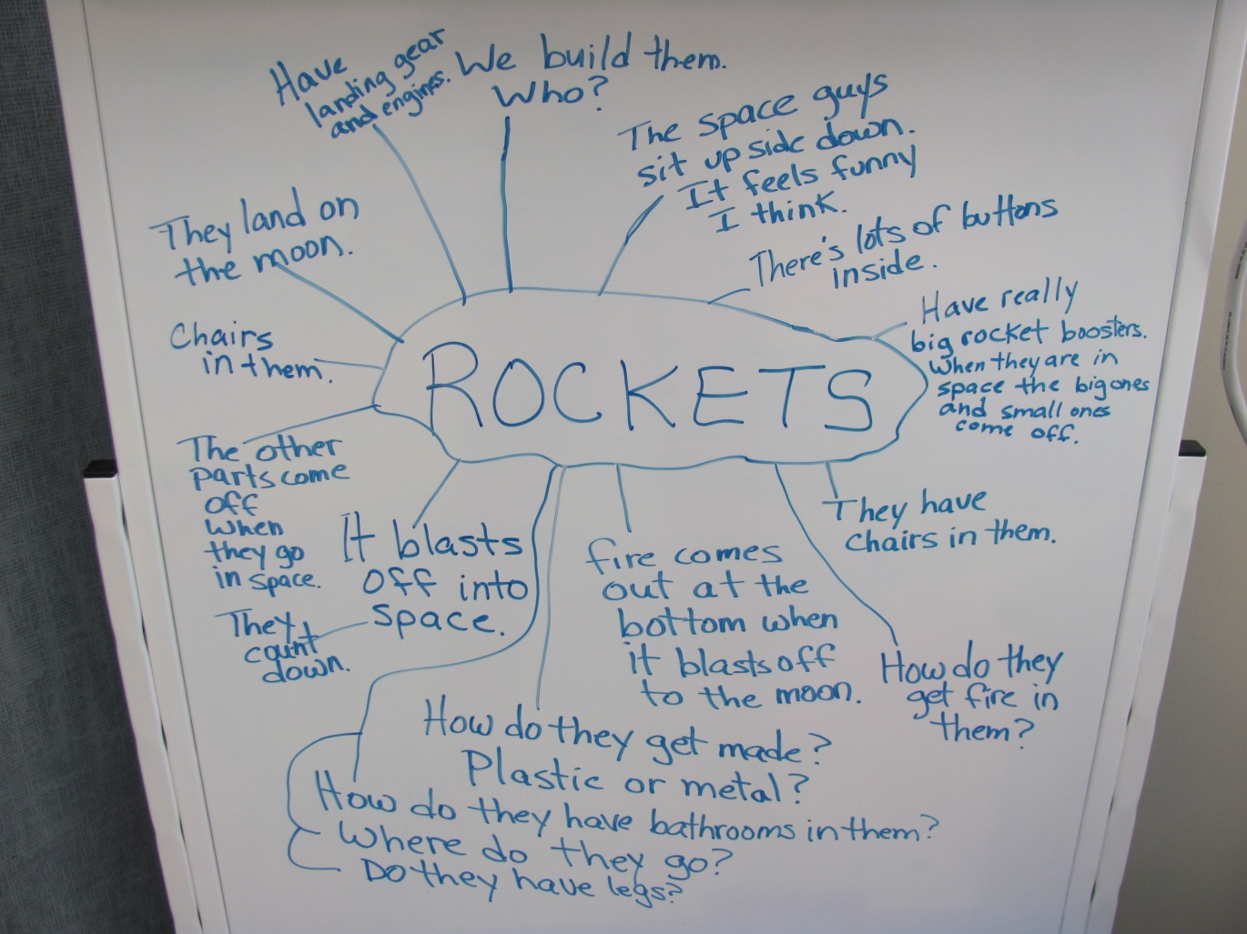
We created a web with the children showing what they already know and what they want to find out.

Slide 5
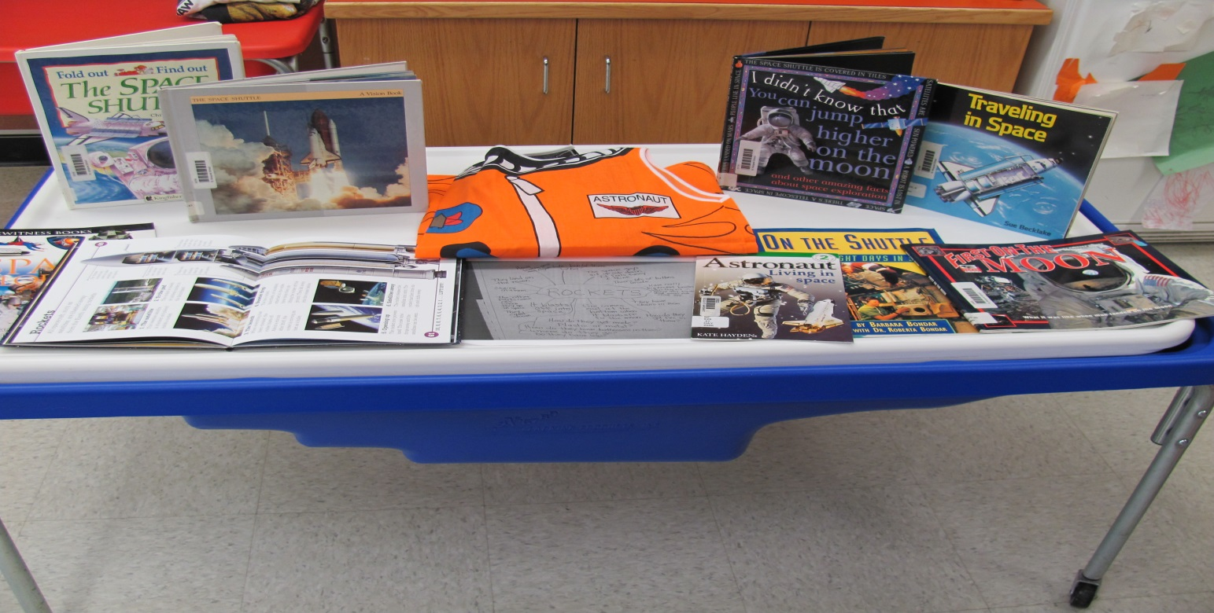
Phase ii – Developing the project
We set out an invitation for the children.

Slide 6
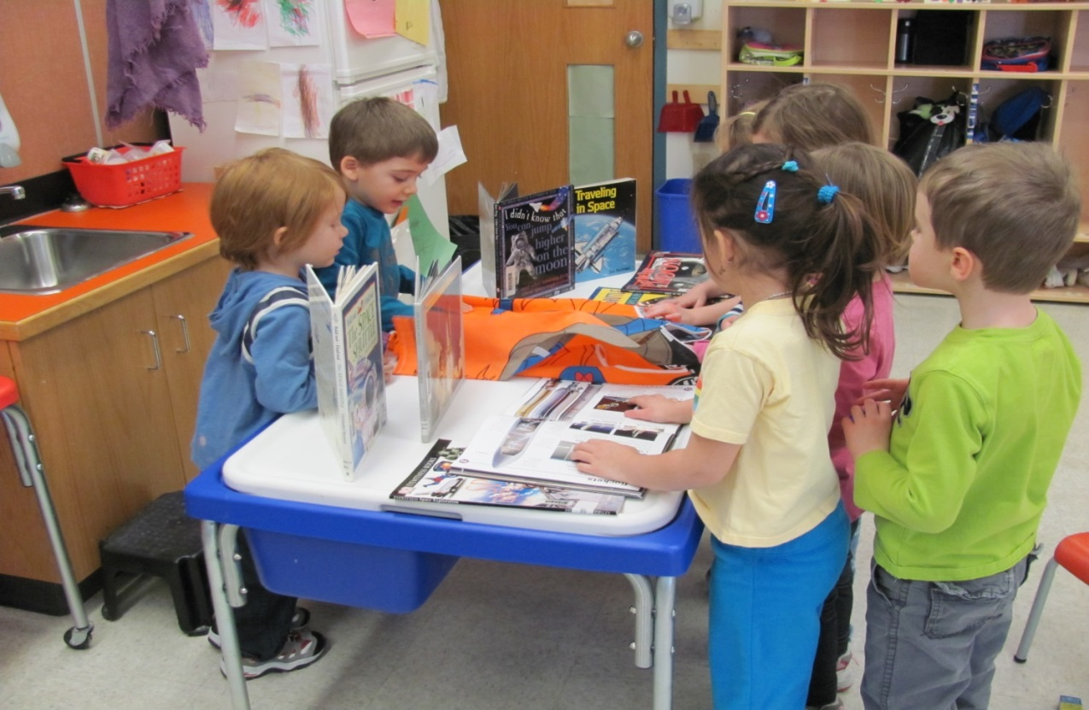
On the first day it sparked interest for some of the children.
“I think this is a space suit!”

Slide 7
Some children decided to build some
rockets to add to the invitation.
“This says rockets!”
“They fly. They have fire
in the back so they can fly!”

Slide 8
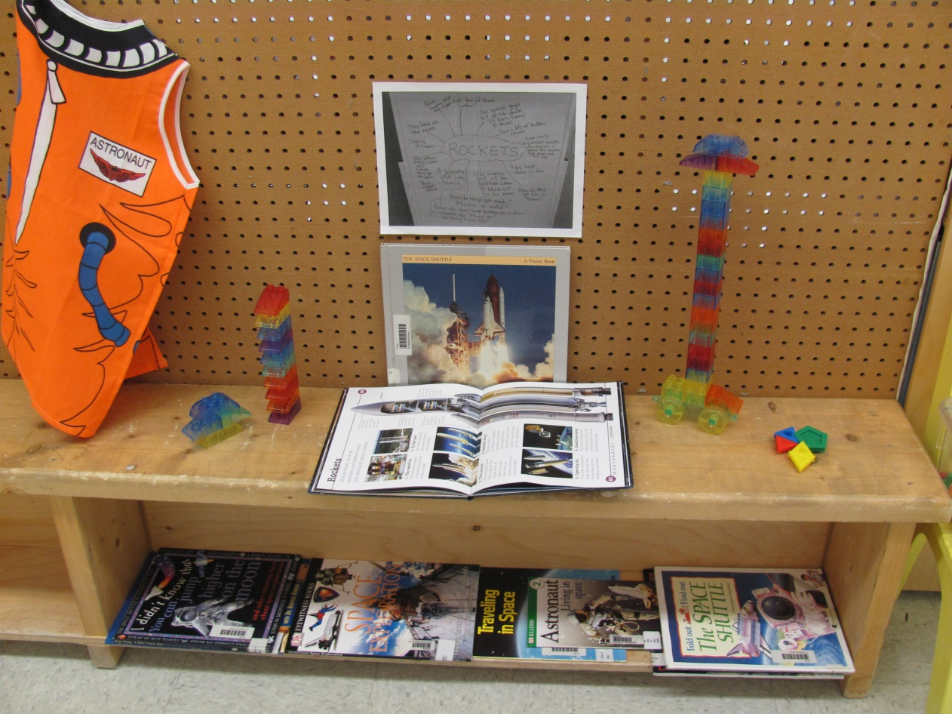
We made a special area for a “rocket studio.”
The other Pre K class respected the area and also enjoyed looking at the books and creations.

Slide 9
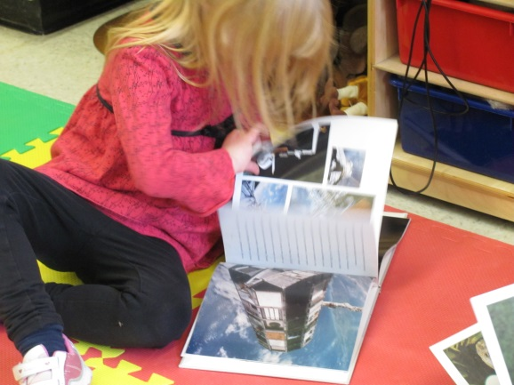
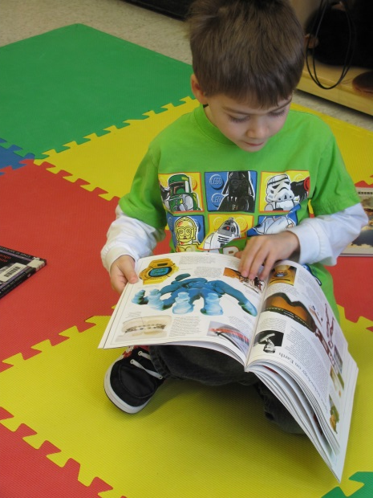
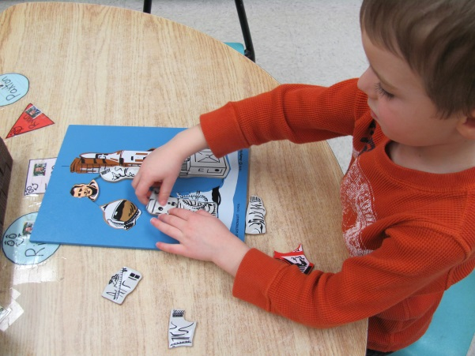
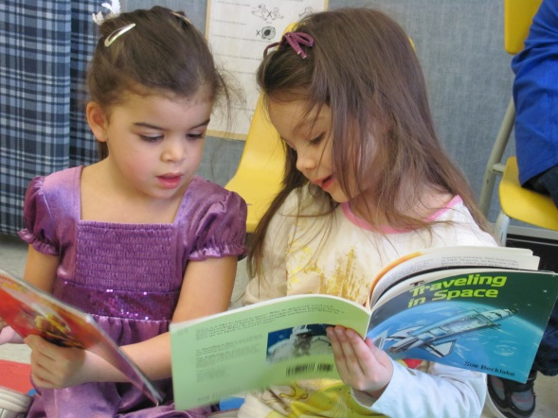
The children looked at books (literacy) and made puzzles (fine motor).

Slide 10
Everyday I read from a book called Astronaut Living in Space by Kate Hayden.
Below are some comments made by the children as the book was read.
They were really interested in the bed and the bathroom in the space shuttle.
“She has a radio and a microphone to talk.”
“It’s going to fix the telescope.”
“When are we going to see the beds?”
“It closes too?” (referring to the bed compartment)
“It looks scary!” (still referring to bed compartment)
“It’s a bunk bed.”
“Looks like a port a potty.”
“They hold on (when they go to the bathroom) because of the handle bars.”
“Where’s the toilet paper?”
“Can we put a bed and a bathroom when we make our big rocket?”

Slide 11
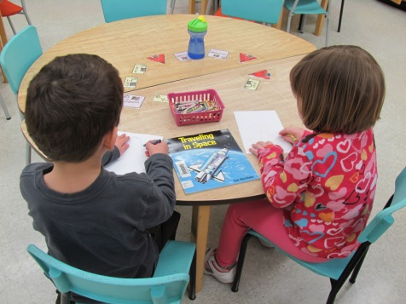
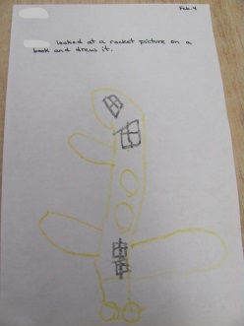
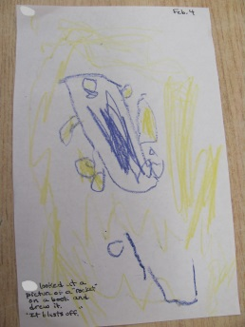
These children looked at a book and decided to draw the space shuttle on the cover.

Slide 12
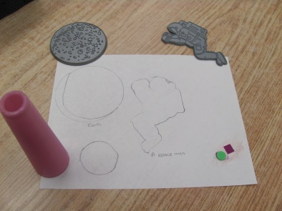
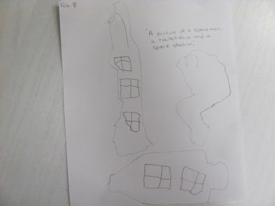
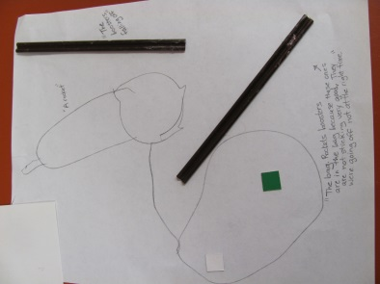
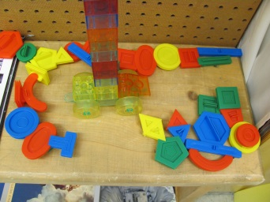
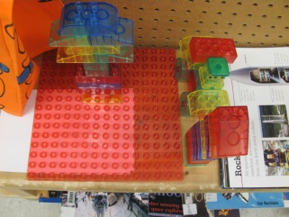
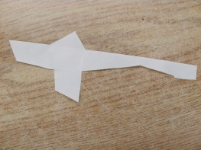
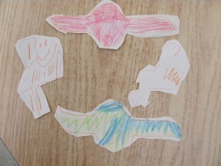
Other children used different materials to make representations.

Slide 13
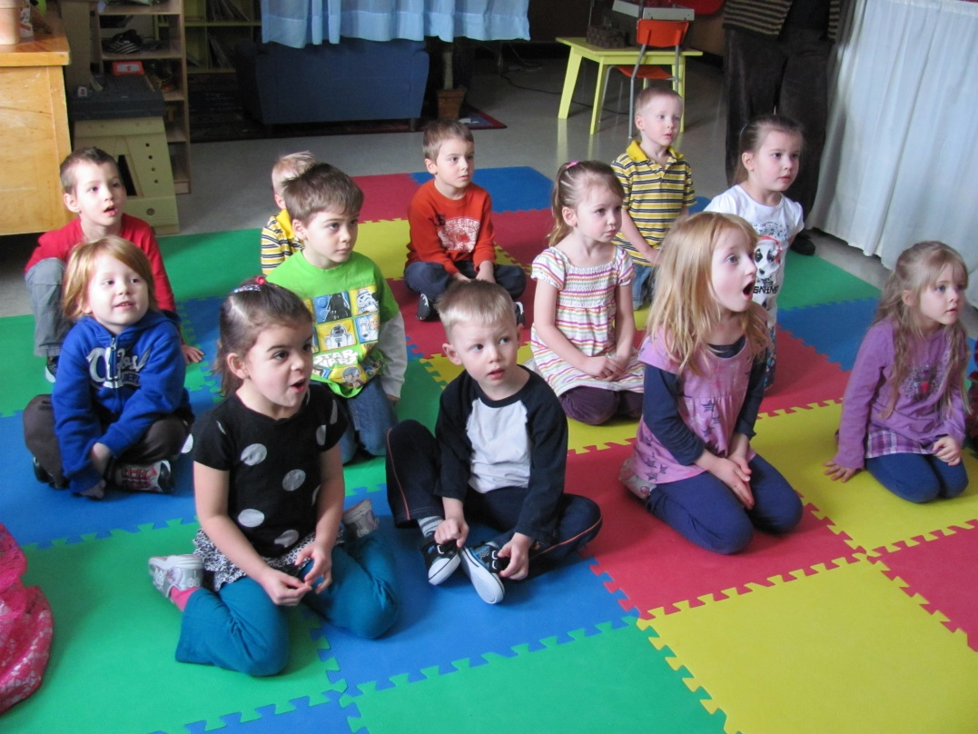
“Boosters help it get
into space!”
We watched a video of a space shuttle blasting off!!
“It’s pretty cool!”
“The boosters are coming off!”
“When it’s very high the
boosters come off!”
“Look at all the smoke!”
“It’s going right into space!”
“It’s a launch pad and it’s going to blast off!”
“Higher, pretty high, like super high!”

Slide 14
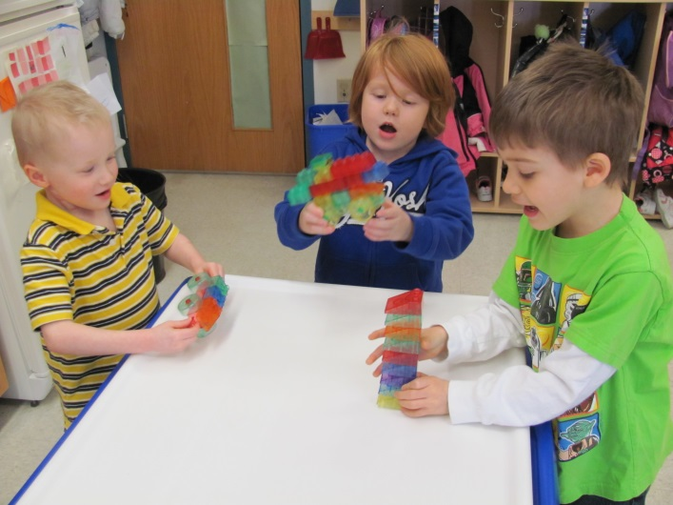
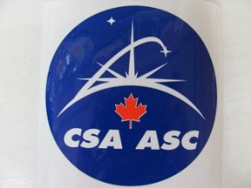
The video inspired some children to take the rockets that they built out of the studio and play with them.
“I’m blasting off!”
“My boosters fell into the water!”
We sent an email home telling parents about the video and what the children have been learning.
The next day a child came to school with a space book to share with the class.
Another child came to school with a sticker from the CSA (Canadian Space Agency), which sparked us to Google CSA to see what it looked like. We also found a video of Chris Hadfield but the children lost interest quickly.
A parent told us that they had a friend in Houston that was training to be an astronaut. Perhaps there will be a way to get an expert into the classroom through technology!!!!

Slide 15
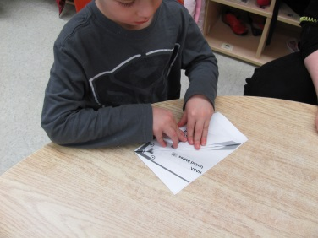
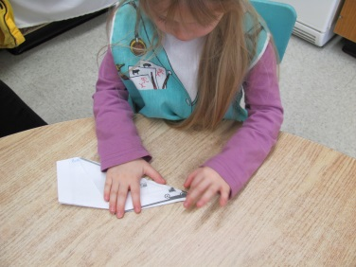
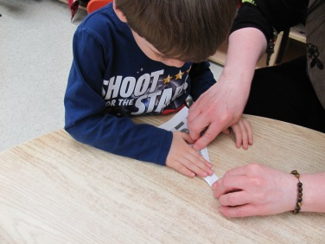
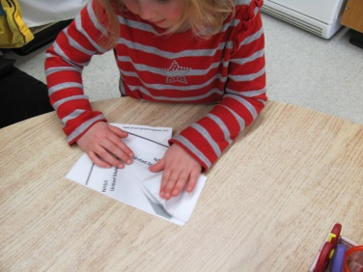
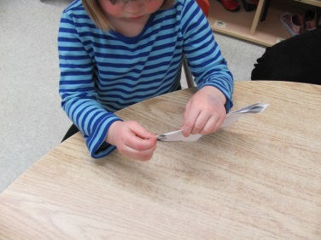
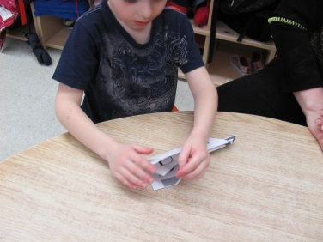
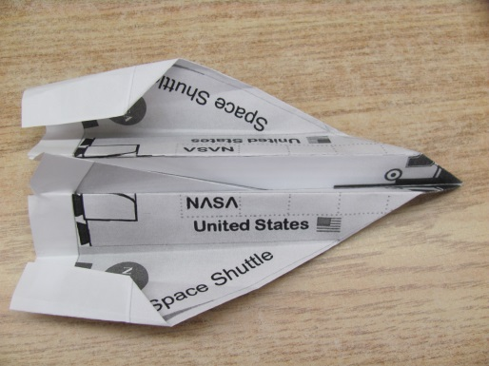
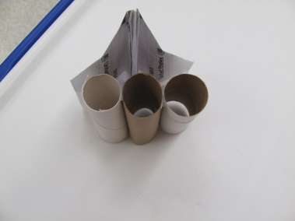
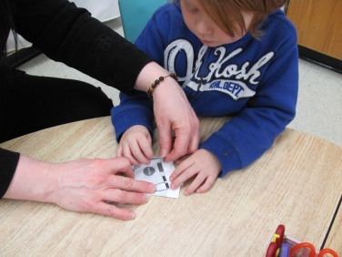
Some children decided to make paper space shuttles.
With rocket boosters and fuel tank.

Slide 16
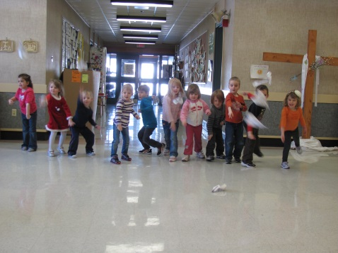
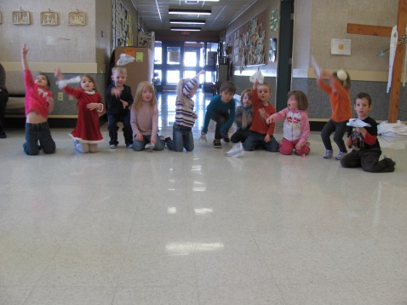
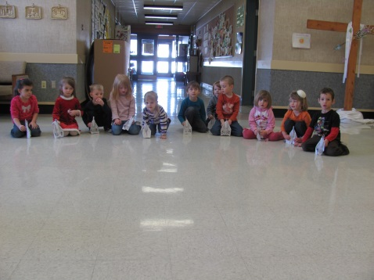
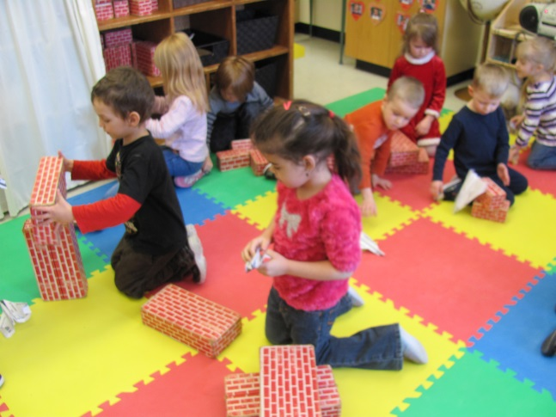
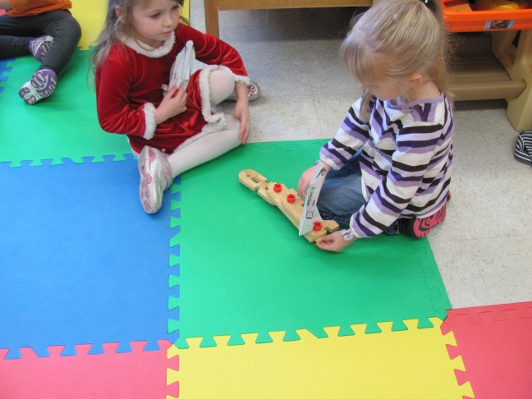
Which led to flying them of course!
They first tried to fly them like a paper airplane. Then we sat on the floor to try flying them straight up like we seen in the video.
Next I asked them to find ways to fly them without using our hands. Here are some ways they came up with:

Slide 17
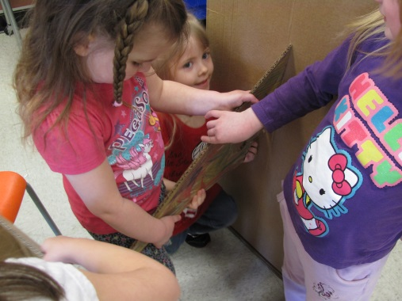
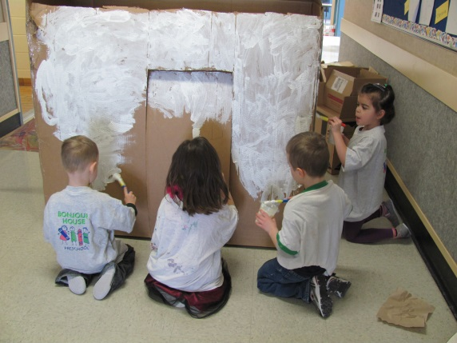
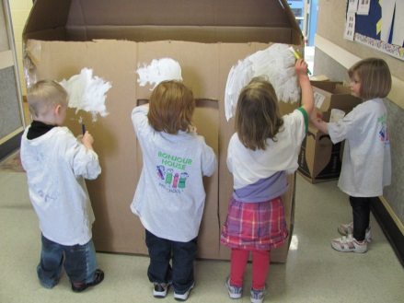
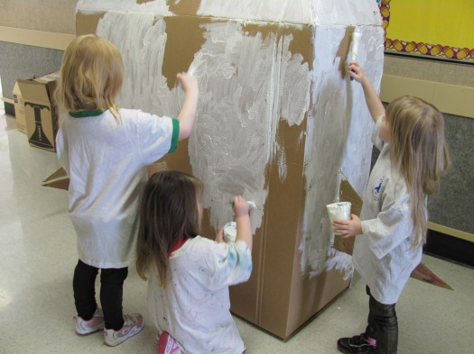
PHASE III – CONCLUDING THE PROJECT
To finish up our project the children wanted to build a “big space shuttle” out of a cardboard box.
They took turns working on the outside of the space shuttle first.
They wanted to paint it white like the real one.

Slide 18
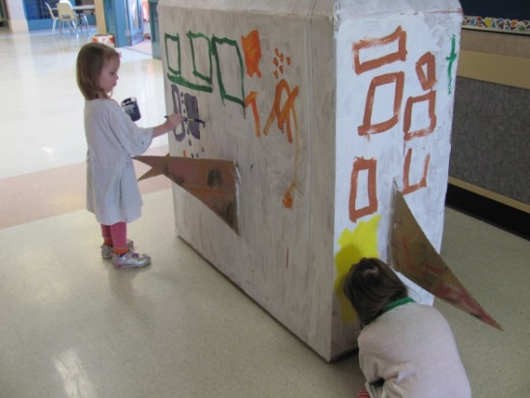
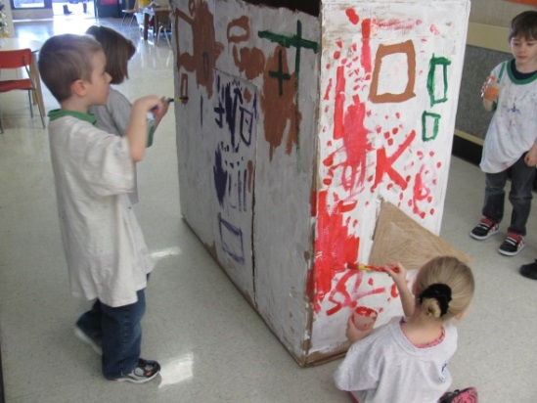
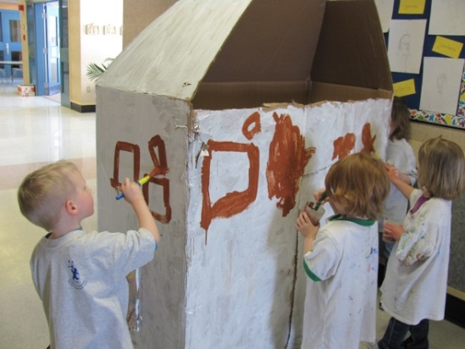
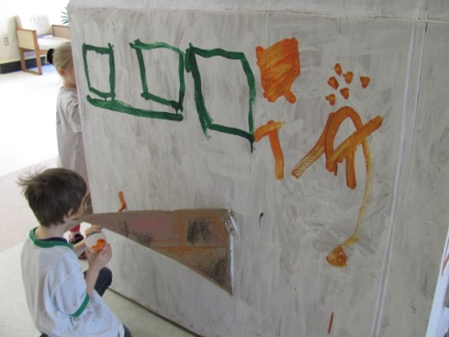
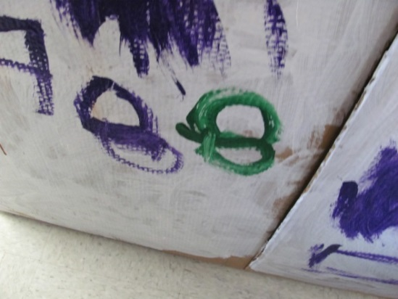
We take turns painting the box in the hallway.
They added windows and their own “decorations”.
One student even gave it a number.
It is interesting to hear the comments of the older students as they walk by.
When parents pick up their child, the child is excited to show them the space shuttle that we are creating.
Sometimes the parent and child have been sighted “testing out” the Space Shuttle.

Slide 19
The project is still underway.
We decided to bring it into the classroom to play with before they did the interior.
There was some dramatic play with the box but we were surprised that it was left unused at times.
I wonder if they will put in a bathroom and bed like they originally planned?
“5,4,3,2,1 blast off!”
“An asteroid hit us!”
“We are walking on the moon.”
“It’s because there is no gravity.”

Slide 20
We asked the students what they have learned about space shuttles. This is what some of them said:
“They blast off into space and the boosters come off.”
“It goes up in the sky.”
“They have wings and buttons.”
“It blasts off into space.”
“Rockets start with R.”
“It has a bathroom – only one.”
“They have boosters so they can blast off into space.”
“Rocket boosters make them fly into space easily. The fuel tank has gas.”
“I learned that they blasts off in space. The fuel tank and rocket boosters fall down.”
“The rocket boosters come off because it is suppose to go in the water.”
“Astronauts fly in it in space.”
“Buttons are inside”

Slide 21
REFLECTION:
During this project we learned a lot from the students. A few of them came with an abundance of prior knowledge on how Space Shuttles work, that they shared with us. Only a handful of students had this interest but once the project developed all the others wanted to be part of it. Sometimes it seemed like we were rushing through things on a particular day then when we tried to revisit it, the students had lost interest.
The most difficult aspect of this project has been incorporating French vocabulary. The books we read and conversations we had were in English so that the students could fully understand and express themselves.

Slide 22
LIST OF RESOURCES USED:
BOOKS:
Traveling in Space – Sue Becklake
The Space Shuttle – Peter Murray
I Didn’t know that you can jump higher on the moon – Kate Petty
First on the Moon – Barbara Hehner
Planets – Penelope Arlon and Tory Gordon-Harris
On the Shuttle – Barbara Bondar
The Space Shuttle – Christopher Maynard
Space Exploration – Carole Stott
Astronaut Living in Space – Kate Hayden
ONLINE RESOURCES:
YouTube – Space Shuttle Launch Audio – play loud – indiegun
YouTube - How the Space Shuttle works – science made fun
amazingpaperairplanes.com

