Slide 1
Winter Submitted by Crystal Boorman Kindergarten
Snow Inquiry Project
Submitted by
Crystal Boorman

Slide 2
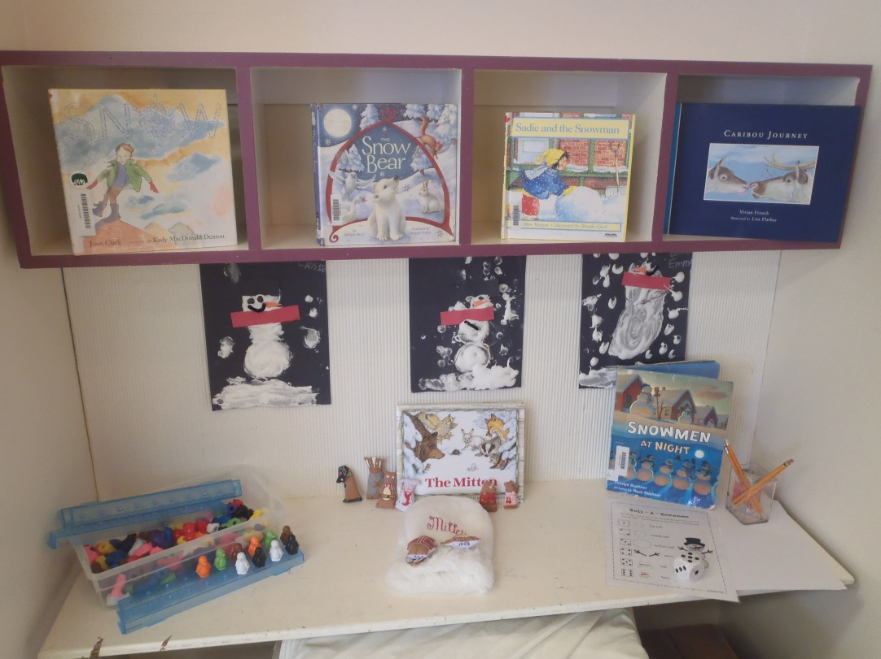
Introduction
The Snow Project involved 40 kindergarten students. I have an am class and a pm class that come to school everyday.
We completed our Snow project over six weeks, from January to February. I noticed the students being interested in the snow outside.
We utilized our centers for snow exploration. We also talked about winter animals, and created a play based on the book The Mitten.

Slide 3
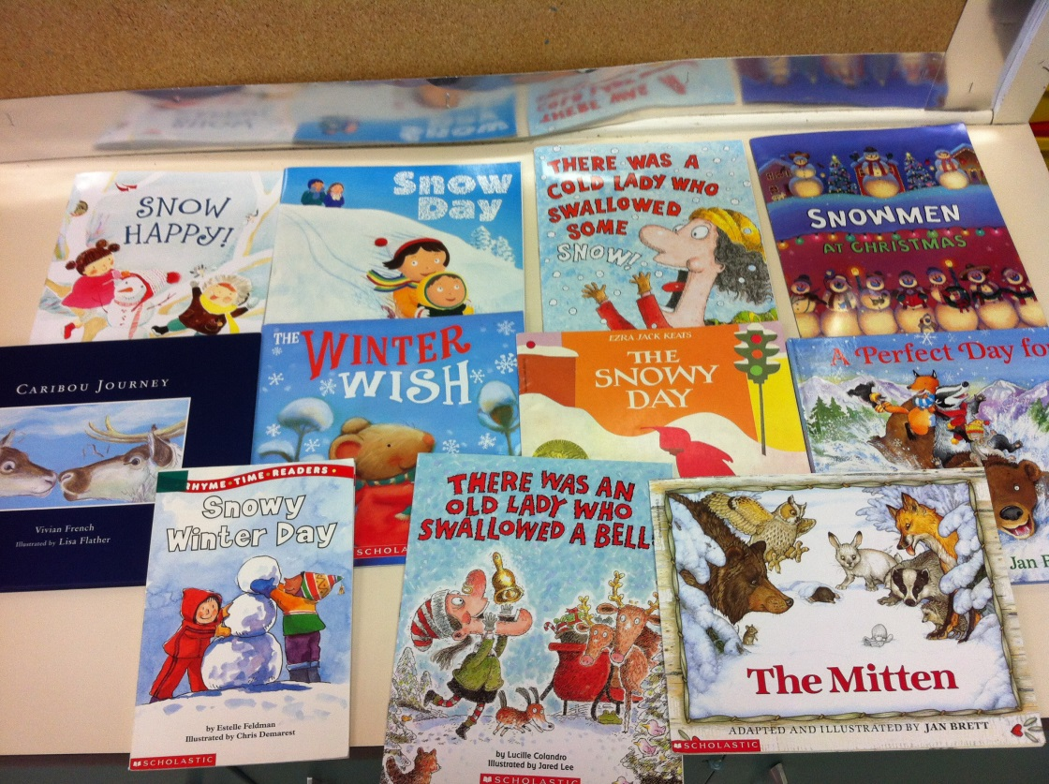
The Beginning
With all the snow storms the students were so excited about the snow; They could not wait to go out for recess. Both classes love playing in the snow. We started reading books about winter and snow. I asked the students to share what season is their favorite and why. Several students loved winter because of the snow.

Slide 4
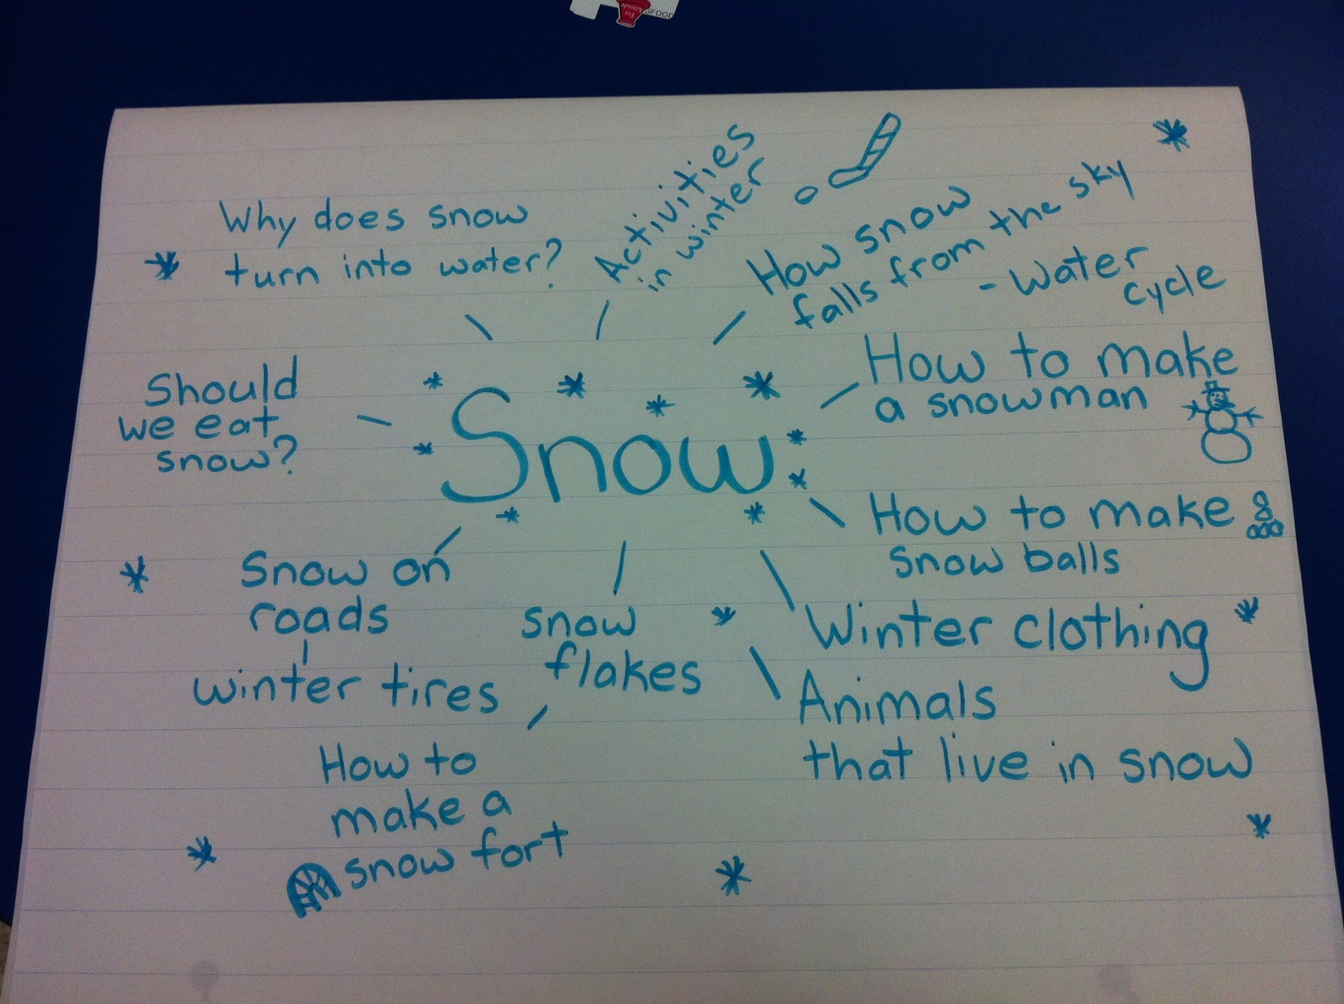
I started to ask the students what they knew about snow, and if they want to learn more about snow. They were very interested, here is a web of their ideas of what they wanted to investigate.

Slide 5
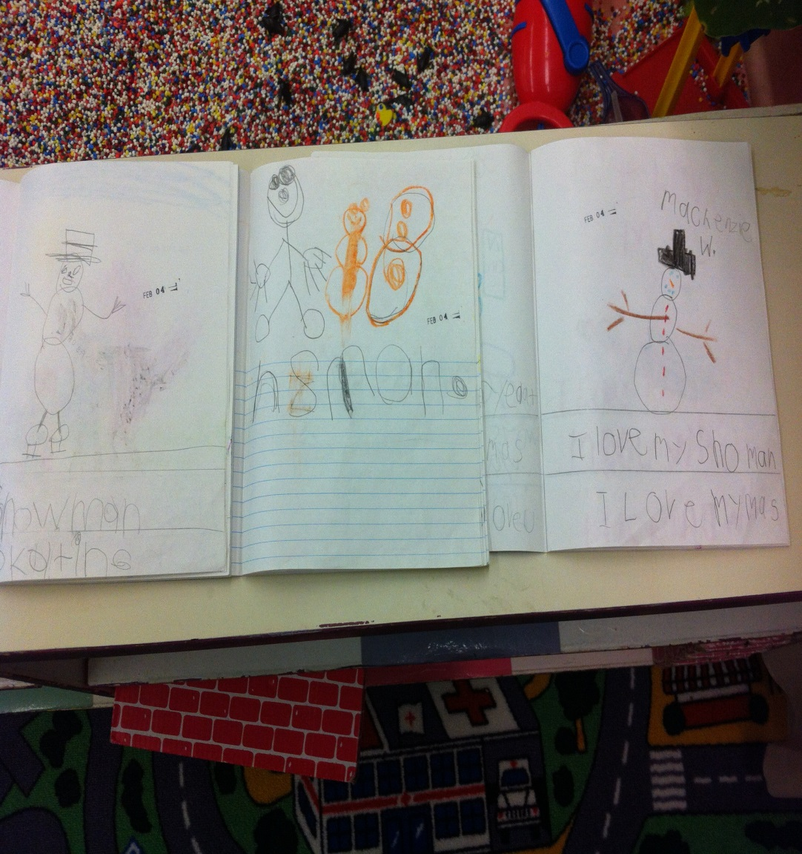
Developing the Project
I had the students create journal entries about what they like to do in the snow. We had challenges in finding experts in the field. We thought of ways we could further investigate.

Slide 6
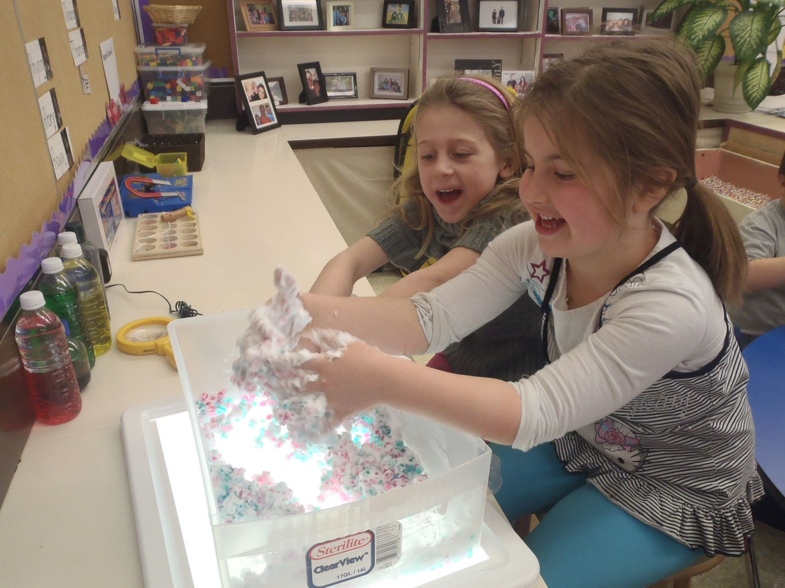
The students are exploring our homemade snow with water beads and shaving cream during discovery time

Slide 7
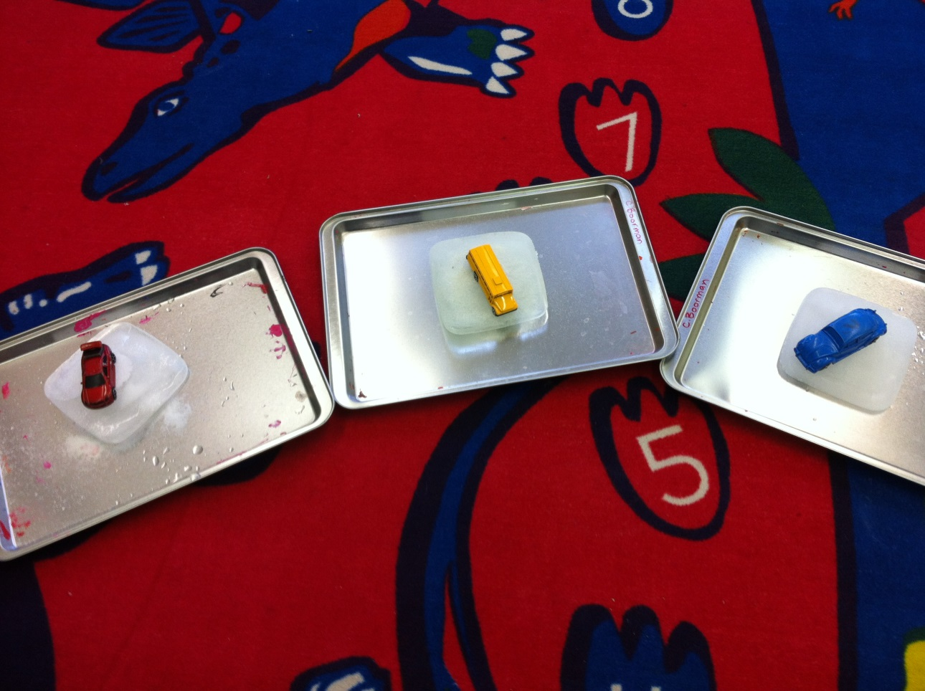
The students were interested in driving in the snow, and winter tires. We completed a science experiment about winter driving. One of the students fathers works at a tire shop, and the student shared with us what winter tires do. We talked about what the snow removal does to the roads. We predicted what would happen if we put sand and salt on ice. The students explored driving on ice, and then driving on ice that has been salted and driving on ice that has been sanded.

Slide 8
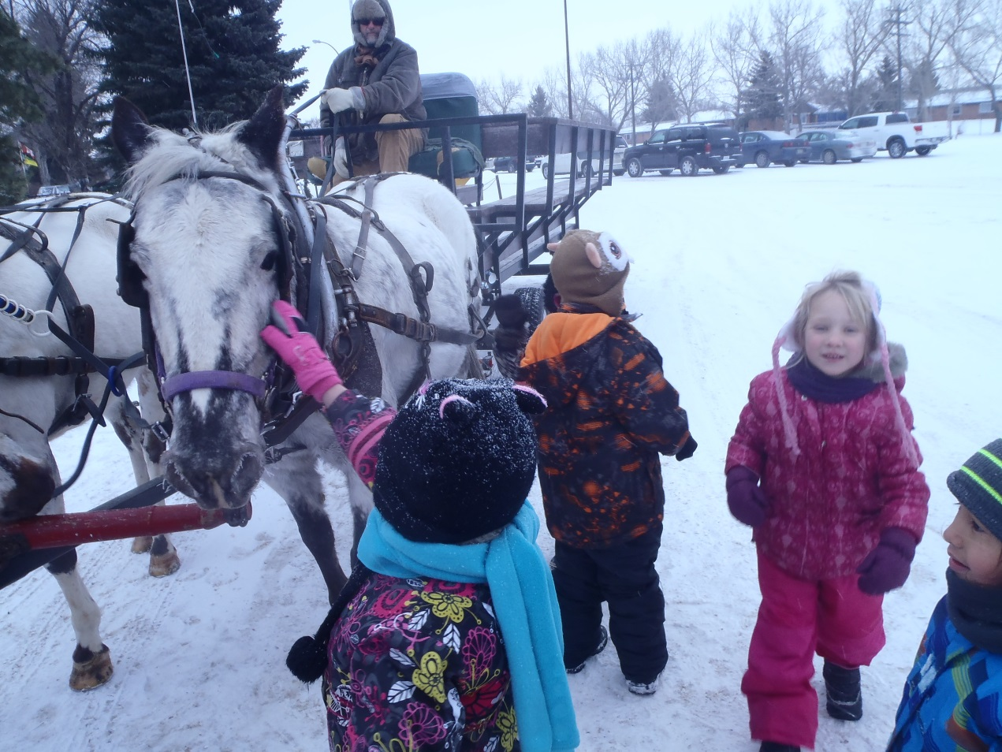
We talked about all the fun things we like to do in the snow. We were very lucky and had a member of the community take the students for a sleigh ride. The students were so excited. They investigated the horses, one of the horses was blind and relied on the other to guide her. It was very interesting, we talked about our eyes and completed some activities without vision after.

Slide 9
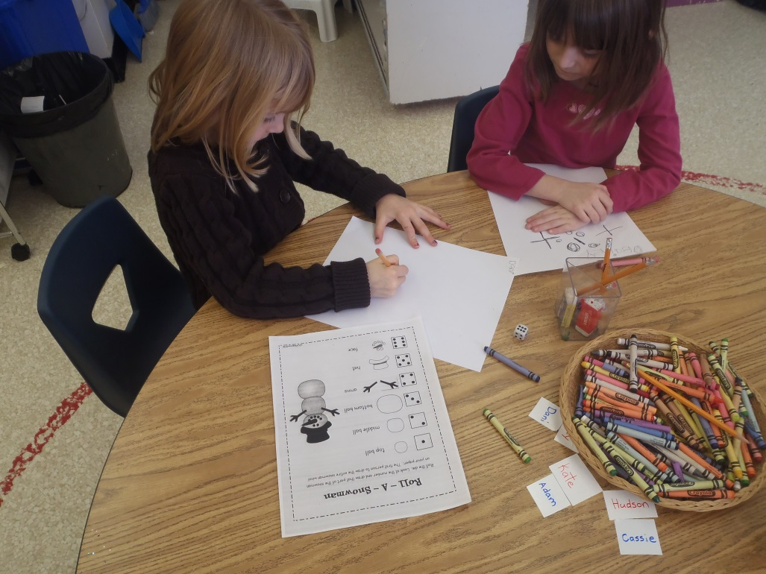
The students are playing a roll and draw a snowman game. To represent their learning, I asked the students to complete a journal entry about what their favorite activity was that we investigated about. It was interesting to see what they picked to write about.

Slide 10
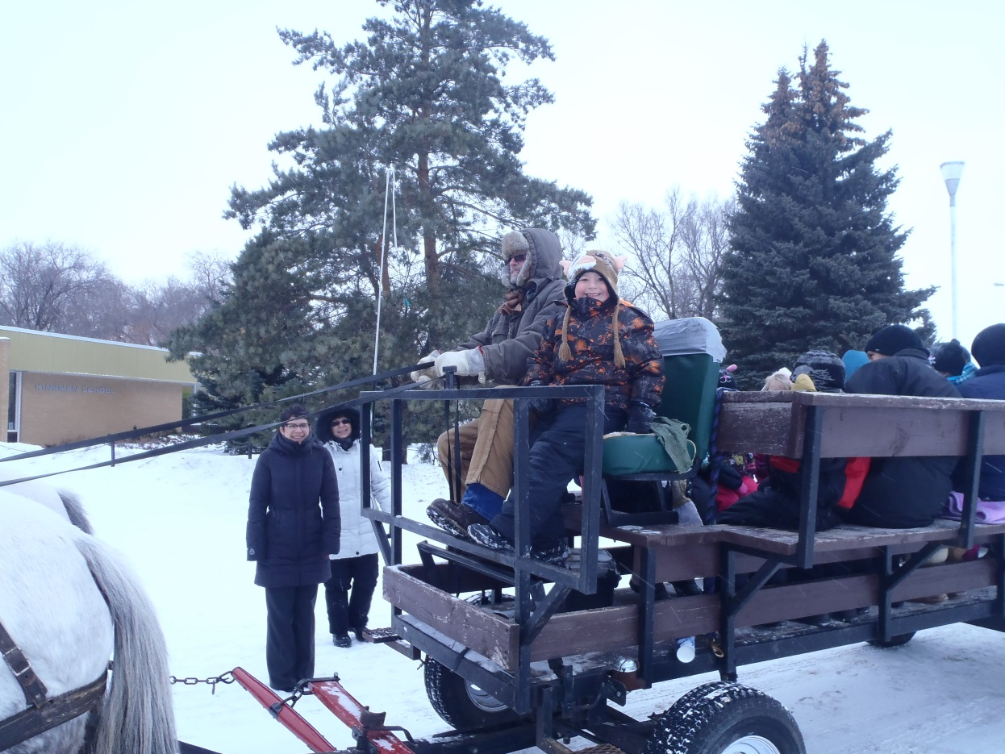
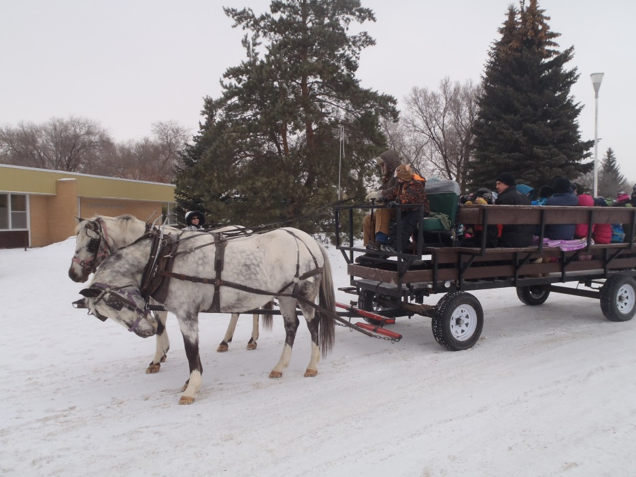
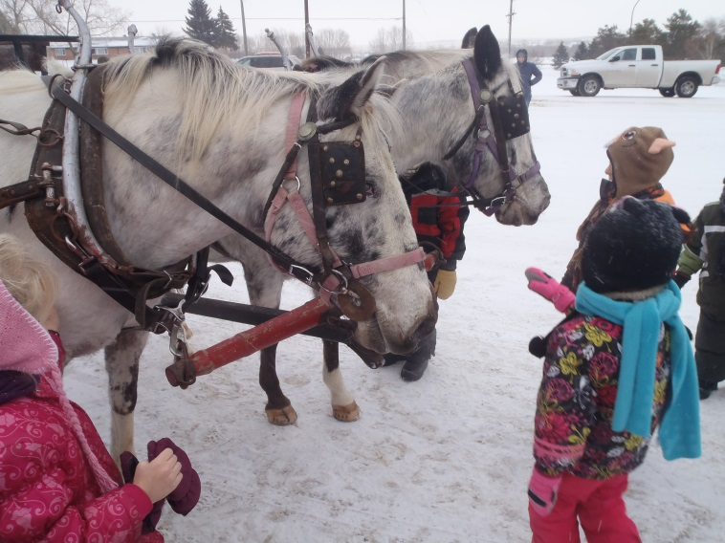

Slide 11
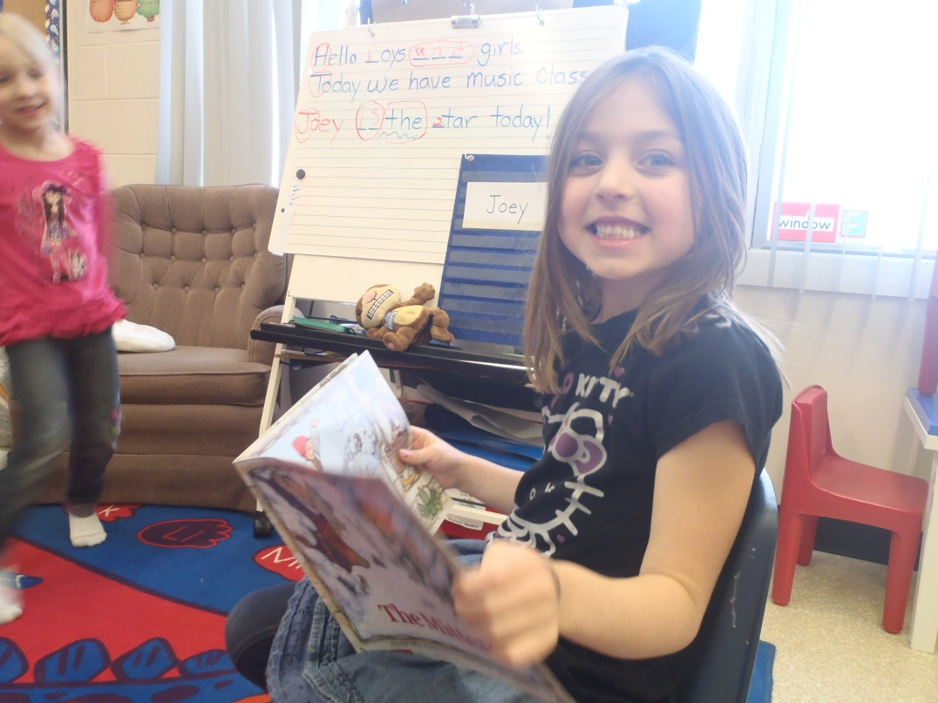
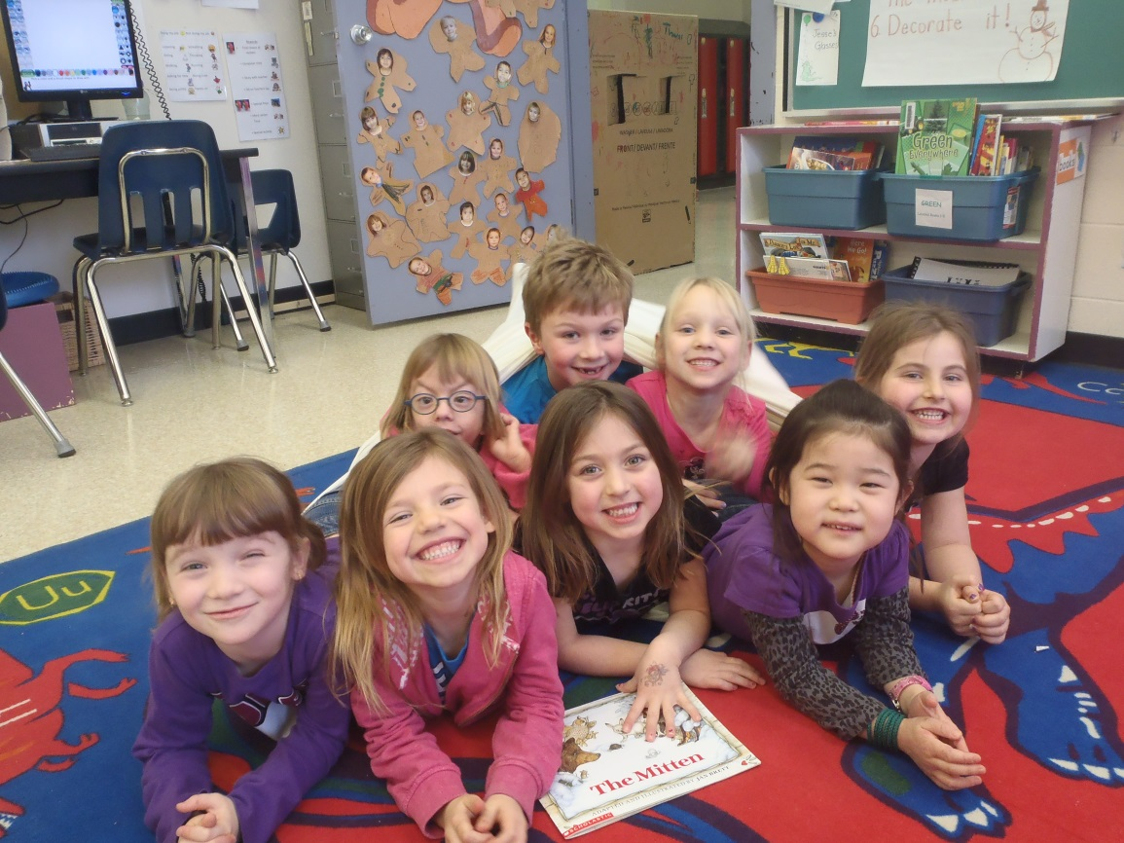
After the sleigh ride we started talking about animals that live in the snow. I read The Mitten, aloud and then as a class. The students loved the book and were interested in doing a play for our classmates down the hall. I had a giant mitten made that the students could explore during discovery time.

Slide 12
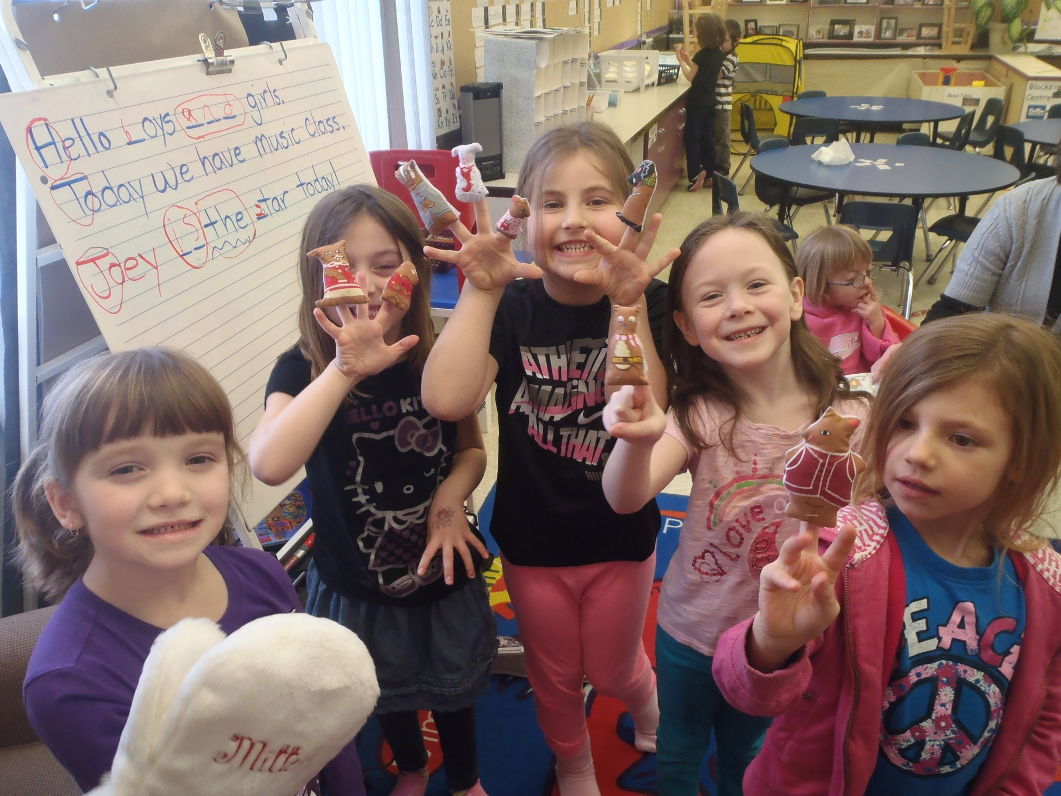

Slide 13
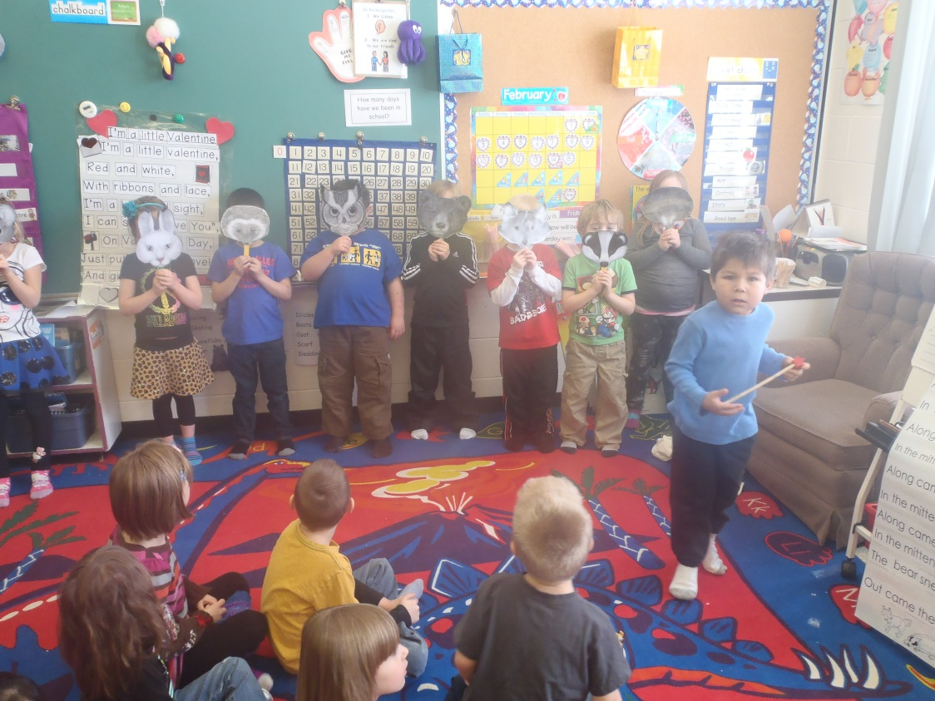
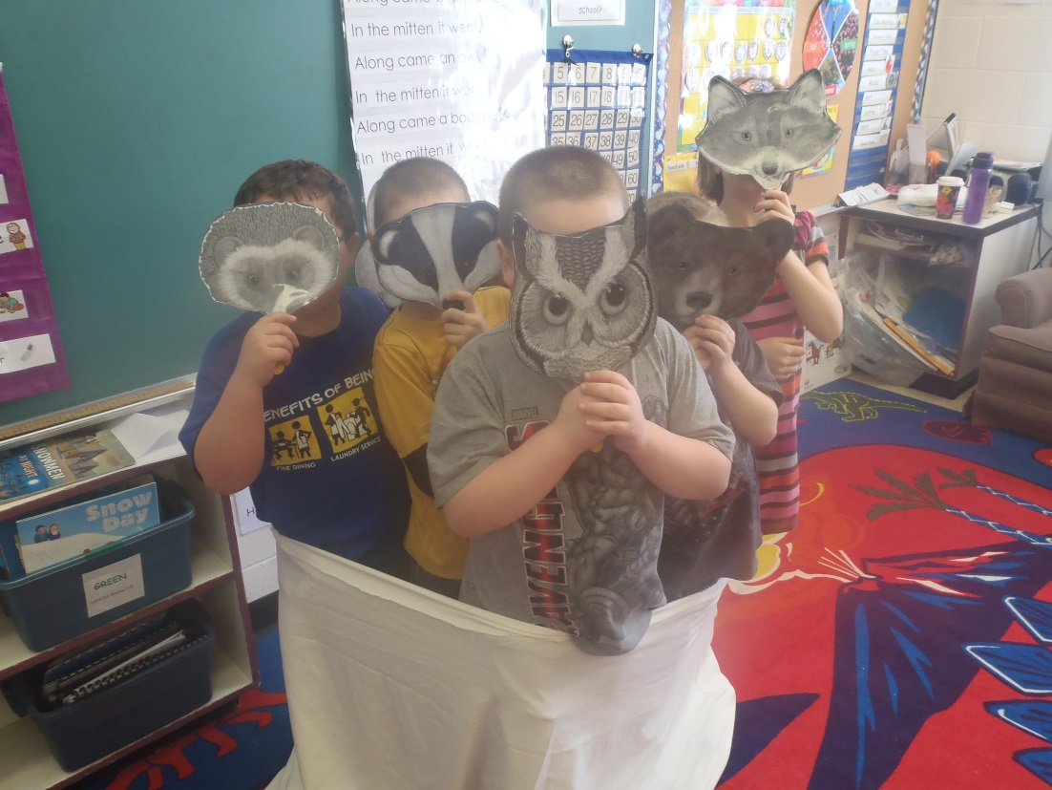
We performed our play for our classmates down the hall. The students were very proud of their show.

Slide 14
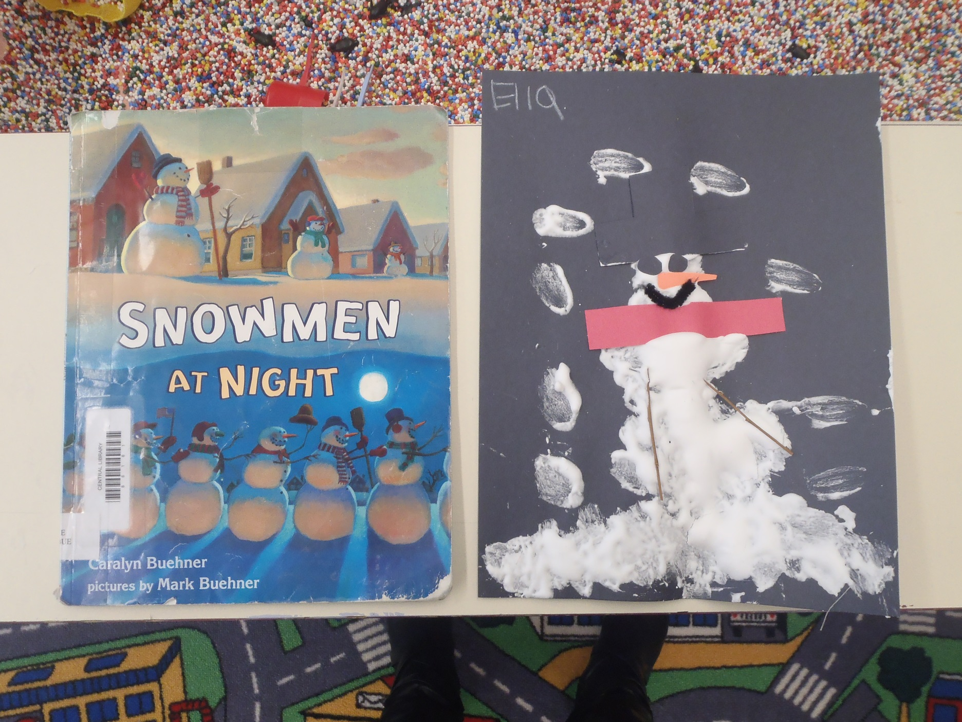

Slide 15
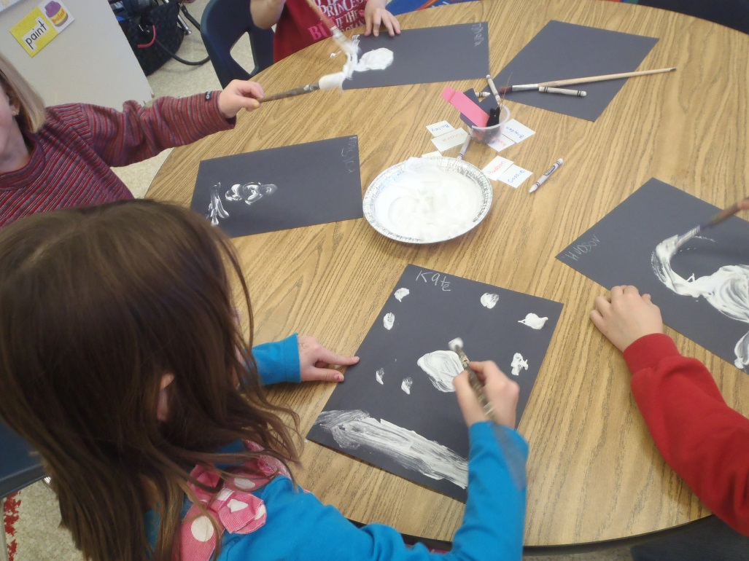
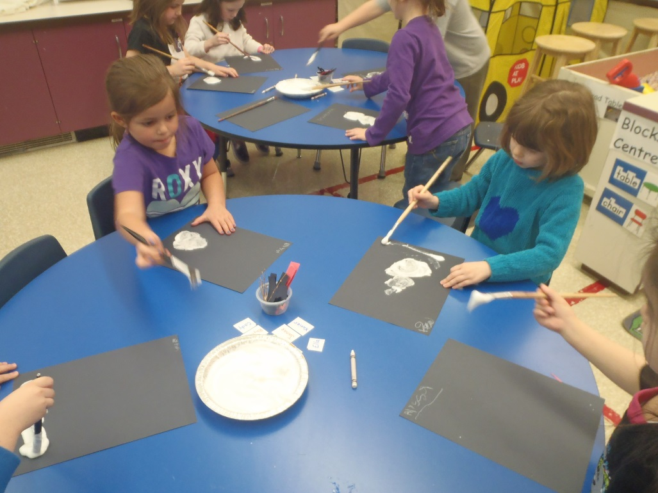
Creating our Snowman at Night. We used shaving cream, it was so much fun making a puffy snowman.

Slide 16
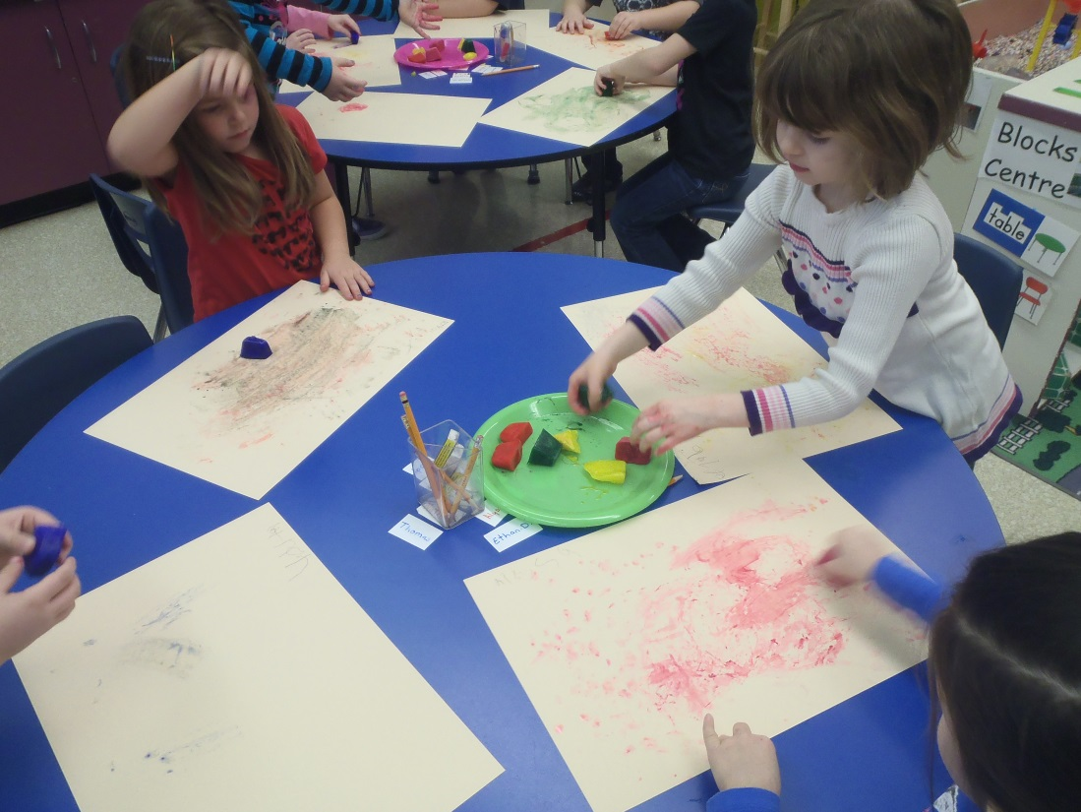
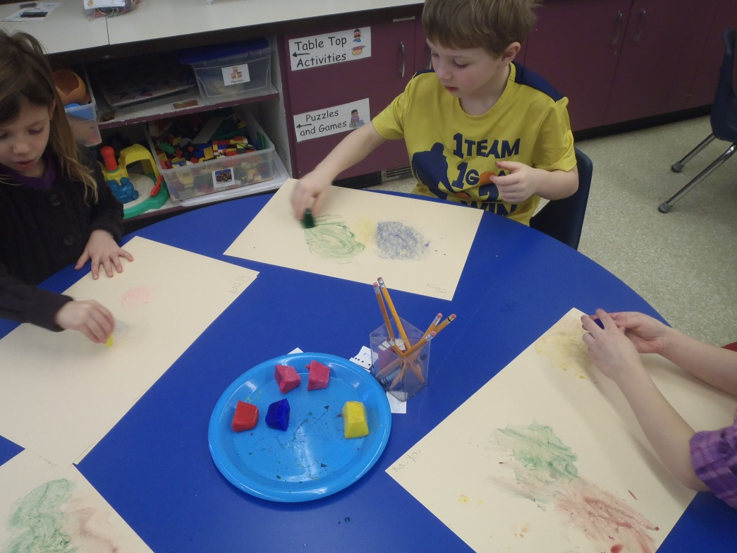
Painting with ice cubes.

Slide 17
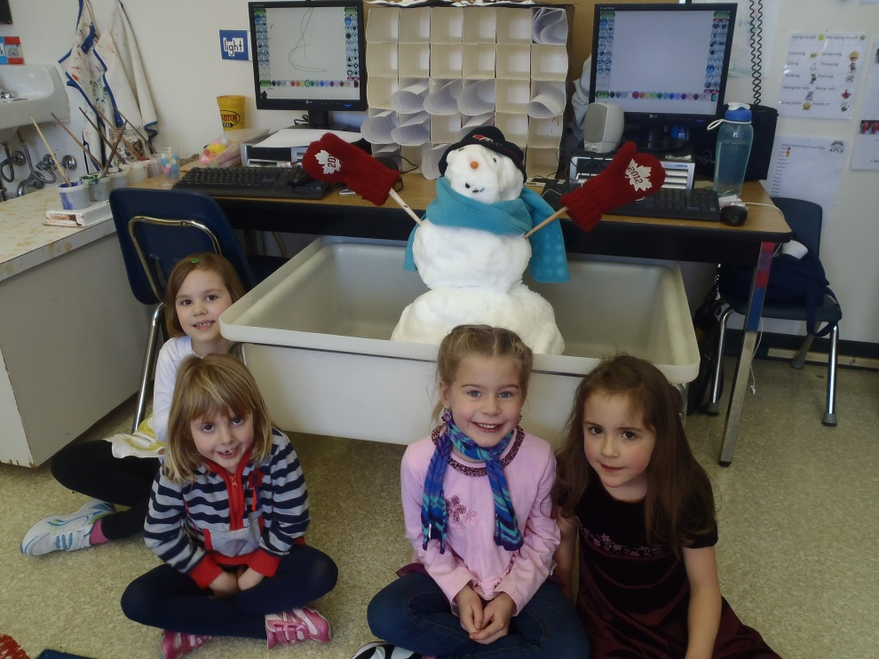
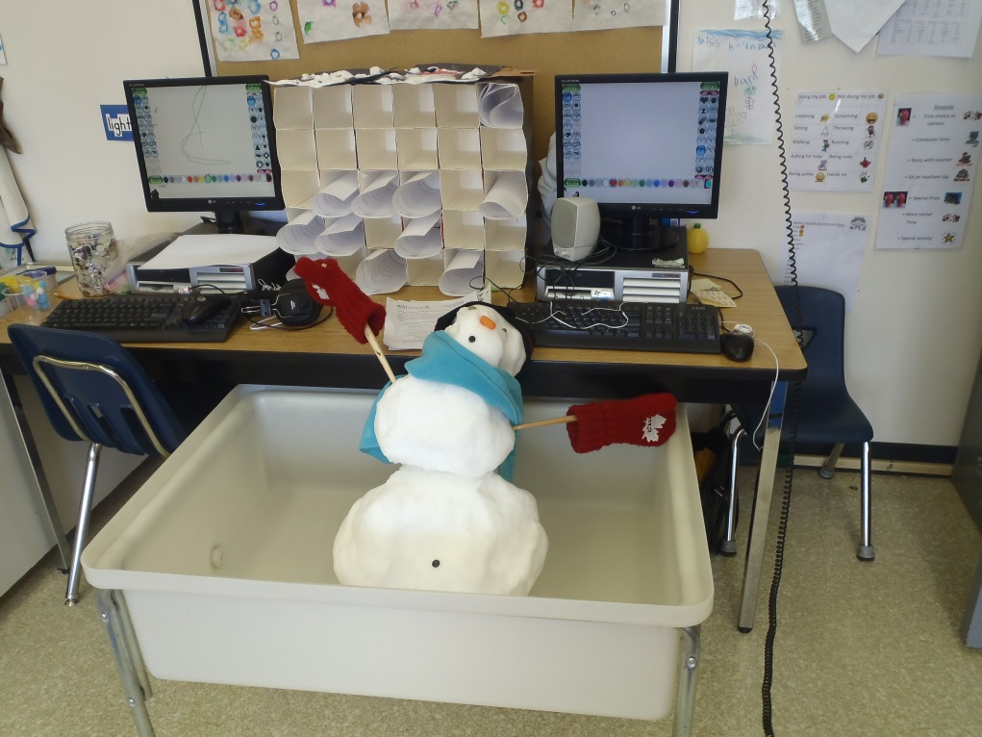
We made a snowman and brought him inside. We predicted what would happen when we brought him inside, and did a journal entry about it. Turns out our predictions were right… he melted!

Slide 18
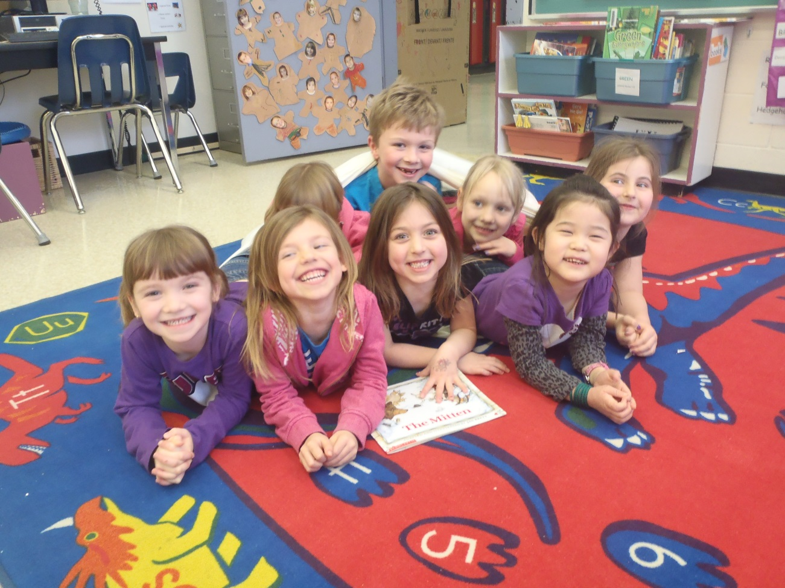
Teacher Reflection
By completing this project I realized how important it is to follow students’ interests. Each activity the students were engaged and it made the activities meaningful and authentic. I found following the students’ interests easier than I had expected. I really enjoyed being able to integrate so many different subjects.

Slide 19
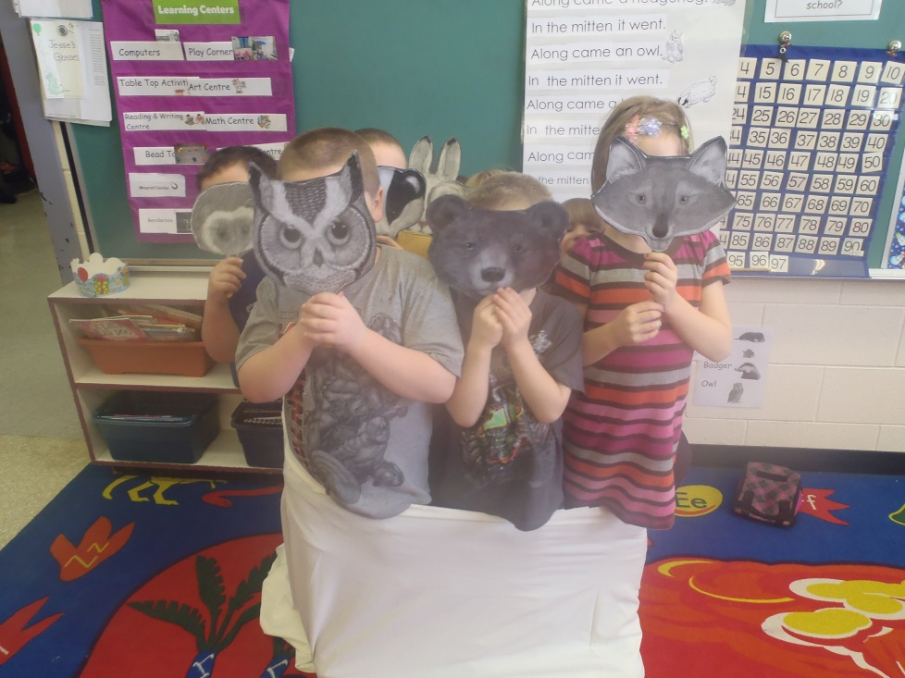
Teacher Reflection
I enjoyed this project, and it is a format I will use in the future. I really liked giving the students so much ownership and responsibility of their learning. I really encouraged all students to contribute to our ideas, and they liked that I followed and implementing those ideas.

