Slide 1
TOOLS
Pre-Kindergarten
Ages 3 & 4
Dec 2012 to Feb 2013
By: Tereen Beriault

Slide 2
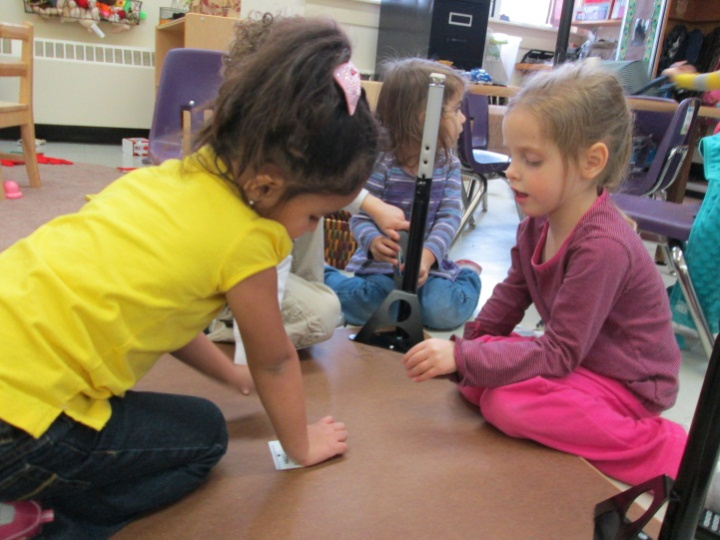
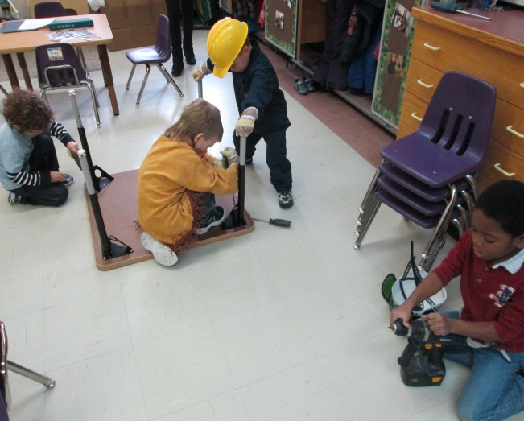
Watching for the “Spark”
The legs on our tables in the classroom needed changing. Of course once we brought out the tools, everyone wanted to help. They were fascinated!

Slide 3
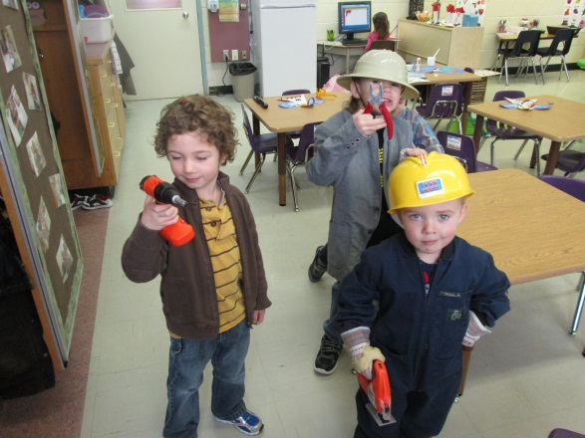
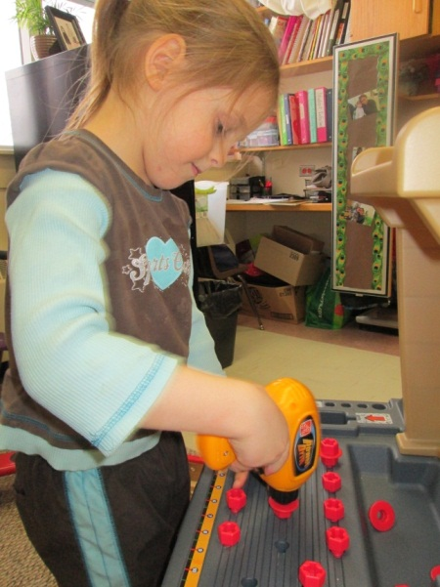
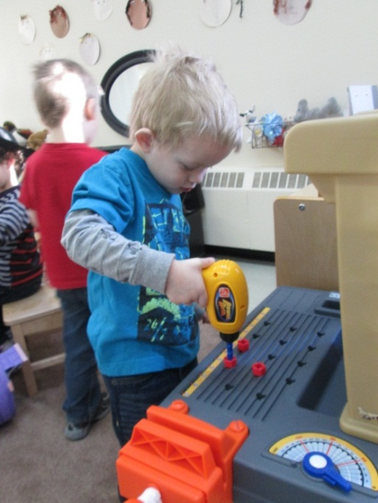
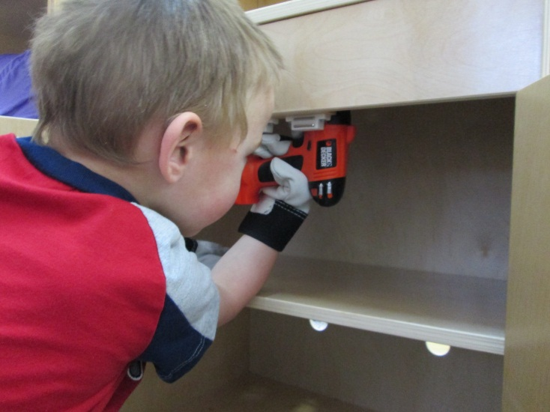
Observations
BEGINNING THE PROJECT
We put out construction hats, overalls, work gloves and added play tools to our dramatic play area. We also had a family donate a tool bench for our class. We noticed that our students were constantly fixing things and incorporating tools into their dramatic play. Our student’s interest had been identified.

Slide 4
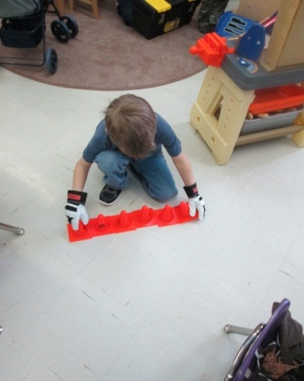
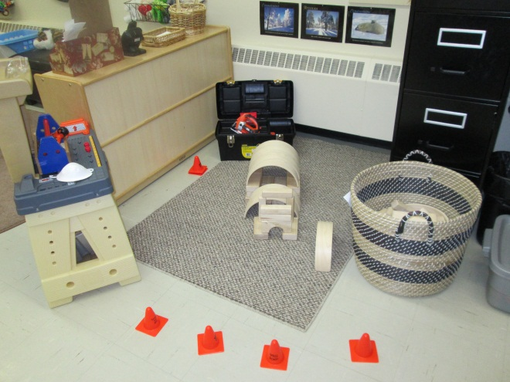
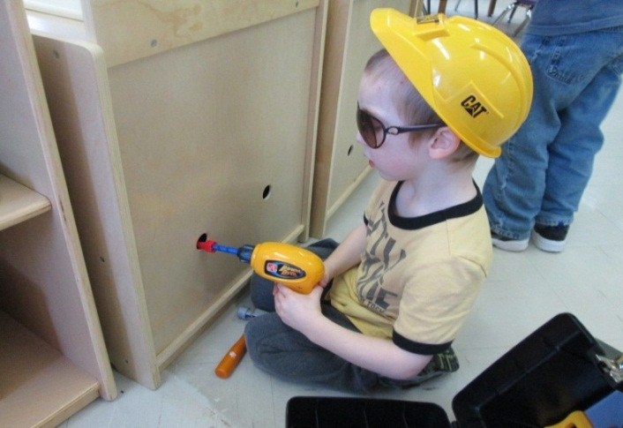
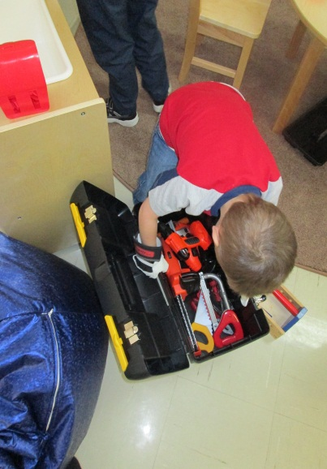
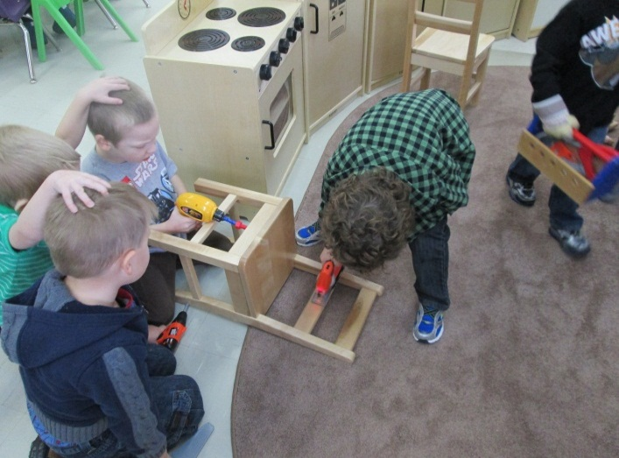
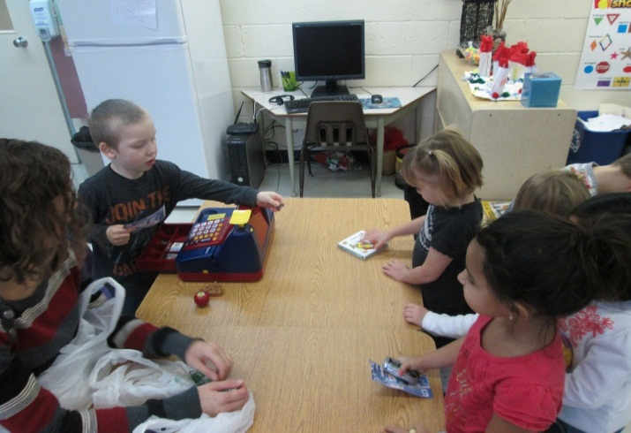
An Invitation area was created and everyday the students came up with new ideas on what needed to be fixed and what tools should be used. We even set up our own Home Depot store.
DEVELOPING THE PROJECT

Slide 5
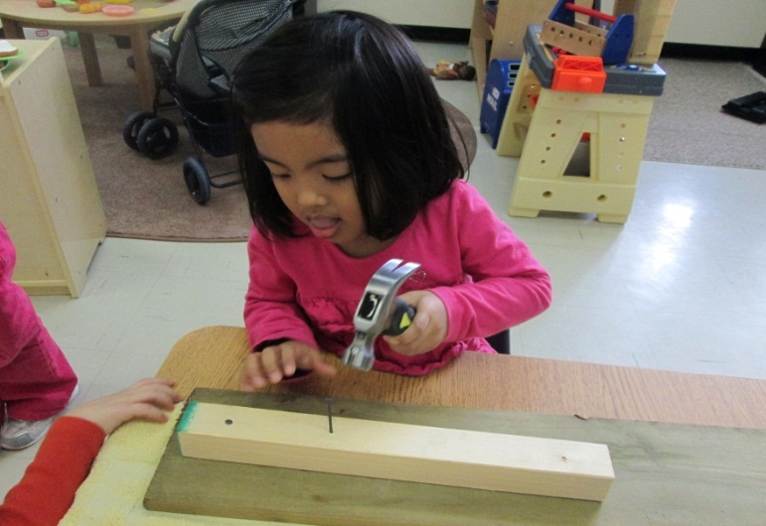
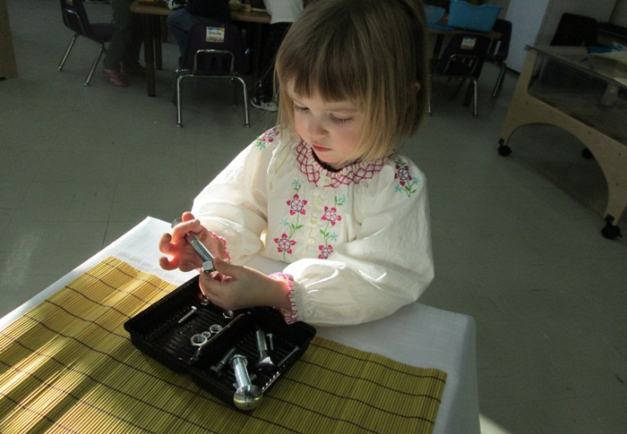
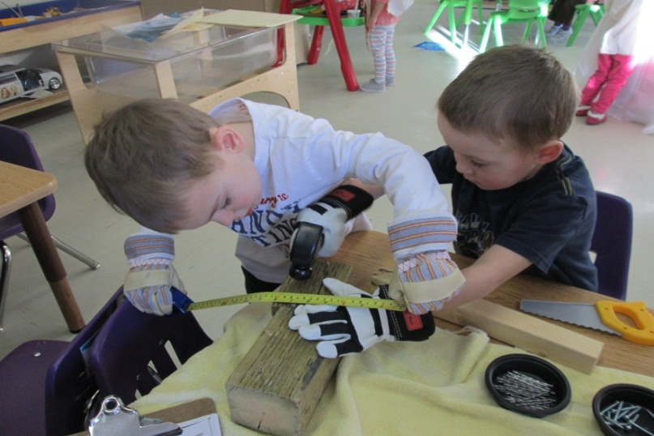
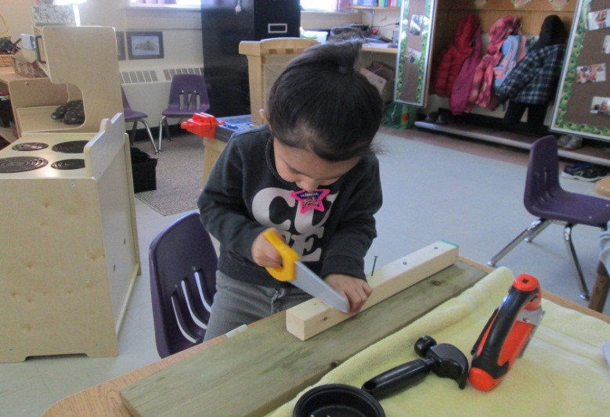
We experienced using real tools!
Hammering
Putting together nuts and bolts
Measuring
Sawing

Slide 6
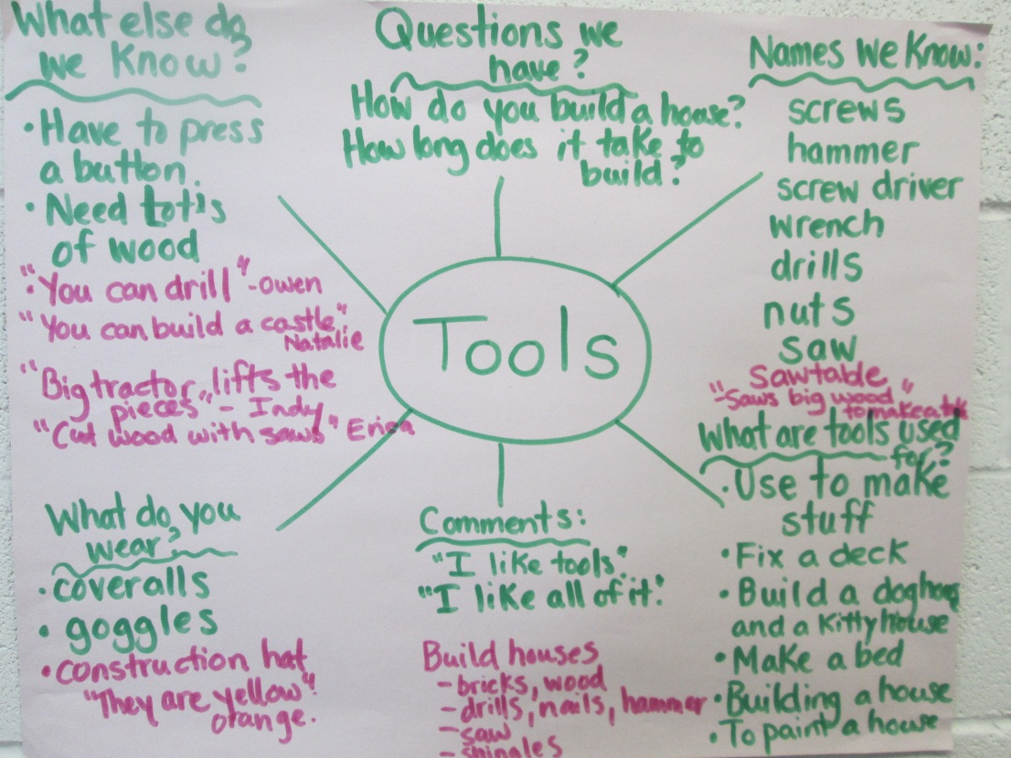
Together we created a web to find out what we know about tools and what we want to know. We did the webbing process at the beginning of our project and the end.
BRAINSTORMING

Slide 7
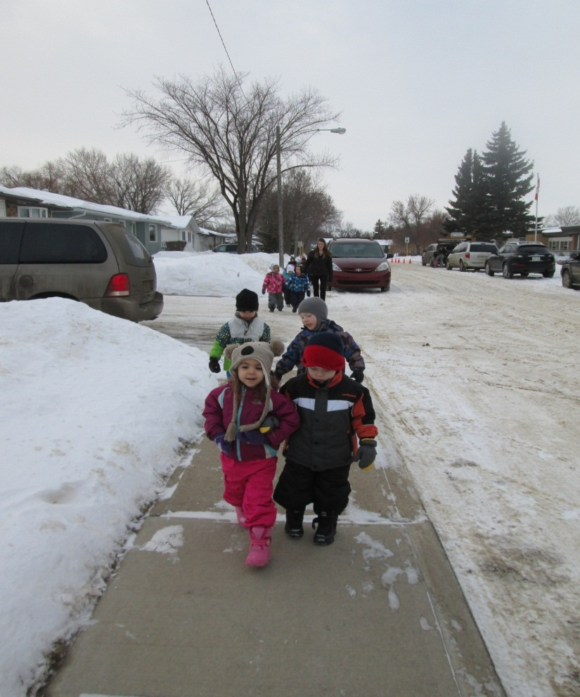
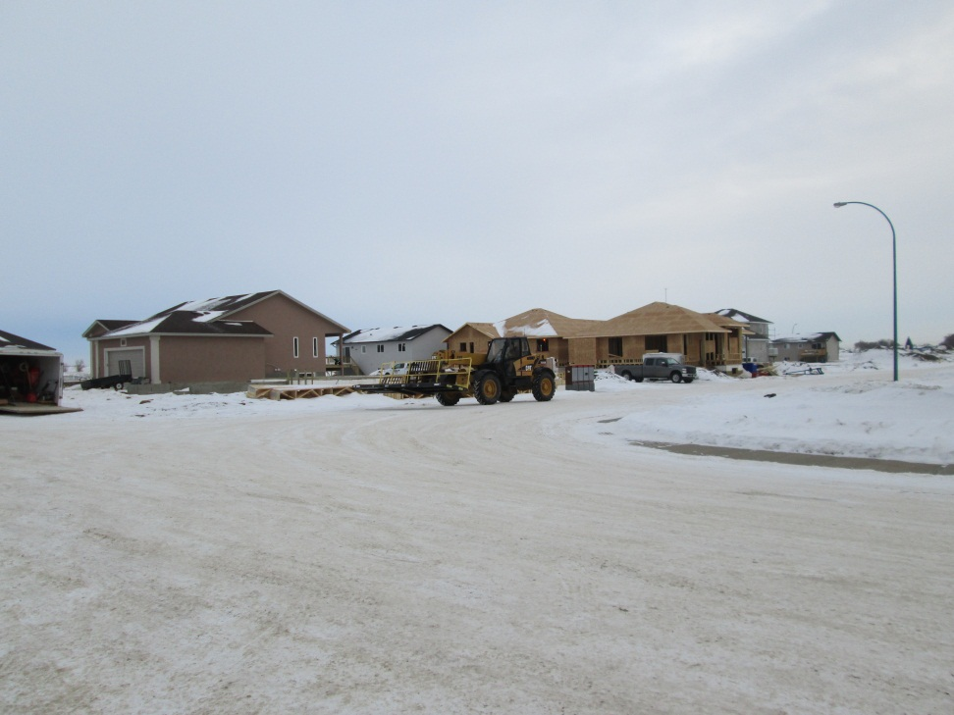
After creating our web we realized that our students were most interested in finding out how to build a house. Luckily a new development is going up close to our school so we decided to go for a walk to check it out.
FIELD TRIP

Slide 8
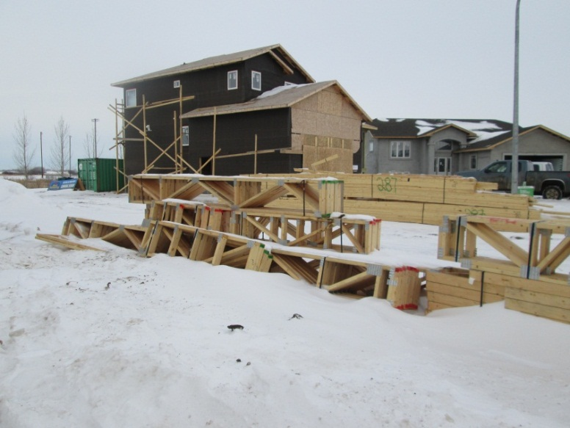
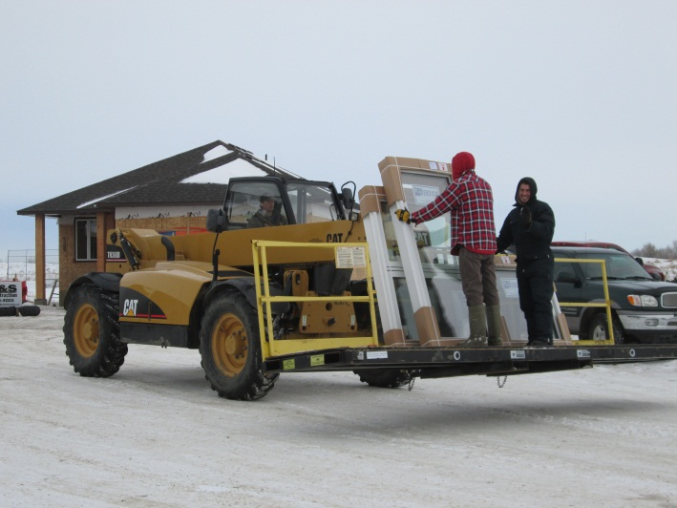
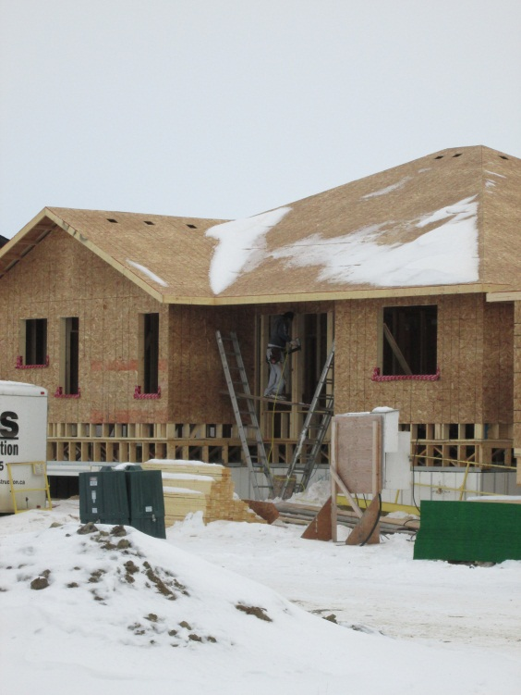
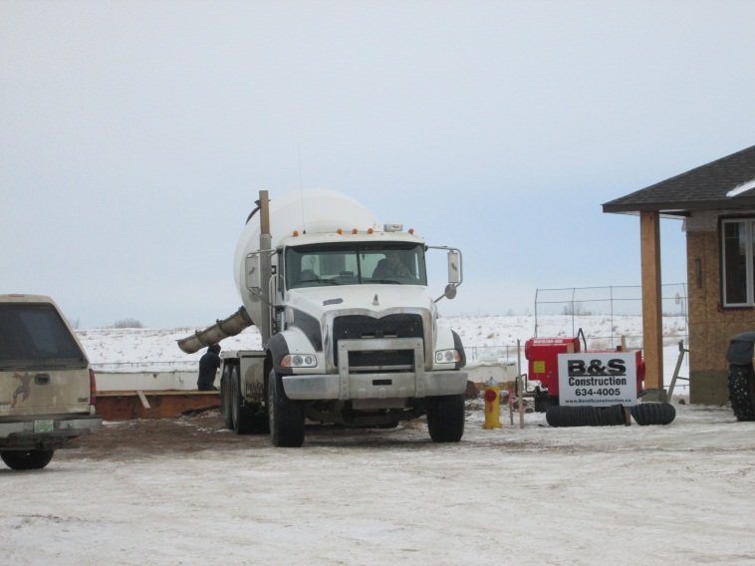
We saw so many great things happening! We saw a cement truck pouring cement for a basement, houses at different stages of being built, windows being carried on a Zoom Boom. We heard hammering, sawing, and big trucks.

Slide 9
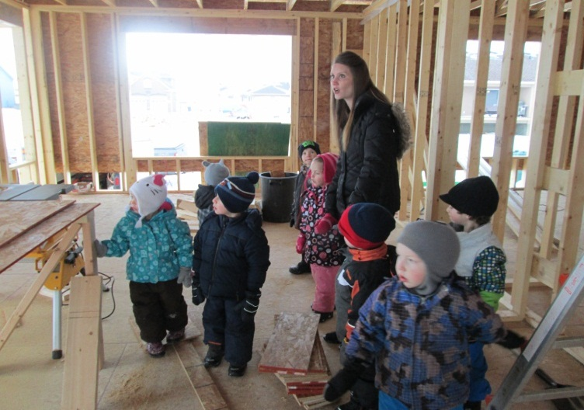
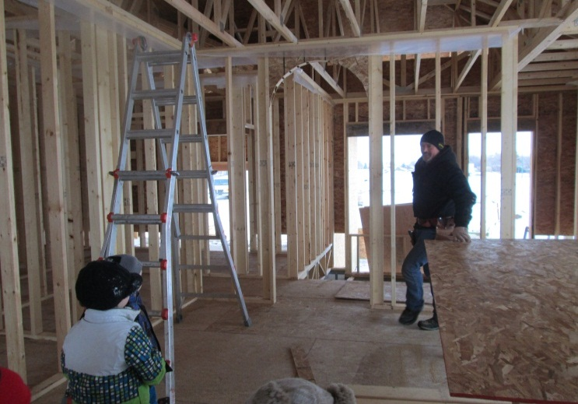
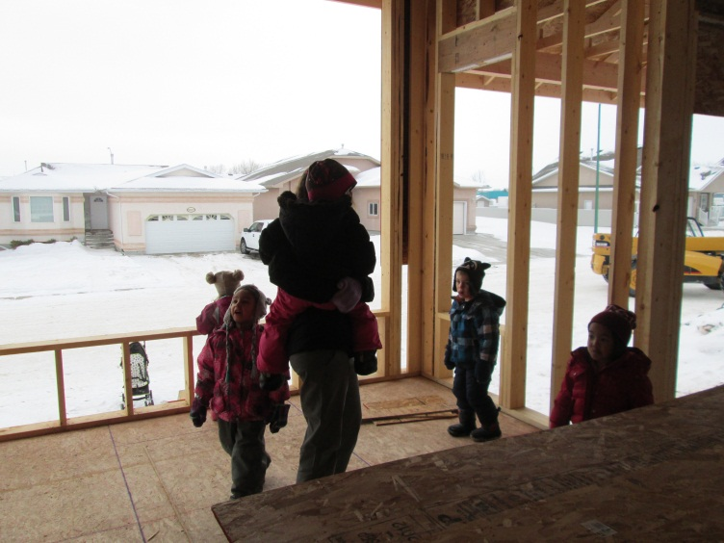
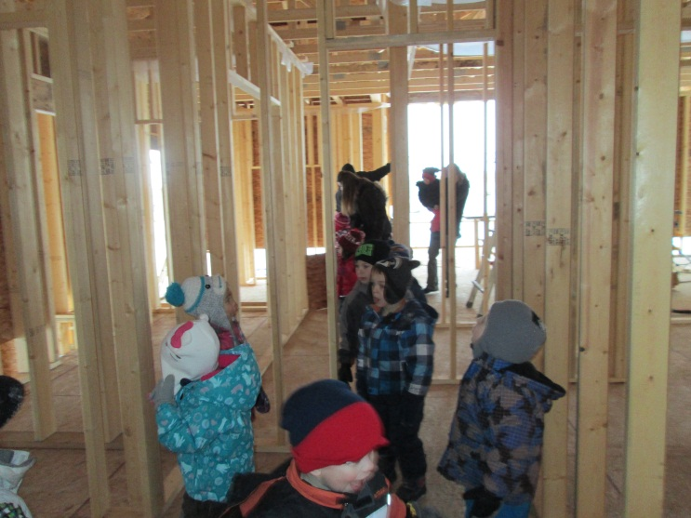
TOURING A HOUSE
As we were checking out a house that was being framed, a very kind worker invited us in to have a tour! So we were able to walk around and ask the worker some of our questions about how houses are built. Our simple walk turned into the best unplanned field trip.

Slide 10
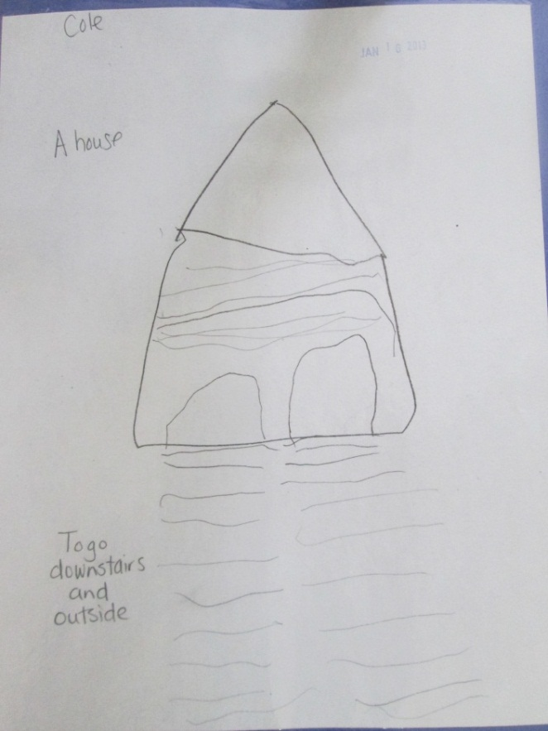
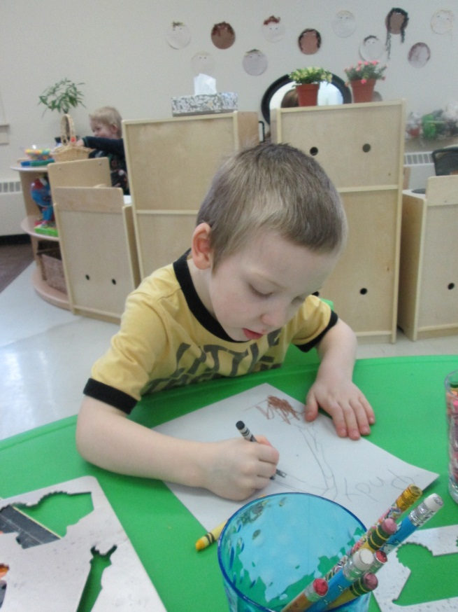
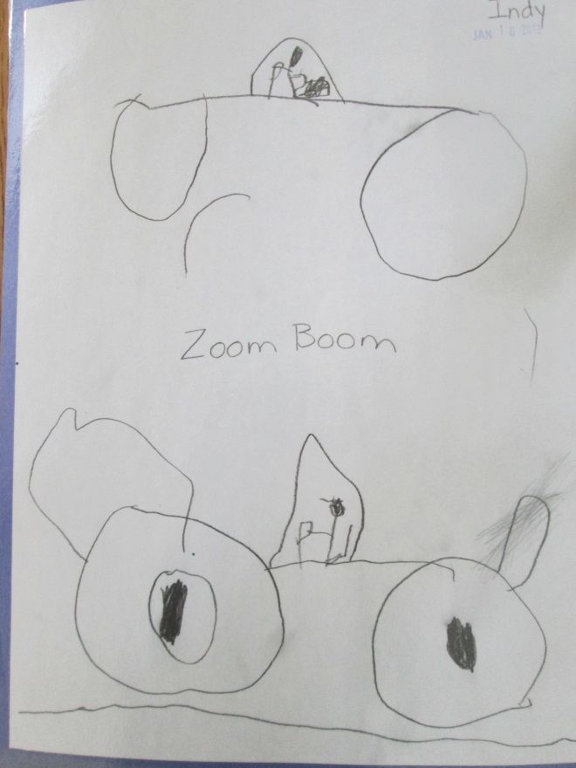
Reflecting on our field trip

Slide 11
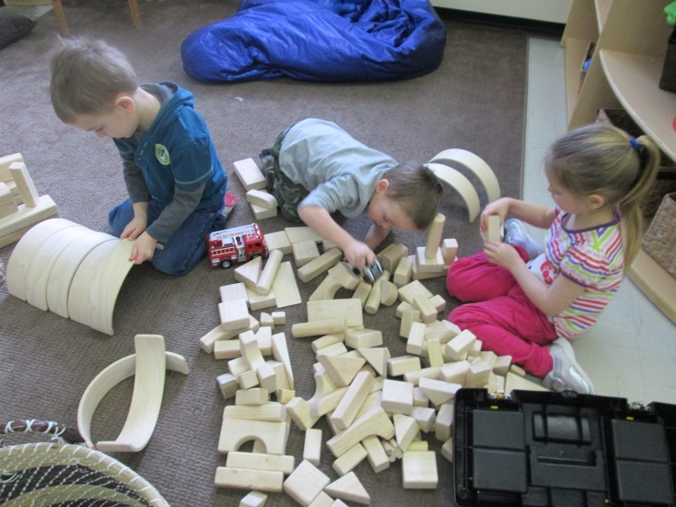
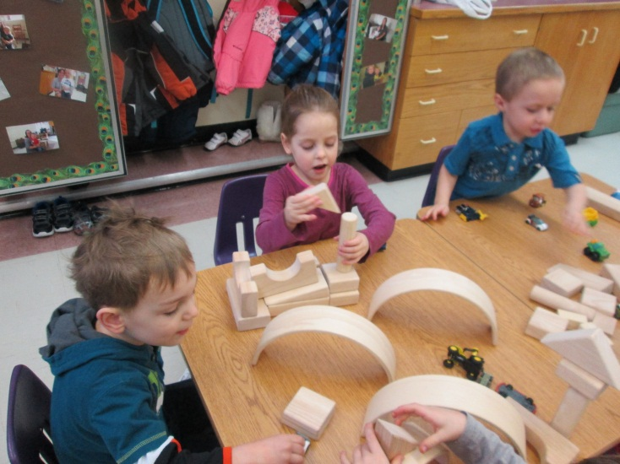
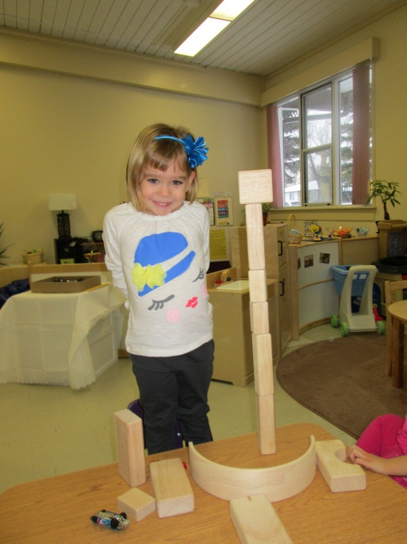
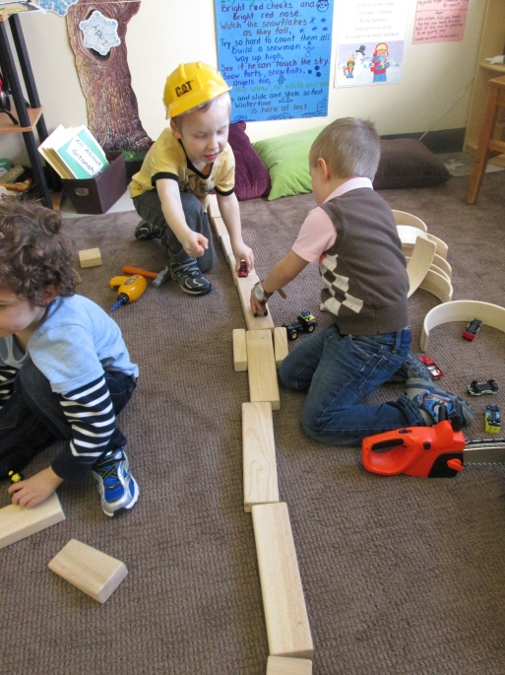
What can we build?
“Tunnels”
After seeing all those houses being built we began to investigate what we could build.
“A House”
“I made a tower”.
“We are making a road”.

Slide 12
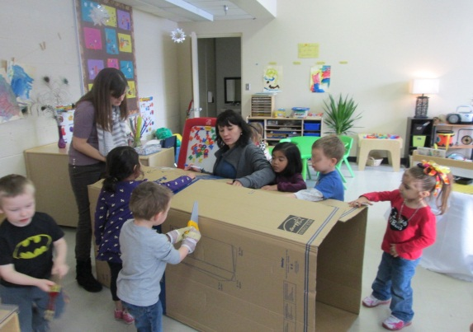
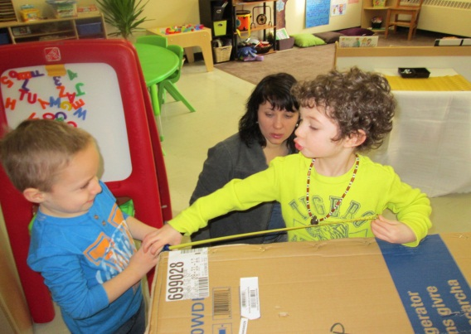
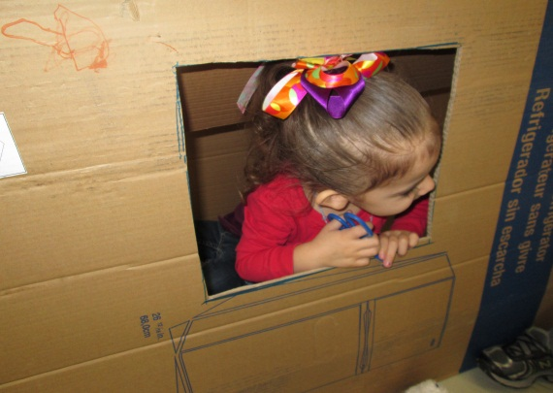
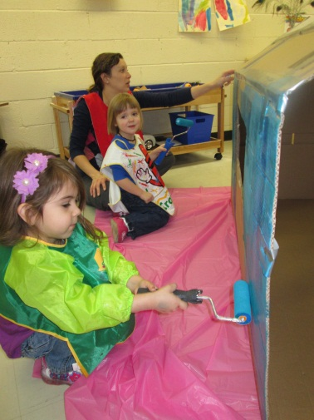
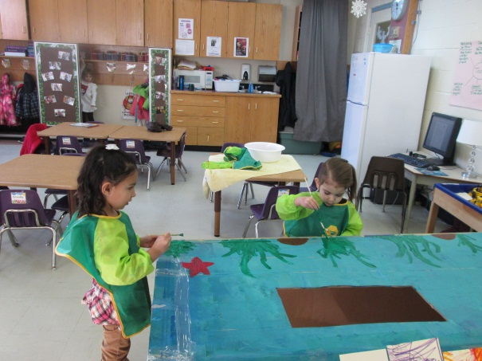
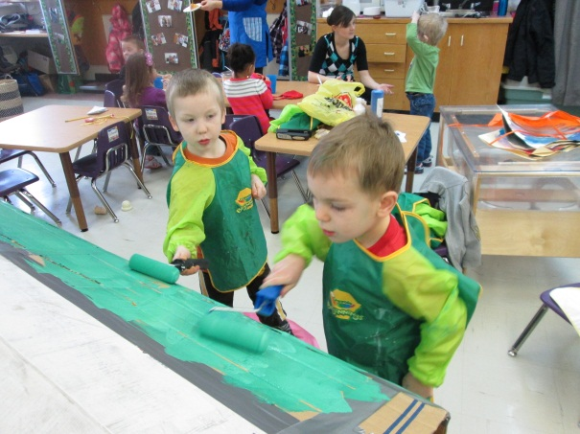
Making Our Own House
Our project was shifting from tools to building. We had a large refrigerator box that we decided to make something with. After some brainstorming the students decided they wanted to make a house. The girls wanted a mermaid house and the boys wanted a jungle house. So the process began to build our own house.
First we made a roof, cut out windows and began painting.

Slide 13
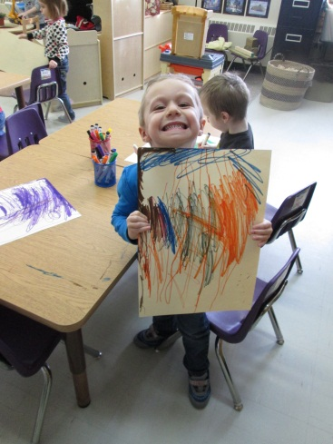
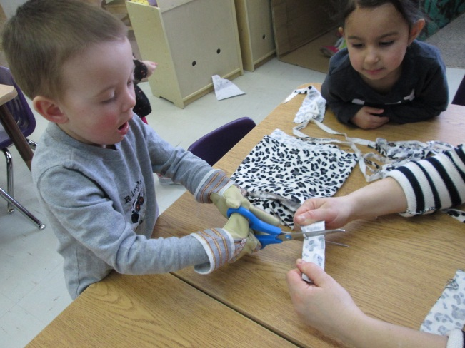
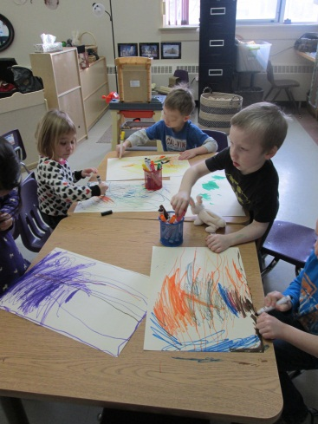
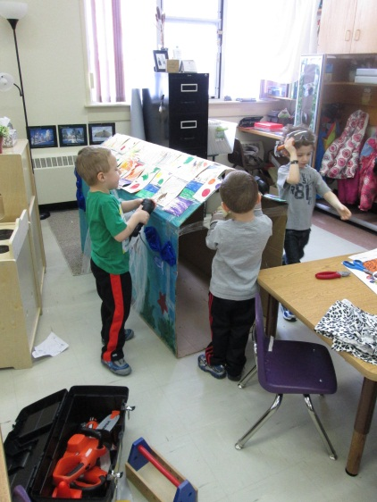
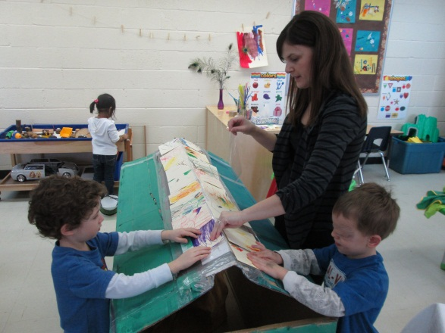
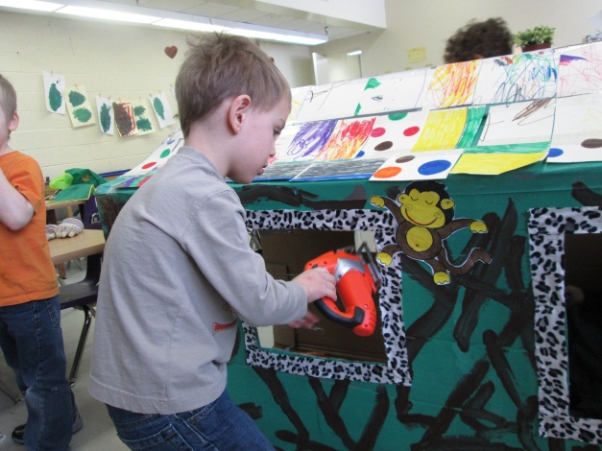
The Building Process
Making shingles for our house
Making blinds for the windows

Slide 14
The Finished Product
THE MERMAID HOUSE
THE JUNGLE HOUSE

Slide 15
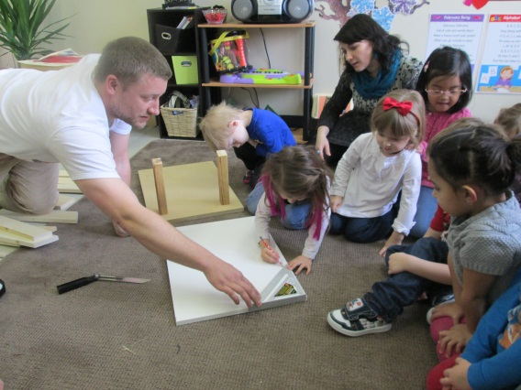
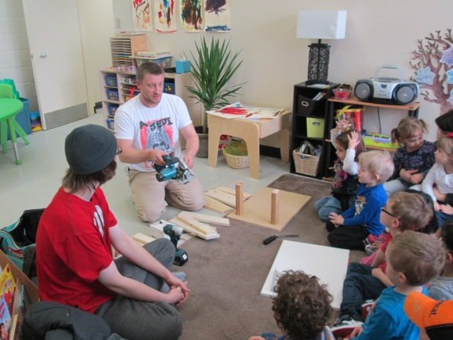
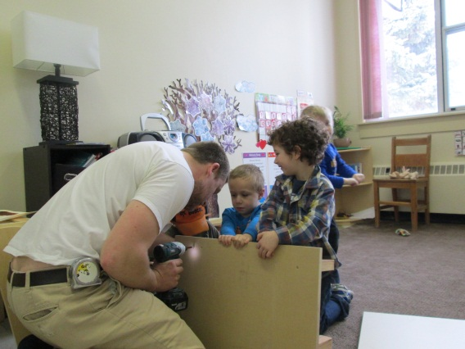
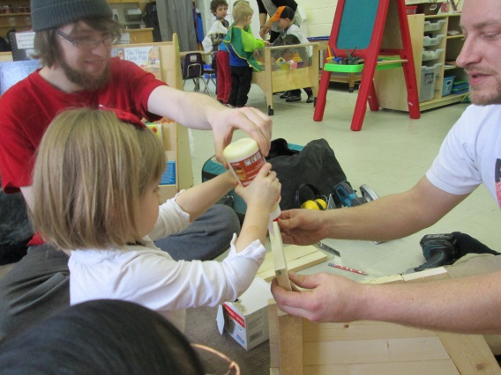
Building Project with one of our Parent’s
Once our parents became aware of our project we had a dad volunteer to come build something with the class. Since we were interested in building houses we decided to build a dog house for our stuffed toys. He showed us different tools and let each of us have a turn helping.

Slide 16
Incorporating Literacy

Slide 17
CONCLUSION
The project was shared with parents and our school community through bulletin boards and displaying our finished products (our own house and dog house). We also made a class book about our field trip.
What did students learn?
They learned about different tools and their purpose. They learned how houses are built and what tools are used. (Building vocabulary and knowledge)
They worked together as a group to make decisions and create
They shared tools and ideas with each other
They related to their real life experiences
Our project provided many opportunities for students to strengthen their fine motor skills, promote imagination and creativity, develop their social skills and relationships, and problem solve.
Reflection This was a great learning experience not only for the students but for myself. I realized how capable my students are and how much more effective the learning is when they are excited about what they are learning. I really tried to let the students guide the project and it was amazing where it went without me planning it all. One of the biggest successes would be that all students were excited and they were eager to learn. One of my biggest challenges would be documenting.

