Slide 1
AFRICA
A Project for our Pre-K learners
Lynette Wilson
Christine Turcotte

Slide 2
Introduction
Our Pre-K program is at an elementary community school. We teach two pre-K classes .Each class comes for a half day and has sixteen 3-4 year olds. There is a teacher and an assistant in the room.
This project lasted for six weeks…much longer than we had anticipated.

Slide 3
The Spark
A grade 5-7 generosity club within the school was fundraising to build a school in Africa. Information about this fundraising effort was included in the daily announcements: a large map was put up in the hallway and each class was given a coin bank to help with the cause. Suddenly all we heard in the classroom was “Africa, Africa, Africa”.

Slide 4
The Web We spent time discussing both what the students knew and what they wanted to learn about Africa.

Slide 5
Our Planning Board Whenever we begin a new project we plan how we can incorporate this concept in the various learning centers in the room.
Math - geometric patterns, counting, sorting the toy animals
Science - African animals, landscapes
Drama - African Hut/African plains
Dress-up - animal prints/ masks/material to Dress-up
Music - Drums, CD`s, You Tube of music and dance
Construction – incorporate African animals in block building and play
Library - Books (fiction and non Fiction)
Fine motor - weaving table, crafts, scissor cutting, beading, etc.
Puppets - variety of African animals
Sand box - add animals and small rocks and plants
Water table - take out water and fill with old Zoo World magazines and scissors
Quiet areas - photo book of a friends visit to Africa, magnetic story books, small multicultural dolls
Carpet time - songs, poems, Ollie The Ostrich puppet
Crafts - endless possibilities

Slide 6
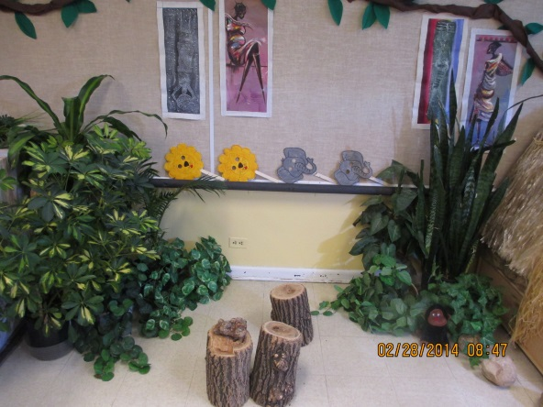
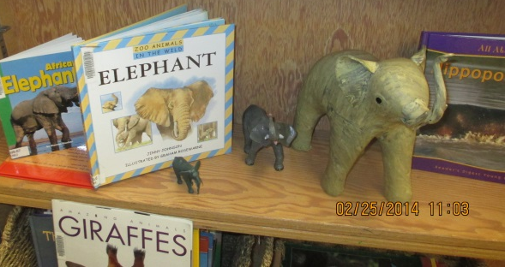
Setting up the Learning Environment We removed our “Canadian house center” and made an African home. We then added live plants for our jungle, we hung paper vines around the room, and made Zebra print material out of an old sheet. We filled the sand table with plants and African animals. Our puppet center was decorated with “grass” material and appropriate puppets were offered.

Slide 7
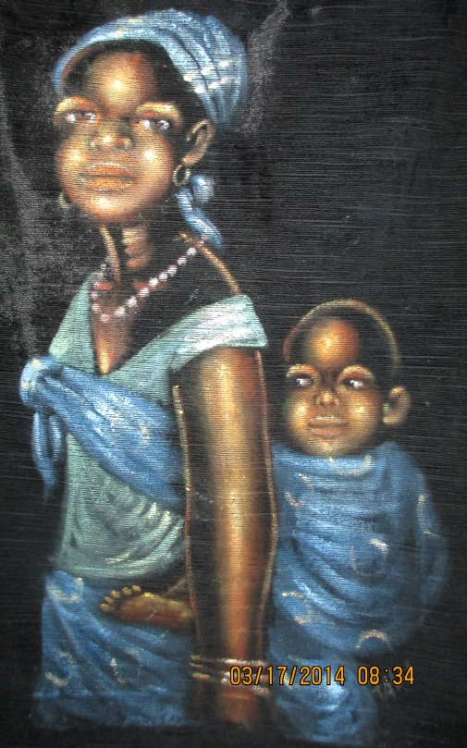
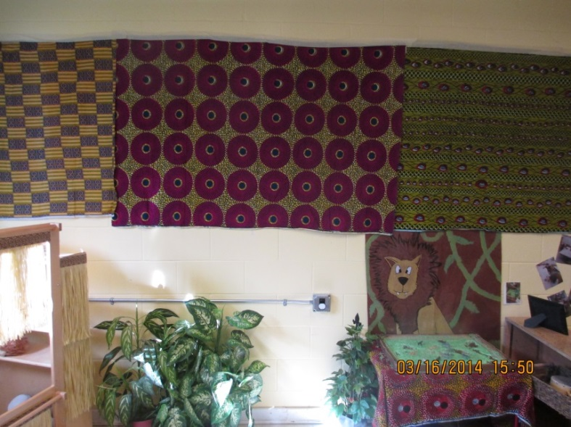
A friend recently returned from Africa and generously lent us photos, cloths, wooden masks, and paintings which we displayed around the room. Our students used these to build upon during their dramatic play!!

Slide 8
A Flight to Africa
“Can we go there?”
This simple question lead us into taking a flight to Africa. We “packed” our suitcases, then handed out tickets and passports. We arranged chairs, made a cockpit and with sound effects from the internet we took flight. We had a short “African based” in-flight movie with snacks and drinks. When we arrived in Africa each student had their passport stamped and we went off to see the sights.

Slide 9
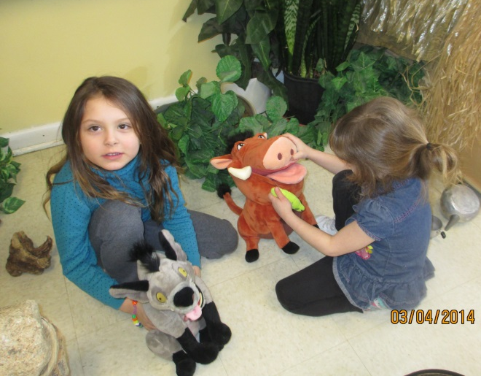
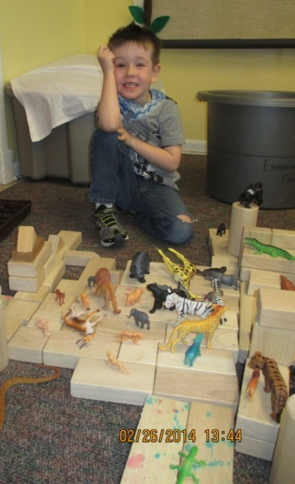
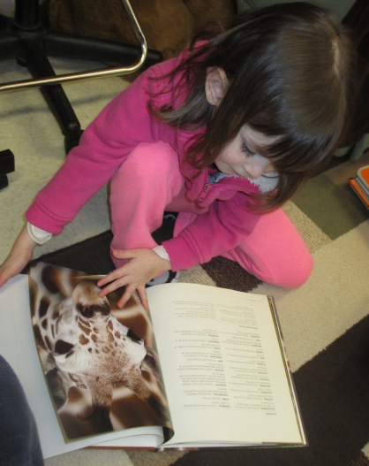
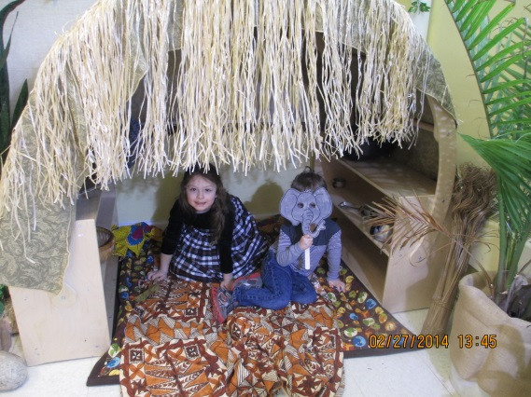
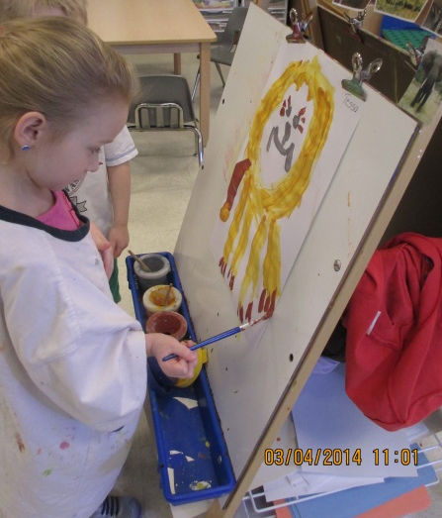
Student Explorations

Slide 10
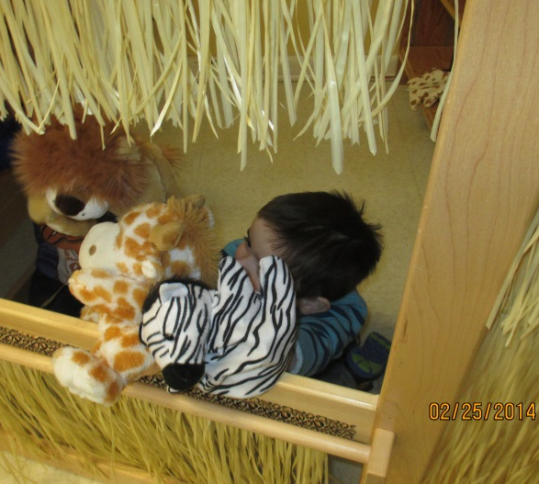
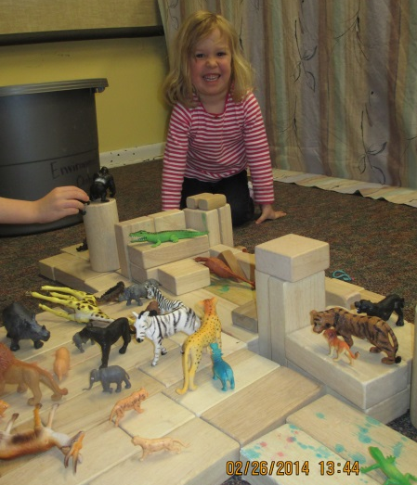
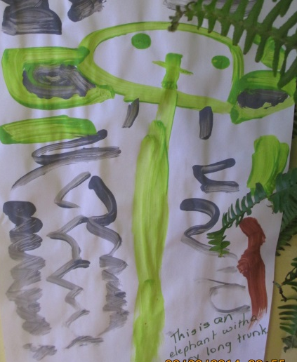
One of the main interest of our students was the plains animals. They were fascinated by the giraffes, zebras, elephants and lions. Each day they would get a new animal stamp in their passport and we would read books and talk about the animal. We would then use You Tube to see and to hear what sounds the animals make (their favourite part). During play time they had opportunities to dress-up as the animals, play with puppets and to represent them through art.

Slide 11
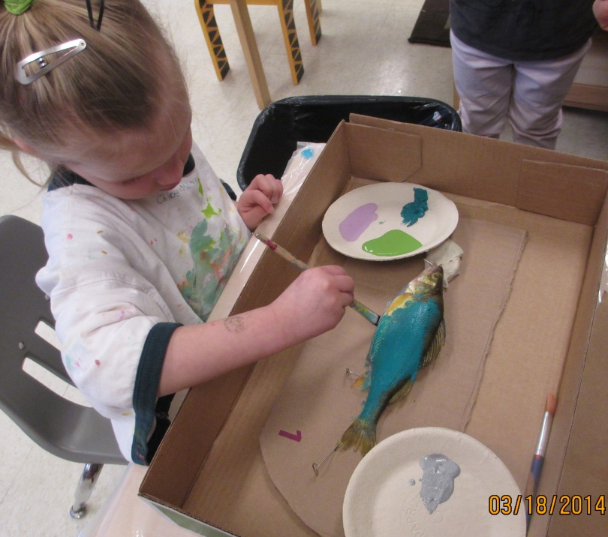
Yes that is a crocodile’s head. (I can’t believe the things people have) The kids LOVED this especially the teeth. And yes, that child is painting a fish. This is actually a Japanese art form, but our intent here was to respond to a question about fish in Africa. Meet Ollie the Ostrich our newest playmate!! Ollie was one of the students favourite reading buddies.

Slide 12
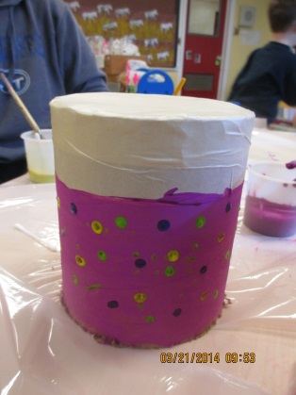
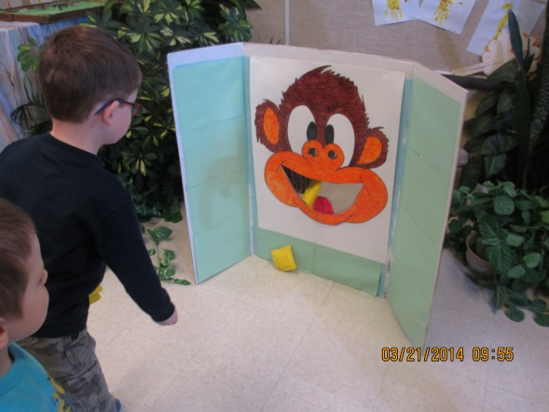
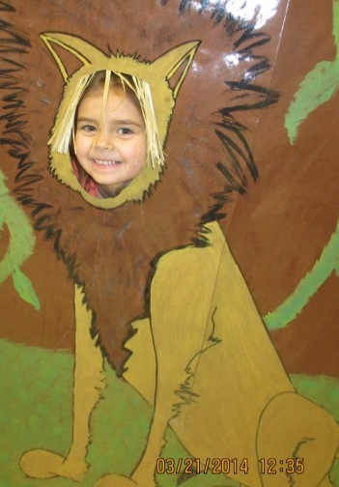
Family Fridays are an important part of the pre-K program. During our family event we made African drums. We have learnt that drums were and are an important part of African music. We also played some games such as A Barrel of Monkeys, Pin the Tail On the Elephant, and Feed the Monkey bean bags toss. Afterwards we had “African inspired” snacks.

Slide 13
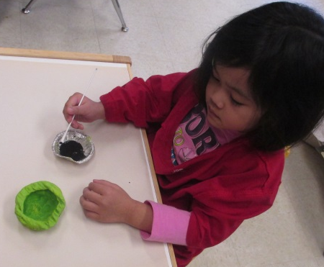
A Field Trip to the Art Museum
The children noticed that the African people used large clay pots and baskets to carry items. Our local Art Museum offers educational programs, so we booked a bus and off we went. We had a great day and each student made a clay pinch pot.

Slide 14
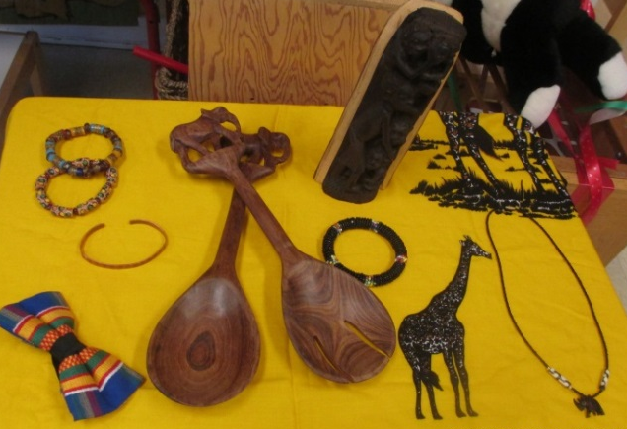
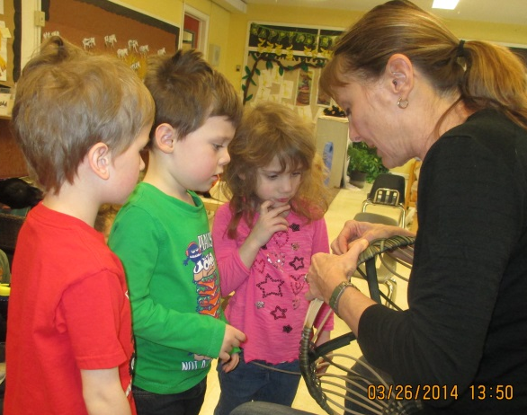
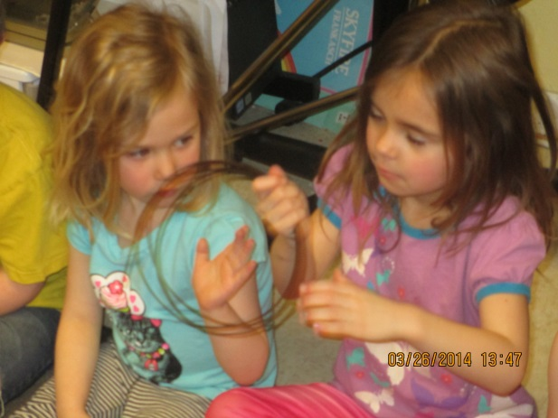
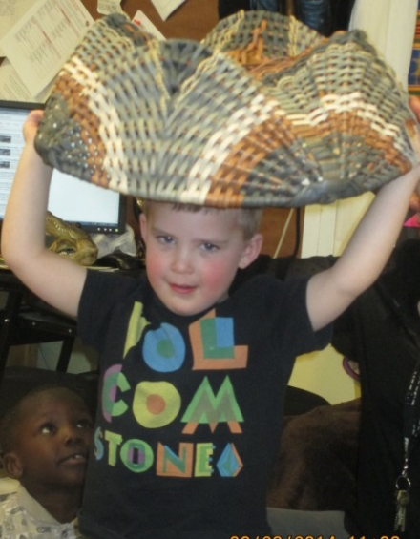
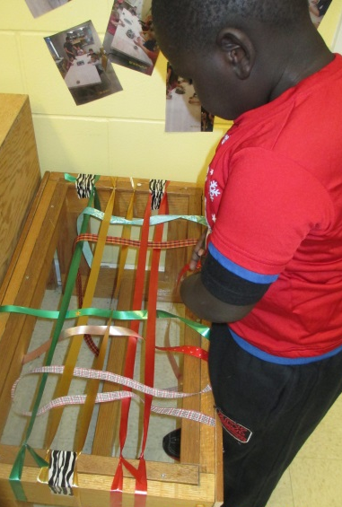
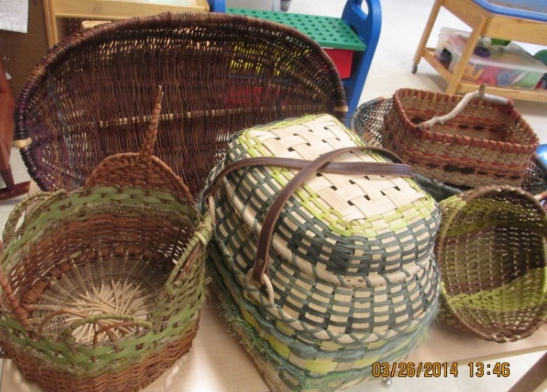
A Local Basket Weaver Beth Crabb is a well known artist who agreed to come into our room to talk about her recent trip to Africa and to demonstrate the art of basket weaving.

Slide 15
Still to come Pre-K Art Show and Sale! All proceeds earned will go toward helping build the school in Africa.

Slide 16
Reflections
- We usually choose topics that are more local and personal to the students so I was surprised at how involved and how long their interested remained on this topic.
- We have three children whose parents immigrated from Africa, they all were excited by the project. It made us aware how limited their culture is portrayed in the school. Sadly, none of the parents were able or willing to come into the class either due to work schedules or insecurity about their English.
- We had a limited knowledge of Africa and were unsure how well we could develop this project. We both found that we enjoyed learning along side of the students and the students enjoyed seeing us as learners.
- By following the student’s lead we found the project went in a different direction than we had first thought. We had anticipated their interest would be centered around the jungle and monkeys.
-We enjoyed the experience of watching the different directions our children’s interests and learning lead to.
-We were pleased to hear from a parent of one of our quieter students, how he excitedly shared what he had learned about Africa with her each day when he got home.

