Slide 1
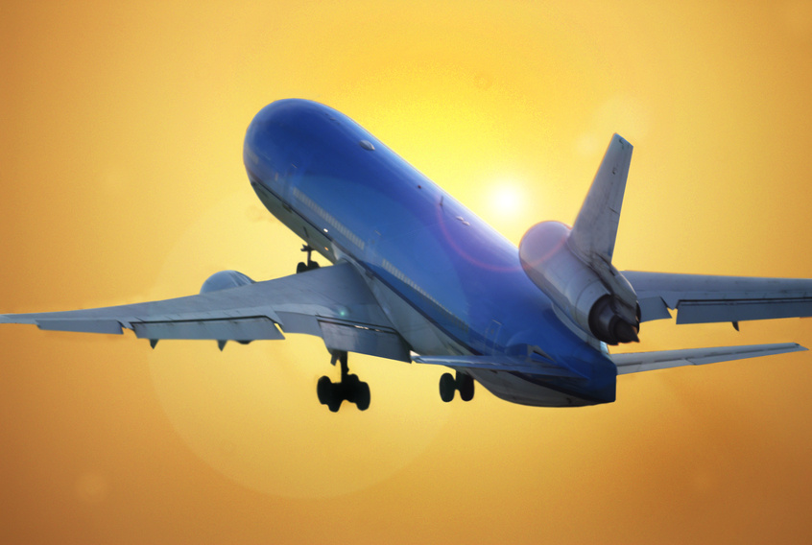
Airplane Project! An idea takes flight!!!
Submitted By:
Richelle Hanley
Anita Gawluk

Slide 2
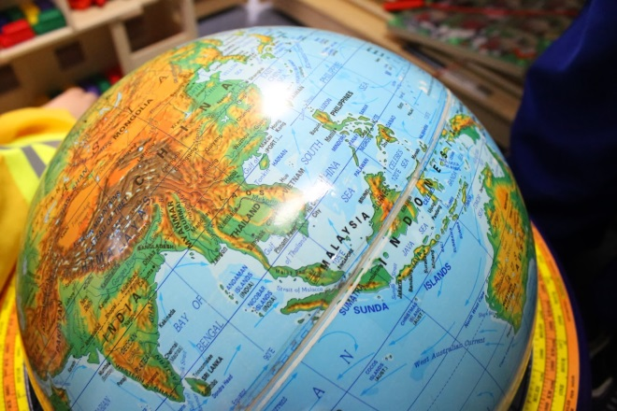
The Airplane Project General Information
The Project was completed by 16 Pre-kindergarten students (three and four year olds) over a three month period. It was completed in a half-day setting (four mornings a week). There was one teacher and three Educational Associates involved in the project.

Slide 3
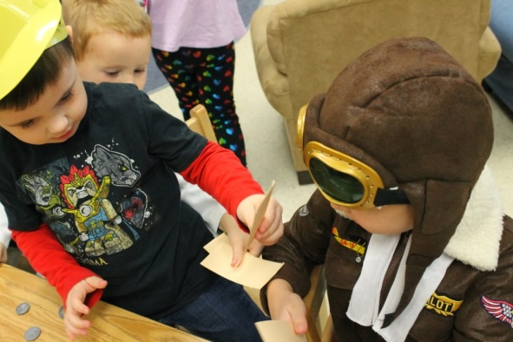
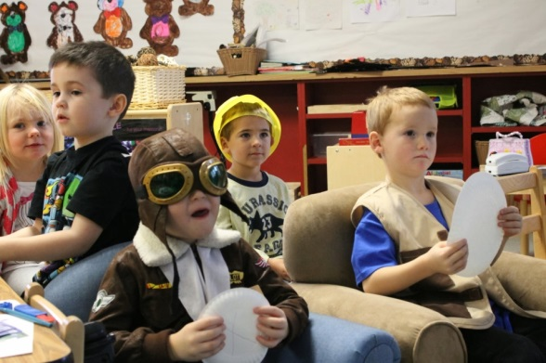
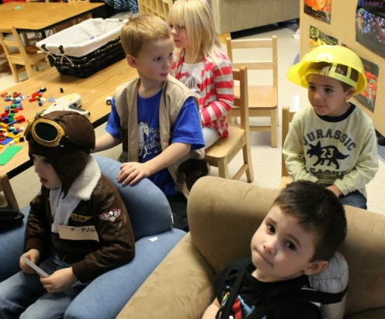
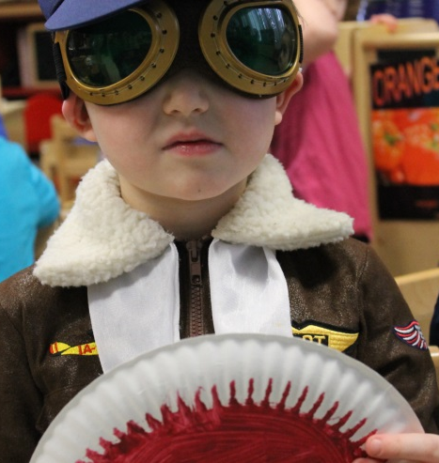
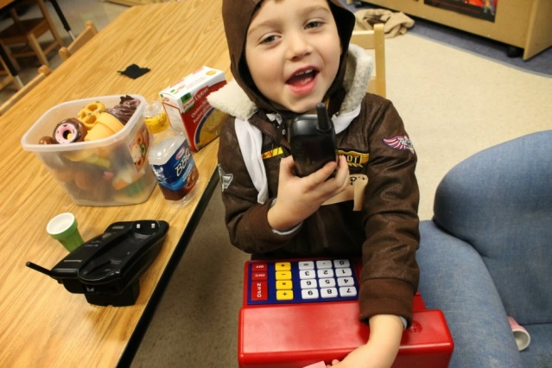
Phase 1: Beginning the Project
The topic of this project was chosen through observation of the children’s play. Many of our students have expressed interest in travel, and a few of our students have been on a plane in the past year (or have known someone that has taken a flight on a far-away trip). The students began with a couple of chairs, costumes, a paper plate steering wheel, and a cash register and phone.

Slide 4
Phase 1: Curriculum Outcome Web

Slide 5
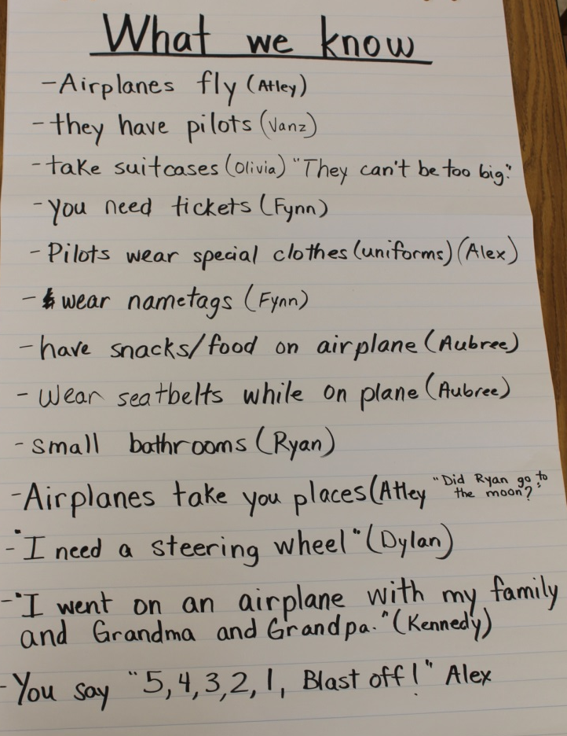
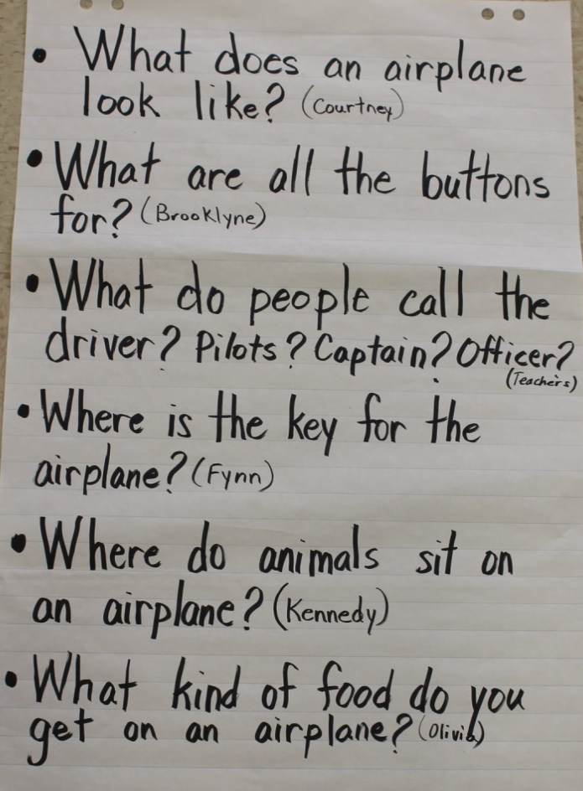
Phase 1: Topic Web
We joined together on our carpet after a couple of days and had a discussion with the students about what they were creating. We wrote down the questions they had, things they knew and places they had gone or wanted to go to.

Slide 6
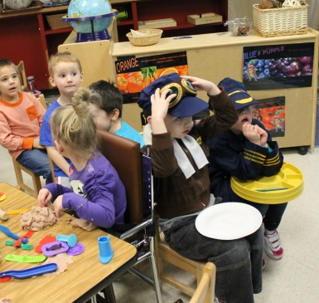
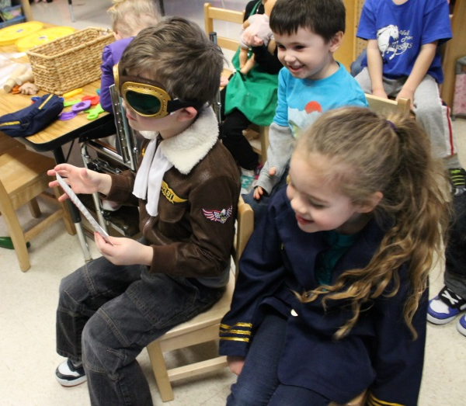
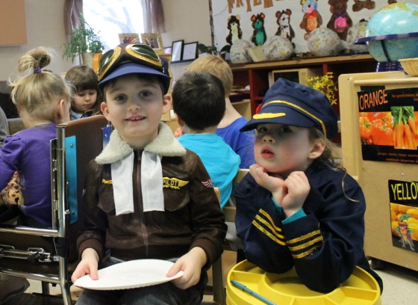
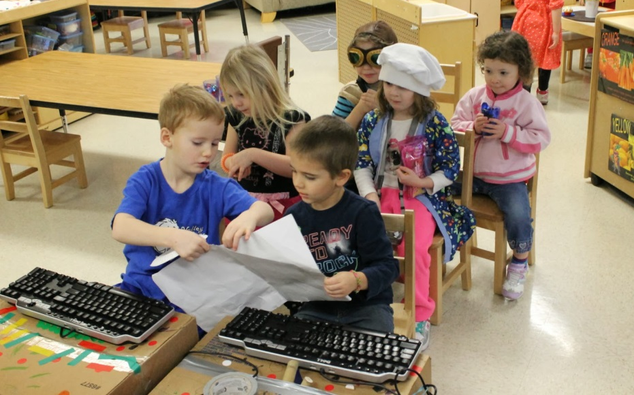
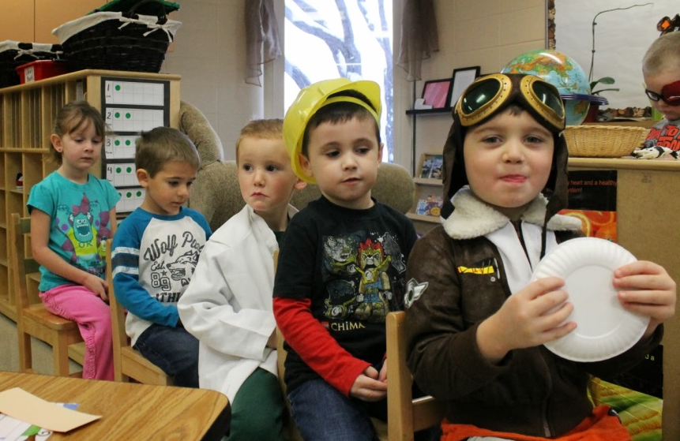
Phase 1: Learning Environment
Our airplane began with two chairs and grew from there. As more students joined the airplane play, more chairs were added along with different costumes and props.

Slide 7
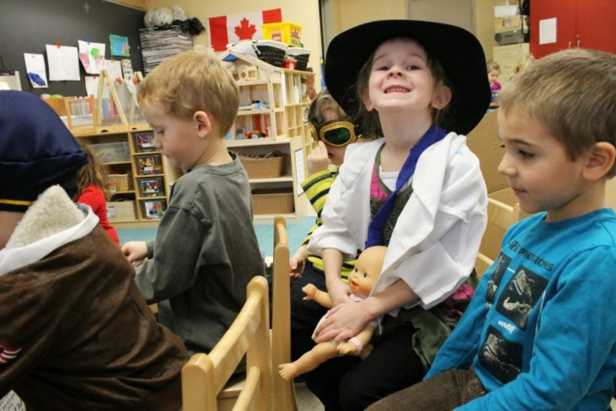
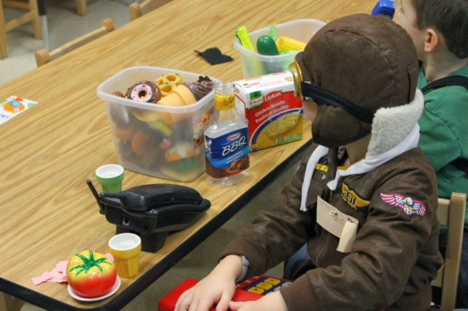
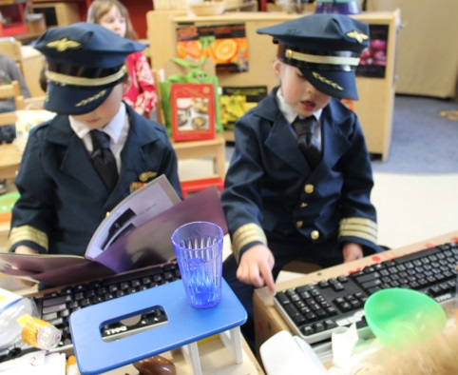
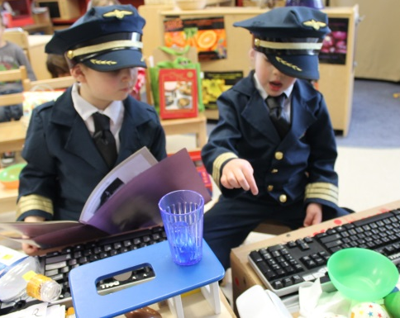
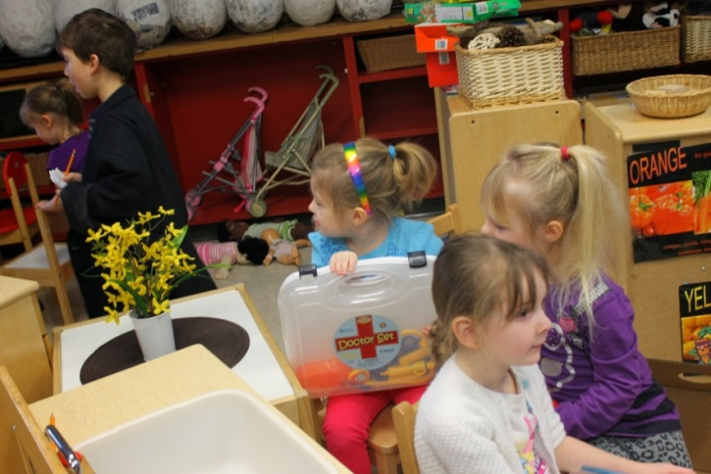
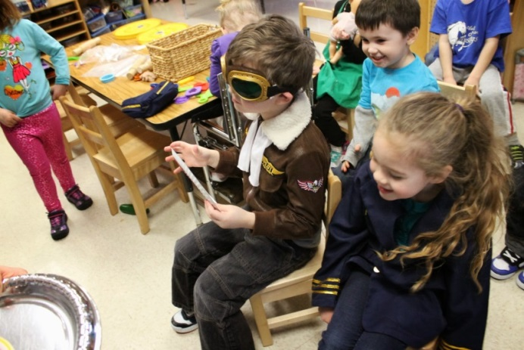
Phase 2: Investigating Who works on an airplane?
A variety of uniforms and costumes were used for various occupations. We had one pilot costume in our class and the police costume became part of the co-pilot’s uniform. Two more pilot costumes were added later in our project. We were also learning that there were various jobs on the plane and in the airport.

Slide 8
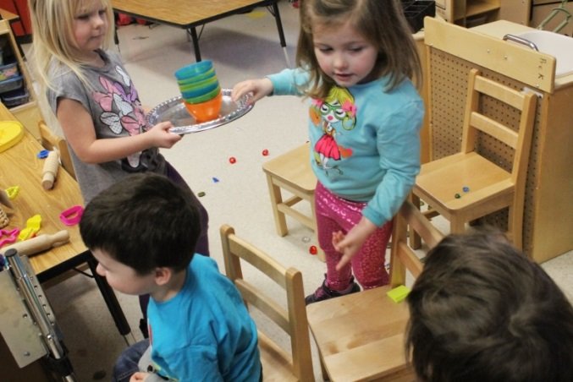
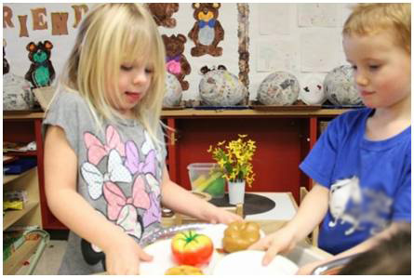
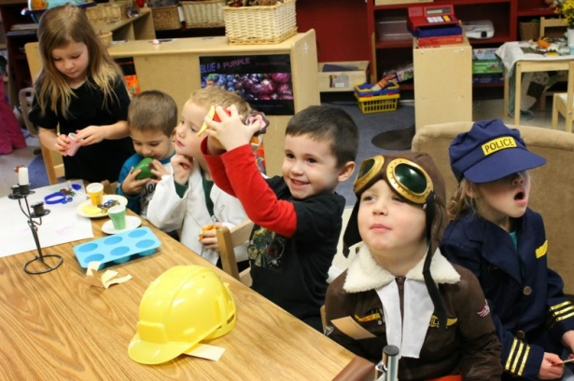
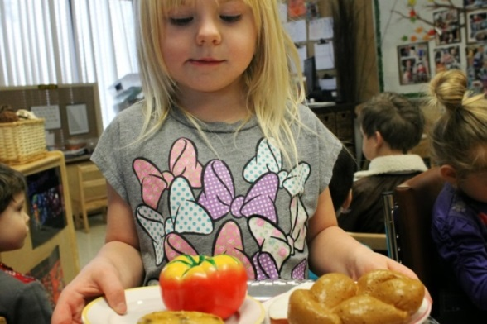
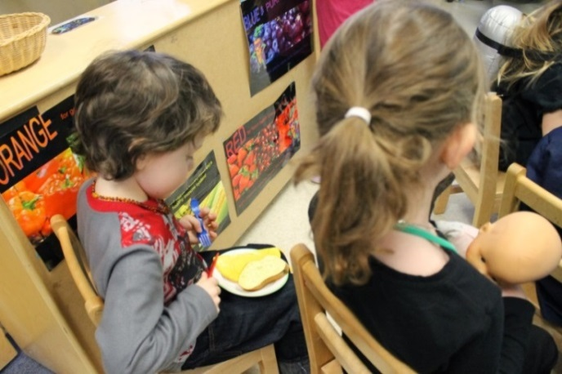
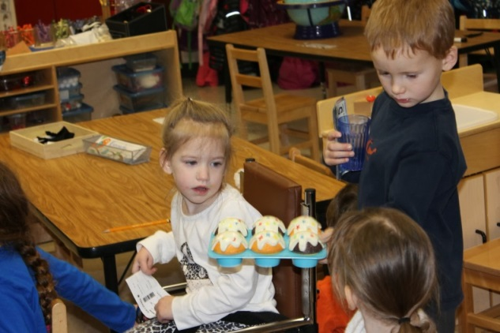
We ate on our airplane!
Students decided that food was an important part of the experience, so flight attendants worked busily in the kitchen and brought food and beverages to the airplane pilot and travelers. It began with the use of a phone and “food tickets”, then changed to students walking up and down the aisles with food trays.
We talked to those students who had been on an airplane and discussed the meals they received while in flight. One student said, “They gave us food, even buns!” Another said, “I just got peanuts.”

Slide 9
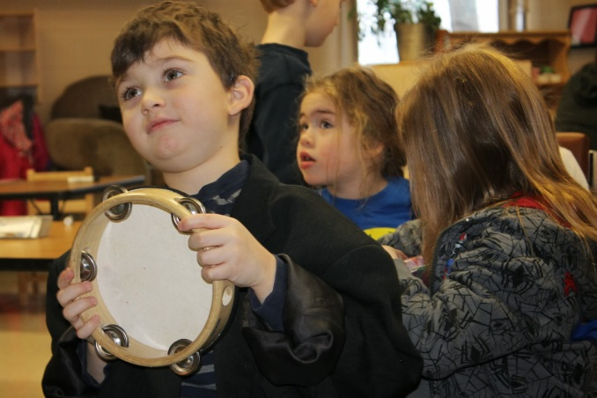
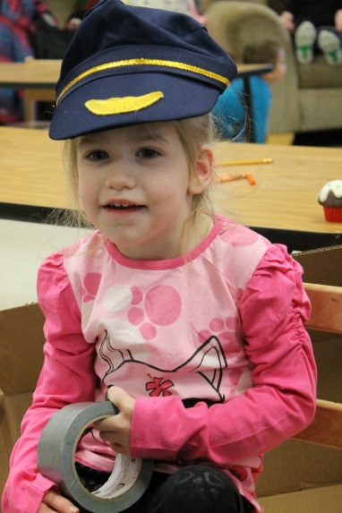
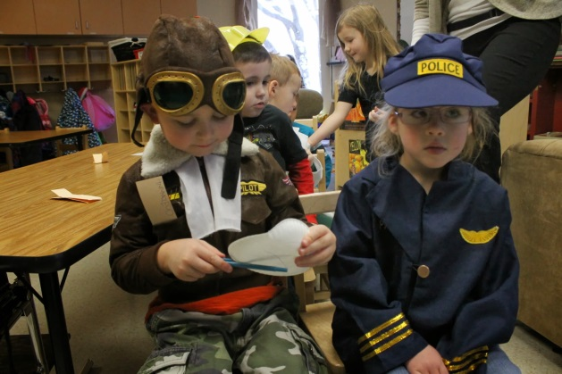
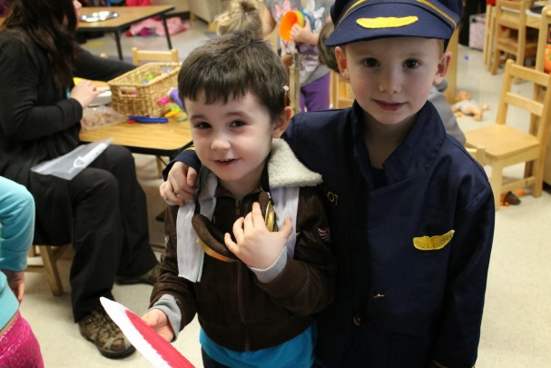
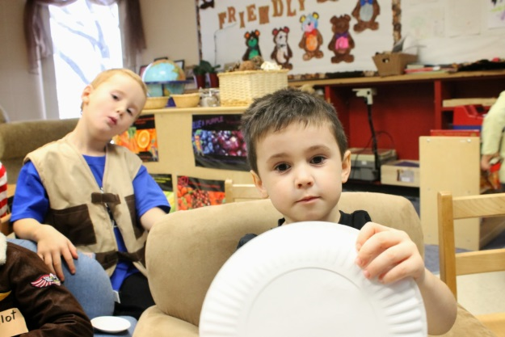
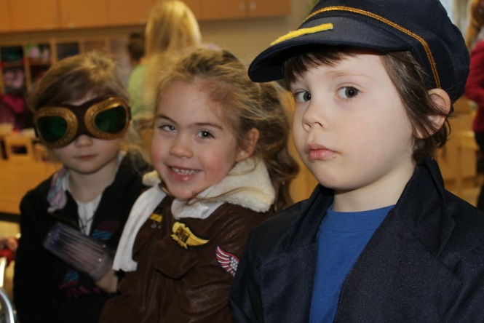
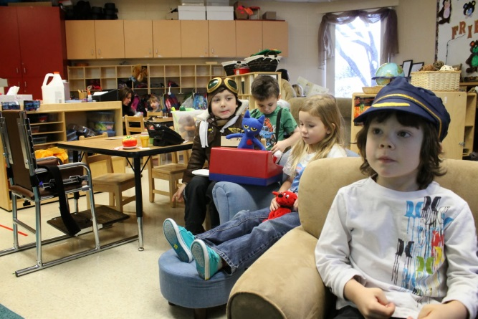
We began construction….
Students took turns as pilots and co-pilots. Steering devices were made of tape rolls, tambourines, and paper plates.

Slide 10
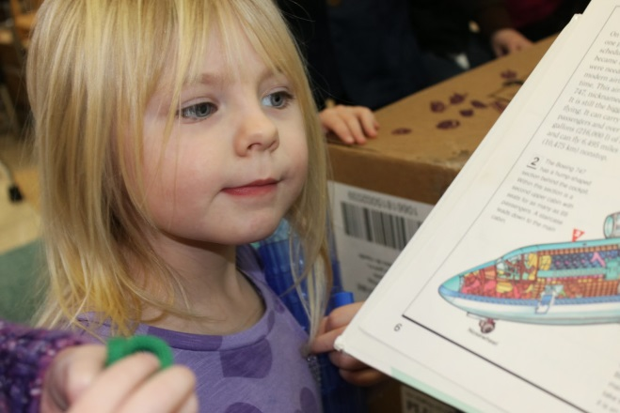
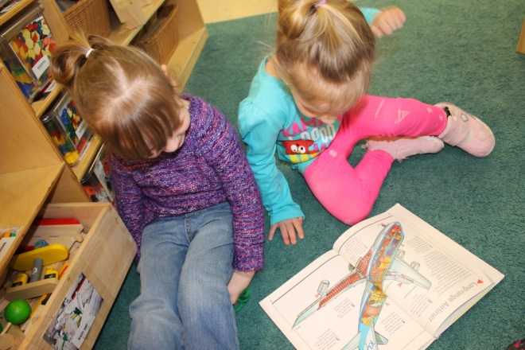
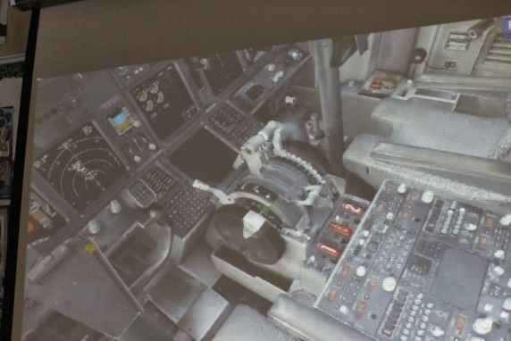
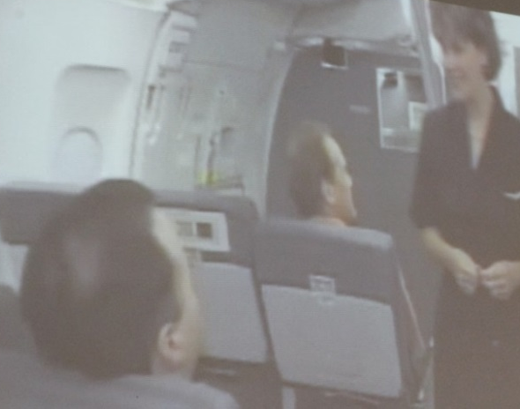
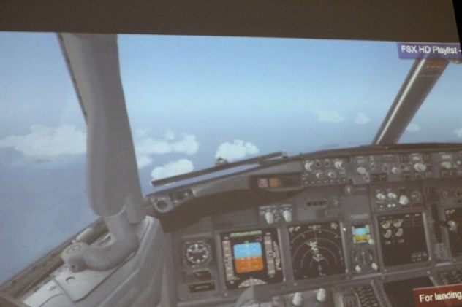
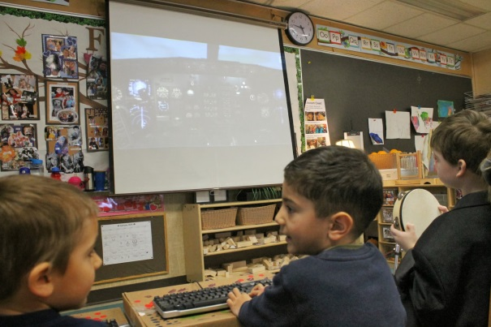
Phase 2: Investigating Construction of our Airplane
Day 1
Books were brought into the classroom for students to explore. We also looked online and found some flight simulation videos. It was fascinating to see real airplanes taking off and landing and to check out the views from the inside of an airplane cockpit.
Authentic airplane noise
added to the plane experience to make our plane realistic.

Slide 11
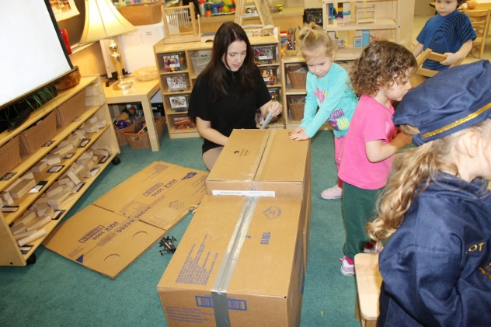
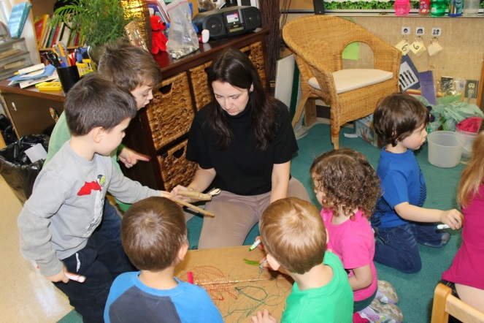
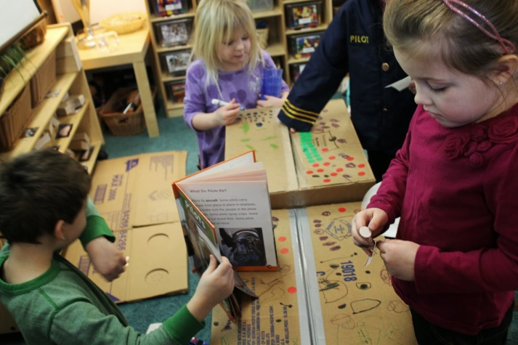
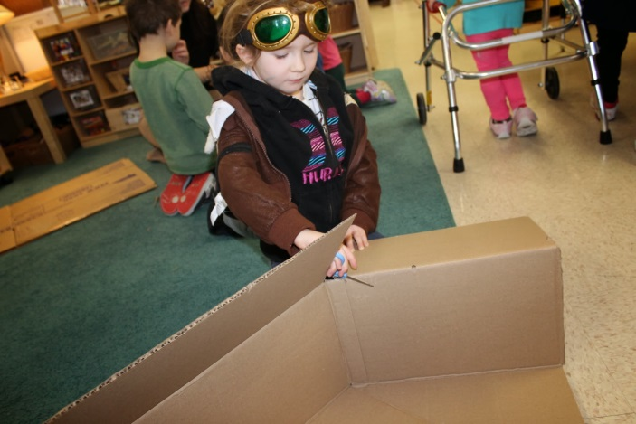
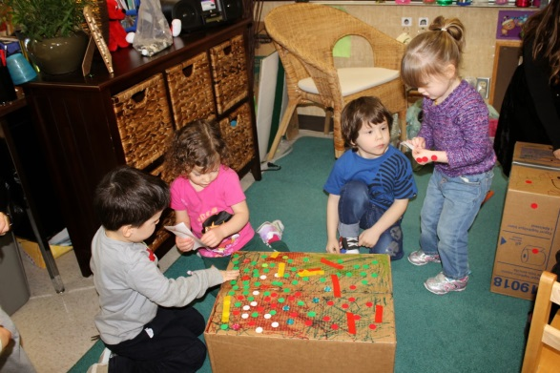
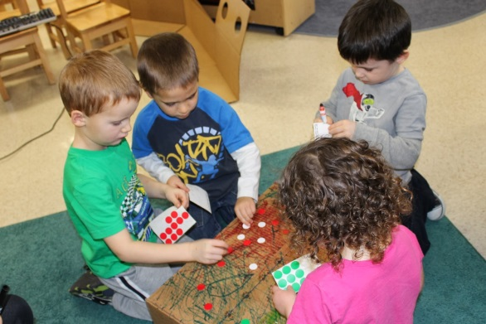
Phase 2: Investigating Construction of our Airplane
Day 2
With cardboard, stickers, markers, tape, wood, and other supplies, the students got hard at work to create the plane they envisioned. Many “buttons” were added with stickers.

Slide 12
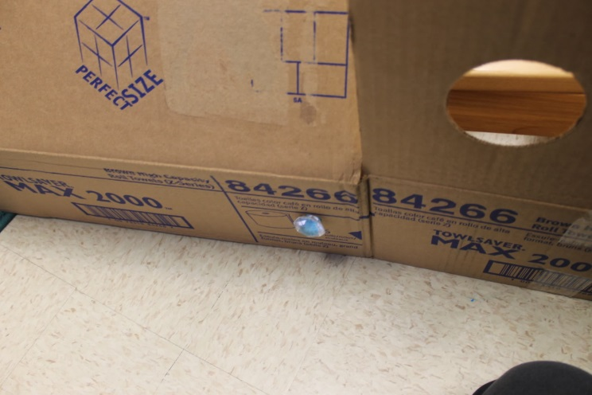
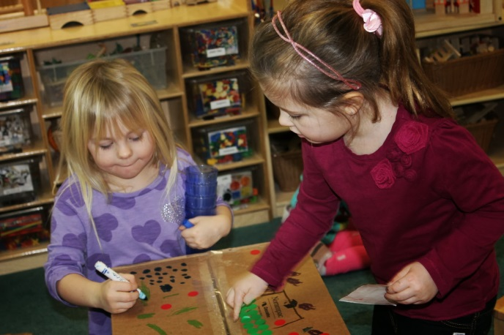
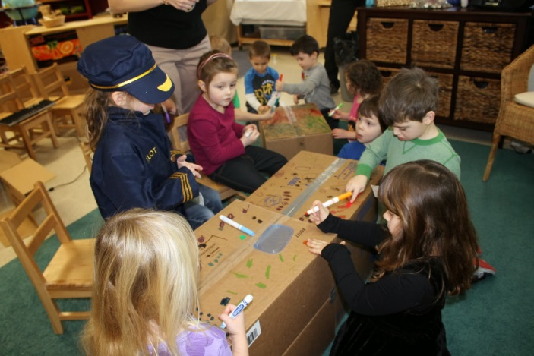
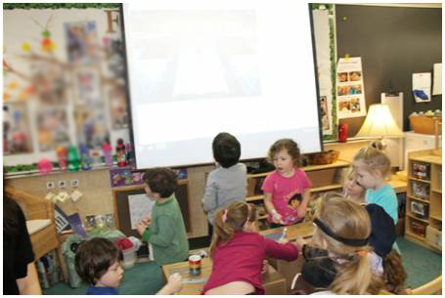
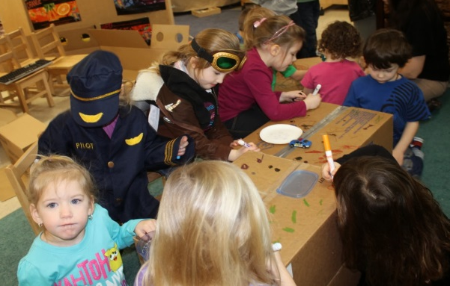
Phase 2: Investigating Construction of our Airplane
Day 2 continued...
A student mentioned that a door was needed for the airplane, so a door was added to the plane wall. Airplane cockpit controls and instruments were added to the boxes. A stick became a gear shift.
DOOR AND WINDOW!
GEAR SHIFT!!!

Slide 13
Our Airplane!!!
A new airplane!
Long cardboard pieces with windows created the side wall of the plane. Computer keyboards were used in the cockpit.
On this particular day, the passengers were distracting the pilots, so Pre-K students set up walls between the crew and passengers!

Slide 14
Phase 2: Investigating Where can an airplane take us?
Pre-K students showed interest in our world map puzzle and the globe. Stories of travels were shared and conversation of places grew. After seeing the Himalayan mountains on a globe, a student commented, “My mom says I'm too little to climb Mt. Everest!"
World maps were studied as the pilots decided on their flight course.

Slide 15
Airplane Play:
Discussion on their perspective of how an airplane takes off and lands were all a part of the fun of playing with the mini airplanes on the globe and on the city play-mat.

Slide 16
Phase 2: Investigating Writing our names
We put out an invitation of official looking tickets, ready for customization, and the students were so excited! Someone got the idea to label their ticket, and all of a sudden there was a focus on creating their own personal tickets. Students rushed to get their name tags to see how to spell their names so that they could put their name on the ticket.
* Nametags and names on tickets are covered up for privacy.

Slide 17
Phase 2: Investigating Airport Security: How do you board an airplane?
Teachers operated airport security and only ticket holders could get onto the plane after they passed security screening.

Slide 18
MORE Airplane Creations!
As the interest in flight continued in our Pre-K classroom, our learning also continued on that topic. The airplane theme showed up during our Family Day activities in February. Some of the students wanted to make smaller cardboard airplanes that they could take home with them! Students enjoyed building airplanes and flying machines out of LEGO.

Slide 19
Phase 2: Investigating Letter matching
We created a travel book. The pilots could choose a destination and type the airport and flight number into their plane keyboard. They worked together to find the letters on the keyboard.

Slide 20
Phase 2: Investigating Paper Airplanes: Symmetry, Measurement
Our Paper Airplane Invitation
We put out a paper airplane invitation. It began with a few students and quickly grew! With the smaller group we focused on how far each plane went using our shoes to measure. This began our discussion about how to make the airplanes go farther.

Slide 21
Phase 2: Investigating Paper Airplanes: How can we make them go faster?
Students shared with each other what worked and didn’t work to help their airplanes fly better.
“If you point it up it flies better.”
“If the nose points down it goes down.”
“Throwing it light helps.”
“If you throw it hard, it goes down and gets broken.”
“It works better with a pointy nose.”
“It needs to look the same on both sides.”

Slide 22
Phase 3: Conclusion Skype with Pilot Paula
Many of our students still had questions about flying and pilots. And the best person to answer those questions is a real pilot! So we contacted Pilot Paula through Skype to learn more about flying and the job of a pilot with Delta Airlines. We had a great morning. She answered many of their unanswered questions!
Pilot Paula has sent us a postcard from her travels since we last talked to her.

Slide 23
Some of our questions and answers:
1.Where is the key for the plane? An airplane actually does not have any keys! There are buttons and thrust levers to start the engine.
2.Where do the pilots sit? They sit at the front of the plane called the cockpit or the flight deck.
3.Where do pilots go after they land? Sometimes they fly to another airport right away. They also go home or to a hotel.
4. What type of schooling is needed to become a pilot? You have to get a lot of different pilot ratings. You can go to university. You have to get a pilot license first and go to flight school.
5.Do pilots take breaks when they are flying? On really long flights they have extra pilots on the flight so they can take breaks.
6.Do pilots eat on the plane? Yes, they do and they usually bring their own food.
7.Do you use a map? How do you know which way you are going? They use paper maps and computer maps. There are roads in the sky called ‘Jetways’ instead of ‘Highways’. They also have air traffic controllers who also help.
8.What kinds of animals have flown on your plane? Cats, dogs and birds
9.What is your official title - Captain, Officer, etc? Co-Pilot or First Officer
10.What is the best part of your job? The beautiful view from the air! The wonderful people you get to meet from all over the world.
We also learned that the stripes on a pilots jacket mean something! Three stripes mean: the co-pilot. Four stripes mean: the Captain/Pilot.

Slide 24
Phase 3: Conclusion Favourite Place to Travel - Class Sharing
We had a special show and tell day where students could share their favourite place to travel. The place could be nearby or far away. Pre-K students enjoyed talking about their favourite place to travel, how they got there, and showed a picture to the group!

Slide 25
Outcomes for Pre-K
Social Emotional Development
Developing a Sense of Others
Interacting with Peers
Resolving Conflict
Developing a Sense of Belonging
Physical Development
Developing Fine Motor Skills
Developing Space and Body Awareness
Spiritual Development
Experiencing a sense of wonder, awe and joy
Experiencing a sense of connectedness and responsibility
Intellectual Development
Solving Problems: Demonstrating curiosity, Exploring, Observing, Understanding Cause & Effect, Anticipating & Participating
Creating and Imagining
Recognizing Attributes & Characteristics
Exploring Numeracy, Time, Position &Direction

Slide 26
Sharing Our Learning
Over the three months that we explored the topic of airplanes, we shared our learning with each other and the Pre-K families. Our questions about airplanes and the list of what we knew about airplanes were displayed in the classroom. The project about our favourite places to travel was put up on the bulletin board so that we could share it with our classroom visitors. Our Pre-K classroom blog showed parents what we were learning and included pictures of our airplane fun , the creativity of the students, and the excitement over the project. We viewed the airplane blog post as a class to reflect on what we had learned. This brought about group discussions, good memories remembering the fun we had, and gave us ideas of where to take the project next in discovery.

Slide 27
Teacher Reflection
This experience was a great way to see how all the pieces we have learned in the past come together. We were able to really see how important good invitations are and how they can help guide learning opportunities for the children. The students really surprised us with how much they wanted to continue in this direction. We were able to involve all the students at times with the many different jobs needed on an airplane. Some students wanted to play at this center everyday, while others came when a new invitation was brought out. It has been great to see how the students have begun to lead their own projects since this one began. They have become so good at using their imagination with our materials and creating new ones for their projects. It has been a wonderful experience for everyone involved!

