Slide 1
An Animal Inquiry Project Pre-Kindergarten

Slide 2
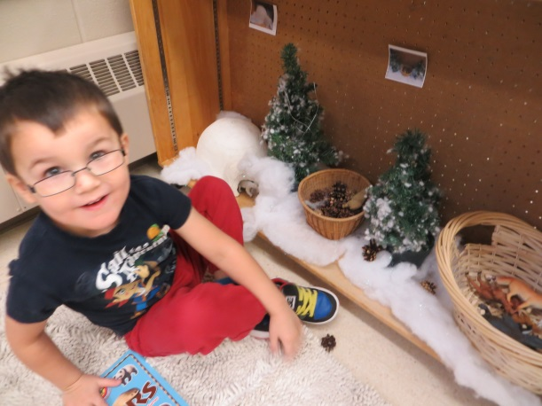
Background Information
This project involved two Pre-K classes; a morning class and an afternoon class. Each class had 16 children ranging in ages from three to five years old. There was a teacher and two associates involved in the project and it spanned out over seven weeks.

Slide 3
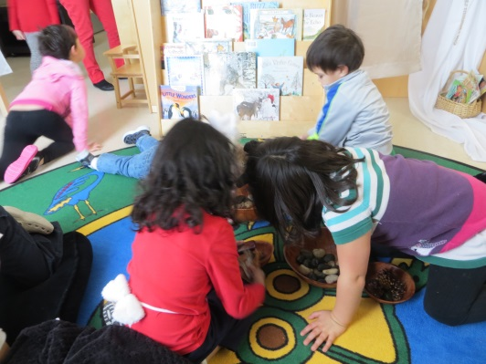
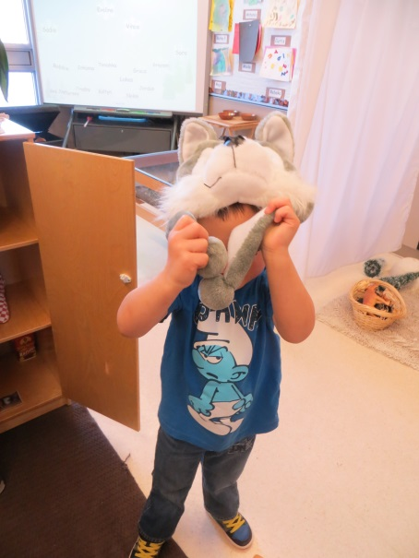
Phase 1: Beginning the Project
We chose to do a project involving animals because the students in both the morning and afternoon classes were VERY interested in animals. They were constantly pretending to be a variety of animals on a daily basis.

Slide 4
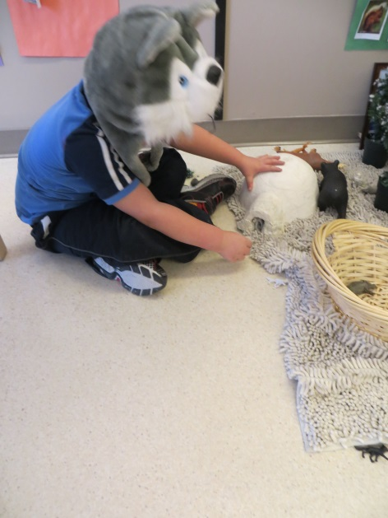
Phase 1: Beginning the Project
To get the students even more intrigued and focused on animals we added a variety of things to our classroom. We added animal costumes to the dress up center, animal figurines to the sensory table, and filled our class library with animal books to spike their interest.

Slide 5
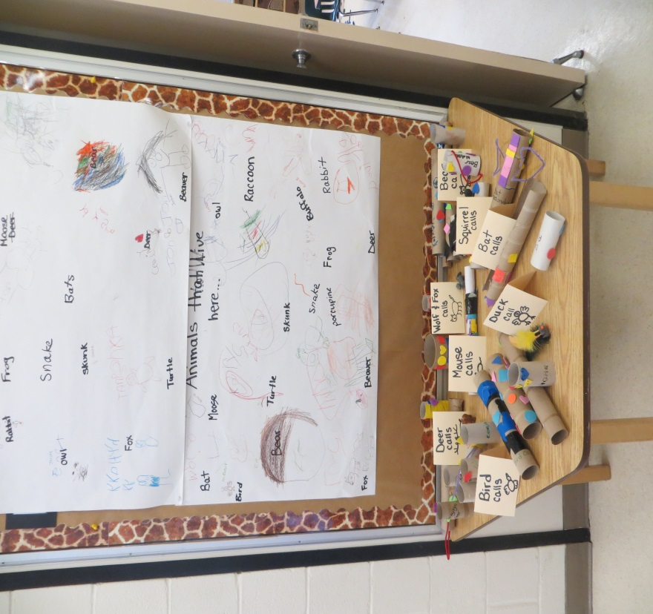
Phase 1: Beginning the Project
In order to narrow the topic, we as a class, decided to focus on wild animals that lived in Canada. Each child represented their beginning knowledge by working as a class to create a list of animals that live here.

Slide 6
Phase 1: Beginning the Project
Wild Animals
These are our questions about animals…
HOMES
Where do they live?
Where do they sleep?
Where do they go in the winter?
What happens to animals that live in the water?
FOOD
What do they eat?
Where do they find food?
APPEARANCE
What do they sound like?
What noises do they make?
What do their tracks look like?
As a class we then formed a list of questions we wanted to learn about animals. We created the question list during our morning/ afternoon meeting and recorded them on our Smartboard. I later grouped them and printed off a list which was posted in our classroom and on the bulletin board in the hallway with our list/drawings of the animals that lived in Canada.

Slide 7
Phase 1: Beginning the Project
This is the teacher web which represents our expectations and ideas for the project.

Slide 8
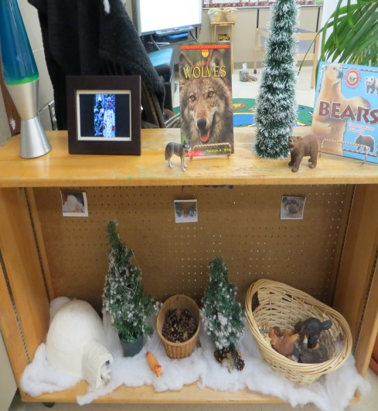
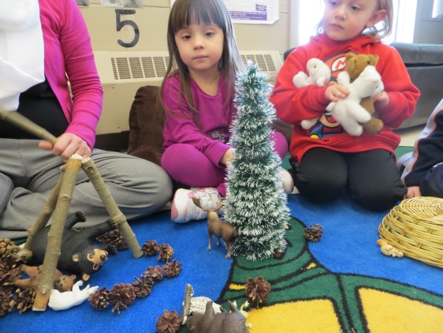
Phase 2: Developing the Project
We broke the project into four main areas and focused on one area at a time. The areas of focus included:
Animal Homes
Animal Sounds
Animal Food
Animal Tracks

Slide 9
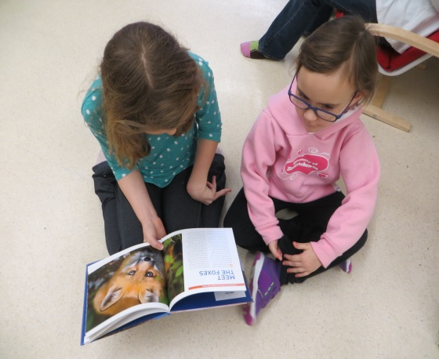
Phase 2: Developing the Project
Animal
Homes
The students started investigating animal homes by talking, reading, and watching videos of animals making their homes. Each child chose an animal to learn more about and our “guardian angels” came and helped the children read books about the animals.

Slide 10
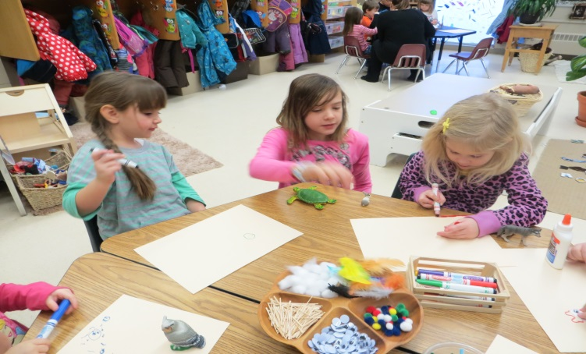
Phase 2: Developing the Project
Animal
Homes
Once they had finished researching their chosen animal the children began drawing a page for our animal book with the help of their “guardian angel.” We proudly displayed our book in the hallway for everyone to see!

Slide 11
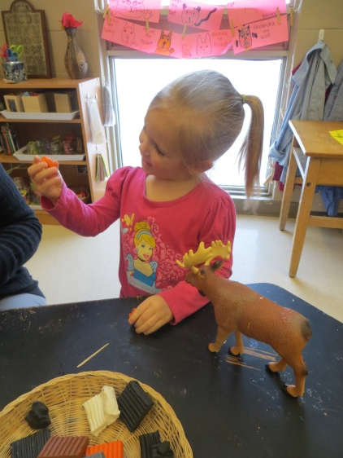
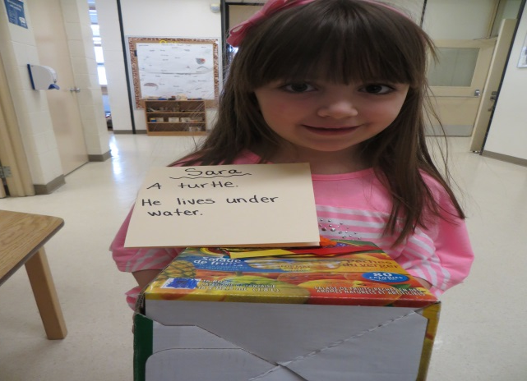
Phase 2: Developing the Project
Animal
Homes
Each child was then given the opportunity to create their animal and its home using clay, recycled items (boxes, cans, toilet paper rolls, etc.) and many other supplies.

Slide 12
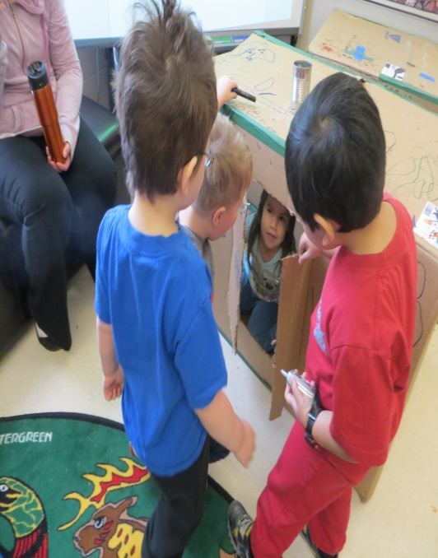
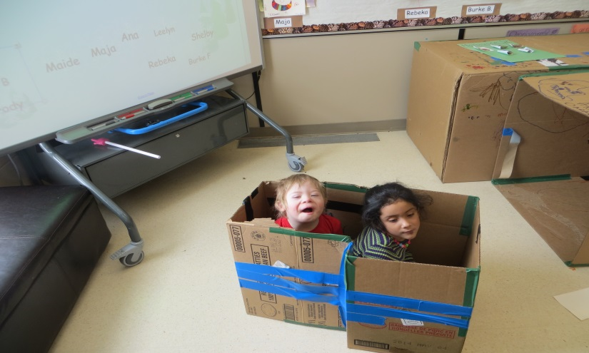
Phase 2: Developing the Project
Animal
Homes
The final representation of the animal homes was done as a class. We brought in large boxes and the students created life size homes for a variety of animals.

Slide 13
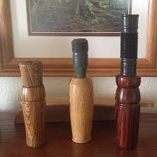
Phase 2: Developing the Project
Animal
Sounds
The students started investigating animal sounds by inviting Tanya’s Family and Michael’s Dad into our class to show us some of the animal calls that they use while hunting.

Slide 14
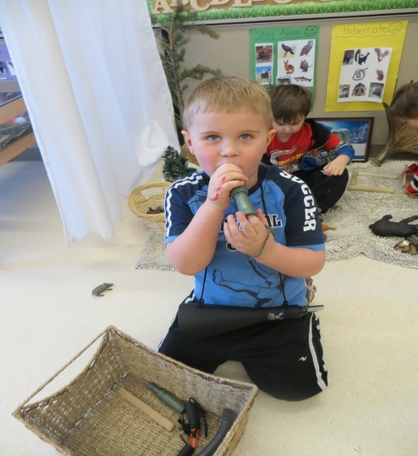
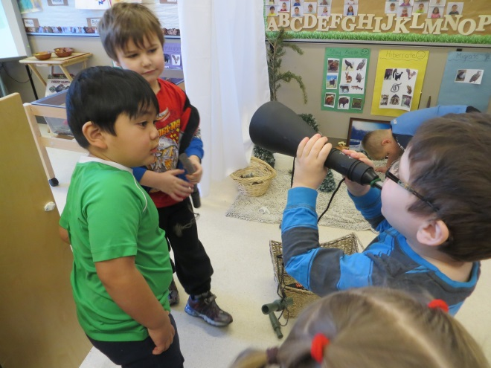
Phase 2: Developing the Project
Animal
Sounds
Next the children began exploring the calls on their own at the animal center. There were a variety of calls such as duck, deer, moose, etc. All were labeled with pictures and words so the students knew what call they were using.

Slide 15
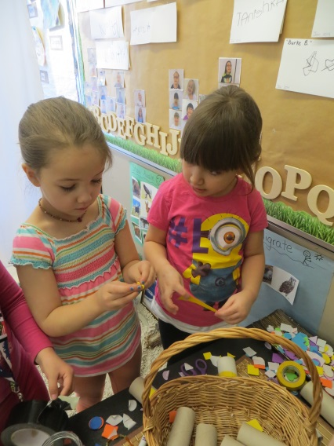
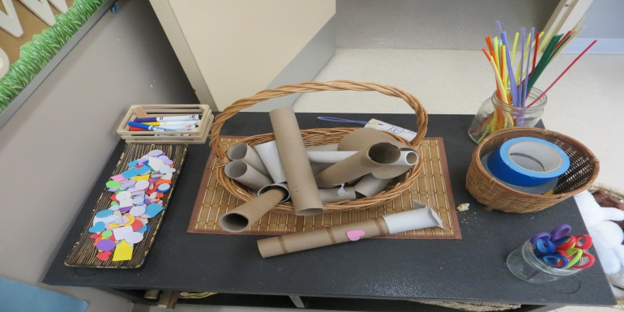
Phase 2: Developing the Project
Animal
Sounds
Once the students had had a chance to explore the real calls on their own they were given the opportunity to represent their learning by making their own animal calls! When they had finished making their call I video taped them showing me how it worked!

Slide 16
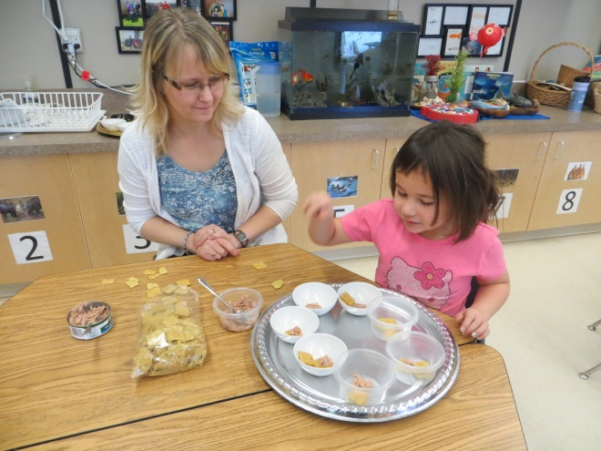
Phase 2: Developing the Project
Animal
Food
We began our investigation into the foods that animals eat by talking about herbivores, carnivores and omnivores. We then prepared snacks that represented each of these categories throughout the week.

Slide 17
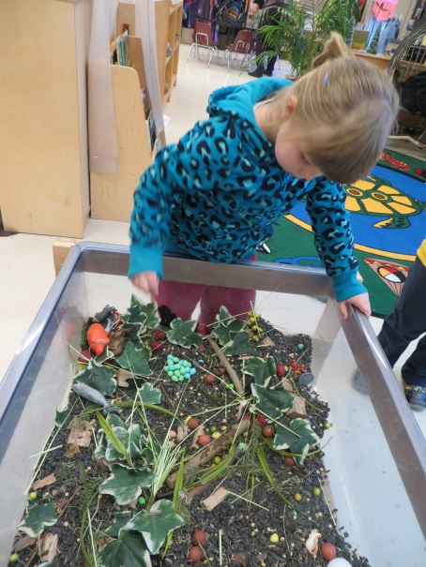
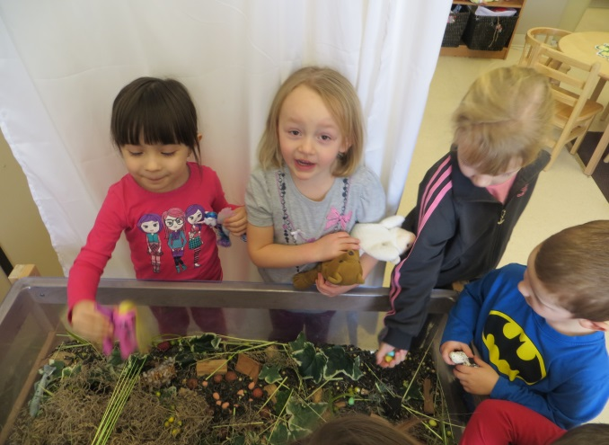
Phase 2: Developing the Project
Animal
Food
Our sensory bin was filled with a variety of fake animal foods for the students to explore. The students fed the animal figurines and their classmates during dramatic play.

Slide 18
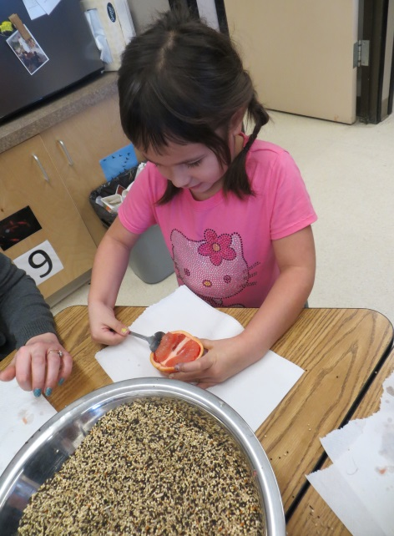
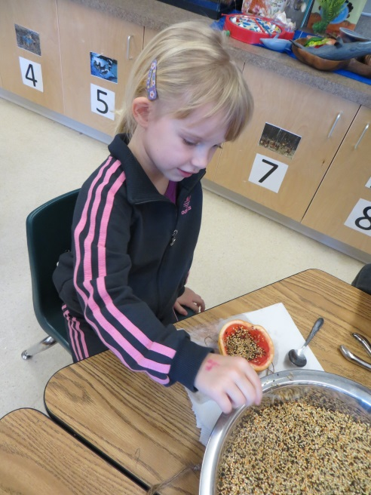
Phase 2: Developing the Project
Animal
Food
The students began asking questions about how animals found food in the winter… So we watched some videos and decided to make bird feeders at our next family night!

Slide 19
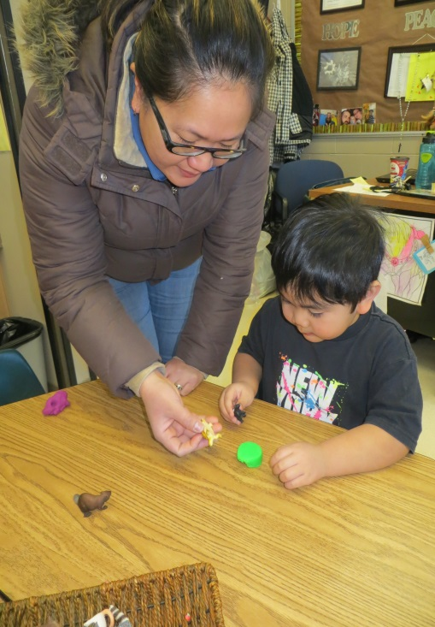
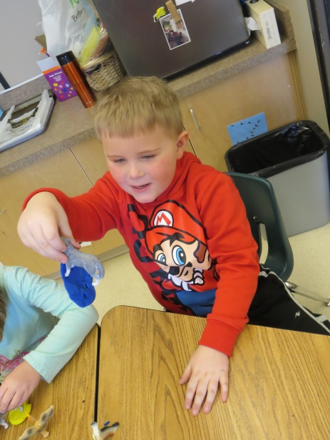
Phase 2: Developing the Project
Animal
Tracks
We started investigating animal tracks by using play dough and our animal figurines to make tracks. We played guessing games and compared the tracks together during our play & exploration time.

Slide 20
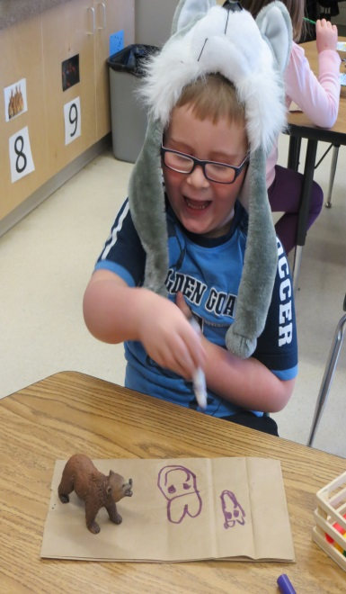
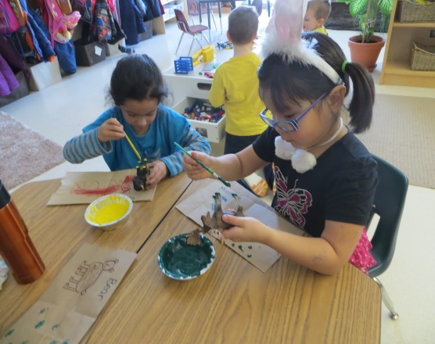
Phase 2: Developing the Project
Animal
Tracks
Once the students had the opportunity to explore animal tracks through the matching game, books, pictures and play dough track making we decided to make our own book of tracks… Students chose an animal(s), drew it, and then painted it’s paws/ feet/ hooves and stamped it on their page for our book. We displayed our books in our class library and in the hallway for everyone to see!

Slide 21
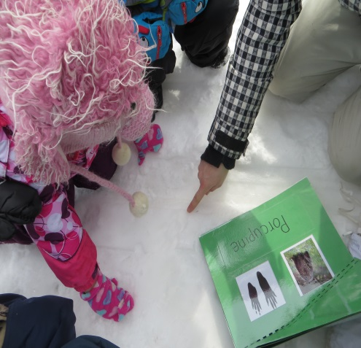
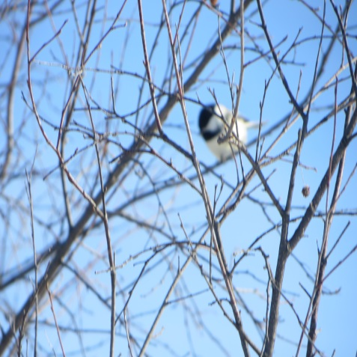
Phase 3: Concluding the Project
Our culminating event was a field trip to Finlayson Island. We went to look for animals, their homes, their tracks, try out our calls (both the ones they made and the real ones) and to fill up the bird feeders to provide the birds with some food. The students really seemed to enjoy the trip and we were lucky enough to see some animals!!

Slide 22
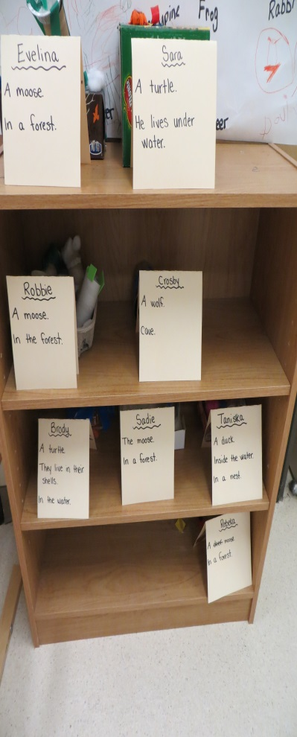
Phase 3: Concluding the Project
We shared the project with our families during our student-led conferences. The students showed their parents:
Their animals and their homes
Their animal calls and their video
How they played in the food sensory bin
Their track books
The photo albums from our field trip

Slide 23
Phase 3: Concluding the Project
Here is a web that outlines what the children learnt from their animal project.

Slide 24
Teacher Reflection
I thought this project went very well. The topic was a good choice because the majority of the students were interested and participated in the project in some way or another.
The most meaningful part for me was the field trip to Finlayson Island because I was surprised at how excited the students were and how much they enjoyed it!! Another meaningful part was when the students presented their project to their families at the student-led conferences. They were so proud and so was I!!!!!!
If I was to do the project again I would try to plan it when the Wildlife Center was open. I tried to book a site visit there but they were closed for the season.

Slide 25
The End

