Slide 1
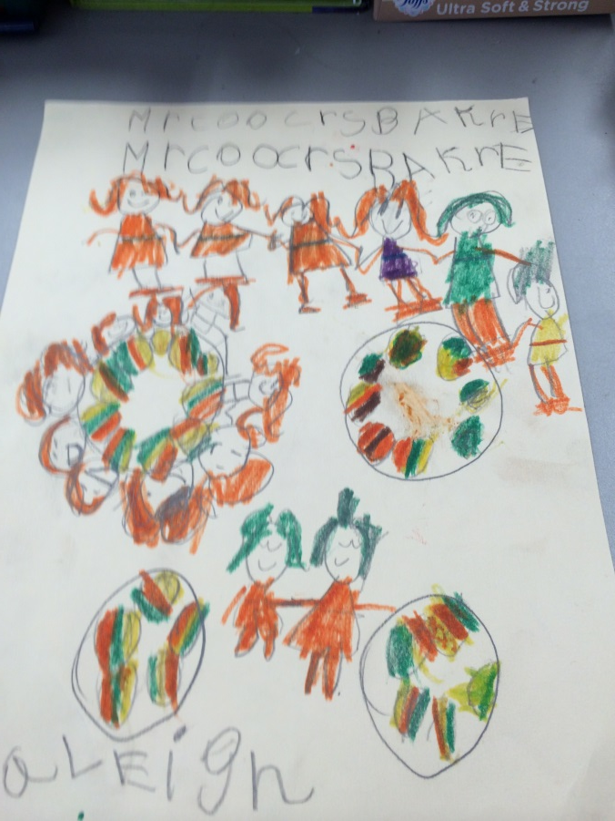
The Bakery Project
Mr coocres bakre
(AKA Mr. Cooker’s Bakery)
Done by: Kerry Price - Kindergarten
2014

Slide 2
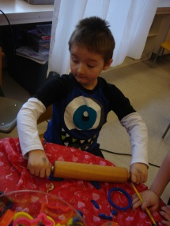
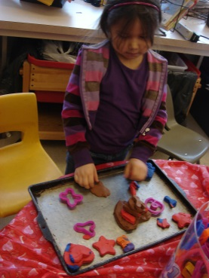
Background Information
The students who took part in the inquiry project are from a full time kindergarten classroom. The class has an enrollment of 20 students, a Teacher and an Educational Associate.
The students had been showing an interest in dramatic play throughout the year. As the year progressed, this interest just continued to develop and they were taking part in dramatic play daily.
The children really enjoyed playing different roles/jobs in a bakery setting and were trying to pretend to cook a variety of different types of muffins and cupcakes that they liked. They also really enjoyed getting into character by dressing up as the baker which really helped develop the character further as the bakers and the customers.

Slide 3
Background Information
I am a first year Kindergarten teacher and was struggling with trying to find ‘the spark’, a topic that the children could study. I needed some guidance so asked Lindsay to come in and model for me. We developed a project based on their interest as most of the children talked about baking different kinds of muffins. I was very happy that this interest was chosen as I love to bake and have a vast amount of knowledge and experience since my Mom had me baking since I was very young. I was very enthusiastic about beginning this Bakery Inquiry Project.
The majority of the children were very enthusiastic and continually preparing different muffins, cookies and cakes for our bakery. They would look at cookbooks and start to write the titles of some of the recipes they would like to include in our bakery as they looked through cookbooks.

Slide 4
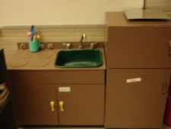
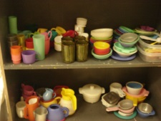
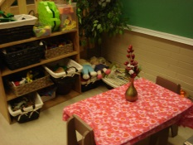
Background Information
I started by rearranging our play kitchen area differently with a separate eating section for the customers. They were so excited when they saw the changes to the kitchen. I brought in some real baking items – cookie sheets, muffin tins, bowls, measuring cups for liquid and dry goods, measuring spoons and dishes.
CPK.2 Explore a variety of drama strategies including: role, imaging, parallel play, journeys, meetings
As the children began working with our new kitchen, I started to ask some questions to find out some background knowledge.
What kinds of basic items would we need to order so that we could begin to do some baking?
Do we have all the tools that we need for our bakery to begin cooking?
My assumption had been that all children bake and cook at home. When I asked the question – How many of you have baked at home with your parents or grandparents? I only had a couple of hands come up so the children had very limited background knowledge on this topic.

Slide 5
Phase I Teacher Planning Web
With the students interested in learning about the bakery, I found that once I created my web, it was quite easy to find a variety of ways to integrate different outcomes and indicators throughout the curriculum to enhance their learning in a variety of subject areas.
Arts Education
CPK.2
CPK.4
The children looked at a variety of photos that represented a bakery. They entered into drama in different roles of those who work in a bakery, and they created representations of their understanding of bakeries using a variety of materials and tools.
Bakery
Went on a site visit to the Co-op bakery to gain some basic background knowledge of a bakery. The children imagined working in a bakery. They created signs, menu boards, found recipes in cookbooks, made their own cookbooks, order forms to stock the bakery and created some money.
ELA
CRK.1, CCK.2, CCK.3. CCK.4
Math
NK.3
SSK.1
Children learned how much a dozen and half a dozen are. Counted to 12. Measured properly with wet and dry ingredients, Worked with pretend money.
Bakery
Cleaned hands, fingernails and equipment. Kept hair out of face. Learned about safety around hot equipment and electrical things. Learned about safe handling of food.
Health
USCK.1 USCK.2
DMK.1
Science
MOK.1
Social
RWK.1
Conducted experiments with yeasts and baking soda to see what makes baking items rise. Talked about what changes occur to the dough after it is baked in a hot oven. Worked together to manage the responsibility within the bakery setting.

Slide 6
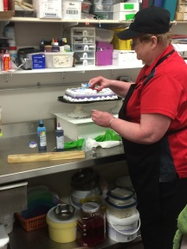
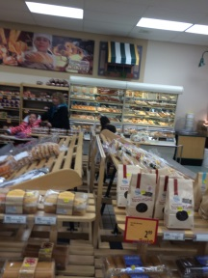
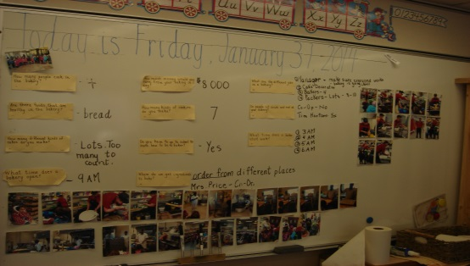
Tour of the Co-op Bakery
Since my students had very limited background knowledge and experience with
baking, I decided that a tour of our local Co-op Bakery would help us gain some
much needed knowledge. Before we went on the tour, we brainstormed and webbed some questions that they would like to ask at the bakery. I recorded each question onto individual pieces of paper and handed the questions out to students who felt confident enough to ask the questions when we were on our tour. When we returned from the tour, we took each question and put them on the board. I wrote the answers that the students’ remembered from the tour beside the questions. We left these questions/answers on the board for future reference and comparisons.

Slide 7
Student Web Students brainstormed ideas which I recorded on the Smart Board for reference in the future.
Jobs
Manager
Cake Decorator
Bakers – 4
Packers
Name
What can we call our bakery?
How do we choose the name?
Recipes
Different foods to serve in a bakery
Signs
Menus/Menuboard (?)
Healthy/Unhealthy food
Safe food handling
Food

Slide 8
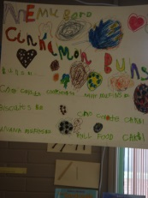
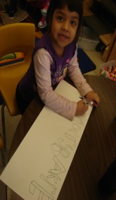
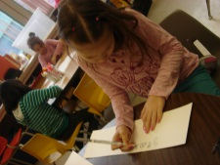
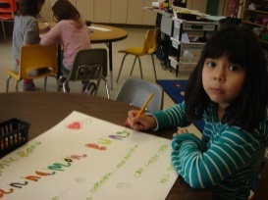
Naming the Bakery
The students decided that the best way to name the restaurant was to come up with a variety of names of the restaurant and vote. We had quite a variety of names and the children finally voted on Mr. Cookers Bakery. We then had a discussion on what an inviting sign would look like – lots of color, some of the different foods that we make and people eating the food, people happy at the restaurant and nice bright colors to attract the customers’ attention. As part of the web, we discussed some of the different foods that we would like to bake in our bakery. This sparked the children into designing different signs, menu boards and looking through cookbooks to start to find recipes for items they would like to bake. We looked at menu boards and signs for bakeries on the internet to give us an idea of where to start . As we were setting up our bakery, we talked about some of the bakeries that we have in our community. We decided that our bakery was the most like a Tim Horton’s bakery because our bakery had a separate eating area for our customers.
CPK.4 Create art works that express own observations and ideas about the world.
CCK.4 Create messages using a combination of pictures, symbols, and letters.

Slide 9
Healthy vs. Unhealthy Foods
After we had brainstormed some of the items we had seen on the bakery tour, we categorized these foods into healthy and unhealthy foods. This then sparked the conversation as to what made a food healthy and unhealthy and what some of the results of eating a diet consisting mainly of unhealthy foods.
Your teeth could develop sugar bugs
You could develop a tummy ache if you ate too much
You could get sick because your body isn’t healthy
USCK.1 Develop basic habits to establish healthy relationships with self, others, and the environment. DMK.1 Establish that being curious about health and well-being is important for developing healthy habits, establishing healthy relationships, supporting safety, and exploring “self”.

Slide 10
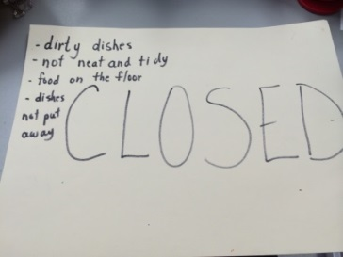
Phase 2 Let the Baking Begin!!
Before the baking could begin, we discussed some of the safety issues and concerns that are present in a real bakery
Keeping hair out of the food
Keeping our baking area clean
Cleaning our hands and fingernails
The use of electrical appliances
Being safe around a hot oven.
As the children were playing and role playing the bakery setting, I kept trying to reinforce the ideas of keeping their bakery clean and following the guidelines. I had put up pictures of how to put the bakery back in order so if they looked at the picture, it was easy to follow and leave the area neat and clean. Finally, one day, they had left the bakery in a disgusting mess so the “health inspector” came in, overnight, and closed the bakery. They were unable to reopen the bakery until they met all the terms stated on the closure sign.
USCK.2
Establish behaviours that support safety of self and others (including safety at school and at home).
CCK.3
Use oral language to converse, engage in play, express ideas, and share personal experiences.

Slide 11
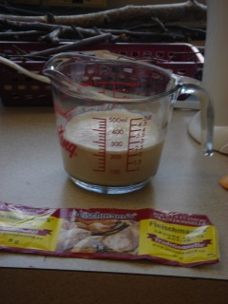
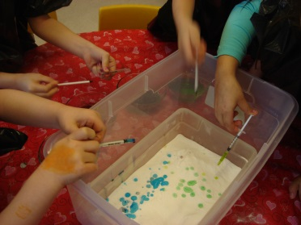
Let the Baking Begin!!!
Our healthy vs unhealthy baking sparked a discussion about where to begin experimenting with our baking. We decided that in order to sell food at our bakery, we would have to try different recipes and taste test our baking to decide if it was worthy of selling. We decided to begin with making whole wheat buns and banana blueberry muffins. Some of the issues that I was presented with was being able to document with photos what we were doing and the experiences that we were having while still remaining safe during mixing and baking. We decided that our best taste testers would be our friends from the other Kindergarten class. We did some science experiments with yeast and baking soda to discover what makes bread and cakes/cookies/muffins, etc. rise. We also discussed and documented some of the changes that took place when we mixed and added heat to the ingredients.
MOK.1
Investigate observable characteristics of familiar objects and materials in their environment. [SI]

Slide 12
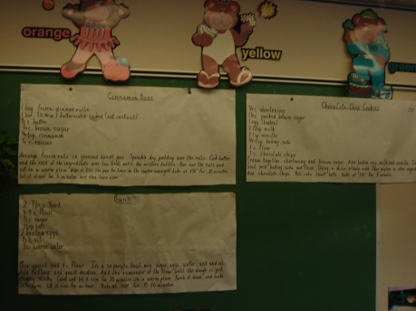
Documentation of recipes
I wrote the recipes out on chart paper so that it was easy for us to follow the directions and so that so that customers could see the ingredients we used. This helped the students to find the names of our products when they were writing down recipes and menus. As we were doing this the children came up with a brain wave. They wanted to make a cookbook from all the recipes that we used so that they could have these recipes at home and bake with their families. Another student said that some restaurants and bakeries have their cookbooks for sale at the bakery so we could put the cookbook out on the counter for sale. As we were cooking, we would go back to our questions/answers on the board.

Slide 13
A cookie – WHAT?! Did you say sale?
As our baking project proceeded, the students throughout the school would be walking by and asking what we were making because it smelled SO good. I had some older students ask if they could come to my class because we always get to do such fun things. Obviously our baking was getting noticed. The chocolate chips cookies, of course, were the biggest hit throughout the school and one of the older students told us we should make cookies and sell them. Well, that was all the students needed to hear and the topic of a cookie sale took off.

Slide 14
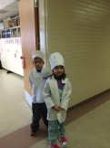
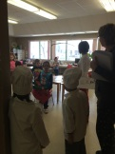
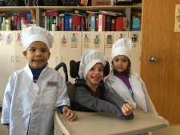
Organizing a Whole School Cookie Sale
We sat down and brainstormed and discussed all the things that would need to be done in order to have this bake sale. Instantly the students realized that a manager would have to be appointed to make sure that everything was done and running smoothly. I was voted as the mostly likely to succeed. The starting point was to decide what kind of cookie we wanted to make. Some of the children decided that the children in the school kept commenting about our chocolate chip cookies and all the students in our class decided that they loved them as well. There really wasn’t a voting session as it was unanimous that we sell chocolate chip cookies. Then we had to decide on how much we wanted to sell our cookies for. The typical response was, “For a hundred”. My response was, “ A hundred what?” We talked about how you could go to a store and a bakery and buy a whole bag of cookies for less than $5 so we finally voted and agreed on $.50 per cookie.

Slide 15
The Cookie Sale
We decided that we needed to set a date and send out notes with a due date on it for the sale. We talked about what might entice the customers from our school to want to take the cookie order sheets home and buy the cookies. We decided that while we were dropping off cookies, some of the bakers would get dressed up in the bakery outfits and would explain to each class what was going on. We also highlighted a specific date to return orders and money.

Slide 16
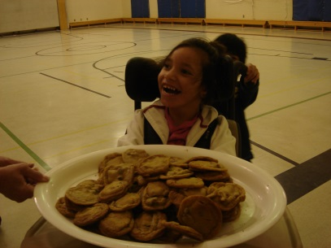
Decision Making
Since this was my first attempt at a project, I believe that my thoughtful principal was feeling sorry for me and bought many packages of the prepackaged cookies so we just had to cut, place on a cookie sheet and bake.
I have to admit, this idea did sound enticing but then I thought, “Would the overall experience be authentic working in a bakery?” There would be many skills such as counting, measuring accurately (dry and wet ingredients), working as a team and putting the effort in that would be lost so I decided that we needed this experience of working together so we did not do the cut and bake cookies.

Slide 17
Decision Making
We were taking in orders, learning how to organize and order our supplies to accommodate the cookies orders and making a list of utensils that we would be needing. Since we had done some baking, as a group, already, they had a much better idea of the basics food items and baking utensils that we would need. I made the recipe bigger and we went through the recipe to make sure that I had all the ingredients listed and was ready to order once we knew the final tally amount. I also wanted all the children to experience as many aspects of life in the bakery as possible.

Slide 18
Tallying cookie orders and organizing supplies
I requested that all orders and money be in by Tuesday, February 4 by no later than noon to give us time to talk and organize what we would need for baking the next day.
At the end of Monday, I had approximately 100 cookies to bake so felt this was a perfect baking experience. By the time noon arrived on Tuesday, we now had to bake over 500 cookies and have them done, packed and ready to be delivered on Friday. I was starting to think that perhaps I had overdone things, just a bit, to cook that many cookies with 20 Kindergarten students. After we learned our numbers, we sat and discussed how many dozen cookies we would need as we had been talking about a dozen.
As it turned out we needed 42 dozen cookies to fill our orders. I am not sure they truly understood how many cookies we were making other than it was A LOT of cookies. They were about to find out how many that was.
NK.3
Relate a numeral, 0 to 10, to its respective quantity. [C, R, V]

Slide 19
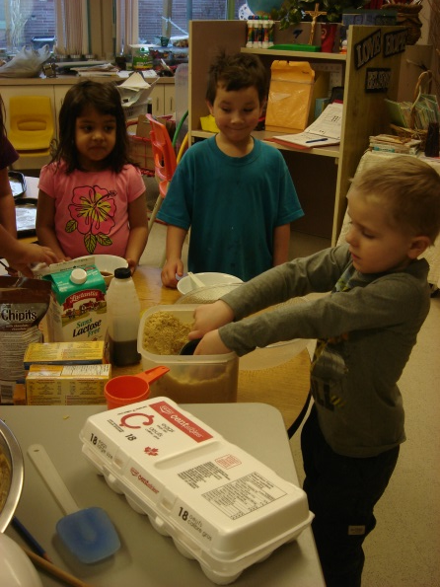
MrCoocrsBakre in full force
I have to admit that the idea of having to bake over 500 cookies with 4 and 5 year olds seemed a bit much so I decided that I would organize this baking center like a station. I would allow five people from the team to come and work with me on a batch of cookies at a time so that we actually did accomplish work and so that they all had an opportunity for hands on experiences. I taught them the difference between liquid and dry measuring items, the importance of being careful of working with electrical appliances and handling food safely as we were selling to the general public.
SSK.1
Use direct comparison to compare two objects based on a single attribute, such as:
length including height
mass
volume
capacity.

Slide 20
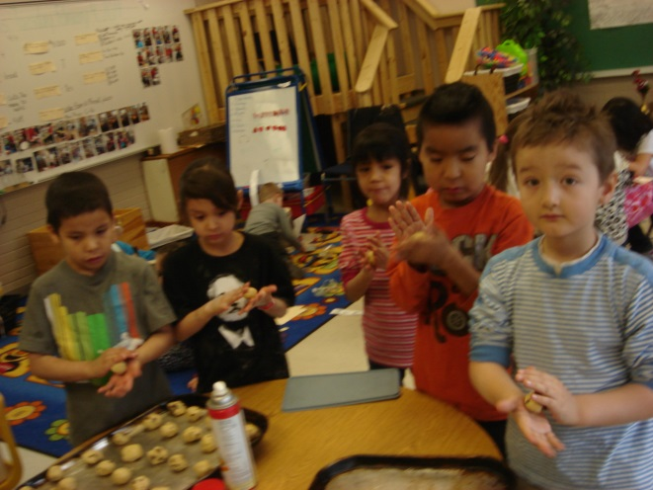
Teamwork, Patience and Independence
We talked a lot about how I could only work with a group of five
students and how I realized that everyone wanted an opportunity
to be a part of the baking process. With over 500 cookies to be
made, there were no difficulties keeping everyone involved.
Those who were not baking, worked on invitations and centers that
I provided for them. I was impressed with their independence and
willingness to let others take a turn.
RWK.1
Examine ways of managing tasks and resources in families and schools.
I had been worried about the length of time it would
Take to make 500 cookies but we worked well as a team
And managed to make all those cookies in one day.

Slide 21
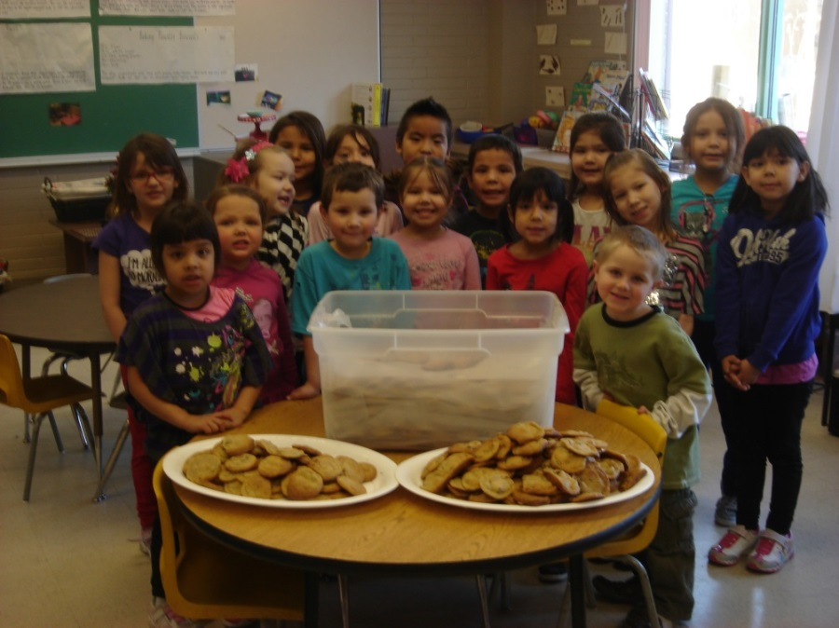
How much is 500?
When we began the baking project, the children really did not have a real idea of how much 500 was. All they really knew was that it was a big number. When we brought in all the cookies to bag and pack, they were in shock!!!!!! My students and other students in the school were shocked by this number and how this number looked when put together!!!

Slide 22
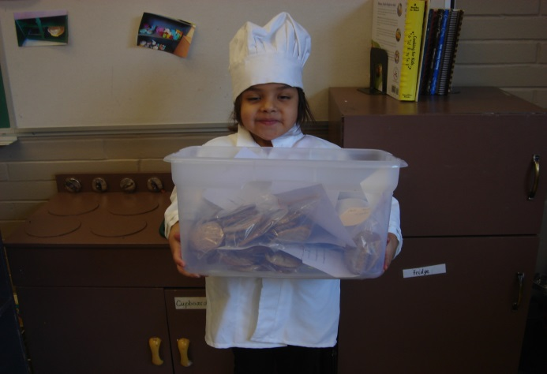
Packing and delivering our product
NK.3
Relate a numeral, 0 to 10, to its respective quantity. [C, R, V]
The fun began with working in small groups, again, and having every child take part in packing the cookie bags. This went very well as those who were confident counting higher could do the big orders and those who weren’t so skilled or confident, could do the smaller orders. We again decided to add our own little touch and have one of the students dress as the baker and hand deliver the cookies to each classroom.

Slide 23
What to do with the money?
We are a Catholic school so have been learning a lot about Lent and how other families and children in other parts of the world don’t have proper clothes, good clean water, food, a place to live, etc. As a class, we decided that we would take our proceeds – approximately $250 – and donate it to Share Lent through our school parish.

Slide 24
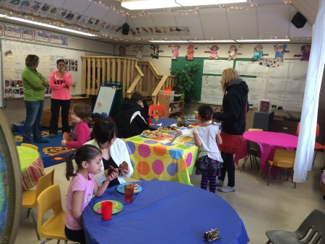
Celebrate with our families
When I initially sent out the letters to inform the parents that we were learning about a bakery, I asked if any parents had any skills or special recipes they would like to come in and bake with the children; unfortunately, I didn’t have any parents respond to this.
Lindsay suggested talking with the students to see if they were interested in having a mug and muffin morning with our families and we would do the baking. We went through our list of items and talked about which of our items would be considered to be a breakfast item and the children chose biscuits and banana blueberry muffins.
Again, we got busy baking for our parents. This really excited the children. In the midst of planning our muffin morning, one of the children became quite concerned about how they were going to bake our recipes with their parents and so another child suggested that we make cookbooks to give to our parents when they came.
The recipes I chose were easy healthy recipes and even included frostings for a boxed chocolate cake and angel food cake. They were designed for success! So …we made cookbooks. We decorated the room to make it as inviting as possible.

Slide 25
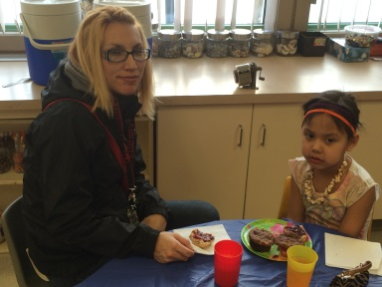
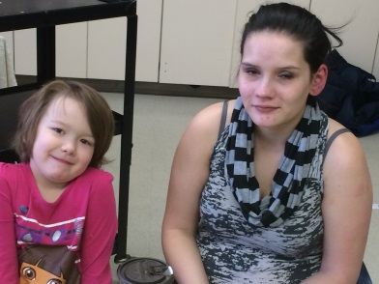
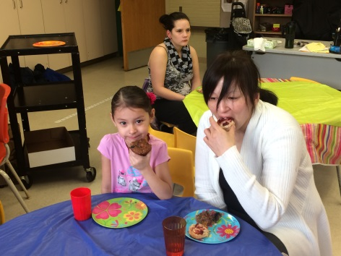
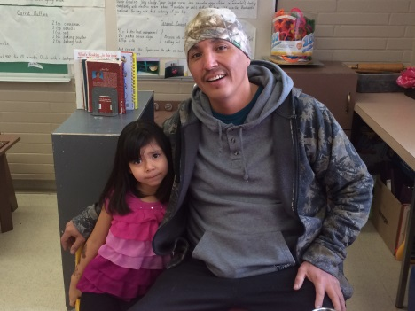
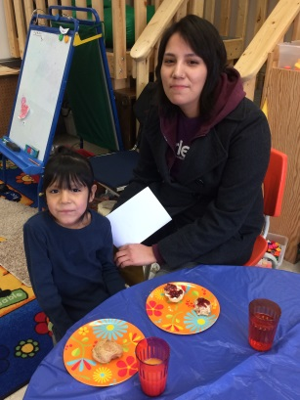
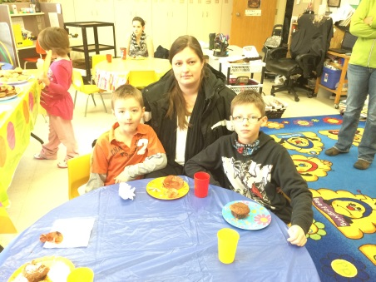
Celebrate
I sent out notes requesting that if the parents were coming to please let me know numbers so we could cook accordingly. I also sent out reminders. We only ended up with six families who were able to come; those that did show were very impressed. I had a lot of positive comments about the project at Student Led Conferences.

Slide 26
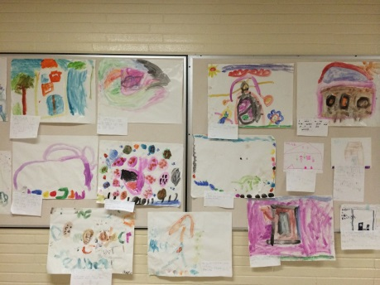
Show me your learning
CCK.2
Use and construct symbols, pictures, and dramatizations to communicate feelings and ideas in a variety of ways.
CCK.4
Create messages using a combination of pictures, symbols, and letters.
Throughout the project, we continually went back and reviewed the student web, our tour to the Co-op bakery and our own bakery. As the students were preparing to show me their learning, we reviewed the web for the very last time. One of my little girls said, “We have talked about how our bakery is set up more like Tim Hortons rather than the Co-op but we missed something important. Our bakery is like the Co-op because we open at 9 and close after school is done. Tim Horton’s stays open all night.”
It was interesting that the students were still looking at and doing their own comparisons.
I put a variety of items on the back counter – plasticine, paints, different colors of paper, ribbons, buttons, yarn, scissors, glue, different materials, etc. and talked about how they would show me what they learned and then write me a sentence to go with their representation

Slide 27
Reflection
I was concerned that the length of my project (six weeks) would find the children tiring from baking as I was gone on a trip for our second last week. When I returned from the trip and they started to plan and bake for the muffin morning, the enthusiasm was still thriving!!!! Everyone was still on board. I struggled a bit with trying to document, have conversations and take pictures while also keeping the students safe, engaged, and getting the baking done. I think that in retrospect, I think I would have tried to use video more to help with some of the documentation. I would definitely love to do the project again as I felt that the students were extremely successful and I felt successful and confident at the end of the project, as well. One of the nicest compliments to the project was on the Monday following us closing the project and moving on to other projects, one of the parents took our recipe book and decided to bake with her child for the first time. They brought their baking to the class to show and share with everyone and the student was so proud of what she had done! To me, that is SUCCESS!!!!

