Slide 3
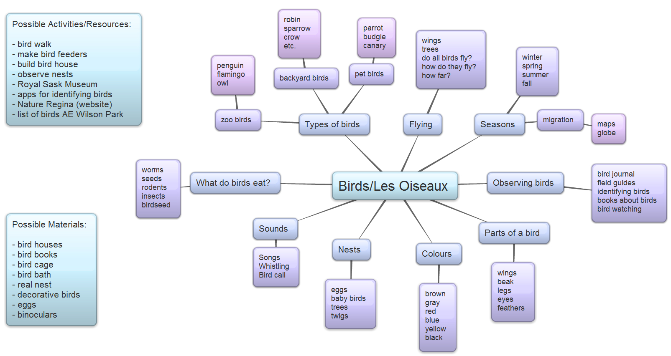

Slide 26
Teacher Reflection
The bird project lasted three months and was so rewarding. It was great to have a topic that allowed us to explore outdoors when the weather permitted.
Students were very engaged and interested in the topic. Each day, we would allow time for the students to share with us the birds that they had seen the day before. Even students with limited language were excited to tell us about the birds they saw.
One of the most exciting parts of the project was the wonderful family engagement. Parents shared resources, photos, videos and stories of birds. There was a real connection between the home and school during the project. Everyone knew that we were learning about birds!

