Slide 1
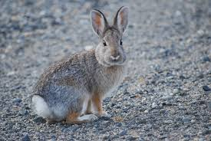
The Bunny Project!
Submitted by: Marcella East and
Lacey Follensbee

Slide 2
Information
The children who participated in the bunny project were between two and 10 years of age. The children range from drop in, part time and full time hours of participation. The staff participating in the project were Marcella, Lacey, Robyn, and Kassi.

Slide 3
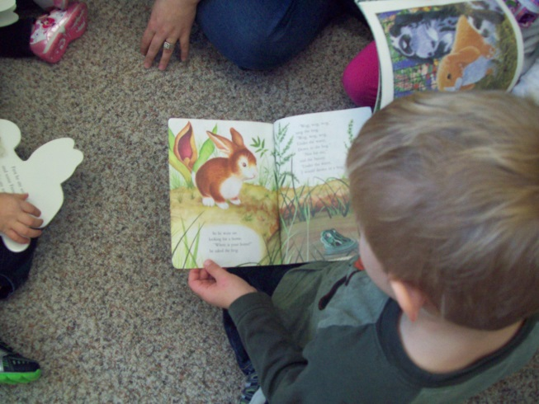
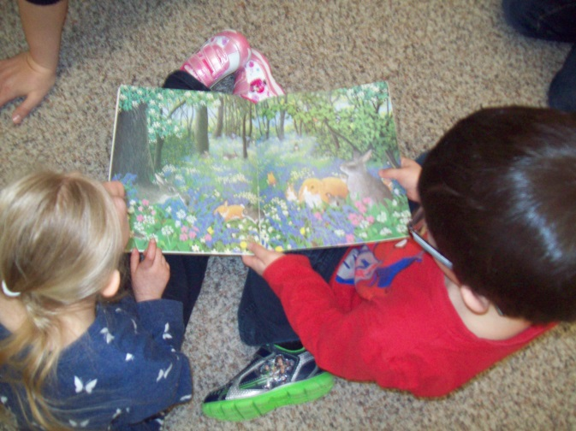
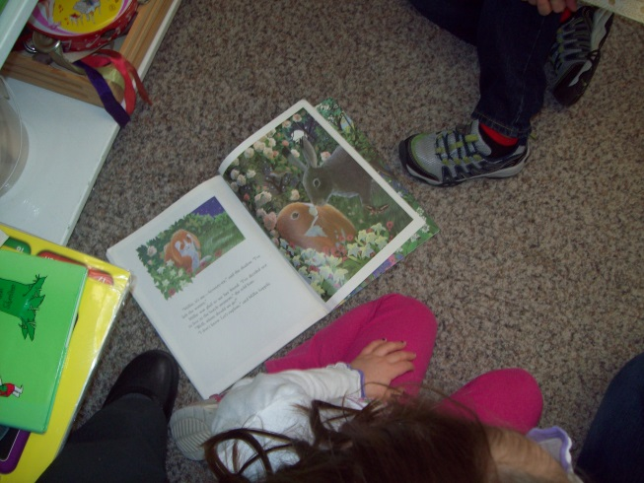
The project began after Lacey started reading books for our Spring unit to the children. One book talked about a little bunny rabbit and the children began to ask many questions about bunny rabbits. Lacey asked the children if this was something they wanted to learn more about. They were very excited to get started!

Slide 4
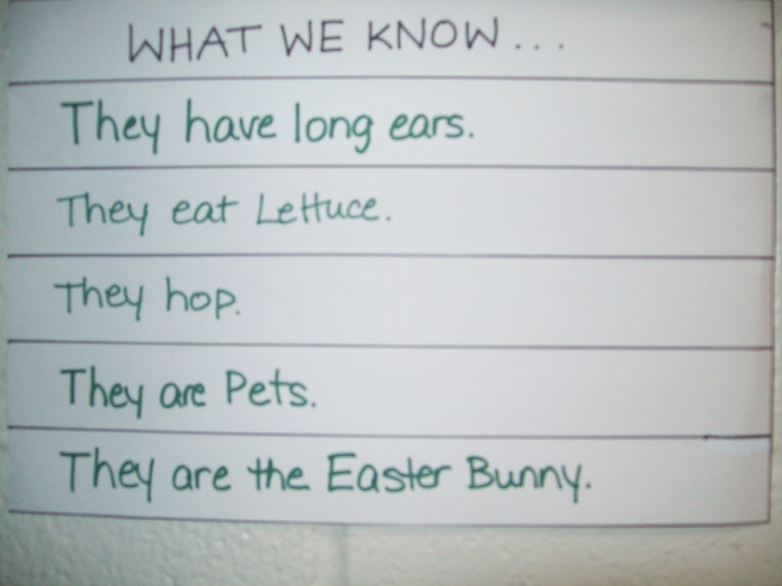
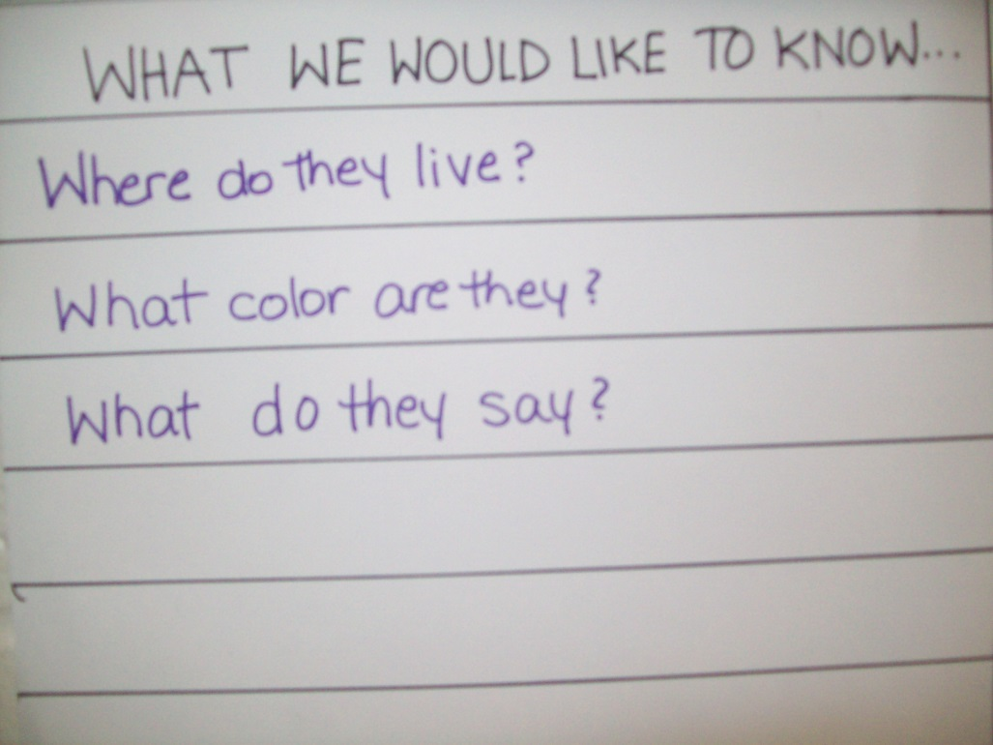
We created a project web and began gathering information!

Slide 5
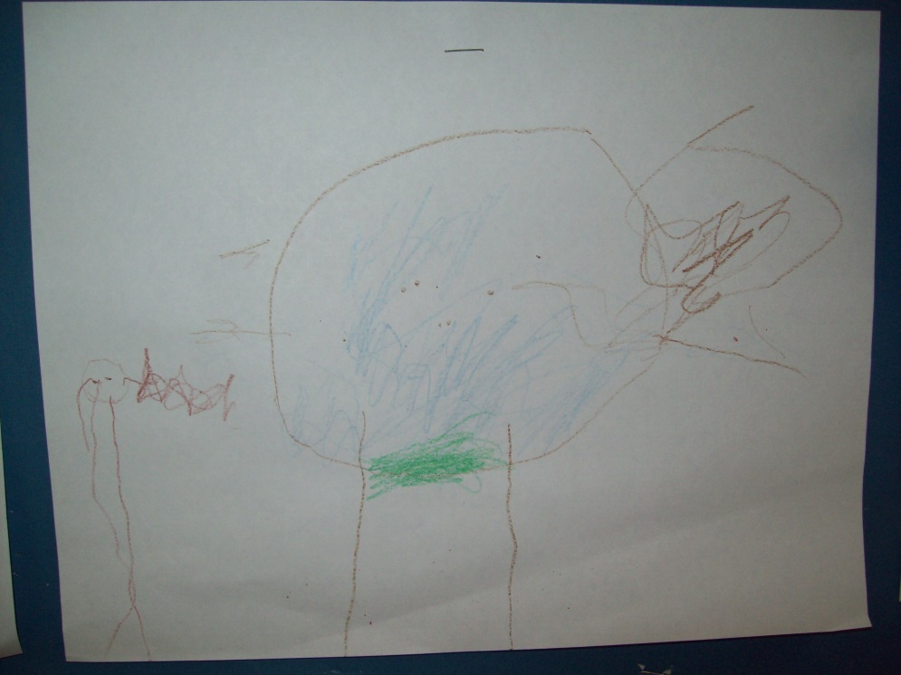
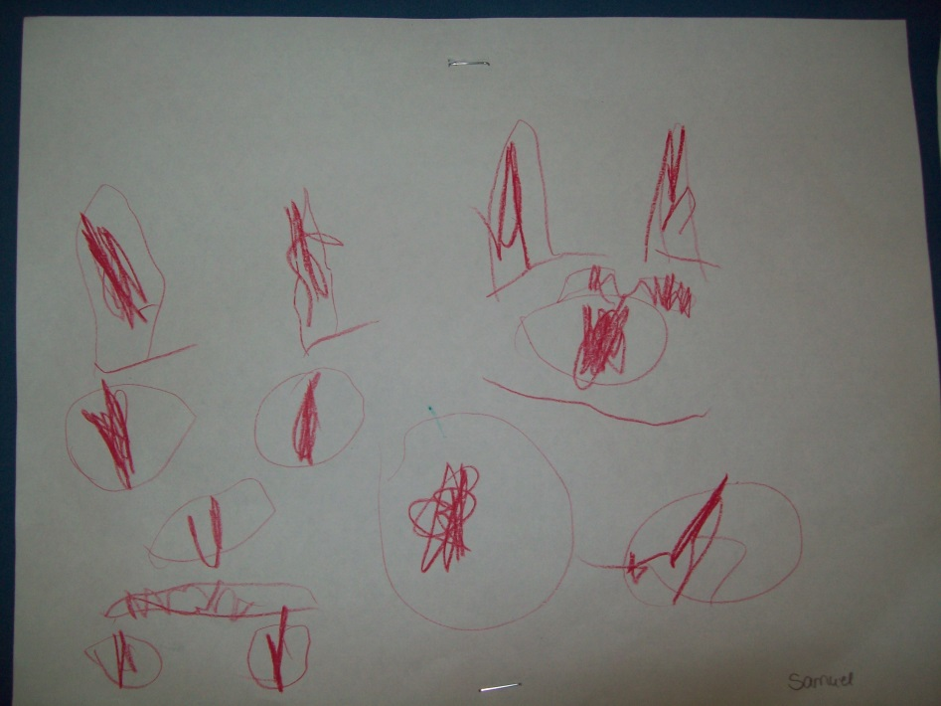
Initial representations of rabbits

Slide 6
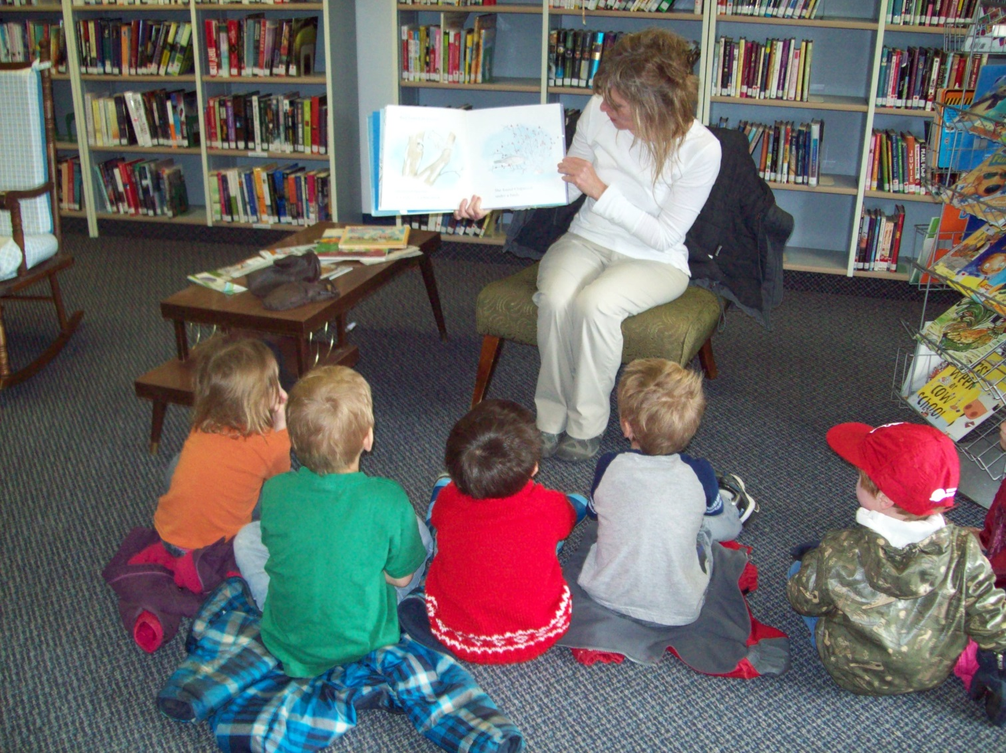
Library Visit

Slide 7
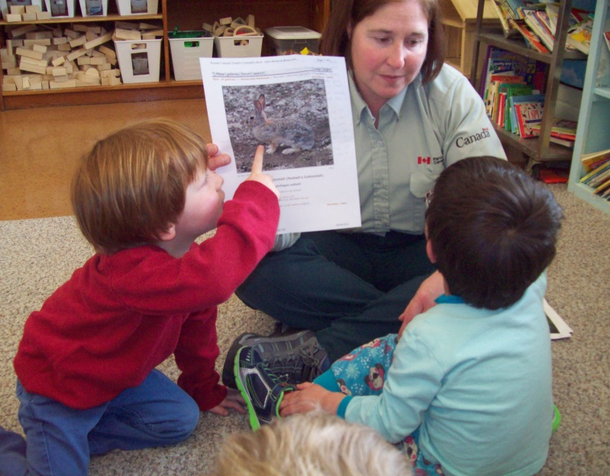
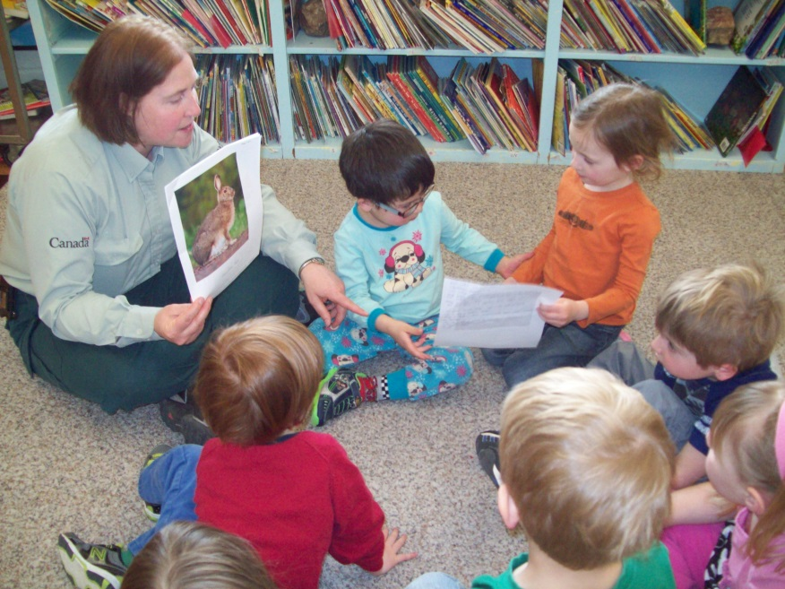
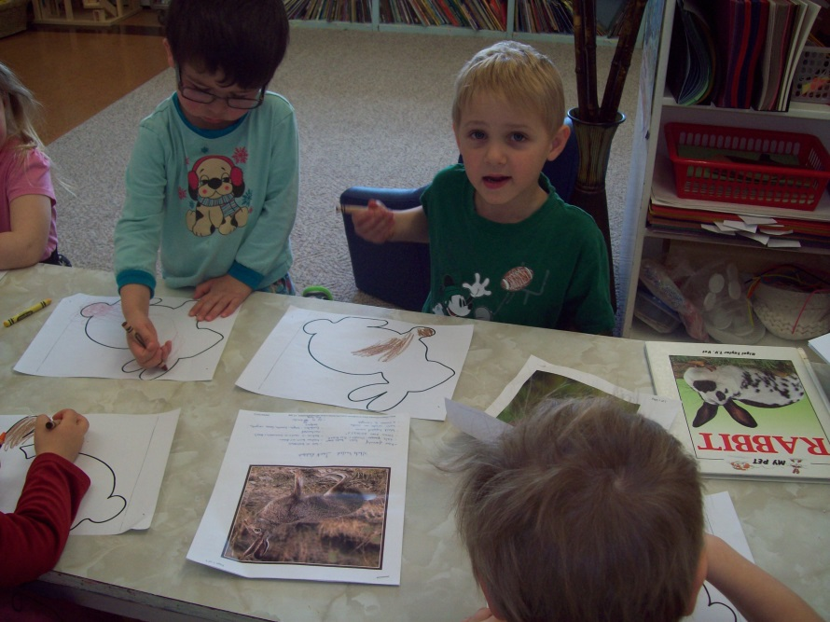
Visiting Expert
Laura James from Grasslands National Park Canada

Slide 8
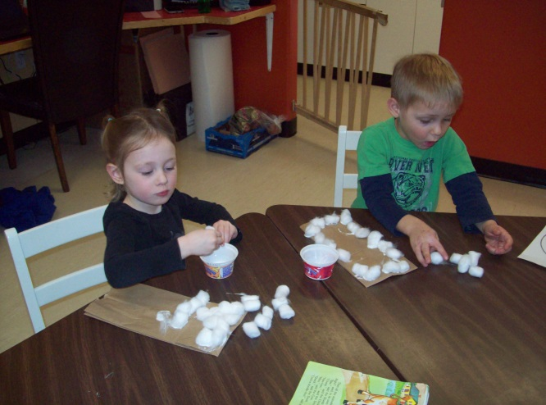
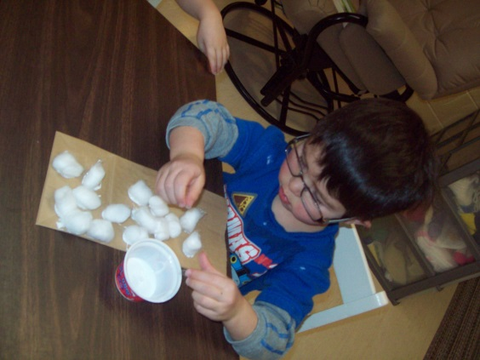
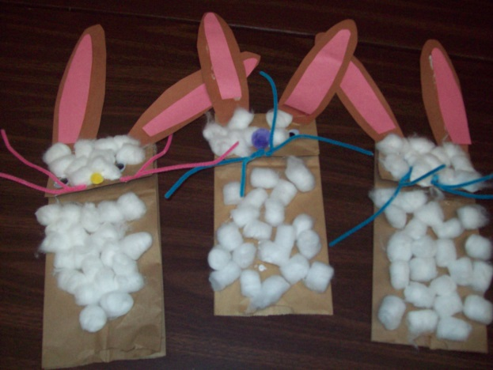
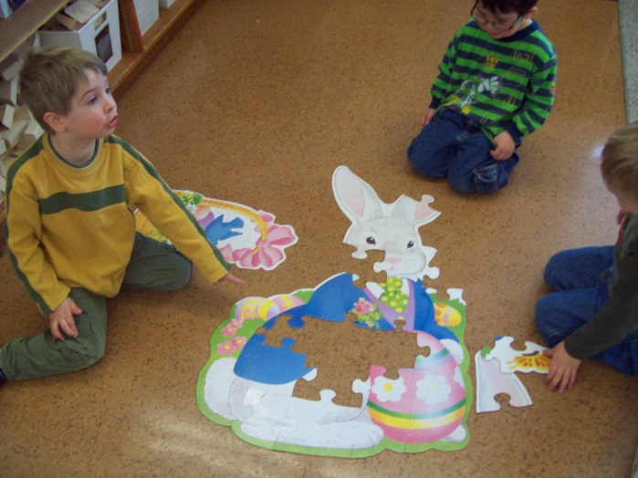
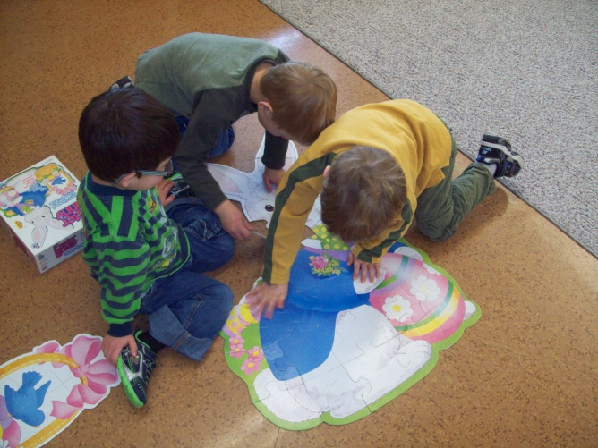
Bunny Project Activities
We got sticky while working on our fine motor skills gluing cotton balls on puppets!
We used our problem solving and teamwork skills to build a giant bunny puzzle!

Slide 9
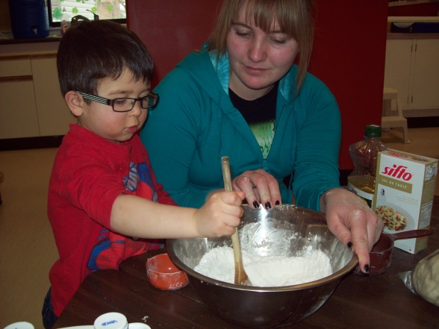
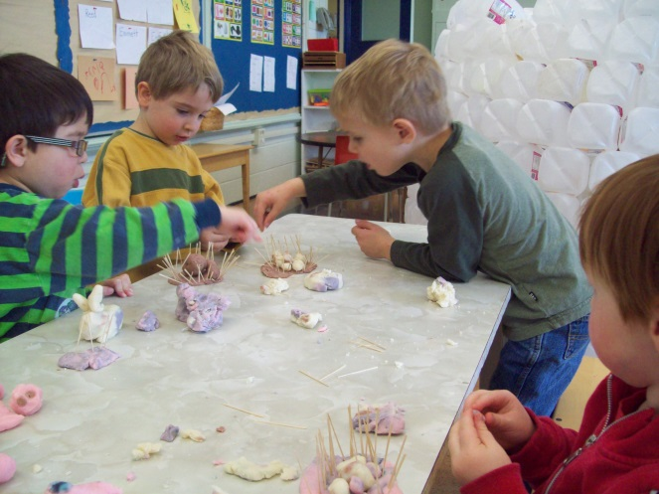
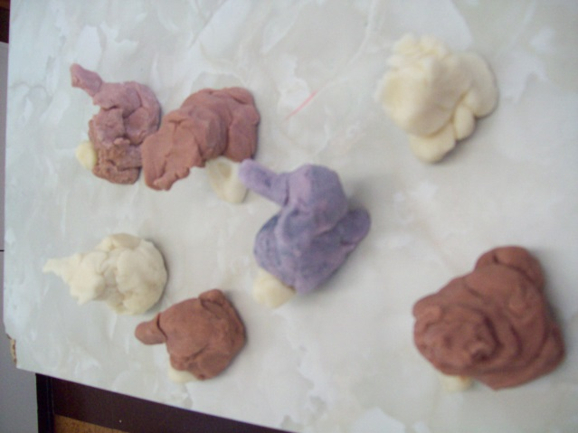
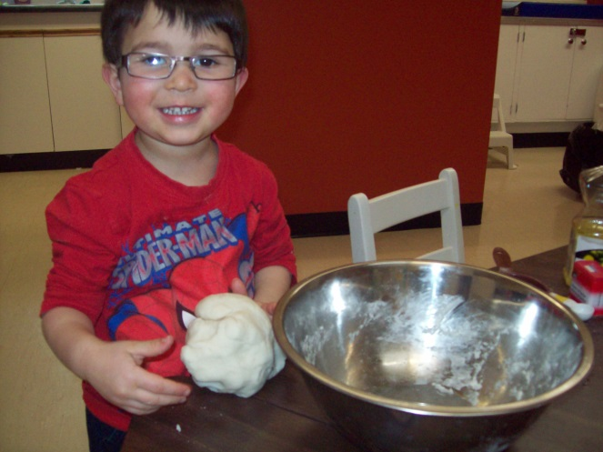
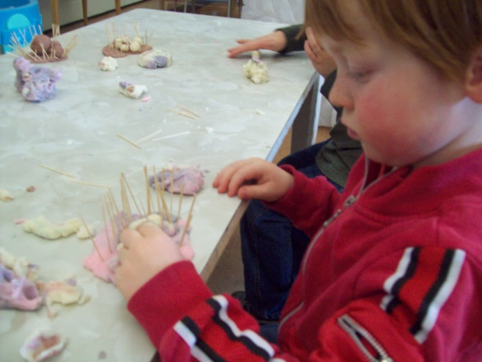
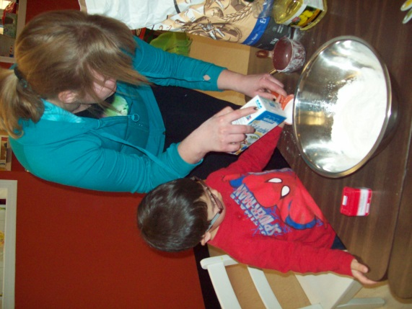
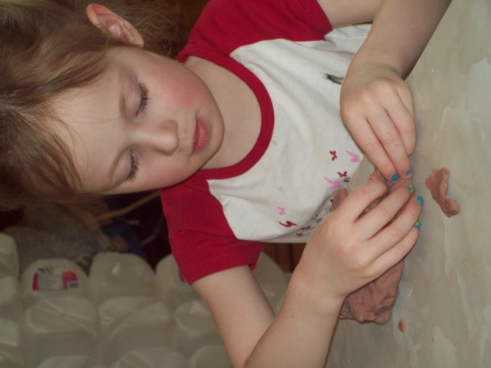
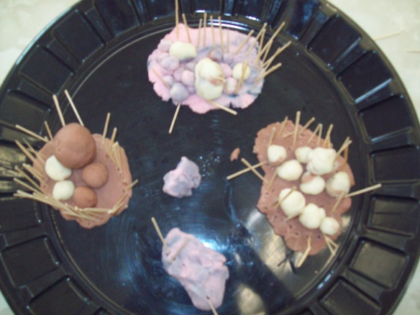
Clay Bunnies and Bunny Hutches
Measuring, pouring and stirring
Sensory and fine motor skills

Slide 10
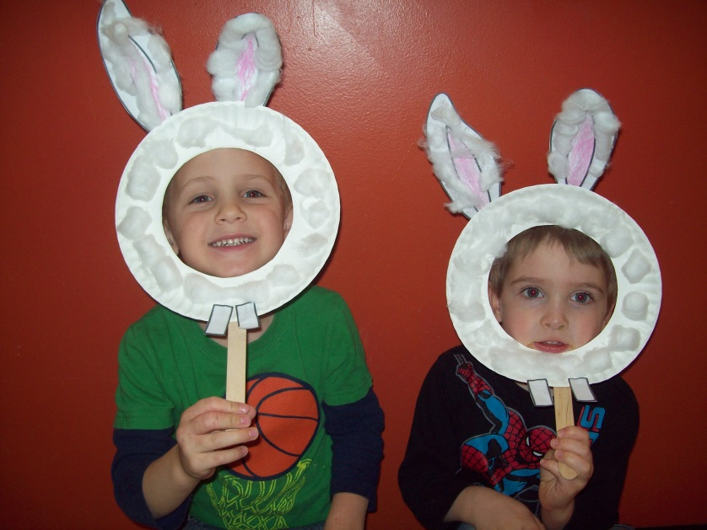
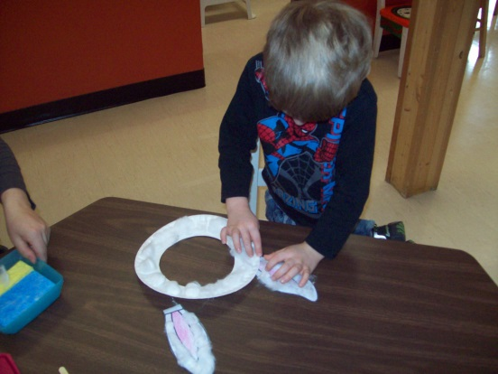
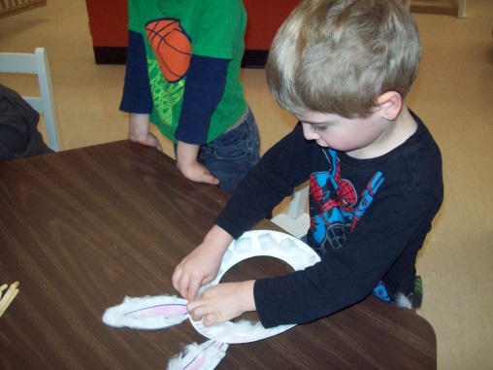
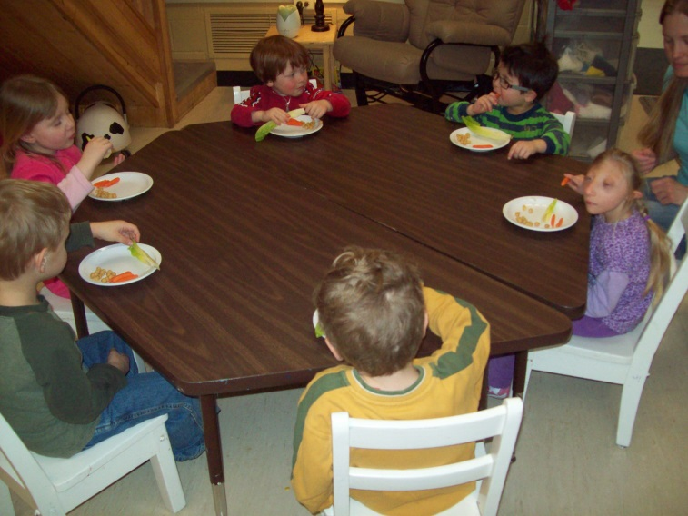
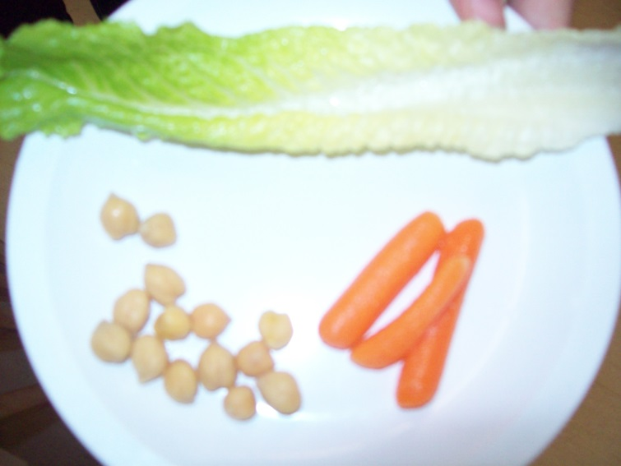
Creating bunny masks for dramatic play.
After a walk to purchase “bunny food” at the local grocery store, we taste tested lettuce, carrots and chick peas!

Slide 11
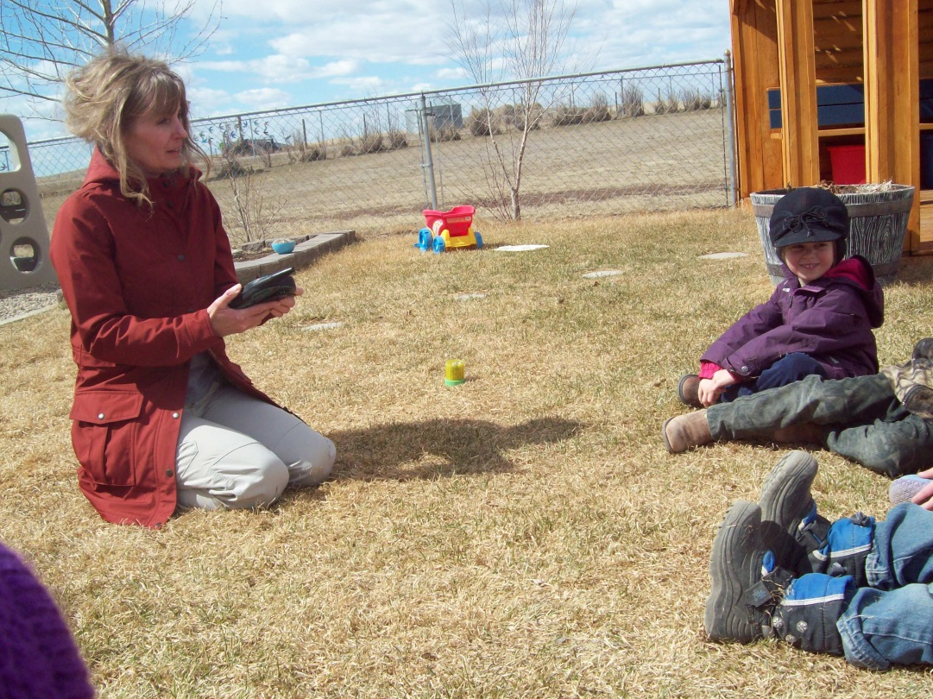
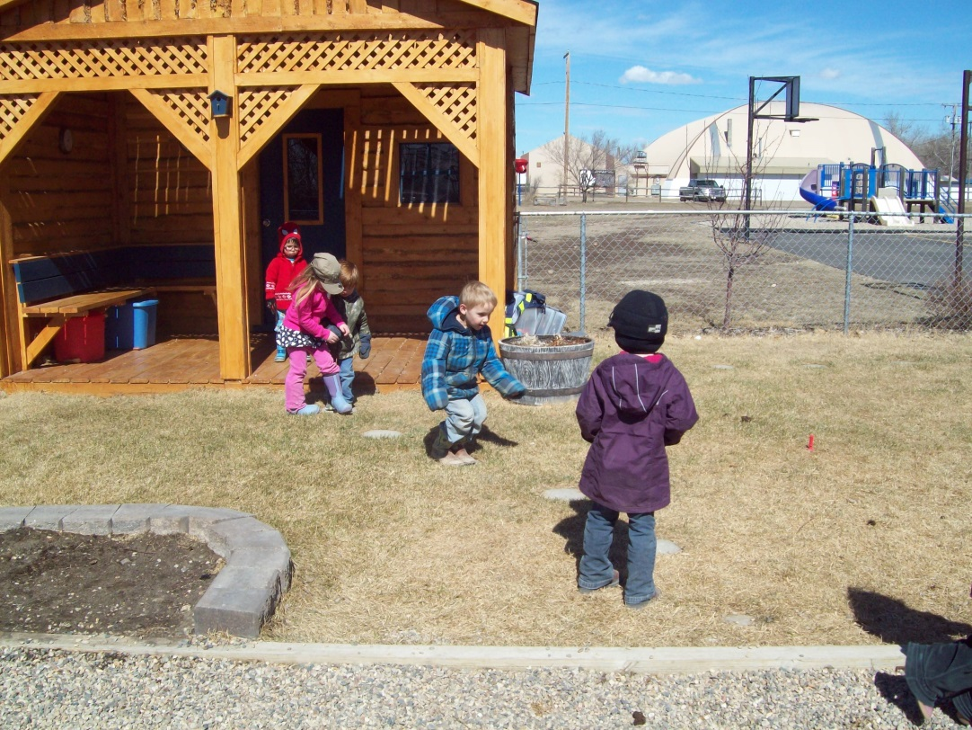
Marcella brought a predator call so that the children could hear a variety of rabbit cries!
From this experience the children created a predator and prey game. One child was the fox and the rest of the children were bunny rabbits hopping to a safe place.

Slide 12
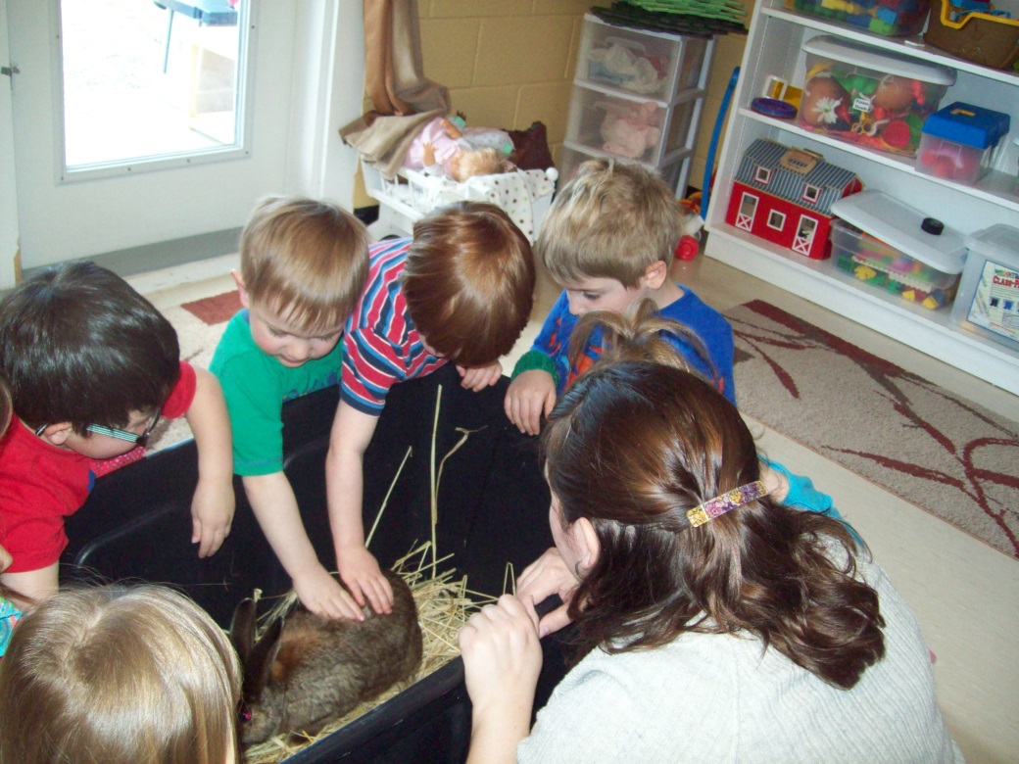
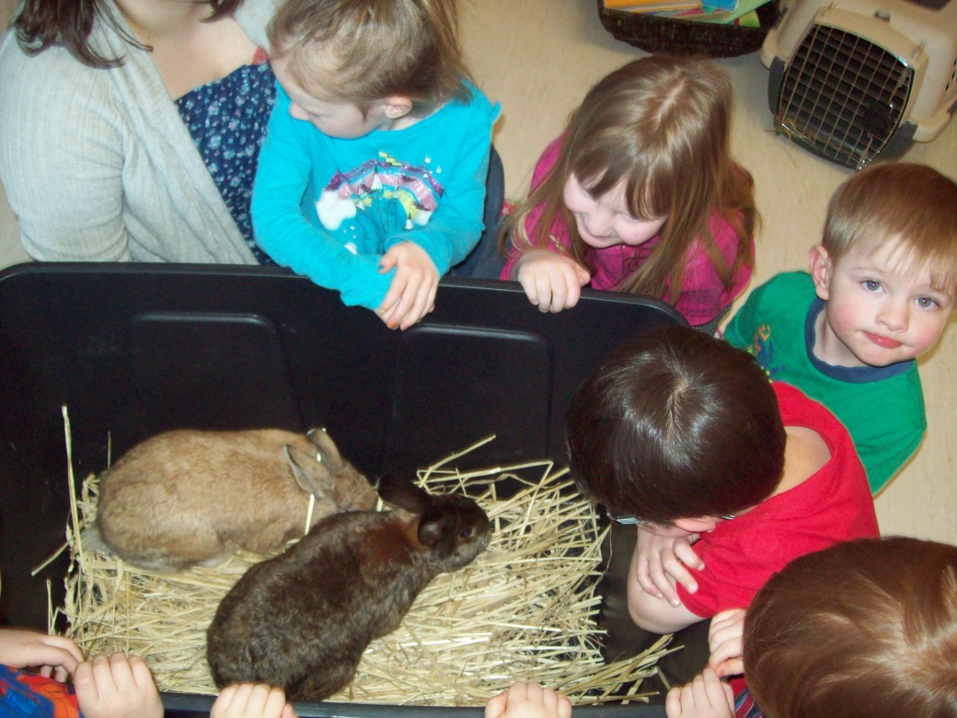
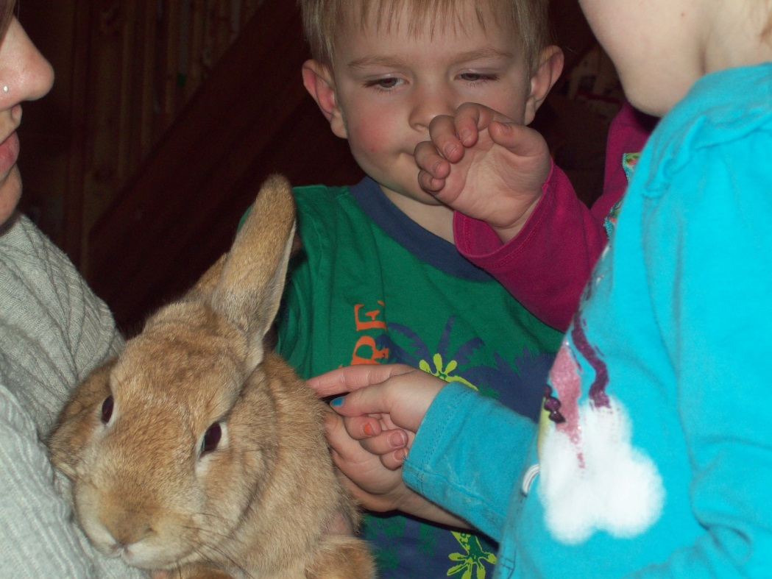
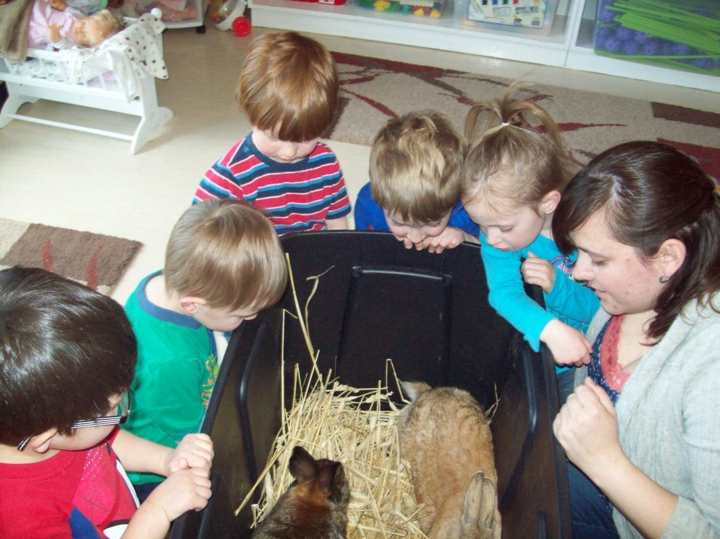
BUNNY VISIT DAY!

Slide 13
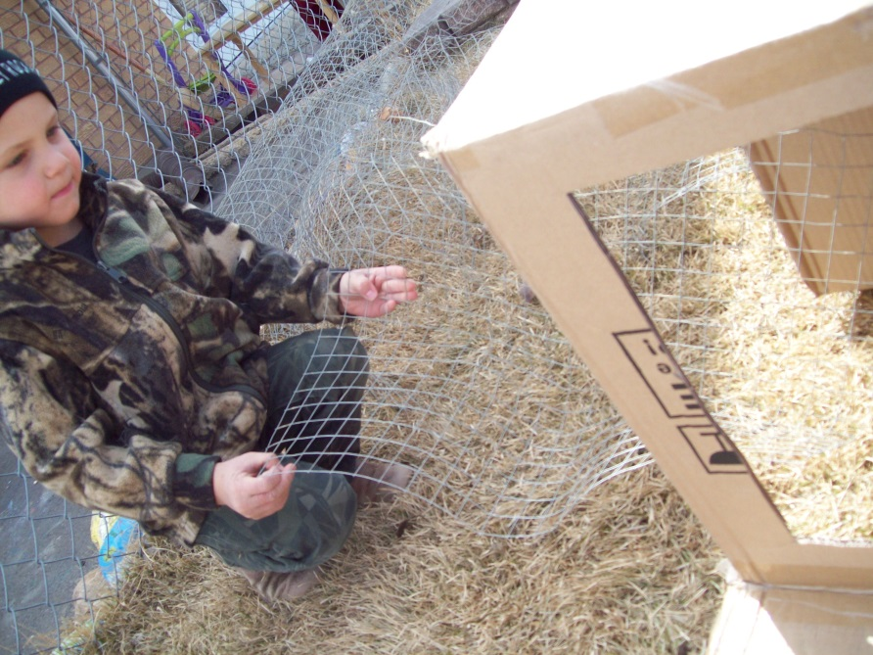
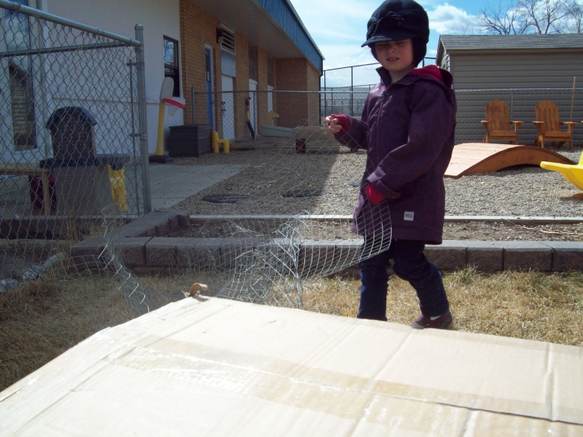
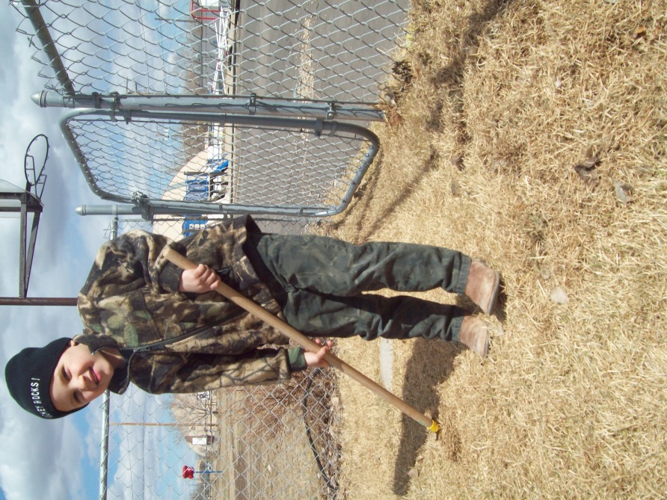
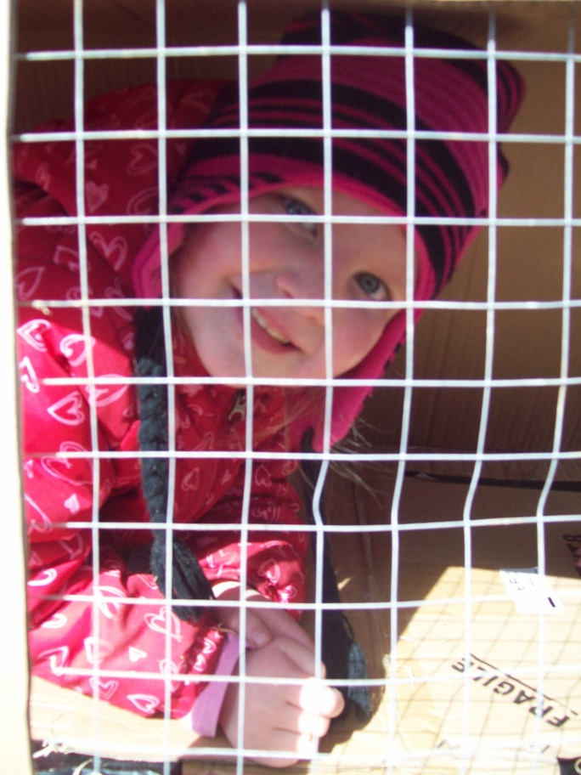
Building a BUNNY HUTCH
of our own!

Slide 14
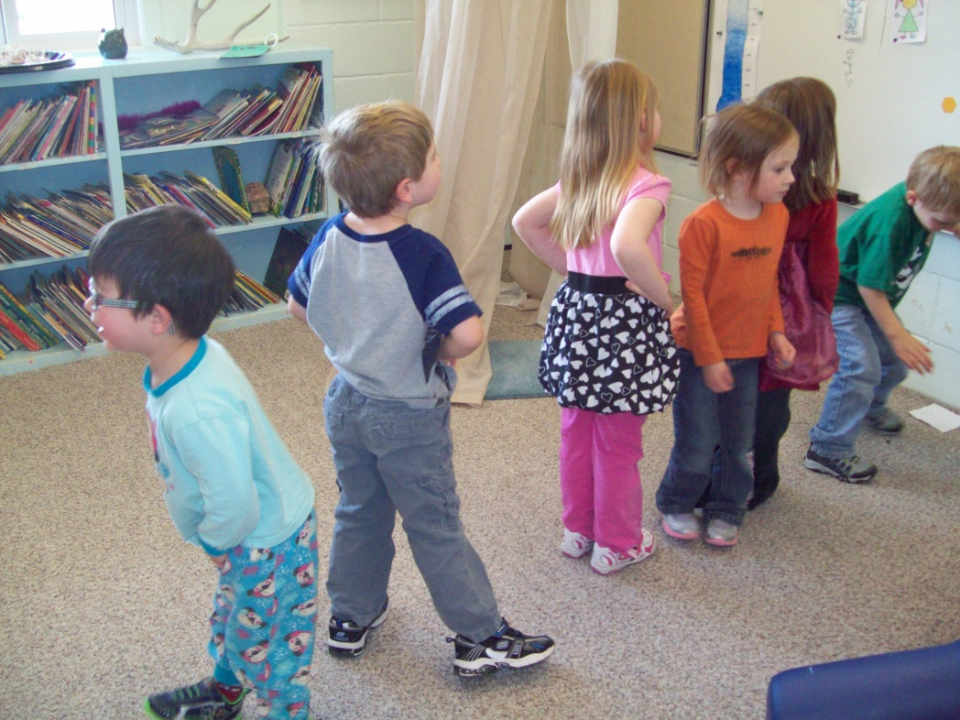
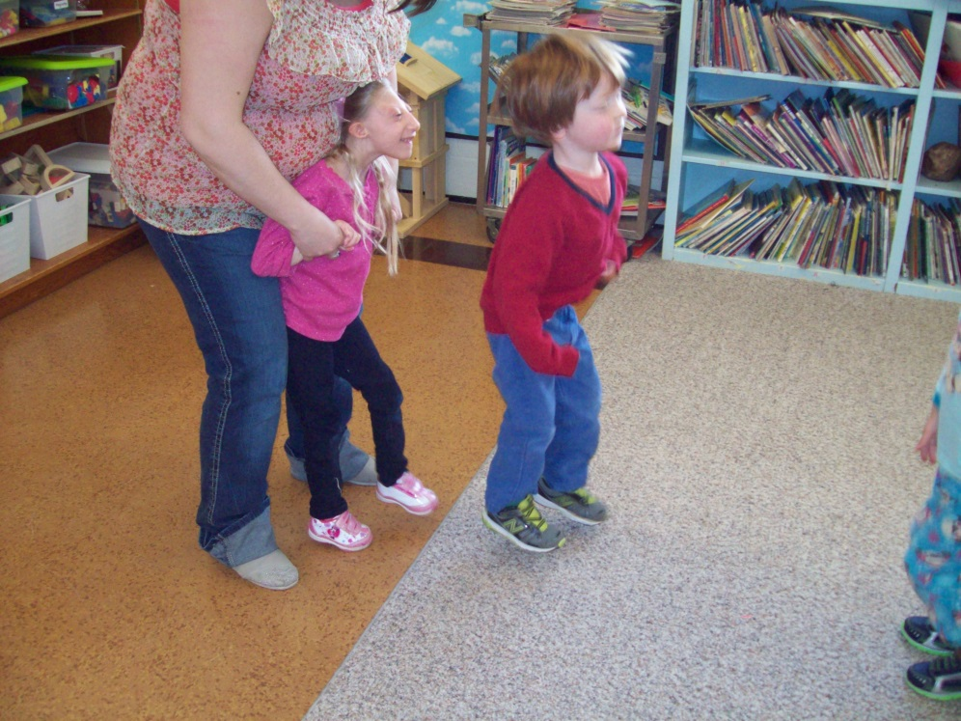
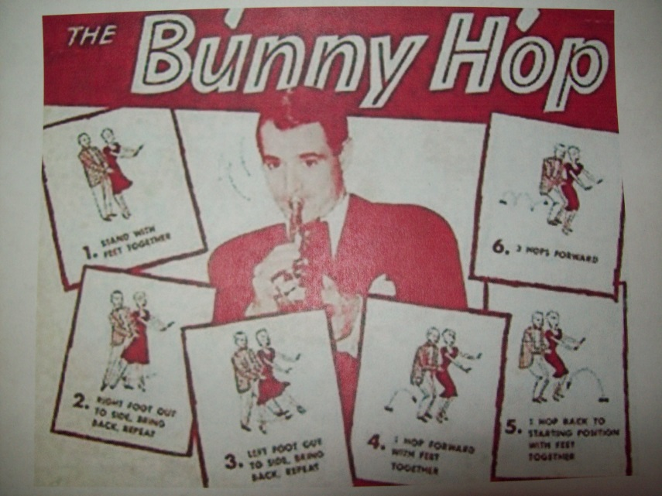
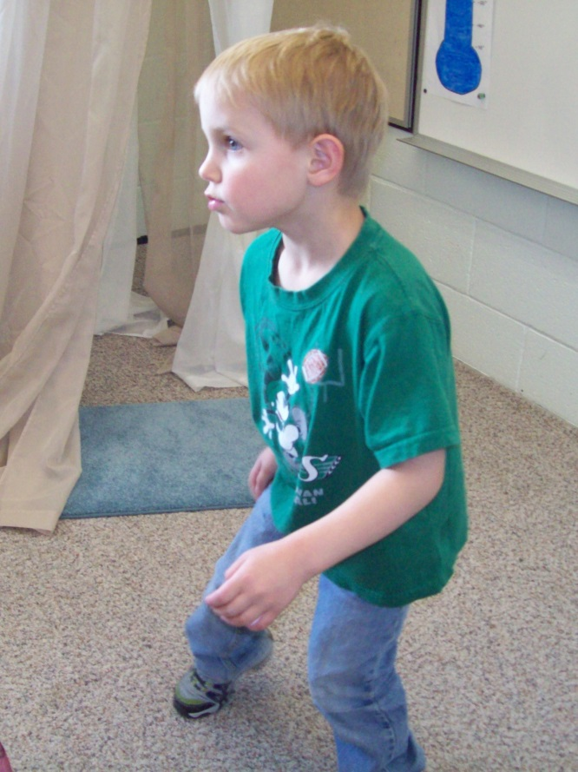
Learning the BUNNY HOP dance!
Music, Rhythm and Gross Motor

Slide 15
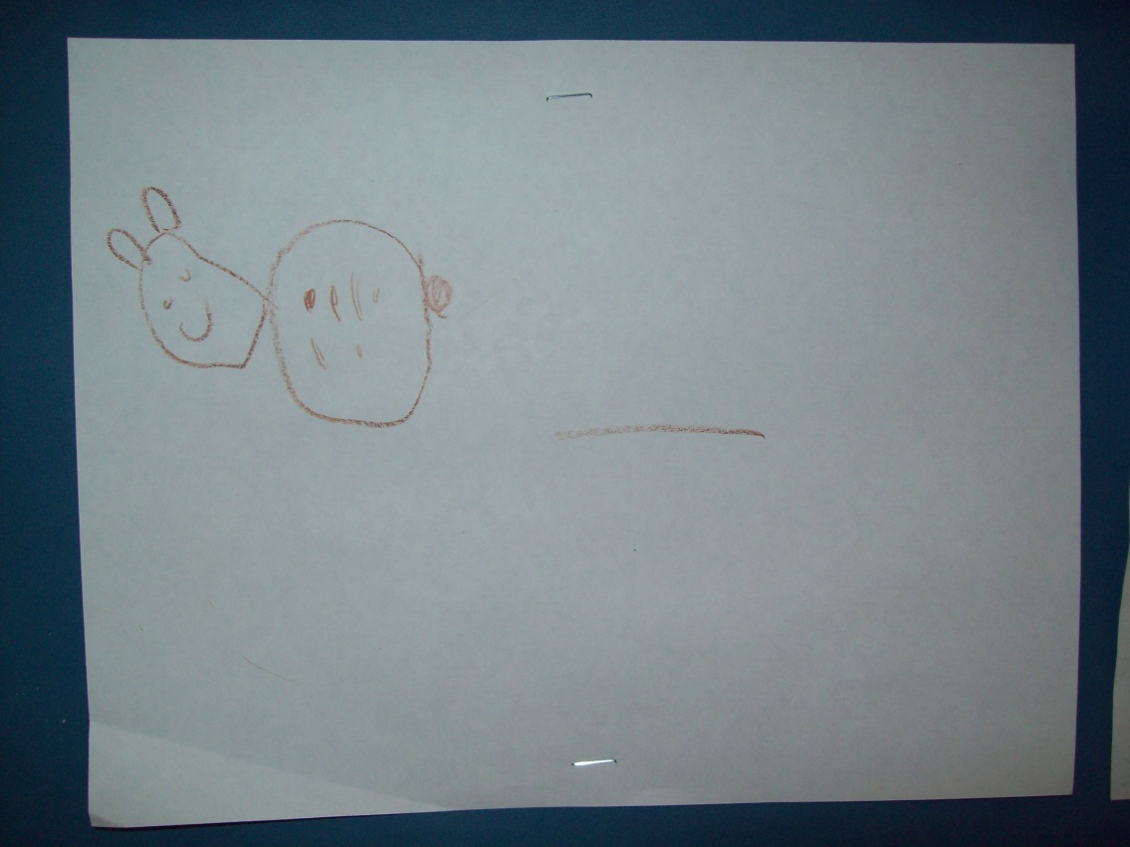
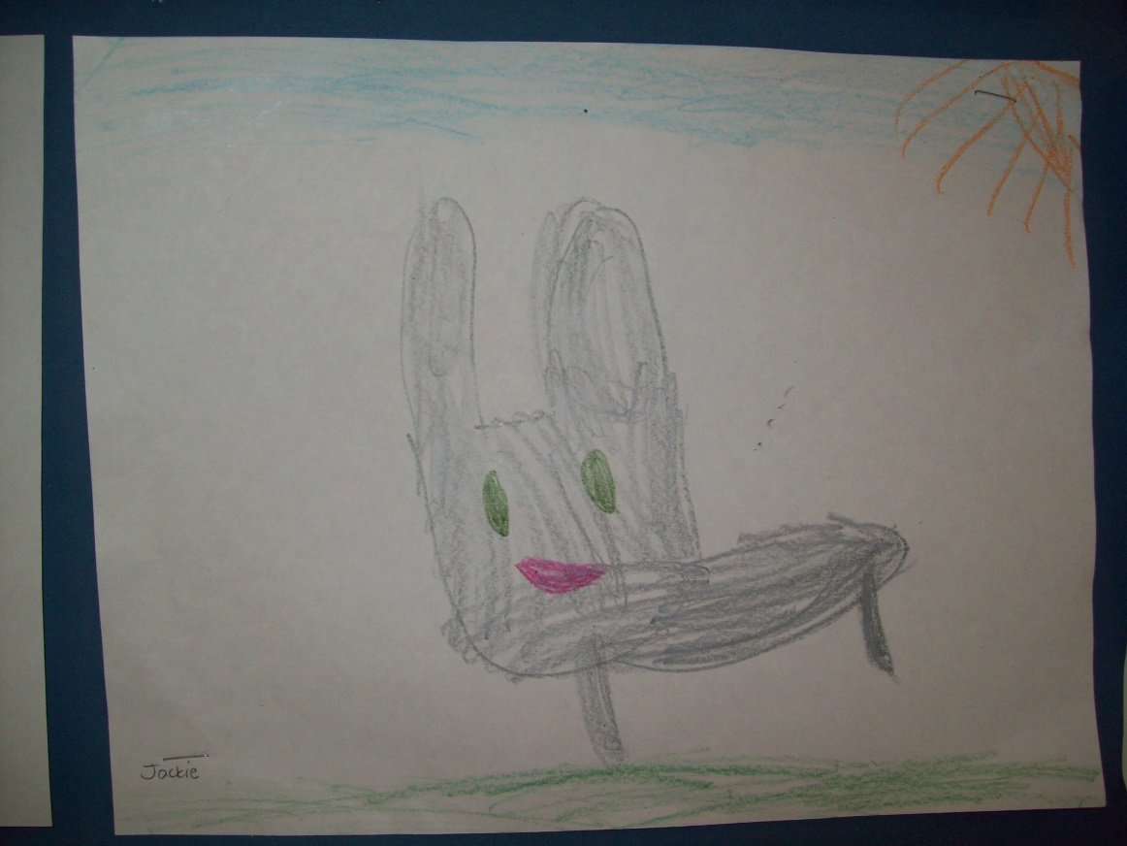
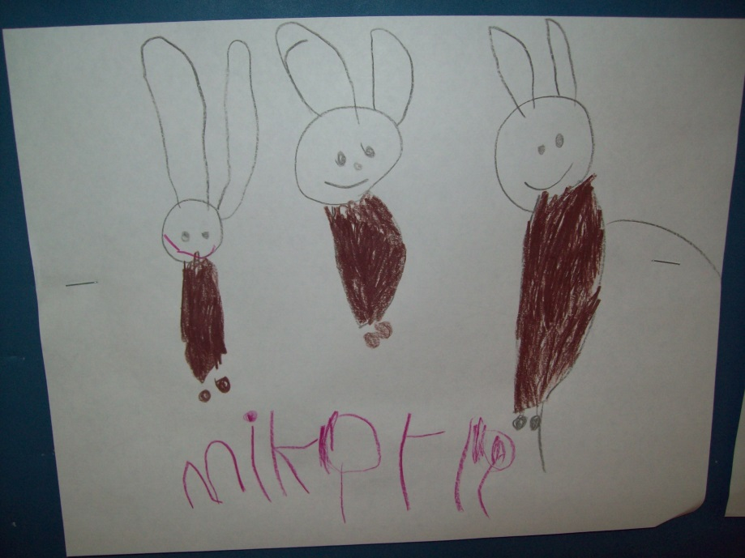
Representations of our new found knowledge!

Slide 16
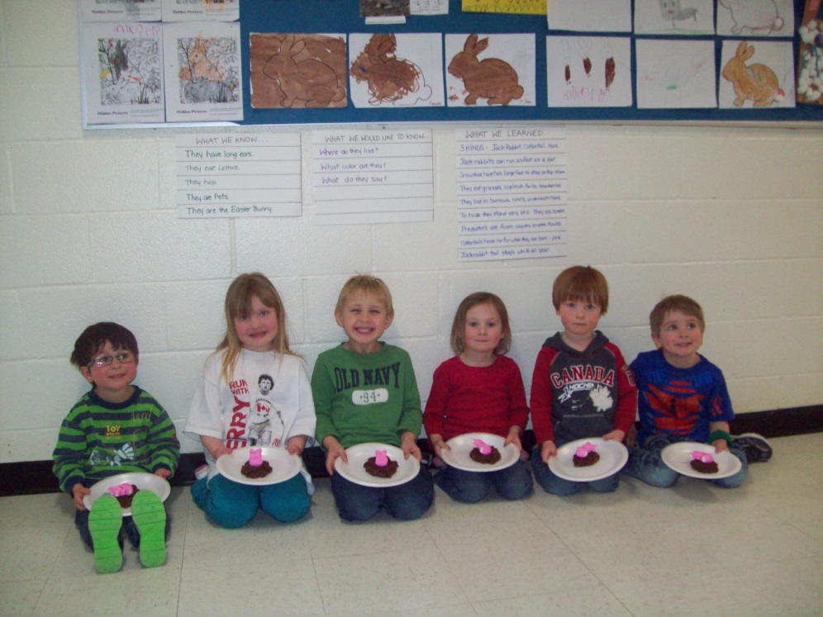
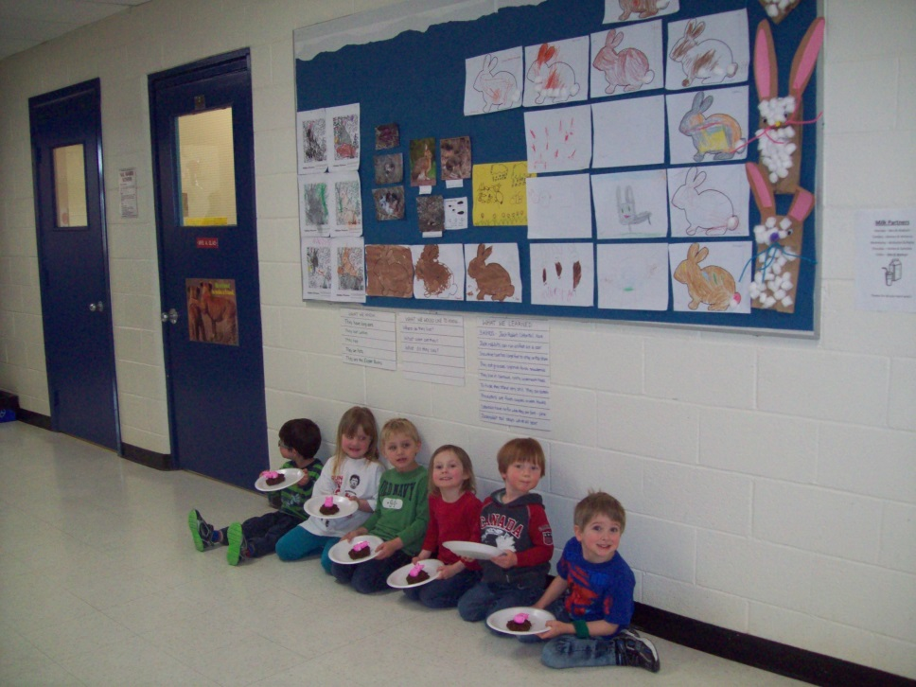
Bunny Project Finale
The Project was concluded with a bulletin board display in the public school for all the parents and community members to view.
The children made nest cookies complete with baby bunnies on the last day before Easter break. Their inquiries have moved on to where lettuce and carrots come from, so our focus will be on seeds, planting and growing our garden!

