Slide 1
Submitted by: Michelle Ullyott
Creating Stories

Slide 2
General Information
Age Group:
5 to 6 years old
Participant:
46 children
2 Groups of 23
Program Type: Alternating
Full-day Kindergarten
The project began when one of the Kindergarten classes became interested in creating their own stories. Shortly after, the second Kindergarten class joined in the project. Our Creating Stories project was completed over an 11 week period from December to March. One teacher was involved in this project and assistance was provided from our Educational Assistants and a high school Work-Ed student.

Slide 3
Phase 1
Beginning the Project
The Spark!
After reading “The Pigeon Wants a Puppy!”, one of the Kindergarten students had the wonderful idea to recreate the book during play and exploration time. The other Kindergarten students enjoyed the book so much that they began to create their own books and stories.

Slide 4
Teacher’s
Web
Before I began this project, I briefly brainstormed possible directions that our Creating Stories project might go. I also listed possible curricular outcomes that we might cover.

Slide 5
English Language Arts:
CRK.1 Comprehend and respond to a variety of visual, oral, print, and multimedia texts that address identity, community, and social responsibility.
CRK.2 View and interpret the basic message of visuals and objects in a variety of texts including models, photographs, dramas, dance creations, and videos.
CRK.3 Listen, comprehend, and respond to gain meaning in oral texts.
CRK.4 Comprehend, retell, and respond to basic ideas in stories, poems, songs, and informational texts read to them.
CCK.1 Compose and create various visual, multimedia, oral, and written texts that explore and present thoughts, ideas, and experiences.
CCK.2 Use and construct symbols, pictures, and dramatizations to communicate feelings and ideas in a variety of ways.
CCK.3 Use oral language to converse, engage in play, express ideas, and share personal experiences.
CCK.4 Create messages using a combination of pictures, symbols, and letters.
ARK.1 Reflect on viewing, listening, emerging “reading”, representing, speaking, and emerging “writing” experiences in the context of teacher-led discussions.
ARK.2 Reflect and talk about new learning.
Arts Education:
CPK.4 Create art works that express own observations and ideas about the world.
CHK.1 Investigate arts expressions found in own homes and school community in relation to own lives.
CHK.2 Recognize a wide variety of arts expressions as creations of First Nations and Métis peoples.
Science:
MOK.1Investigate observable characteristics of familiar objects and materials in their environment.
Possible Curricular Outcomes
Educators’ Expectations: I expected that I would help to support students in their own learning and discovery about creating and writing stories. I was hopeful that the students would have a better understanding of creating stories and view themselves as capable writers by the end of the project.

Slide 6
As a class, we brainstormed and I recorded what the students knew and wanted to learn about books and creating stories.
Student’s Knowledge:
Student Wonder’s
Questions to Investigate:
What Do We Know About Books?
They are good for your brain.
We learn how to read when we look at them.
Be careful with them.
They make you smart.
Take care of them.
They tell a story.
We Wonder:
How do we write stories?
How do you make books?
Who can write stories?
What do the pictures in the books mean?
What makes a book?
Our Questions:
How do we create and write our own stories?
What do the pictures in the books mean?
What makes up a story?

Slide 7
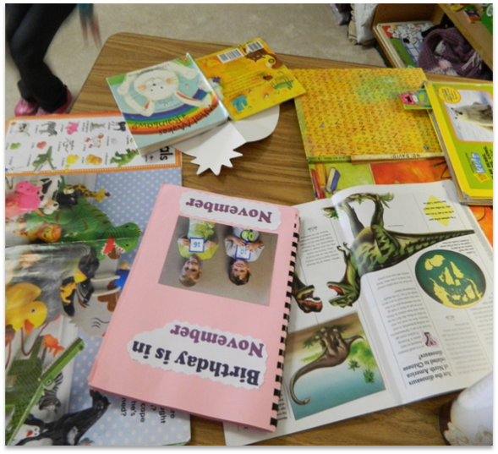
Phase 2
Developing the Project
The students were so excited to learn more about creating stories!
Let the adventure begin!

Slide 8
Materials and the Classroom
Materials: There were a variety of items available for the students to create stories with. They could choose from different colors of paper, scissors, different writing tools, staplers, stencils, tape and whiteout.
Classroom: All the story creating materials were accessible for the students at all times. Students usually collected what they needed to create their story and worked in various areas around the room.

Slide 9
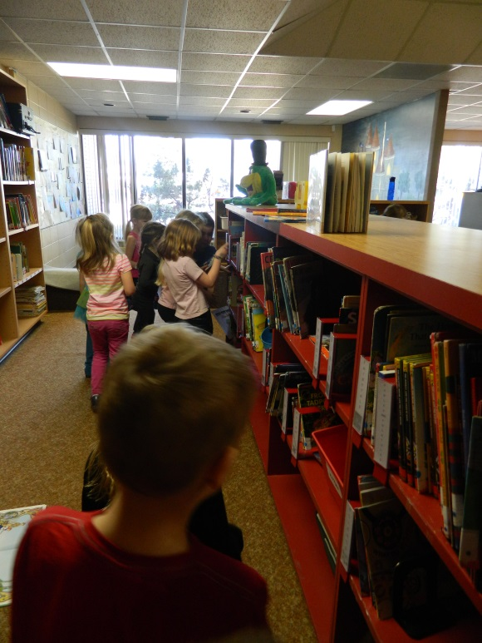
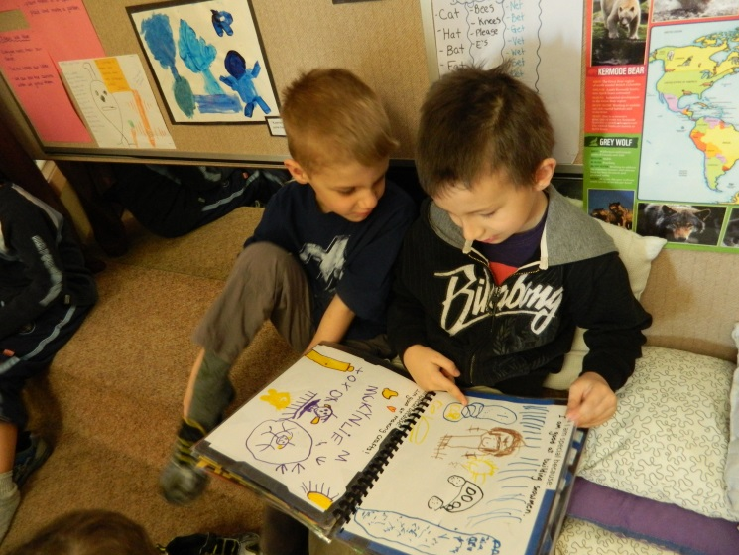
Research and Investigation
To learn more about creating stories we began by investigating what makes up a story in our classroom books.
Next we went on a trip to the library to research and learn more about books and stories.

Slide 10
We studied a variety of book types and stories including picture books, fiction and non-fiction stories.
We examined different illustrations and discovered how pictures tell an important part of the story as well.
We experimented with different ways to bind our books together, including using tape, glue, staples as well as folding.

Slide 11
The students spent time telling stories about things they were familiar with to the class.
The students investigated stories in the classroom as well as on-line and audio stories. The resources they found to be most valuable were the books in the classroom that they could handle.
We emailed the author Dianne Young with questions the students had generated about her book:
-Where did you get the idea of making the story? -Why did you write the story? -How did you choose the words to your story?
The kids were extra excited to discover the author lived in the same place they did!

Slide 12
Refocusing Our Investigation:
As our investigations unfolded, the students began to be more interested in the reasons behind why we include different things in our story books. They developed a strong interest in the thoughts and choices of pictures and words that illustrators and authors use to tell a story.
As we learned more, we began to add our own words to our picture stories.

Slide 13
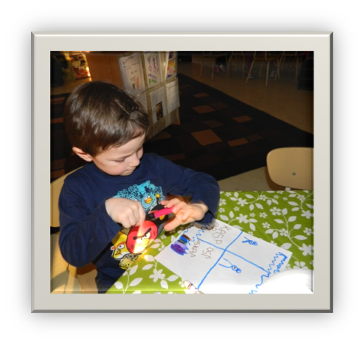
Play and Exploration
During our play and Exploration time, the students chose to create a variety of different books. Students worked both individually and in groups as large as seven to create wonderful stories.

Slide 14
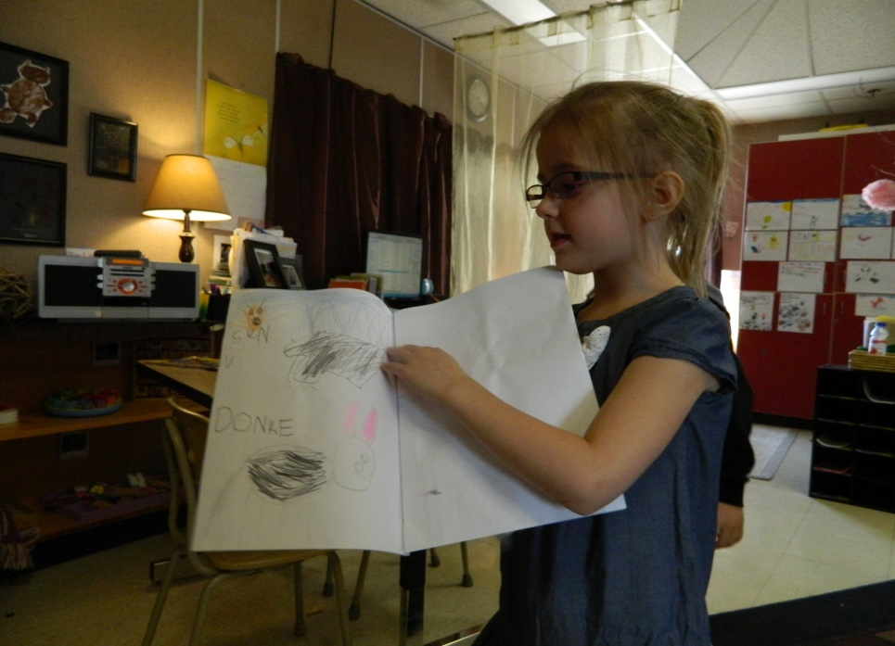
The students were so excited to create and shared their own stories!

Slide 15
The Kindergarten students created many different types of stories! They wrote both fiction and non-fiction stories about a variety of different topics!

Slide 16
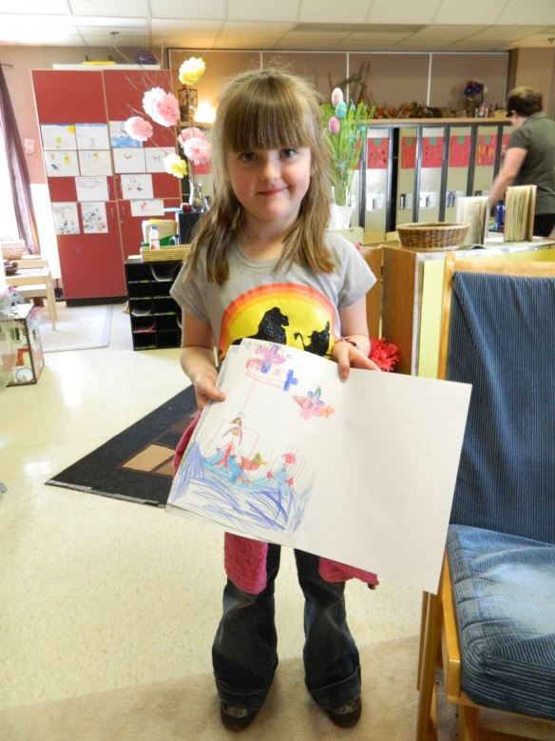
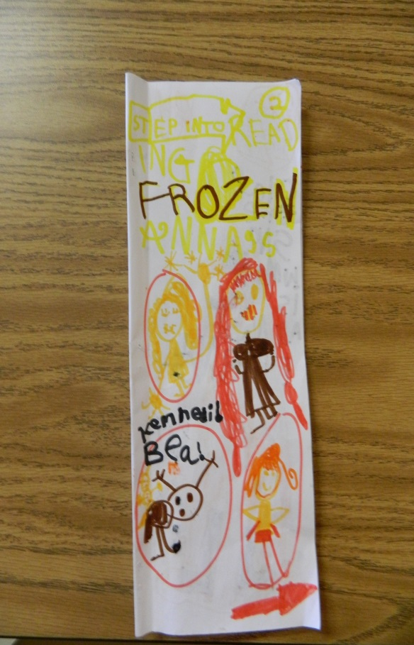
Phase 3
Concluding the Project

Slide 17
Sharing What We Have Learned!
The Grade 6/7 class had also been creating picture books. They came to our classroom and we took turns sharing our stories with each other!
To conclude our project, each Kindergarten student created their own story book.
We had a book reading event where each student shared their story with their classmates.

Slide 18
Video Recording of
Student’s Stories
With the help of our school librarian we recorded the students as they told each page of their story. This recording was first shared with the other students then emailed home to share with friends and family.

Slide 19
Our stories were displayed in the classroom as well as on the bulletin board in the school hallway.

Slide 20
Our Knowledge and Understanding
When asked what they now know about writing stories and creating books the students were quite detailed in their responses.
The students explained that when creating a story you…
Put words in them.
Write words you know.
Think about what you are doing before you draw.
Draw pictures you want for your story.
Put lots of good stuff in it … (“details” another student added).
Make the pictures look good.
This includes:
You can trace.
You don’t scribble or sit somewhere where you can get bumped.
You draw different things.
You add color to your drawings.
Take your time!
Put the characters you want in the story.
Put a cover on your story.
On the first page we put the author’s name and the title.
Sometimes you can end the story with “The End!”
You can staple, glue, tape or sew the pages of the story together into a book.

Slide 21
Questions We Still Have:
When asked what other things the students’ wonder about creating stories the they replied:
We wonder:
How published books are put together?
How are books made?
How do authors decide what to write about?
How do you chose the words and think about what you want to write?
When talking with the students, I realized that they are still very interested in this area. We are planning on changing directions and proceeding in further investigations focused on either the decisions authors make or how books are published and bound together.

Slide 22
What did the Students Learn:
The students learned so much from this project! They learned about story writing and about how authors and illustrators make decisions. The students learned about planning and thinking ahead as well as revisiting work they had already completed.
Students worked together as a group to make decisions and create stories. Stories are all around us, and the students realized that they are capable authors and illustrators able to take those stories and create story books.
Our study about creating stories has provided students with the opportunity to develop their fine motor skills as well as their ability to remain focused on an activity. Their creativity and imagination were encouraged in the creation of their story books. Our project fostered the student’s ability to work cooperatively and strengthened their problem-solving and social skills as well as their self-confidence.

Slide 23
Curricular Outcomes Covered:
English Language Arts:
CRK.1 Comprehend and respond to a variety of visual, oral, print, and multimedia texts that address identity, community, and social responsibility.
CRK.2 View and interpret the basic message of visuals and objects in a variety of texts
CRK.3 Listen, comprehend, and respond to gain meaning in oral texts.
CRK.4 Comprehend, retell, and respond to basic ideas in stories, poems, songs, and informational texts read to them.
CCK.1 Compose and create various visual, multimedia, oral, and written texts that explore and present thoughts, ideas, and experiences.
CCK.2 Use and construct symbols, pictures, and dramatizations to communicate feelings and ideas in a variety of ways.
CCK.3 Use oral language to converse, engage in play, express ideas, and share personal experiences.
CCK.4 Create messages using a combination of pictures, symbols, and letters.
ARK.1 Reflect on viewing, listening, emerging “reading”, representing, speaking, and emerging “writing” experiences in the context of teacher-led discussions.
ARK.2 Reflect and talk about new learning.
Arts Education:
CPK.4 Create art works that express own observations and ideas about the world.
CHK.1 Investigate arts expressions found in own homes and school community in relation to own lives.
Science:
MOK.1Investigate observable characteristics of familiar objects and materials in their environment.

Slide 24
Teacher Reflection:
I found that this experience was very rewarding for both the students as well as myself. Throughout the project, the students were excited and engaged with activities because they were interested and proud of what they could accomplish. I was very impressed with the ownership and understanding the students developed when creating their own stories. This project allowed each child to be successful in their own way.
I was proud of how hard the students worked and pleased with the growth in their confidence as they grew to see themselves as competent authors and illustrators. The thoughtful higher level thinking and planning the students demonstrated impressed me! I was also surprised at how many areas of the curriculum we were able to integrate during this project. Documenting this project was challenging as well as finding experts to consult with. If I were to do this project differently, I would organize an author to come for a classroom visit.
This was a great topic for the students! They were both engaged and inspired to continually learn and deepen their understanding of the subject.

