Slide 1
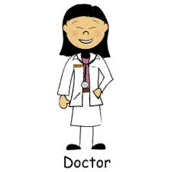
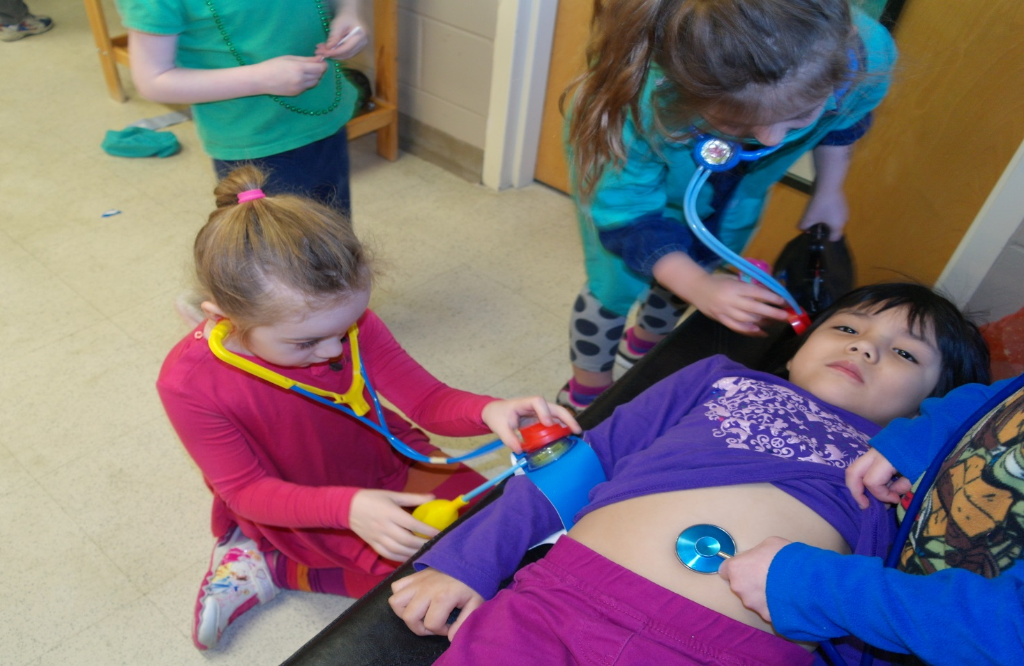
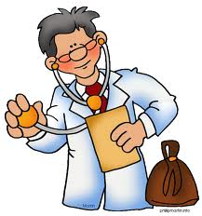
The Doctors are in.
Doctor Inquiry Project
Linda Walls/Deb LaFreniere

Slide 2
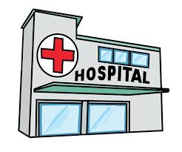
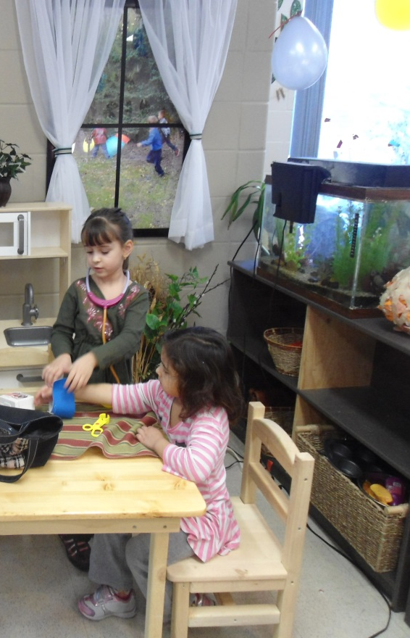
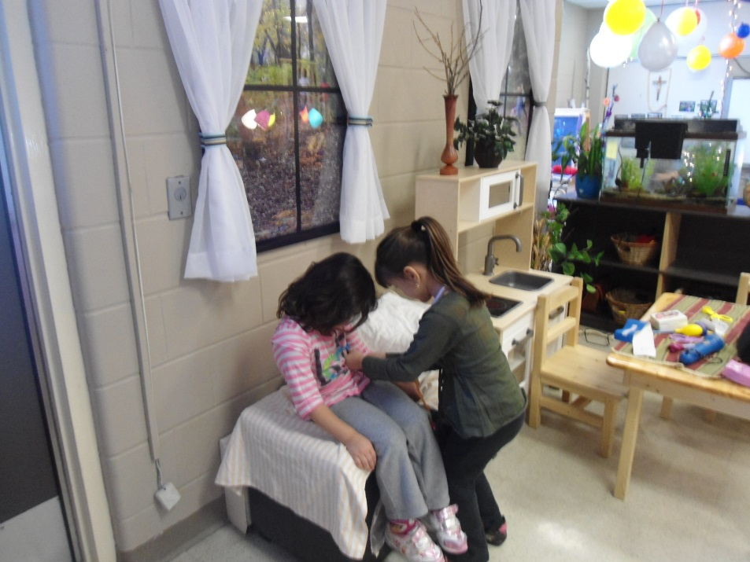
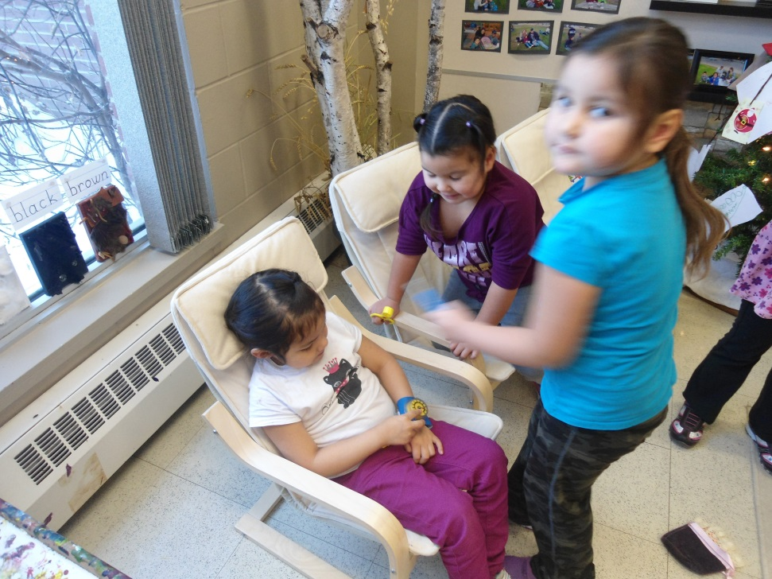
The Doctors are in!
The Beginning.
One day the Pre-K students came to school and found a couple doctor kits. WOW!! All week they played doctor. This was so much FUN!! Then one day they said, “Mrs. Walls, we need a doctor’s office. We could put it over there and the kitchen can be the waiting room.” “What do we need in a doctor’s office?” asked Mrs. Walls. “We need ……….

Slide 3
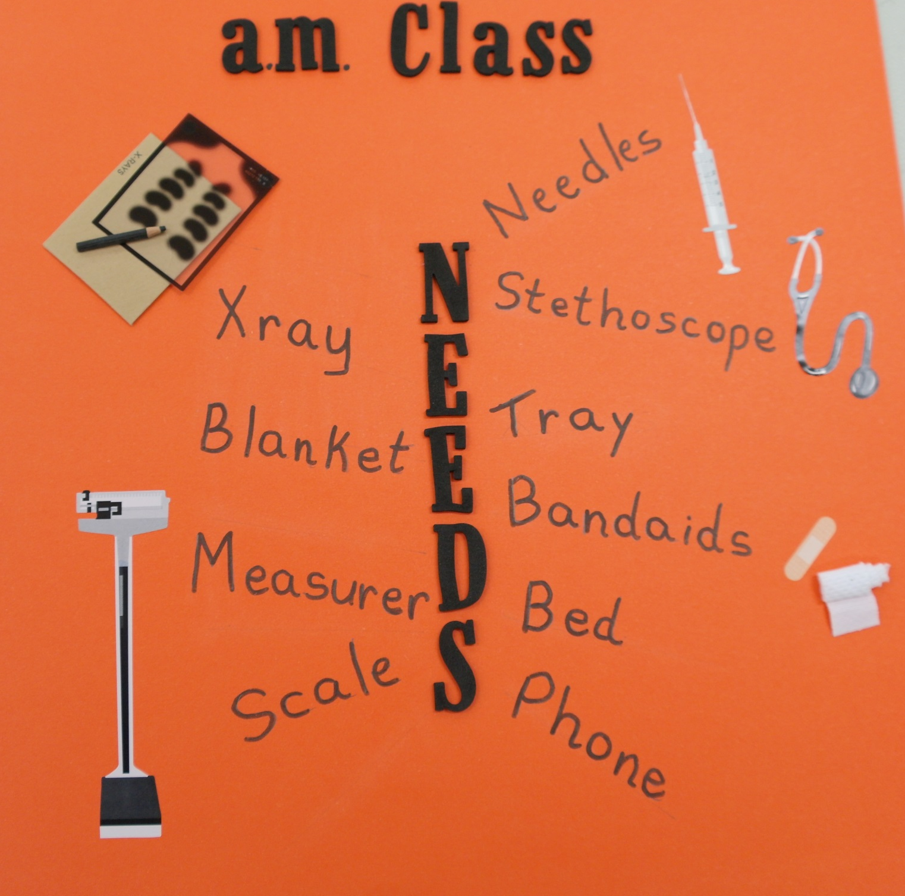
Student web.

Slide 4
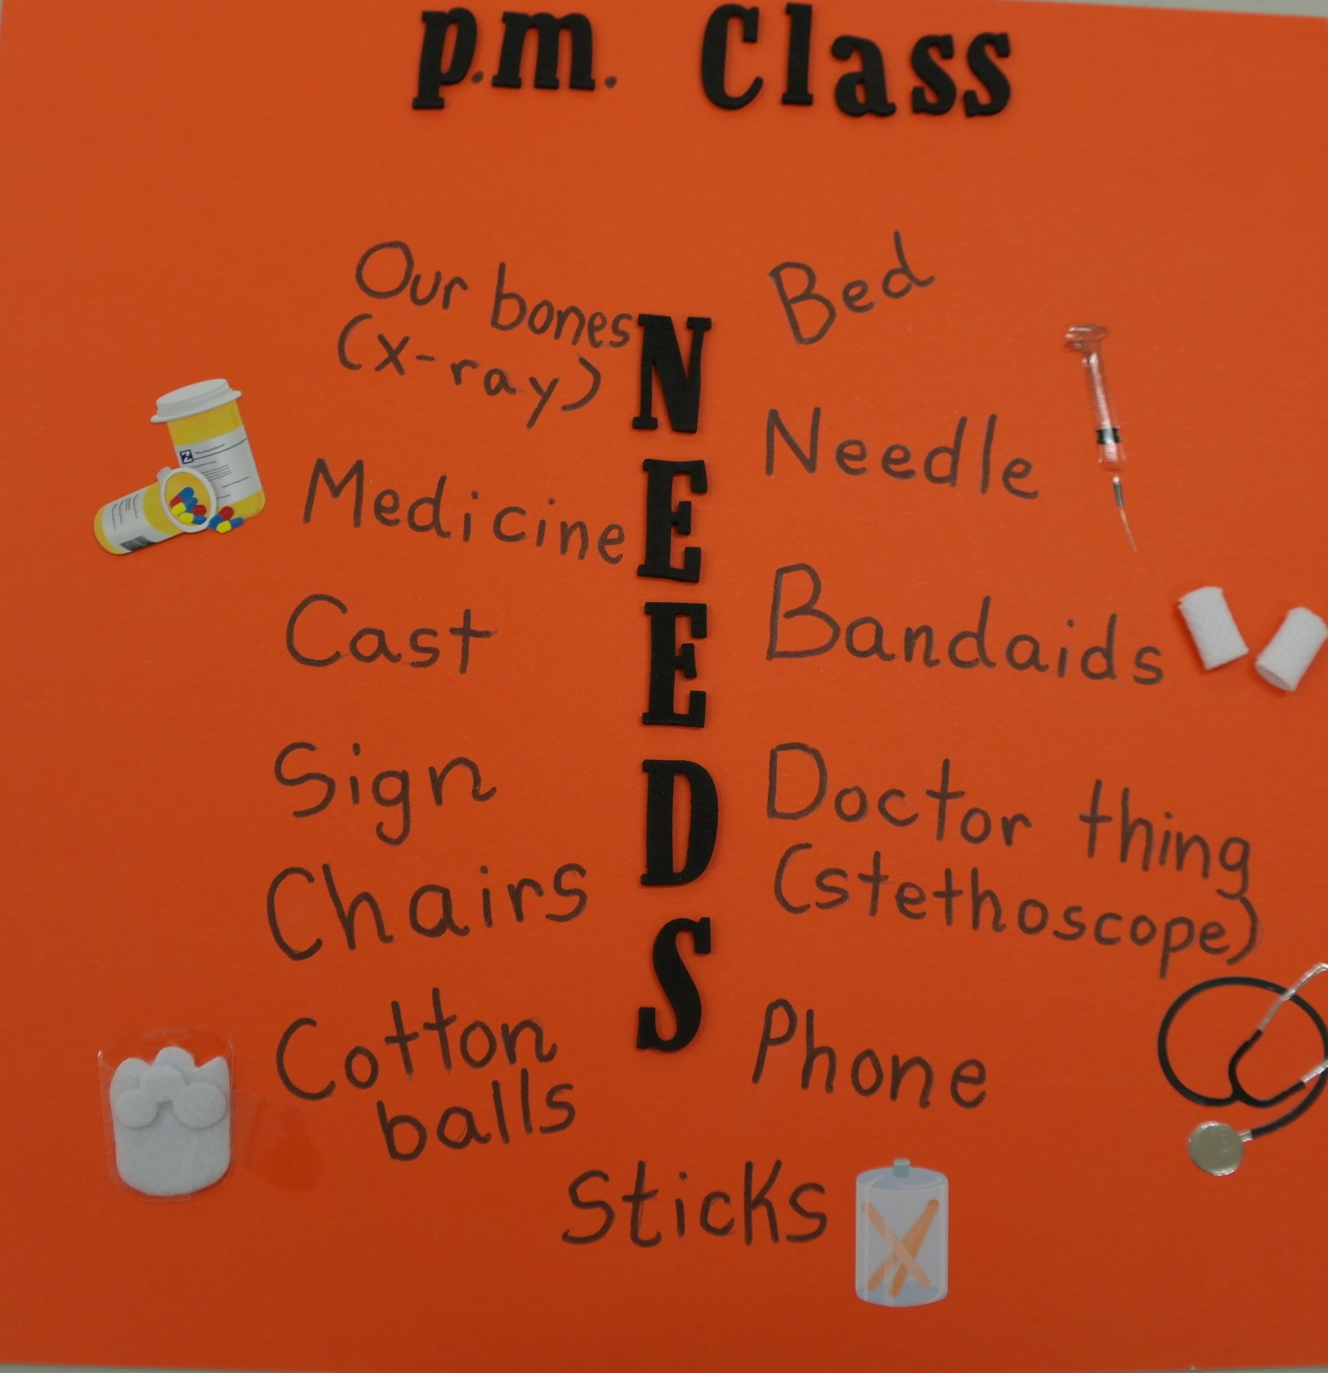

Slide 5
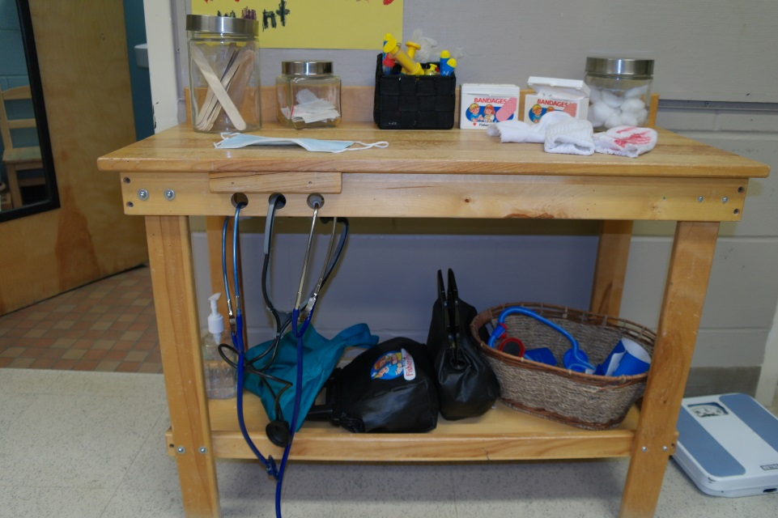
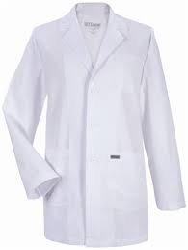
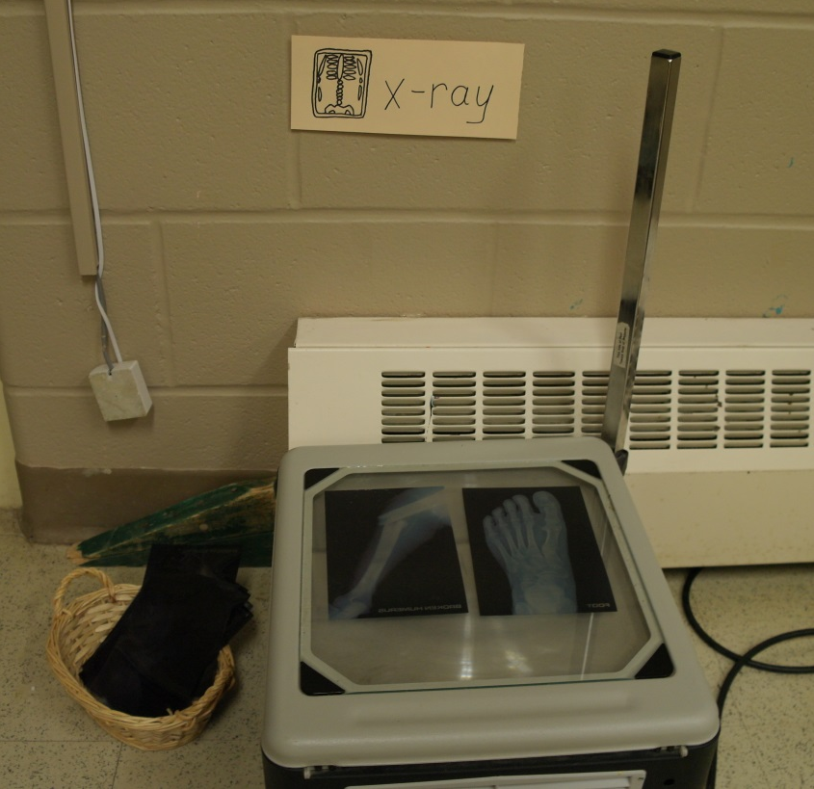
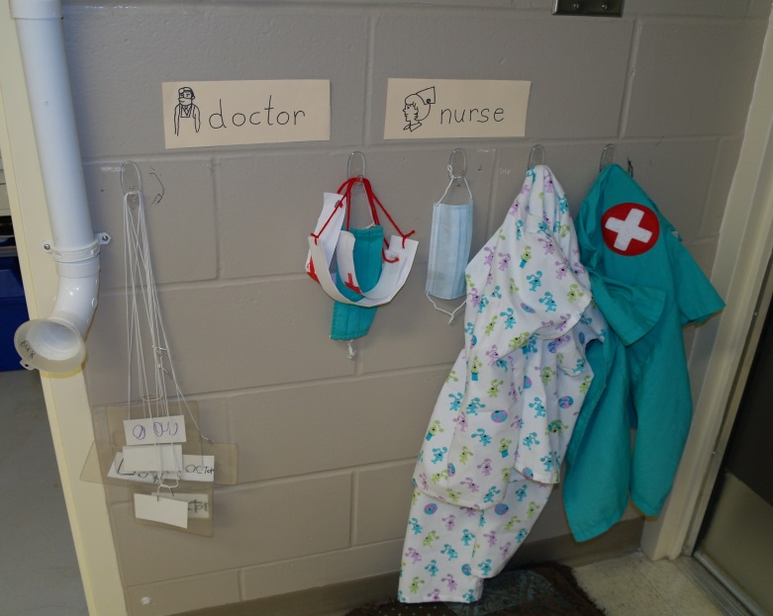
So we began putting together our office.
Work station
X-rays
Name tags and scrubs

Slide 6
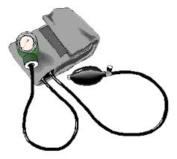
As the students looked at books on their own and listened to stories about doctors during circle time, they came up with more ideas of things they needed.
Intellectual Development Language and Emergent Literacy:
Gaining meaning from a variety of visual formats and text material. Taking an idea and using it in a purposeful way during play.

Slide 7
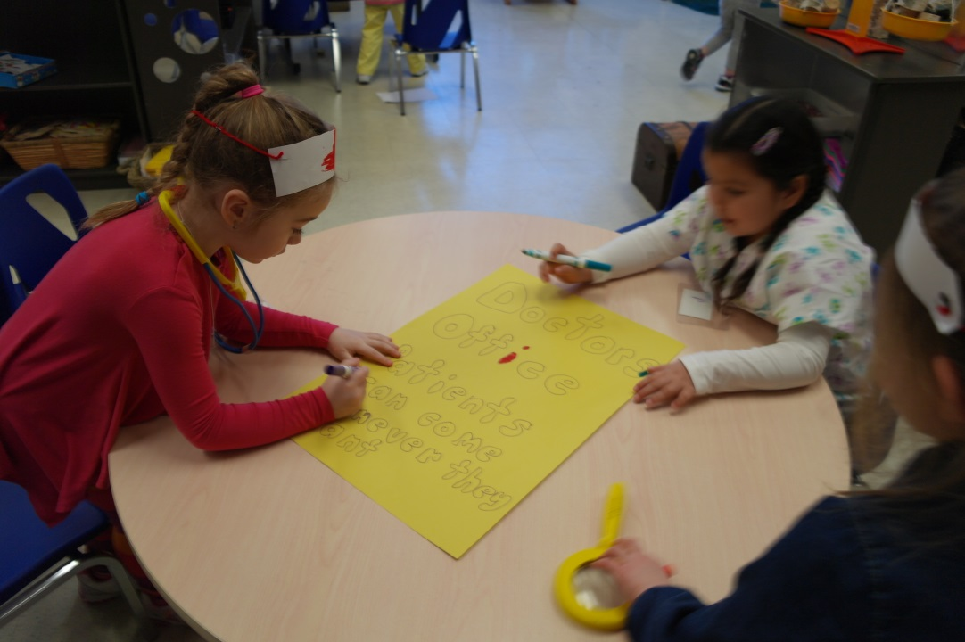
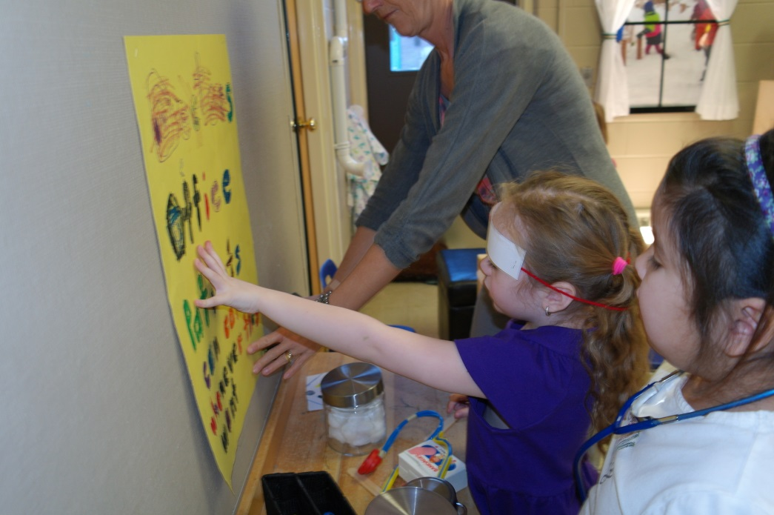
A Sign
Intellectual Development Language and Emergent Literacy:
Exploring how print works. Becoming aware that speech can be written down and carries a message.
“Patients can come whenever they want.”

Slide 8
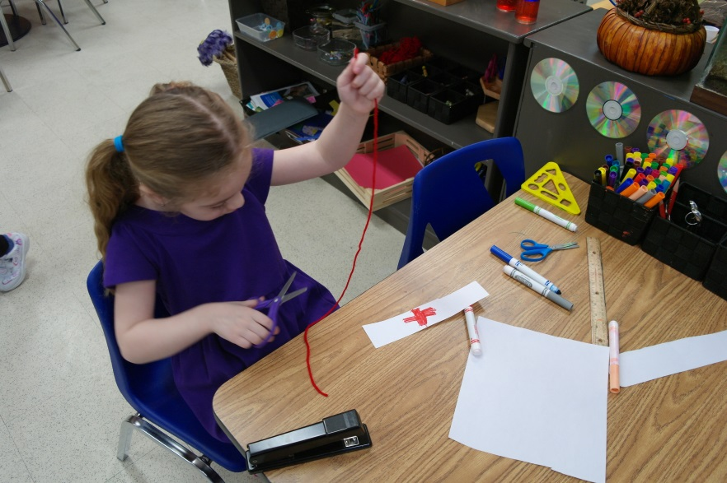
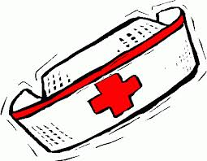
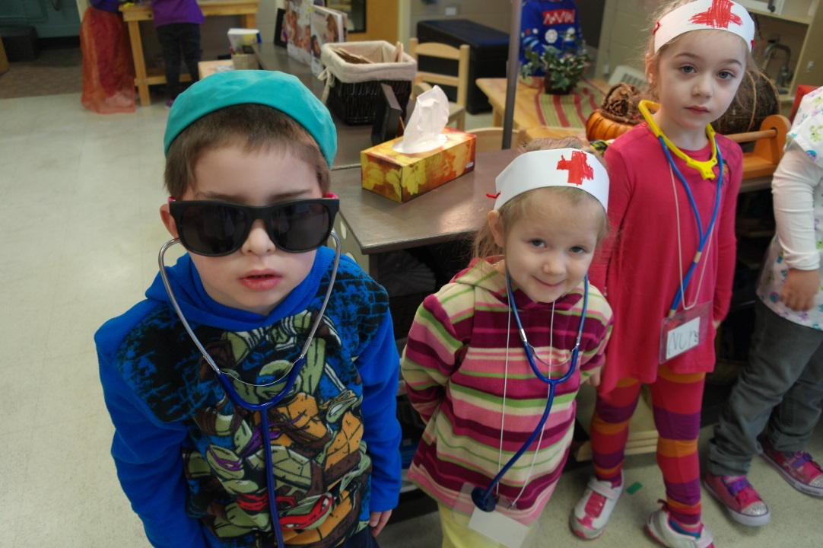
Nurse hats
Intellectual Development Language and Emergent Literacy:
Representing ideas using expressive forms.
K. “Take my picture. I have hat too.”
Mrs. Walls “Do you wear you sunglasses when you operate?”
K. “Yes.”

Slide 9
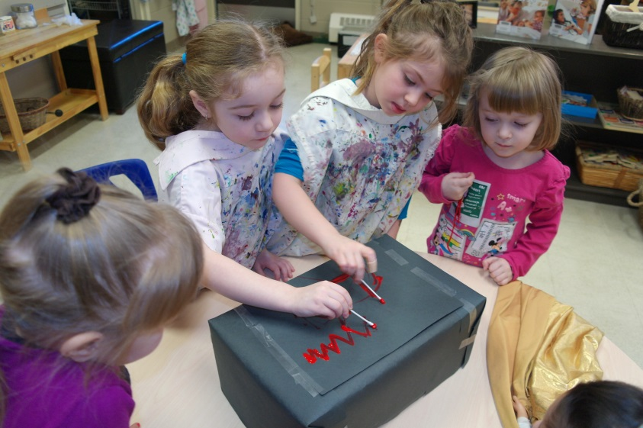
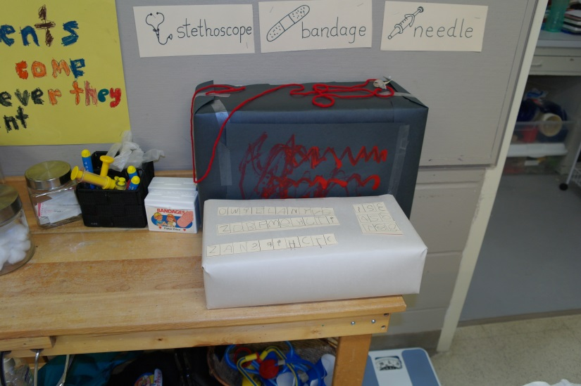
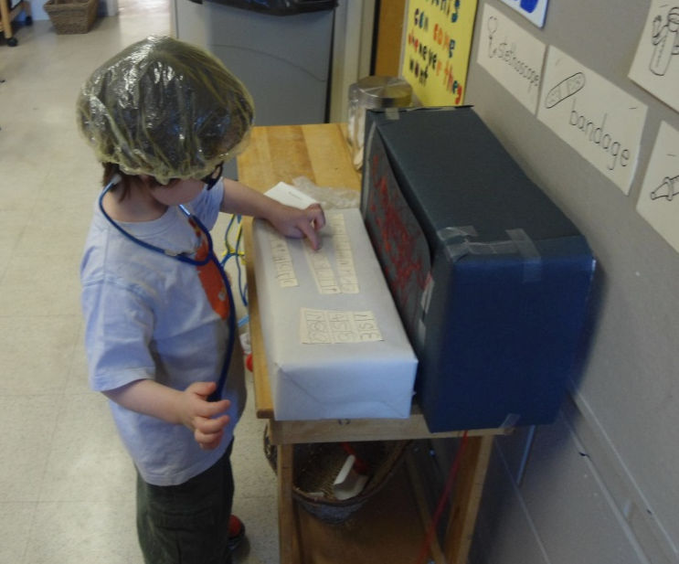
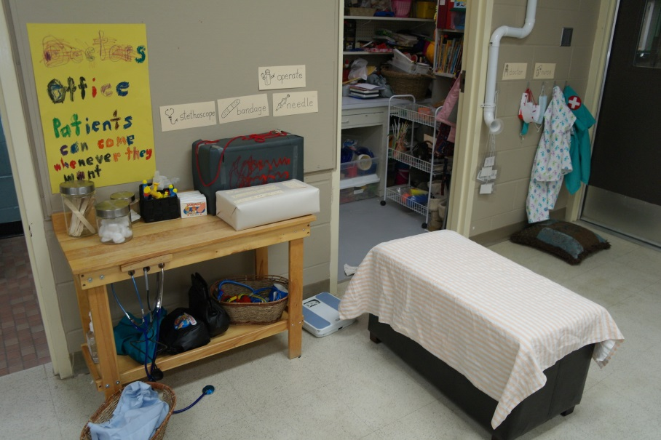
It wouldn’t be a doctor’s office without an ECG!
Complete with keyboard
Intellectual Development Language and emergent literacy:
Representing ideas using expressive forms.
Social Emotional Development: Interacting with peers.
J. “I don’t know the password!”

Slide 10
Gloves
Leighton”How do you put these on?”
Surgical hats and masks
Intellectual Development Language and Emergent Literacy:
Incorporating ideas and vocabulary from prior listening experiences into play and exploration
“Oh I know! BLOW!”
Casts (tube socks)
Slings

Slide 11
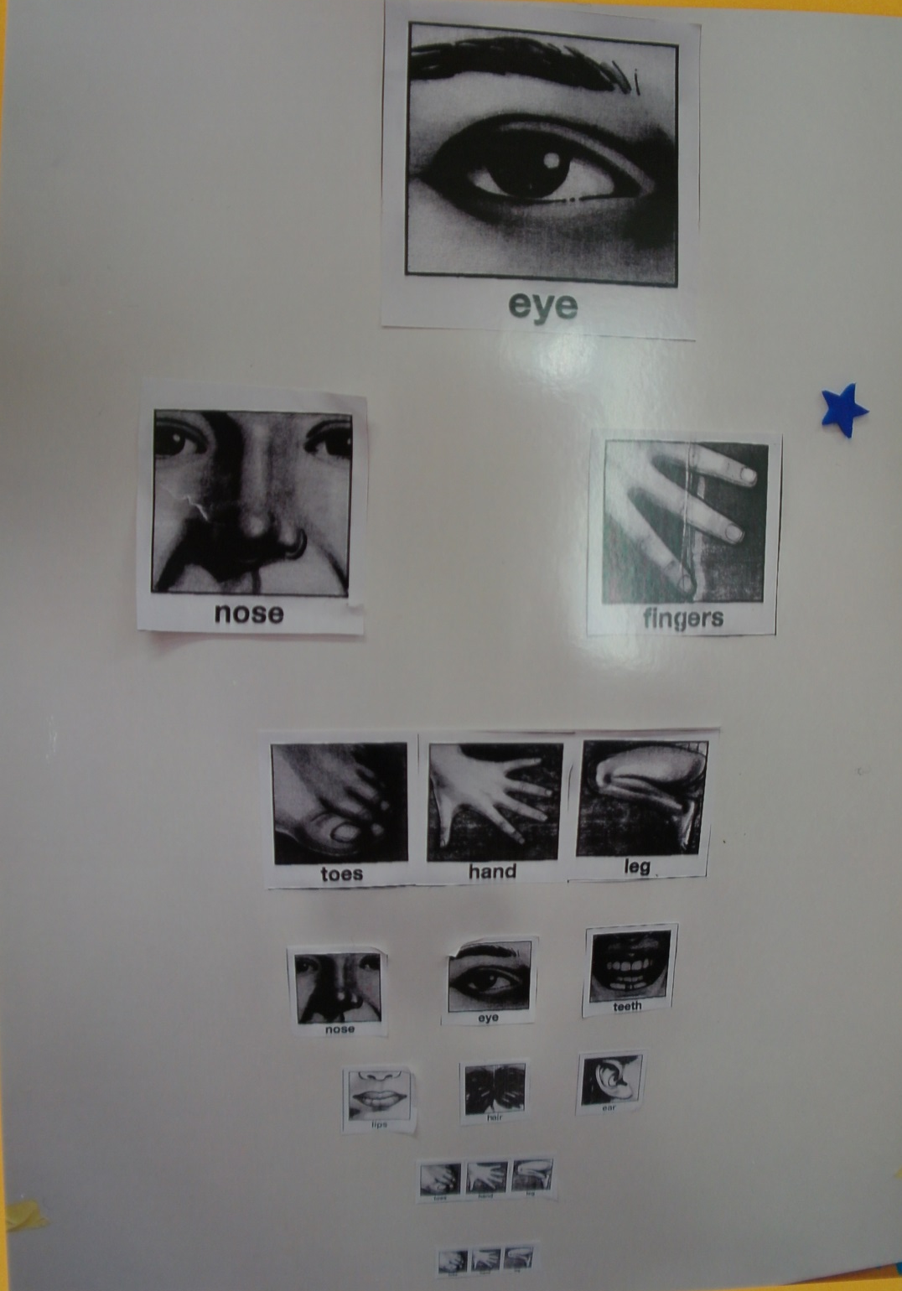
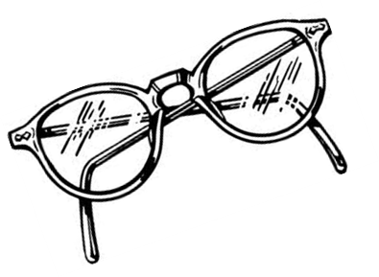
And of course we need an Eye Chart
Intellectual Development Language and Emergent Literacy:
Incorporate ideas from prior experiences into play and exploration.
The students picked pictures of body parts for their eye chart.

Slide 12
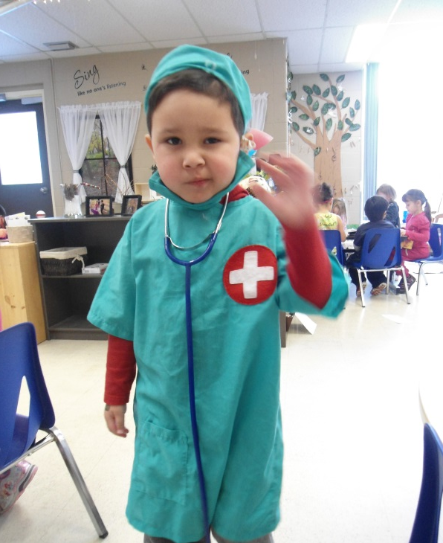
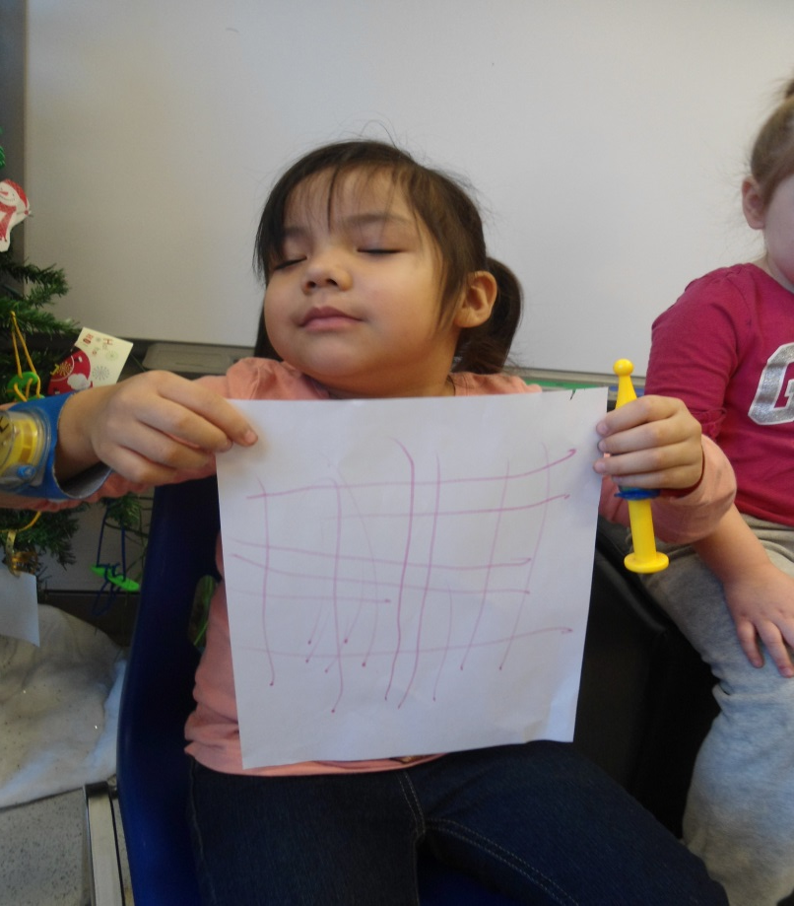
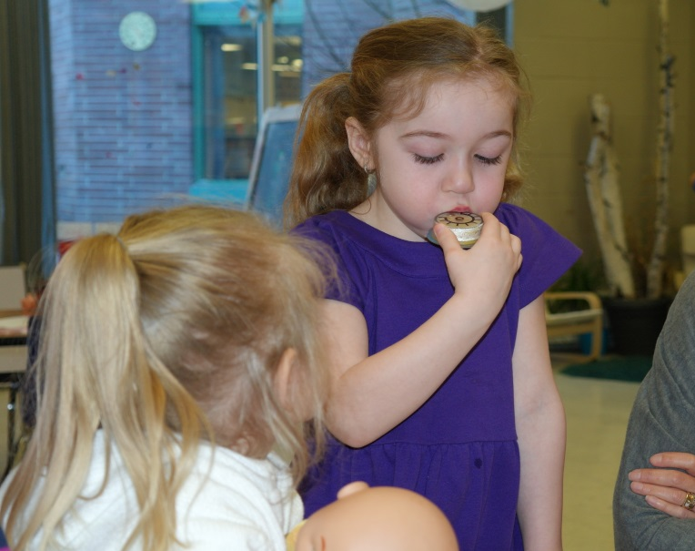
L.“My bones.”
M. “If there’s any patients, I blow the whistle so all the doctors and nurses come.”
The Doctor’s Office opened up a lot of creative play.
Intellectual Development
Creating and imagining.
Dramatic play

Slide 13
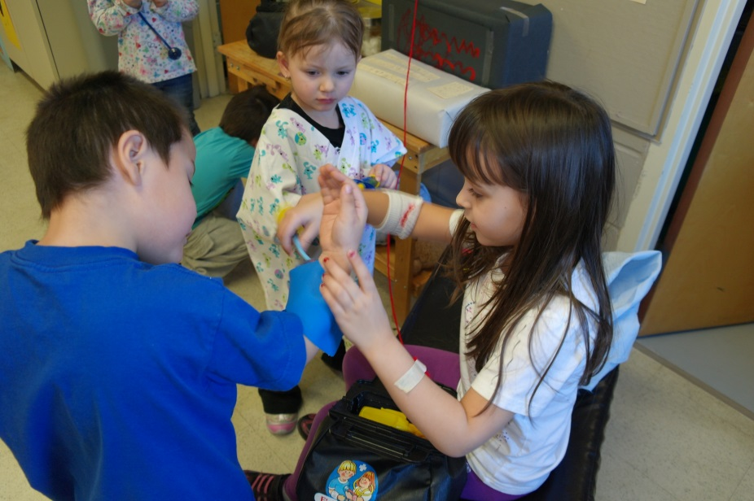
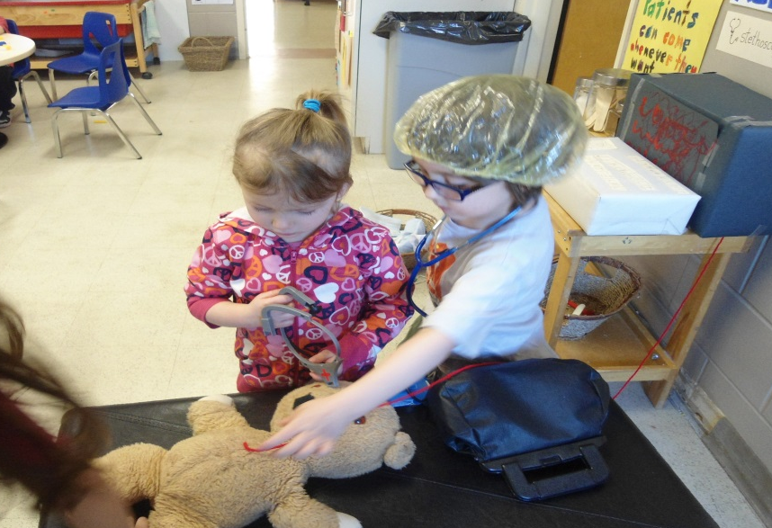
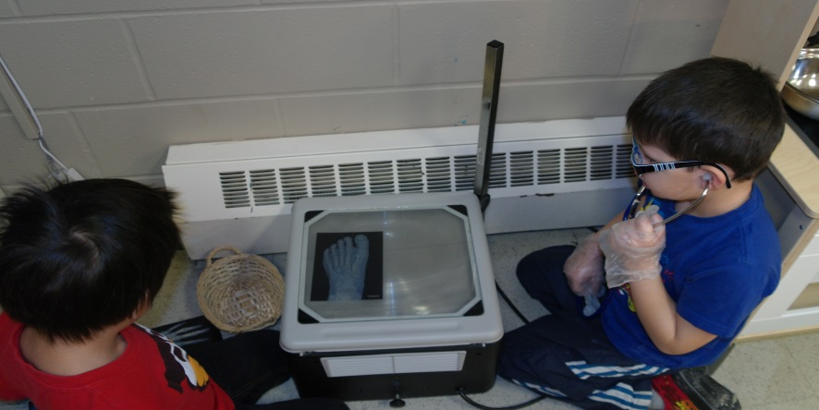
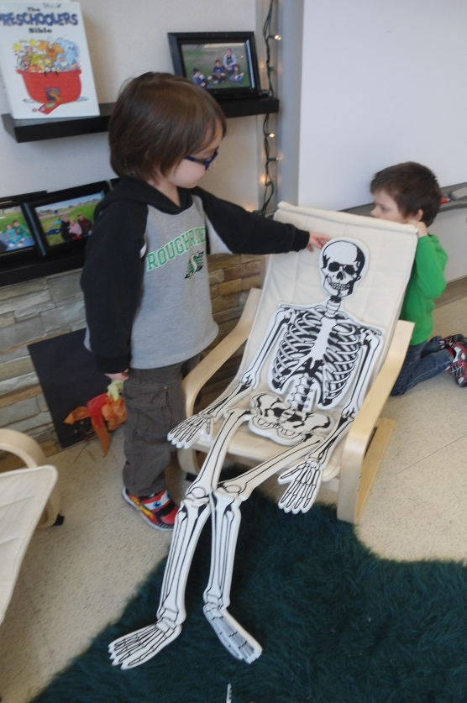
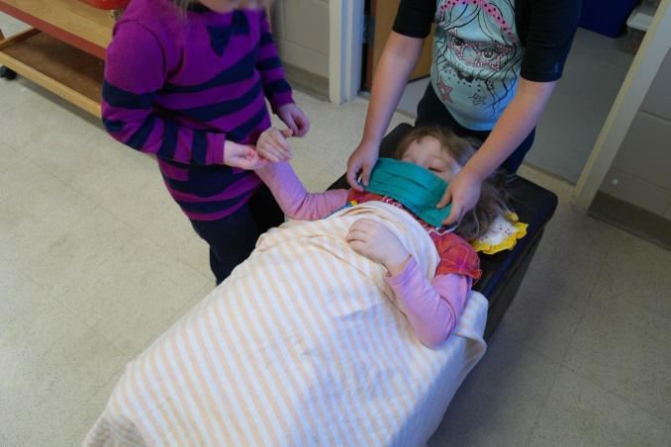
J. “The sun is in his eyes and then his head would fall off.”
Learn as we play

Slide 14
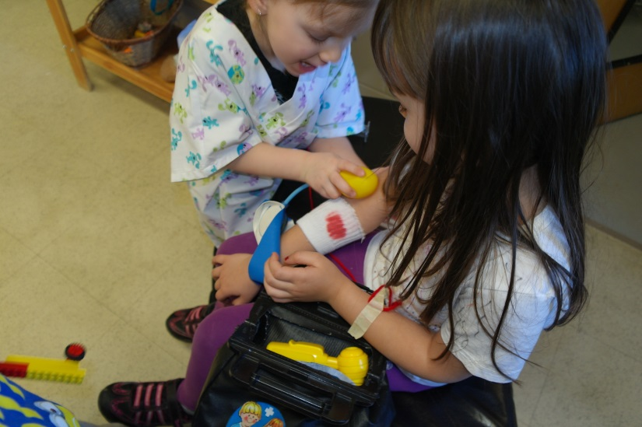
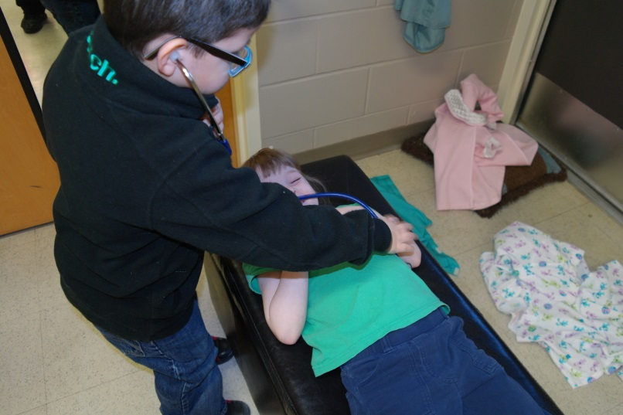
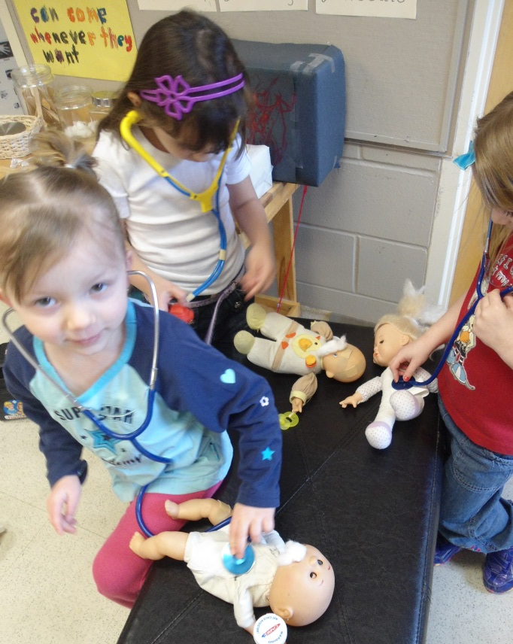
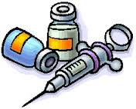
S. “I got bones. Bones in my body.”
Play as we learn

Slide 15
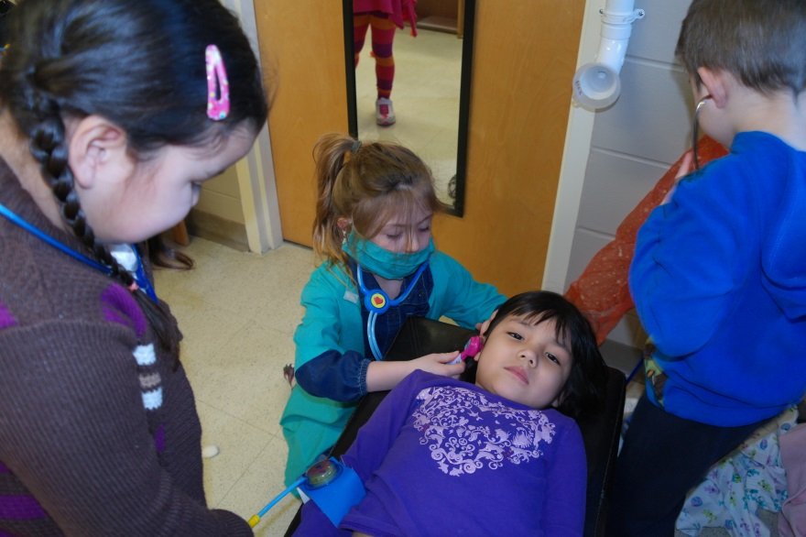
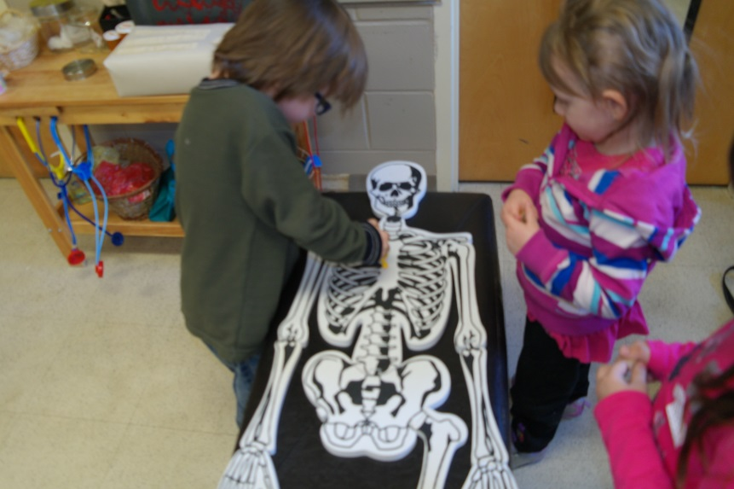
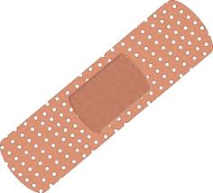
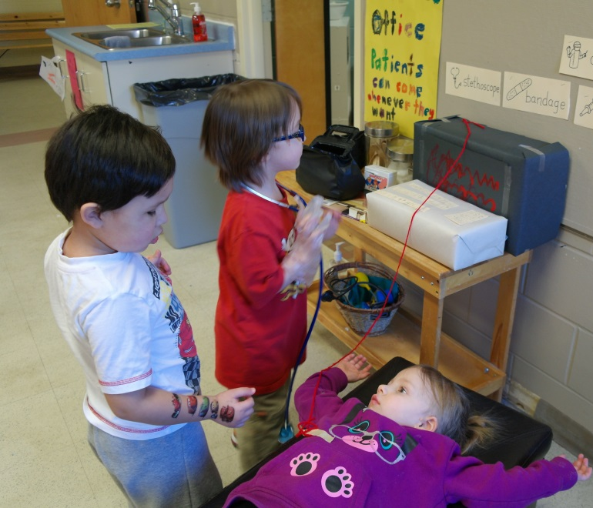
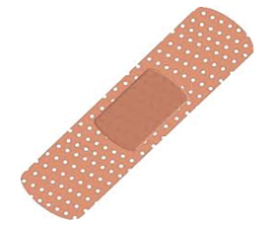
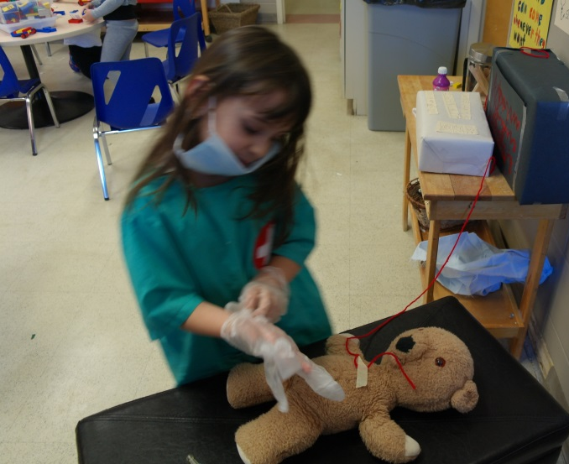
While playing in the doctor’s office a lot of learning took place.
Social Emotional Development:
Interacting with peers.
Resolving conflict.
J. “It will just take me a couple minutes and I’ll be ready.”

Slide 16
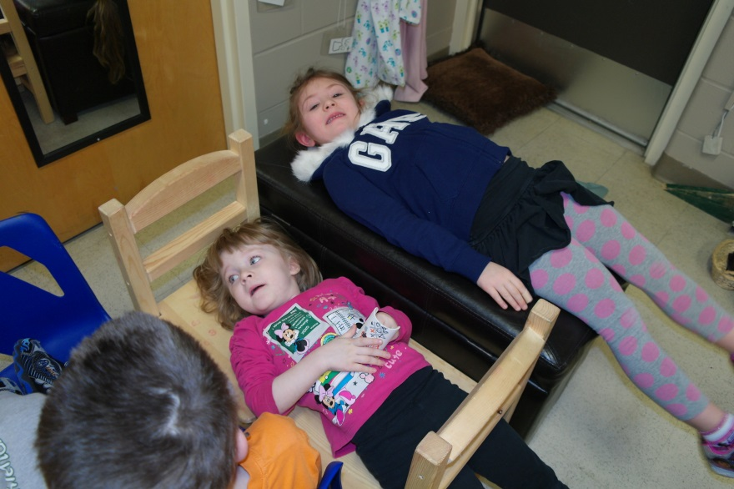
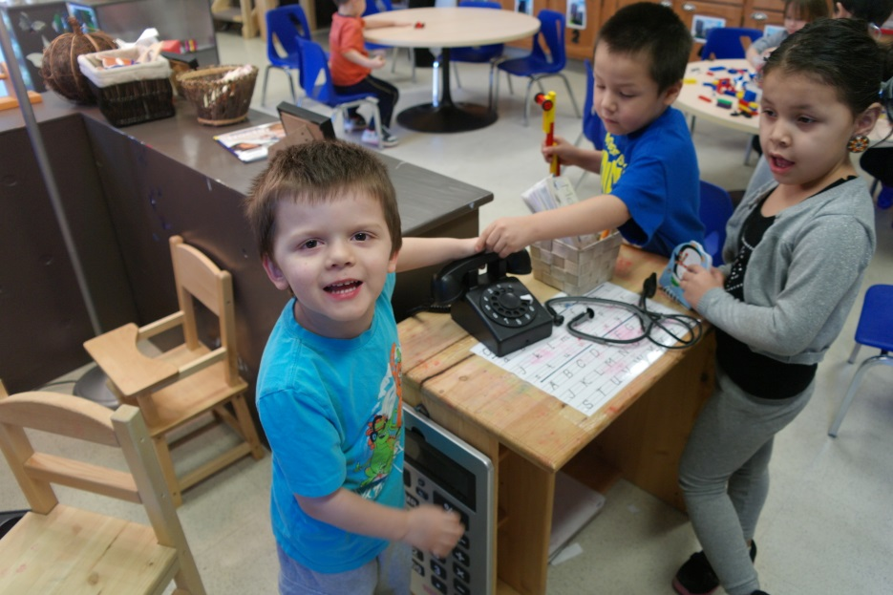
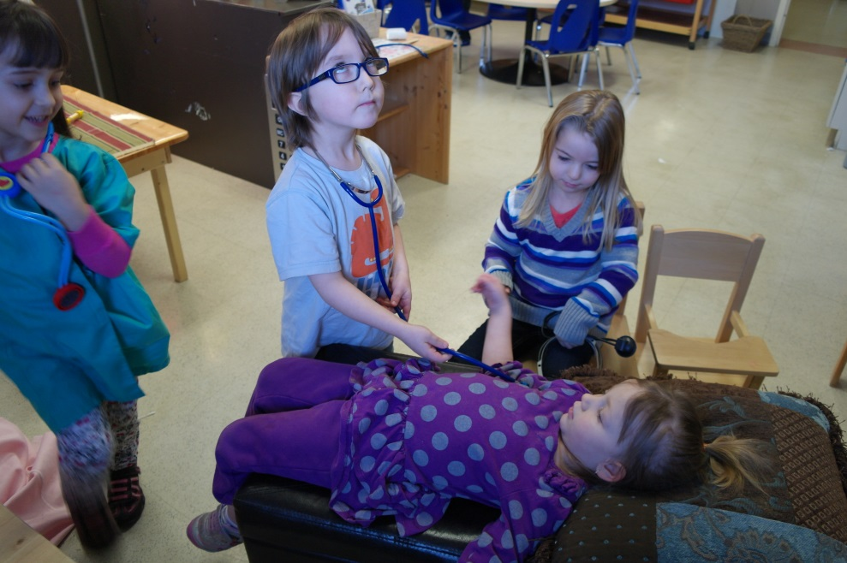
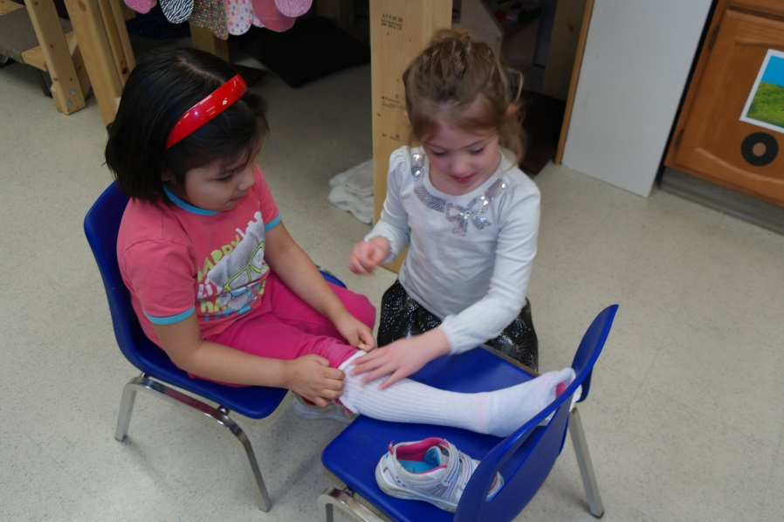
Intellectual Development
Solving problems.
Creating and imagining.
Responding to communication initiated by others.
B. “Someone called and said they have a booboo. Why’d they call here?”
Mrs. Walls “Isn’t this a doctor’s office?”
B. “Oh ya! (picks up the phone) Come to the office.”

Slide 17
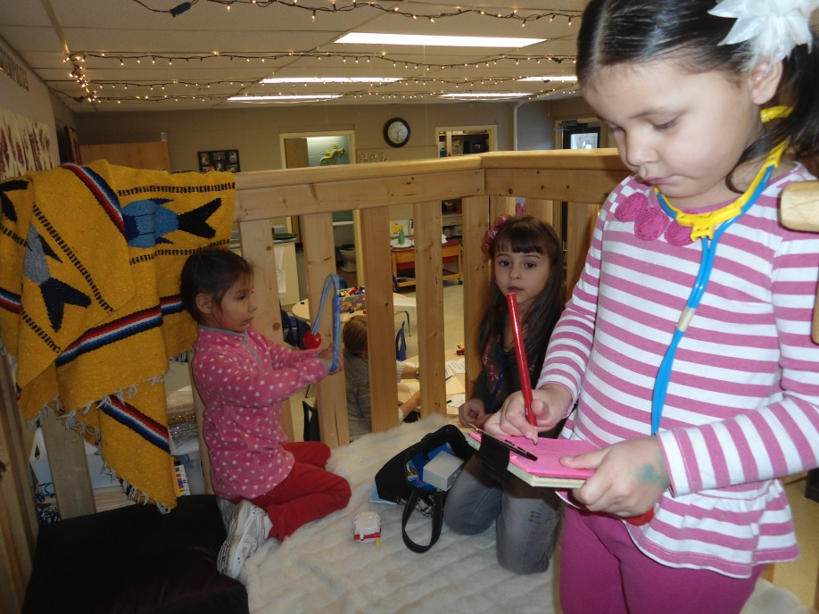
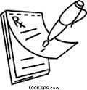
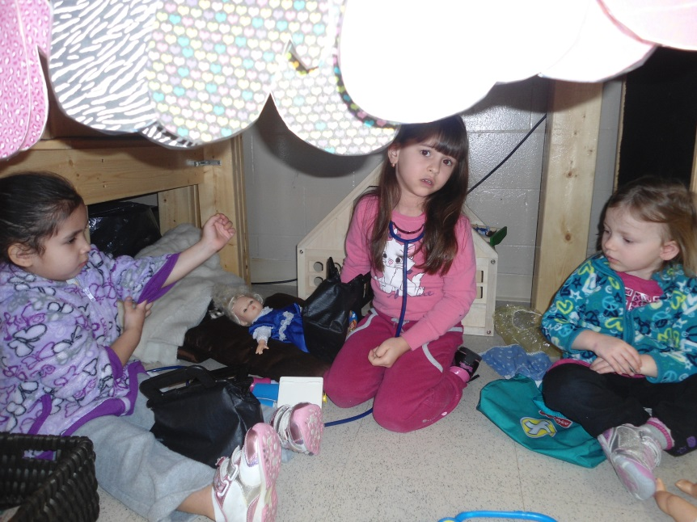
M. “This is the baby doctor place. This chair is to change the babies. This chair is for the mommies to wait.
Baby Clinic
Taking notes about patient
Kaylee “It’s a baby hospital.”
Intellectual Development Language and Emergent Literacy
Exploring how print works.
Engaging in role play writing.

Slide 18
1st count and sort
Our Pharmacy
Next pour
Then put the lid on

Slide 19
L. “I need my medication.”
M. “You need three blue and two red.
Intellectual Development
Recognizing attributes and characteristics (sorting by color and size).
Exploring numeracy
Using numbers and numeracy concepts to count.
Physical Development
Developing fine motor skills.

Slide 20
Parents and staff came to see the doctors.
“My tummy hurts.”

Slide 21
All doctors stat!!

Slide 22
A. “I was pretty scared cause it was really, really, really wet. You have to get some dry water.”
How to make a cast.
Intellectual Development: Language and Emergent Literacy:
Responding to communication initiated by others (teacher)
Following one or two step directions.
Physical Development
Developing fine motor skills.

Slide 23
“It feels like when you put your own hand in a wrapper” M.
“It feels smooth and watery.” S.

Slide 24
All casts must be signed by friends
Intellectual Development Language and Emergent Literacy:
Exploring how print works.

Slide 25
Each class wrote a story (together) telling how this person broke her arm. It was a great opportunity for the students to be creative, share ideas and work together.
Intellectual Development: Language and Emergent Literacy:
Recounting an event or experience, retelling or telling a story. Being able to create a brief imaginative narrative.

Slide 26
Learning about weight and measurement
Intellectual Development; exploring numeracy.
Using numbers and numeracy concepts to count measure and compare.
Learning about our body parts

Slide 27
J. “See if I’m the same size.”
Intellectual Development:
Recognizing attributes and characteristics. Comparing materials using differences such as size and shape.

Slide 28
We wrapped up our Doctor Project with a visit from WPD
S. “I was a little scared but it was fun. I thought they were going to take me and put me in the back of the car.”
L. “It was fun up there.”
A. “I can see everything!”

Slide 29
J. “Checking his heart. Putting something on his ear.”
Using the radio.
Intellectual Development”
Listening with interest and engagement during brief experiences with spoken language.
Showing interest, watching intently and making comments.

Slide 30
S. “My heartbeat.”
L. “Put that machine on me and it tickled me.”
D. “Checking my heart. Some stickers on me.”

Slide 31
“I was scared in there.” M.
“He had a telescope.” M.
“We covered our ears. The siren was loud.” M.
J. “The siren isn’t as loud as my yelling voice.”
Intellectual Development;
Recounting an event or experience.

