Slide 1
Our Exploration of Shapes
By Kaylee Peters and Kyrstin Millham- Norton

Slide 2
The topic for our project was shapes. We identified this topic because we are a mixed age group center and many of our children spend a portion of their day at either kindergarten or Pre-k. We noticed that the older children were coming back with a general knowledge of shapes . We then noticed on several occasions that these older children were helping the younger children identify the different shapes of a puzzle. This sparked the idea for the topic because we thought that since many of our children had prior knowledge of the basic concept of shapes they could then help “teach"their younger peers what they knew, as well as expanding on the things the older children already knew.

Slide 3
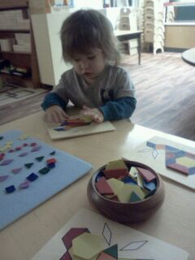
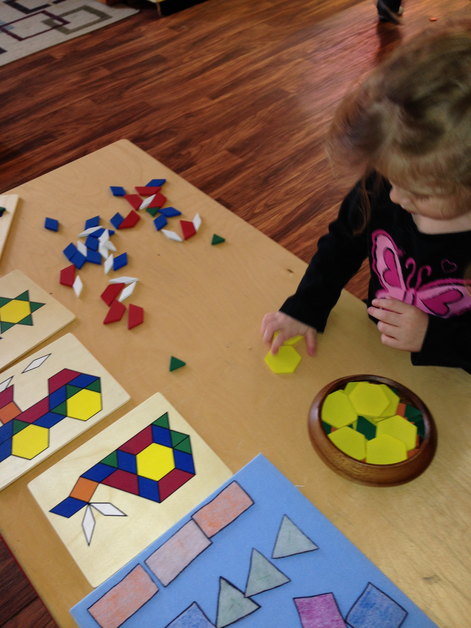
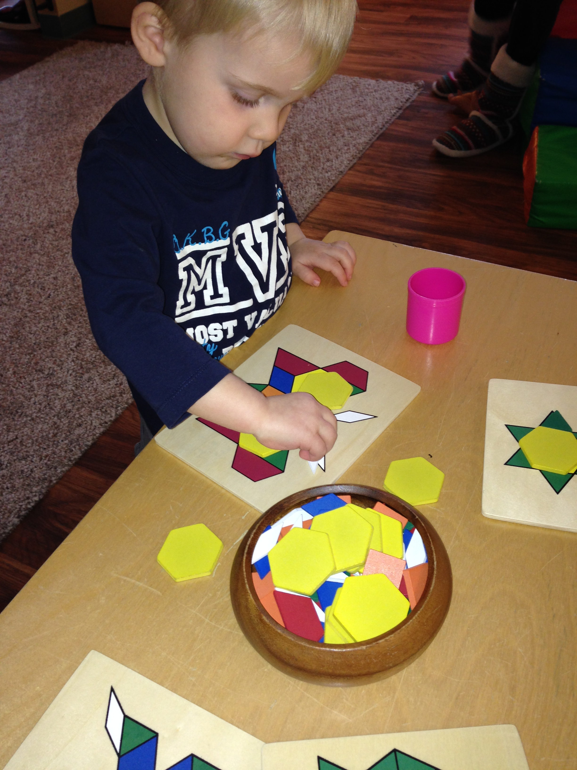
We opted not to do a topic web with the children, instead we jumped right into setting up the invitation. Our invitation consisted of felt board with different shapes, pattern blocks with the pattern boards to follow as well as encouraging the children to try their own patterns and designs. Many children were immediately interested and began experimenting with the shapes.

Slide 4
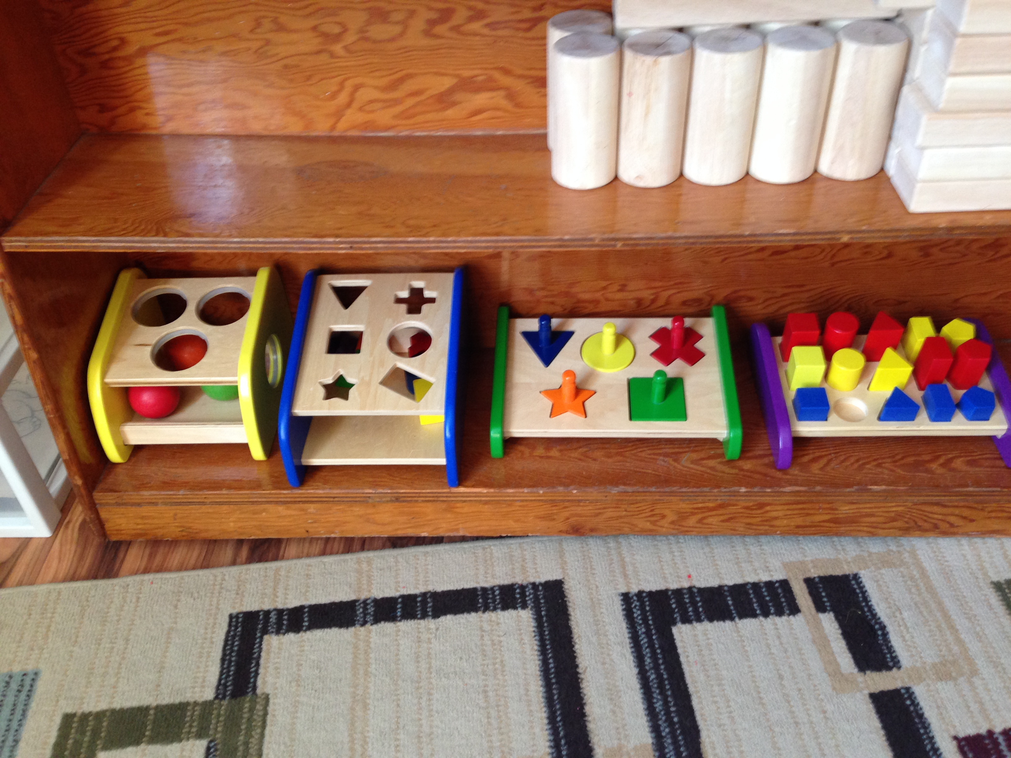
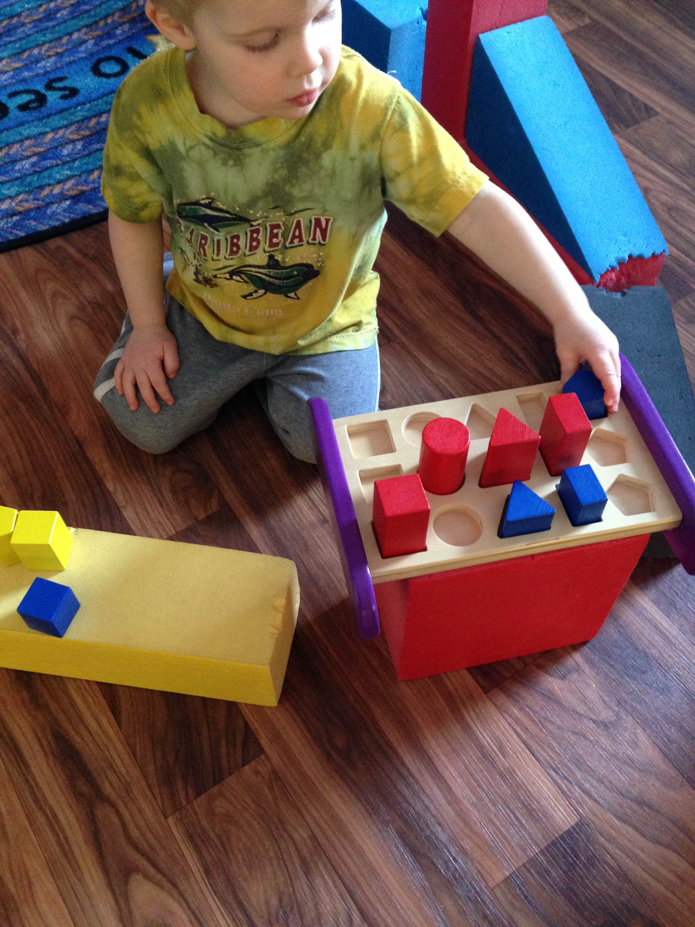
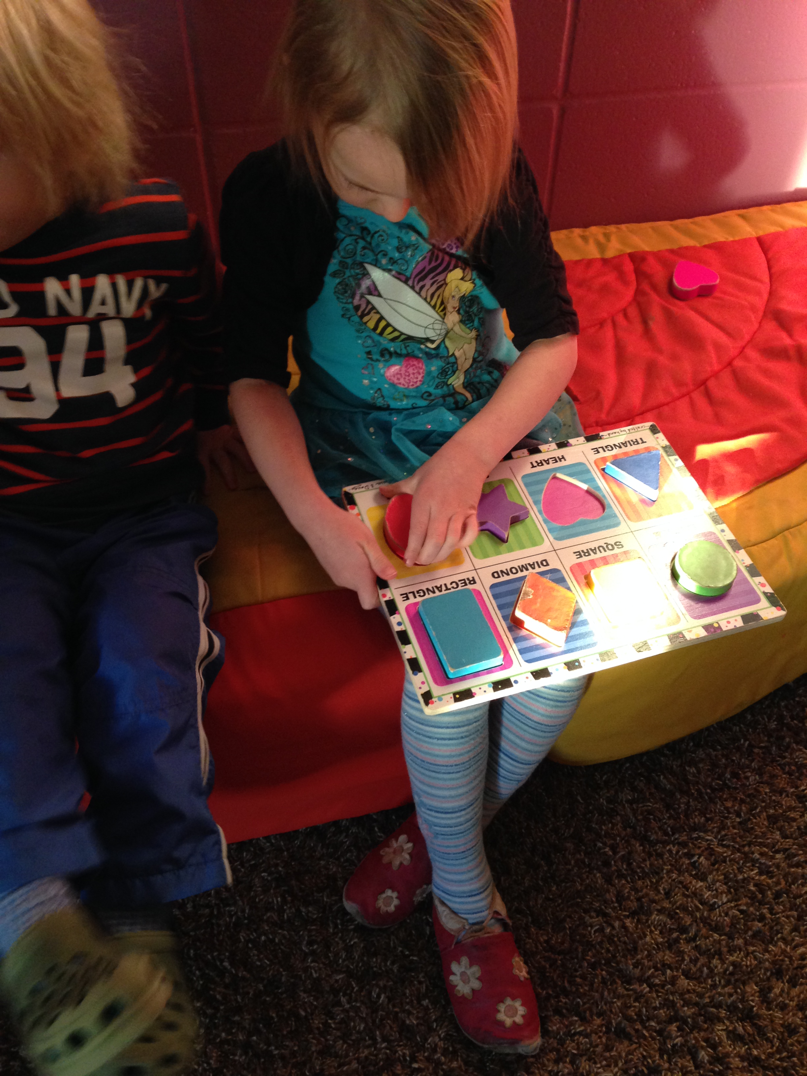
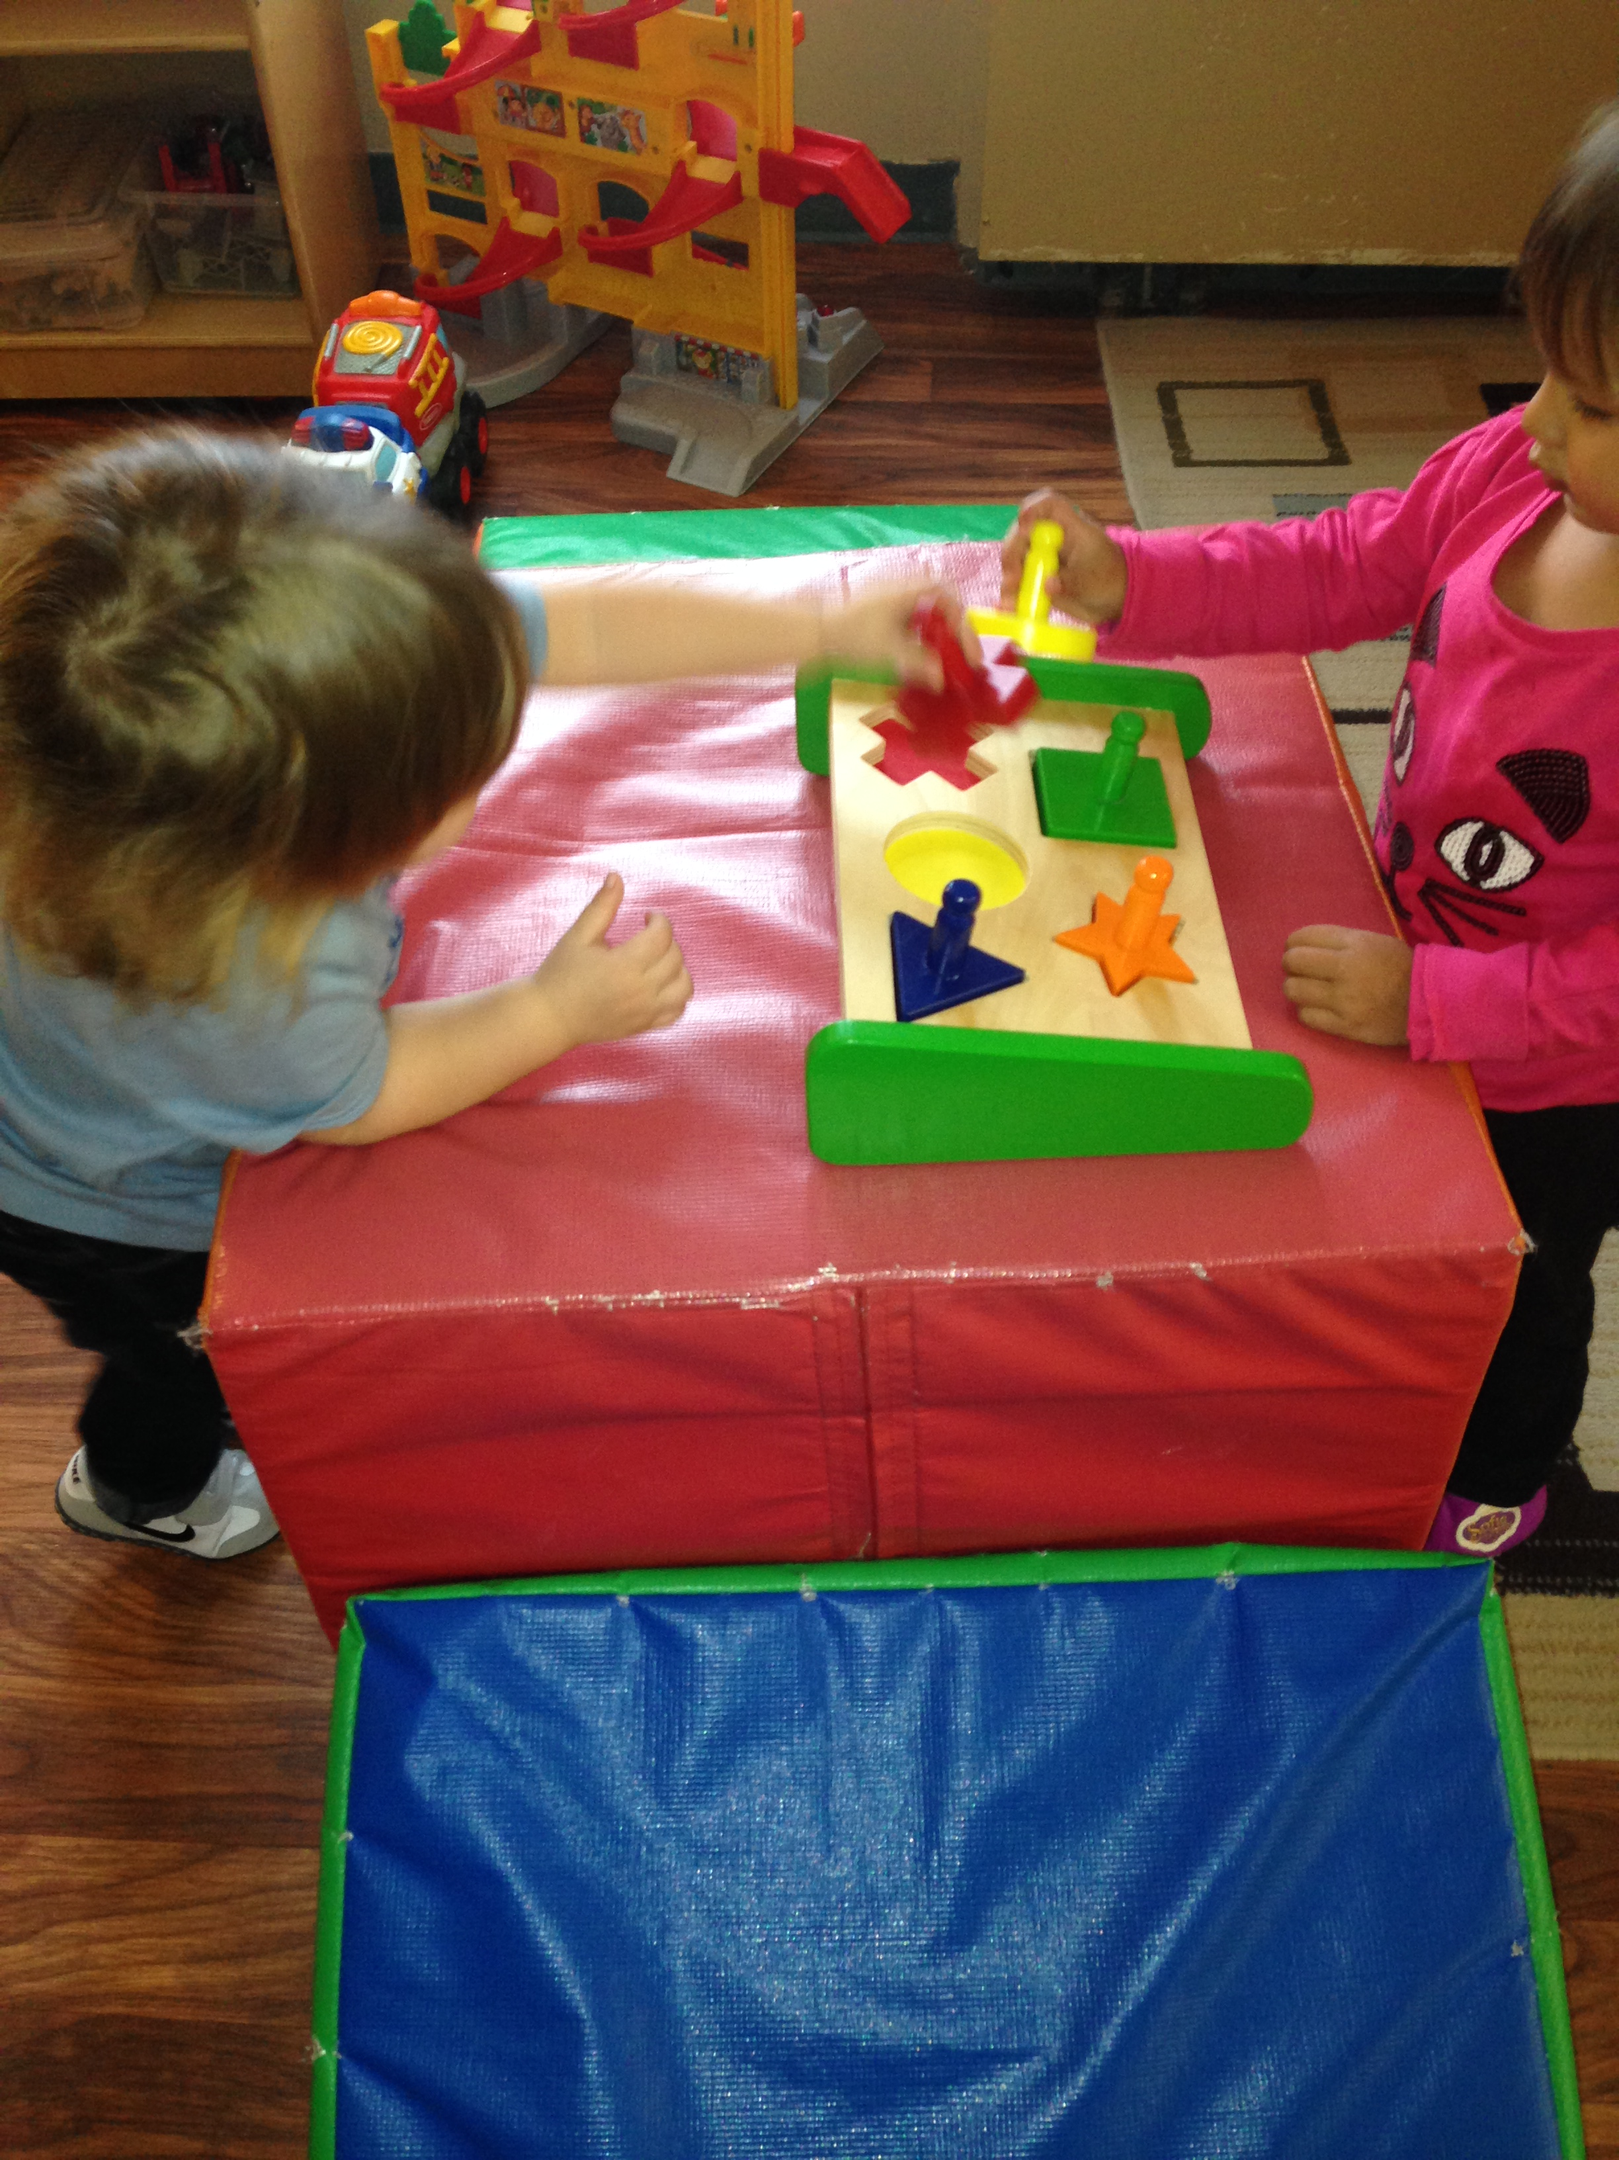
Activities and our explorations
After the invitation was a success and the children showed interest we began presenting them with items that focused around shapes that would be available to them at all times. Some of these items included books, puzzles and sorting toys.

Slide 5
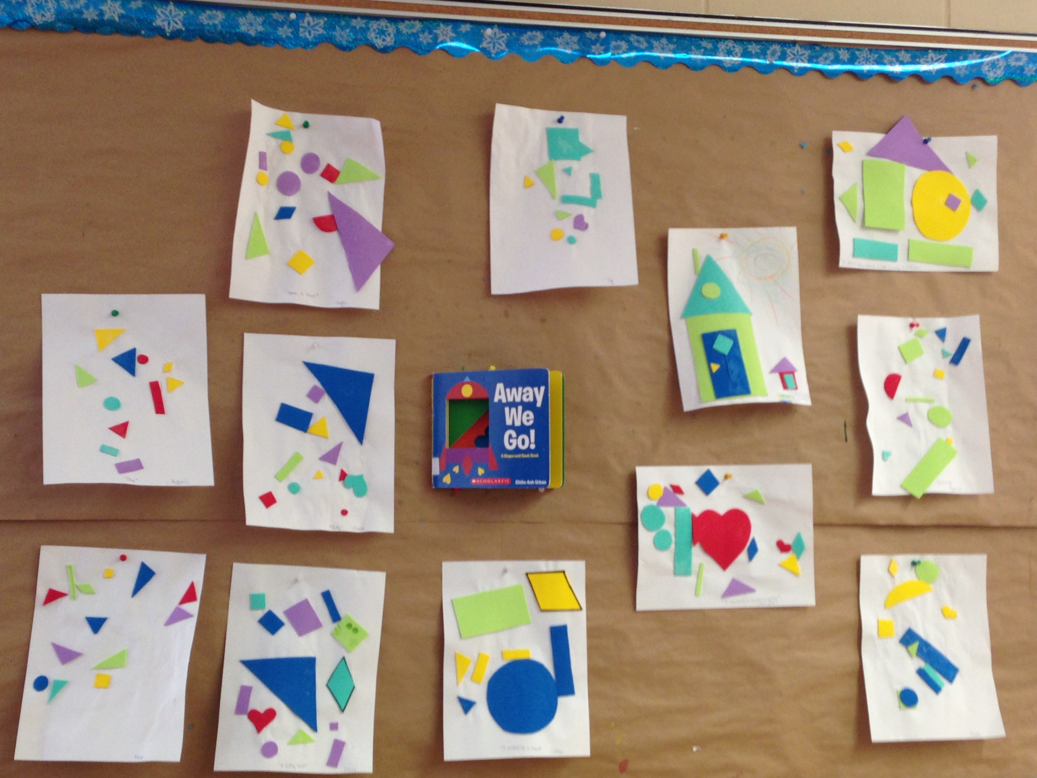
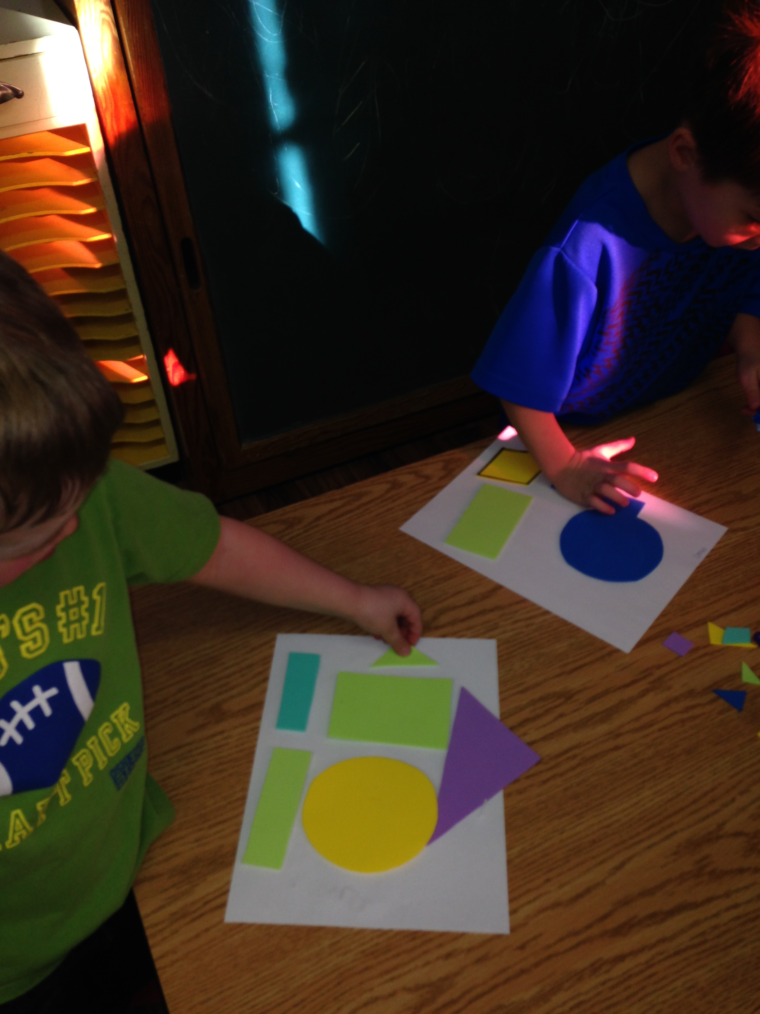
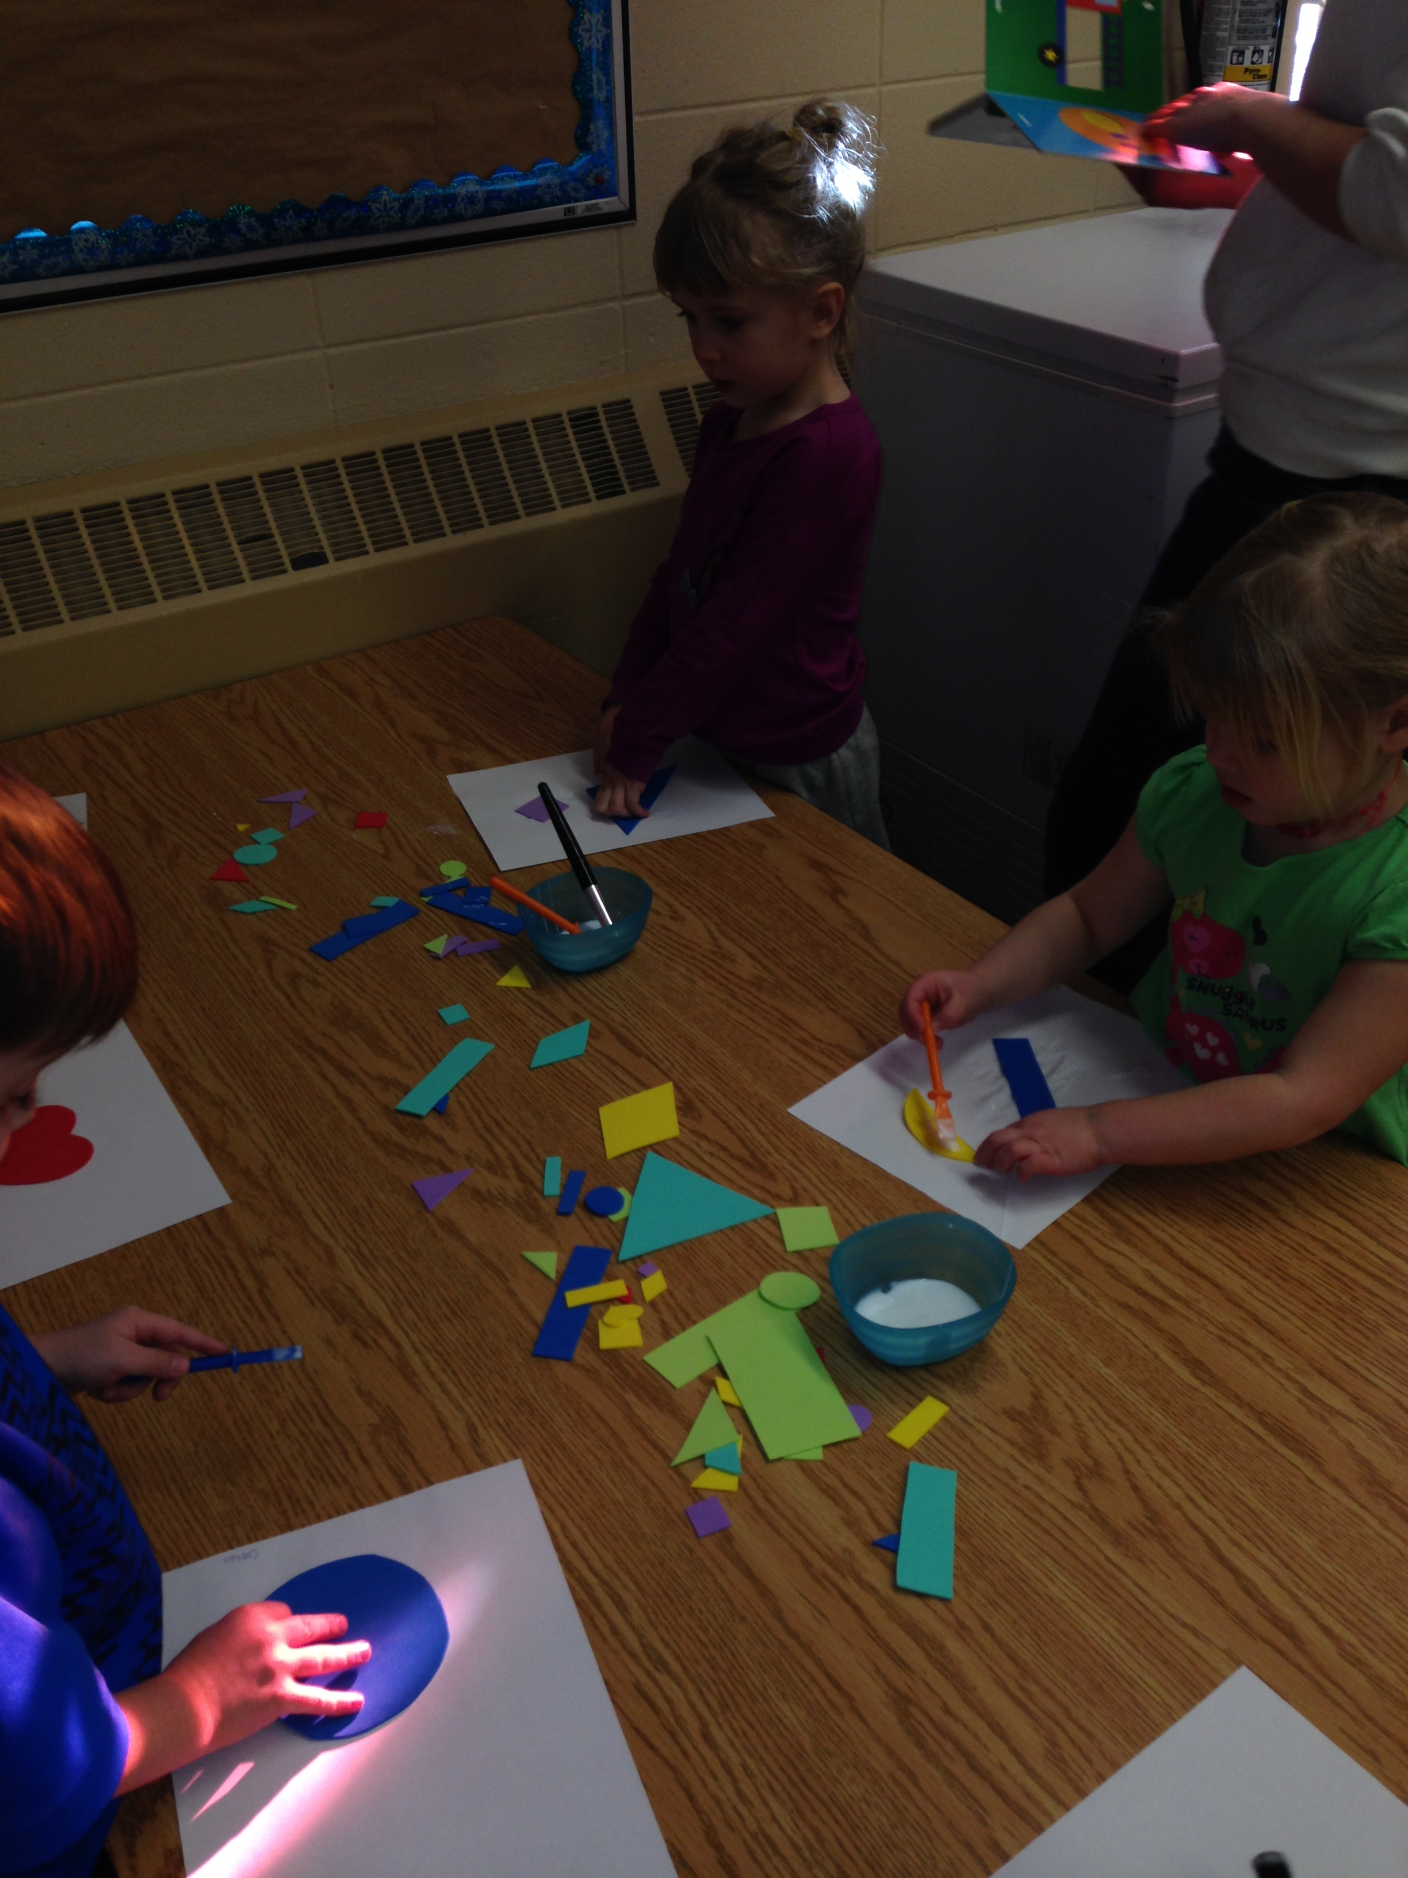
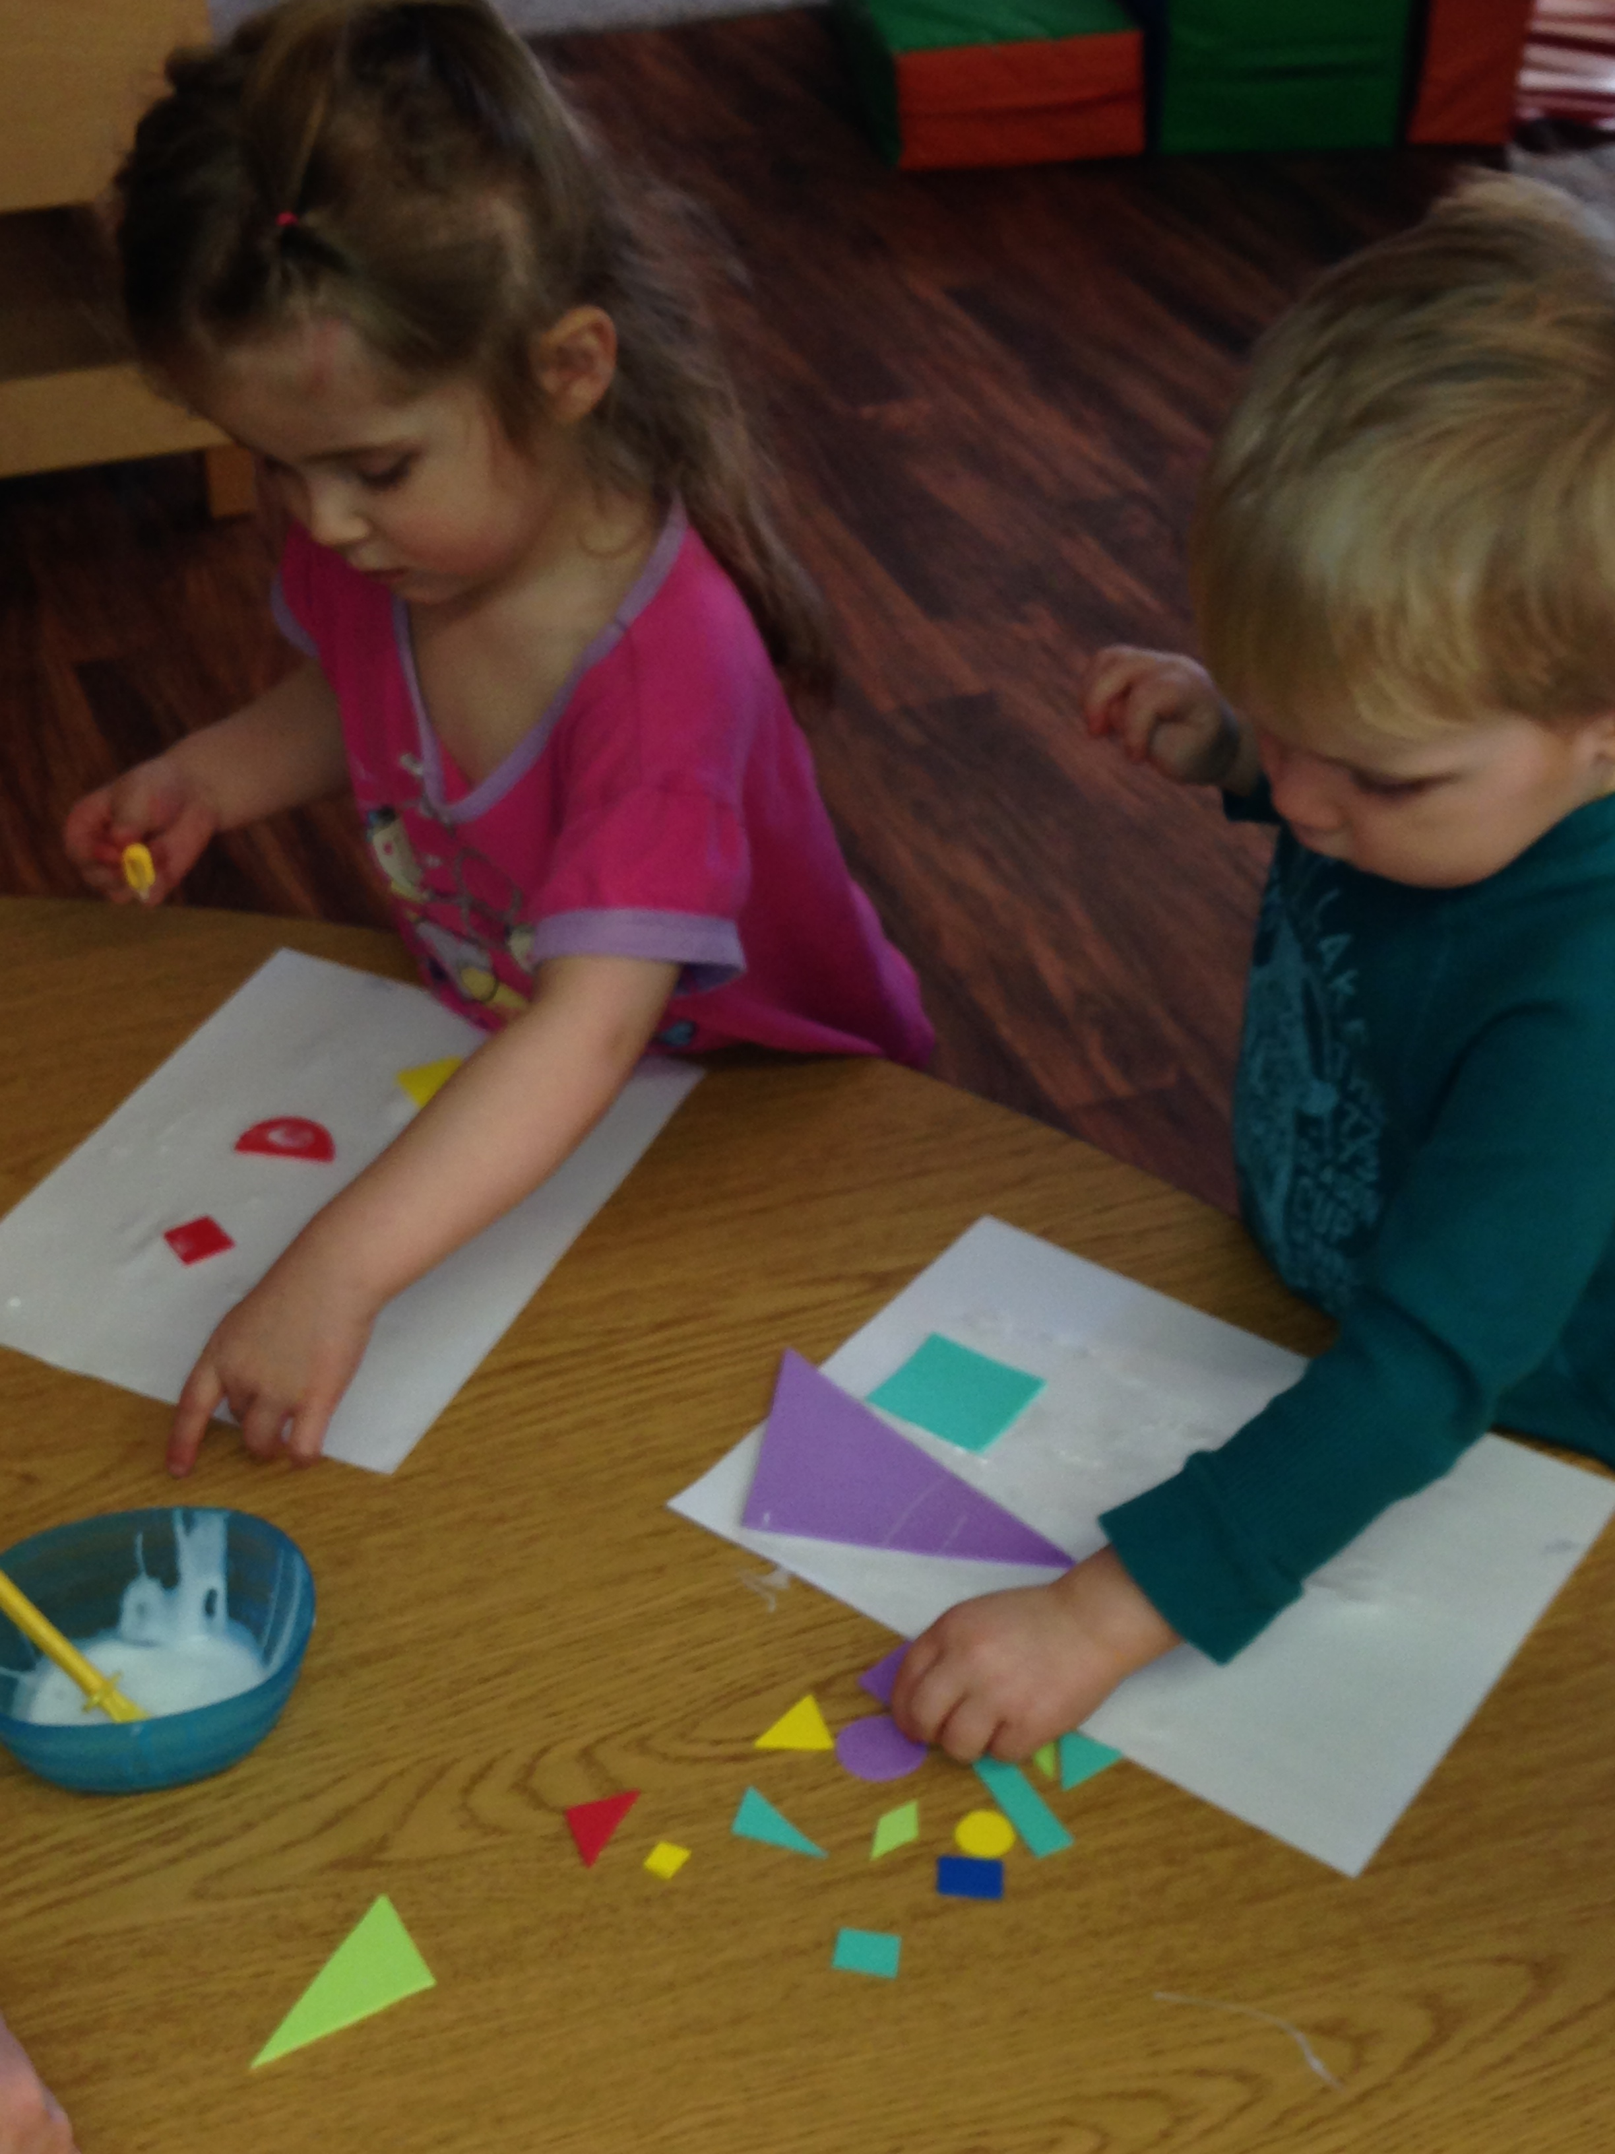
After the children showed interest in the shape related toys and items we began introducing a different shape based activity a few times a week. First we read a book called Away We Go by Chieu Ahn. This book identified all the shapes and how they are present in every day things ie. A car or house. We then presented the children with shapes of construction paper and a blank piece of paper. They then proceeded to create there own “everyday things” with the shapes. After they were finished they told us the story of what they created and we wrote the stories out for them. Many of them were very proud and eager to show their parents their pictures and stories.

Slide 6
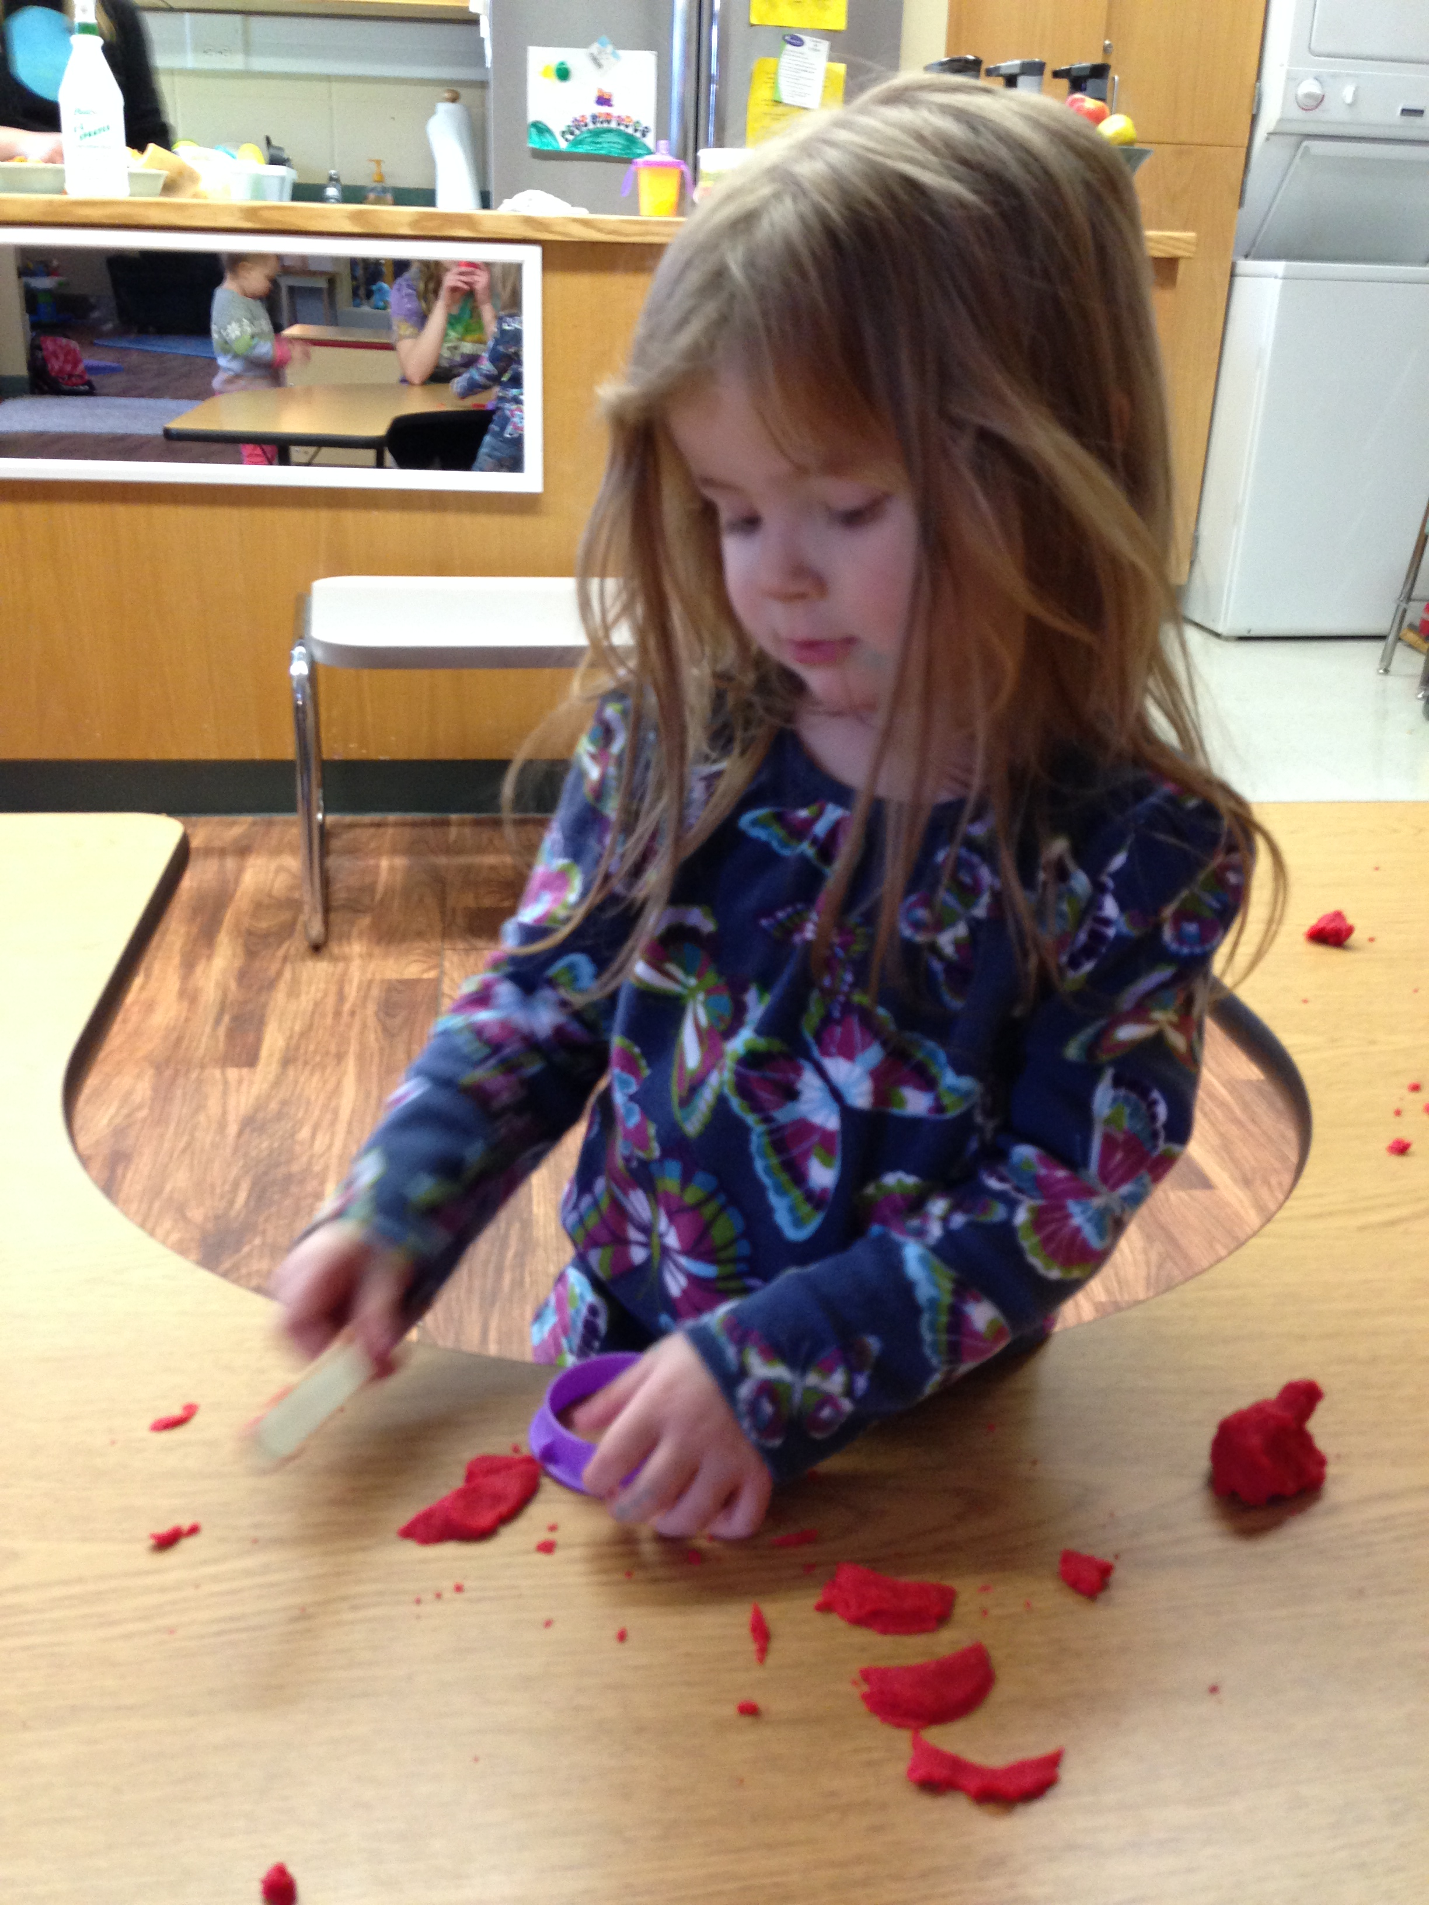
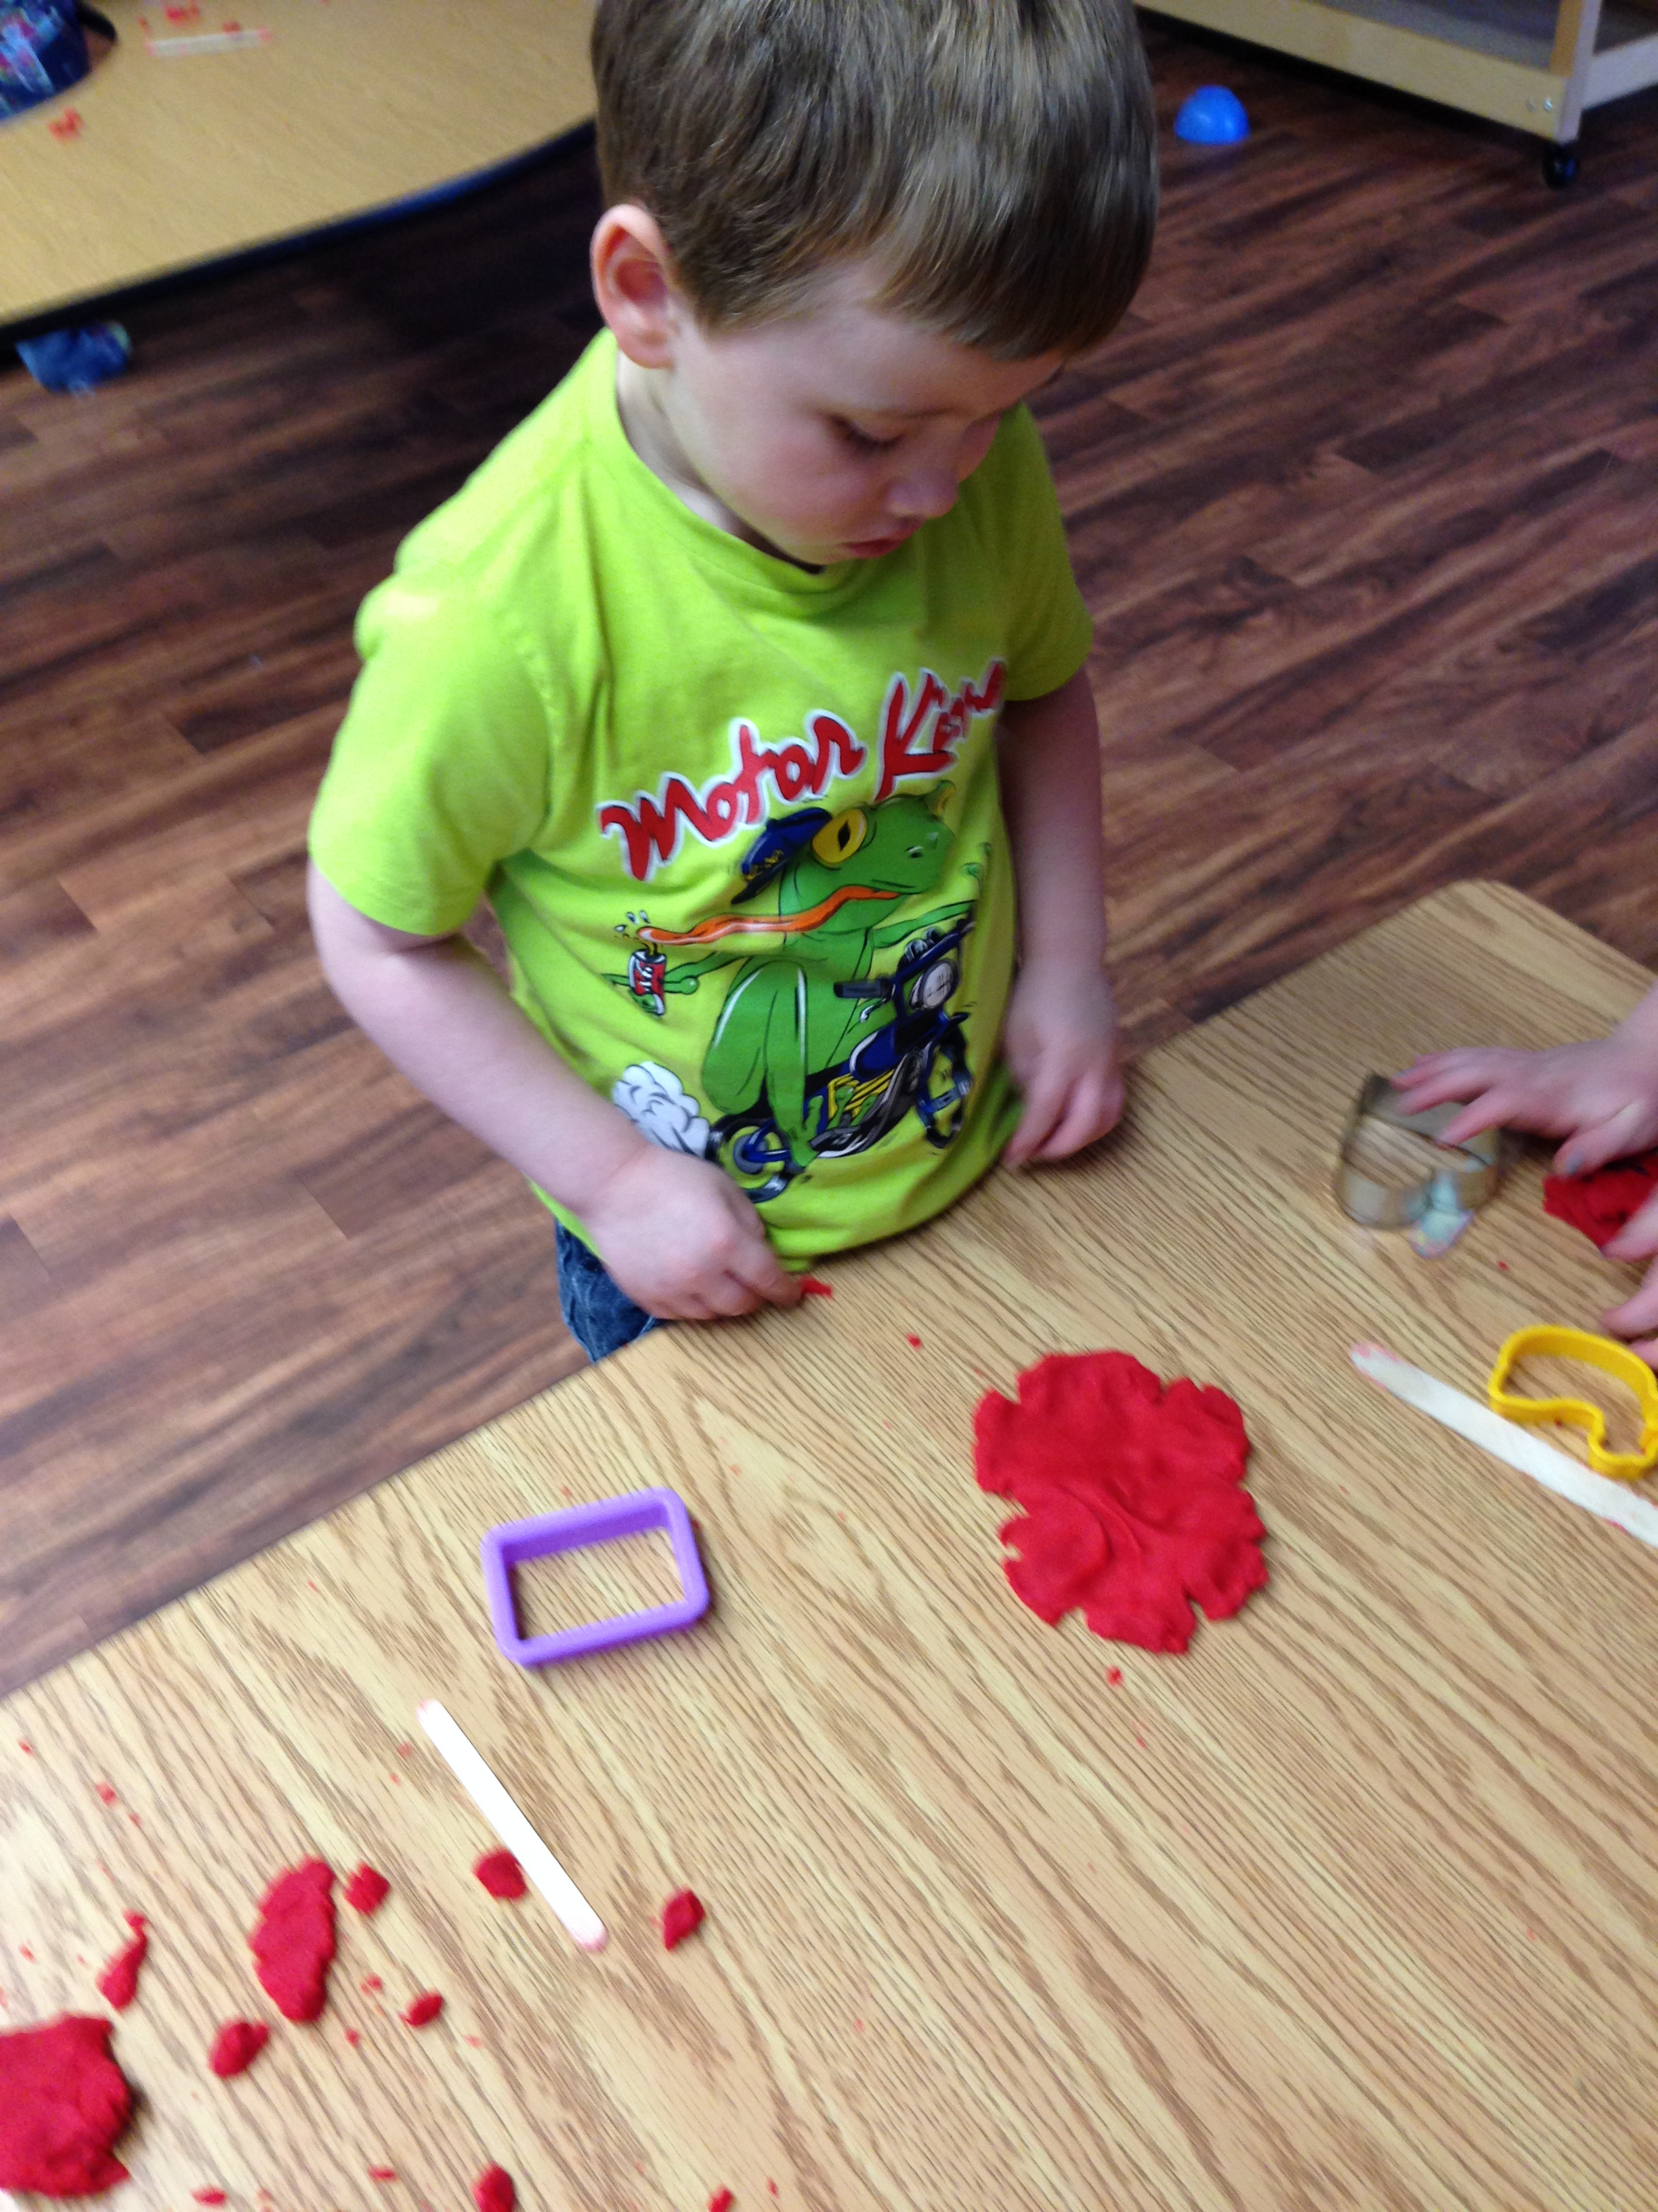
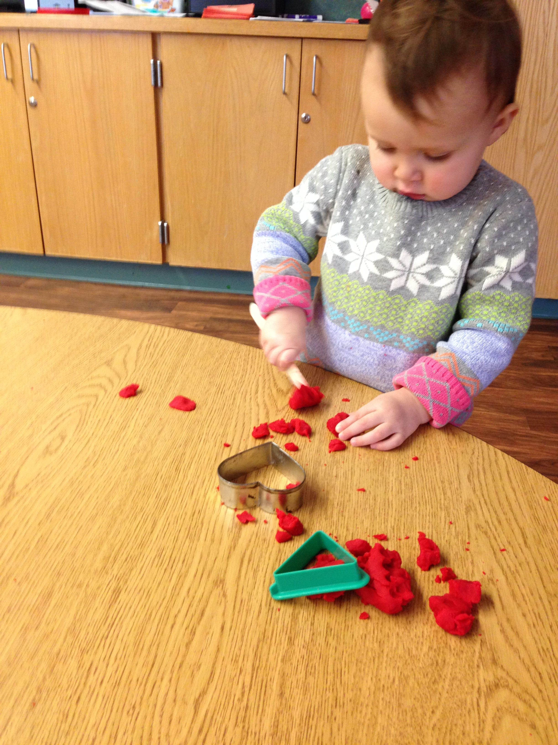
The second experience we had was a sensory experience. We presented the children with play dough and cookie cutters shaped like the various shapes we were learning about. The children really enjoyed themselves and we could tell through their dialogue with each other that the younger children were beginning to be able to identify the names of the shapes on their own. The older children were experimenting with their play dough cut outs and making things like flowers, houses and cookies.

Slide 7
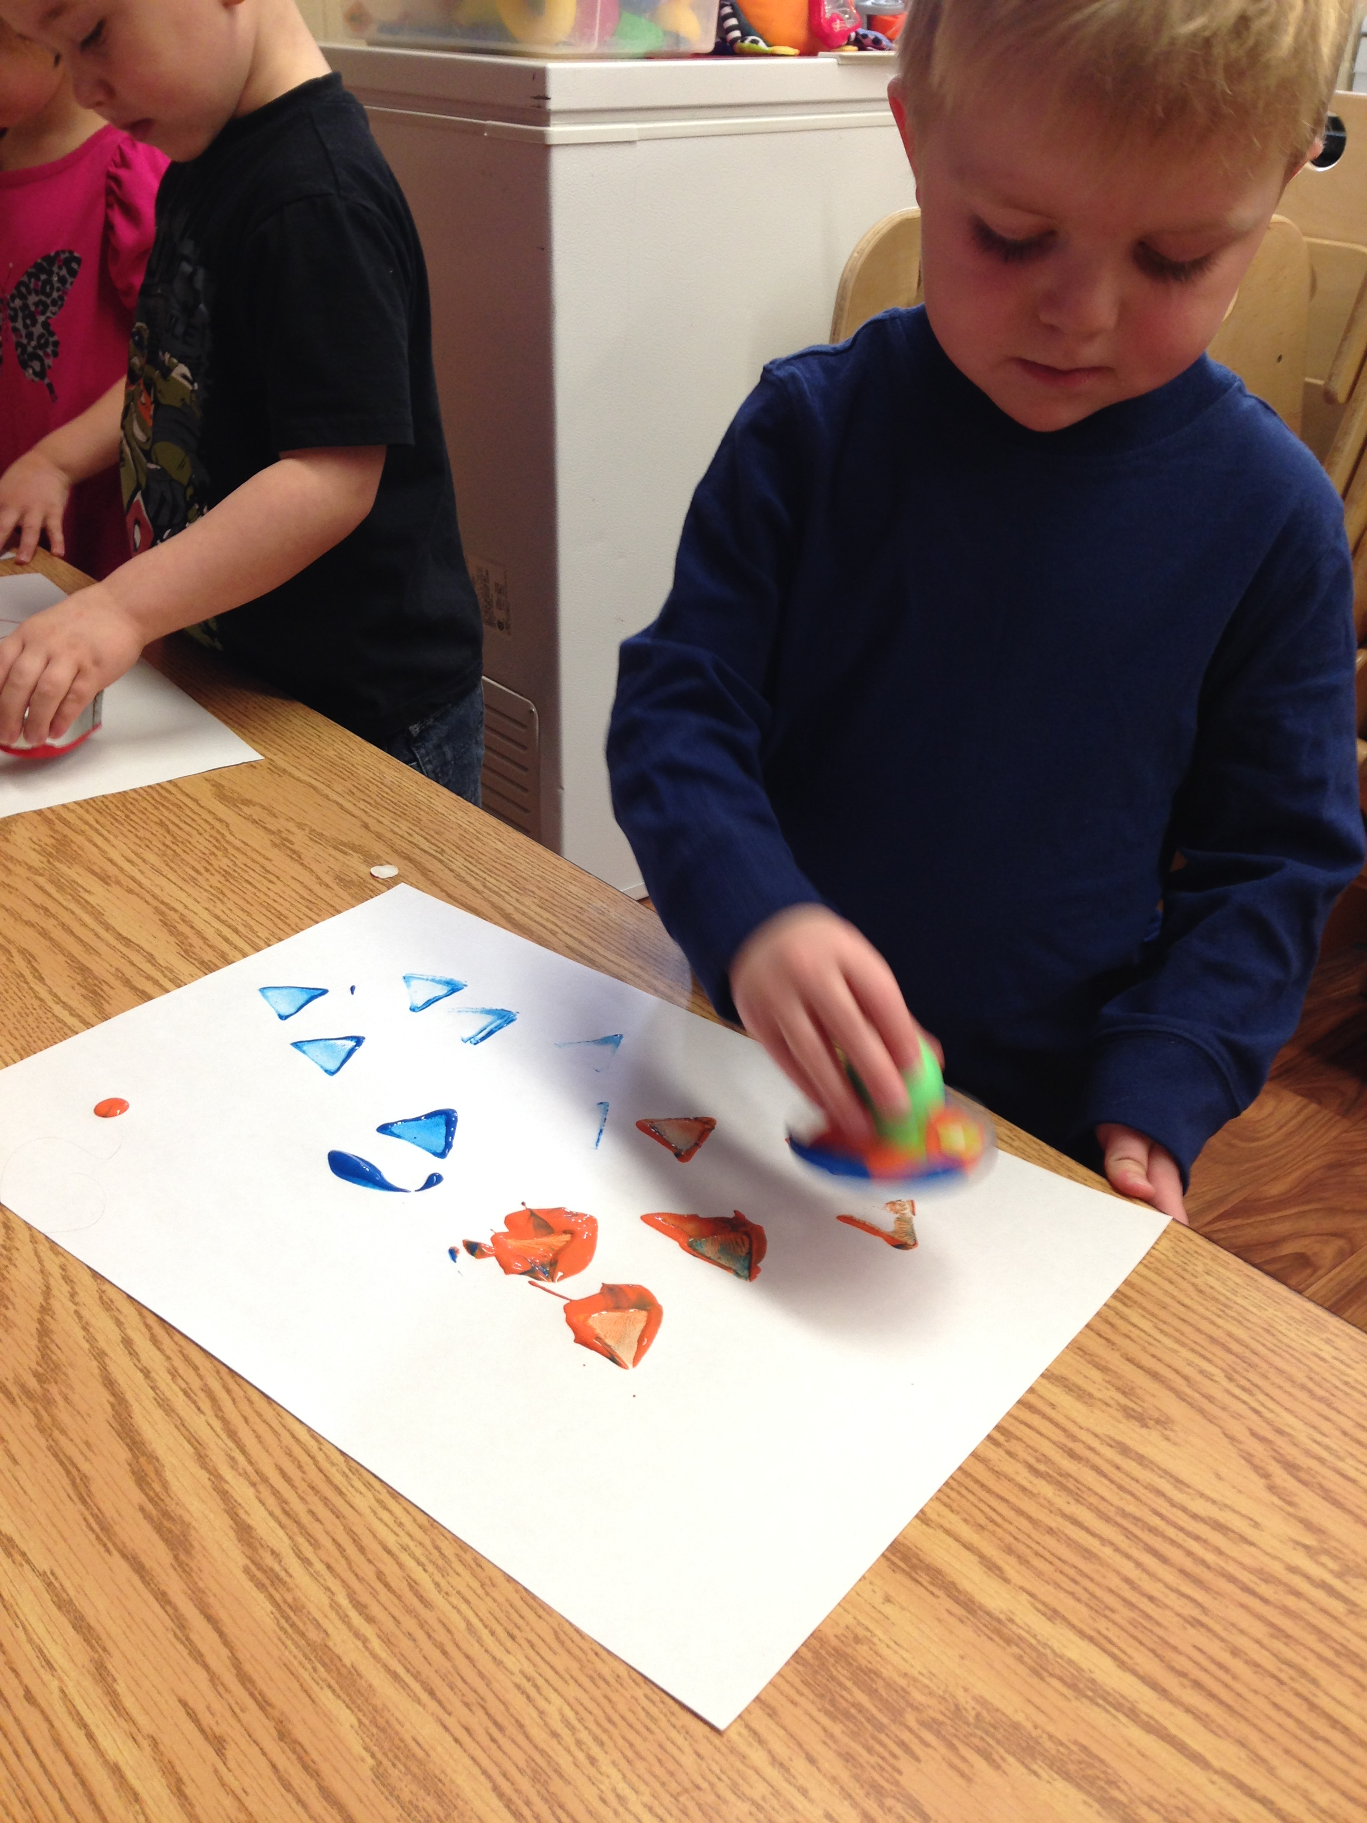
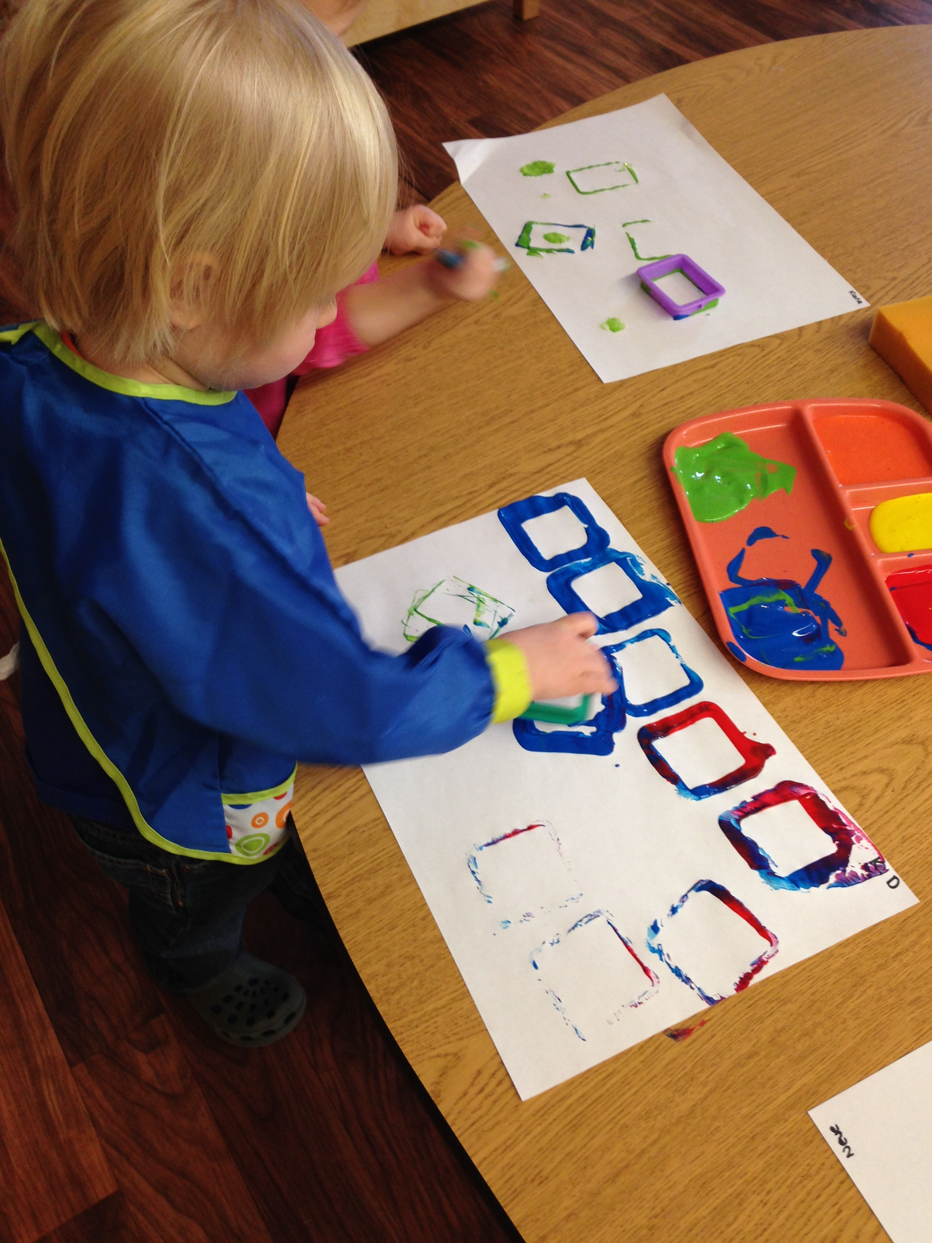
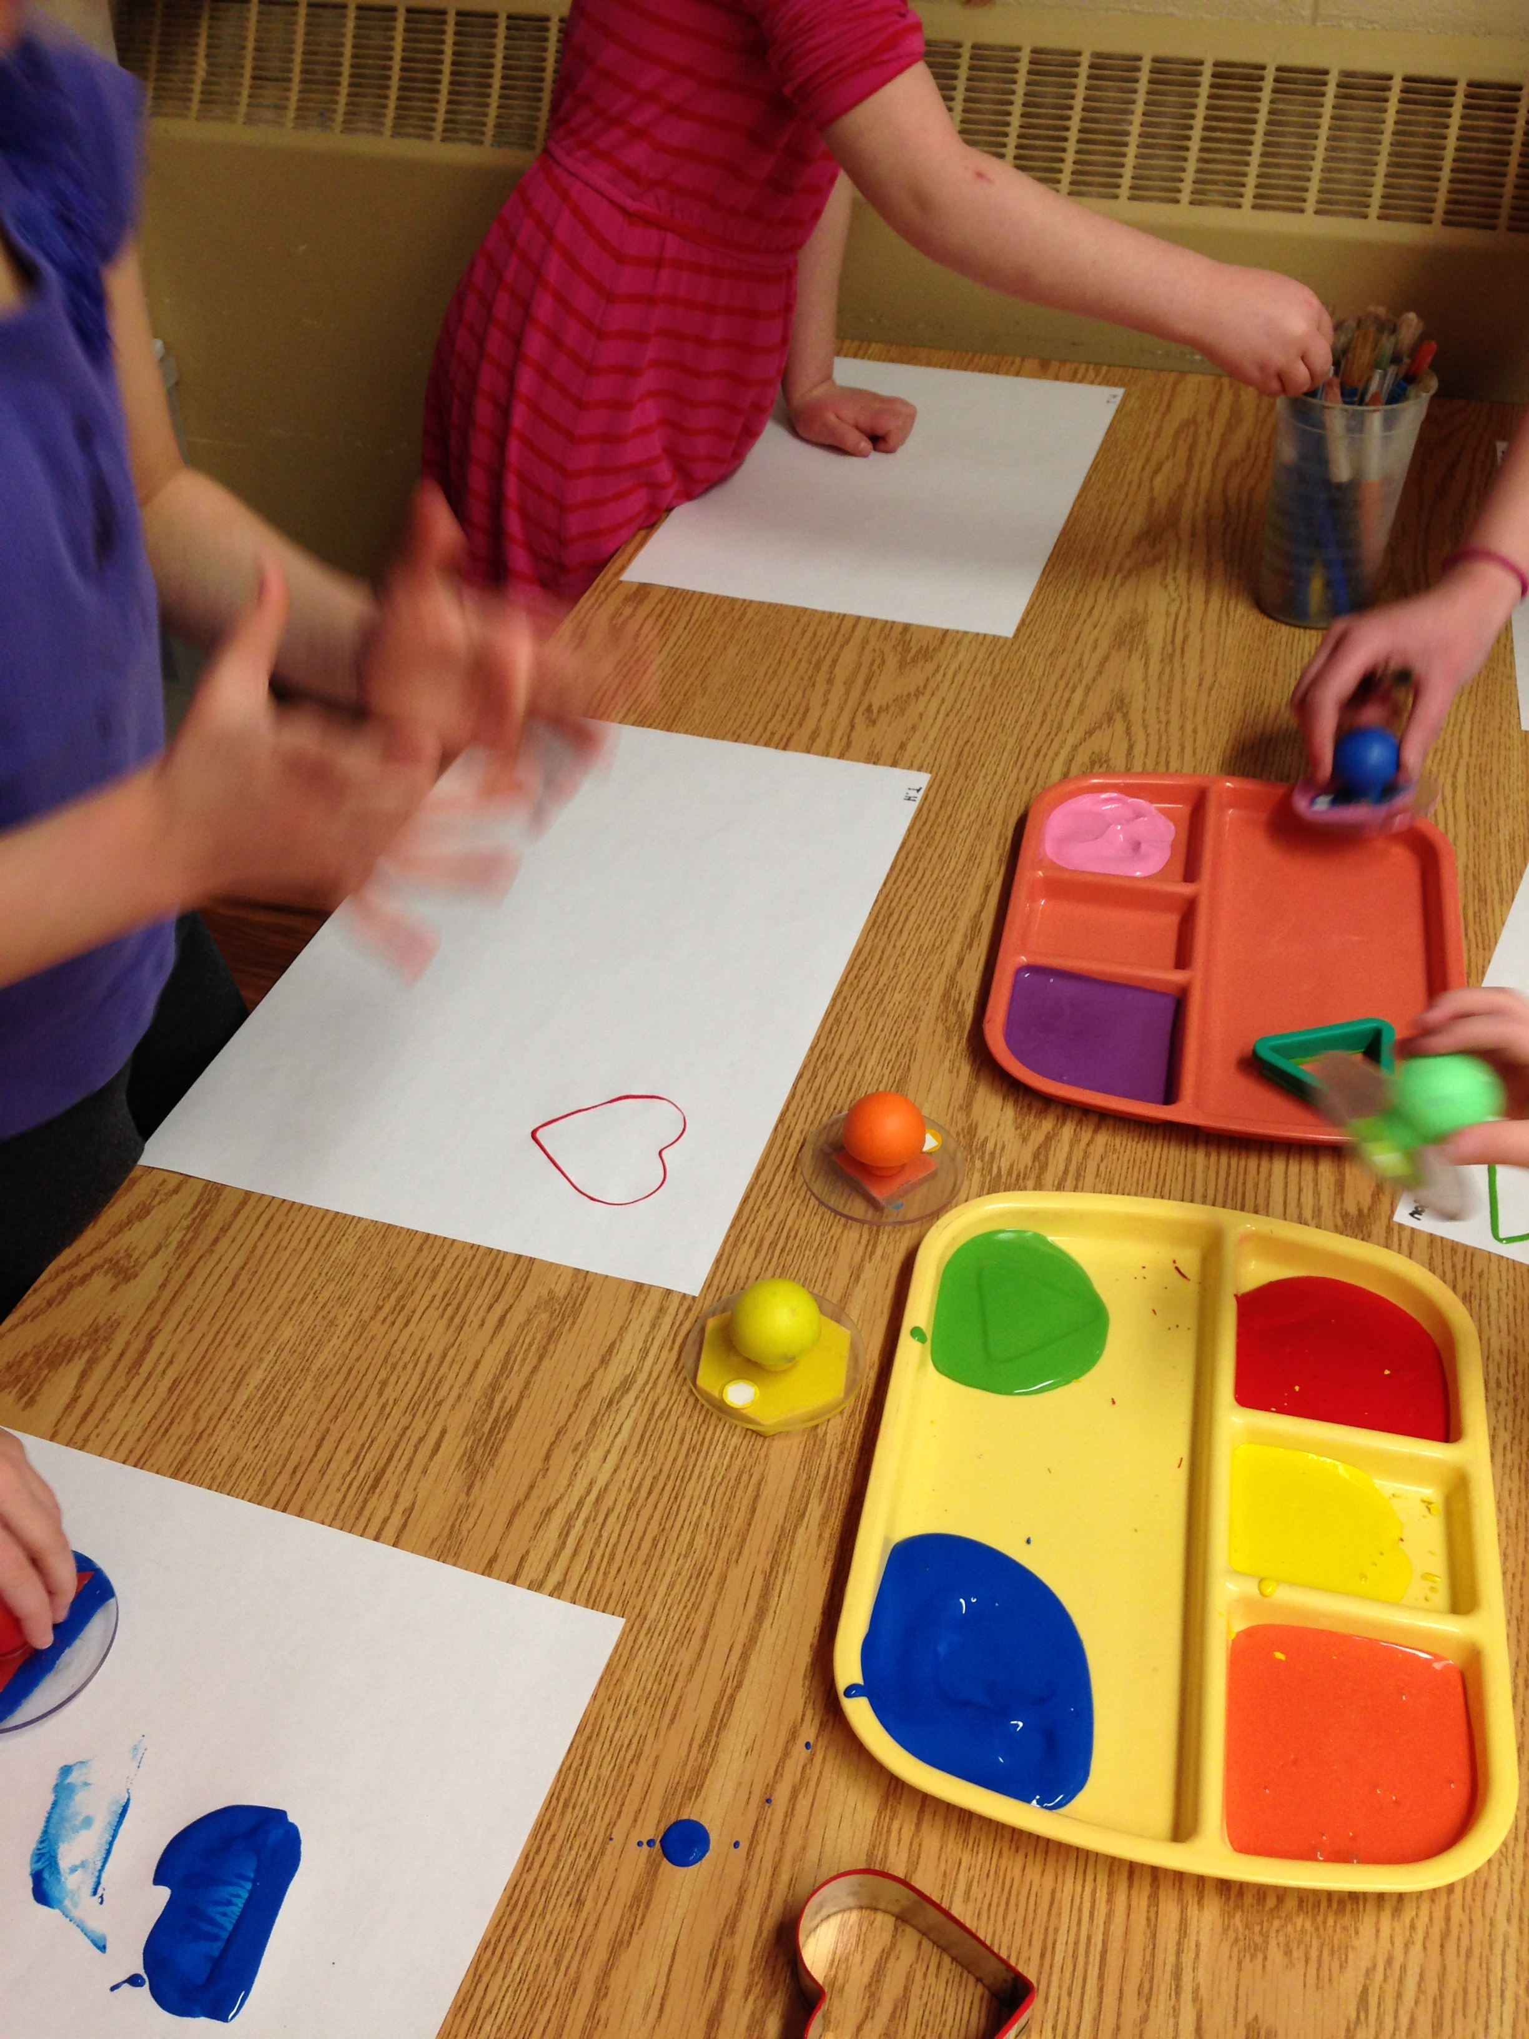
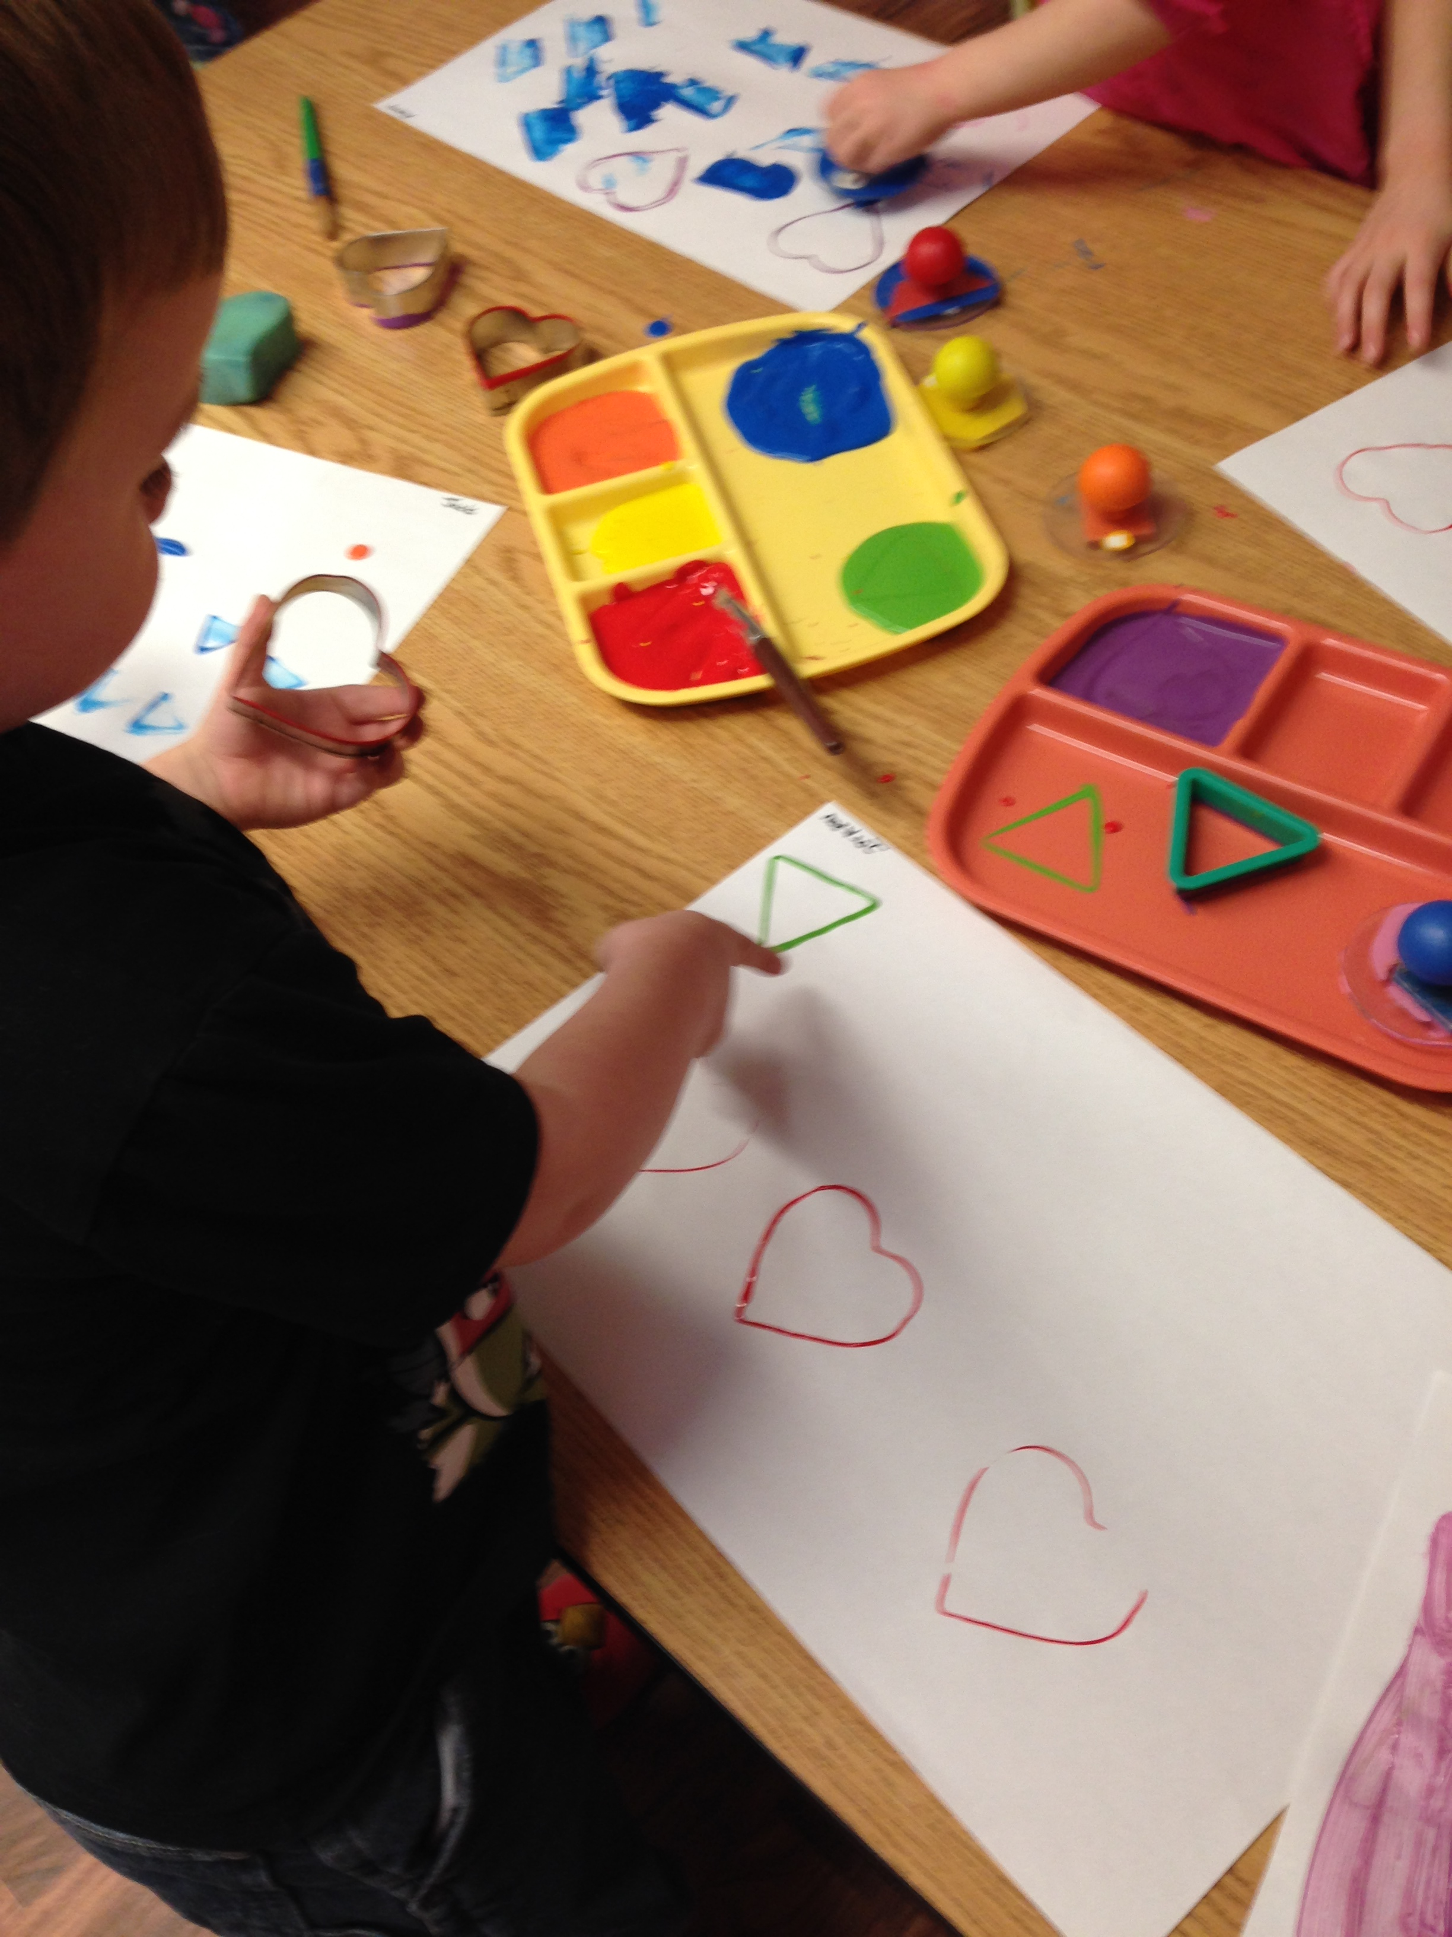
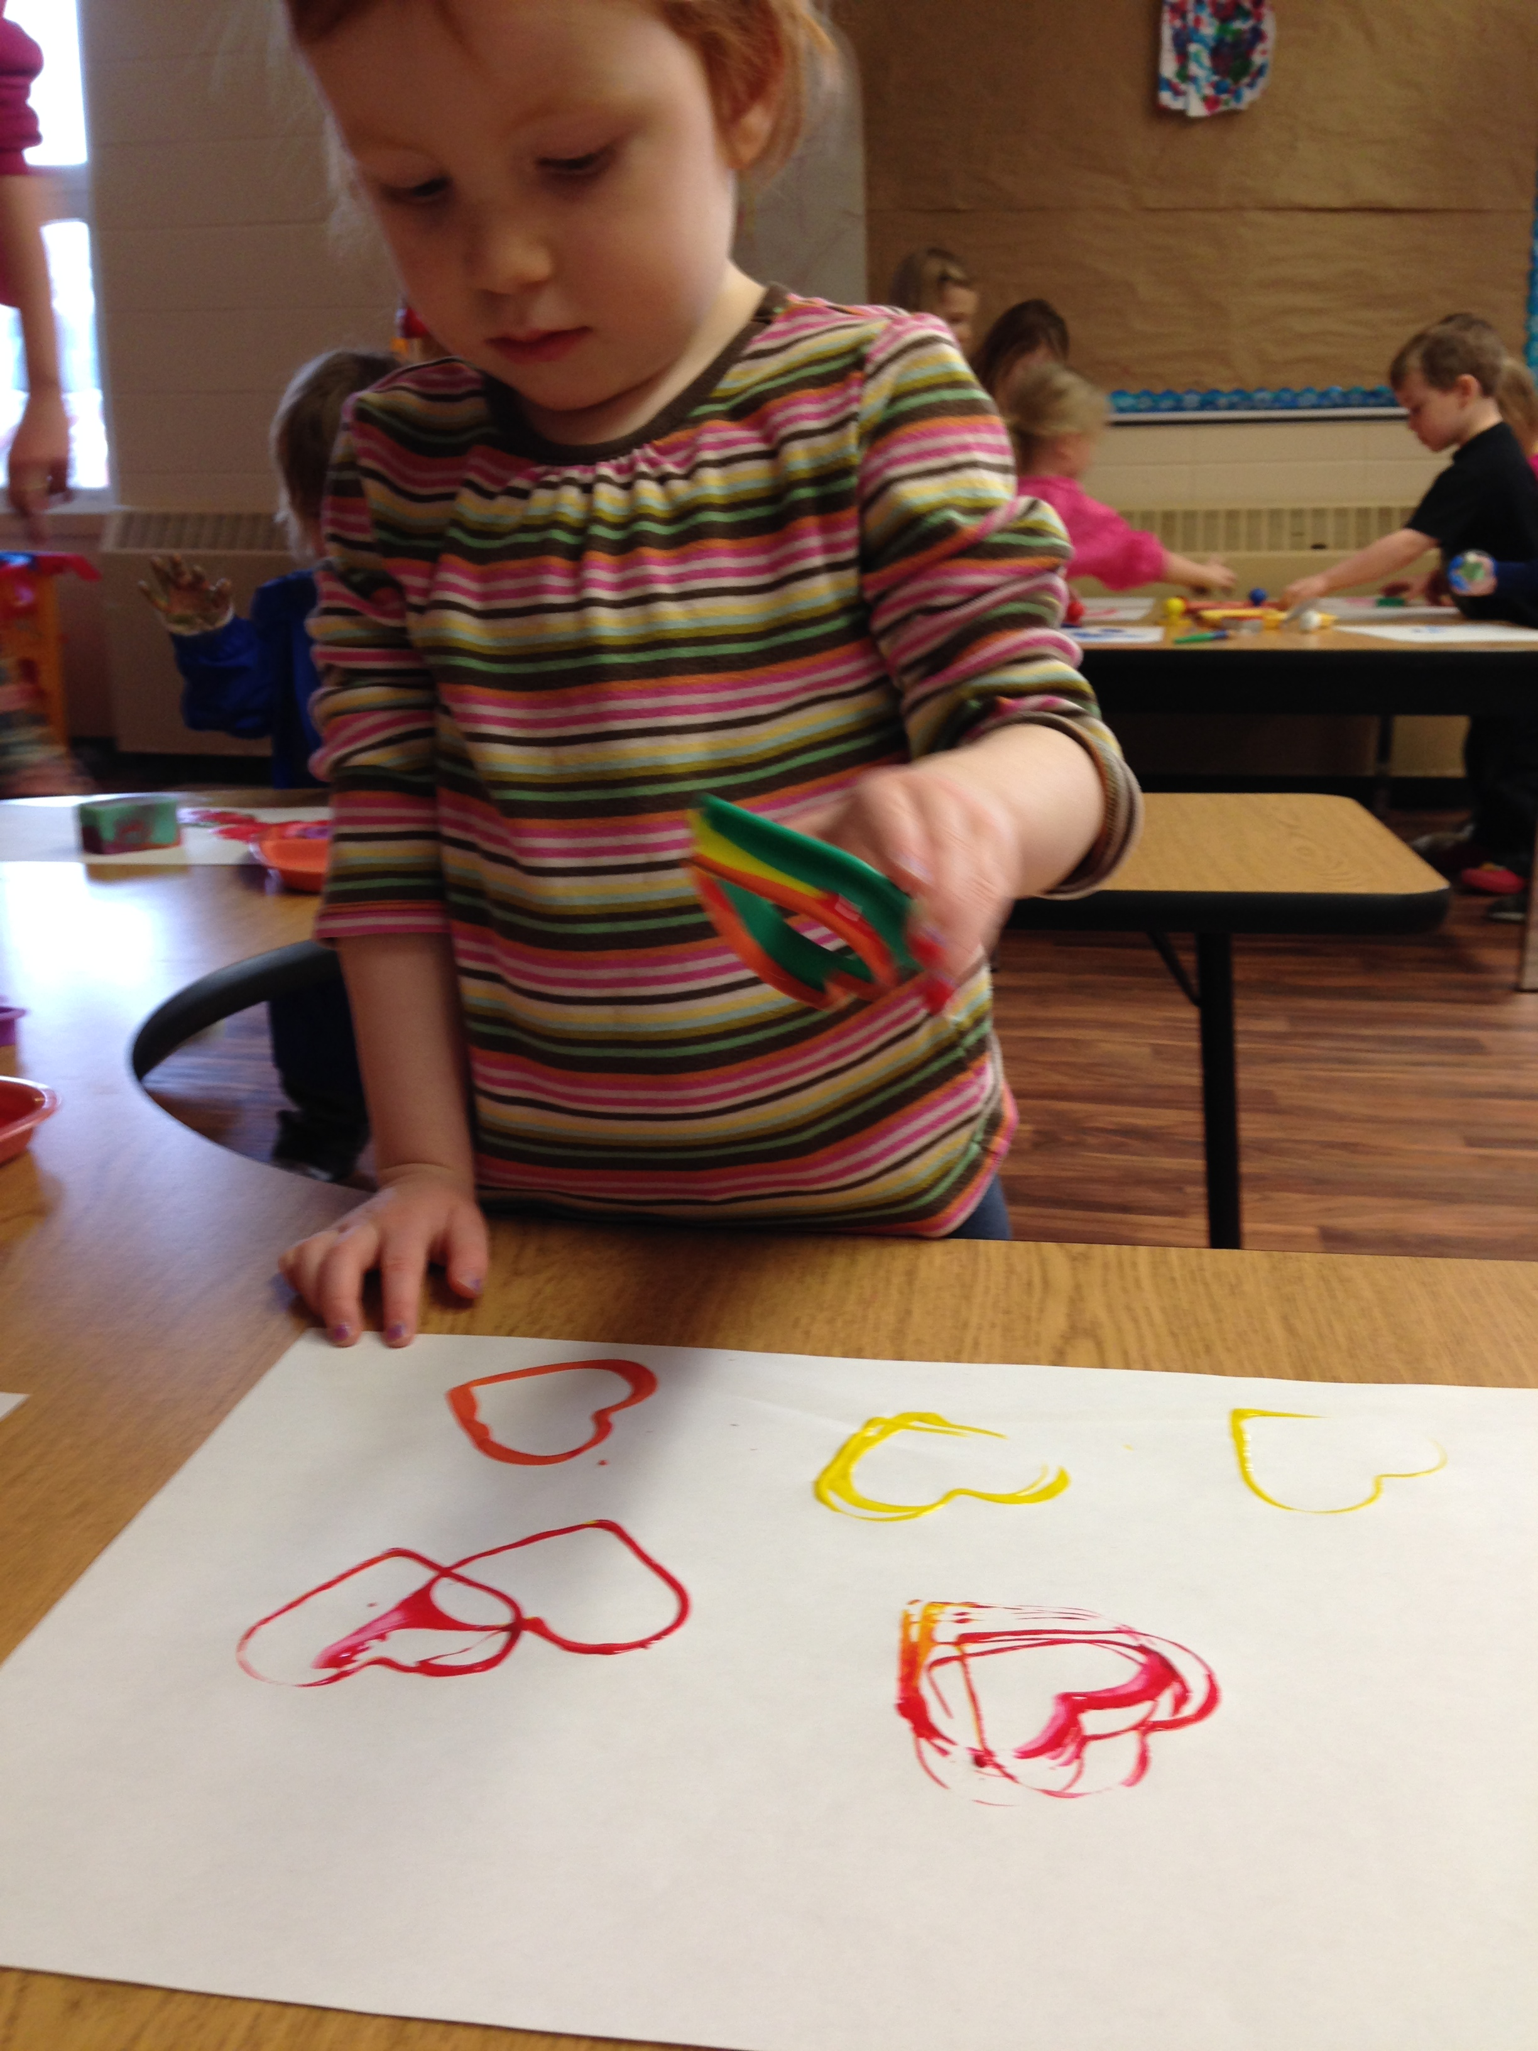
Using the same shaped cookie cutters as well as stamps we gave the children paint and they made prints. They experimented with the different shapes each cutter/stamp made. As the painting progressed we noticed some of the older children creating patterns with the shapes and also incorporating the different colours into their patterns. There was lots of discussion between the children about why they made certain patterns or designs and the colours they used.

Slide 8
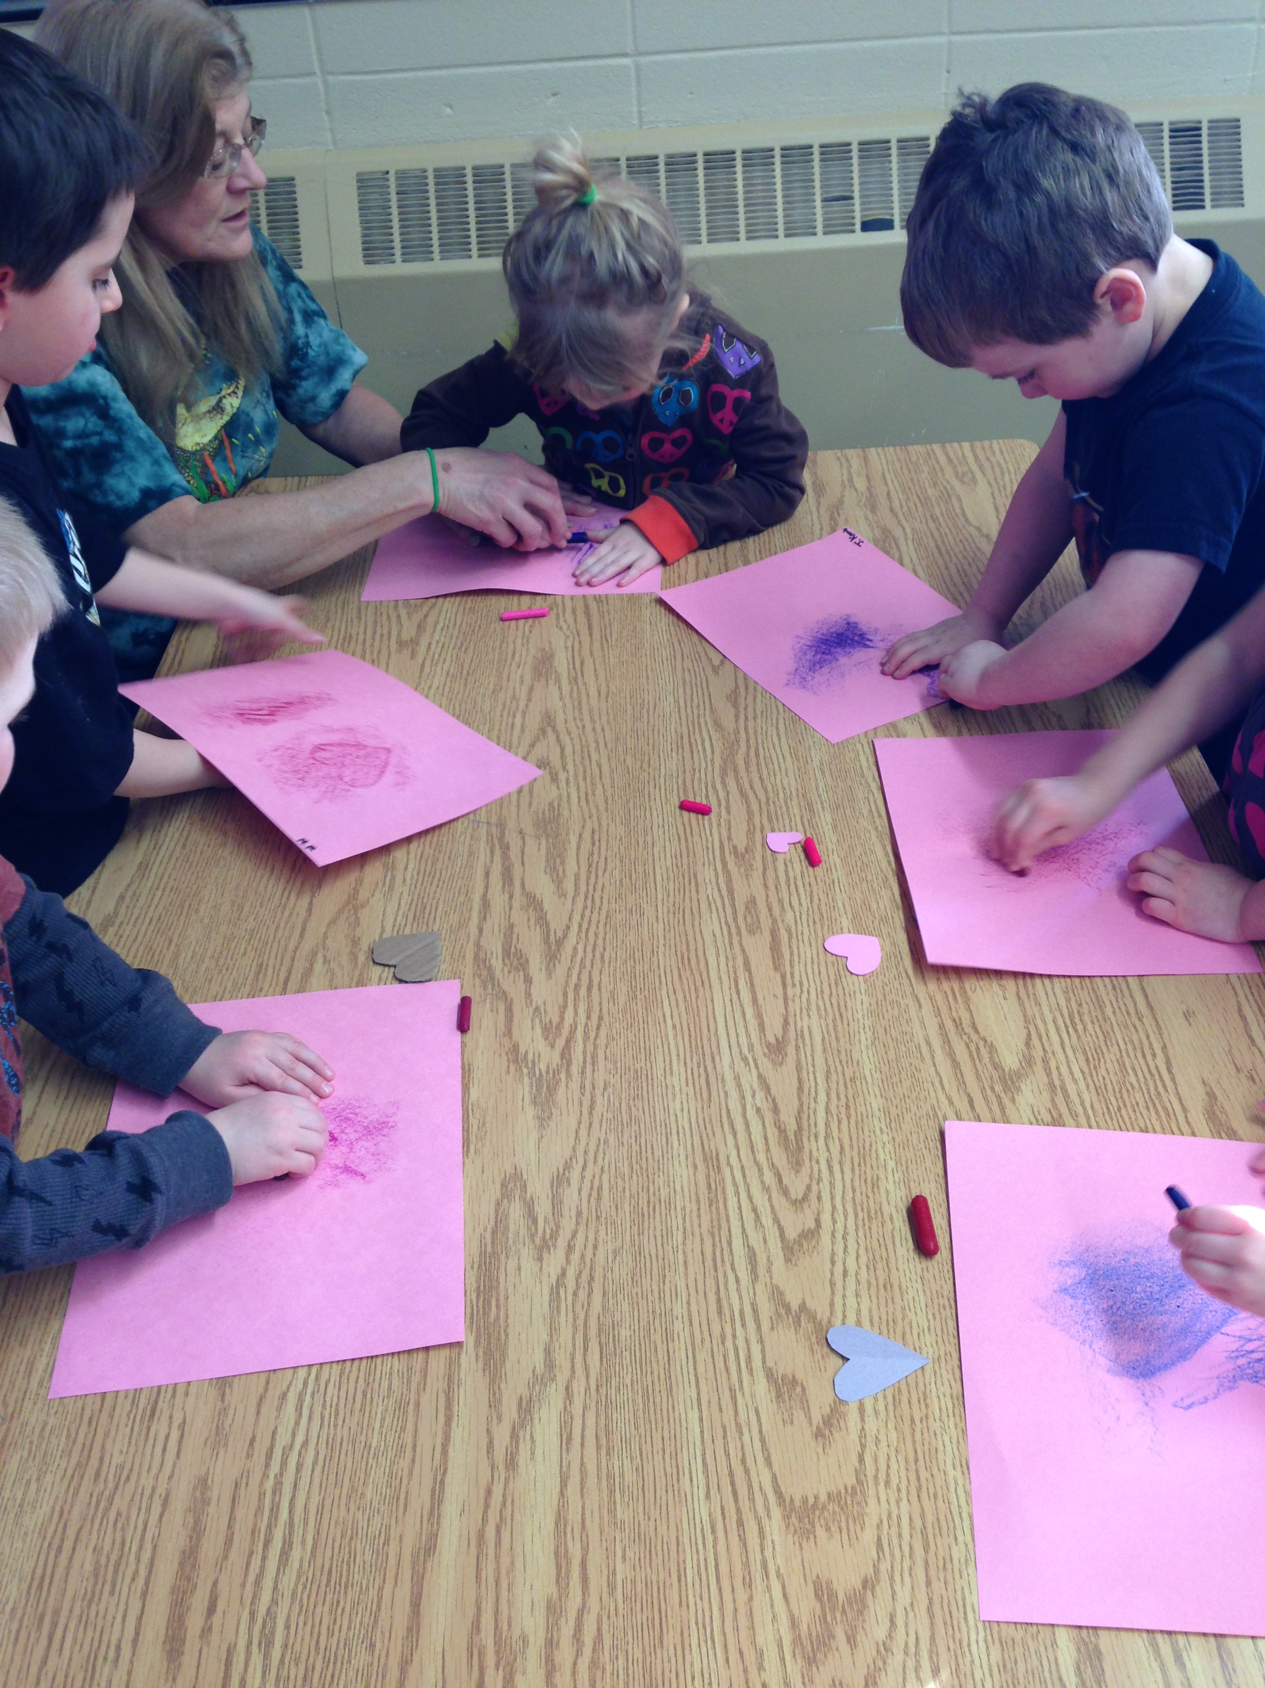
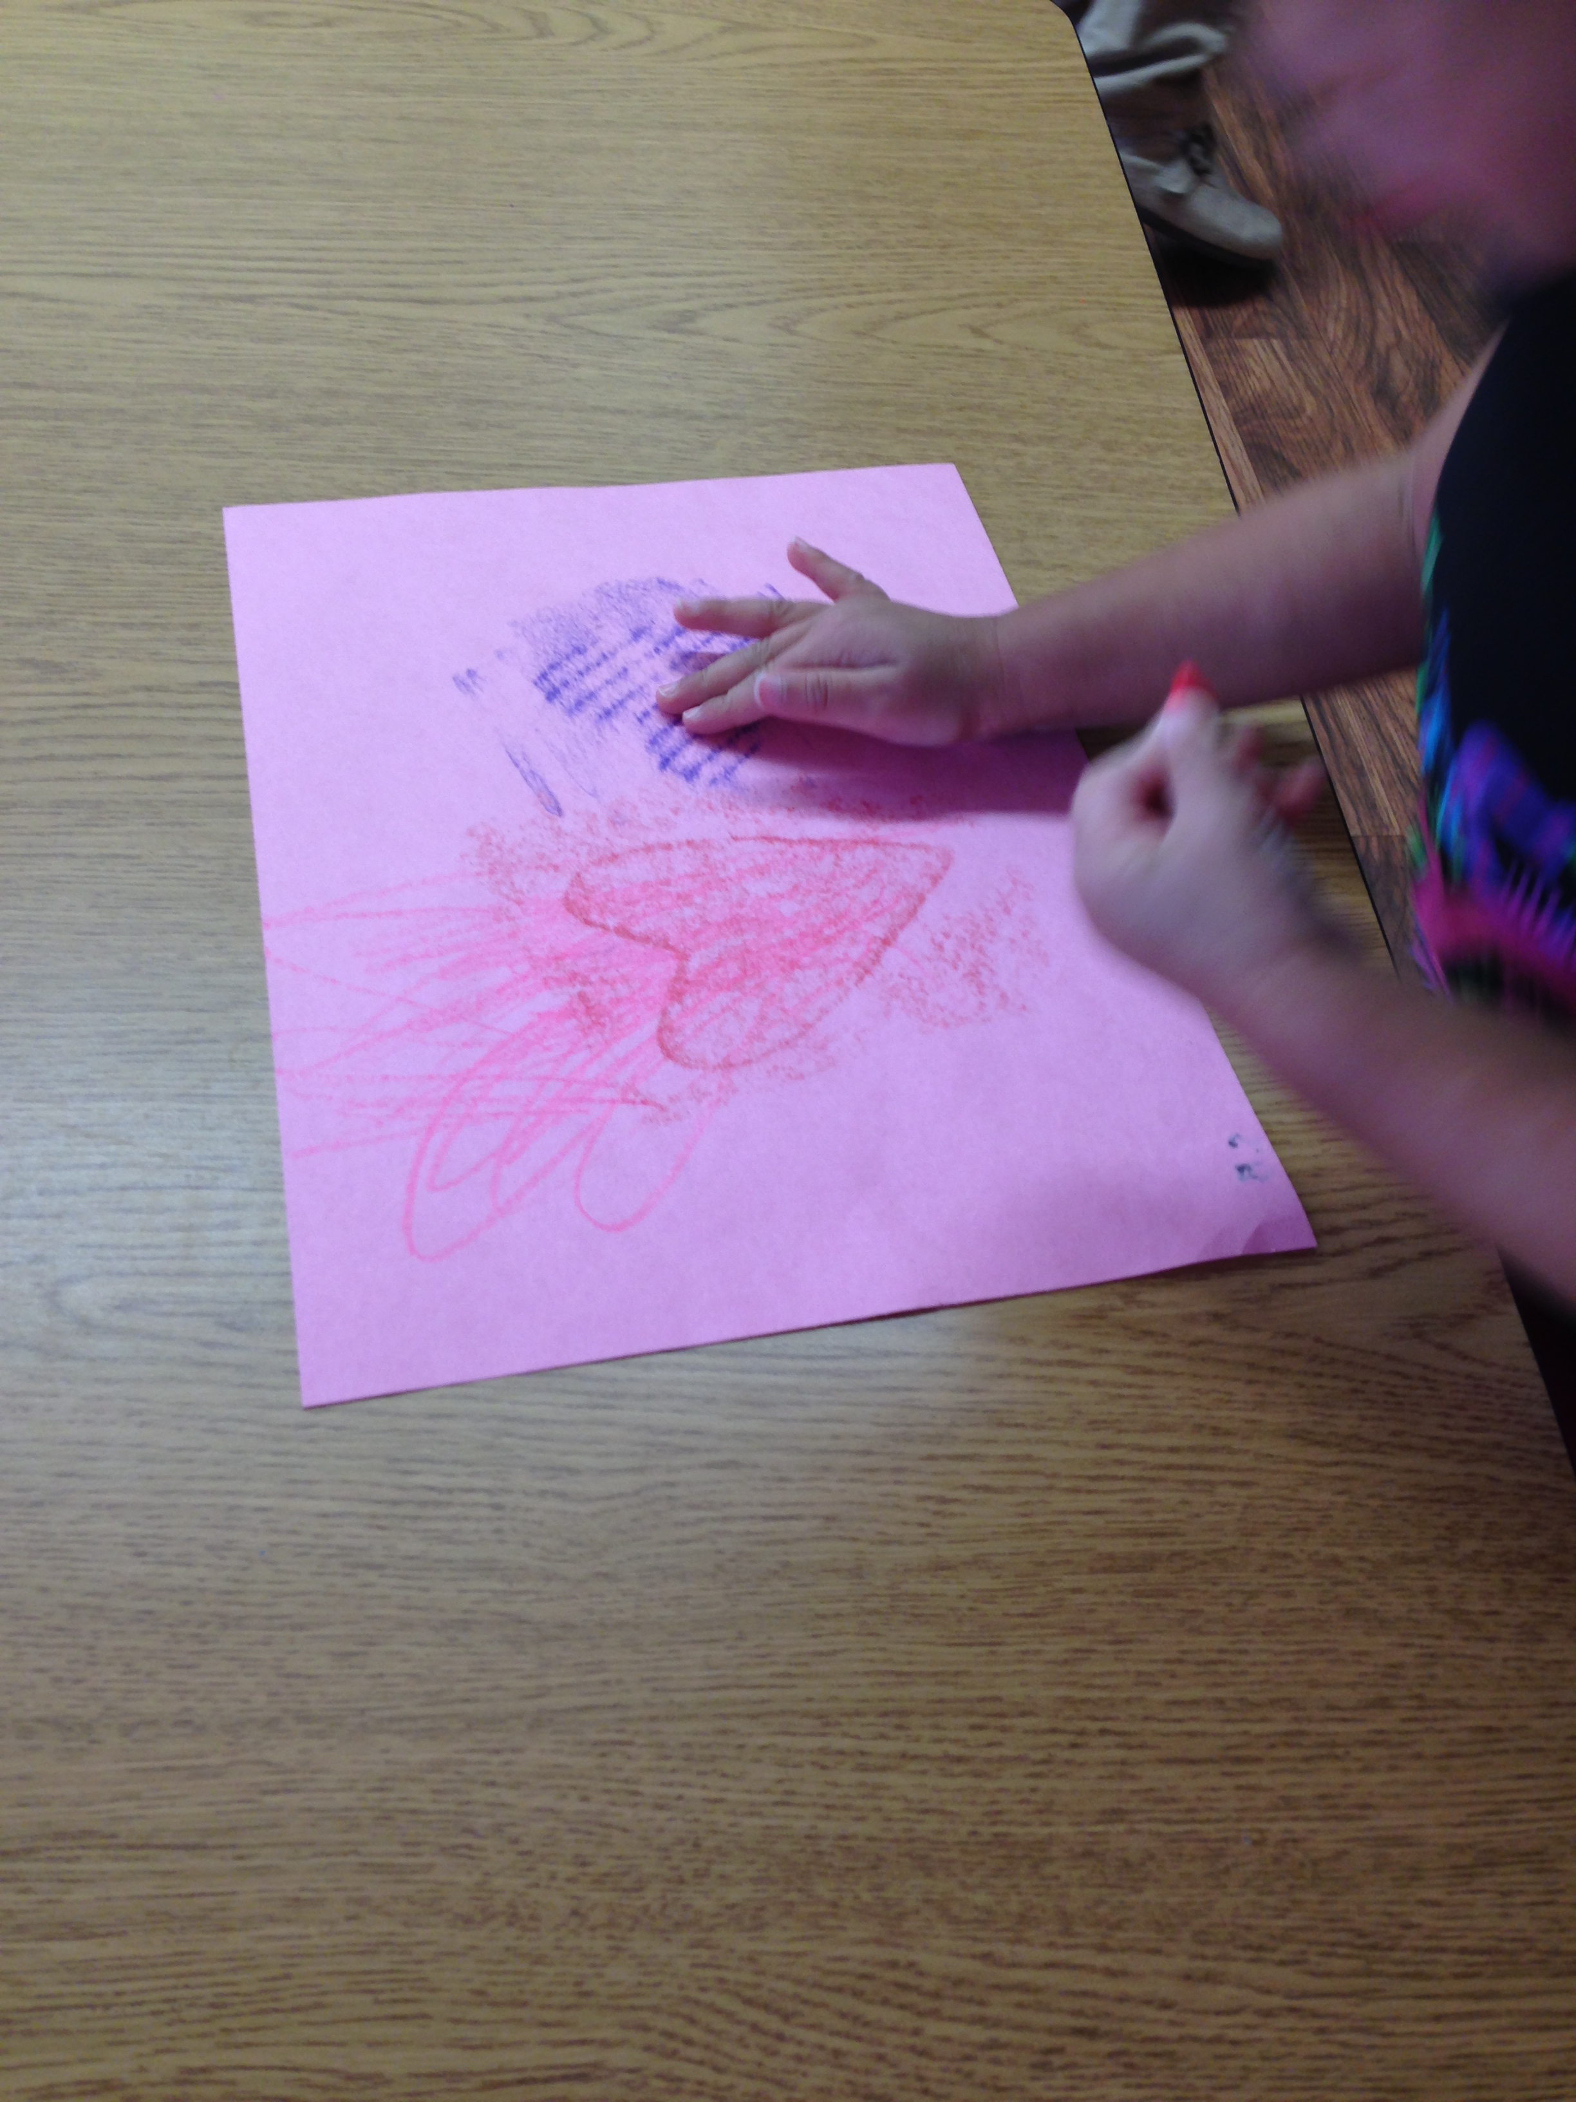
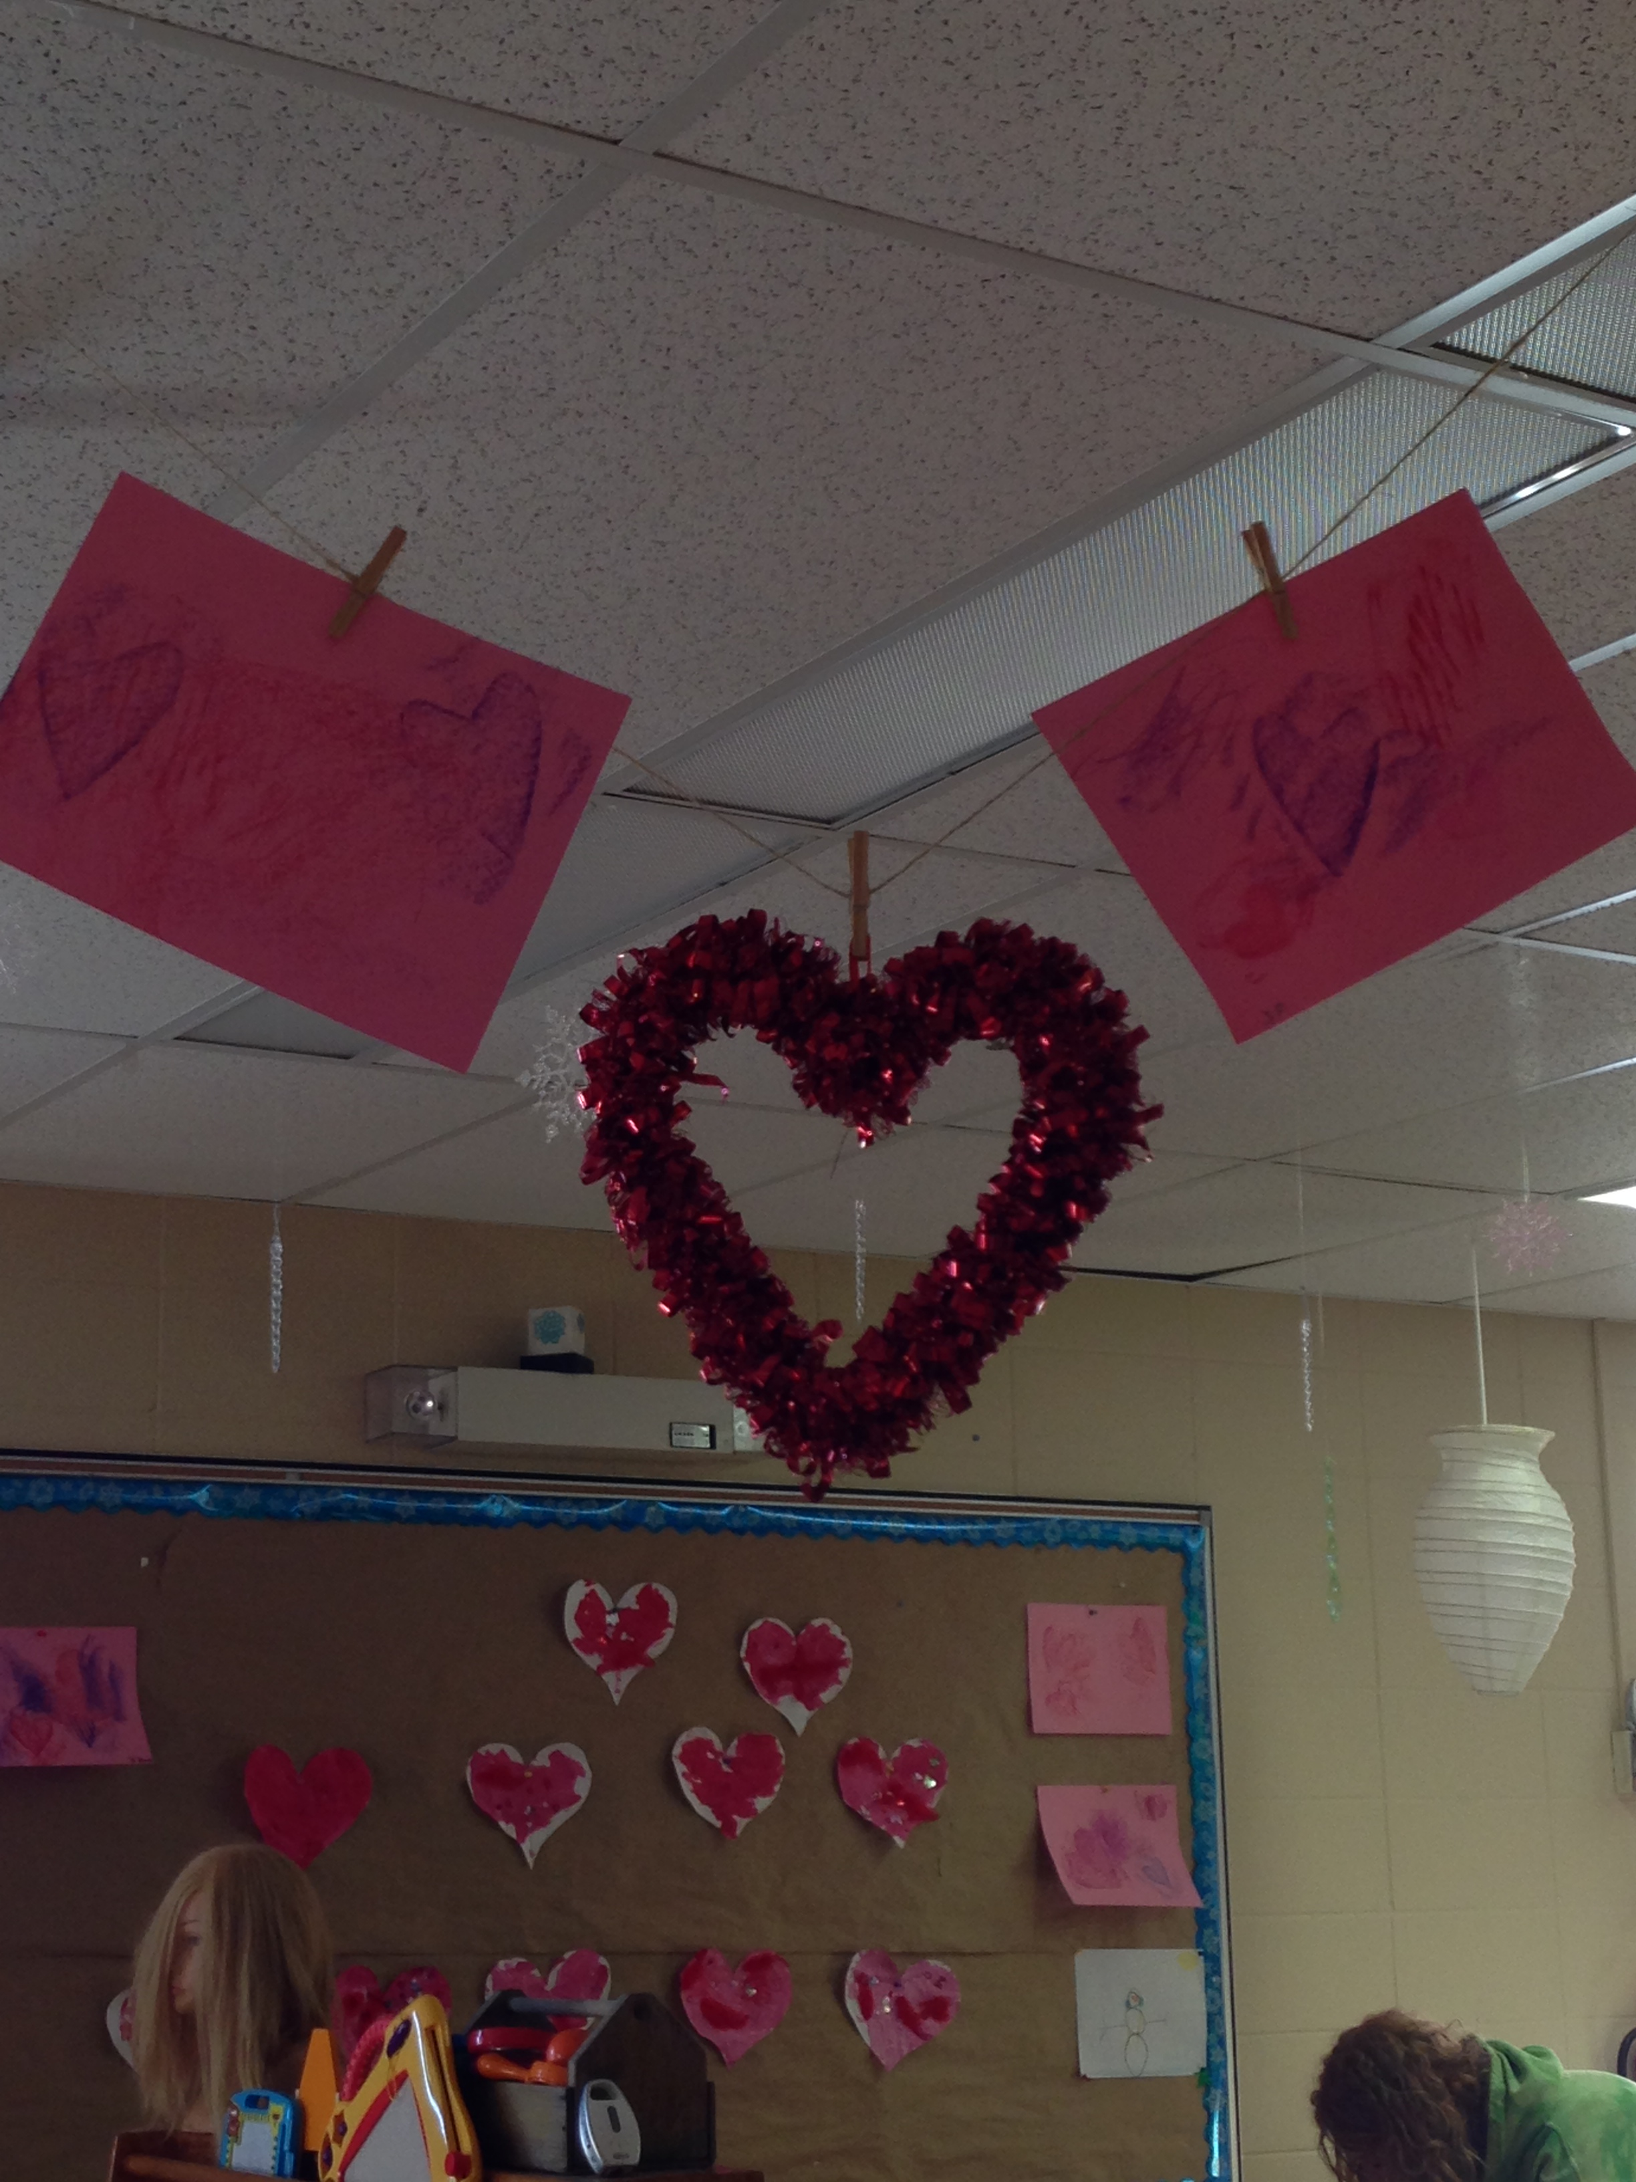
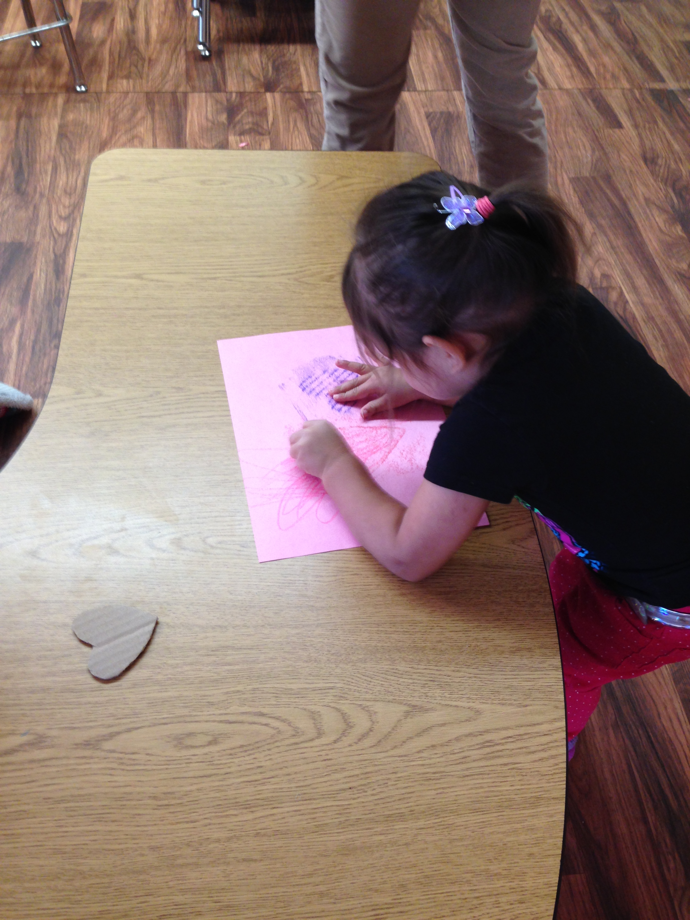
Our next activity was heart rubbings. We chose to do heart rubbings because it was close to Valentines Day so we thought we could put the two themes together as one. We cut out different textures of hearts for example: cardboard which the kids found made the hearts have lines through them. We also used foam sheets and paper, the children were happy to see the different textures the hearts made.

Slide 9
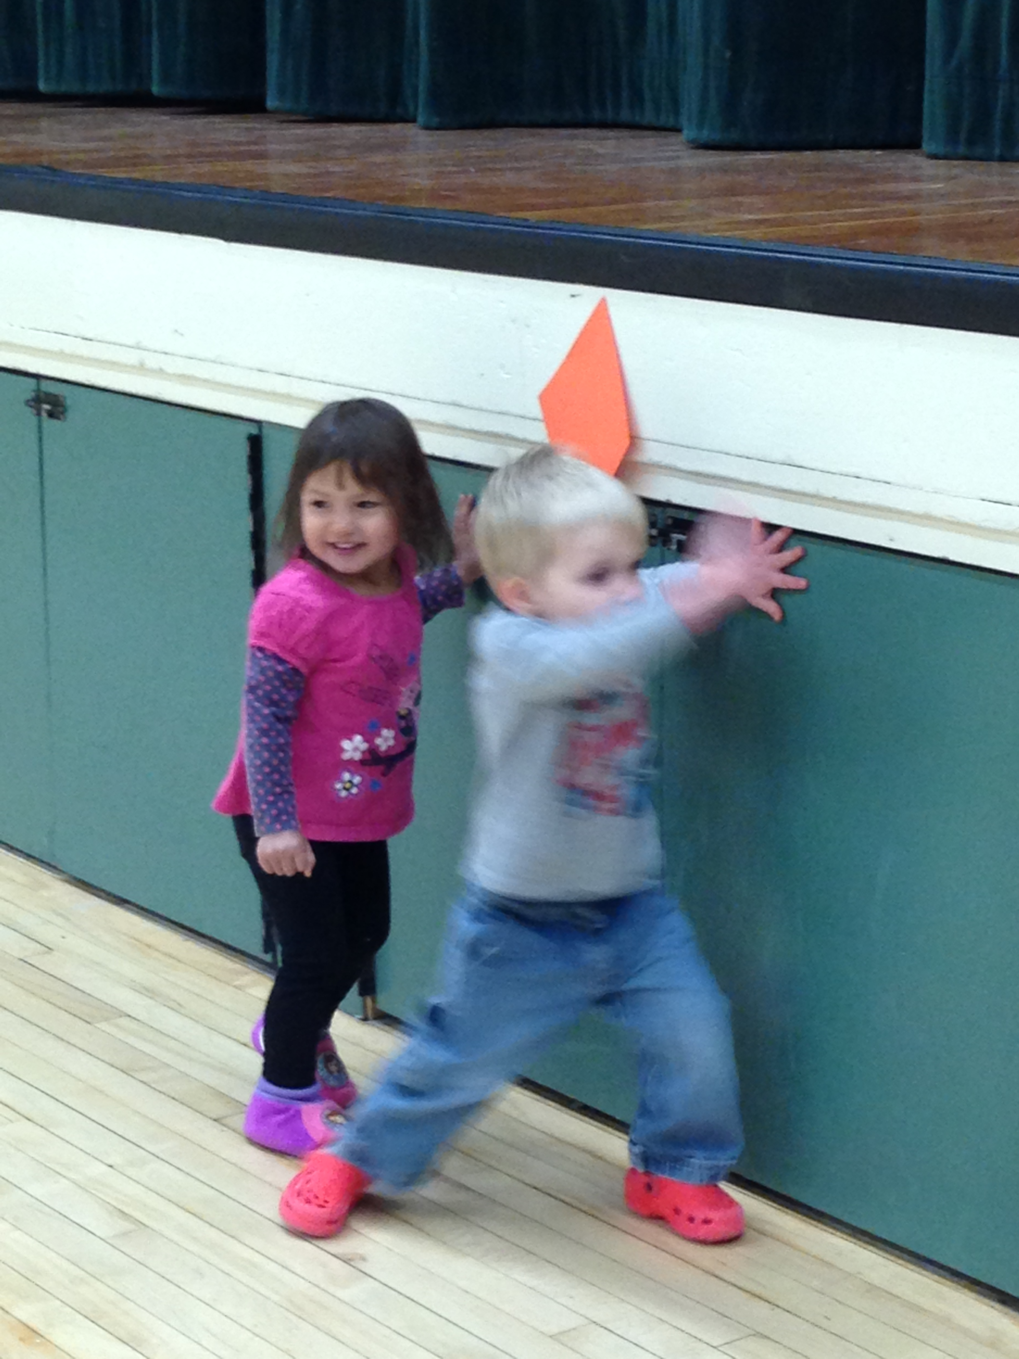
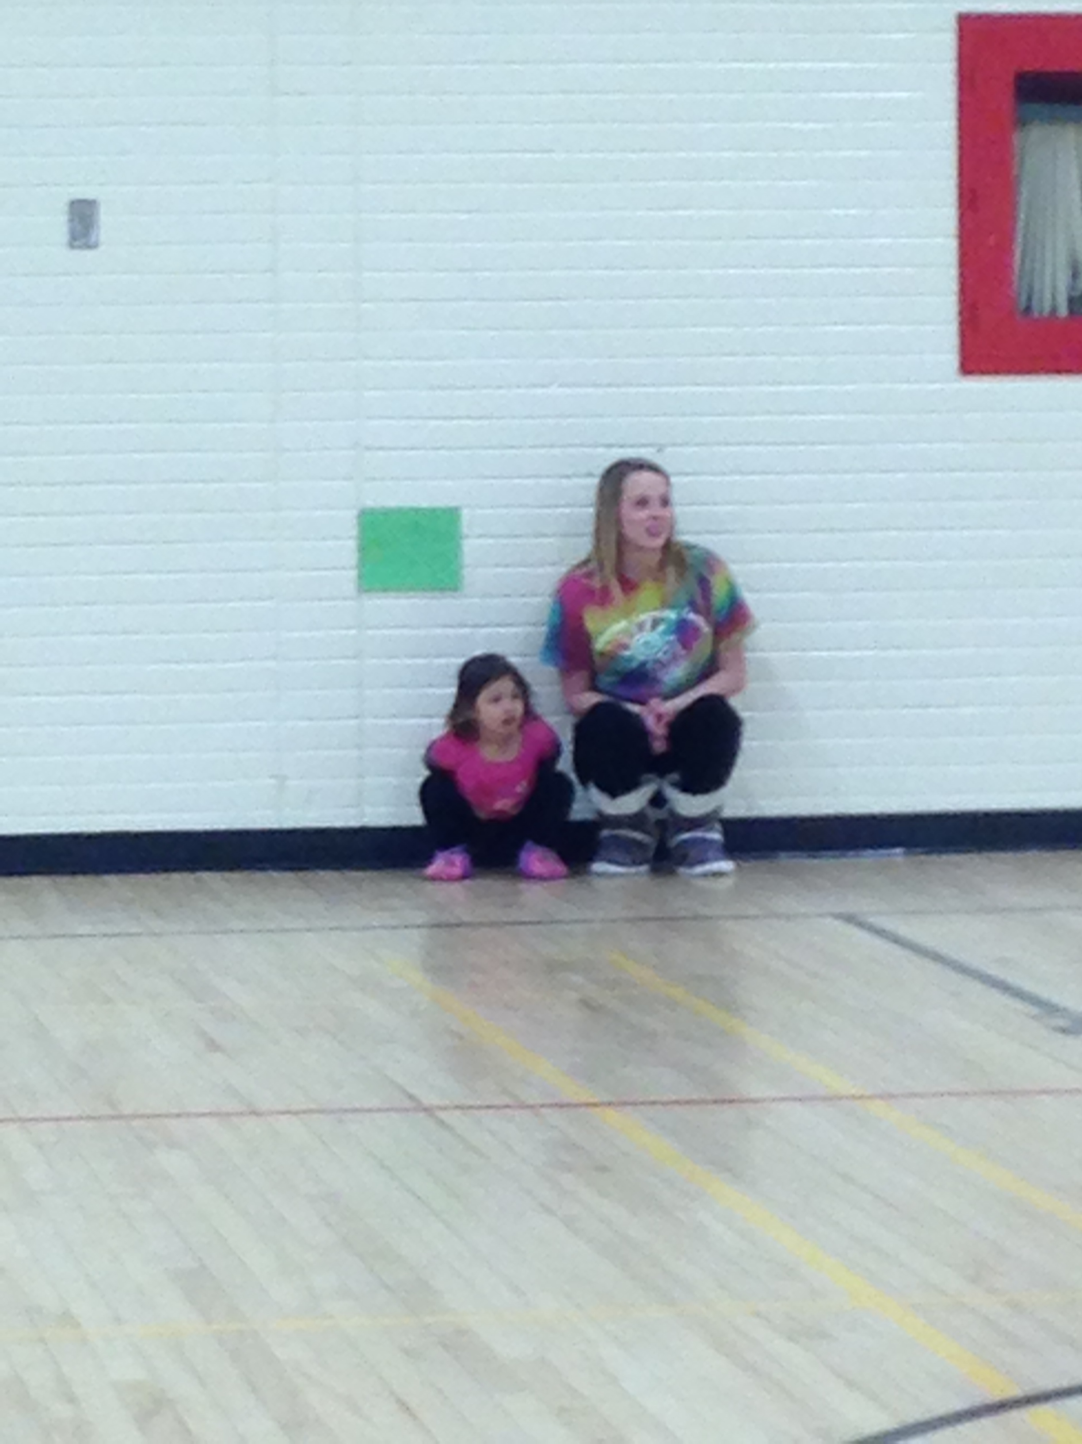
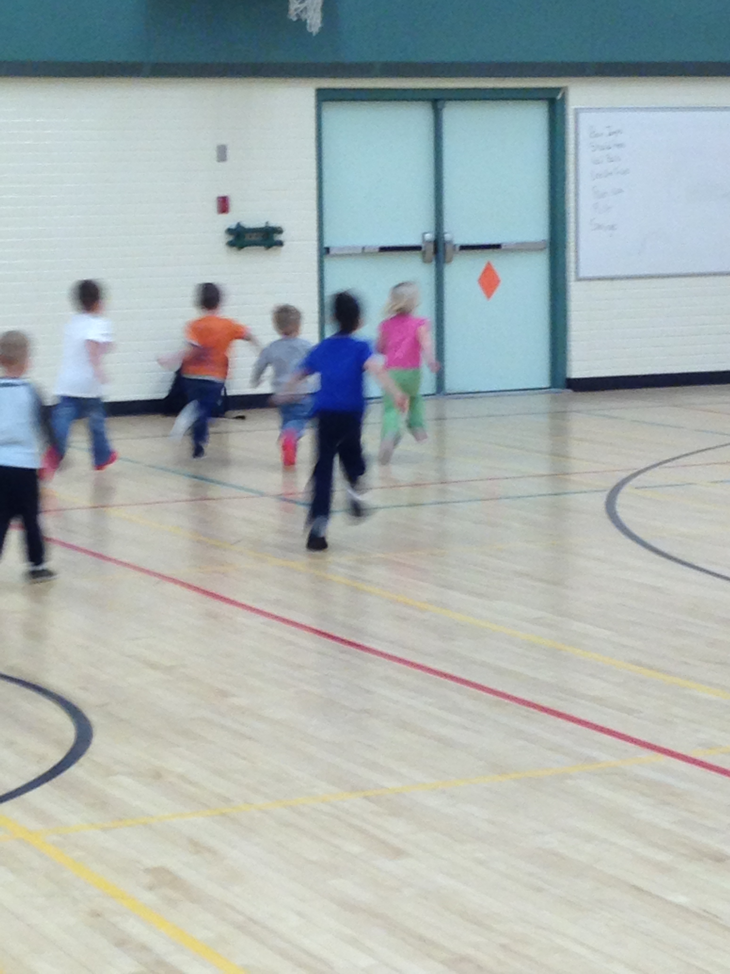
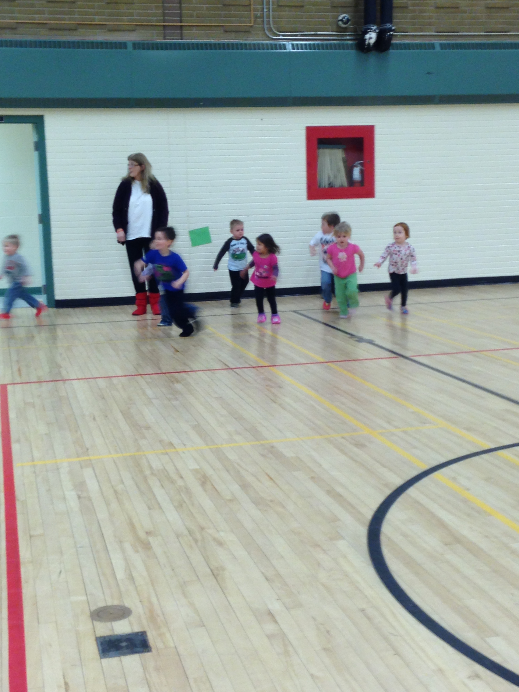
As part of our gym time we created our own version of “Simon says” We placed different shapes around the gym and would call out “Simon says find the (Shape)” and the children would run to the corresponding shapes on the walls. This activity allowed them to not only be physical but practice identifying the shapes on their own. This activity also allowed the older children to assist the younger children in identifying the shape if they were having difficulty.

Slide 10
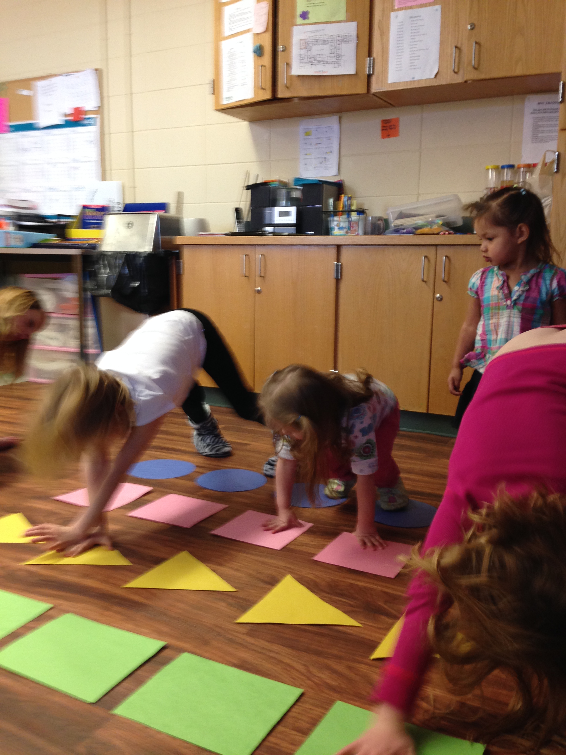
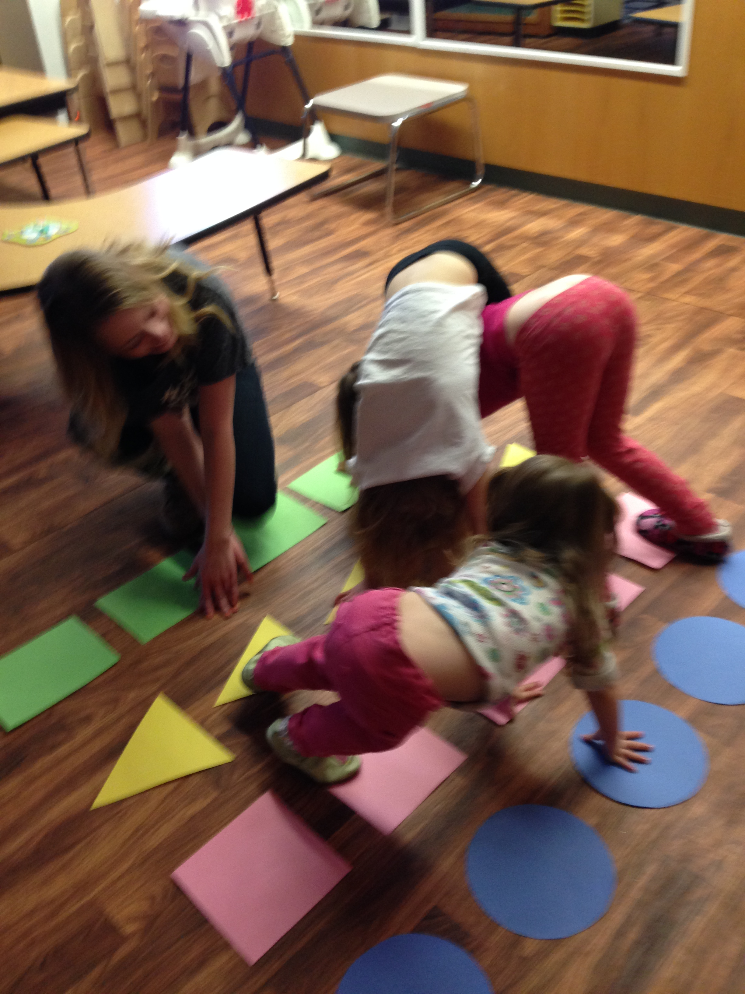
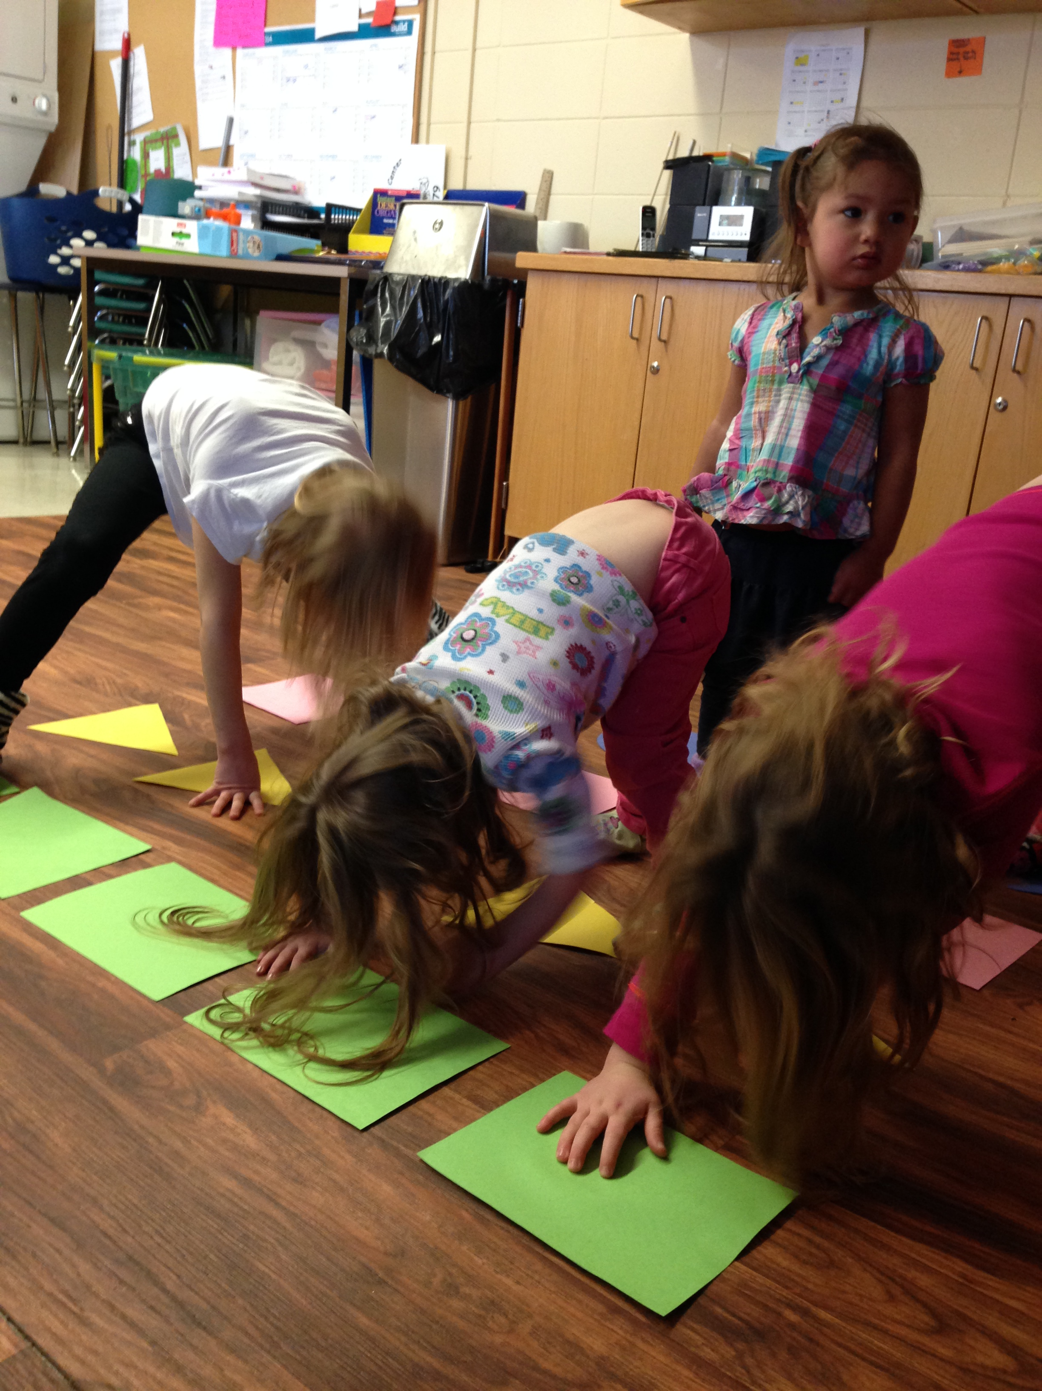
Another movement activity we set up was a“Shape Twister”. The rules were virtually the same as regular Twister but with coloured shapes. The older kids really enjoyed the game and were able to easily play it. The younger children weren’t exactly 100% sure what was going on, but they still seemed to enjoy copying what the older children were doing.

Slide 11
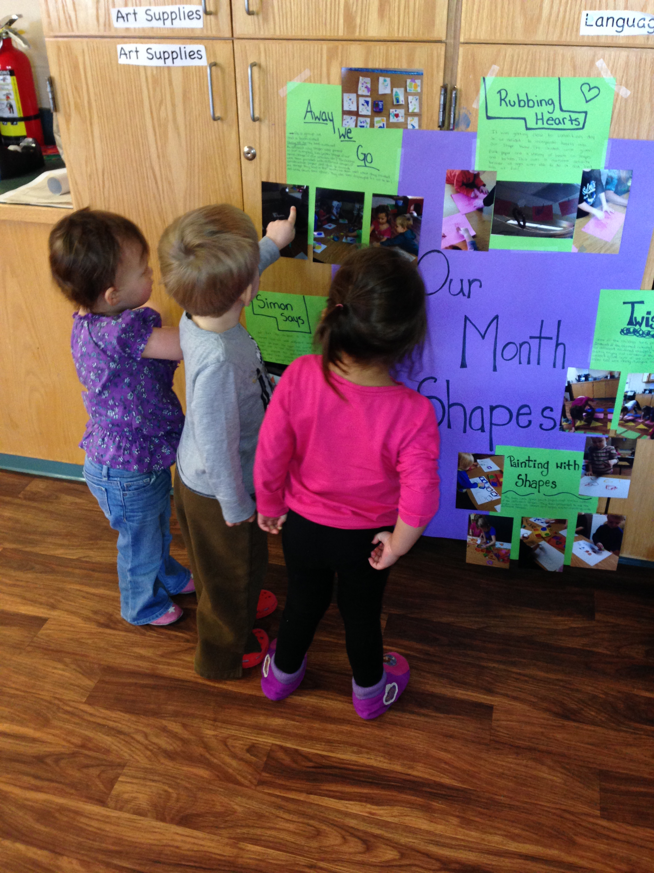
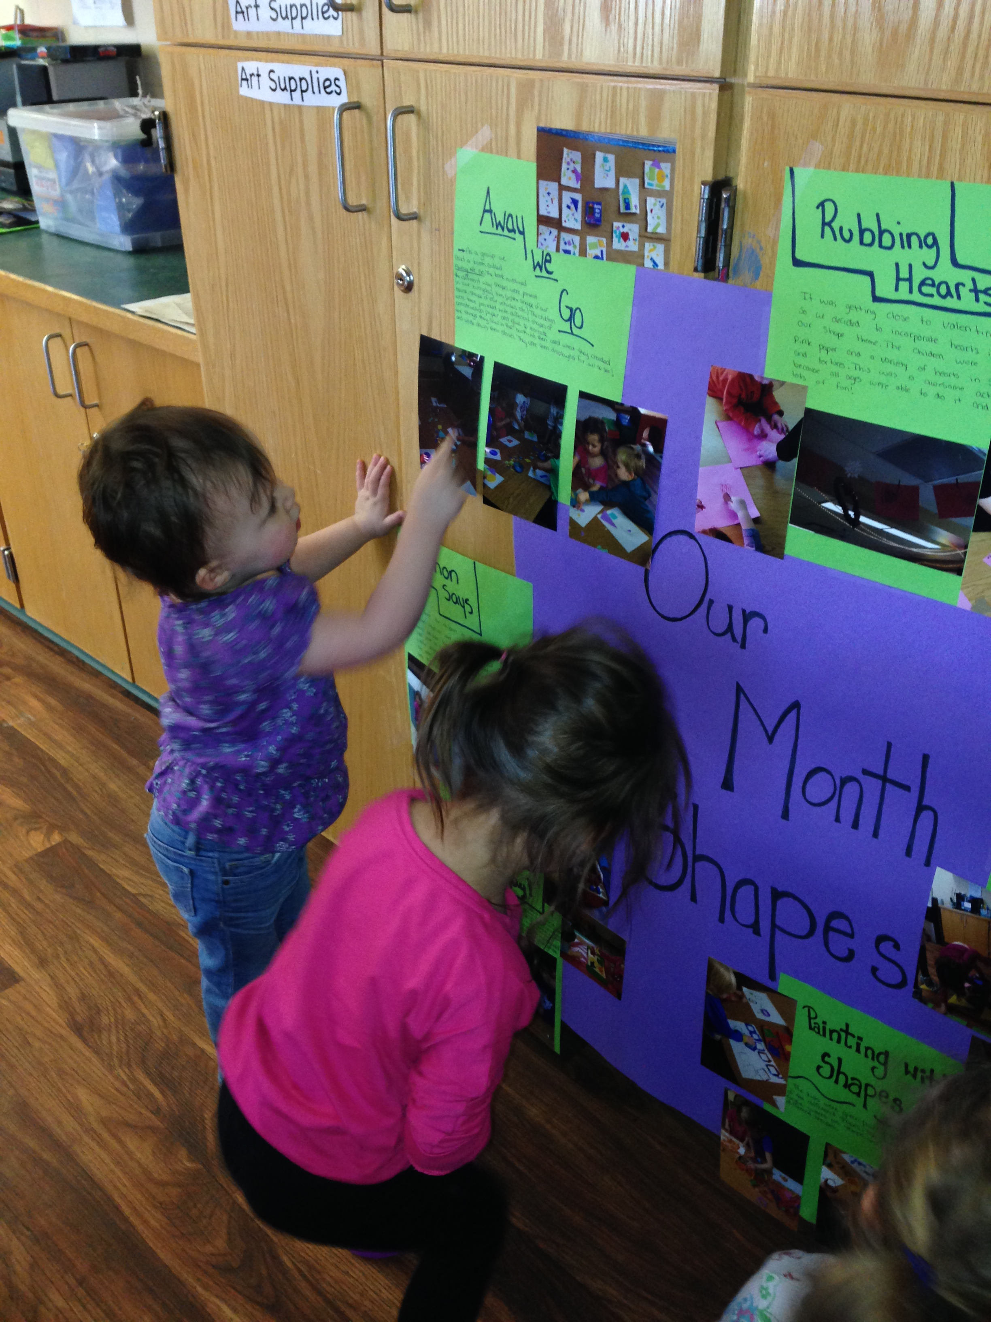
Concluding our Project
There really wasn’t a large culminating event that closed our project. We let the children continue in their shape experiences until their interest seemed to fizzle and they had developed an interest in something new. This new interest happened to be colours, which seemed to develop along with their shape experiences.
To keep track of our experiences and discoveries we made documentation panels of each activity we did. As the explorations progressed we began connecting the display panels and ended up with one large documentation board. This was displayed on a low cupboard so the children would re-visit there experiences through the pictures.

Slide 12
Reflection
As these experiences progressed we discovered how difficult it is to plan for a multi- age group. We felt that finding activities/explorations that all age groups could be equally involved in was a little bit difficult, and for future we may try breaking up the groups.
We felt this topic was a good choice because there were many different ways to explore it, and everybody learned something. We found that the younger children learned the most. Almost all of them came away able to identify a shape by name. We were very surprised at how many of them remembered the shape names and how they continued to identify them in every day things ie. A little boy saw a triangle and a star and put them together then said “look a Christmas tree.”

