Slide 1
SWEET SHOP

Slide 2
Educator Information:
Juli Campbell
Kindergarten Teacher
General Information:
Title: SWEET SHOP
Full-Day Kindergarten
(Two classes / 32 five-year-olds)

Slide 3
Beginning the Project:
The idea of setting up a candy/bake shop came from watching the children during centre time. They had been sorting the ‘Candy Construction’ building set pieces and using the puppet theatre as a store front. The children were pretending to sell the candy to their friends and the roles of buyer and seller would change daily.
An invitation to learning was created and the rest, as they say, is history!

Slide 4
Learning Outcomes:
Comprehend & Respond:
CRK.2 View and interpret the basic message of visuals and objects.
CRK.4 Comprehend, retell, and respond to basic ideas in informational texts.
Compose & Create:
CCK.3 Use oral language to converse, engage in play, express ideas, and share personal experiences.
CCK.4 Create messages using a combination of pictures, symbols, and letters.

Slide 5
Number Strand:
NK.3 Relate a numeral, 1 to 10, to its respective quantity.
NK.5 Compare quantities, 1 to 10, using one-to-one correspondence.
Shape & Space Strand:
SSK.1 Use direct comparison to compare two objects based on a single attribute (length, mass, volume, capacity).
Drama:
CPK.2 Explore a variety of drama strategies (role, imaging, parallel play).
CPK.4 Create art works that express own observations and ideas about the world.

Slide 6
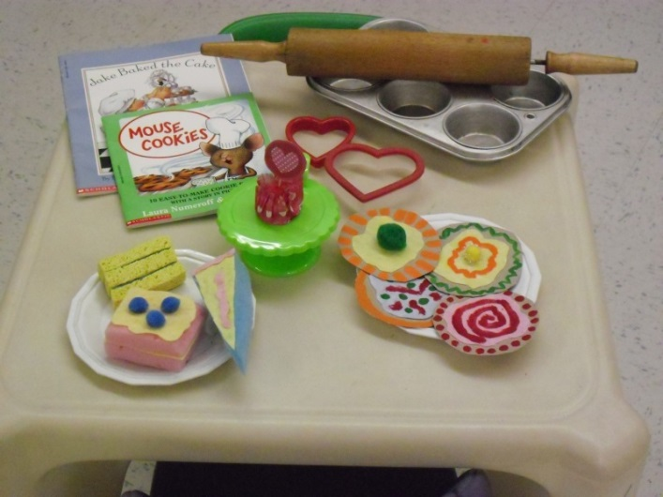

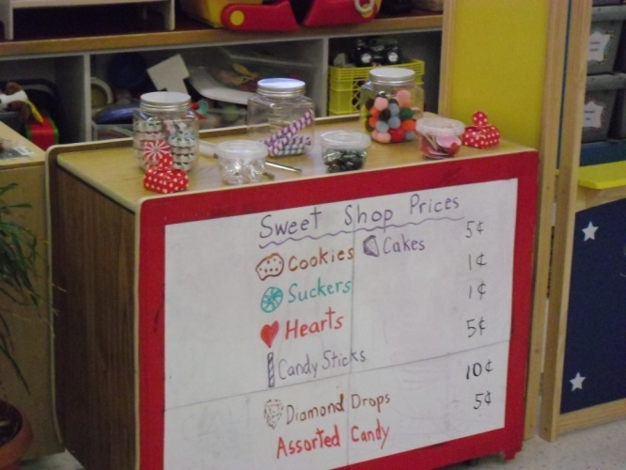
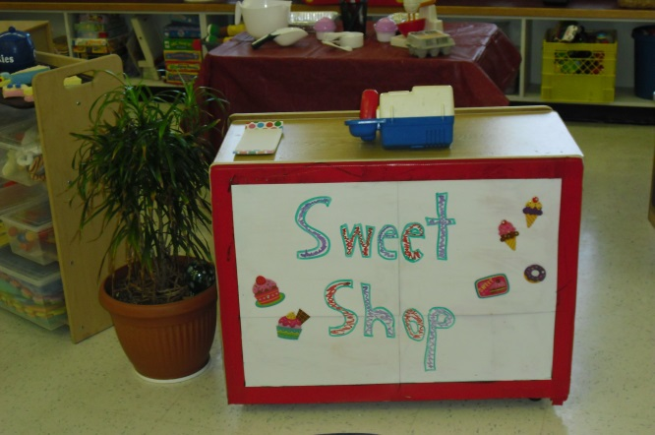
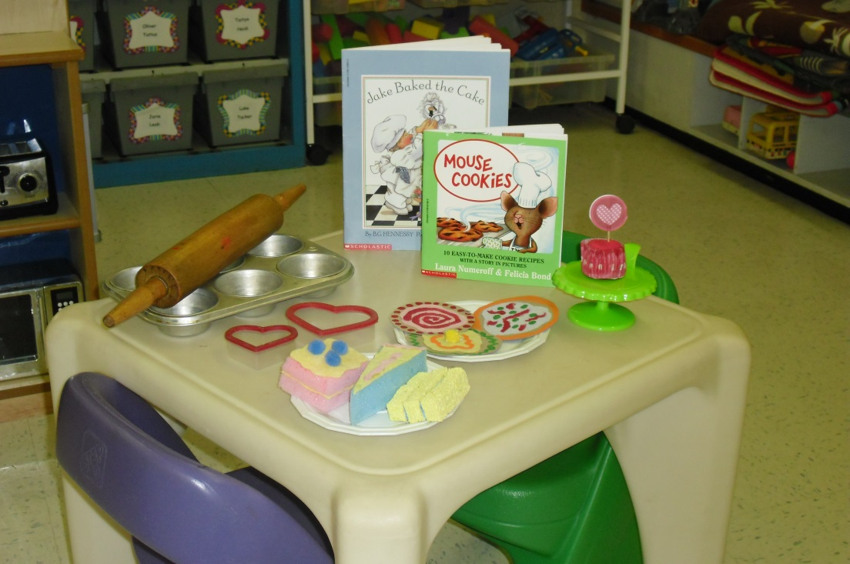

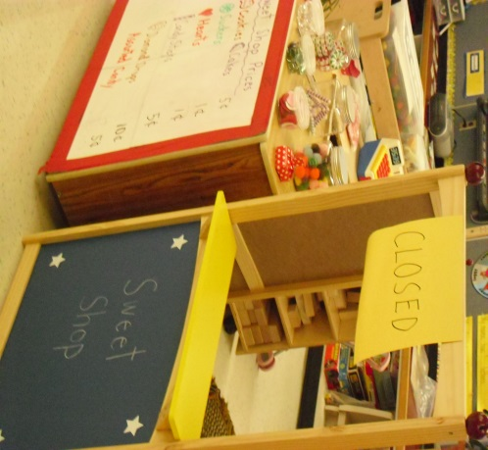
INVITATION TO LEARNING

Slide 7
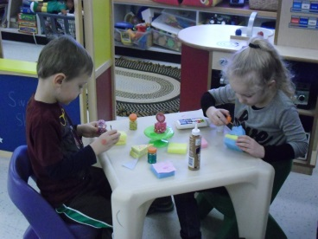
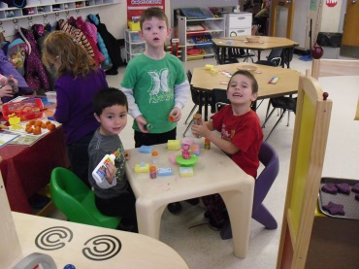
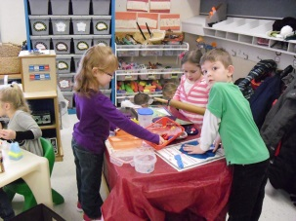
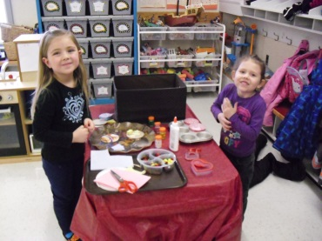
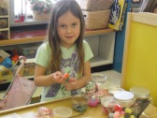
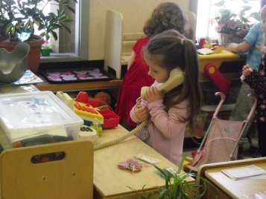
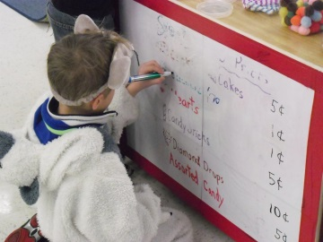
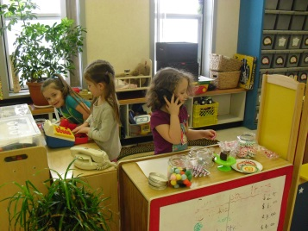
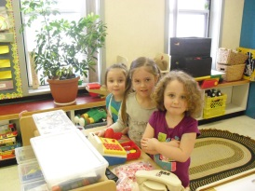
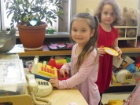
Developing the Project:
The children were eager to play at the centre by…
Making
Taking orders and…
Organizing

Slide 8
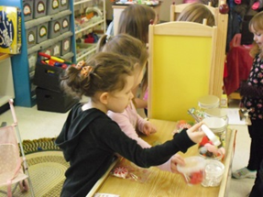
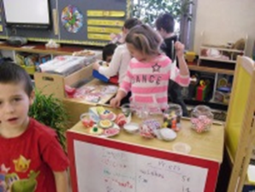
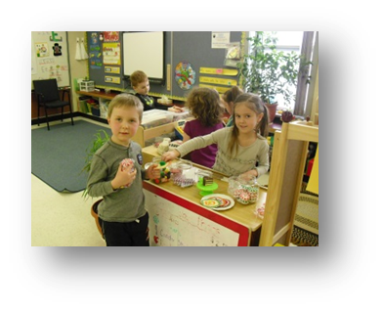
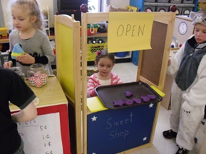
Selling
Buying
…and selling some more!

Slide 9

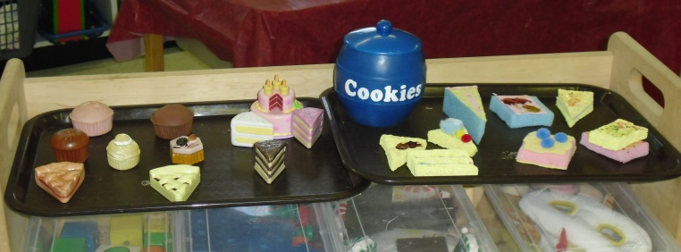

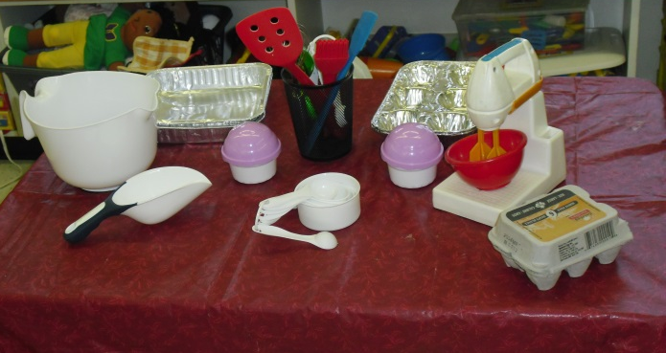
After a week or so, interest at the centre began to fade. Play changed and the children created scenarios in which they would steal the candy from the store and the money from the cash register! The children who were still interested in maintaining the candy store became frustrated with the others.
After a classroom discussion on stealing and honesty - even in play - it was decided that is was time to change the centre. The shop was closed for renovations and when it re-opened, it was a bakery!

Slide 10
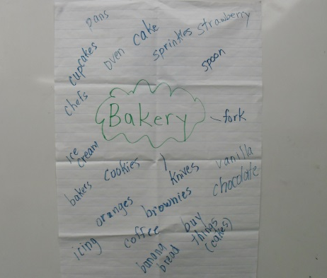
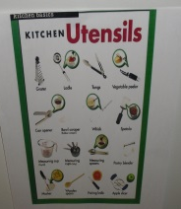
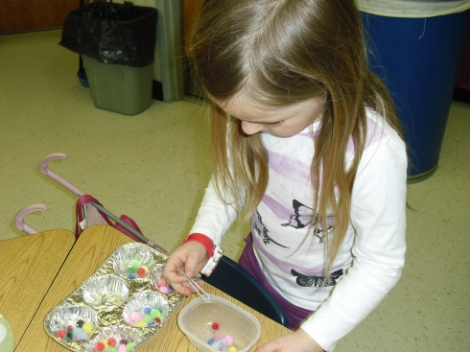
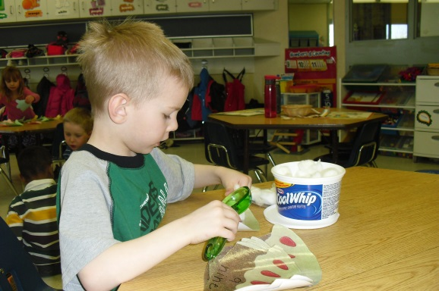
As a class we made a topical web
about bakeries. We also named
and identified special utensils
bakers would use.
We read fiction books about the topic and looked at cookbooks (non-fiction text). We also followed our own recipe and made
cupcakes!
During this project number recognition activities were introduced for the children to work on. These included measuring ingredients, counting objects for decoration and estimating the number of cupcakes to be made.

Slide 11
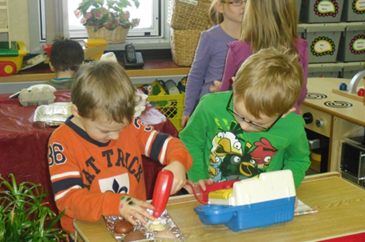
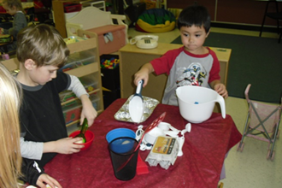
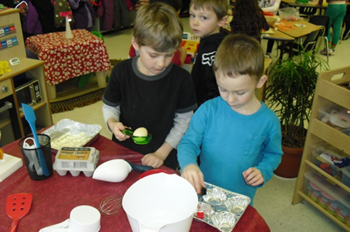
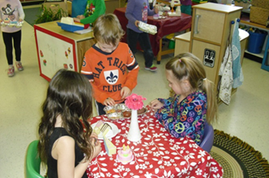
After making real cupcakes, the children represented their learning by continuing to pretend to work in their own bakery. They used the baking utensils, made cakes and cupcakes from various materials, and served customers who visited the Sweet Shop.

Slide 12
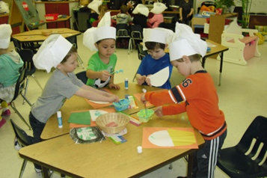

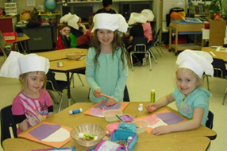
One favorite activity during this project was when the children iced their own paper cupcakes by using shaving cream and glue.
The Sweet Shop adventures were documented and displayed for the community to view.

Slide 13
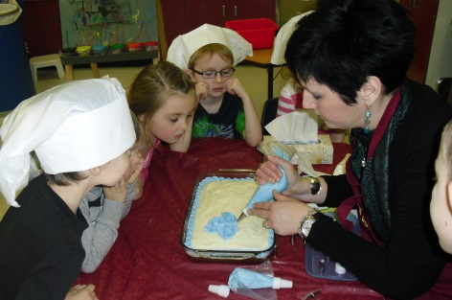
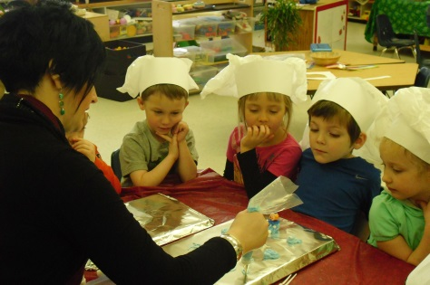
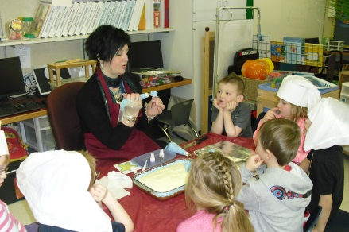
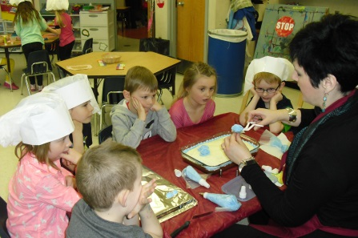
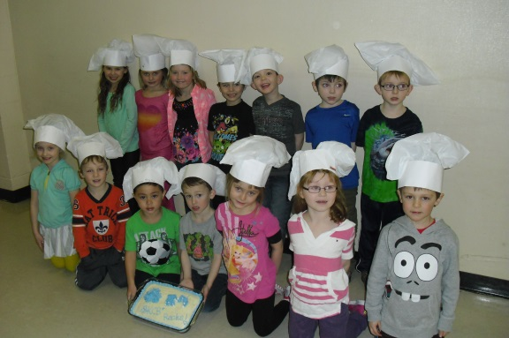
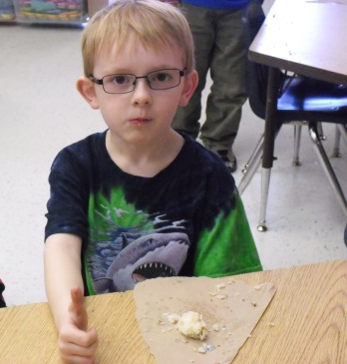
Concluding the Project:
As a culminating activity, our teacher-librarian was invited into the classroom to share her cake decorating techniques. The children watched as she demonstrated how to make a rose, fancy flowers, and even a clown with icing!
They were very interested in the process.
The best part of the activity was getting to eat the cake!!

Slide 14
Teacher Reflection:
By participating in the two day “Responding to Children’s Interests” workshop, I was able to focus on one topic for an extended period of time.
The most challenging part of the project was selecting a topic that the majority of the children would be interested in. When they started sorting and selling the ‘candy construction’ pieces, the idea of doing the same thing on a bigger scale developed.
Almost all the children visited the centre during the four weeks. Everyone participated in the special group activities (i.e. baking, cake decorating demonstration; icing paper cupcakes).
When the Sweet Shop had difficulty maintaining itself as a candy store, it was renovated into a bakery.

Slide 15
Once the topical web was made and the utensils were discussed, the children were more focussed and engaged in their learning.
Enthusiasm increased and the children became very goal-directed.
This project reaffirmed for me that when children are interested in something and encouraged, they become responsible for their own learning and can take discovery and accomplishment in directions the teacher may never have thought possible.
For myself, I witnessed an extremely high level of imagination, visualization, and realization. The children did a great job of activating their own learning and my role of facilitator took on new meaning.
I look forward to the next project!!

