Slide 1
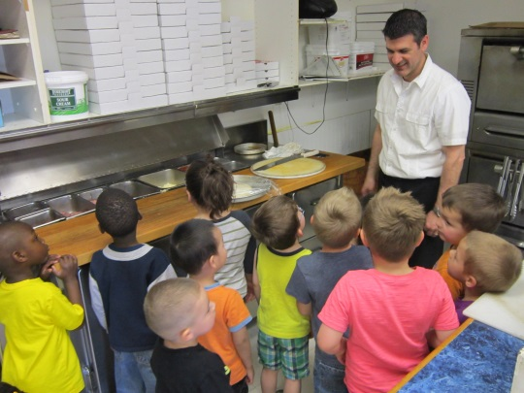
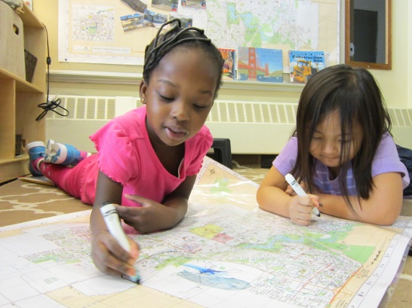
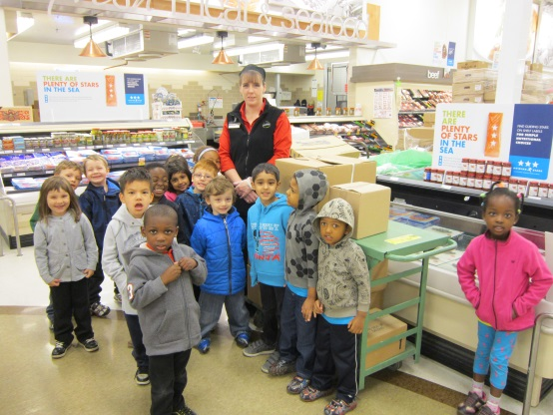
“Exploring Our Community”
McLurg School Pre-Kindergarten
Regina, Saskatchewan
Spring 2015

Slide 2

General Information
This project was completed by 3, 4 and 5 year old prekindergarten students at McLurg School.
29 children were involved.
The project began in February 2015 and concluded in late May 2015.
Submitted by teacher Mrs. Melissa Overholt and teacher associate Mrs. Melissa Desjarlais.

Slide 3
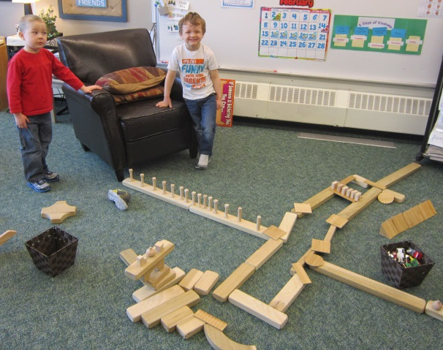
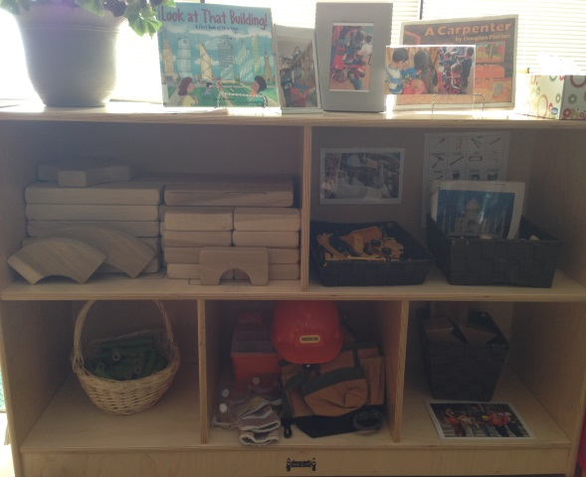
Beginning the Project
Throughout the year, our students have shown an interest in building blocks. We continually added to and rotated the items in our building area to encourage more creativity in their building projects.
We began to notice that the children were using a small tool kit with plastic tools to pretend to cut and hammer the building blocks. Thinking that they would enjoy more tools to play with, we decided that this was perhaps the direction we should take for our project.

Slide 4
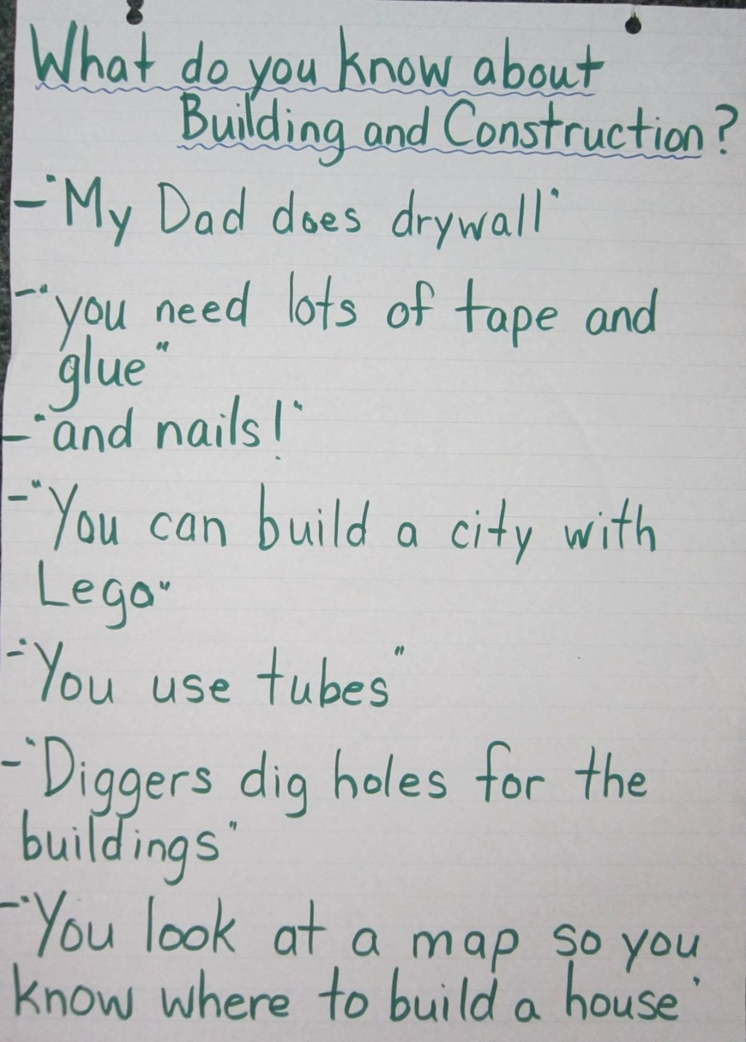
Our Planning
Mrs. Overholt and Mrs. Desjarlais began gathering materials and created a web with ideas and possible directions that we thought the project might take. We later asked the children what they knew about construction and building and created a list . We also added their ideas and suggestions to our web (their ideas are in green printing, the teachers in blue).
The students ideas and suggestions were taken into consideration as we began to set up a “new and improved” building and construction center in the classroom.
*It should be noted that parents were kept informed throughout our project by monthly updates at family day and via newsletters. We also welcomed parents to events held throughout the project.

Slide 5
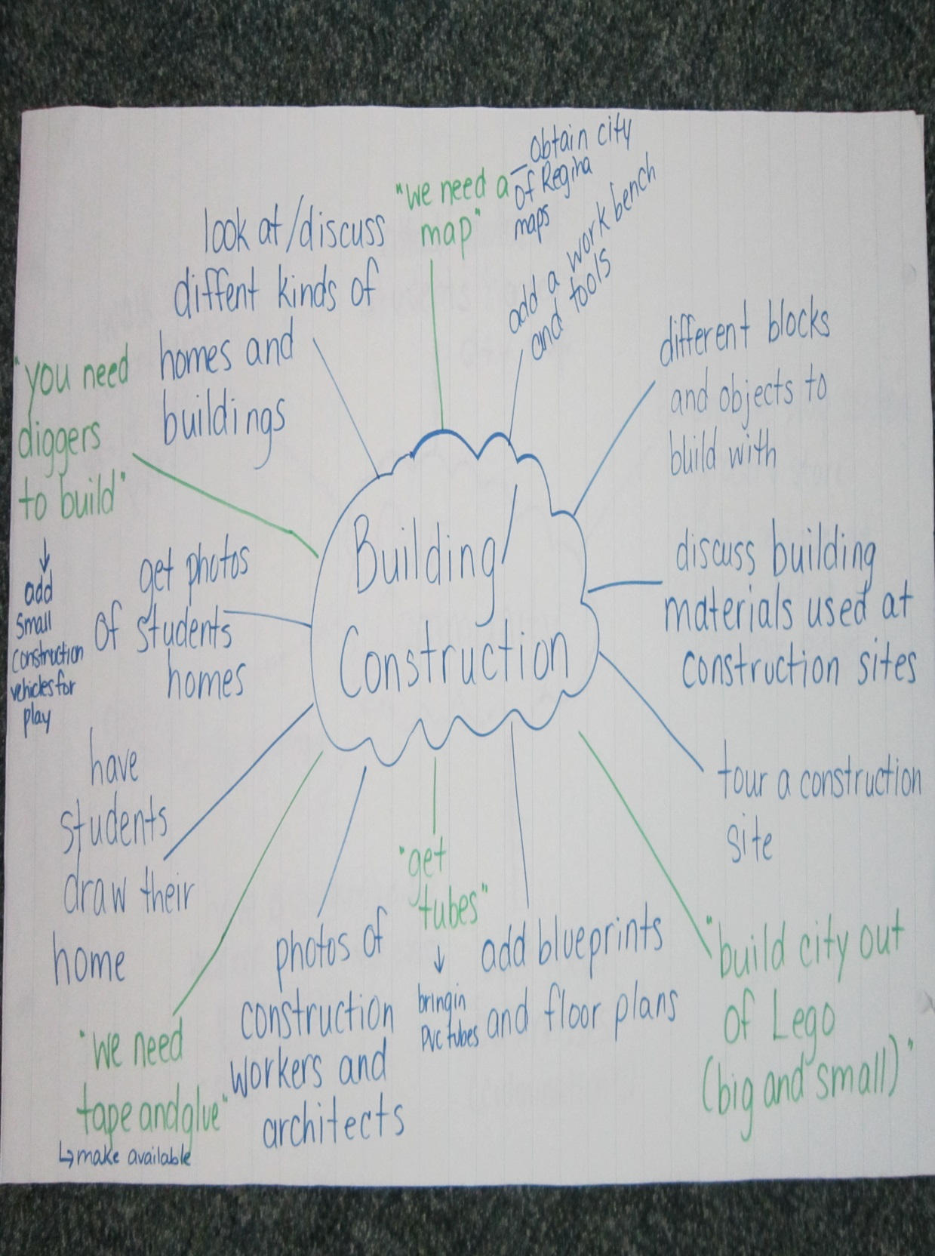

Slide 6
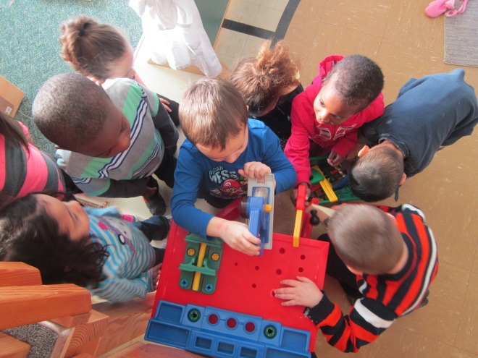
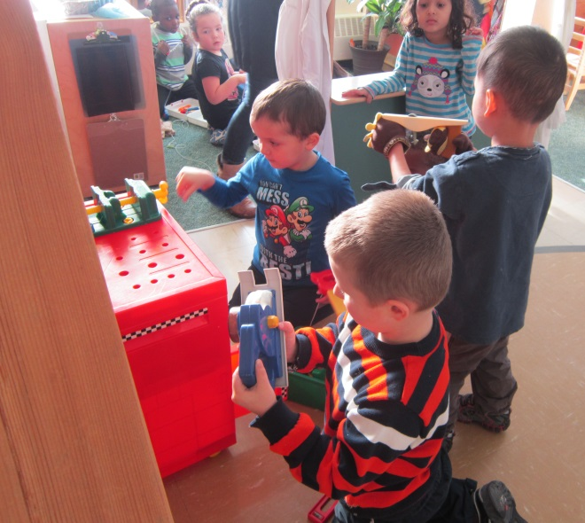
Our focusing event was the introduction of a small tool chest filled with toy tools that Mrs. Overholt brought from home.
The children were thrilled with this addition and spent several days, “hammering,” and “cutting.” They enjoyed pretending they were construction workers. Books about construction, labels, building blueprints, toy construction vehicles, and photos of construction workers were added to the center to encourage new vocabulary and creativity.

Slide 7
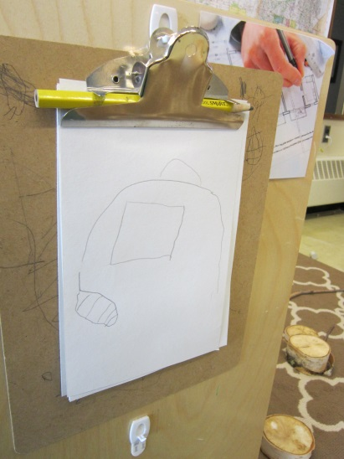
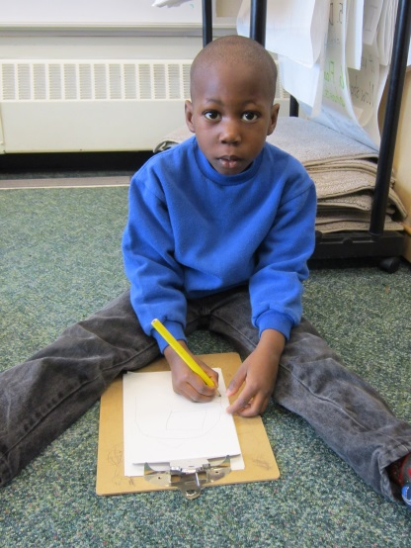
Clipboards with paper and pencils were present at the center so that the students could represent their ideas in drawings.
Just when we thought we had the children “hooked” on the construction theme and began to plan anticipatory activities, things began to change…
“I’m drawing a house”

Slide 8
Plans Changed…
After about 10-14 days of being very interested in the new items in the newly created “Construction Center,” the children’s interests began to shift. It started with discussions about building/constructing houses. This led to the children asking about each others homes and where their classmates lived. At this point, Mrs. Overholt suggested to the students that we take a look at a map. She called the City of Regina and was able to obtain a 3’x5’ map of the city as well as a few 2’x3’ maps.

Slide 9
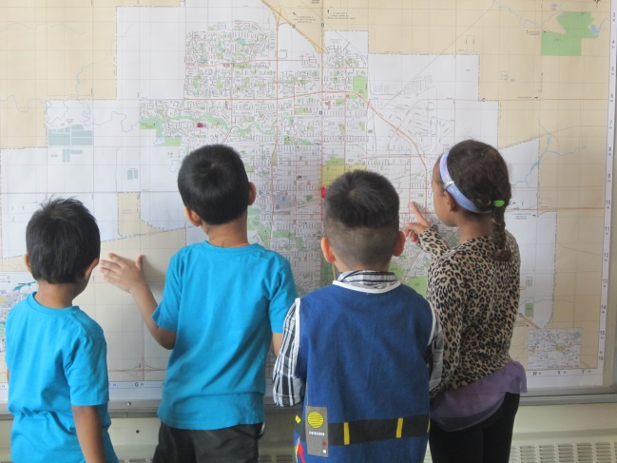
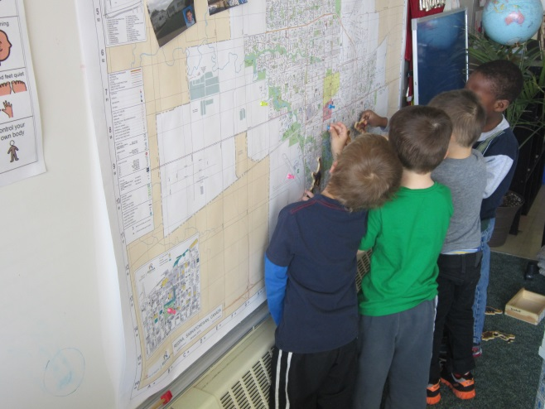
The large map was hung up on the wall – low enough for the children to be able to see it clearly and to point to places. The smaller maps were laminated so that the children could use them in their play or draw on them.
E - “This is the airport!”
R - “Where is the School?”
J - “Where is my house?”

Slide 10
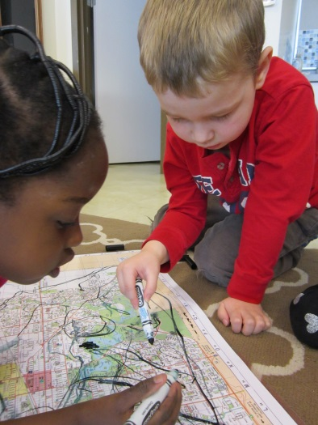
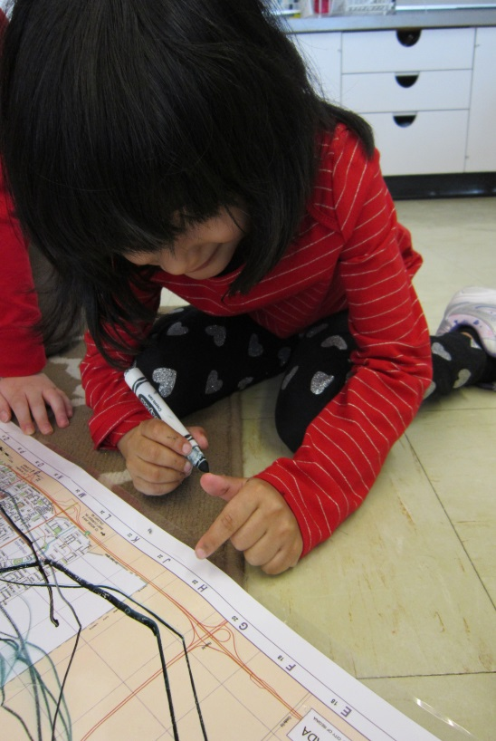
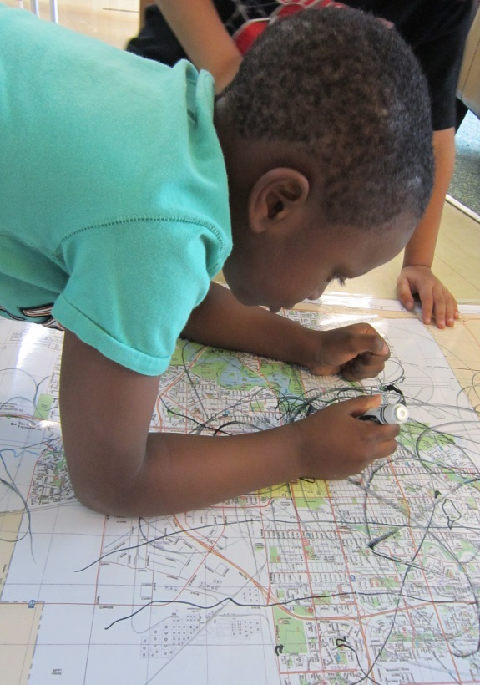
Drawing on Maps
“This is the road to my house”
“Look! There’s letters. This letter is in my name!”
“I’m making roads”

Slide 11
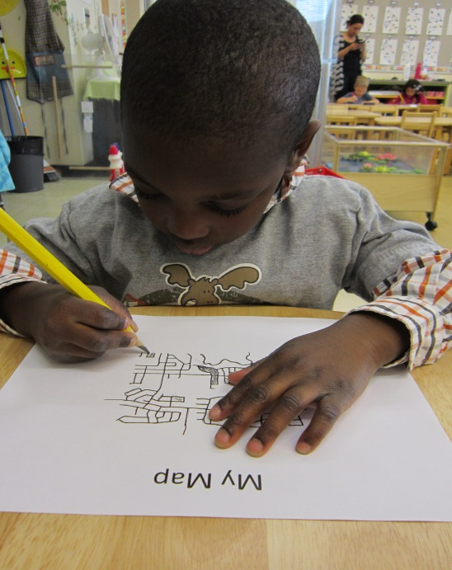
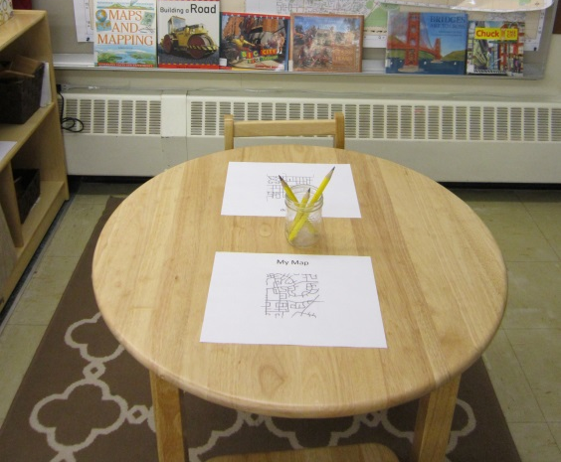
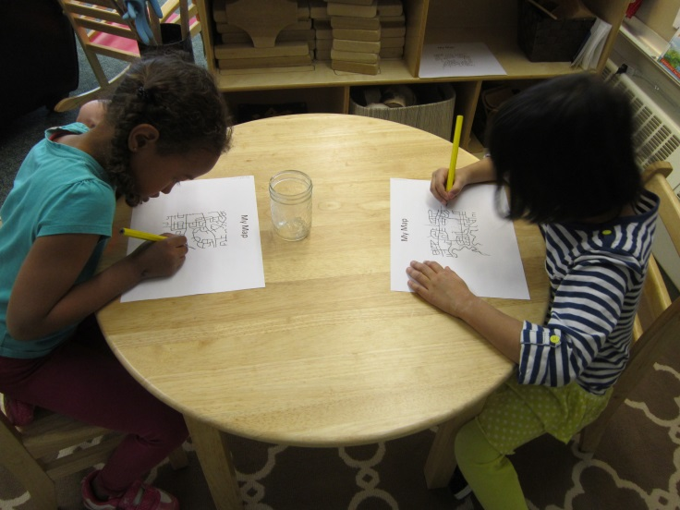
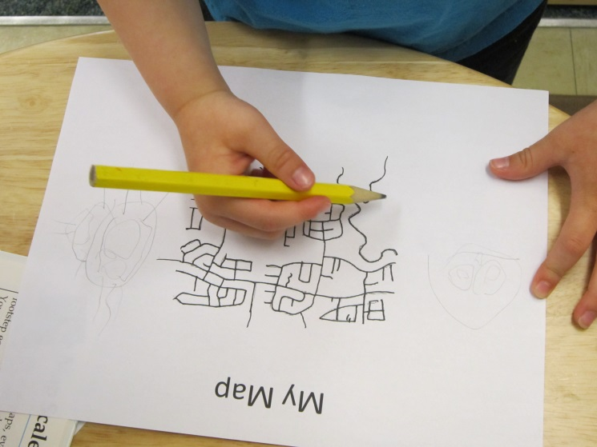
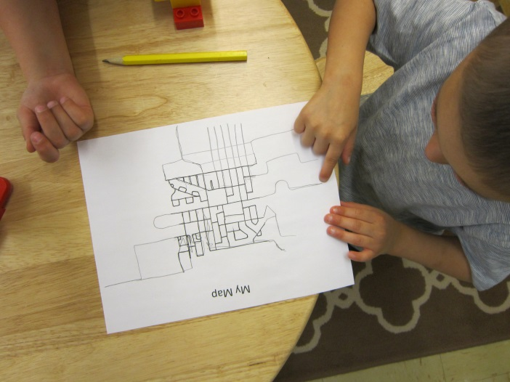
Creating Maps
Photocopies of a simple map were set out as an invitation for the students to create their own map.

Slide 12
The children were excited and were asking “Where do I live?” asking the teachers to point it out on the map.
At this point, parents were contacted and asked to send a photograph of their home. The photographs were printed out, and string and push pins were used to mark out where each of the children’s homes were on the map.
They loved looking at each others homes and where their friends live. Differences between the size and “style” of the each home were noted by the children.

Slide 13
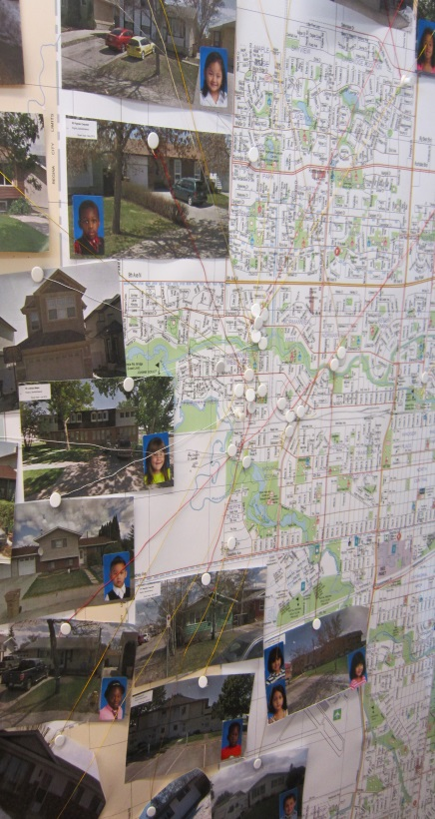
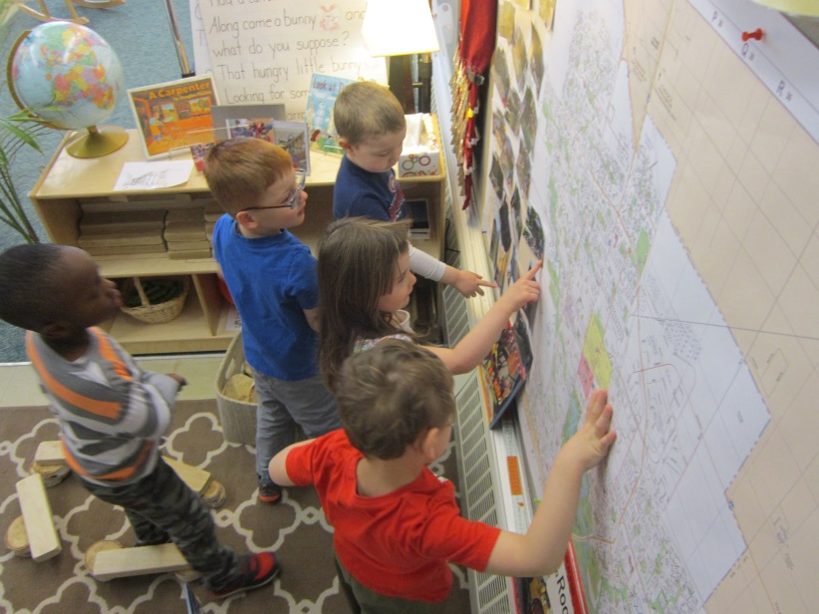
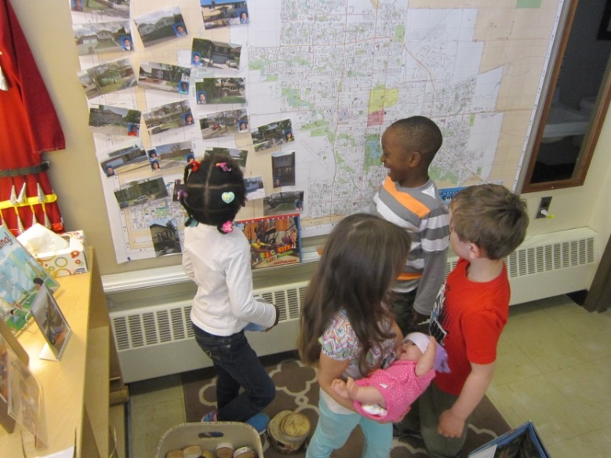
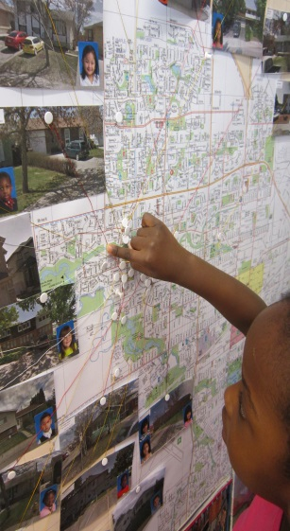
The map was located close to the building materials. Students were encouraged to build their house out of blocks.
H – “This is where I live”
C – “You live close to me!”
S – “J, where do you live?”

Slide 14
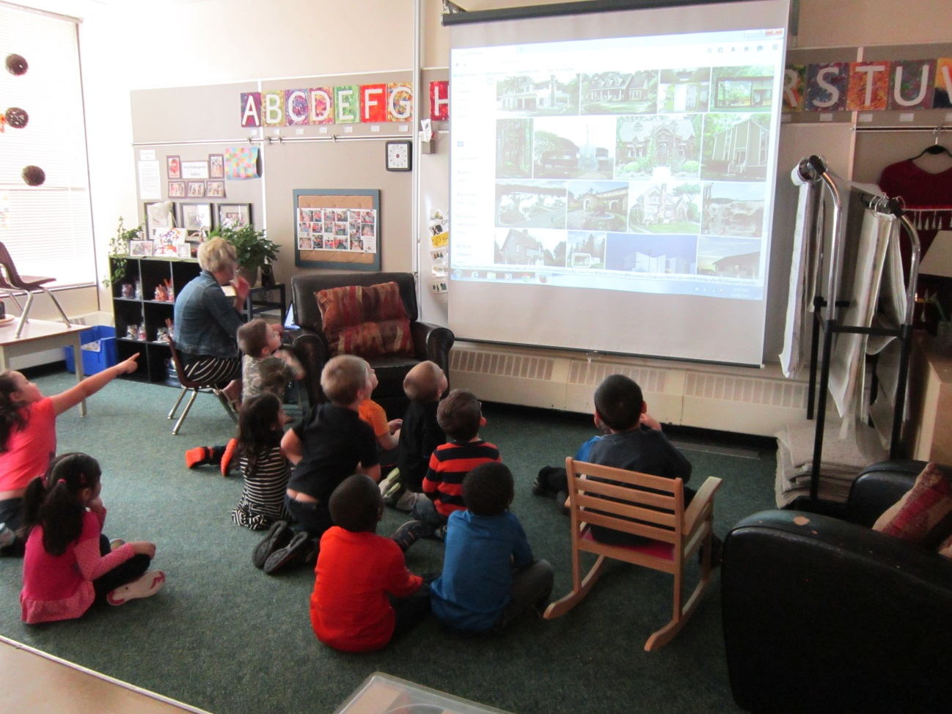
With homes/houses being such a hot topic, Mrs. Overholt took the opportunity to show the students a variety of different house styles online.
It was also discussed that some people live in “single family dwellings” and others in “multi-family dwellings” such as apartments buildings or condos. This led to discussions on the type of homes that people around the world live in.
The teachers pointed out to the students that most of the children’s homes were located in close proximity to each other. The words “neighbourhood” and “community” were discussed. Books on these topics were brought into the classroom.

Slide 15
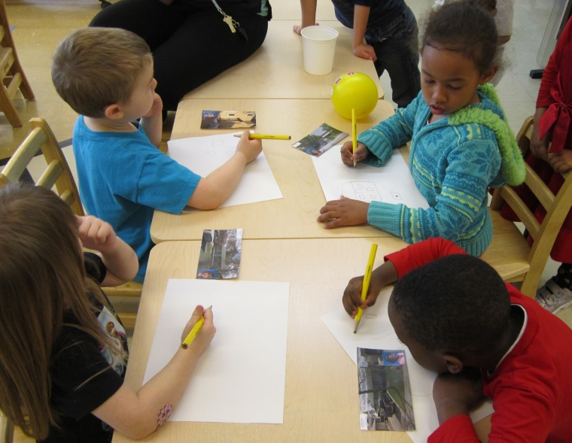
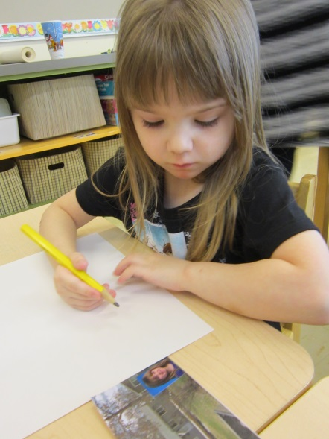
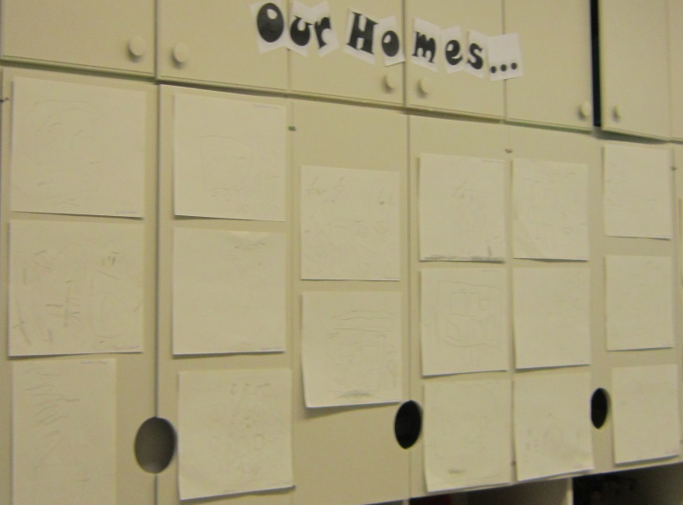
Drawing our houses
The students were asked to draw a picture of their home. They used the photo of their home to copy from. Math concepts such as, counting (how many windows, doors, etc.) size and shape were discussed as they drew their pictures. Their drawings turned out really well. Parents enjoyed looking at their child’s drawing at our Family Day.

Slide 16
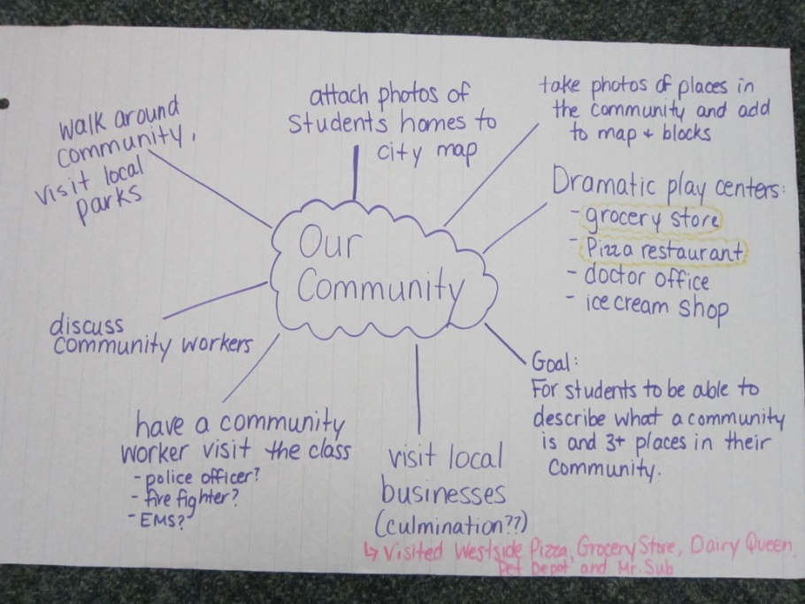
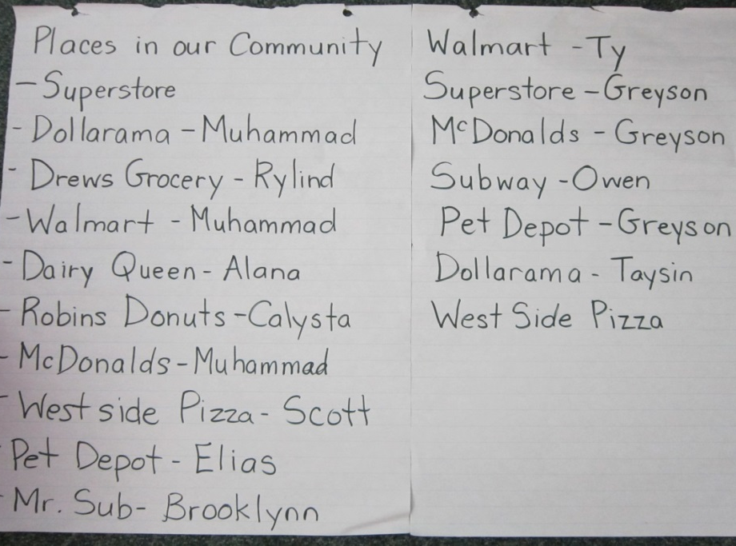
A New Topic Emerges
As the children explored the city map, and talked about homes, the word “community” was used several times. The easiest way to describe what a community was to the children, was to begin by listing some of the most obvious businesses in the vicinity. The children immediately joined in and started listing off places in the community. It wasn’t long before a student suggested we visit one of the places on the list. In the web, the teachers ideas and goals are written in purple. The highlighted centers are those we completed. We did not get to all of our ideas.
Thus began our exploration of “our community!”

Slide 17
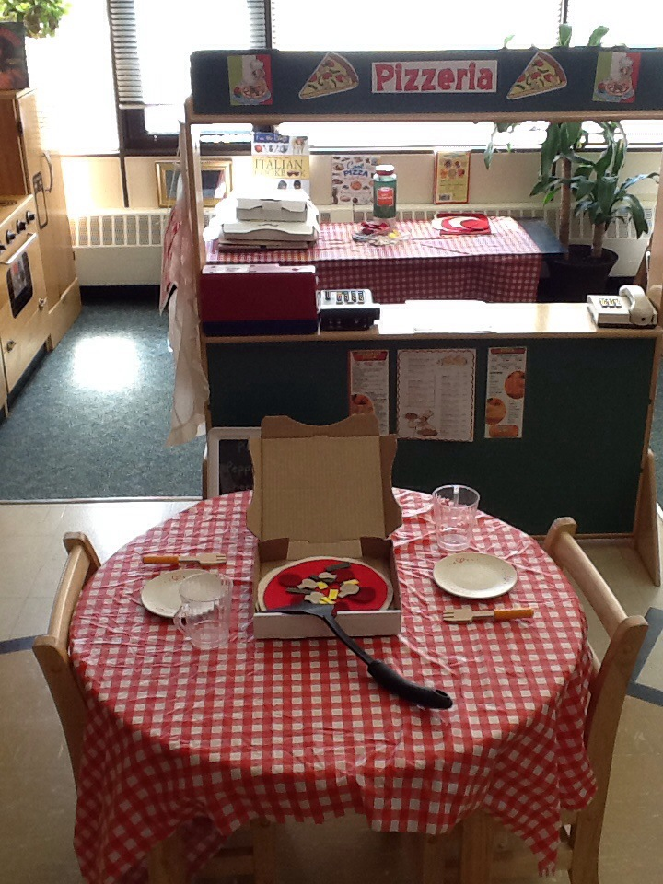
One of the businesses located within walking distance of the school is a pizza restaurant called Westside Pizza. Thinking that this would be an excellent place to visit with the students, arrangements were made for the class to walk to the restaurant and to eat pizza while there.
To get them interested in the idea, we created a “Pizzeria” dramatic play centre. Westside Pizza was generous enough to give us pizza boxes of various sizes to use in our play center.

Slide 18
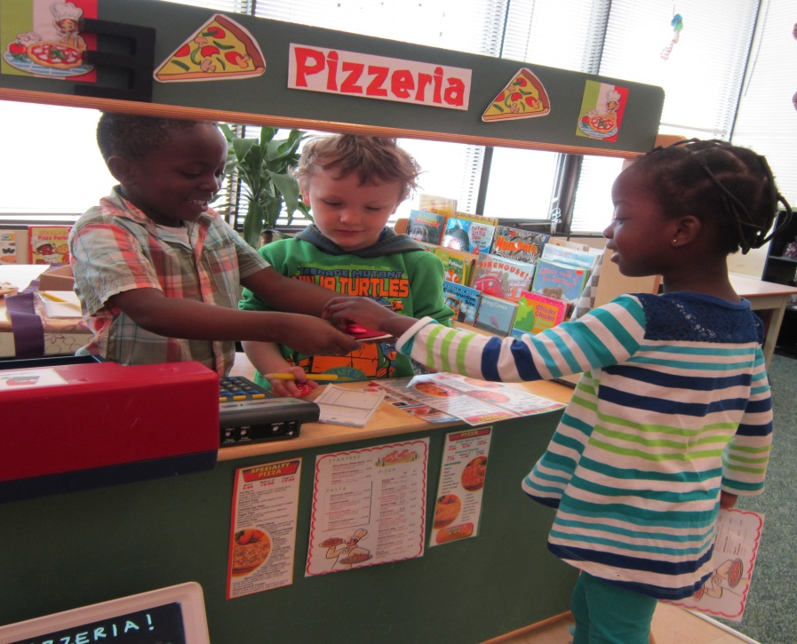
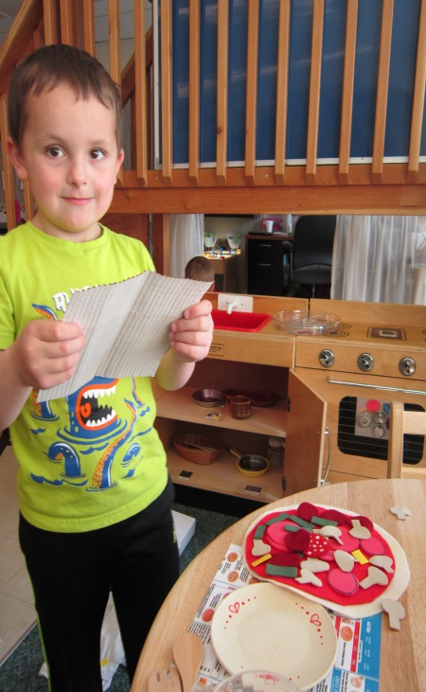
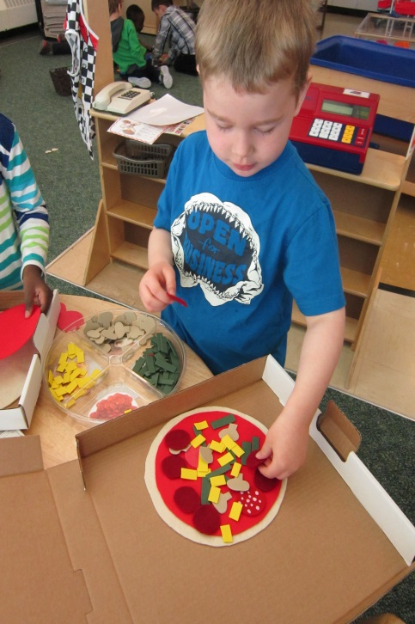
The Pizzeria
The children LOVED the pizzeria! They enjoyed creating their own “pizza’s” using felt pieces and putting their finished creations into real pizza boxes. It was time to see how pizza is really made – and of course try some real pizza as well.

Slide 19
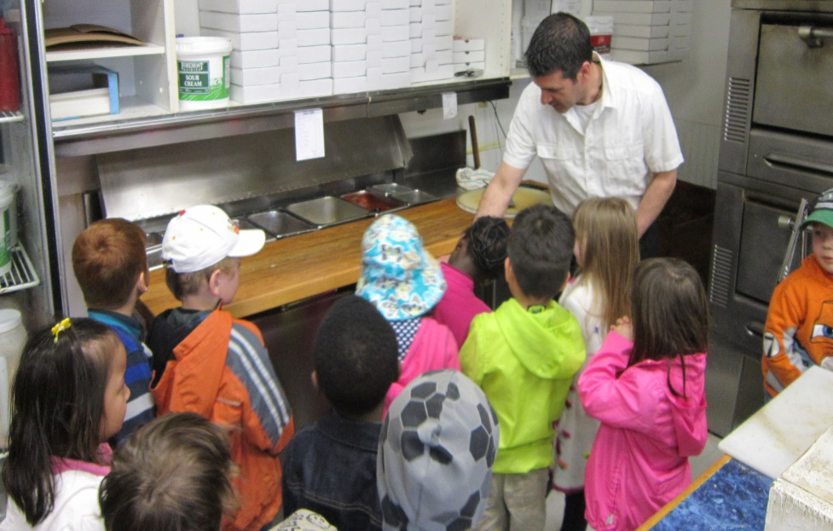
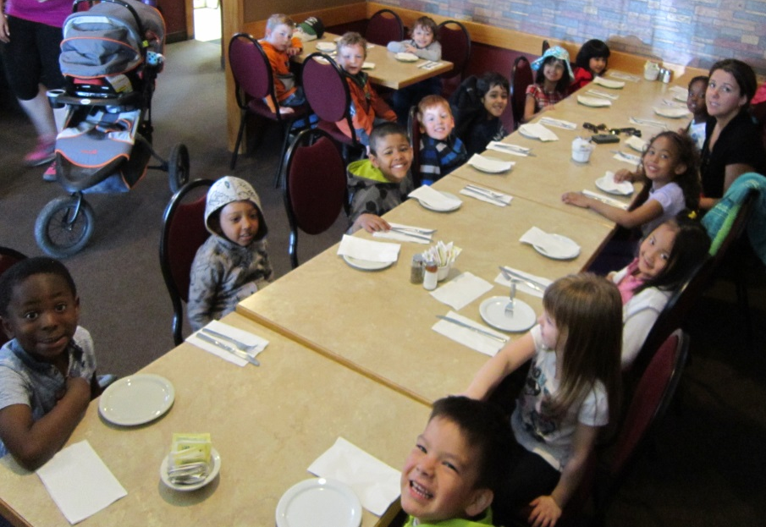
Trip to Westside Pizza
On Wednesday, May 6, we walked with the children to Westside Pizza. The manager, Louis, took the students into the kitchen and showed them how to make a real pizza. Afterwards, we went back to the dining room where we all enjoyed some delicious cheese pizza! Several of our students commented that they had never been to a pizza restaurant – in fact, some had never been to an actual restaurant. What an exciting experience for them! This excursion was so much fun, that when we returned to the school, we immediately began discussing where we could go next!

Slide 20
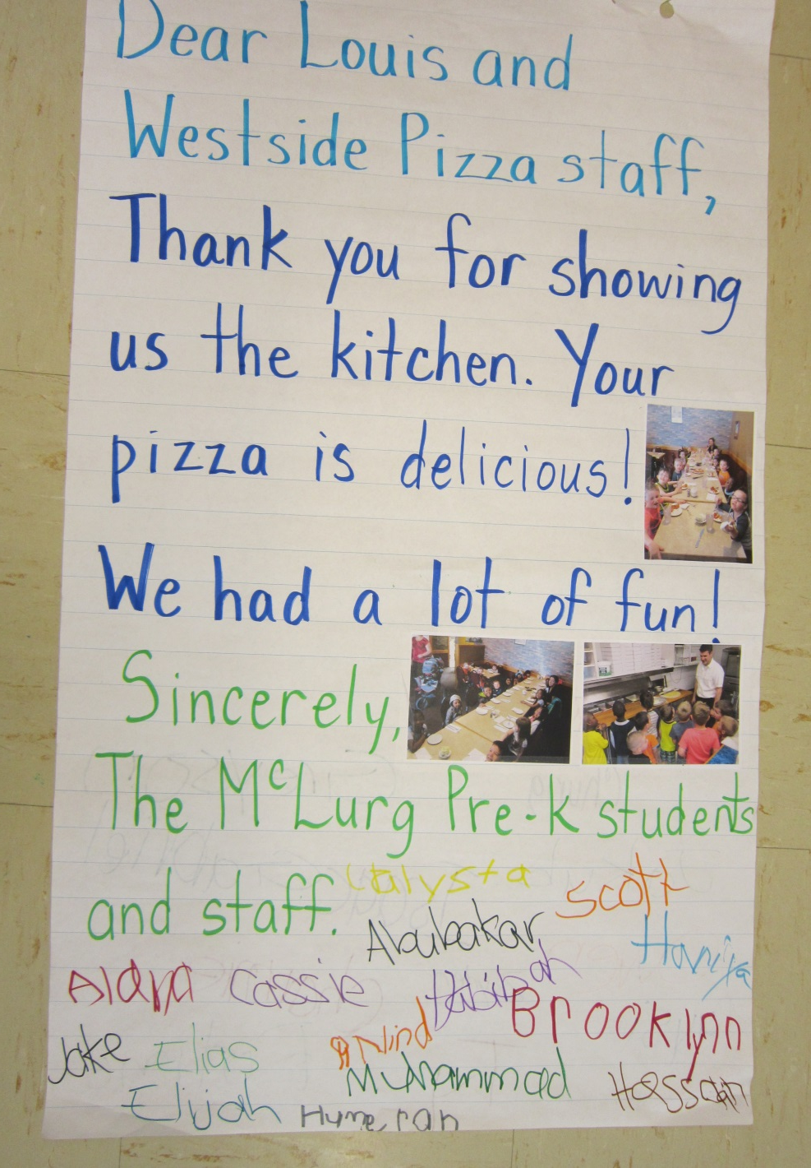
The day after our trip to Westside Pizza, we asked the students what we could do to thank the staff at Westside for their generosity.
Some of the suggestions included sending them flowers, sending them money, or even sending the staff a pizza to thank them!
One student suggested that we write a thank you letter. We decided that was the most logical thing to do.
We wrote a letter on chart paper and included some of the photos from our trip. All of the students signed their name at the bottom of the letter.

Slide 21
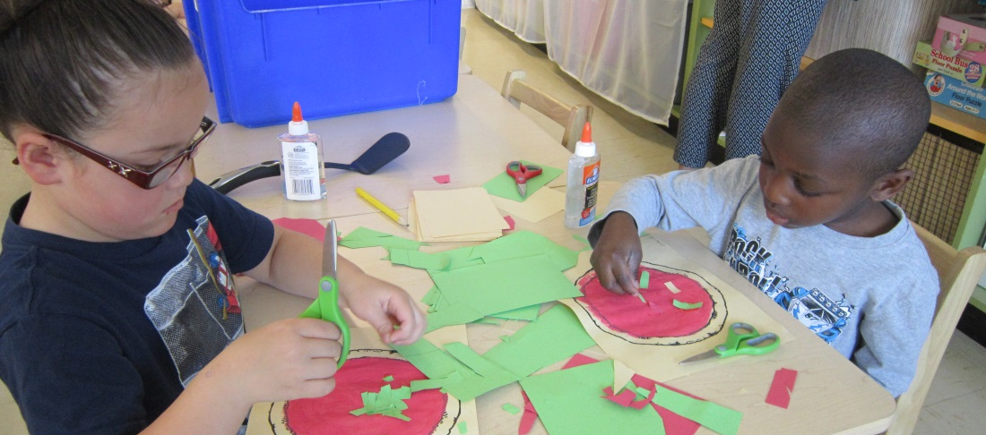
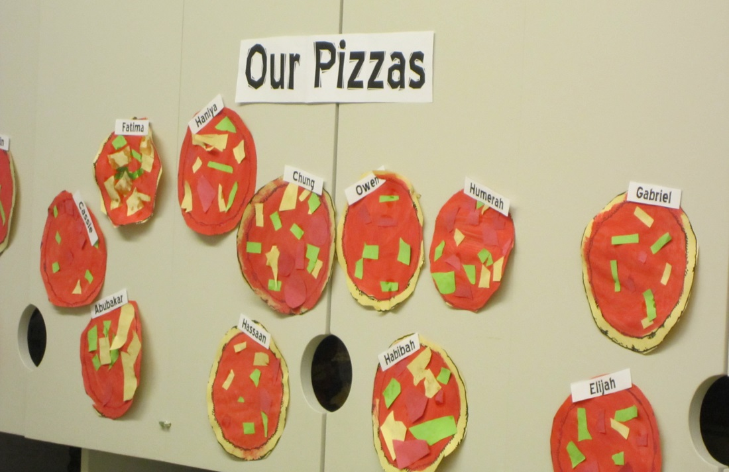
Making our Pizzas
Later that week we also had the students paint/create a visual representation of their favorite pizza.
After painting “sauce” on a circle, they were given colored paper and scissors to cut out toppings from.

Slide 22
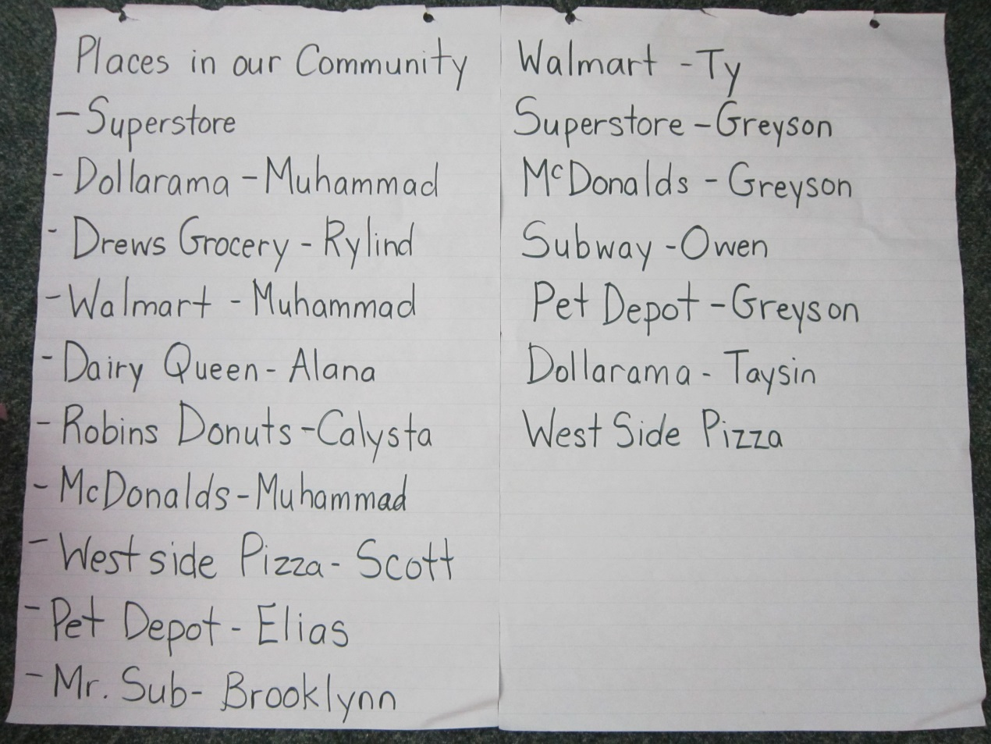
After a few weeks of focusing on the Pizzeria and Pizza, we thought we should return our focus to other community places/businesses on the list we had made earlier.
We asked the students if they had any new places that they had thought of, that we could add to our list. One student mentioned “Dairy Queen.” Another student added, “My Mom works there!” We soon made arrangements to tour Dairy Queen. Because Mr. Sub, Pet Depot, and Drew’s Independent Grocery Store were on our original list as well, we decided to include these businesses in our outing. Drew’s also offered to do a store tour.
With only a month of Pre-K left, we teachers, decided that this would be our culminating event, as it was time to begin wrapping up our Pre-K year.

Slide 23
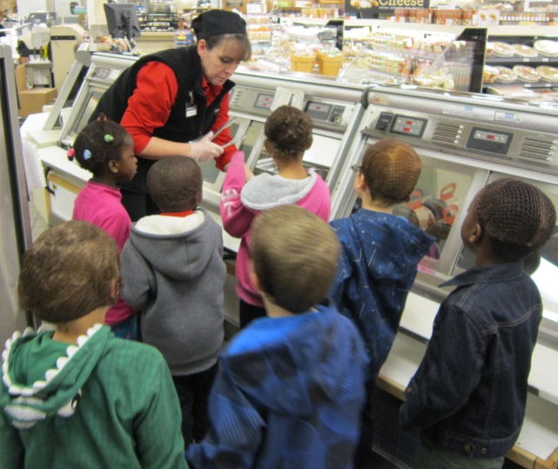
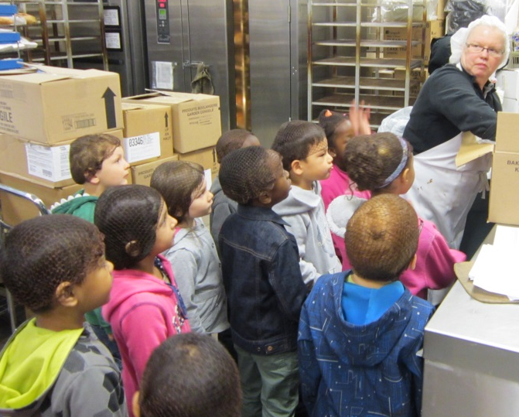
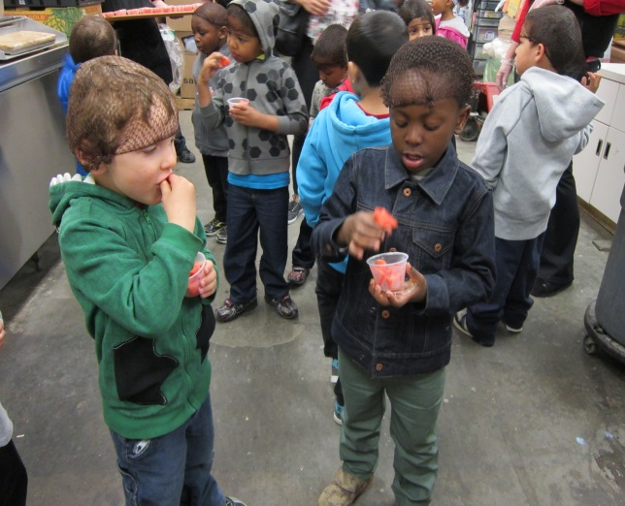
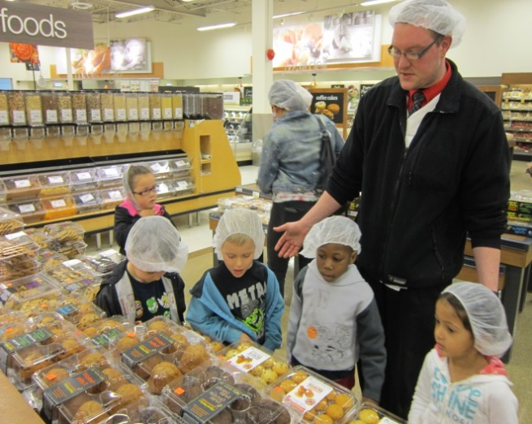
Community Tour
On Thursday, May 14th, we had all of our students meet us at Normanview Mall. We began by touring Drew’s Independent Grocery Store. The store’s staff planned an amazing tour and gave the students several food samples along the way. Staff from each department discussed their job and daily responsibilities.

Slide 24
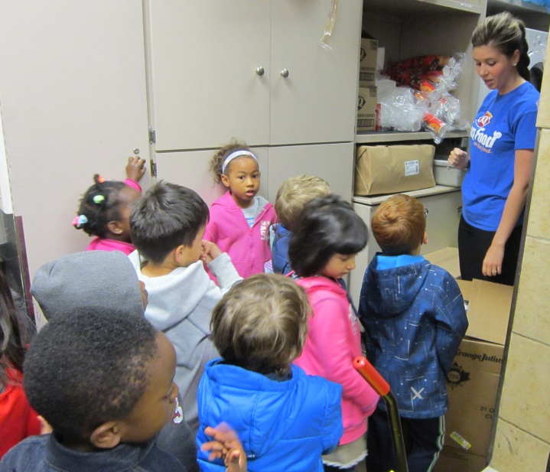
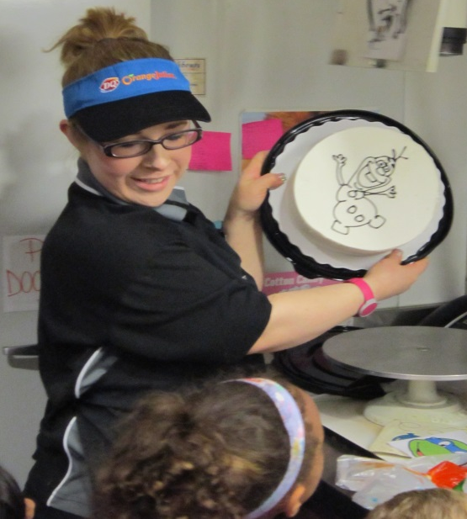
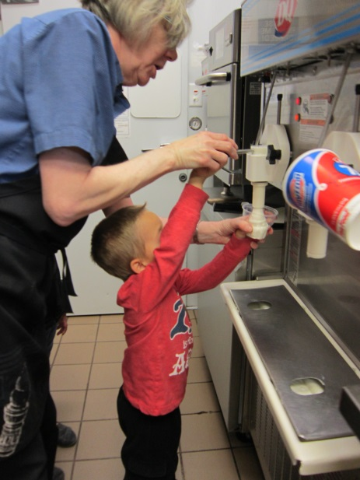
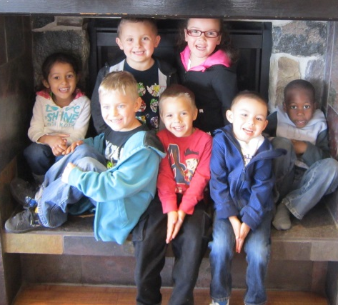
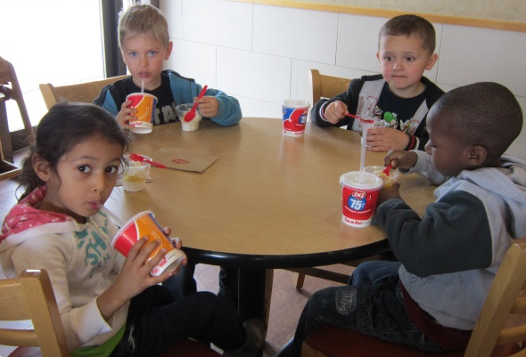
After that, we walked to nearby Dairy Queen where the students received a tour, a cake decorating demonstration, and were able to make their own ice cream sundaes!

Slide 25



Next we walked over to Pet Depot and toured around the store. They had fish, guinea pigs, birds, a bunny and a kitten that the children loved seeing. The staff were kind enough to give out dog/cat treat samples to all of the students that had pets at home.

Slide 26


Finally we walked over to Mr. Sub. We watched a sub sandwich being made (by a Mother whose children also attend McLurg School), and then each of the children received a small sub sandwich to try. That was our last stop of the day. It had been a whirlwind day, but weeks later, the children were still talking about this trip!

Slide 27
Graphing our favorite part of our trip…
Following our trips, we asked the children which location was their favorite. Having toured each of the places and learning about what happens at each of them, the students had a new appreciation for these businesses and the people that work at them. We thought their favorite place would be Dairy Queen as they all loved the sundaes they made, however, we were wrong! We did a poll and created two different types of graphs to visually represent our findings.

Slide 28


Making our own Grocery Store
Our Trip to the Grocery Store inspired yet another dramatic play center – the “Pre-K Independent Grocery Store!”
We brought in real food packages, grocery store fliers, grocery bags, and sorted foods into baskets by food group. We spent a few days explaining to the students how the food had been sorted and discussing the four food groups. This also led to discussions about healthy vs. not so healthy foods.

Slide 29




Taking Babies grocery shopping
“Here’s your change”
“You need a basket!”
Filling up on healthy foods!

Slide 30
Teacher Reflection
This project was a lot of fun for both the teachers and the students. As teachers, it gave us the opportunity to create some dramatic play centers that we had never used before. We also visited places that we had never taken students to before – so that was exciting for us! What surprised us with this project was the different directions it took. Our students had been so in to building and blocks, that we thought a construction themed project would work out great. We found that as the project got going, it became easier to follow the children’s lead, as at first it was difficult not to jump in and intervene by asking questions, giving answers and making suggestions. What we found to be difficult was getting the project started. We knew the students interests, but envisioning them as a project was hard. As teachers, we are used to doing all the planning ourselves before starting a theme or project. Once we got going, we found new topics were popping up weekly. We feel that although our project did not start out with the best topic, what that initial topic lead to was something great! If we were to do it again, or if we had had more time, we would have looked in to community workers more – as this topic was just beginning to emerge at the end of our project. What we found to be meaningful was hearing students say that they had never been to a pizza restaurant before (or one of the other places we visited). One student even said that they had never walked across a bridge before – which we did on our walk to Westside Pizza. We loved seeing the children’s faces light up with excitement at Pet Depot, and their pride as they made their own ice cream sundaes at Dairy Queen . The best part of this project was definitely taking the student’s to all of these great places in our community!

Slide 31




Resources Used
Special Thanks To…
Westside Pizza
Drew’s Independent
Dairy Queen
Pet Depot
Mr. Sub
City of Regina

