Slide 1
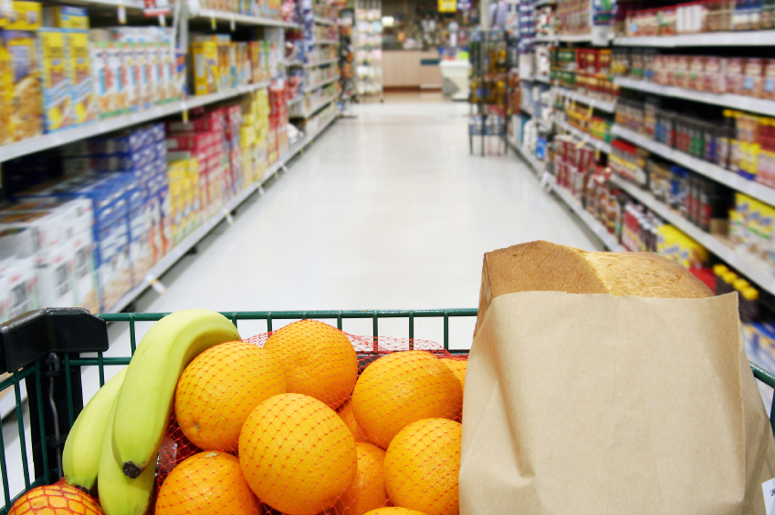
GROCERY STORE
WISE OWL SCHOOL AGE CARE INC.
BY CHERYL GERO

Slide 2
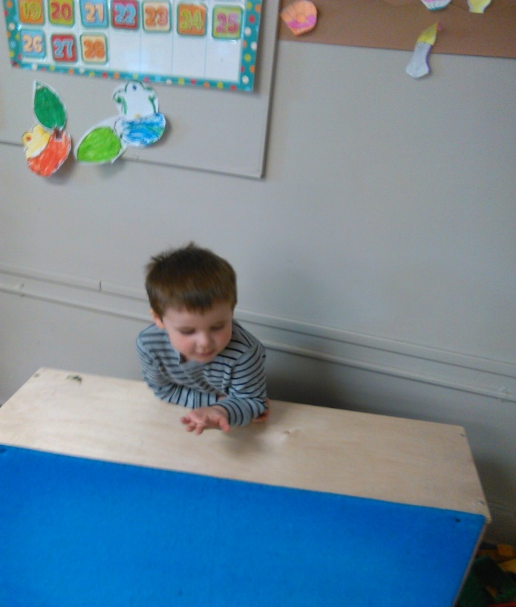
WILL THAT BE DEBIT OR CASH LADY?
It all started from a little boy standing behind a felt board cupboard saying, "Will that be debit or cash lady?" I asked him if he would like to make a grocery store. He really wanted to. All ages were interested, and helped to set it up.
We have about 32 children from ages 3 to 11.
My special needs child, and other special needs children were involved whole heartedly too.

Slide 3
We set up a huge grocery store with lots of parent involvement. Many, many things came in, from a talking, debit cash register with intercom, purses, bags, coke fridge, boxes and boxes of empty cereal boxes, coffee cans, everything imaginable.

Slide 4
They made labels for all the foods and made the money themselves.

Slide 6
All the children helped put up the labels for the food by looking at the pictures or reading the labels.

Slide 7
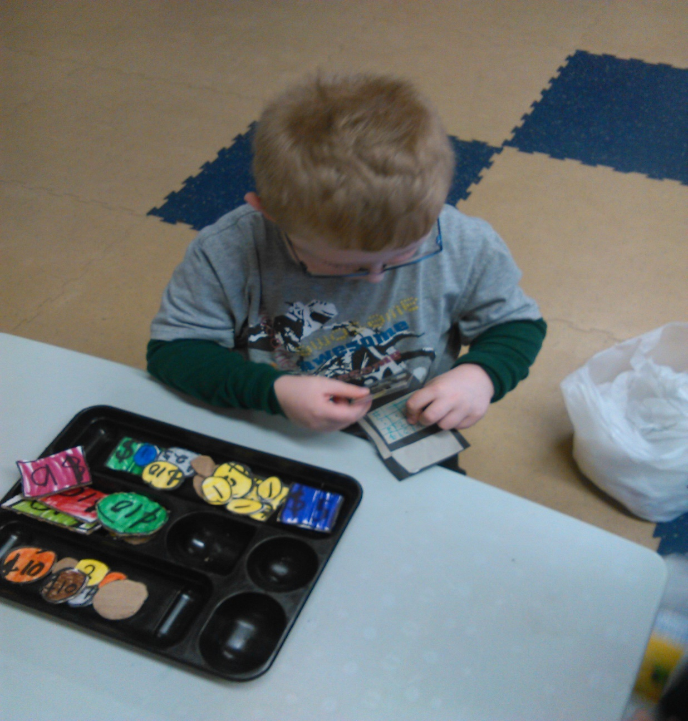
THE CHILDREN MADE THERE OWN MONEY BY CUTTING OUT PRINTS, AND MAKING THEIR OWN BY DRAWING COINS AND BILLS.

Slide 8
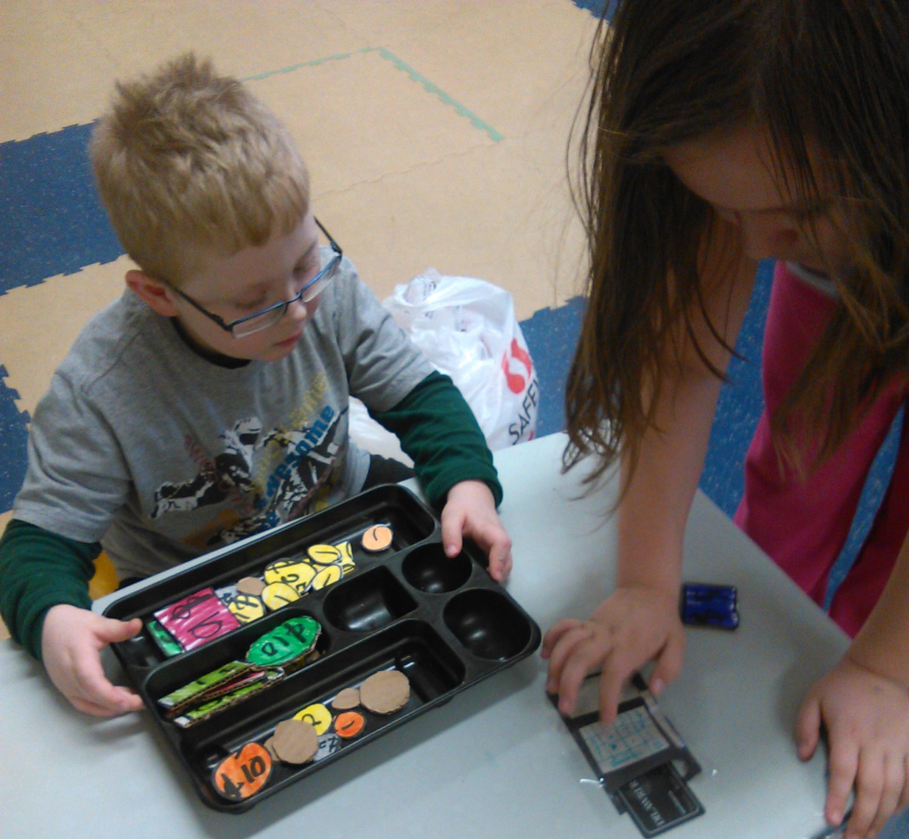
CLARA LOVED OUR GROCERY STORE. SHE WAS THE ONE WHO THOUGHT THE STORE NEEDED A DEBIT MACHINE. SHE MADE A HOME MADE DEBIT MACHINE ALL BY HERSELF.

Slide 9
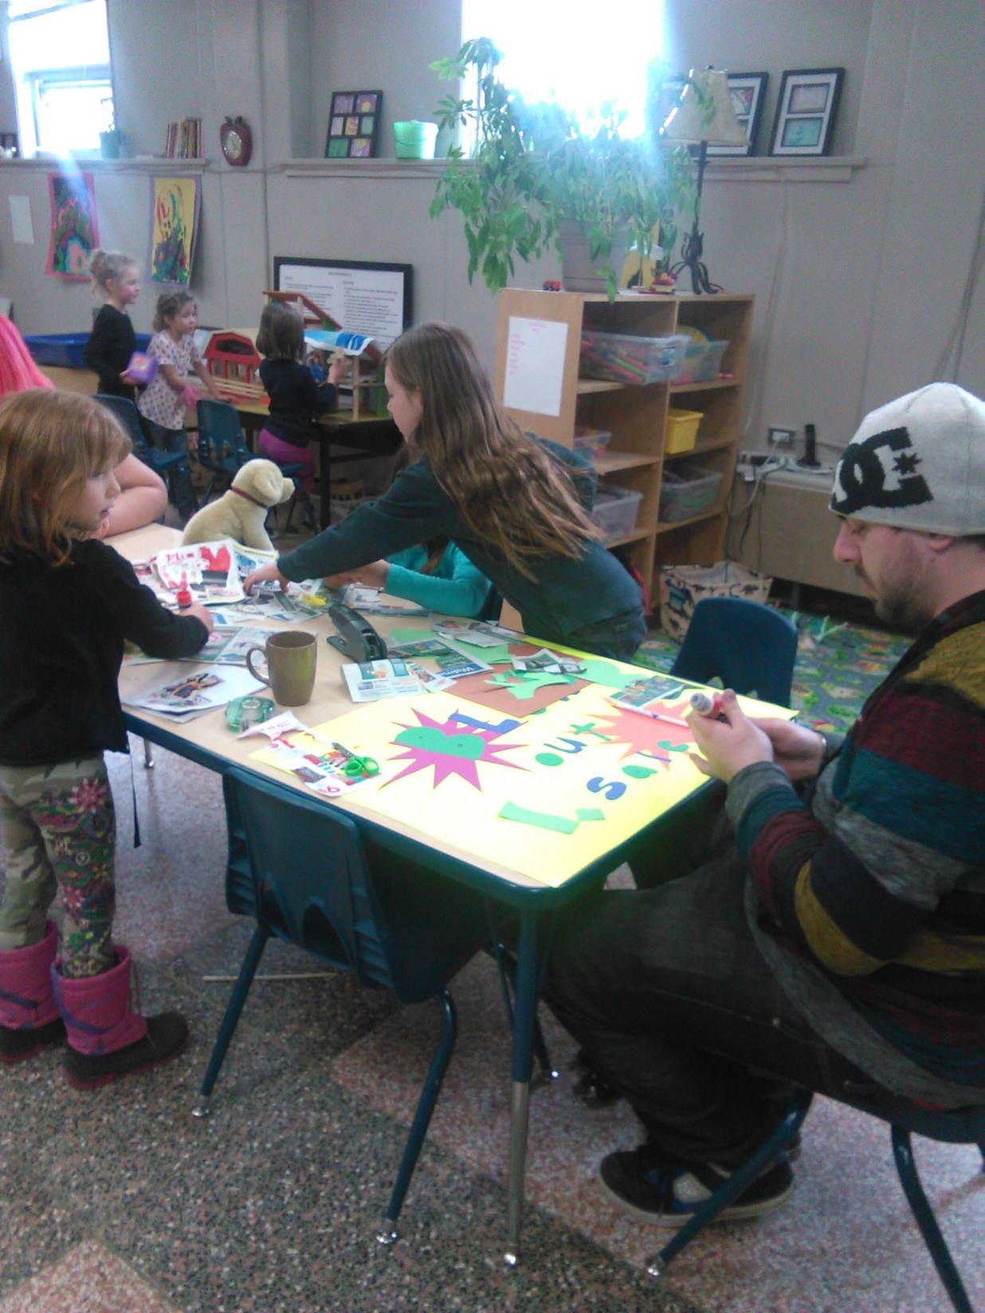
The children made signs, and a big advertisement sign.

Slide 10
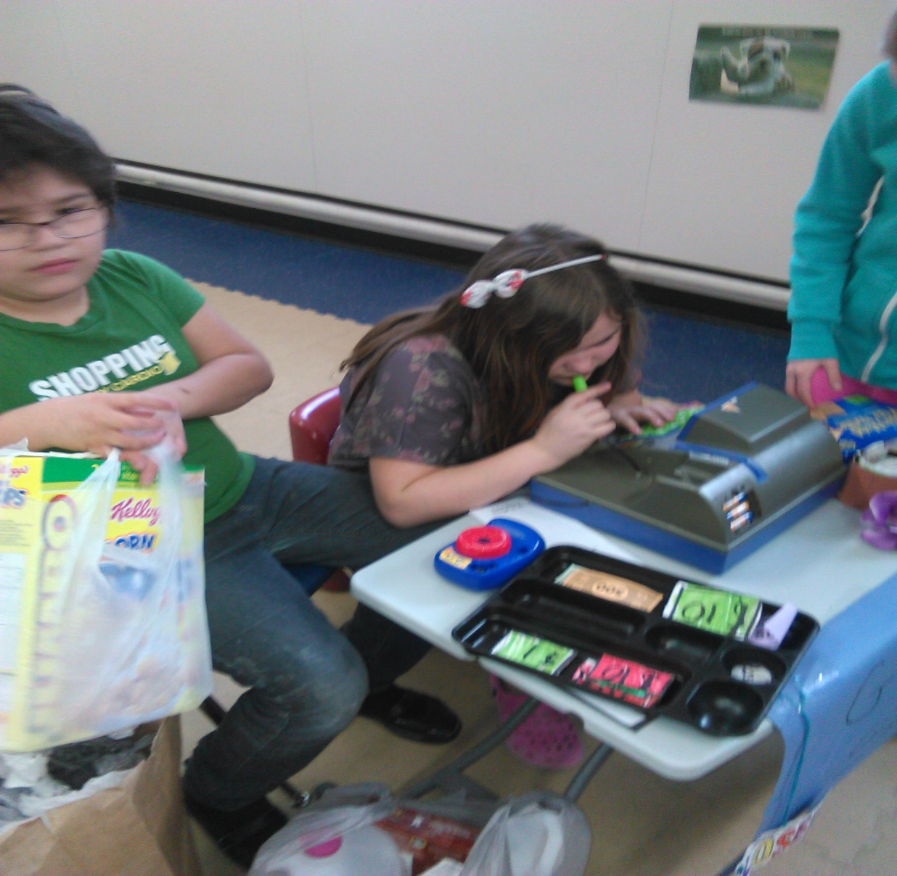
The children played and played with the grocery store. They played house and shopped for groceries.

Slide 12
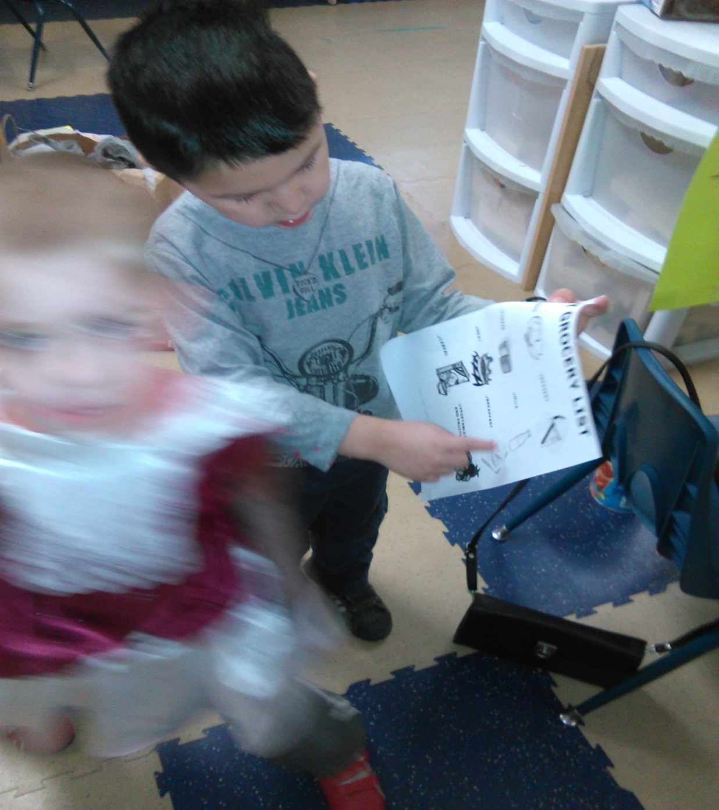
We read books about nutritious foods. They followed grocery lists, and shopped for nutritious food for their pretend families.

Slide 14
A grocery store owner came from Mike's Independent Grocer located on Broadway Ave. He stayed over an hour answering all their questions. The little ones had such impressive questions. They learned a lot.

Slide 15
WHAT WE WANT TO KNOW

Slide 16
MORE QUESTIONS

Slide 17
Essential Learning Experiences

Slide 18
They camped and shopped for groceries. We then set up a camping site with camping chairs, a tent and a gazebo beside the grocery store.

Slide 19
With their keen interest in camping, we decided to go to Cabela's camping store.

Slide 20
They had archery lessons there.

Slide 23
The pre-schoolers were able to do archery too.

Slide 24
WE HAD DELICIOUS FUDGE.

Slide 25
We had a scavenger hunt. We looked for all the animals set up in the store, that were from Ontario and Saskatchewan.

Slide 28
After the trip we read a book about wild animals.

Slide 29
For our wind up we made a real Deli. We made special sandwiches made from fun shaped cookie cutters. They had bunnies, hearts, angels, bologna, ham and cheese sandwiches with a little bit of mayo. They loved making them and eating them.

Slide 30
LUCY IS HAVING AN ANGEL BOLOGNA, CHEESE, AND MAYO SANDWICH.

