Slide 1
If I Could Build a School
Connaught Prekindergarten
2014-2015

Slide 2
Our project began because our 102 year old school was being taken down to build a new school. Picture from CBC News Posted: Mar 26, 2014 7:28 AM

Slide 3
Five of the twenty four students in our current morning or afternoon pre-k classes attended the old school as three year olds. Although the rest of the three and four year old students never went to school in the old building most of them live in the neighborhood and watched the demolition occur. Picture from Globlal News September 11, 2014 12:50 pm

Slide 4
We wondered…
They told us: I like to…
What do the children like to do at school?
Play play dough and go down the slide. Fischer
Build with blocks and play with magnifying glasses. Raine
Do puzzles. Jackson
Paint with water paints. Seth
Play guitar. Jeremiah
Playing with dinosaurs and ponies. I like building things. Perla
Read a book. Lilou
Play with dolls and play upstairs. WiYanna
Play with dinosaurs and the iPad. Faeryn
Play everything, and the playground. Sam

Slide 5
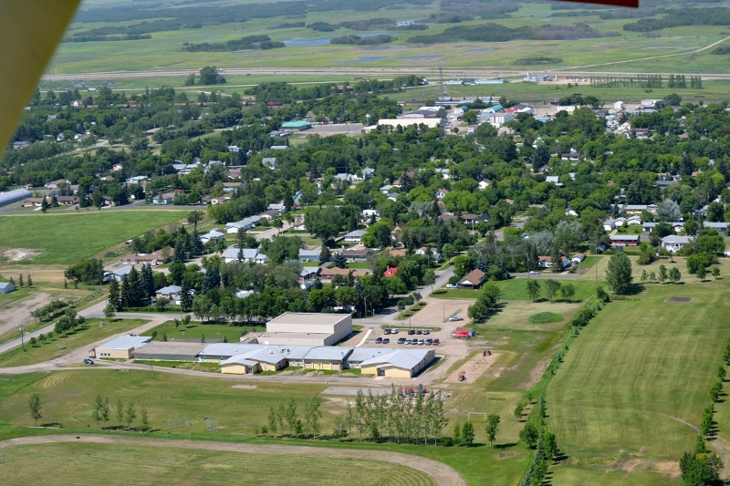
We wondered if all schools are the same? Are they different in small towns?
We e-mailed Mr. Racette’s K/Pre-K class in Broadview to ask about their school. These are the answers to our questions:
Dear Connaught Pre-K Students :), We have sleds, and a big hill to slide on. We have swing sets, a big slide, a little slide, climbing wall, and play structures. Yes we do have an exercise room. No we don't go bowling in our gym. No we don't have doughnuts at school, we might have some at a special party. Our farm animals live on the farm, near a pond or in a barn. Small animals like rabbits live in a cage cows & horses live in fences or corrals. Yes we have 2 girl and 2 boy washrooms. Yes we have a Kin Park in our town and are raising money for a splash park. Yes we see butterflies and caterpillars outside on our playground in the spring/summer. We hope you like the pictures we took in our school and on our playground. Thank you for asking us those awesome questions. It was Fun Broadview Pre-K/K

Slide 6
The design Process Begins
Every school needs
A classroom with toys.
A gym.
A library.
A place for coats, shoes, and backpacks.
A painting room with a place to dry paintings.
A playground with rocks.
Garbage cans.
A kitchen for cooking.
Closets or storage room for extra toys.
A living room with a big couch and a rocking chair.
A plant room.

Slide 7
Our dream school
It would have a big tree with grass, with lots of presents under the tree, and ornaments on the tree. We would like to have an elevator, lots of different sized doors to go in and out of, and a fridge and couch. We would have an office, an exercise room, a cafeteria, a Santa Shop room, a swimming pool, and a petting zoo.

Slide 8
Our Design Process Begins The morning class design

Slide 9
The morning class made a red school with a tower. It had a large blue door and lots of green windows. This school has an elevator to get up to a small green triangle door in the tower.

Slide 11
Afternoon Class Design

Slide 12
The afternoon class designed a purple school with a large pink door for the people to go in. It also has a small blue door near the ground for mice, and a yellow circular door with a perch near the top of the building for birds. They included a door up high for people, as well as lots of brown windows and trees.

Slide 14
We wanted our families to join in the fun so we had a family day where everyone designed their own school.

Slide 15
The children’s designs included: a rainbow school 100 windows a climbing wall on the outside sunshine inside a big playground for kids and a little playground for animals

Slide 16
We sent our design ideas to the architects.

Slide 17
The Architects reply!
“This is amazing - made my day! I love the range of their ideas from the big picture (“I want my school to be a rainbow, that is what I want”, “fireworks”, “sunshine”), to the smallest detail (“a small door for mice”, “bird feeders”, “climbing wall”), to the absolutely sublime (“indoor snowman, that’s melting)!
Gabe Derksen numberTENarchitectural group.

Slide 18
“I agree, these are truly inspirational! Thanks so much for sharing these with us. I loved the ideas that came out of this from a playground for animals, to a stars and hearts room, apple trees, slides and exactly 100 windows - how would that be for learning to count! From towers to geodesic domes, there is a lot of creativity in this bunch! They have set a high bar for us to meet and we will rise to the occasion. Can’t wait to hear their feedback on the design.”
LeeAnn Croft CITE360 studio.

Slide 19
Our ideas were included as artwork in the designs for the new school

Slide 20
The architects sent us pictures of different school designs that the children looked at to choose their favorite design ideas for different areas in the school like the gym, library or classroom.

Slide 21
We used the pictures as an inspiration to plan what to include in our designs.

Slide 22
Let the Building Begin What do we need to build our school models?

Slide 23
They began by making a variety of smaller individual building designs. Initially they built schools but soon began building all types of buildings and machines from kitty cat machines to mouse houses.

Slide 29
The children explored the building process using a variety of materials.

Slide 30
We noticed the structures become more complex.

Slide 31
They began to display their buildings.

Slide 33
One day we noticed the children using cardboard to go around their buildings and asked if they would like to use larger boxes to build with. This sparked a whole investigation about measurement and exploring what it is like to be inside a structure.

Slide 36
We measured everything.

Slide 38
The architects returned to show us their new school designs and answer questions.

Slide 39
To demonstrate what we had learned the students decided to design their own school model. Their second choice had been to make up a dance about building a school.

Slide 40
We made our school model out of cardboard to use as a template for the wooden version.

Slide 41
When the wood was cut we used screws to fasten the boards together.

Slide 42
We filled all the cracks with plaster.

Slide 43
We sanded and cleaned the surfaces.

Slide 44
We painted a primer coat on the wood.

Slide 45
We began to paint our school

Slide 46
We taped and finished painting our rainbow.

Slide 47
Our School

Slide 48
Now comes the fun part playing with our school!

Slide 49
Social Emotional Development
Developed a sense of self worth by sharing their designs with professional architects.
Interacted with peers to work cooperatively when building together.
Resolved conflicts about the design of spaces and the sharing of materials.
Developed a sense of others when sharing and listening to others needs and ideas.

Slide 50
Physical Development
The use of a variety of materials and tools developed fine motor skills by drawing, painting, grasping, stacking, and taping.
Building structures that they could fit inside developed their balance and stability as they climbed in and out of buildings.
Developed space and body awareness by working in small and larger spaces.

Slide 51
Intellectual Development
Listening and engaging in language as they shared ideas about how and what to build.
Incorporated vocabulary from the building process like, lighting, vents, windows, towers, sandpaper etc.
Responded to directions from others “I need the red tape” or “Can you turn the light on in my garage?”
Used language to express ideas.

Slide 52
Spiritual Development
Experiencing a sense of wonder awe and joy as they see their building projects come together.
Experiencing a heightened sensory awareness as they worked with a variety of materials. They liked the weight of the bricks and the way light shone through tunnels in their buildings.
Developed an appreciation of beauty and symmetry when designing spaces.

Slide 53
Teacher Reflections
In the end? We were surprised at how both our classes were interested in this project! Throughout the entire six month project of the school design. Our children’s enthusiasm piggy-backed one idea to the next. Their ideas were specific and detailed. Even the quiet children expressed excitement and individuality, especially towards the end!
From the start to finish, our children were immediately engaged and their interest evolved and became more detailed. It was fun and exciting to see how both our classes engaged not only each other but their parents/caregivers, and us as well! We went from ideas and conversations to paper documentation-”blue prints” to detailed 3-D actual models. It was exciting to see how both classes wanted a “Rainbow school with lots of windows” and this vision became a reality. Not limited to a specific room but rather a striped rainbow formation on the exterior!
It was amazing to see how this project evolved from a simple conversation and how their comprehension of this project was immediate! They loved how their ideas came to life from simple, everyday tools. This project made our children feel so involved in some way!
Ellen Noyes
Starlene Starblanket

