Slide 1
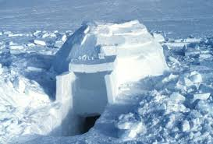
Igloo Project
Wikipedia.org
Lisa Howat & Connie Bailey
Canwood, Saskatchewan

Slide 2
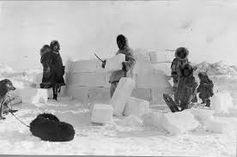
General Information
Students who participated in the project were and 4 years old and attend a full day program.
There are 18 children and at times all children were involved in the project, other times only two or three were interested.
The project began in January and went until late March.
Windows2universe.org

Slide 3
Activities
snowmobiling,
sledding, skiing
skating, snow
shoeing, building
Planning Web
Food
Slush,
snow cones,
Snow taffy,
Freezes, popsicles
Animals
Igloo
How to build,
ice blocks,
milk jugs, fort
building, sugar
cubes
Snow
Arctic animals,
sled dogs
Snow
Flakes
Snowmen
Craft center,
real snow,
sensory, fake
snow
magnifying glass,
coffee filters,
paper plates
Ice fishing
Snow globes
Weather
Snow painting
Driving in snow
snow plow,
grader, trucks,
cars, snowmobile
Why does it snow?
What is snow made of?
When does it snow?
Where does snow come from?

Slide 4
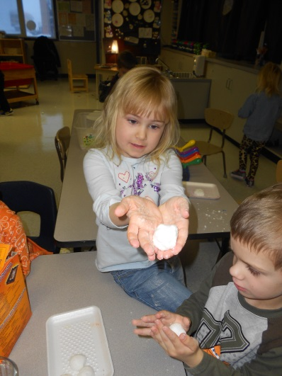
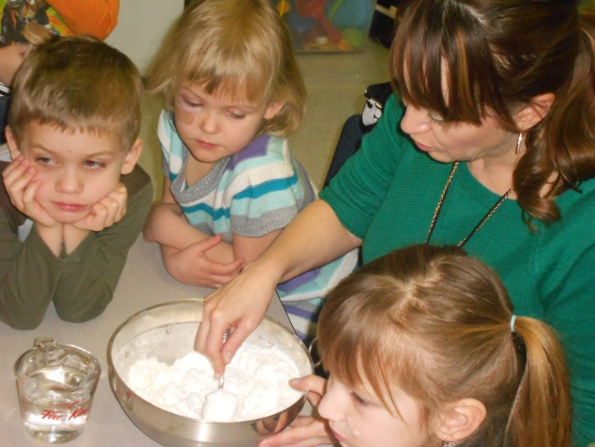
Phase I-Beginning the Project
Our project began with the subject of snow. The reason we choose snow was because the children were very excited about the first good snowfall and during recess built snow sculptures. Many talked about snowmobiles and sledding during circle time. Also for November family day we did snow painting and most were engaged. We decided to put out numerous snow invitations and then observe the children to see where their interests took them.
Making
‘snow’

Slide 5
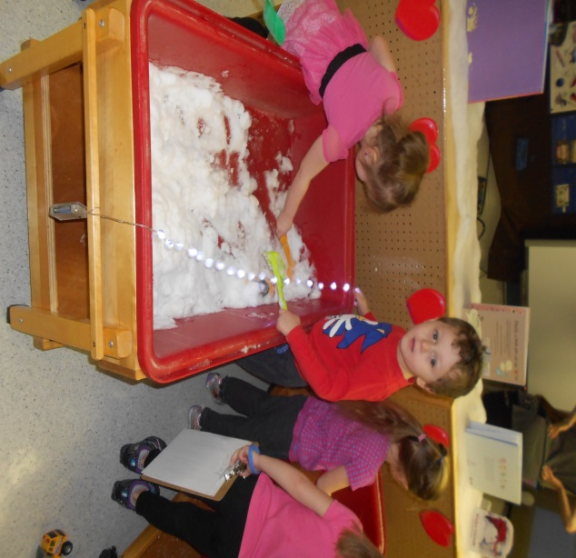
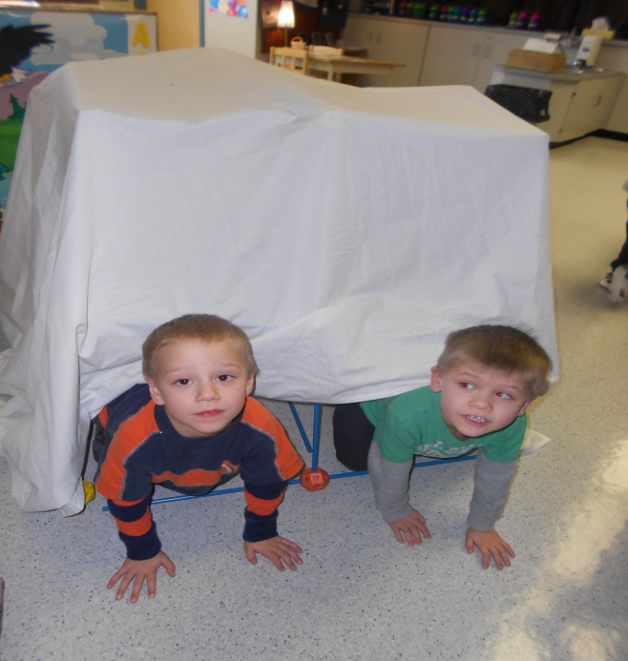
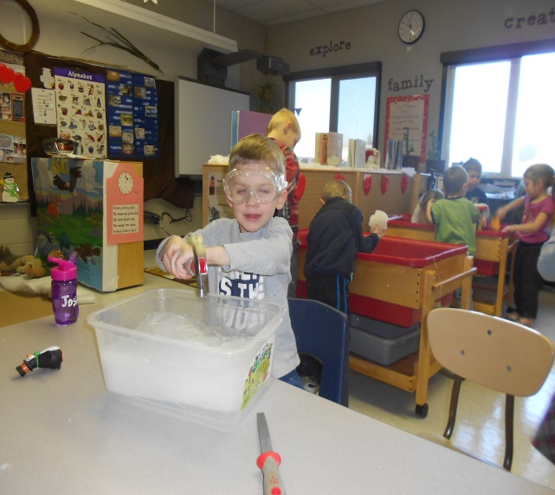
Examples of Snow Invitations
Snow fort building
Materials.
Real snow with tools and vehicles.
Ice with hidden objects and tools.

Slide 6
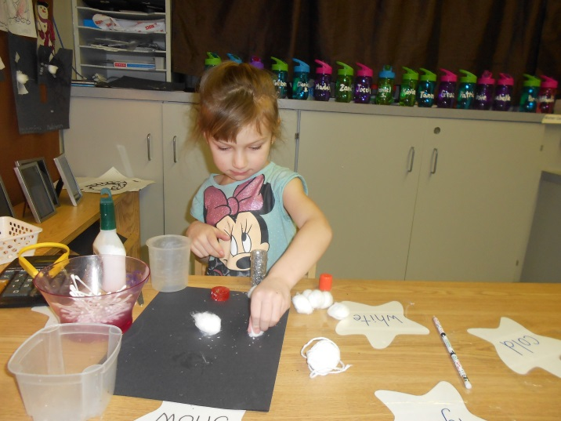
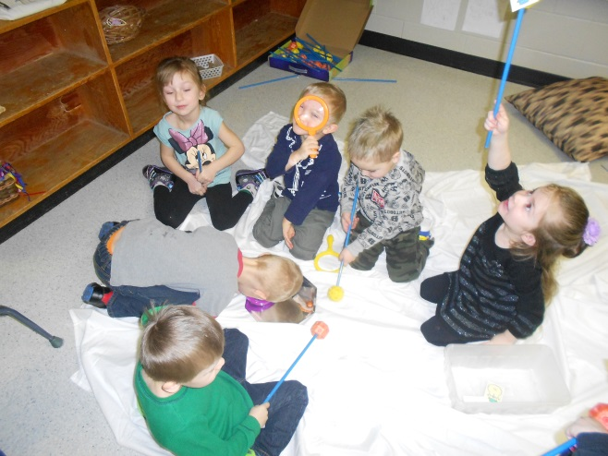
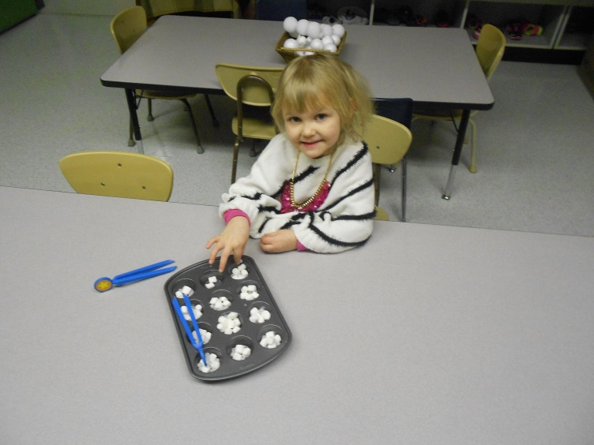
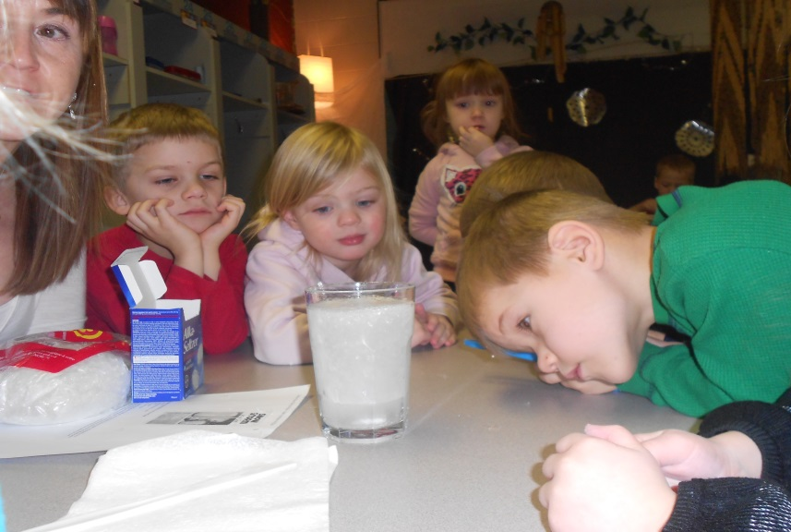
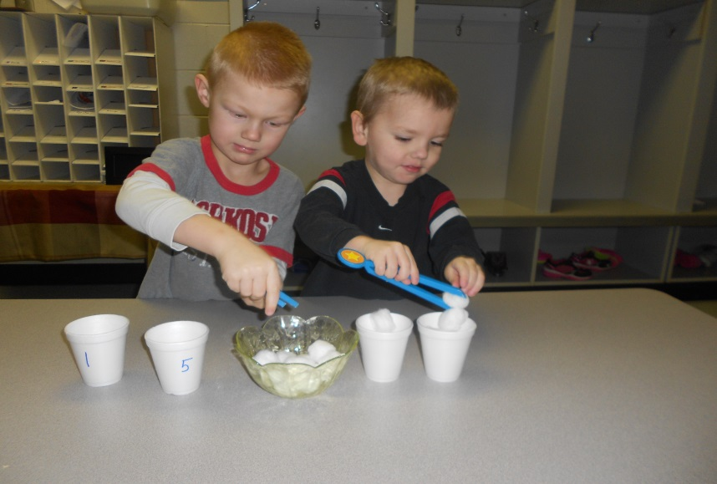
More Snow Invitations
Snow crafts
Sledding
Ice fishing
Snowstorm in a jar
Snowballs

Slide 7
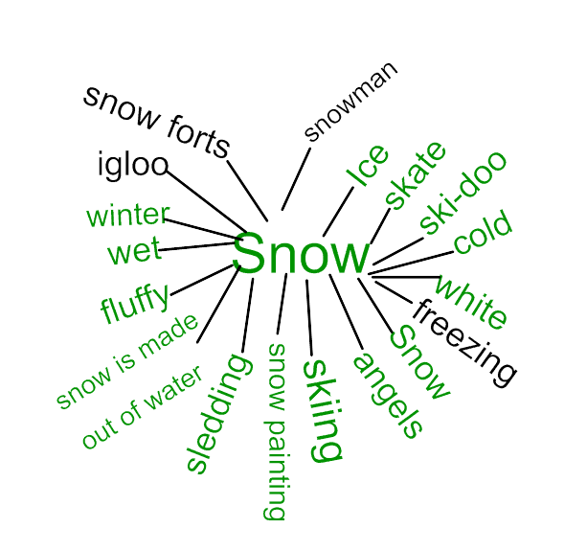
Phase I continued- The process
This is the snow web the class created.

Slide 8
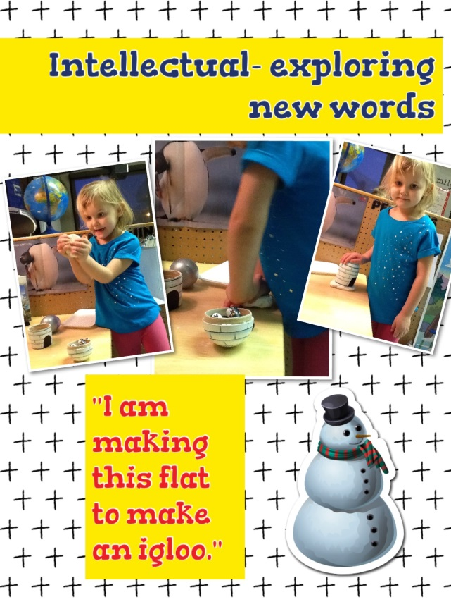
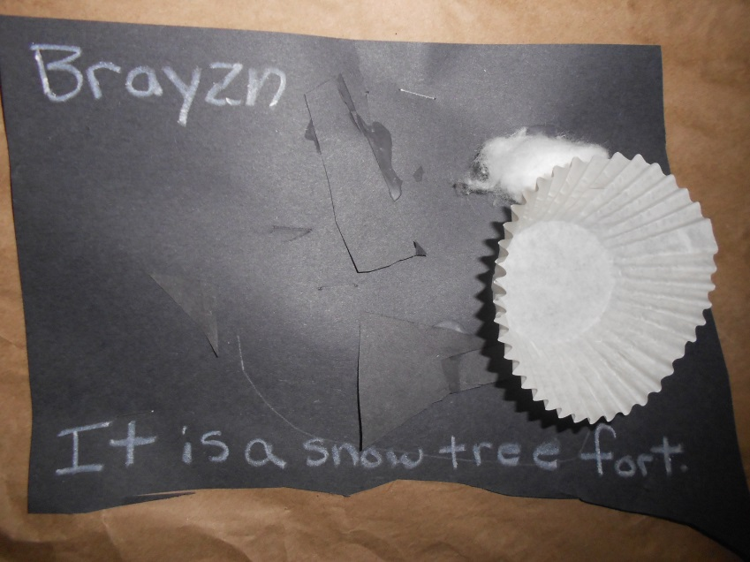
The Process Cont.
During their exploration we noticed a couple students making a snow fort out of some of the materials and saw that another child had made a picture of a snow tree fort and another had made an igloo out of clay.

Slide 9
During circle time we discussed snow forts/igloos and watched a video of Inuit making an igloo. This lead to more discussion and we asked the class if they would like to make a snow fort/igloo in our class, the response was a resounding YES!

Slide 10
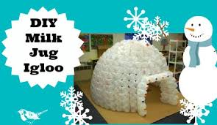
The Process Cont.
We asked the class how we could make an igloo in our classroom, this lead to more discussion. Student “We could bring lots of snow in and make one.” Different student “The snow would melt inside.” Another student “What about wood?”
We decided to look online to see if any other classes have built an igloo in the class, we found a milk jug igloo. Now they were eager to build our own igloo. We sent home a note asking for milk jugs and put a note in the school newsletter because we needed over 300 jugs to complete the project.
Craftgossip.com

Slide 11
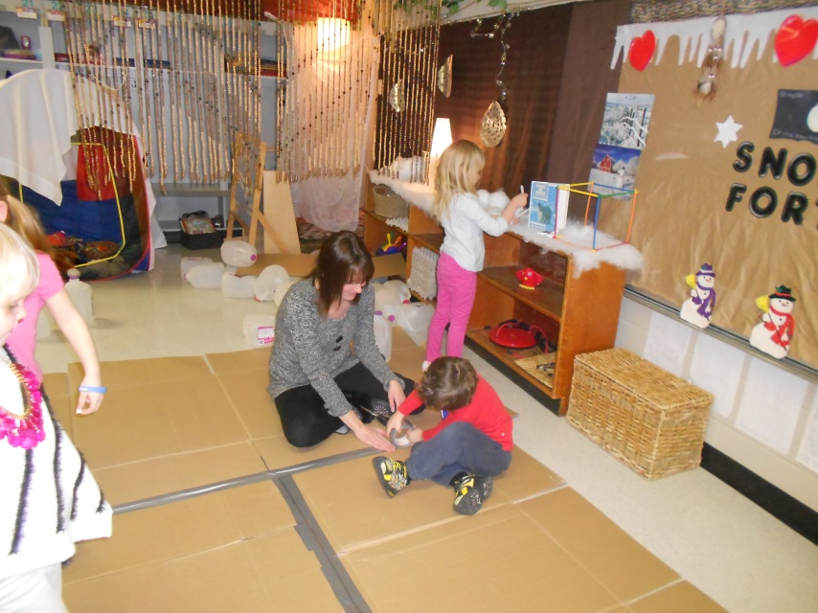
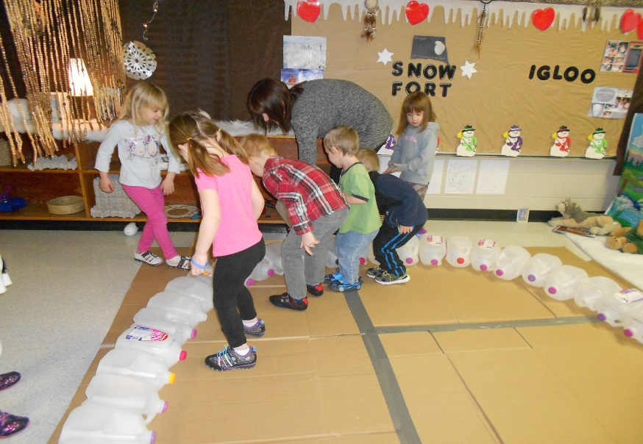
Phase II- Developing the Project
We began by researching how to build a milk jug igloo,
discussing what other materials we would need besides milk jugs
and the steps involved. We discovered we needed 30 jugs to begin,
and a cardboard base to glue the jugs onto. It did not take long to accumulate the jugs we needed to begin.

Slide 12
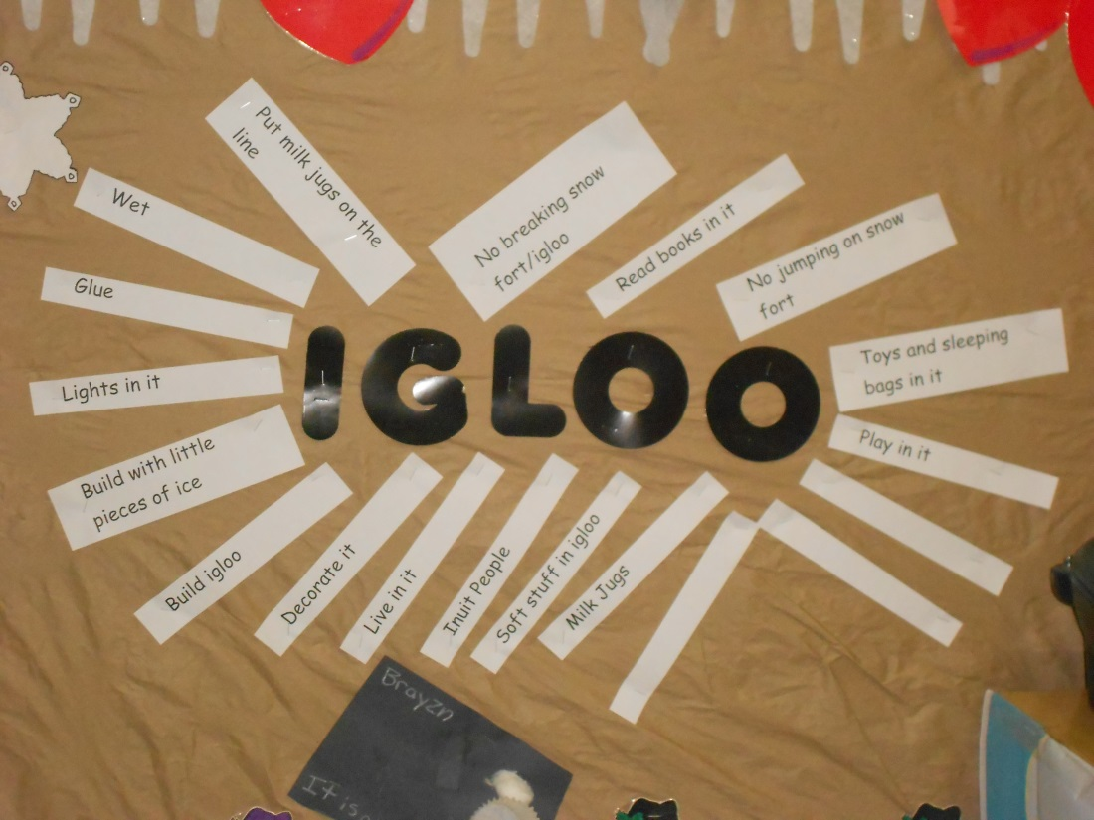
Phase II- Investigating
We made an igloo web and discussed what we knew about igloos, could do in our igloo and what we should not do in our igloo. We then hung these webs up in the class for future reference.

Slide 13
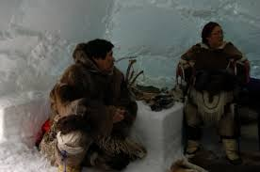
More Investigating
Why did the Inuit build igloos? How did they build igloos? What does it look like inside Inuit igloos? Who are the Inuit?
We read information books and stories about igloos and the Inuit.
We researched our questions on the internet and watched and discussed the information.
We recited a poem about igloos every morning.

Slide 14
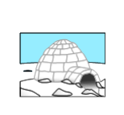
My Igloo
My igloo is round with a tiny door. (Make circle w/hands then hold hand low to ground.)
It’s made of cold ice & snow. (Pretend to shiver.)
The inside is covered with blankets and fur. (Spread hands over wide area.)
So it’s warm when the winter winds blow. (Hug self to keep warm.)

Slide 15
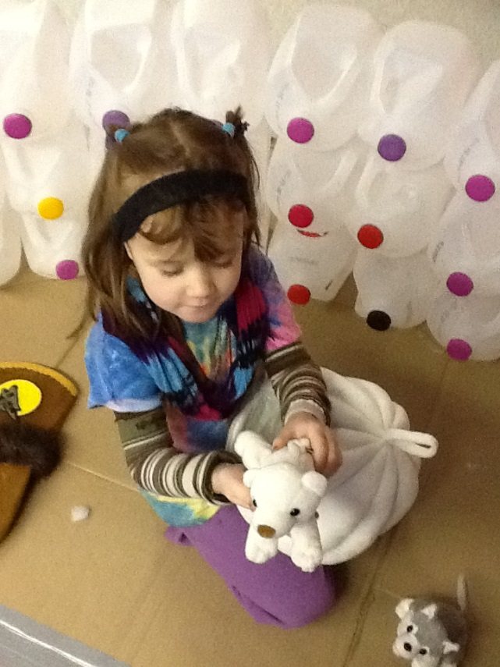
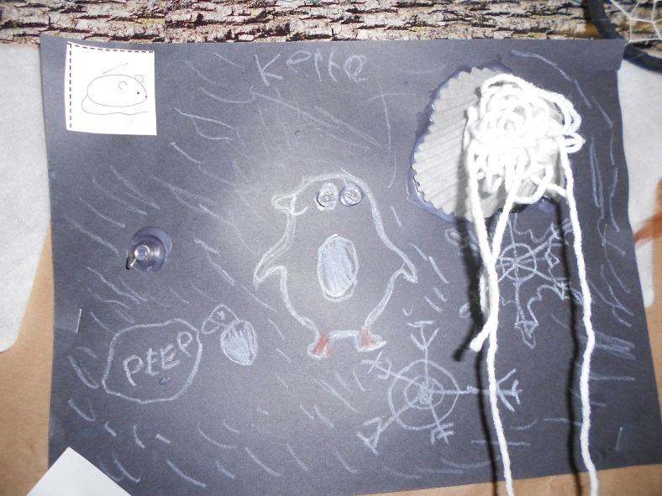
Every school day there were more milk jugs and we continued to add on to the igloo. We also had items available for the children to represent their
learning; such as a small plush igloo with arctic animals
and white craft supplies.

Slide 16
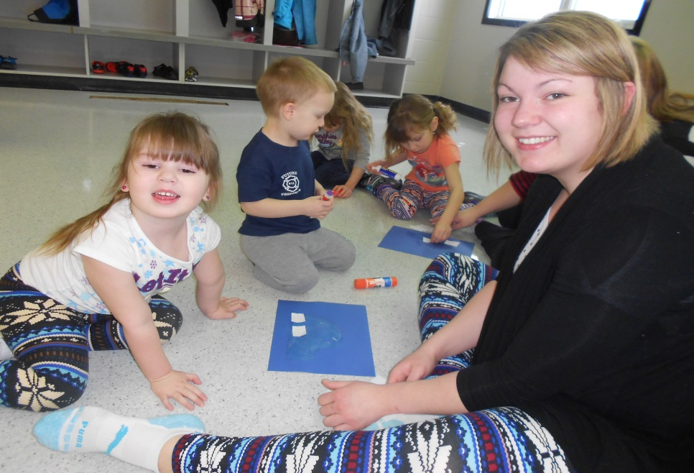
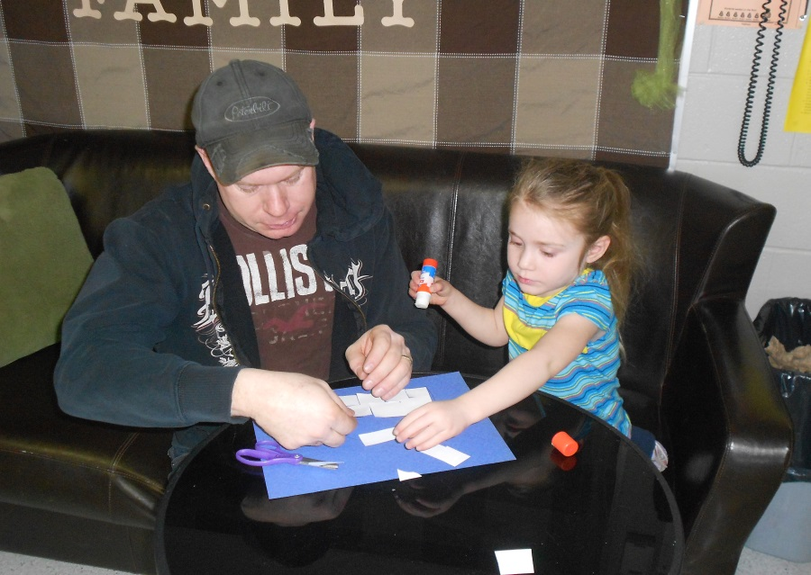
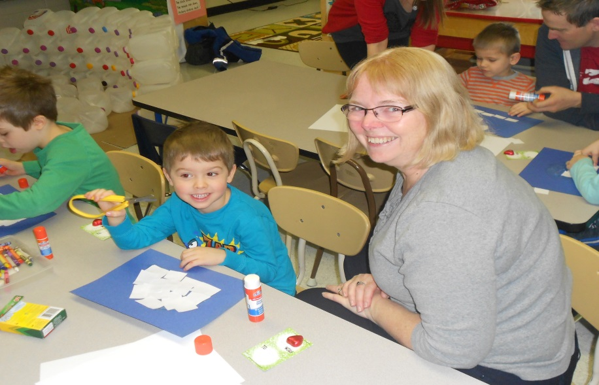
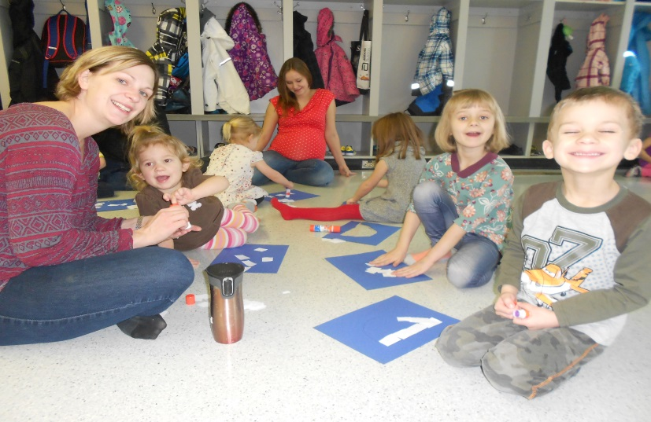
For February family day each family made an igloo with the materials we provided.

Slide 17
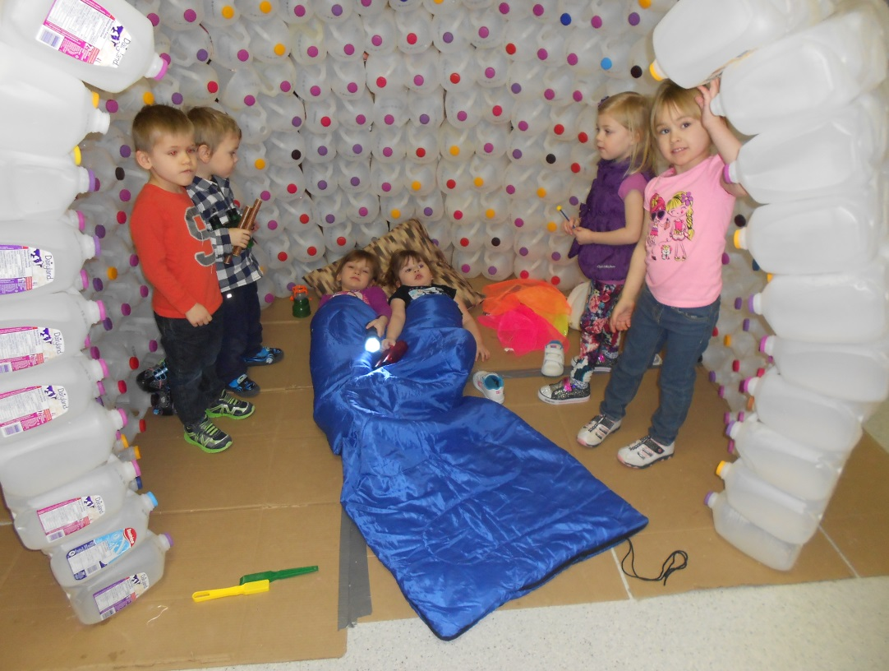
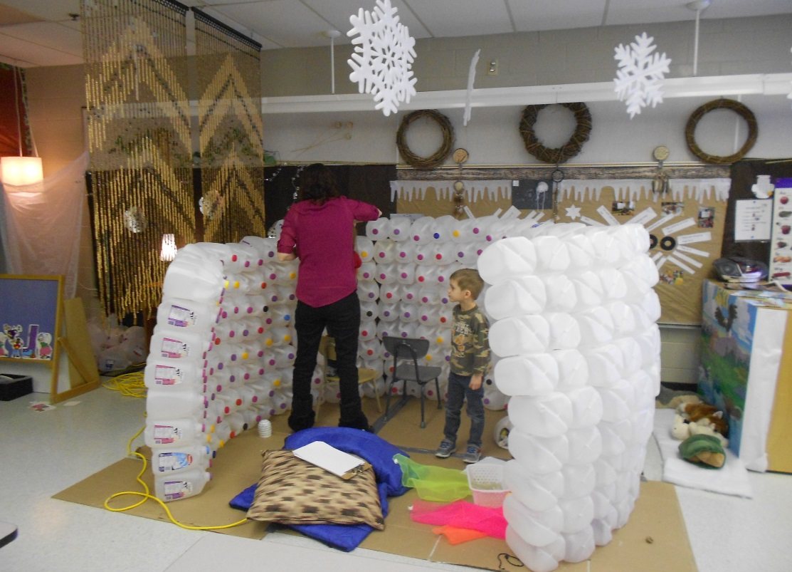
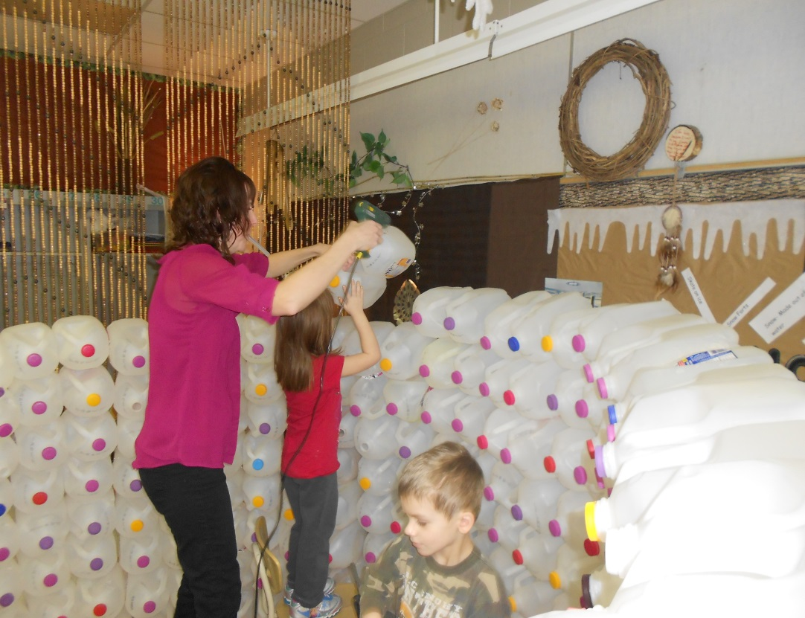
Most of the children helped
at different times with the
building. They also played in the igloo while it was being constructed. Mostly they played house, so that is when we decided to explore different types of homes.

Slide 18
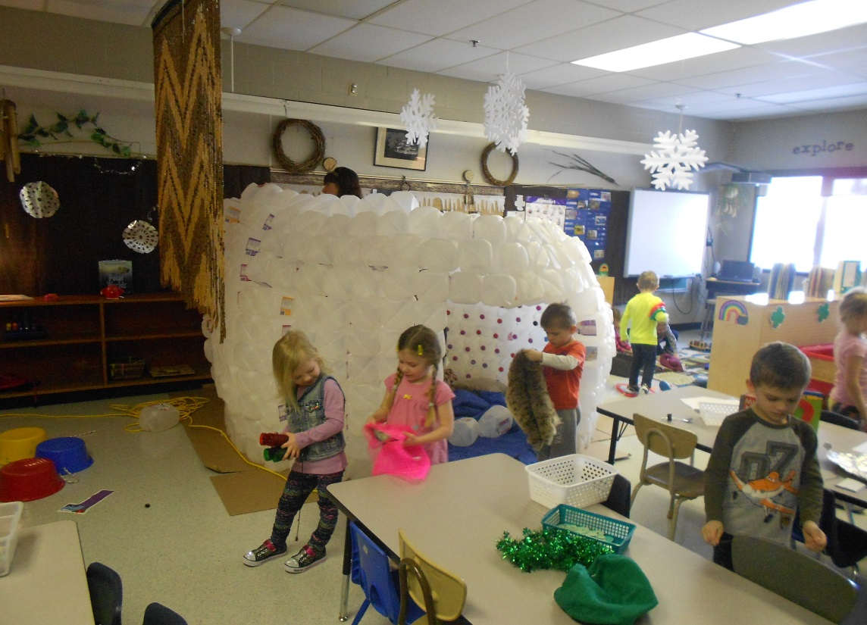
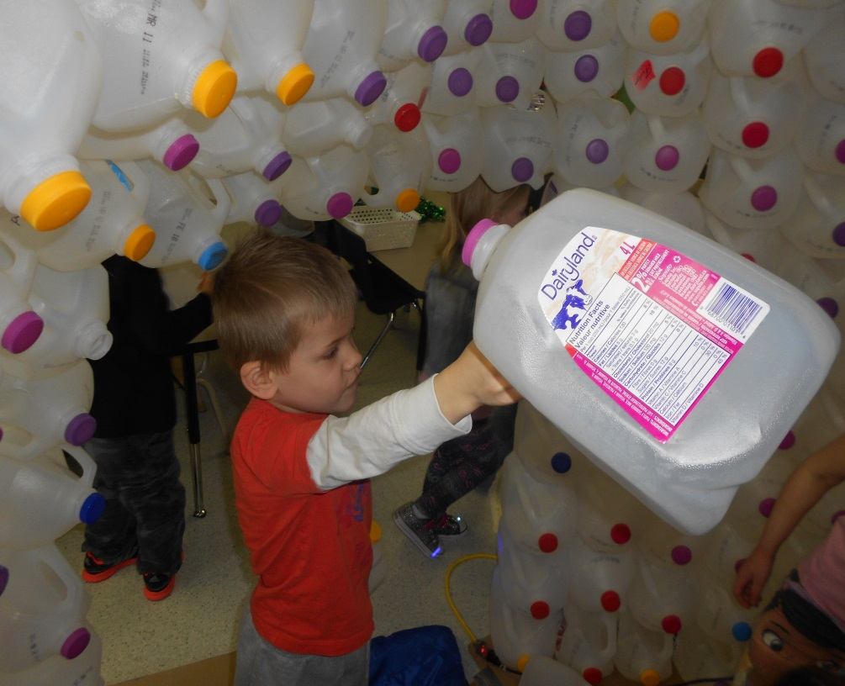
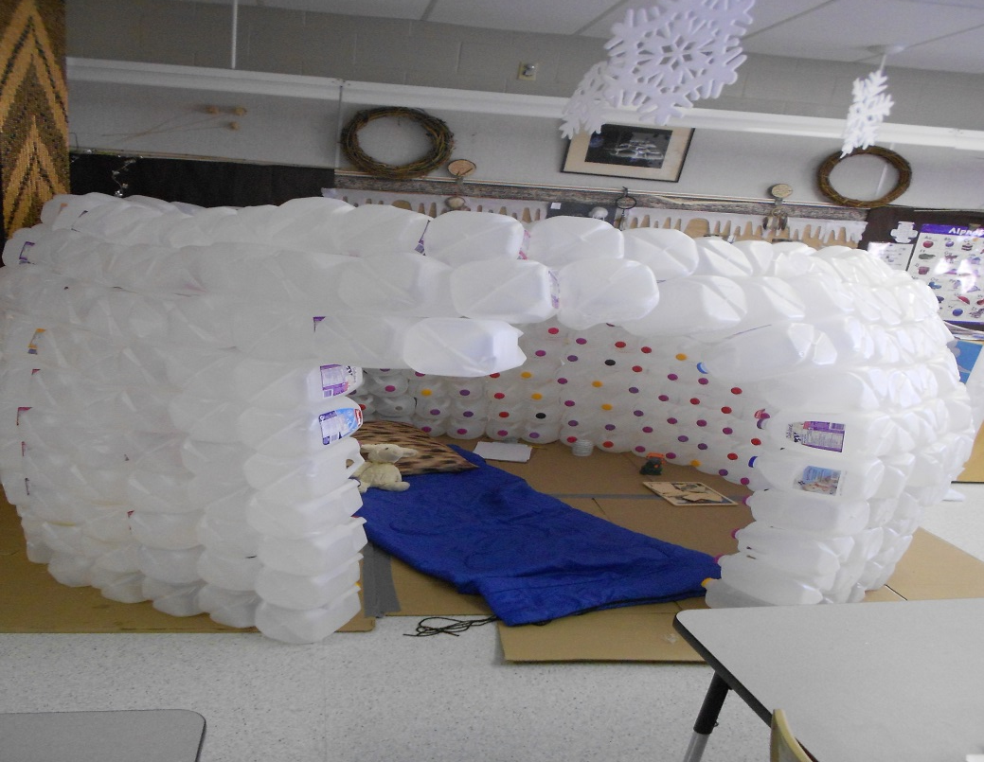
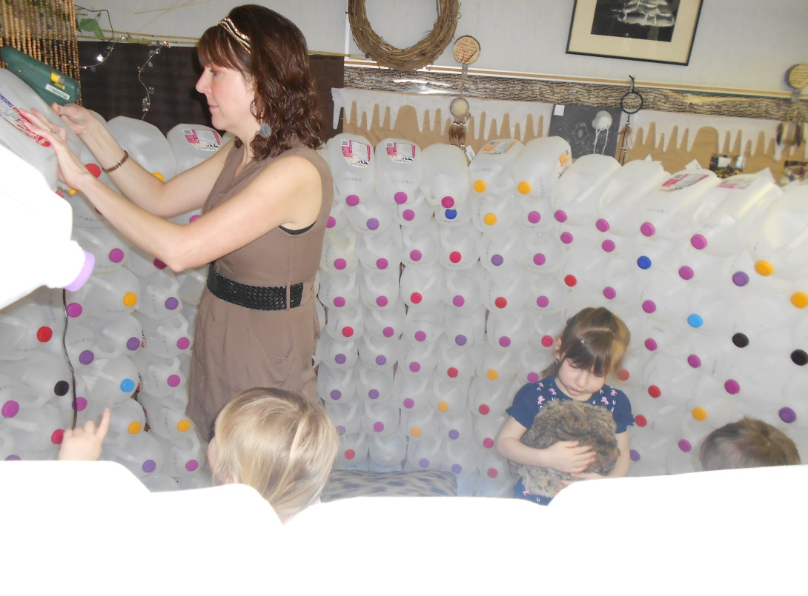
Almost complete.

Slide 19
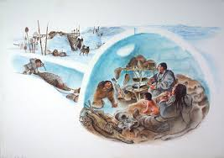
We discussed different types of homes and read books about
different types of homes. We brought in dishes, blankets,
pillows and other house stuff for them to play with in the igloo.
.

Slide 20
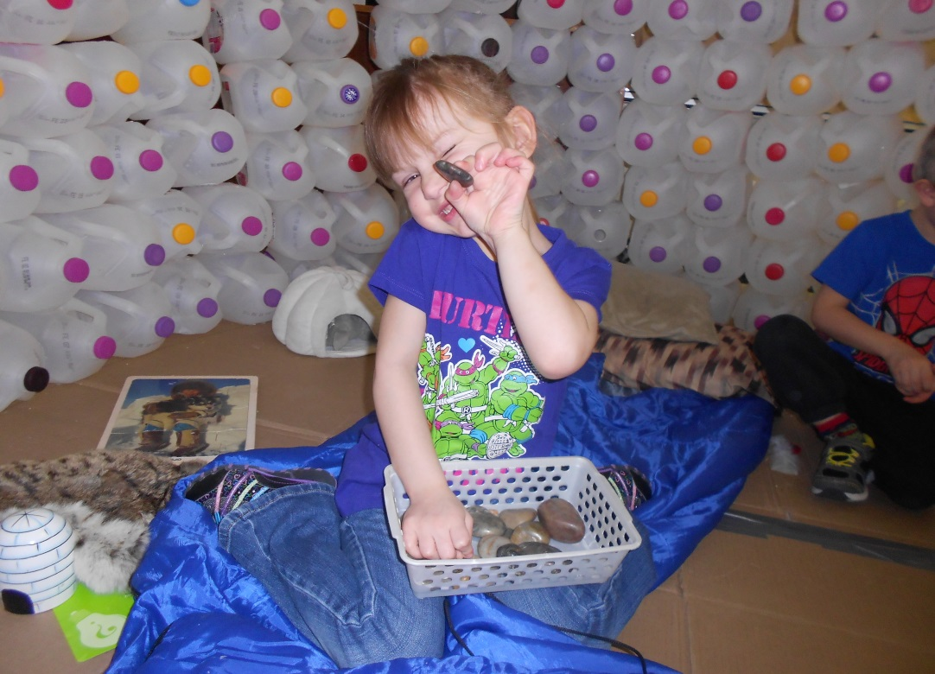
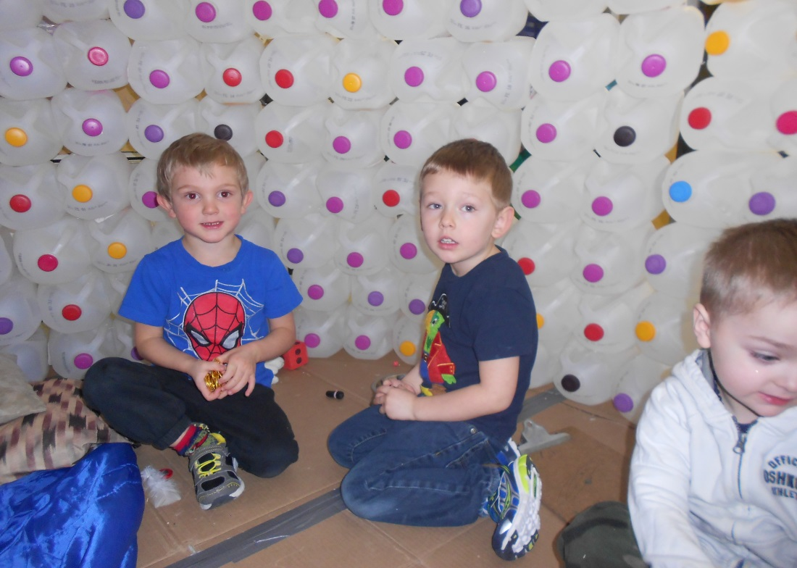
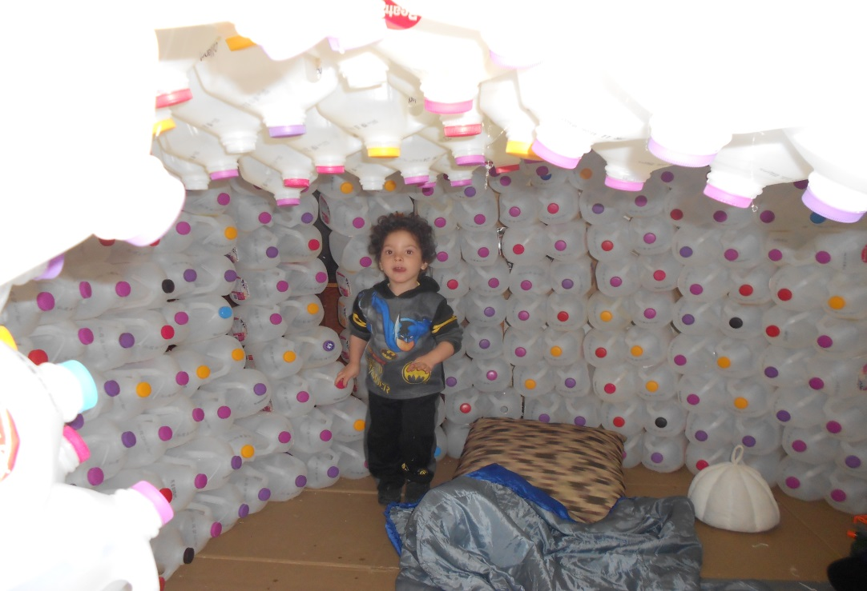
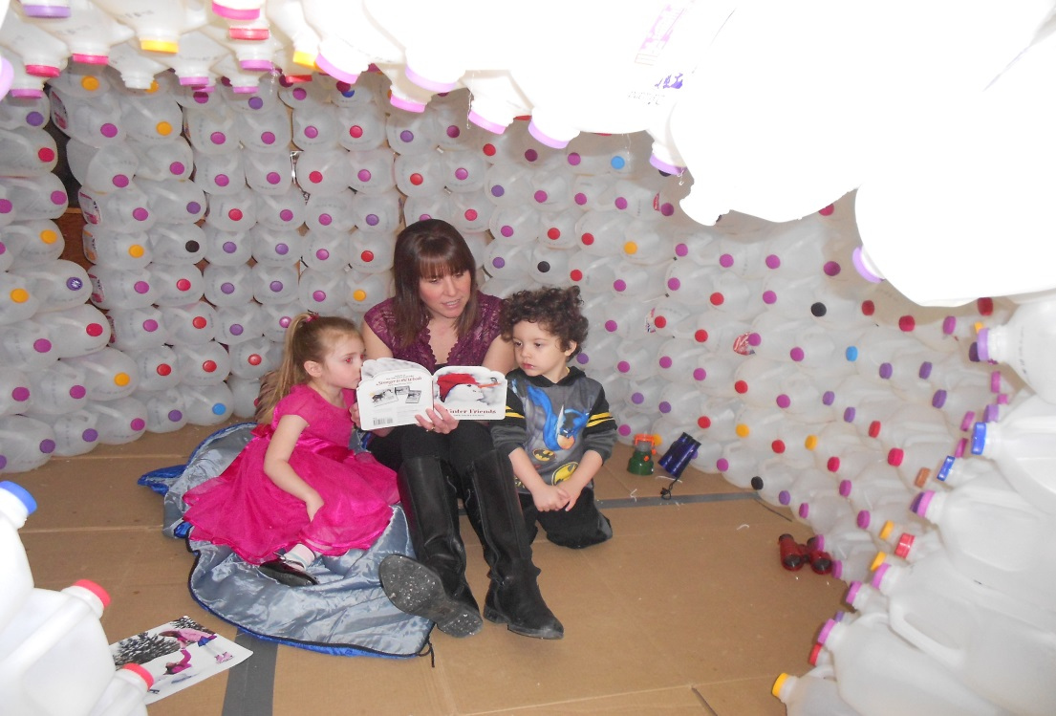
The beginning of March, our igloo is complete!

Slide 21
Curriculum Connections
Social-Emotional: Interaction with peers while: building, problem solving, and dramatic play. Gaining self-confidence in their ability to build, problem solve and through peer interaction. | Physical: Help with building igloo using both fine and gross motor skills. Using fine motor and perceptual skills to represent their learning, through drawing, painting, play dough, poems and songs.
Spiritual: Fostering a connection with nature through contact with natural materials such as snow, ice & play dough. Using five senses while exploring various centers. Learning about the Inuit and their spirituality and connection to nature. | Intellectual: Problem solving and representing ideas. Exploring numeracy skills, developing and extending vocabulary, engaging with print: poems, stories and information texts. Creating & imagining while representing their learning.
This was a holistic learning opportunity; many activities included all four domains and Pre-k essential learning experiences.

Slide 22
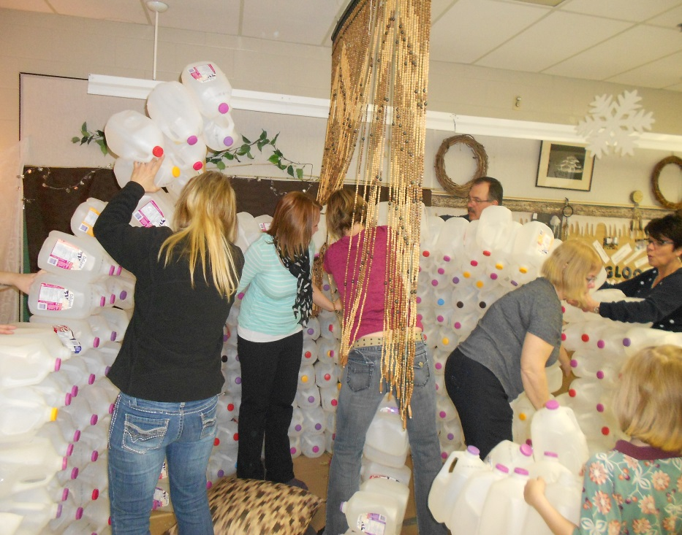
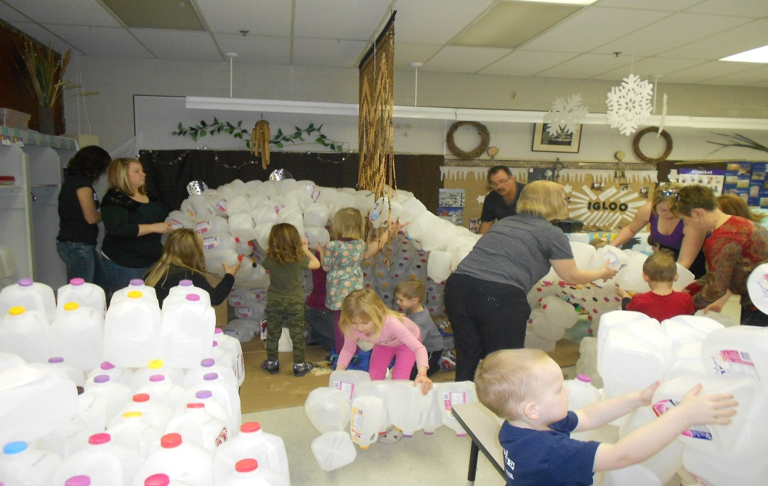
Phase 3:Conclusion
Our plan for a culminating activity was to take place on the
March family day, unfortunately the igloo fell down the day
before . We were going to share our igloo with our families, read
stories, play in it and take a family picture in it. Instead we showed the students and families the damaged igloo and discussed what should happen. The children wanted to try to save what we could, so that is what we did. It turned out well and they were happy with
the results.

Slide 23
Reflection
Most of the children were very interested in the project in the
beginning, as the project progressed a few remained involved
while others came and went.
The kindergartens share the same classroom and were also interested in the project but we did all of the building in pre-k. I feel this project would have been better suited for the kindergarteners because their interest remained constant and
they had many in-depth questions during the process.
Most of our pre-k class were three years old, they enjoyed playing in it, some enjoyed helping to build and were excited about the end product, but we sometimes found it difficult to sustain their interest in the process. Many of the discussions took place during circle time/class meetings and quite a few students had trouble focusing.
We would do this project again, if there was interest but with an older group; mostly four year olds.
We would also do a better job of building the igloo so it would be more sturdy and last longer.

