Slide 1
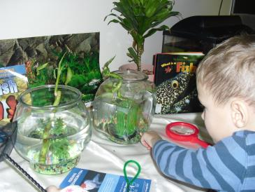
Our Fish Project
Westberry School Kindergarten
Kindersley, SK
Pamela Sawatzky
306-463-2433
pam.sawatzky@sunwestsd.ca

Slide 2
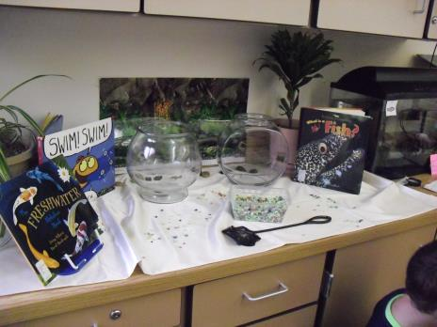
By the Numbers
5, 6 year olds
44 students
2 full day, every other day Kindergarten
2 educators- 1 teacher and 1 educational assistant
Support from 2 learning coaches
4 months to complete project

Slide 3
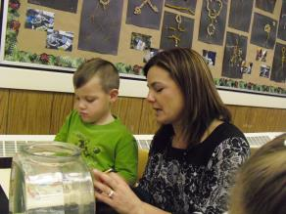

Phase 1: Beginning the Project
This topic was chosen because of a problem that arose with our fish tank and our fish, “Princess Shiny”. The tank was getting a lot of algae in it and I complained to the students that it had taken me a long time on the weekend to clean it. One of the students who has a fish tank at home told me that I needed to get Janitor Fish to clean the tank. I said I had thought of that but I knew from past experience that this particular fish had already eaten 3 other fish! Another student suggested snails and still another suggested we get other fish that could be friends with Princess Shiny but live in other bowls. I could tell that there was a lot of interest in this topic because we kept coming back to it over the course of several days. Additionally, many of the children had background knowledge from their home lives.

Slide 4
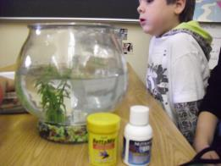
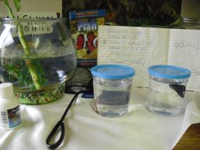
I went to the pet store in Saskatoon to enquire about adding other fish to Princess Shiny’s tank. They said the best bet were snails and even then, the fish may eat them. In addition, I bought 2 Beta fish. Prior to the purchase we had polled the class to choose colours of the fish.
Preparing for the new fish. Conditioning the tap water.
.

Slide 5
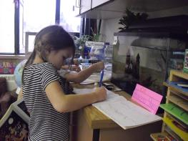
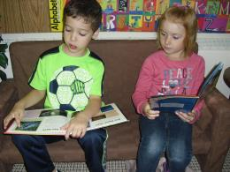
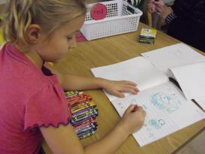
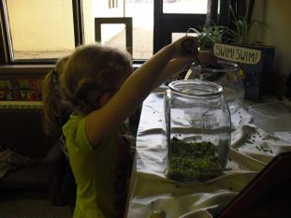
The students recorded their names in the fish journal after feeding it.
Building background knowledge and interest engaging with books about fish.
Representing in journals.
Exploring materials.

Slide 6
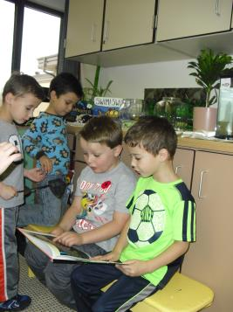
Fish Project
Math –graphing, counting
ELA – journal writing, book looks, research
Other- experts on fishing,
Ocean in a Bottle craft-
Art- dance, visual art (mural)
Science- habitats
Teacher Topic Web

Slide 7
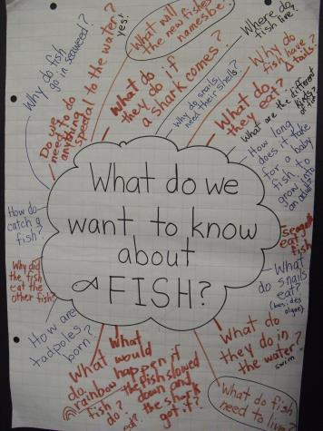
Questions that were decided to investigate:
What do fish eat?
Where do fish live?
How do fish protect themselves?
How do fish hear?
Our web of questions

Slide 8
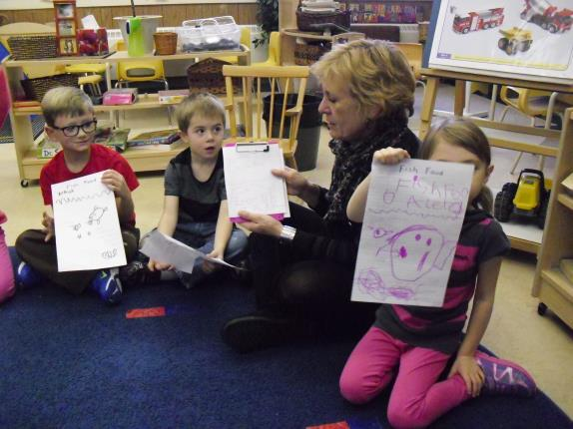
Phase 2: Developing the Project
I invited the support of 2 learning coaches to take groups to do research on the questions chosen to investigate. Each group found information in different ways. Books, Google searches, and prior experience provided the answers. Student represented their learning by drawing pictures and writing key words with support from the educators. Teachers also created word documents that included photos to represent the student’s findings.

Slide 9
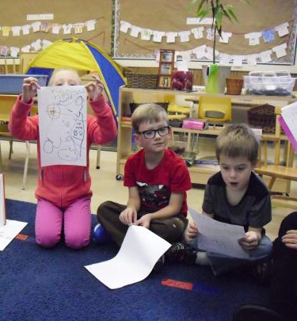
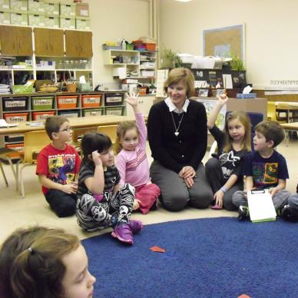
Sharing our research findings……

Slide 10
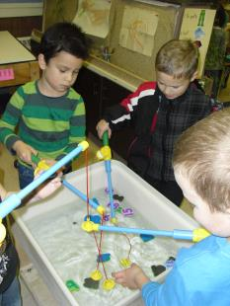
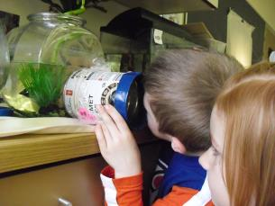
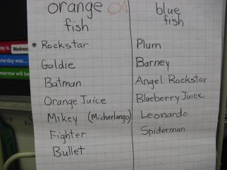
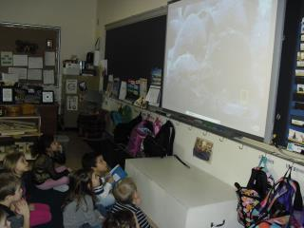
Developing the Project
Numeracy: Fishing for numbers, voting for the names of the new fish
Creating an underwater viewer, watching ocean video

Slide 11
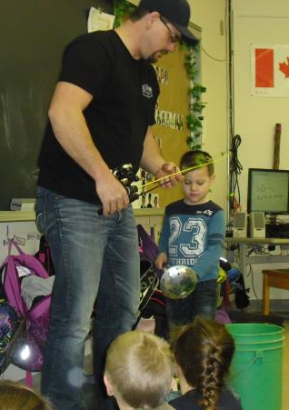
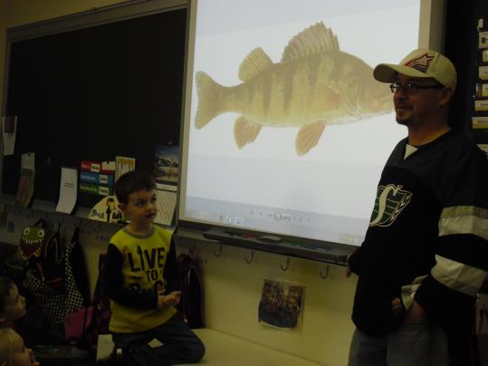
Ask an Expert
I invited two fathers who fish a lot to come in and share their expertise.

Slide 12
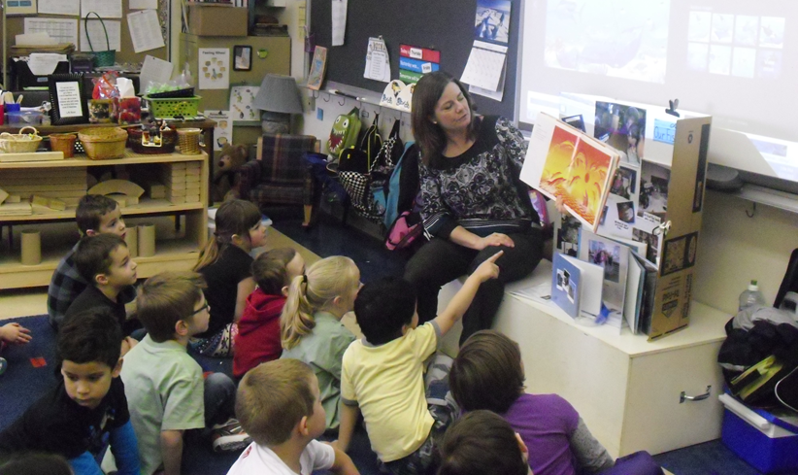
Concluding the Project
Our concluding project was an ocean mural. I built knowledge of murals by showing Google images and reading the book Sky Color by Peter H. Reynolds. I also used the book Aska’s Sea Creatures by David Day to stimulate the children’s thinking about what they wanted add to the mural.

Slide 13
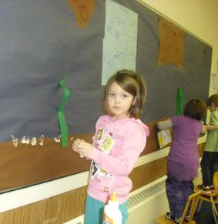
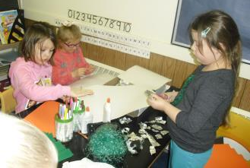
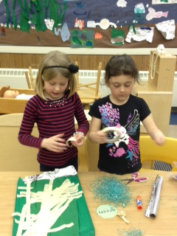
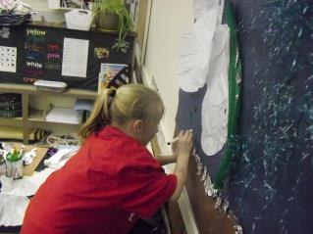
My goal for this part of the project was to stimulate creativity and collaboration.
I provided a variety of open ended materials such as aluminum foil, crepe paper, “Easter grass”, coffee filters, tissue paper and paper plates. I let the children decide on their contribution and facilitated their work.

Slide 14
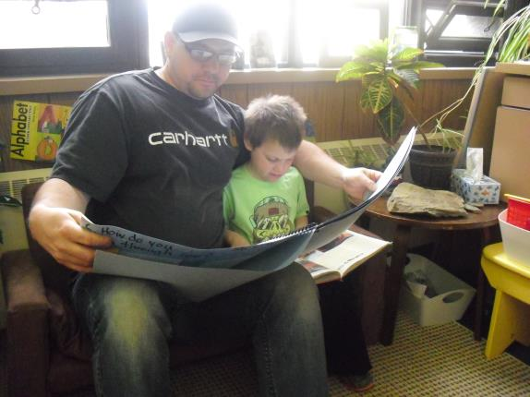
Sharing Our Knowledge
Our culminating event was a Science Fair . Parents and children were invited to participate in a variety of science stations. One of the stations had students telling what they had learned during the fish project and explaining their contribution to the mural. Another station was fish tasting. Trytin’s (right) Grandpa caught Jackfish for us so we could have a sample of real fish.

Slide 15
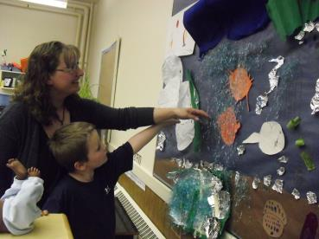
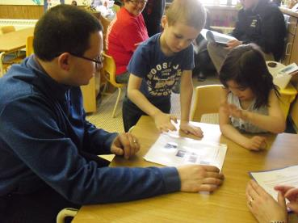
Sharing our Knowledge
Showing off our Ocean Mural
Explaining our research to Dad.

Slide 16
What curricular outcomes were included?
(Summarised)

Slide 17
Knowledge, Skills, Dispositions
The students learned quite a few facts and information about fish such as what they ate, how they protect themselves and where they live.
New vocabulary was learned such as predator, prey and camouflage.
They developed an inquisitive stance as a learner and to ‘wonder’ about things.
Students developed their capacity for creativity and collaboration.

Slide 18
What did I learn?
It is important to choose a topic based on student interest and one that has a wealth of information from which to springboard other ideas.
It can be a good thing to stretch a project over several months if student interest is maintained. We would do something related to the project, leave it and then revisit the topic weeks later. By the time we revisited it, student knowledge and skill level had grown and they could address the subject with new insights.
Drawing on the funds of knowledge of parents is an effective way to engage families.

Slide 19
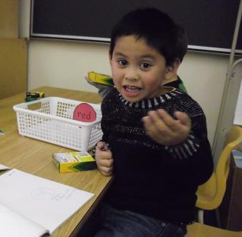
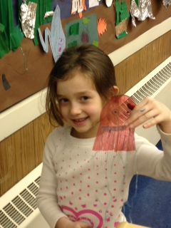
The End

