Slide 1
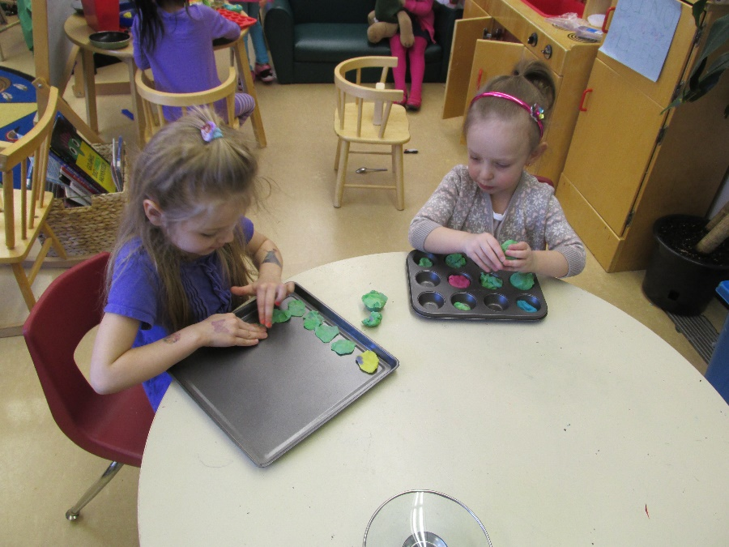
Restaurant/Bakery Project
Lisa Cooper and Leanne Van Betuw

Slide 2
Background Information
This project developed in our pre-kindergarten classroom.
Our classroom is made up of children from ages 3-5. We have a morning class and an afternoon class. There were 29 students involved in this project that lasted approximately three months.
As several ideas for a class project were being considered by the educators the children were engaging in their own project. We looked back and reflected on what the children were engaged in and what was engaging the majority of the children during centre time. We found the beginnings of our project in our “kitchen dramatic play area”.

Slide 3
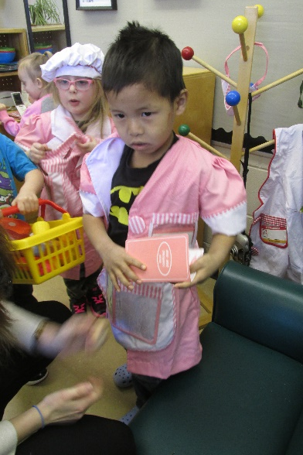
What was the spark? Adding a few extra materials into the area after reflecting on previous student interests and involvement.
This year we noticed when we set up the “House-Dramatic Play Centre” again in January, that the children we engaged in cooking and baking activities more than previous years. This caught our attention and we began to observe more closely.
Each day the children would enter the centre and declare what they were making.
L: “I’m making an apple pie!!!”
G: “Can I help?”
D: “I want some apple pie!!”
The children enjoyed setting the table and “inviting friends over for parties”. There was always activity happening in the kitchen centre that spilled over to other areas of the room
Playdough became an extension that children were busy making cakes, pies and pizzas at.
Construction zone became the place where the children would go to “work” and then head back to the kitchen for “lunch time”.
Picnics began popping up in several different areas of the classroom as well.
It was time to start developing some learning experiences to engage the children in higher level thinking and exploration. We began by adding a few additional items to the dramatic play area….

Slide 4
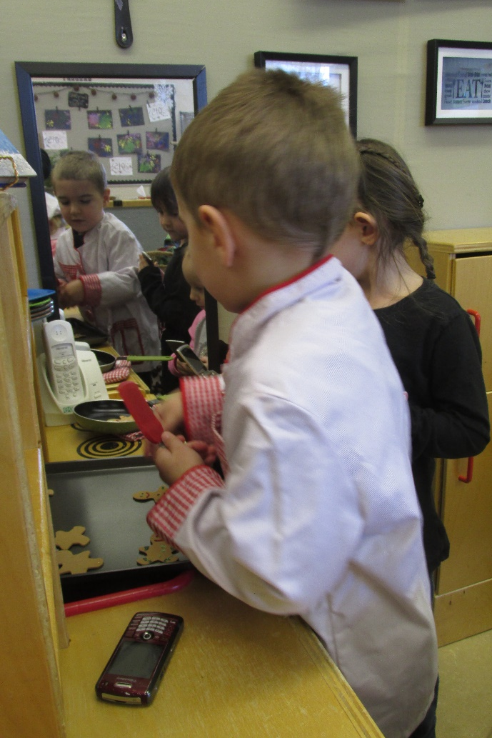
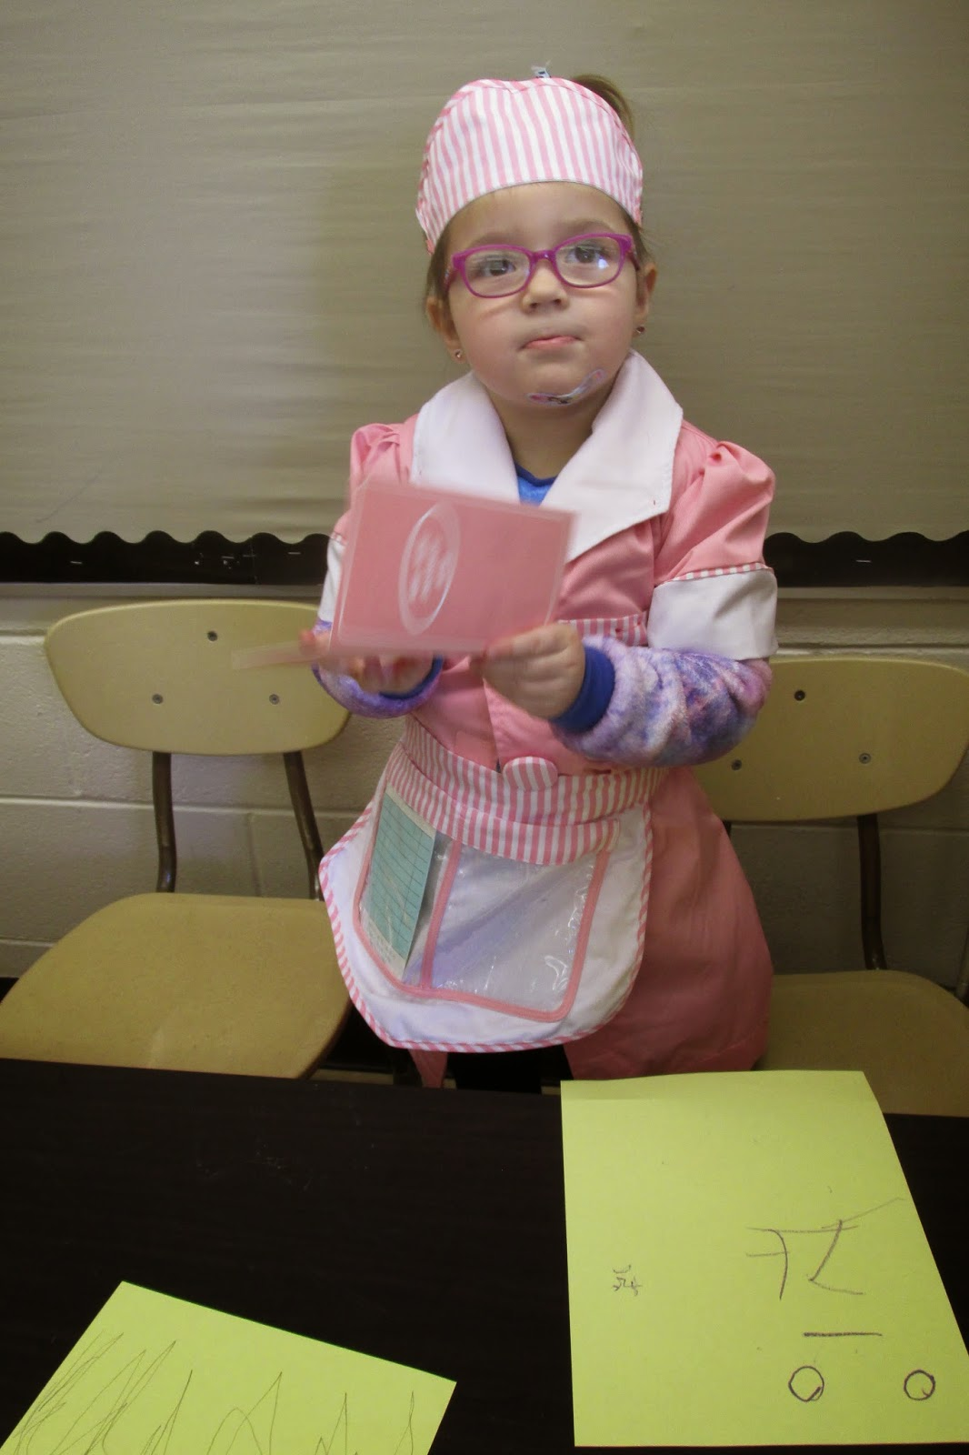
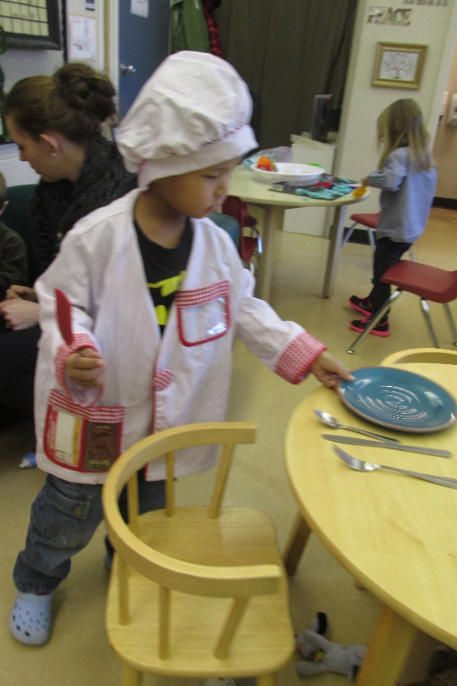
The new additions started the second week of January 2015.
A tray of ginger bread cookies, a flipper, a few restaurant outfits, menus and some pretend eggs.
The children were reading menus, taking orders and preparing food for the people in their restaurant. One day a fire broke out and we had to call the fire department. Luckily they were very speedy and put the fire out!

Slide 5
Planning for Holistic Development and Essential Learning Experiences
With the excitement shown from both classes we began planning immediately for possible learning experiences and areas for development.
What experiences could we engage in the classroom?
What do the children know and what could they learn from this project?
Could we go on a trip somewhere to gain knowledge?
Where can we find out more when questions arise?

Slide 6
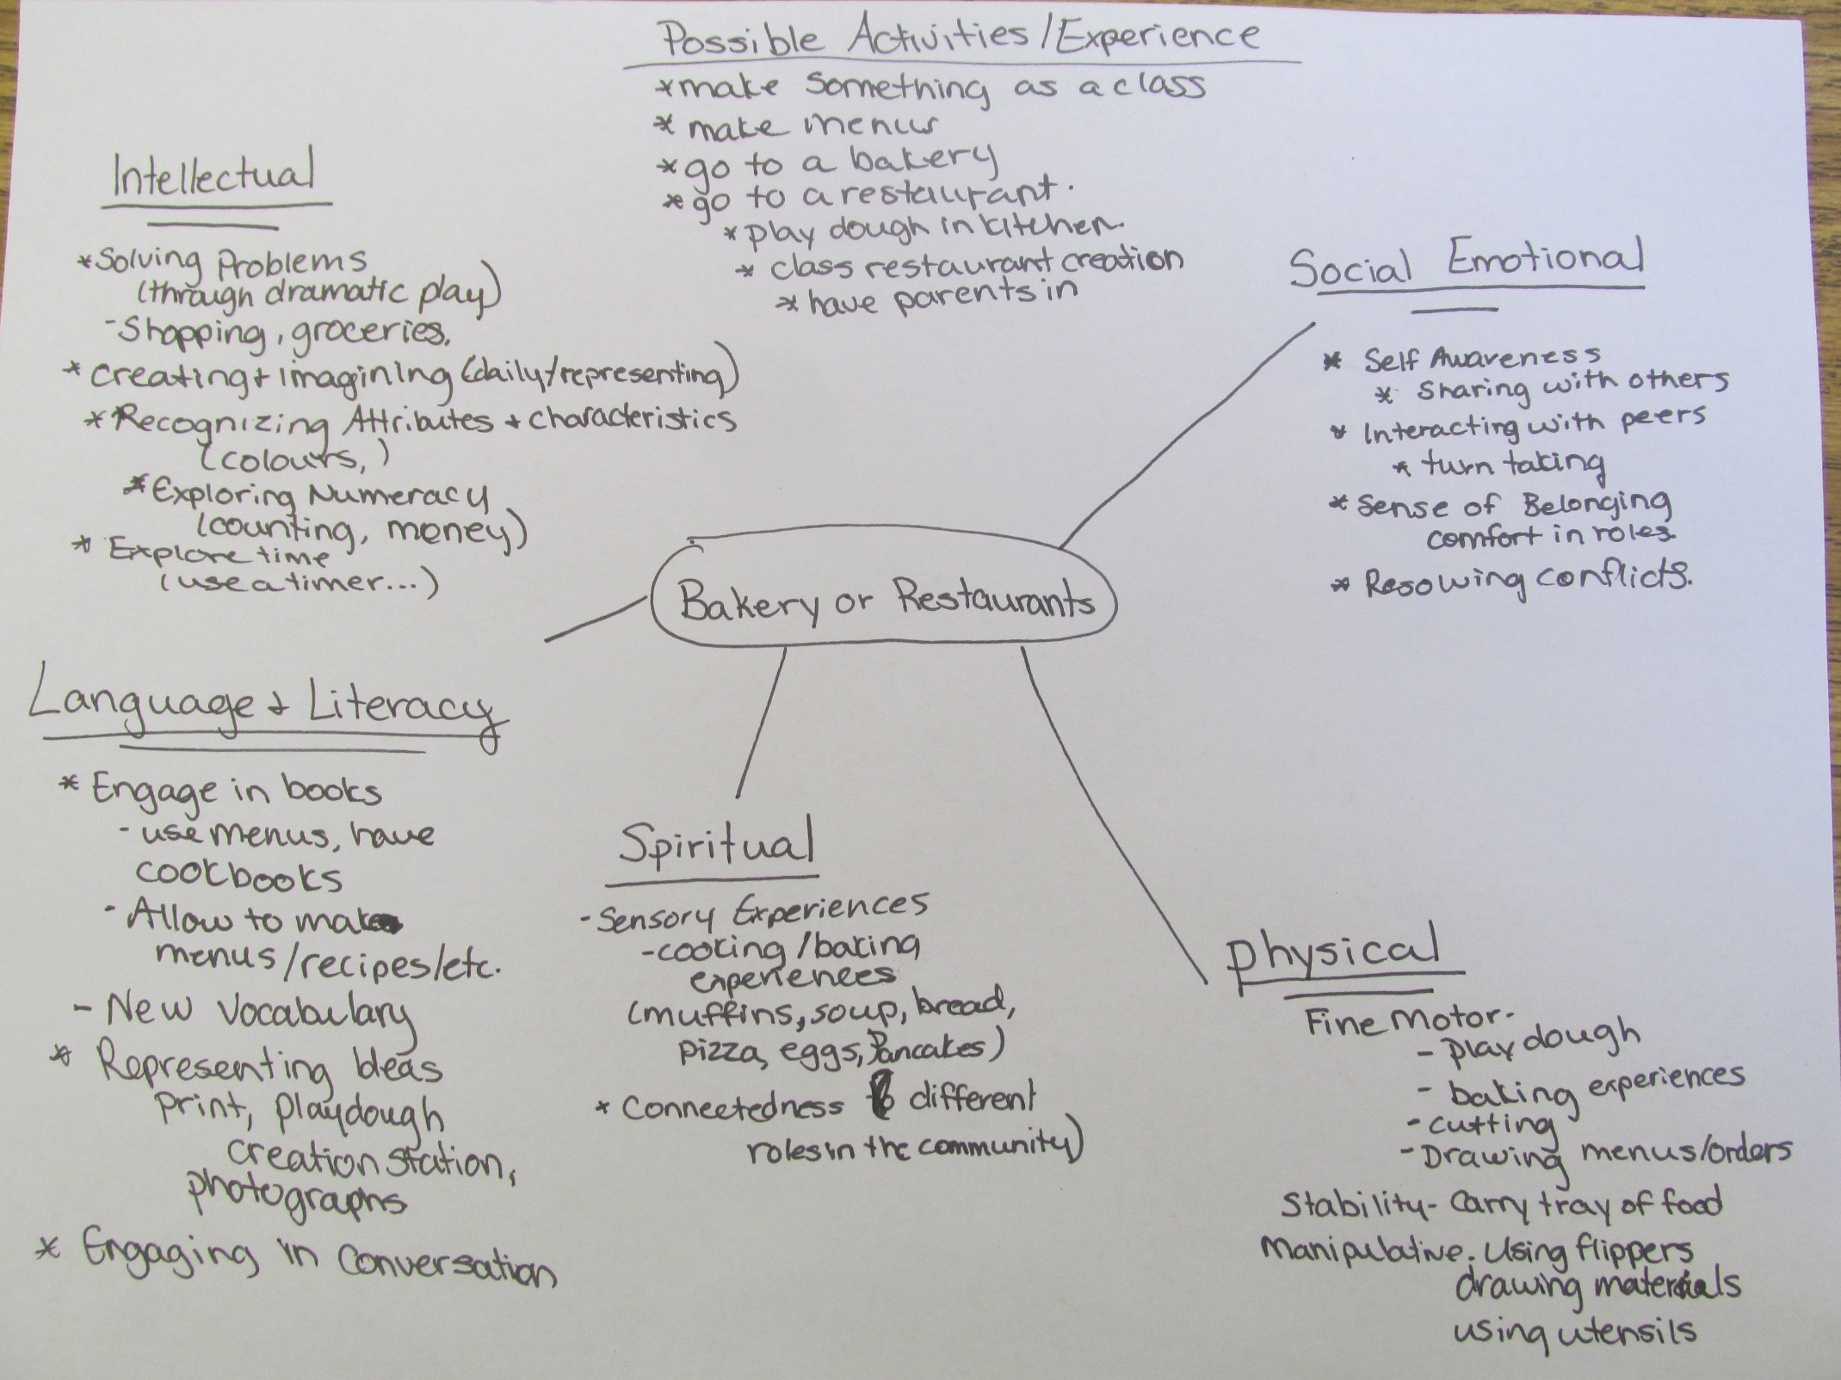
Initial educator planning

Slide 7
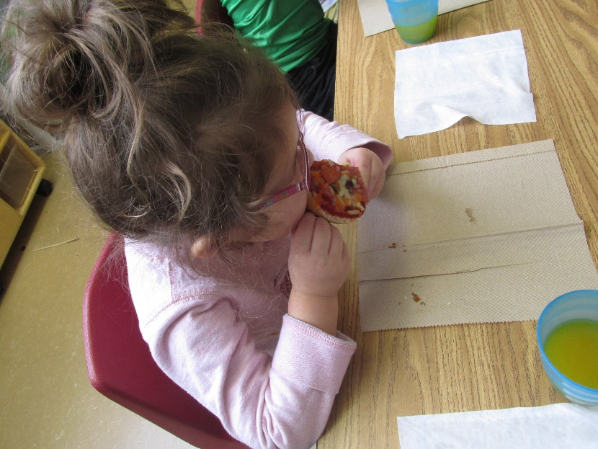
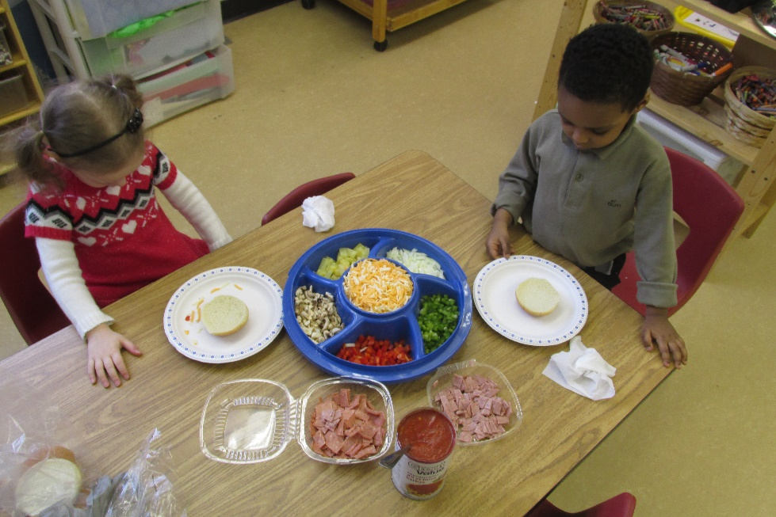
Making Pizzas
Making Pizzas! We talked about things that Start with “P”. Some of the children made paper pizzas. They used red paint for the sauce and then cut pieces of paper to be the toppings. We made a shopping list and planned to make real pizzas the next day.
The day we made real pizzas the children tried all of the toppings to see what they would want. After trying an onion one student said "Too spicy for me, I don't want that on my pizza!"
The pizza were a huge success and we were able to talk about healthy eating, food groups and hand washing.

Slide 8
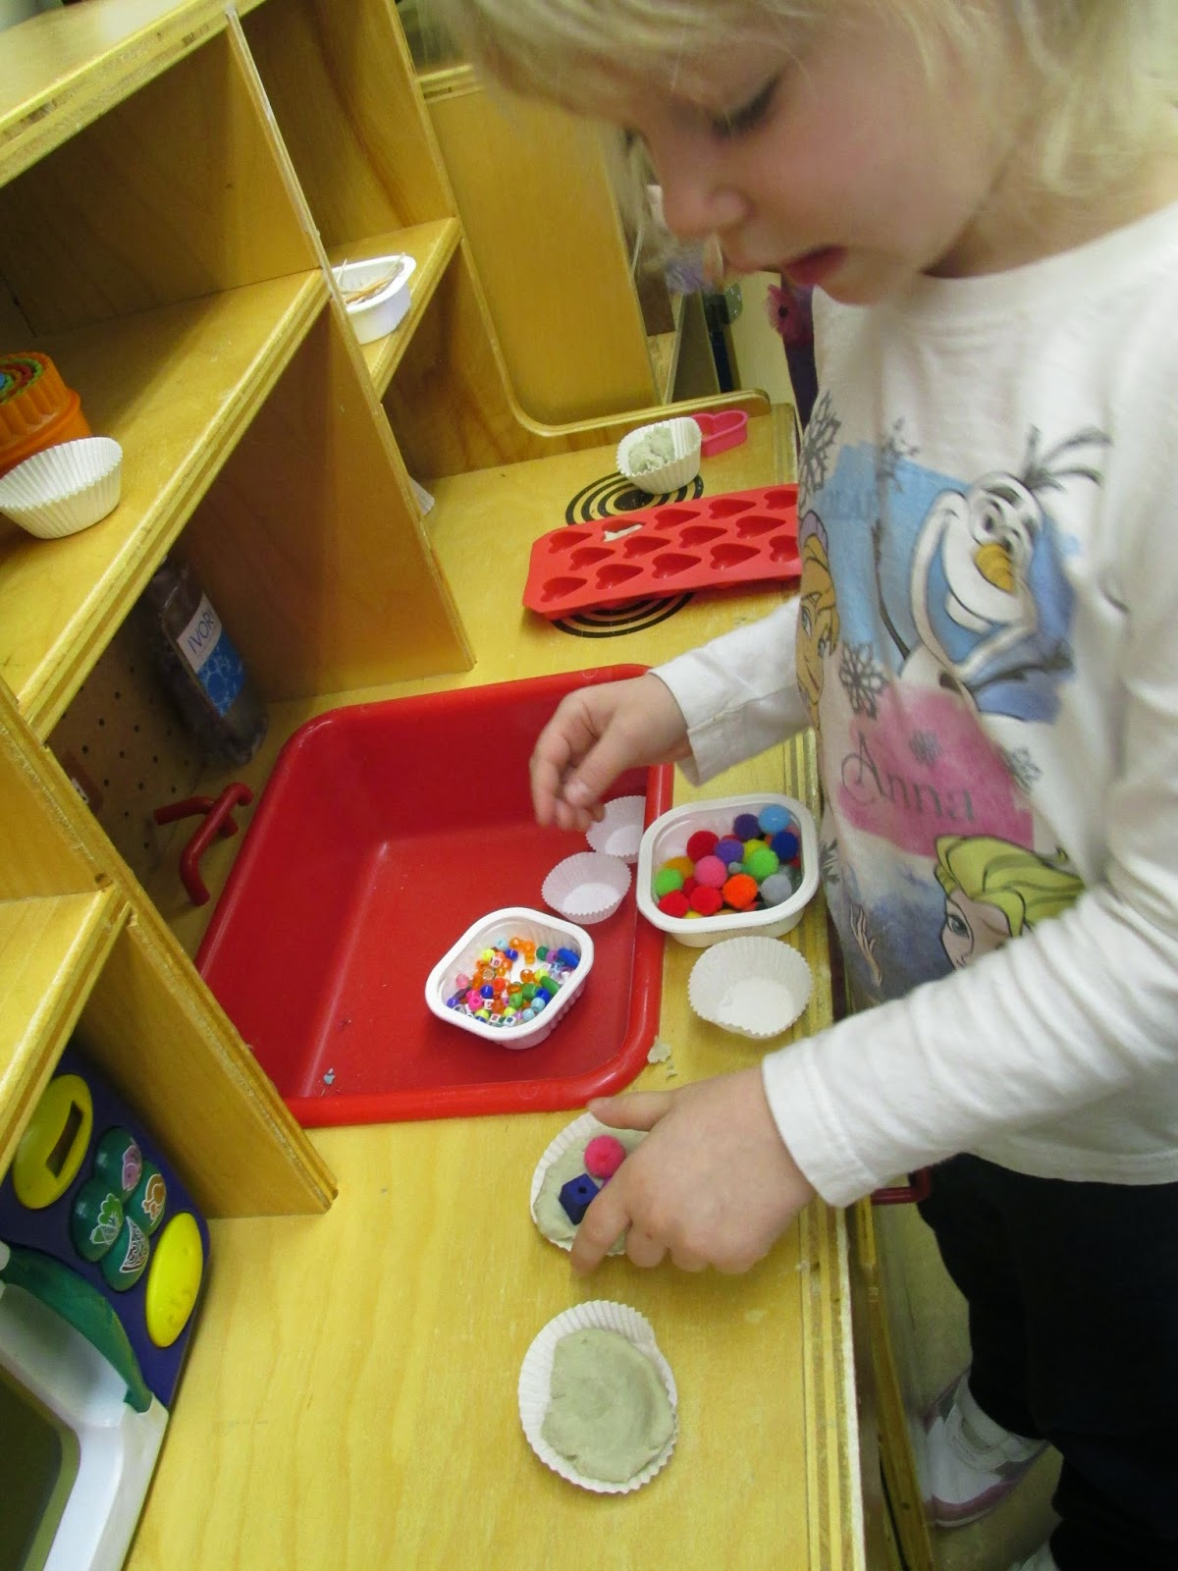
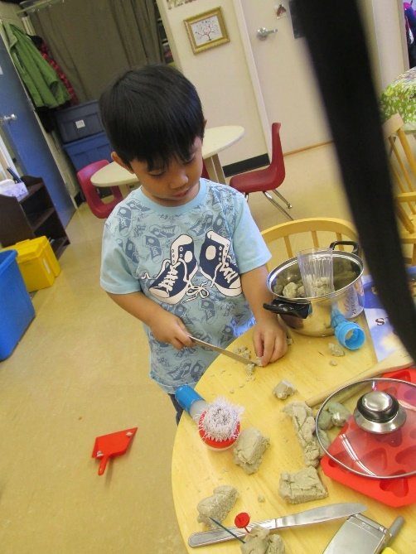
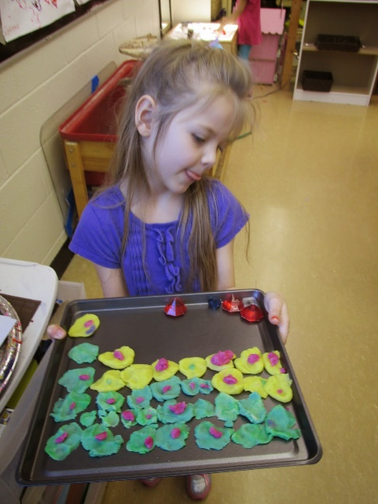
Making food with playdough
In an effort to encourage imagination and creativity in the kitchen, we removed all the food and replaced it with a simple beige playdough and topping materials.
The children enjoyed making muffins, cakes, pies, cupcakes.
J: “There is no more flour” while making a batch of cupcakes.
After baking the children would walk around and sell their food.
After our playdough got dried up we followed a recipe and made playdough together. Each child was given a ball and got to pick which colours to mix the together.
The addition of coloured playdough encouraged more ideas. (Pizzas, ice cream, tacos, pancakes, etc.)

Slide 9
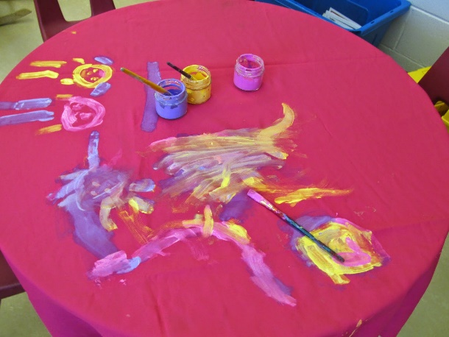
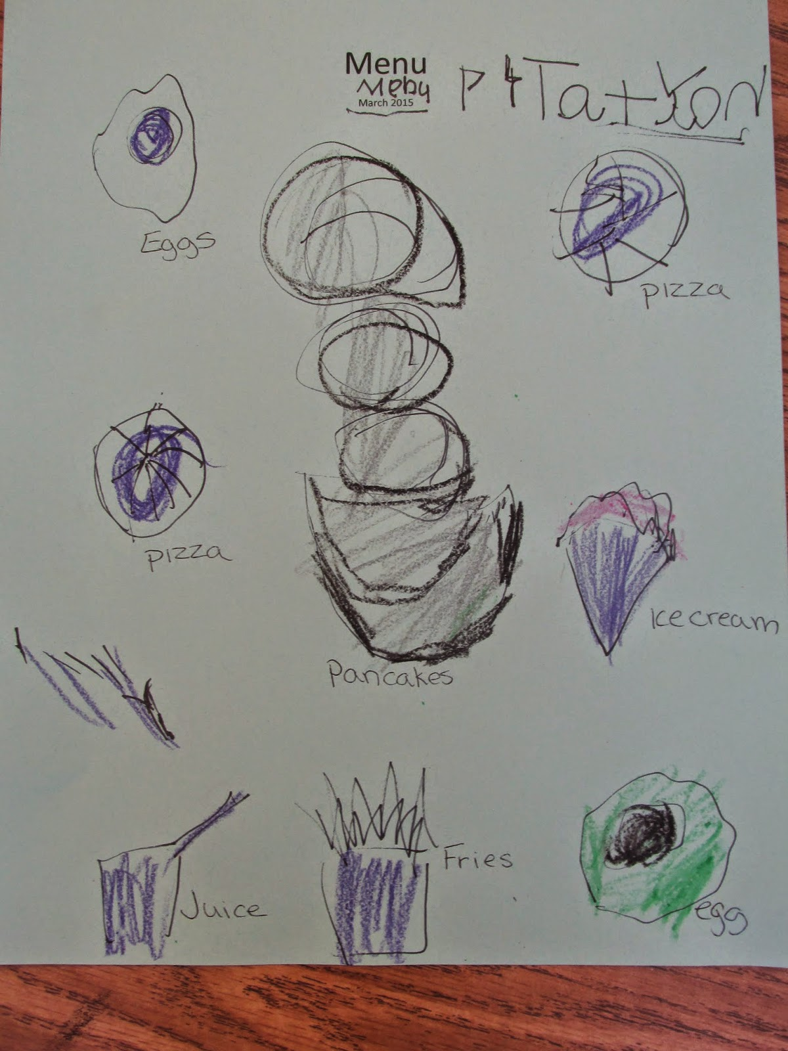
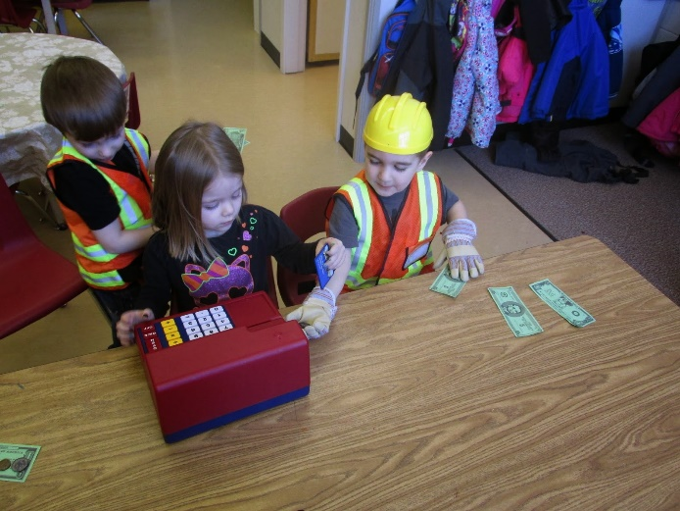
Making a Classroom Restaurant
After reading a few stories and watching children interact we wanted to engage the children in more hands on learning and about restaurants.
We read some stories and made a web about what we knew about restaurants. As a class we compared our current dramatic play area to what we knew about restaurants and spent a couple days changing our dramatic play environment with the children to reflect what they knew about restaurants.

Slide 10
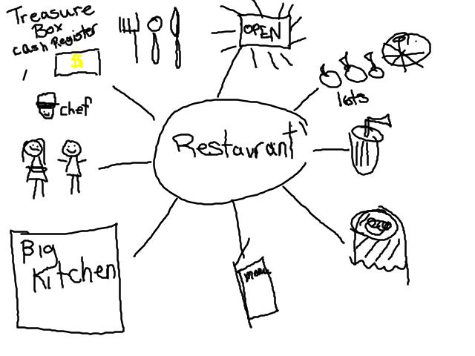
What we know about Restaurants? (Morning)
We made a web using pictures as it was for the children to refer to when making the classroom restaurant.
Light up open sign
Fork, spoon, knife
Lots of food
Juice
Fancy table cloths
Menus
Restaurants have BIG kitchens
Waiters
Chef
A treasure box to keep money

Slide 11
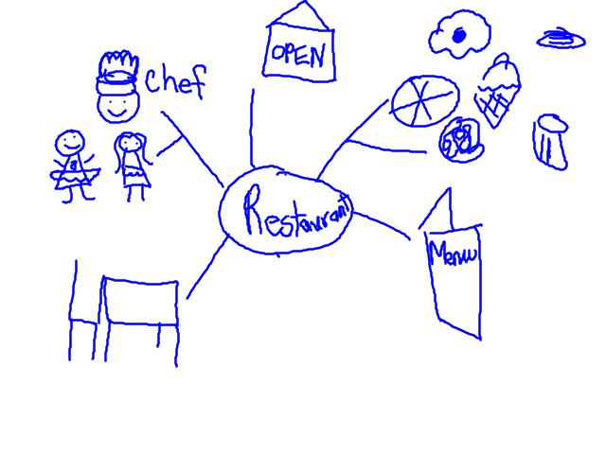
What we know about Restaurants? (Afternoon)
We made a web using pictures as it was for the children to refer to when making the classroom restaurant.
Open sign
Lots of different kinds of food
Menu
Tables and Chairs
Chef
Waiter

Slide 12
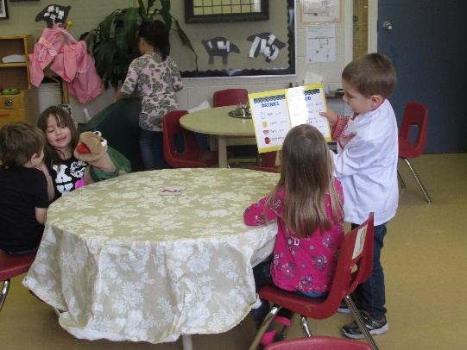
Setting up a Restaurant
Did you know that restaurants need to have a sign that lights up so people know when it's open!? We had to make one of those - we attached the letters. O.P.E.N to the lamp and it worked great!
Restaurants also have fancy table clothes so we had to decorate some table clothes.
We talked about where the money goes once you buy your food. One student said "It's a treasure box thing, but not called a treasure box!" We learned how to use the classroom cash register and how to make receipts and take orders.
We also started discussing the types of food you can get at a restaurant. Some were confused with the food you buy at a grocery store and how it is different from a restaurant. Other children learned that you can't get the same kind of food at each restaurant! They all have a different menu! We made our first menus on Thursday! The children drew pictures and we helped write the words.

Slide 17
Reflection
When we first started to think of a project we couldn’t decide. Almost like we were getting too complicated and not looking at what was right in front of us.
Once we went with the restaurant/bakery theme it was easy. All the children were engaged and involved throughout the project. This project extended almost three months. We enjoyed watching the children learn from one another and develop questions and find ways to answer those questions.
We would have liked to have had a culminating activity of inviting our parents to our restaurant but the timing didn’t work out and the children had begun showing interest in another project. Looking back we think we could have invited our big buddies and that would have been a great way to culminate. Our project ended with our trip and we shared with our families through our photographs we had taken by creating a bulletin board and posting on our class blog.

