Slide 1
The Seeding Project
Created by: Kalie Hendry classroom teacher at Nokomis School
Grades: Kindergarten/Grade 1 (ages 5-6) (15 students)
Full day alternating day Kindergarten program
Started: April 14, 2015
Ended: May 20, 2015

Slide 2
Choosing the Topic: Seeding
I decided to try this topic because of some of the conversation that I heard out on the playground concerning farming as well as because of the time of year. I knew that there would be resources outside of the school that I would be able to access and that it was a good time of year to be planting. I was thankful that the students were interested in the topic as well!
My hope for this project is to see how many of the outcomes I can fit into it and to have the students experience more hands on activities as well as more interest based experiences at school.

Slide 3
Phase 1: Beginning the Project
Explain safety procedures with tools
Making healthy choices
Science:
LTK.1
FEK.1
Health:
USCK.2
APK.1
Planning Webs: Teacher Curriculum based
Based on the Kindergarten Curriculum
Physical features of a plant
Similarities and differences
Build a farm
Have a discussion about plants
Compare different types of plants and seeds
What do plants need to live
Use materials to build a seeding operation
Social:
INK.1
DRK.1
Seeds/Seeding/Farming
Arts Ed:
CPK.2-4
CRK.1
CHK.1
ELA:
CRK.1-4
CCK.1-4
ARK.1-2
MATH:
NK.1,3,4,5
PK.1
SSK.1,2,3
Read books
Represent in a variety of ways
Make books
Have a local expert come in and do a demonstration
Record information
Count seeds
Make graphs
Grouping seeds
Measure length
Learn the song, ‘Farmer in the Dell’
Make a collage of farm land with seeds
Dramatize
Paint our equipment

Slide 4
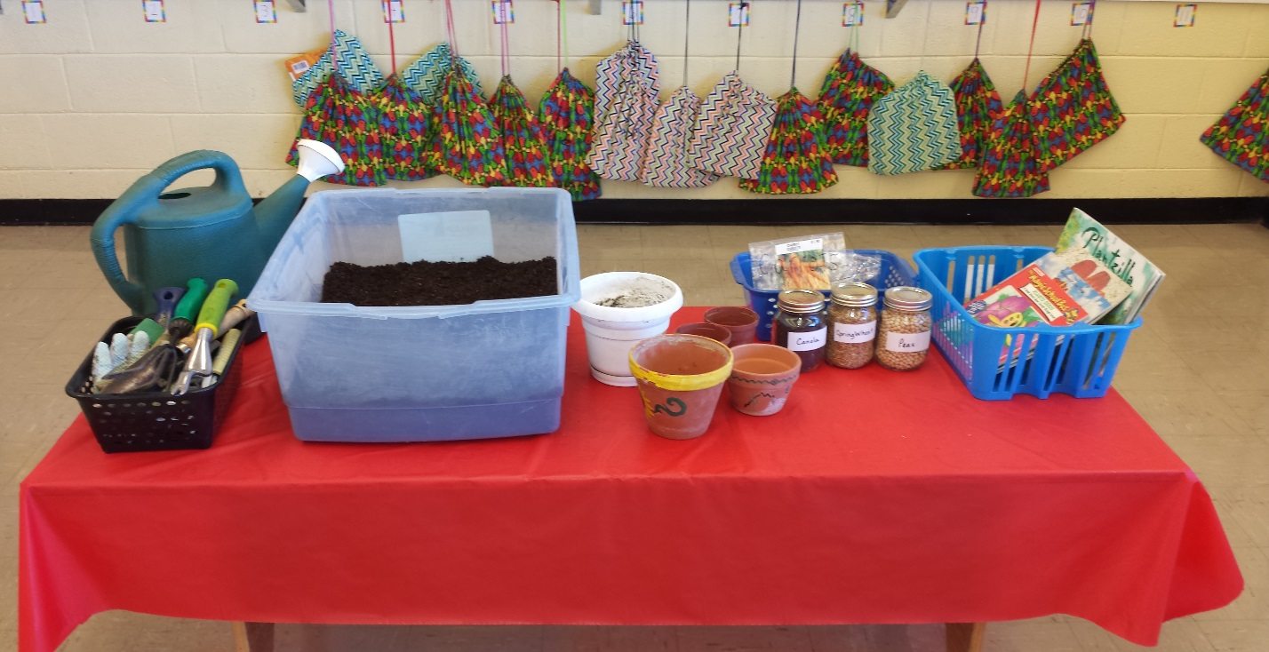
Phase 1: Beginning the Project
The Invitation: (Includes: Pots, labeled seeds, books, gardening tools, watering can, dirt)
I put out material that I thought the students would enjoy. We had a discussion on how to safely use the tools as well as the clean up process. Then I let them explore all of the items for about 30 minutes.

Slide 5
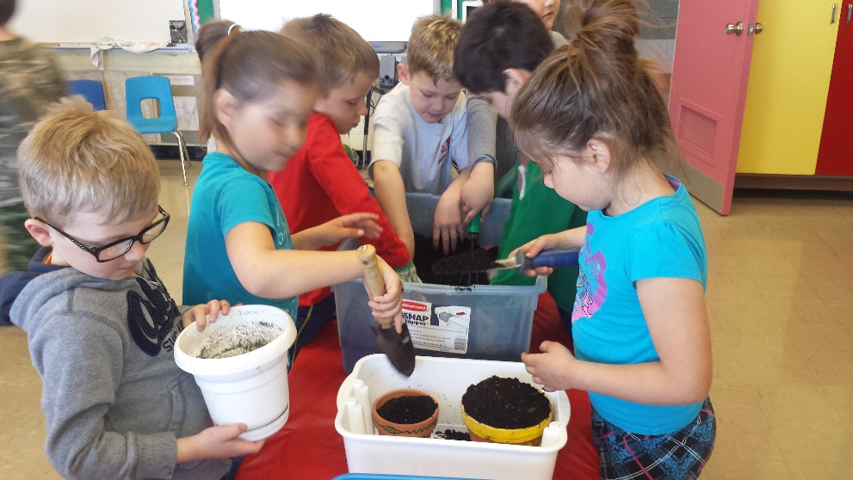
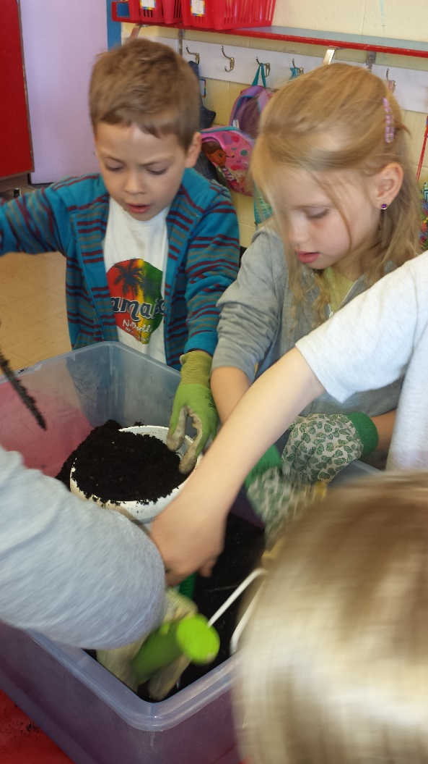
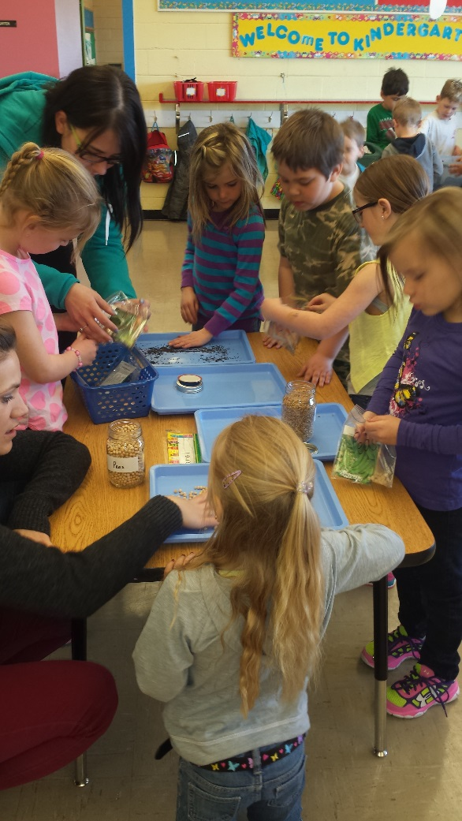
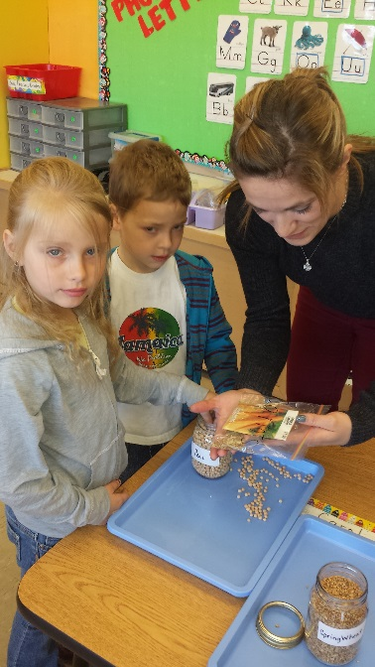
Exploring the Invitation!
The students loved
feeling the seeds
as well as getting
their hands into
the dirt!

Slide 6
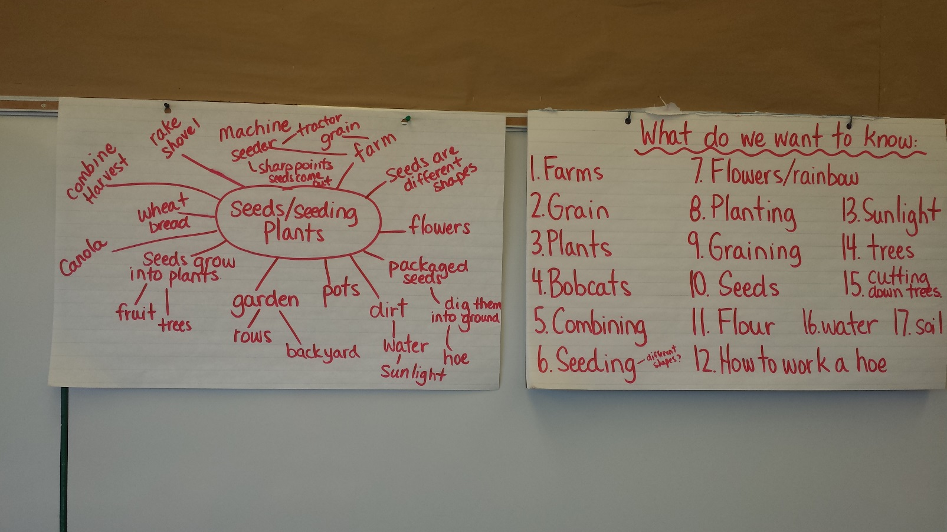
Student Web
Students were asked what they KNEW about the topic for the web and then asked what they WANTED to know about the topic. This new list prompted additional material being added to the invitation.

Slide 7
The New and Improved Invitation!
After the students created the web it was obvious that they were interested in the farming/planting aspect of the invitation. This prompted me to get some additional literature on farms and farming including machinery as well as some actual toy farming implements to pretend play with. The toys were a big hit.

Slide 8
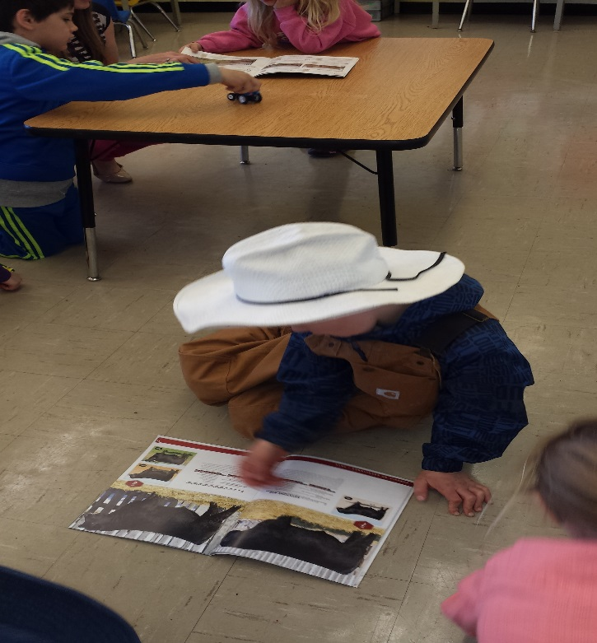
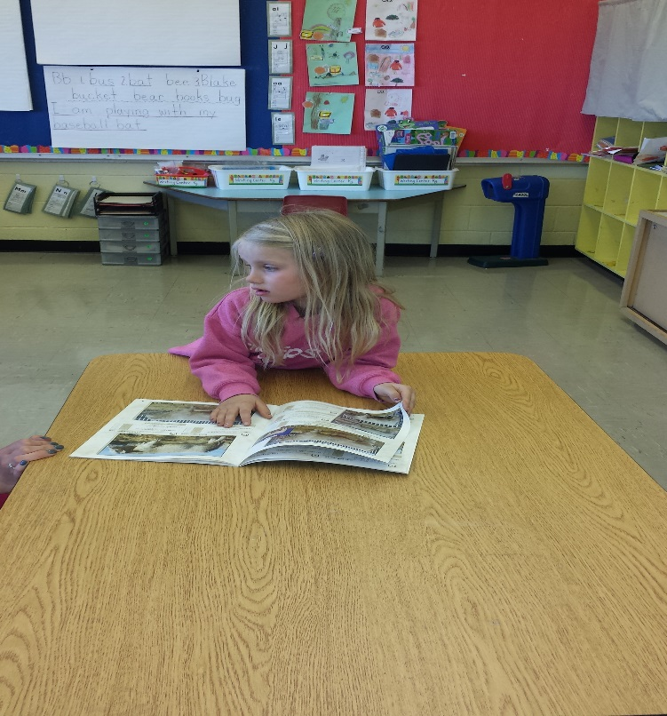
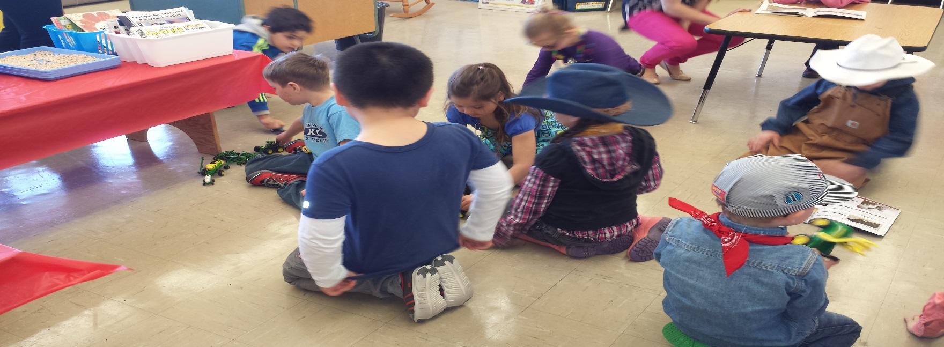
More Explore!

Slide 9
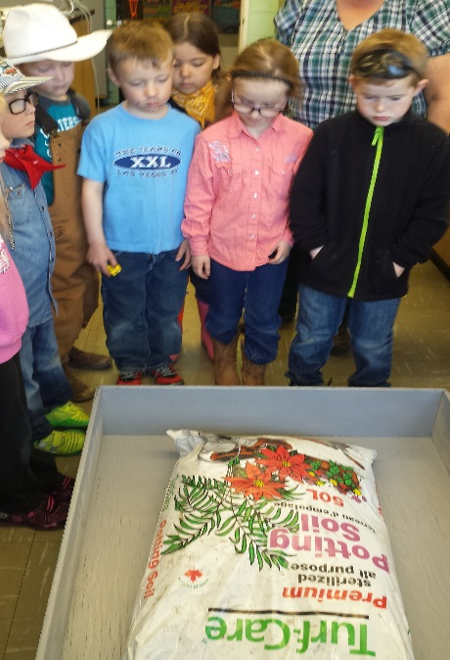
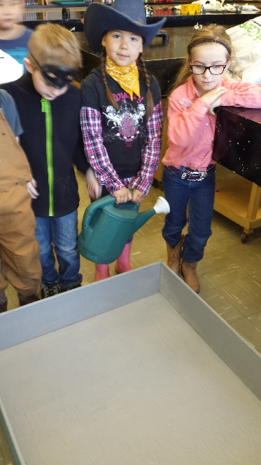
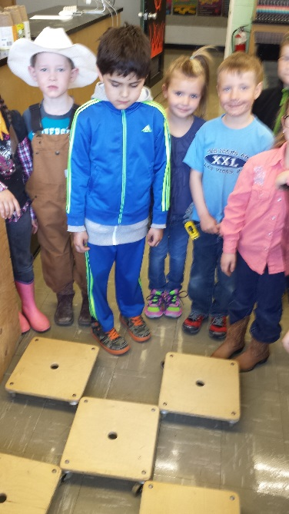
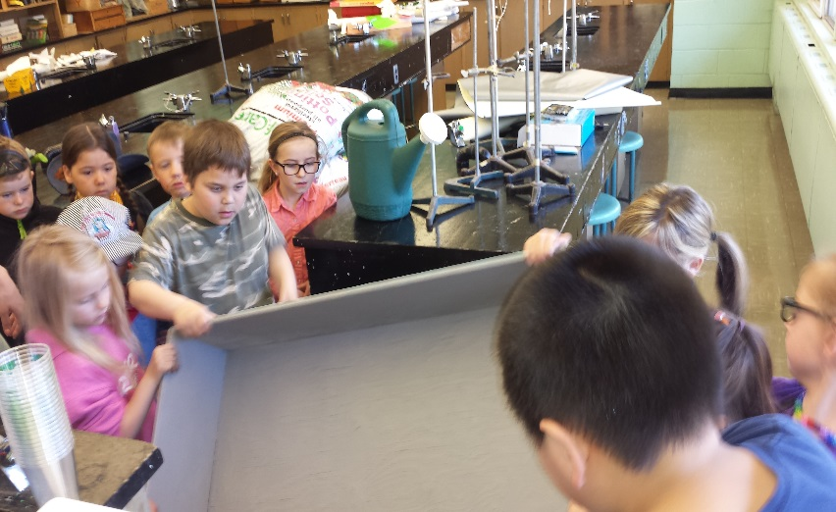
First Activity: Creating our garden!
The students decided that one thing they would like to do would be to plant their own garden and watch it grow. I bought some potting soil and 3 types of seeds and we got to work. We first put our garden on some rollers so that it could be easily moved. We then talked about what we saw on the potting soil bags, letters, words, etc. Everyone who wanted, got a turn to do each job. Playing in the soil, digging the rows, planting the seeds and finally watering the garden.
NK.5, NK.2(b),INK.1(a,c), USCK.2(b), CRK.1(f),2(d),3(a,f), CCK.2(h,I,j)

Slide 10
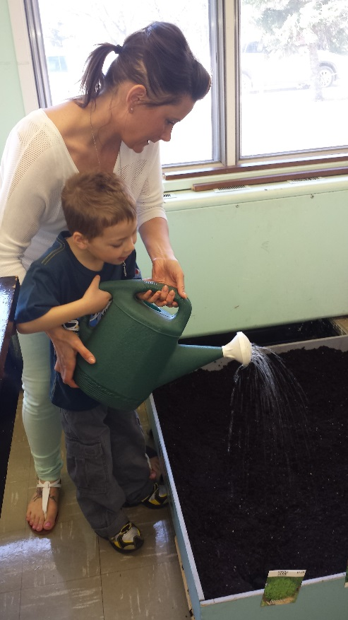
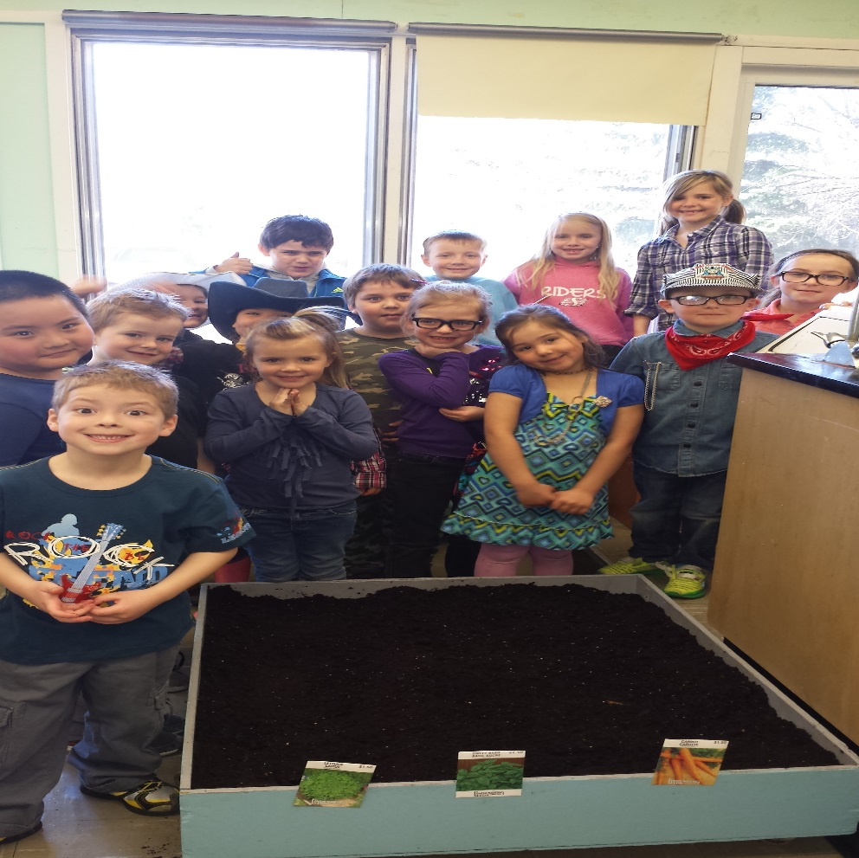
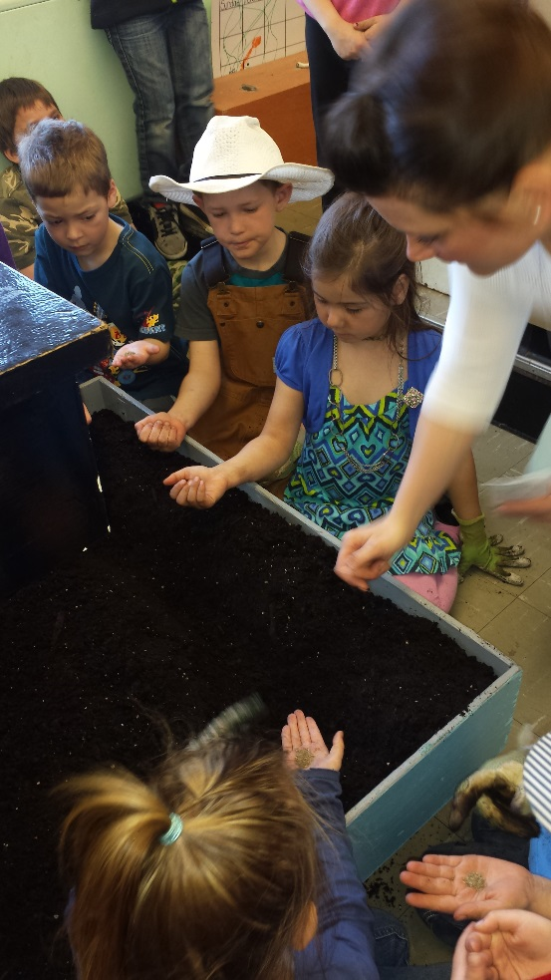
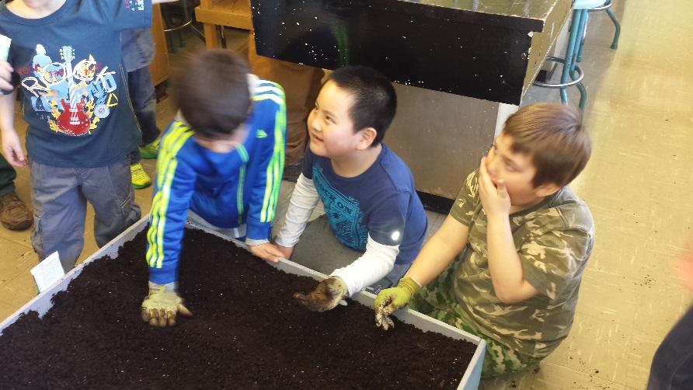
Our End Result! (So far!)
There were lots of steps in the process of planting our garden!
The students thought it would be a good idea to put the packages on the outside of the box so that we would know what we planted and where we planted it.

Slide 11
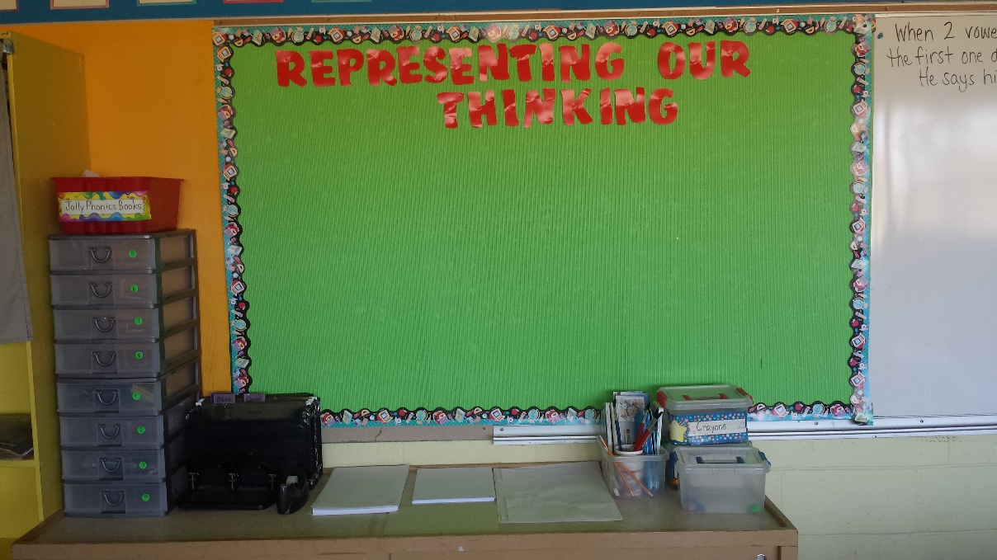
Representing our Thinking!
The “Representing” Station
Step 1: Explain what “representing your thinking” means.
At the station I included, paint, pastels, pencils, plasticine, crayons, markers and different sizes of blank paper as well as lined paper.
I explained to the students that I wanted to know what was going on inside of their heads, but because I couldn’t see in there, I needed them to show me in some way. I told them that I had set up a Representing Station, where they could choose how they wanted to show me.
I posed this question to help get their ideas flowing. “ What will our garden look like at the end of our project?”

Slide 12
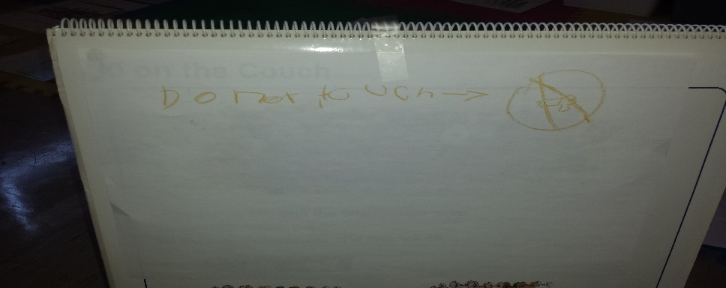
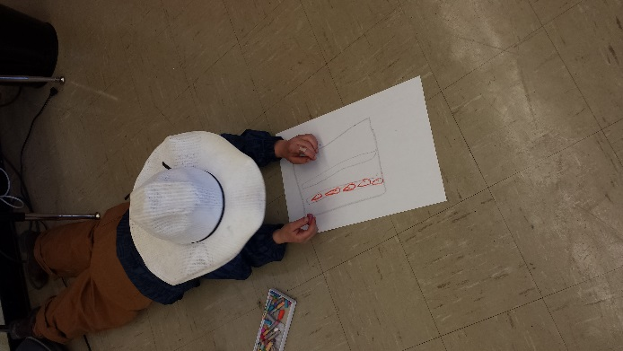
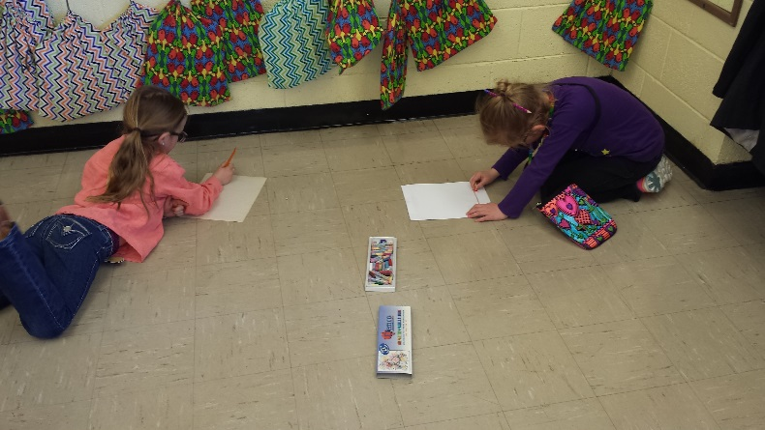
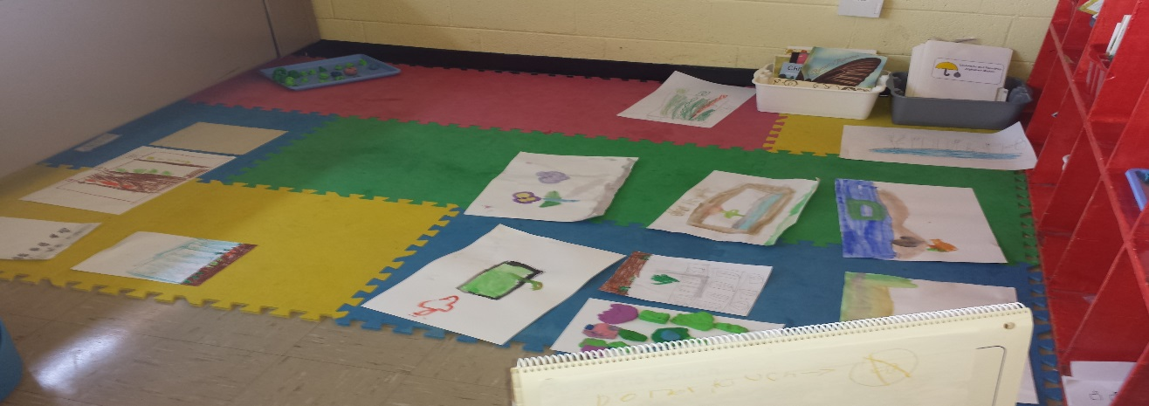
Representing our Thinking (cont’d)
Step 2: Let them create!
Step 3: We ran out of time!
When the bell went the students decided their work needed to be protected so they put them all in a safe spot and one student created this sign!
They each chose how they were going to show me what they were thinking.
The sign says, “Do Not Touch”
Some
representations
were easier to understand than
others. Others needed explaining!
The “safe” spot was blocked by our Big Math Book.

Slide 13
Activity #2: Graphing our predictions
Today we went and checked on our garden. The students noted that some of the lettuce had started to sprout. We then brainstormed some questions we had about the garden. Lastly, we voted on two questions that we wanted to graph and then each student took a turn putting his or her seed onto the appropriate part of the graph.
Questions Generated:
How long will it take?
What will grow the slowest?
Why do they need to grow?
What did we plant again?
CRK.2(a,i), CRK.3(d,g), CCK.1(d)
CCK.3(c,d),NK.1(c),NK.3(c), SSK.1(a)

Slide 14
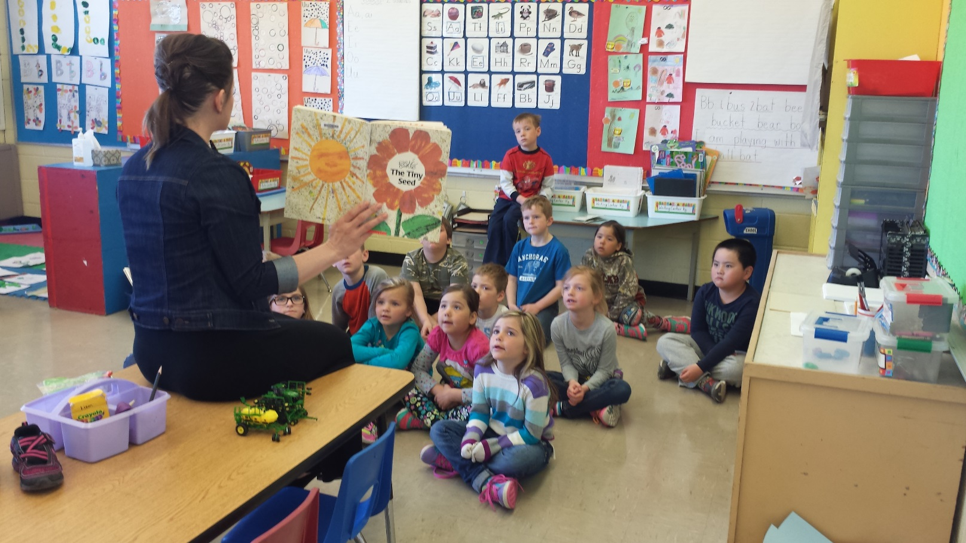
Activity #3: Reading
We read the book, “The Tiny Seed” by Eric Carle and this prompted some discussion on the similarities and differences between the seed in the story and the seeds we planted. I showed the students the toy model I had of an air seeder and the discussion then centered around that. We eventually came to the fact that they want to see how lots of seeds are put into the ground and what kinds of things affect those seeds.
We decided we needed to go out and see a real seeder. They then told me they would decide after how they would “represent” their thinking!
CRK.1(a,b,e),CRK.3(g,h),CRK.4(d),

Slide 15
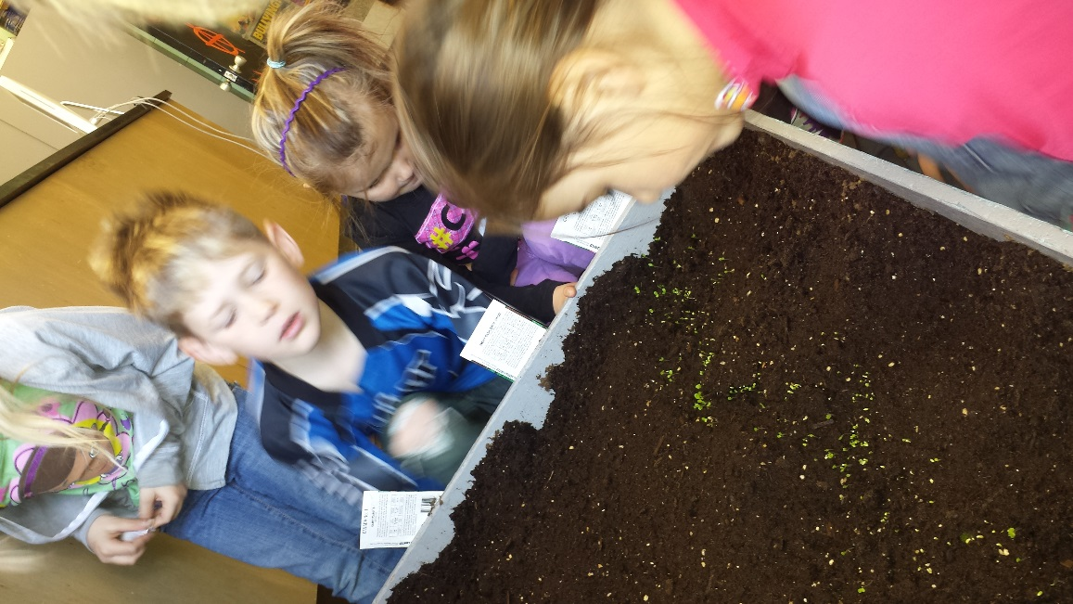
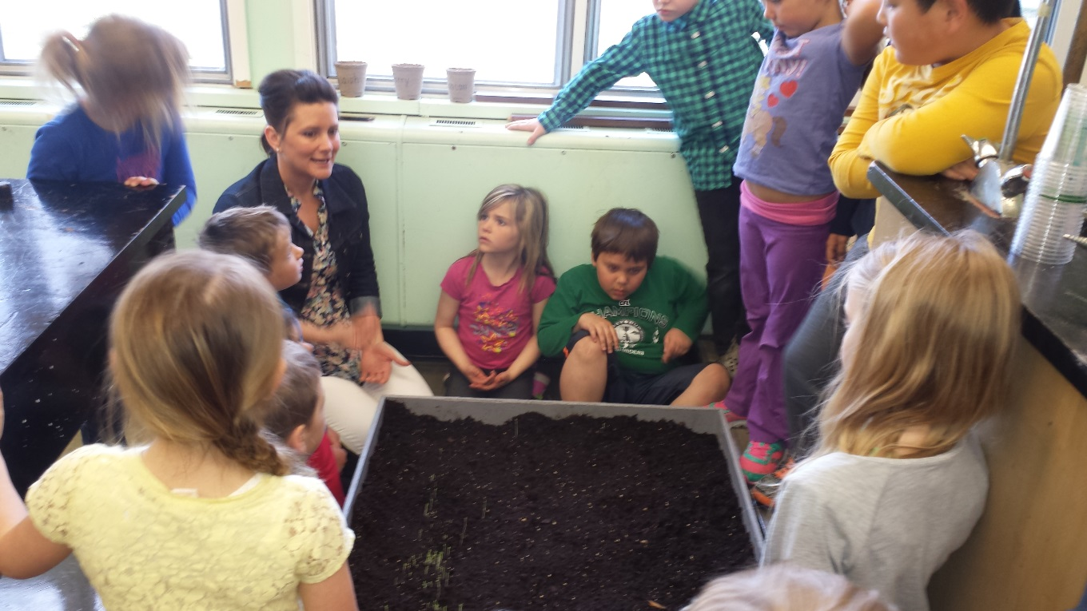
Checking up!
We headed down to where our garden is located to check and see what was happening and if anything was growing. We talked about what we saw and this prompted questions on what was happening underneath the soil and why some seeds had already poked through and why some had not.

Slide 16
Activity #4: Video time!
The students questions gave me the perfect Segway to show them a video I had found on a seed germinating outside of the soil. The video prompted a lot of interesting comments on what it reminded them of!
You Tube: [Time-Lapse] Mung Bean Germination
CRK.1(a), CRK.3(f), CCK.1, ARK.1(a)

Slide 17
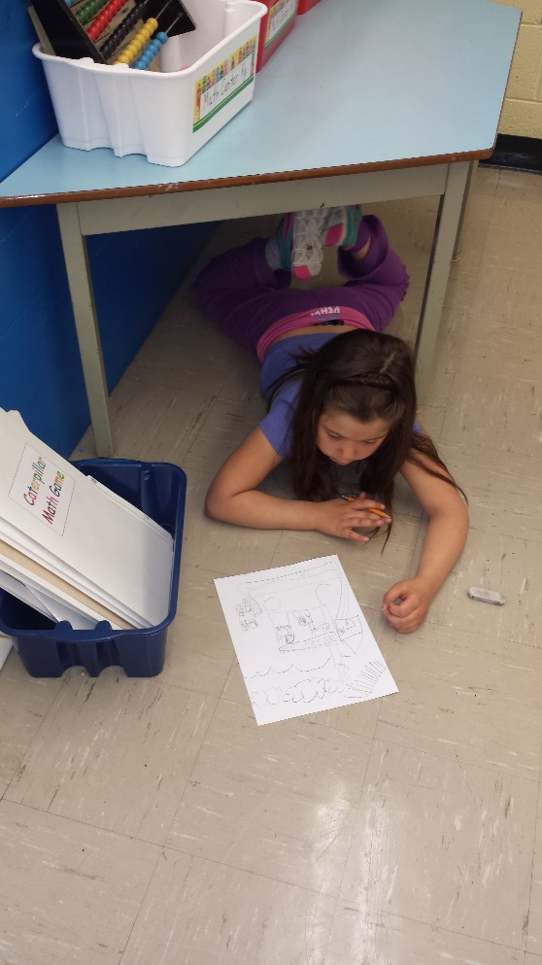
Activity #5: Book Making
The students decided today that they wanted to pick a topic that has to do with what we have been talking about and create a book. Some were in pairs others chose to work independently.
CRK.4(e,g,i),CCK.1(a,d), CCK.2(f,d,b), CCK.4(a,h,e)

Slide 18
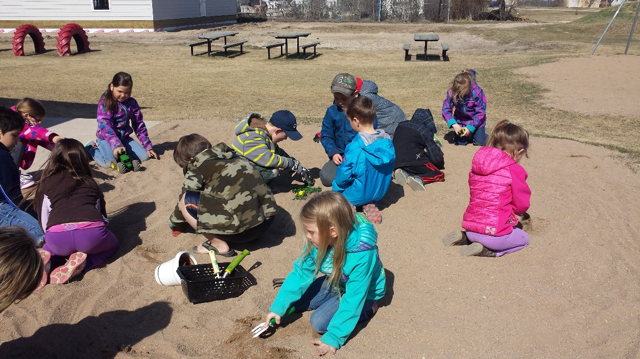
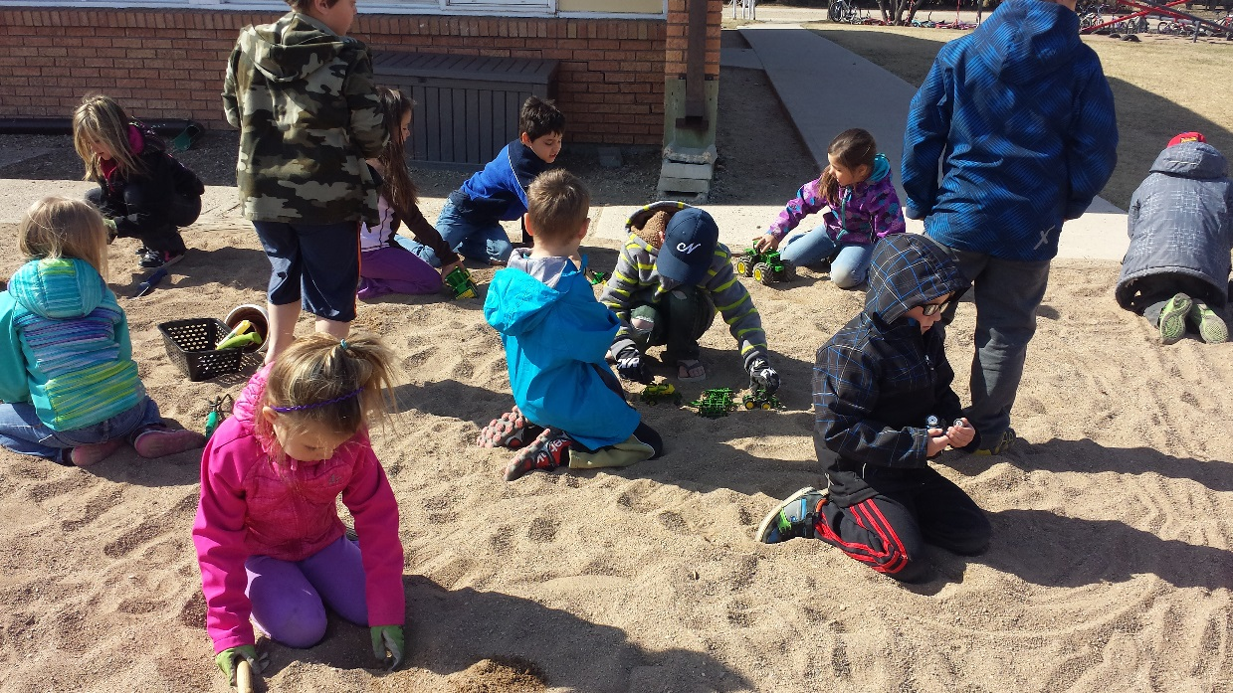
A little outdoor play!
We took our Invitation materials outside to see how they would work in the sand!

Slide 19
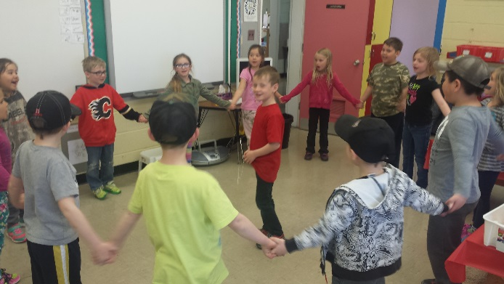
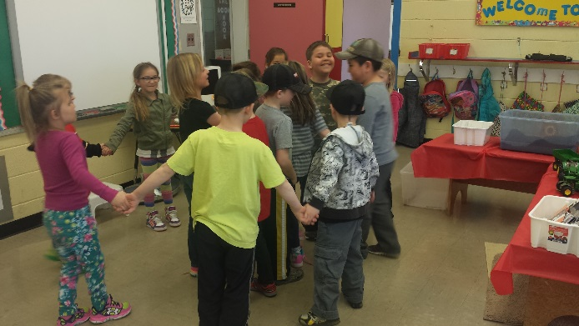
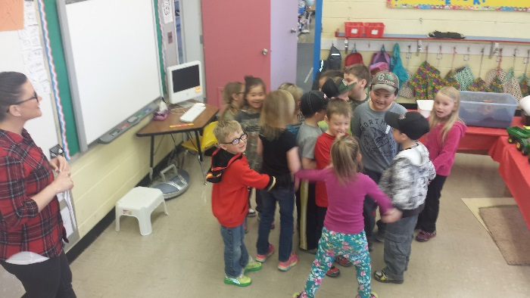
Activity #6: Farmer in the Dell
I taught the students the words and the tune to the song The Farmer in the Dell. We practiced a couple of times before we did the actions. The students enjoyed pulling others into the circle and we made sure to play enough times that all of the students got a chance to be in the circle.
I printed the words and a general reminder of the game from: http://www.dltk-teach.com/rhymes/farmer/song.htm
CPK.2, CPK.3

Slide 20
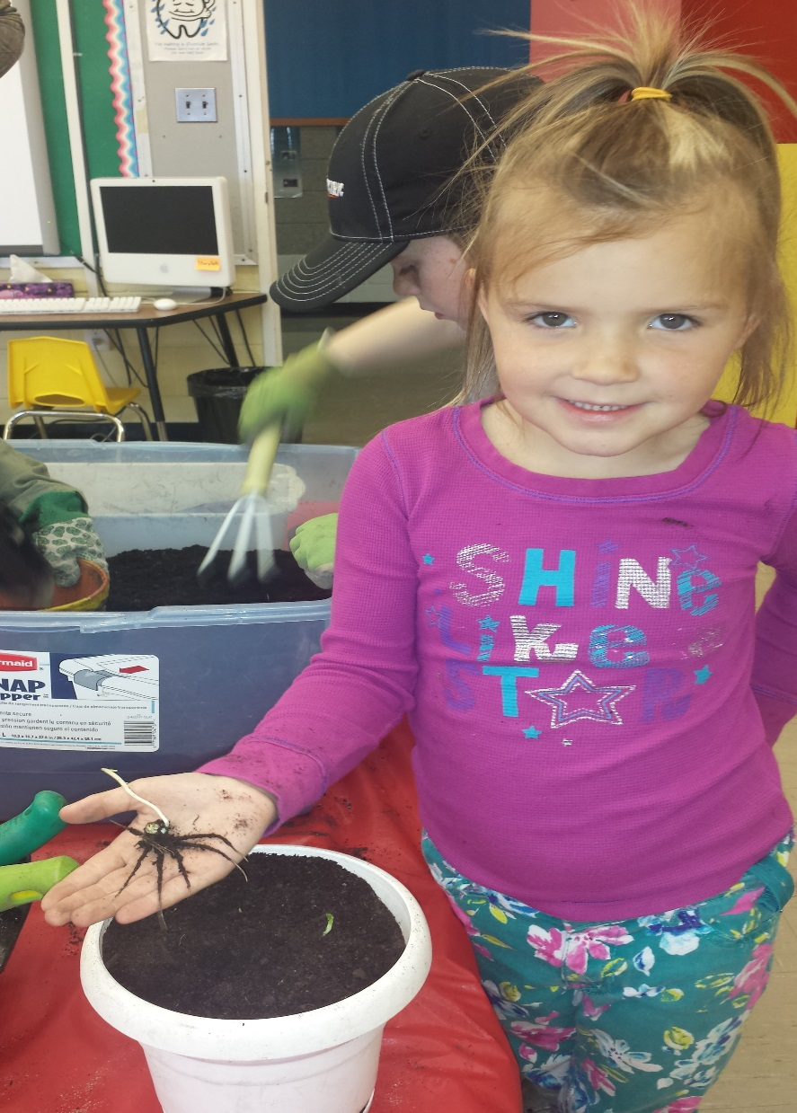
Something Amazing!
The first day that we explored the invitation
some students thought that they would pretend
to plant some of the pea seeds that we had been
given to us from out local elevator. We thought
that we had removed them all from the dirt. We
were wrong! During this students explore time
she found some of the forgotten pea seeds and was
amazed to find that they had began to grow! We
decided we should plant them in a proper pot and
see what happens.
Questions that arose:
How did they grow without water?
How did they grow without sun?

Slide 21
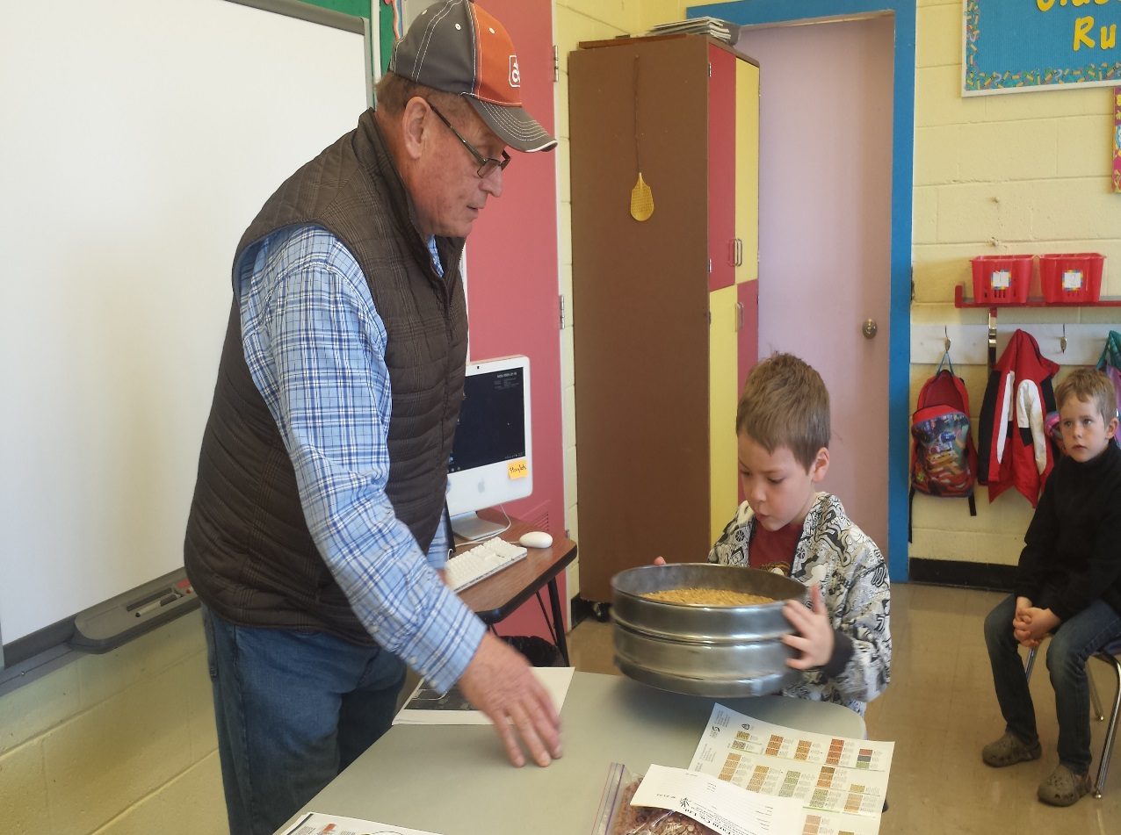
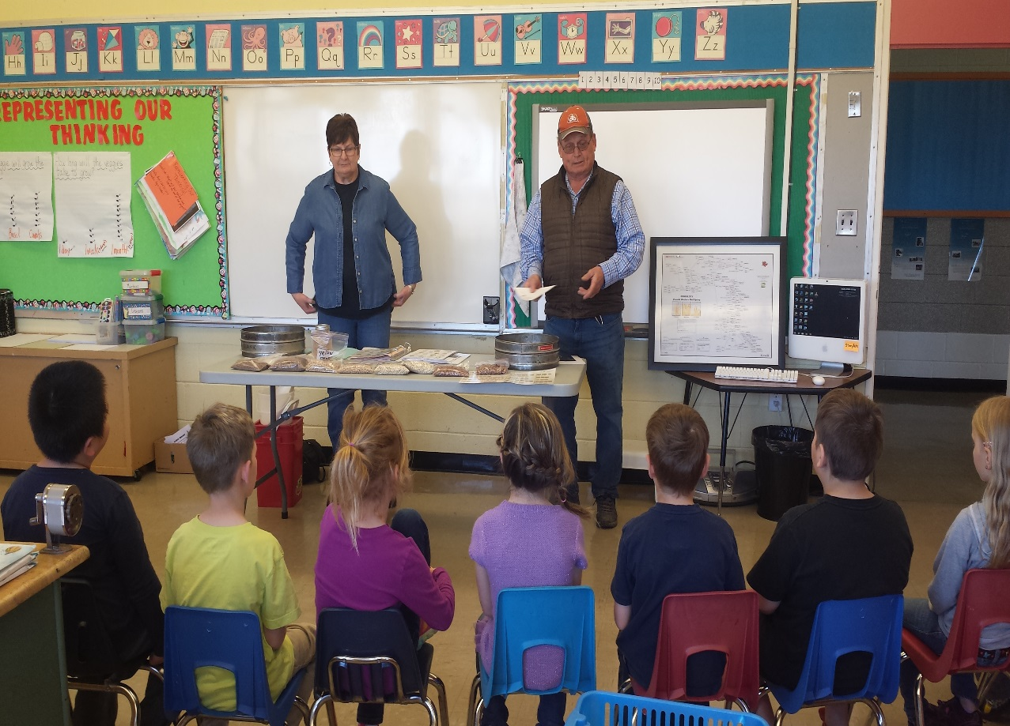
Guest Speakers: Edwards Farm Company
Today we invited the owner operators of a seed cleaning plant in to explain to the students what they do. They explained how the seeds are cleaned, grown and what is done with them. It was a great presentation. We even got to keep some different kinds of seeds!

Slide 22
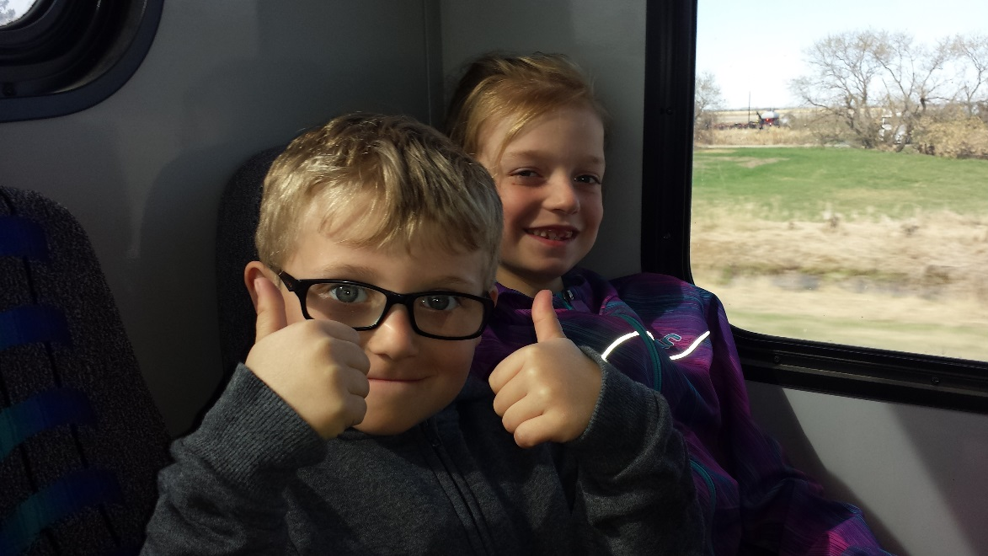
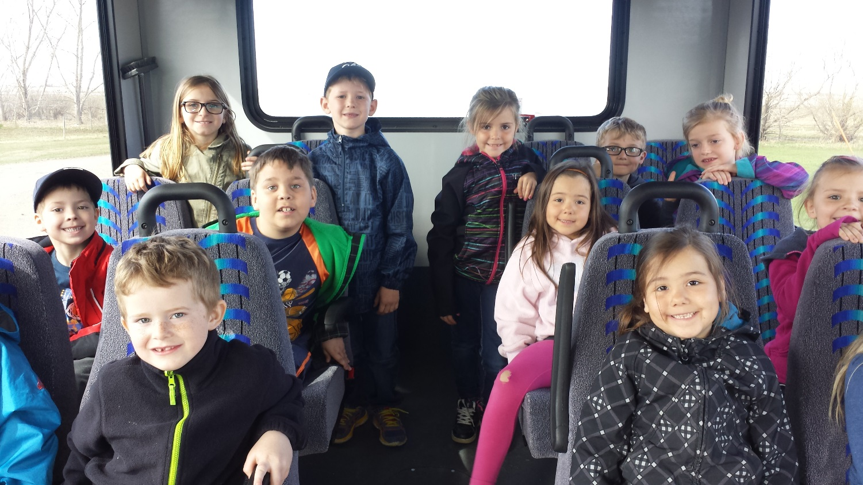
Field Trip: Mortenson Farms
After we learned about seeds we decided we needed to go and see how they get into the ground on a mass scale. We went out to a local farmers yard and he showed us and explained to us the whole process of seeding.
The bus ride was the first “amazing” part
Of our trip out to Mortenson Farms!

Slide 23
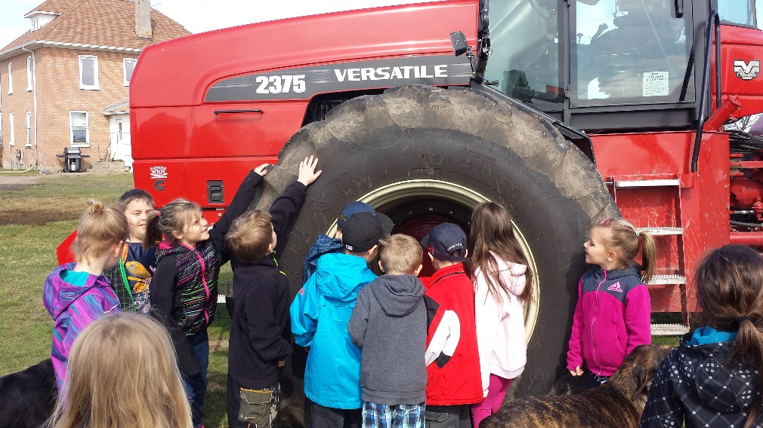
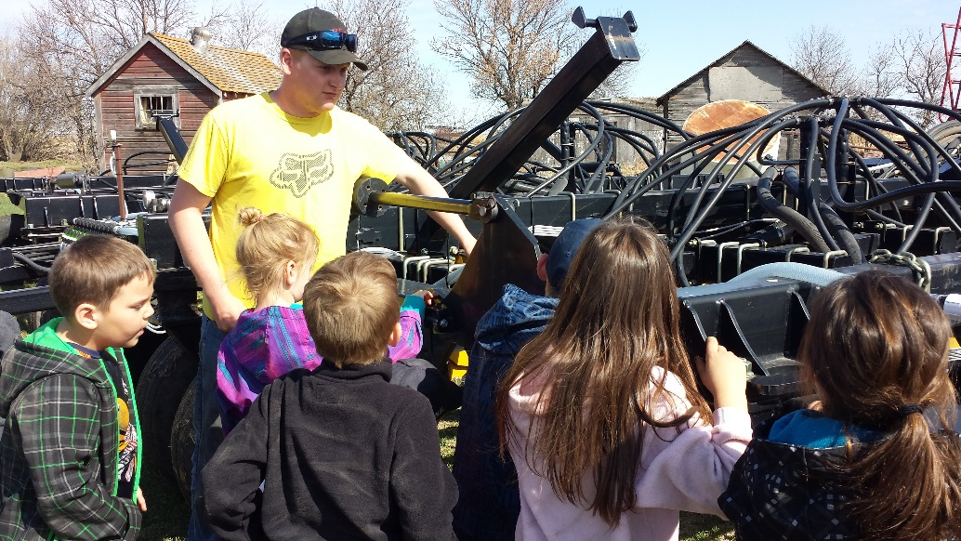
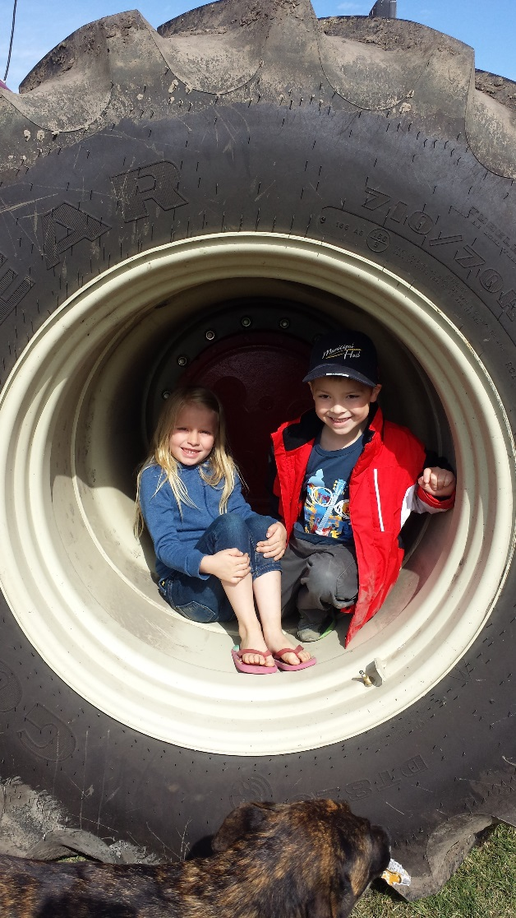
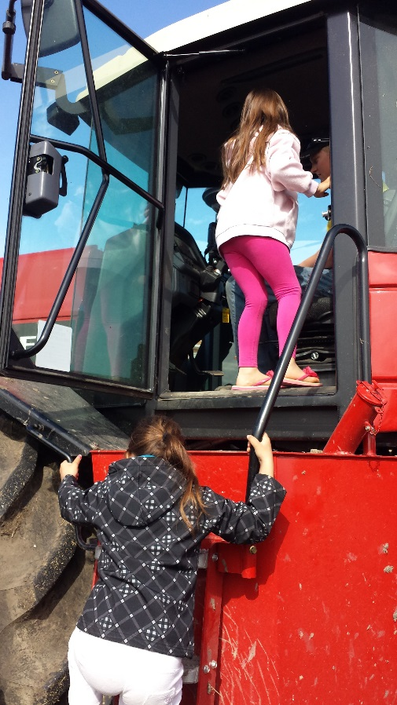
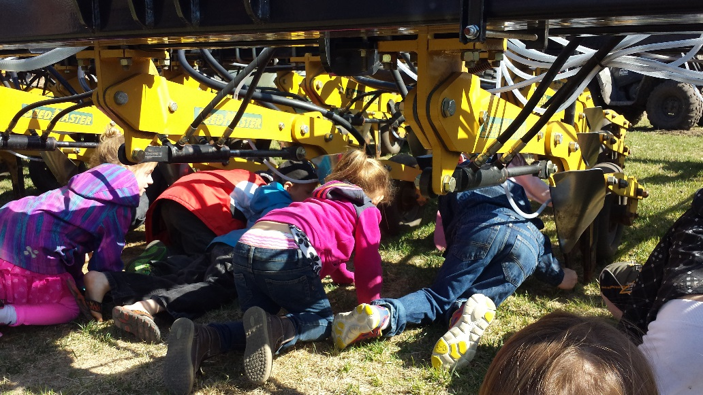
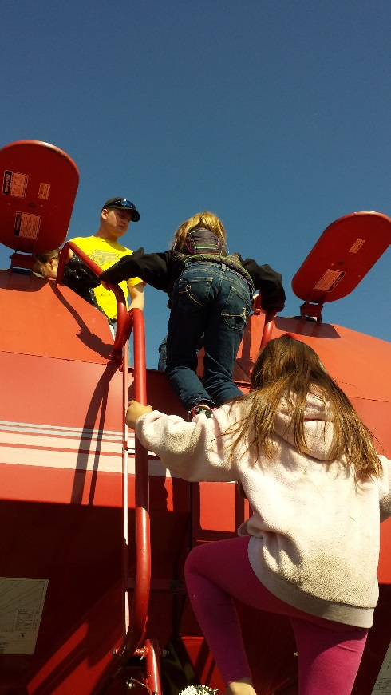
Logan showed the students all of the
different parts of the seeding operation
starting with the tractor all the way back
to the fertilizer tank!

Slide 24
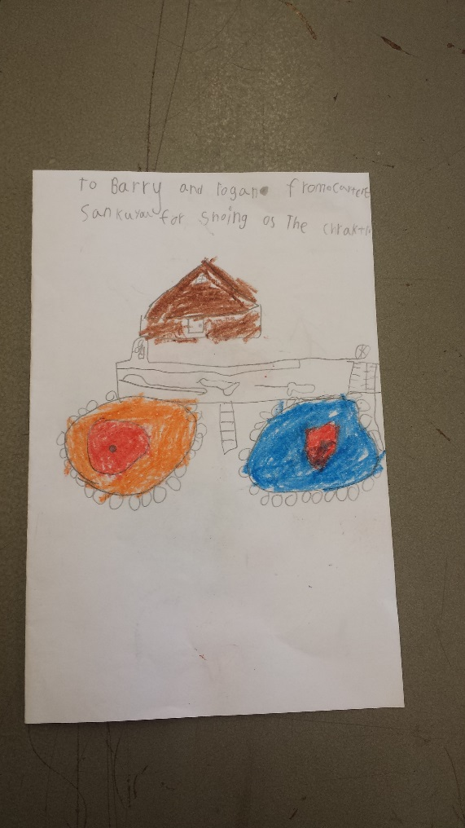
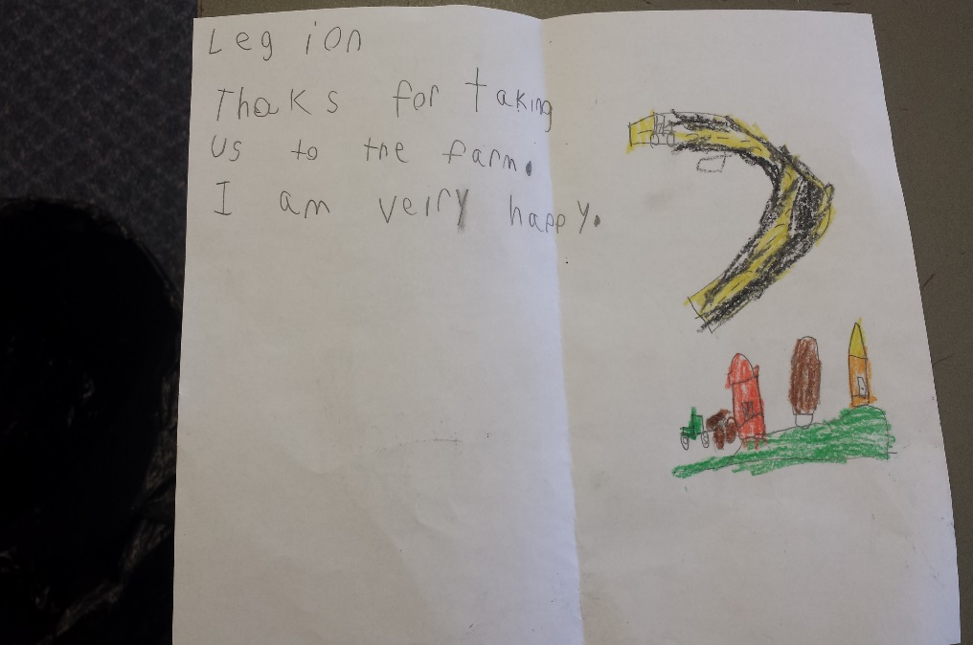
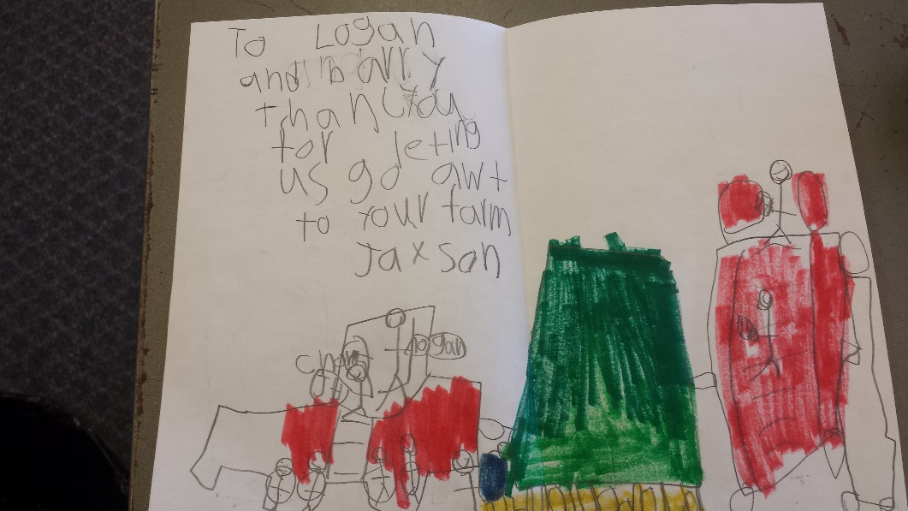
Thank You!
The students decided that they needed to send thank you cards to the people that came to our room and the farmers who let us come out to their farm. They even went as far as wanting to thank the bus driver who drove us out to the farm!

Slide 25
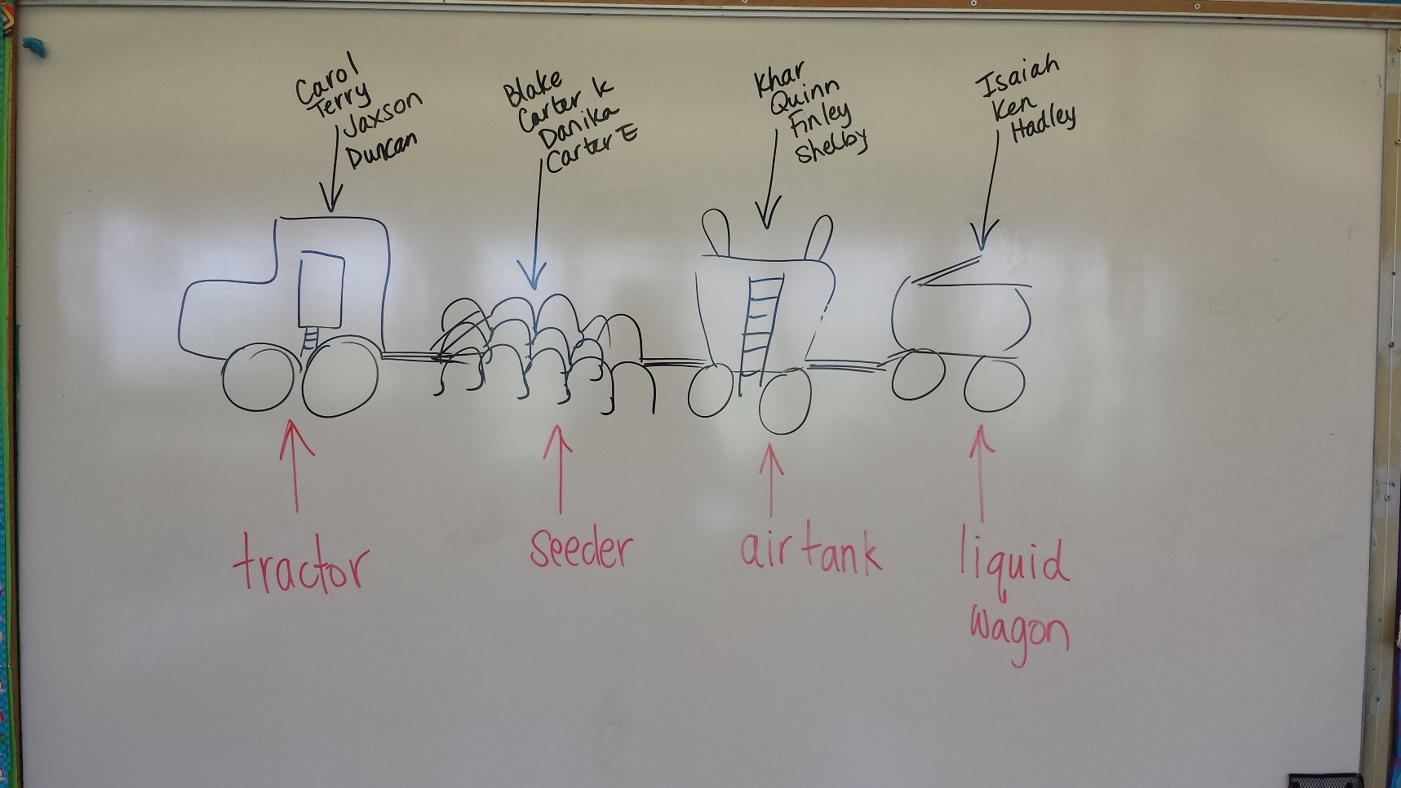
Building Time: Where our plan started!
The students reviewed what they saw at the farm and I drew it on the board. Then we split into groups and each made a plan for their part of the operation.

Slide 26
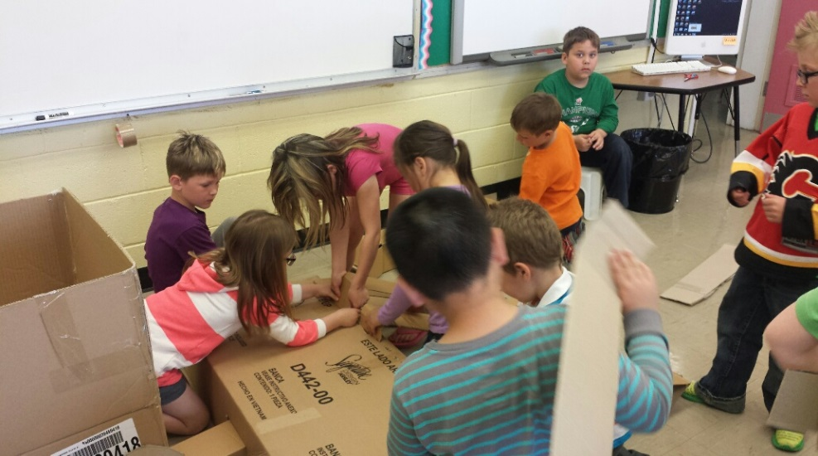
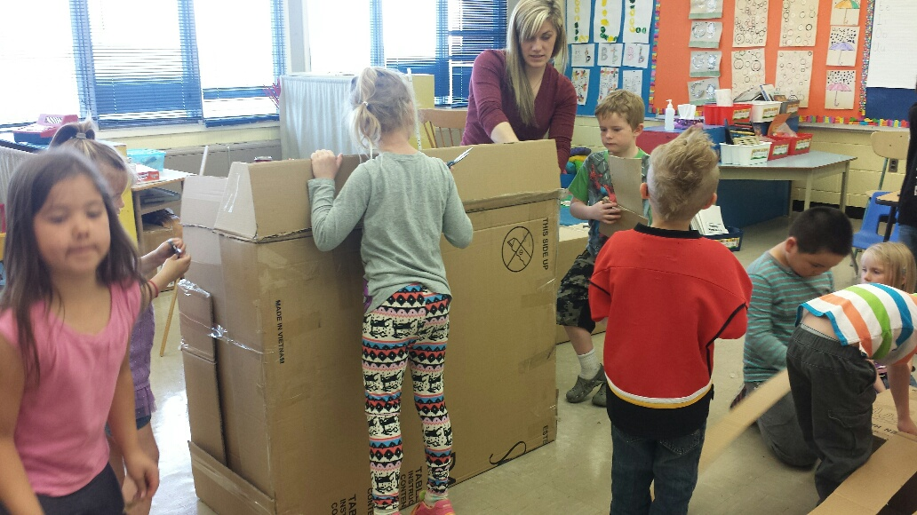
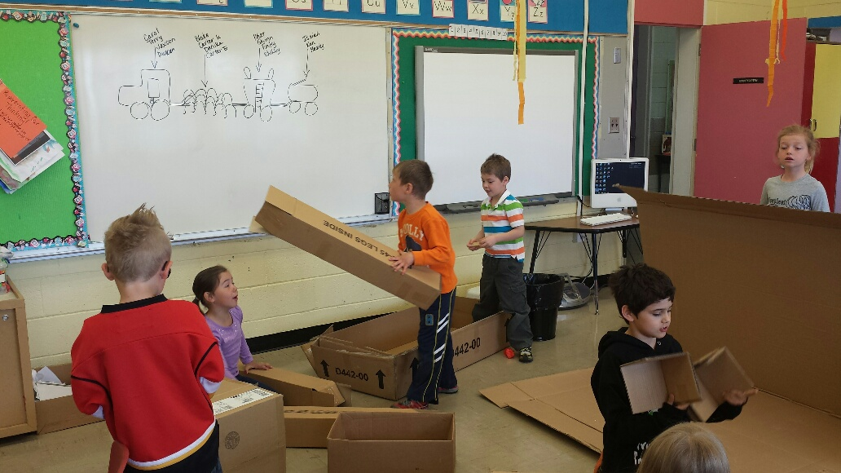
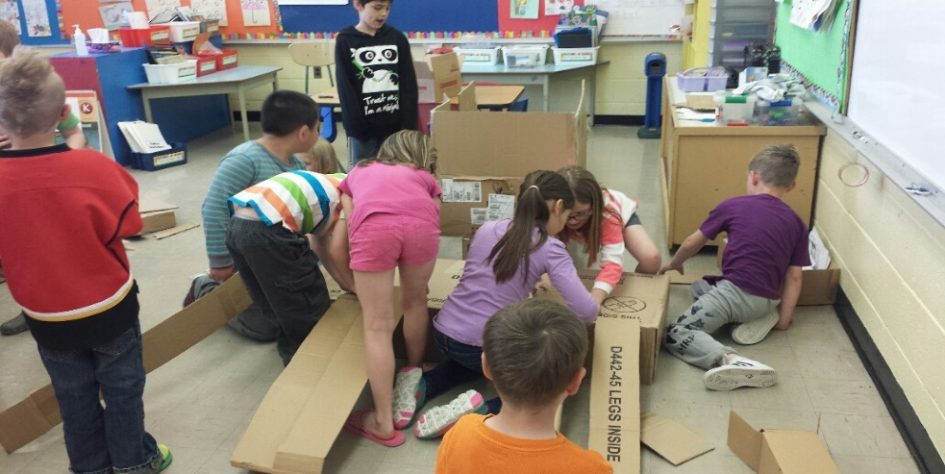
Building our Operation! Day 1
The students looked at the “blueprint” we had drawn on the board and went o work. They had great ideas, but putting it into action was hard. They needed a lot of help with the building part. But in the end it worked out fantastic!

Slide 27
End of Day 1: Pieces built, now the detail!
Tractor: Pulls
everything.
Seeder/Air drill: Puts the
seeds into the ground.
Air Cart: Holds seed and
some fertilizer.
Liquid Wagon: Holds
liquid fertilizer

Slide 28
T
H
E
D
D A
E Y
T
A 2
I
L
Everyone
was happy with
the detail they
had added to
the
equipment!
This
group
was
very
literal
when it
came to
the logo
on their
piece.
The John
Deer logo
was a
favorite!

Slide 29
Putting content on our Information Boards
The students recorded
information they knew about the piece of equipment the built.

Slide 30
Our Final Display!

Slide 31
Making Invitations
We decided we wanted special people in our lives to come and see all of the hard work we had done and to watch us take a ride in our creation. Invitations were also send out to Mortenson Farms and Edwards Farm Co.

Slide 32
Welcome Friends!
Parents, special guests and fellow school mates joined us to show off all of our hard work! It was a great way to end a great project!

Slide 33
Teacher Reflection
This was a totally new way to teach for me and the biggest thing I noticed was how much fun it was! Not only were the kids engaged and having fun, but so was I. This topic was a good choice for a few reason, time of year, resources and of course interest. I was amazed at where we started and what we ended up with.
Because of the numbers in my Kindergarten room I had to incorporate the grade ones as well, which was a good fit because the 2 kg’s tried to model the writing that the grade ones were doing. Most of the writing that was done was done by the grade ones, but it helped immerse the kg’s in even more reading and writing.
I am already planning my next project that will incorporate Kindergarten graduation. I am also planning a Social Studies project to do with the one and two’s.

Slide 34
Reference Page:
Books in Invitation:
The Tiny Seed by Eric Carle
The Magic School Bus Plants Seeds
Plants with Seeds by Dorothy Wood
What is a Plant? By Bobbie Kalman
Plantzilla by Jerdine Nolen
Copies of farming newspapers,
auction flyers, bull sales, crop info.
Videos:
Mung bean germination on You tube
Special Guests/Field Trips:
Edwards Farm Company (Beeler Seeds)
Mortenson Farms

