Slide 1
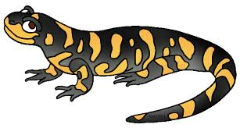
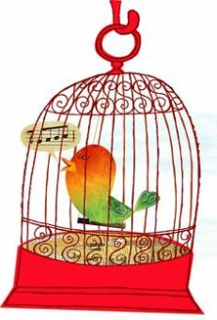
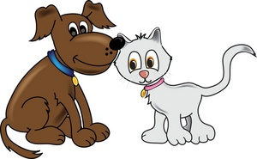
The Littlest Pet Shop
Pre-Kindergarten at Bishop Klein Community School
January to March 2016

Slide 2
How it all began….
The children were always playing “Kitties” in the kitchen but it wasn’t deep meaningful play rather they just loved to make the loud “meowing” noise simultaneously which was loud and disruptive for others in the room. I felt like I was always saying quiet kitties or telling the kitties to have a nap. So I needed to give the children a purpose and heighten their dramatic play by creating a learning rich environment with a focus on pets.

Slide 3
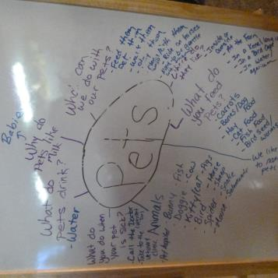
What we want to know about pets?
What do they eat?
What do they drink?
Do they go to a hospital?
Do they take medicine?
Where do you get pets?
How much are pets?
What kinds of things are pets?
Why do some pets live outside?
Why would they go see a doctor?
How do they take medicine?
Do they go to a doctor like us?
What are those things on the window?
(x-rays)
Do they brush their teeth?
Who cleans them or cuts their fur?
Why do some pets have to stay in a cage?
Do pets like milk?
What do pets need?
What do you do when a pet gets sick?
What can you do with a pet?

Slide 4
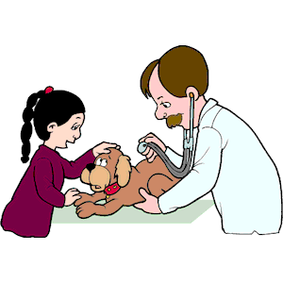
Things we need in a veterinary clinic
Stuffed animals for pets.
Kennels and dog beds.
Collars and leashes.
Food dishes and food.
Medical kit (needles, stethoscope, blood pressure meter, scissors, thermometer, tweezers, eye dropper, syringe, tensor bandages, gauze, gauze pads, band-aids, finger/toe splints, medicine bottles.)
Medical checklist.
Scrubs and aprons.
X-rays.
“The educator creates an environment that reflects children’s interests, and which supports the child’s holistic growth.” (Play and exploration, p.9)

Slide 5
A student brought her puppy to the vet clinic and said “he is bleedid, but he betta now! Oh no, his teeth are going so faster he can’t breath. Whew, my friend is fixing it now!”
The girl looks into the puppies mouth and pretends to pull something out. Then says “Look, it’s what's making him sick.”

Slide 6
Getting Ready for a Walk
E – “I’m the mommy and I need to take my doggy for a walk.”
K – “How about my puppy?”
E – Okay, K he is all ready.”
K – “Just a minute I need a glass of milk.”
E – “And some mediscene.”
E pretends to give her puppy some milk and medicine “Ummmmm. Okay, let’s take our pets for a walk!”

Slide 7
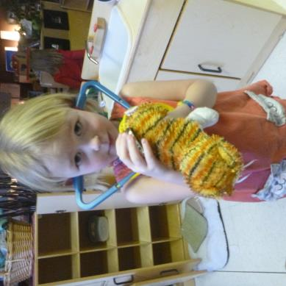
Pet’s Heart Beats
A boy places the stethoscope on the puppies back and says “I hear my doggies heart beat. BUP BUP BUP”
He hands the stethoscope to another student and she also places it on her kitties back and excitedly looks up and states, “I hear my kitty too! MEOW MEOW MEOW”

Slide 8
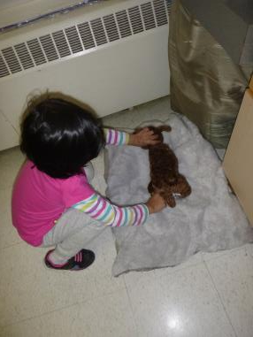
Puppy Has A Cold
“My puppy is soooooooo sick. He got a cold.
ACHOOOO, ACHOO, ACHO
Oh no, I need to keep him.” She then takes the stuffed dog and uses the different medical instruments to give him an examination. She then takes the dog and put him on a dog bed and says “You need to sleep” and covers the dog up.

Slide 9
Poor Doggie Got An Owie
A child came up to me one day and said,
“My poor doggie got an owe, do you have any band-aids?
I replied, “I sure do!” She gets an excited look on her face and says “Oh GOOD!” Places the band-aid on the puppy and turns to her friends and explains “There I put a band-aid on him he’s much better now!”

Slide 10
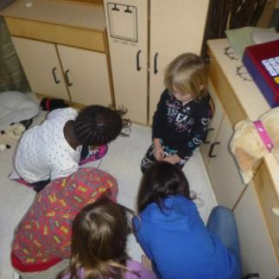
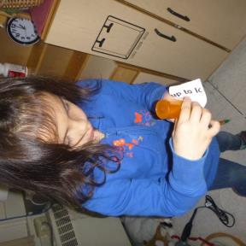
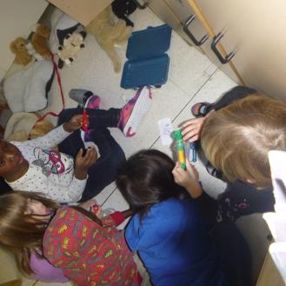
Freddy the Ant
The children found an ant on the floor by the name of Freddy. The ants are our friends in the classroom. By accident one of the little girls stepped on Freddy the ant. The children quickly rushed him to the vet clinic to make him better. This is what they said:
K – “Oh no, he’s dead. She squished him. Let’s fix him!”
L – “Oh no, urry (hurry)!
F – “I’ll give him an injection.”
C – “Want a needle?”
M – “Just leave him alone, he’s speeping (sleeping).”
F – “He’s sad, wakey Freddy, peas.”
K–” He’s Moving!! I’ll cover him up.”
F –” We givedem tis medicine, it werked (worked)!”
K – “Will it turn into a butterfly?”

Slide 11
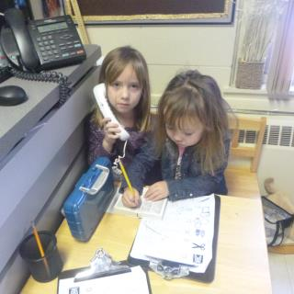
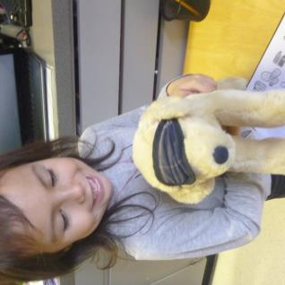
Hurry He’s Dying
The children were busy playing in the vet clinic pretending to be doctors and pet owners.
A student places the stethoscope up to the dog and shouts out “Oh no, the heart stopped breathing. Oh, (she begins to laugh) he’s just sleeping! But, I think my puppy is sick.”
Another student announces “I can fix him, I have a doctors kits! “I’ll help her.”
Student C –”I’m not sure what’s wrong?
Student K – Oh no poor puppy!
Student B – “I’ll look in tis book.”
Student K – Hurry he’s dying!

Slide 12
Doctors
Student J - We’re playing doctors (looks at another child), right?
Student C – Yep, we need water right?
Student J – Yeah, I’ll put water in it!

Slide 13
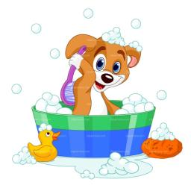
As we observed the children we noticed that they were wanting to groom there animals so we added things to the vet clinic to also make it a pet grooming shop. We added:
- Dog brushes and others brushes and combs.
- Towels and clothes.
- Hair bands and hair clips.
- Blow dryer.
- Dog grooming mitts.
- Toothbrushes.
- Empty Shampoo bottle.
“Children constantly use materials to learn about the world, explore their questions, and represent their thinking”(Curtis and Carter).

Slide 14
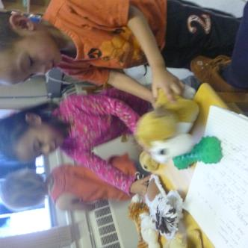
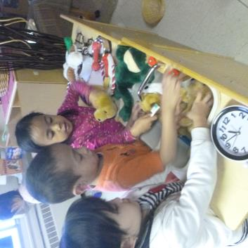
Taking Care of Puppies is Hard Work
The children were very busy pretending to be veterinarians.
K- These doggies are sick. (turn to look at C) Give them a bed?
C – Ok. She then takes the dogs from K and places them on the dog bed and covers it up with a blanket. She turns to J and asks “Do you puppy wants some bones? J shakes his head yes. C then asks “Big or little?”
J replies “Big”, C says ok! And gives J the big bone to J to feed his puppy.
C then asks J “Does he want to play fetch or something? J responds “Yeah!”
They take the green chew toy bone and pretend to play fetch with the puppy.
C then exclaims “Oh no, he got so dirty. He needs a bath I think.” J agrees and relies “Yeah! And his teeth brushing from that bone!” Together they groomed the dog!

Slide 15
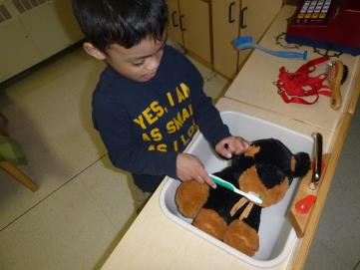
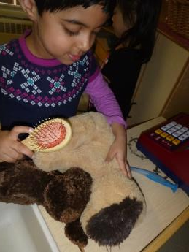
“Ahhh, my puppeigh are sick.”
“Doggie Sick.”
His hair is sooo knotty”
“I’m brushing his teeth off. He dirty, had a lot of chocolate.”

Slide 16
Feeding Time
Two children were busy feeding the animals.
B – “He doesn’t have any (as he holds one of the dogs).
J - “I’ll give him one bone.” She then gives J one of the dog bones. She then starts to pretend to put her dog and she says to him “My puppy likes to have his ears petted; right here. Then she demonstrates for J where her dog likes to be scratched.
J- “Here’s a snack,” holds a piece of pretend food up to the dogs mouth, “yum, yum, yum!”

Slide 17
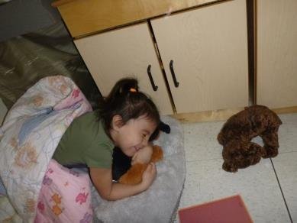
Incorporating Literacy
Two students were reading the stories about pets to the pet puppies. The were telling the story in their own words by reading the pictures.
K- “ Ahh he is digging, and now he is going for a walk.”
Turns a few more pages
“Oh man, this is a long book.”
D – “Yeah!”
K – “Good night, lays down to nap with her puppy.”

Slide 18
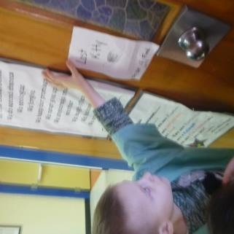
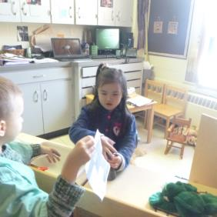
Lost Kitty
A student was moving around the classroom asking everyone if they had seen kitty; kitty lost. I then suggested to him that he make signs to hang up in the room to find his kitty. So he did!
Very proud of his sign he runs over to another student in the room and asks, “Did you find it? Did you See it?: As he is holding up his sign to her.
He had fun looking for his lost kitties for several days. He enjoyed hiding the kitties in different places in the room for the other kids to find, and he also liked hanging up his signs throughout the classroom.
One day when the boy was looking for his lost kitty he said to me very excitedly, “Kitty lost, close eyes.” She I put my hands over my eyes peaking slightly to see what he was doing…… as I peaked I noticed he was taking marker and drawing on the floor just about to draw on a cloth chair when I shouted “please stop.” He looks up at me with a big grin on his face “kitty tracks!” My reply, “Ooh…. look at that there are kitty tracks, but lets find you something else to use as tracks. And that is what we did we found small circular paper cutouts to use as tracks.

Slide 19
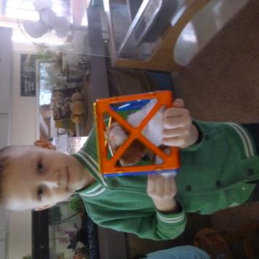
The children then began to build homes for their animals. They used the legos to build a dog house and their favorite thing to do was to build dog kennels and cages for the dogs and cats. The vet clinic/groomers quickly turned into a pet store. We added a cash register, money, and the children made a sign, and price tags.
“When children are interested in an idea or concept, providing different materials to extend their exploration helps them make further connections and build upon their ideas”(Curtis and Carter).

Slide 20
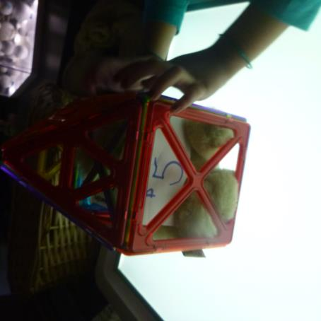
Pets For Sale
The children then began to sell their animals in their cages. I would over hear them saying “doggy for sale,” or “Do you want to buy my kitty?”
I asked the kids if they wanted to make this into a pet shop and they all thought that would be a great idea. One of the little girls very excited perked up can we name it “The Littlest Pet Shop!”

Slide 21
I asked the students what they would need and they said:
A sign
Money
Cash register
Price tags

Slide 22
Making the Pet Store Sign
Some of the children and I went to the paper room and they picked what colour of paper they wanted their sign on. They then took the paper back to the classroom and made their sign for the pet store. Just being able to draw and colour on this big piece of paper was very exciting!

Slide 23
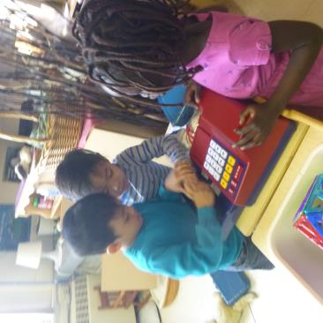
Playing in the Pet Store

Slide 24
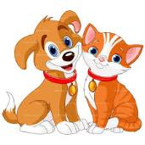
What is a Pet?
We talked with the children about what kinds of animals we can have as pets.
We made a graph to see what kind of animals the children would like to have for a pet.
We brought different animals into the school for the children to see.
What Are Pets?
Cats
Dogs
Birds
Fish
Snakes
Rats
Horses
Cows
Turtle
Bunnies

Slide 25
What Kind of Pet Would You like….

Slide 26
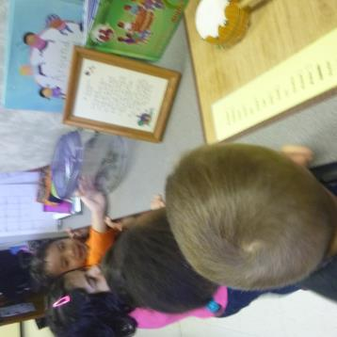
Sully The Salamander
Here are some of the things that the children said when they were watching Sully:
“Wow, look at his hands he has five fingers in the back and four in the front. His mouth is going up and down! He’s sooooooo……. slimy.”
“Ewwwe he’s soooo…. Pretty. Ahhhh… we can’t touch it. We’re big he’s small. Wow, he does move.”
“Don’t touch it’s gunna bite.”
“It’s not so scared. He wanted to eat this (holding his finger to the cage and Sully snapped at it). I just touched it and he went yum! He cans see me!”
“Why is there water?” A student answers “Because that’s where is lives!”
“Look, he is standing?”
“Is he a fish?”

Slide 27
Snappy
After watching Sully the salamander in his aquarium a student goes and grabs a pair of tweezers off the table, hold them up to her mouth and says “Look, I’m snappy just like Sully!”

Slide 28
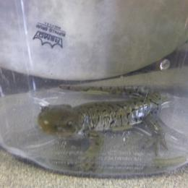
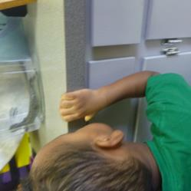
We learnt that Sully was a Tiger Salamander.
What We Learned About Salamanders
We learned that the owners found him in their basement. They made him a home and now he is their pet.
Salamanders cannot get dry or they get dehydrated.
They like to eat at night.
They eat insects, frogs and worms. Sully ate turtle food and worms.
When they are in the wild they can live 12 to 16 years.
They grow 18 cm to 35 cm. Sully was approximately 22 cm.

Slide 29
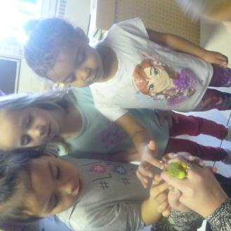
Bat Girl the Bird
Here is some of the things that they children talked about when watching the bird:
“She has wings to fly (as she flapped her arms in the air like she was flying)!”
“Does she have a bathroom in her home?”
“Why isn’t she flying? (The bird tweets) What did she say?”
“Her feather came off. HELLO She’s soooooo cute and pretty! Hey, come down here to me! How does she sleep?”
“There are feathers. She is biting her feathers.”
“I see her feet. How does she put her head backwards? Maybe she bends it.”
“I think she is itchy.” (A feather falls off the bird and lands on his cheek) He laughs and says, “Maybe I can fly now!”
My dad held his left finger out like this (points her finger out like a branch) and held a bird on it!”

Slide 30
What We Learned About Bat Girl and Budgies
Bat Girl and Budgies
They eat seeds, and often crack them and make a big mess!
Budgies grind their beaks when they’re happy or relaxed similar to cats when they purr.
They can learn to “talk” or repeat phrases. They can even learn to count up to three! Bat girl liked to sing.
When they are very still they’re usually sleeping, and many like to tuck their heads under their wing. Bat Girl liked to sleep upside down that how she got her name.
She poops Lots!
They lose feathers just like we lose hair. Old feathers fall out and new feathers grow.
Budgies like to play! Bat Girl would come up to the cage and peck at a persons fingers.

Slide 31
Bat Girl Loves To Sing
A student discovered that if he squeaked the dog bone squeaky toy near the cage Bat Girl would sing! The children thought that this was the funniest thing!

Slide 32
Spidey The Beta Fish
Dotty The Bearded Dragon

Slide 33
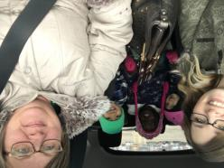
And we’re off…
We decided that a great way to wrap up our pet project would be to visit our neighborhood pet store.
We picked up our friends and headed to the store.
I wonder what kinds of animals we might see there?
Some thought giraffes or zebras, maybe a puppy or a cat or perhaps a monkey!
The children were quick to point out that we had reached our destination. They could tell we were there by the paw prints on the outside of the store.

Slide 34
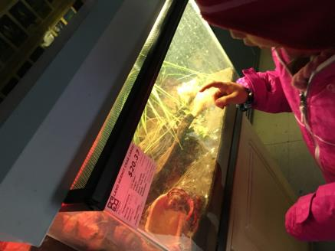
We headed for the back of the store where all the fish and water animals could be found. A student discovered the hermit crabs. “They move so fast!” Some of our other friends discovered the snakes. “Yucky!” That is not a pet that Mrs. C. or Mrs. W. want in the classroom.

Slide 35
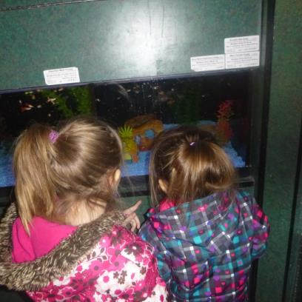
There were many different kinds of fish. We found gold fish, angel fish and even one that was called a mini shark! The children were super excited to find where Sponge Bob lived! They were looking to see if they could find any of his friends!

Slide 36
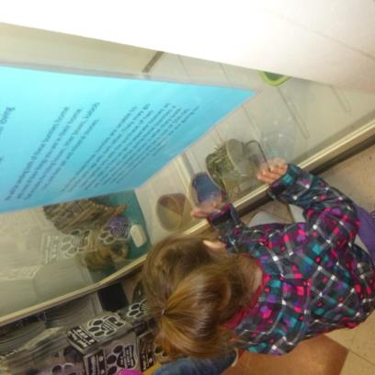
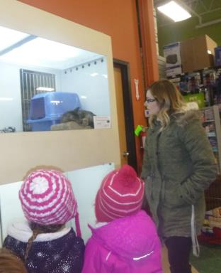
Time to check out the animals that were up for adoption. There were a couple of cats and even a cute little bunny. We all would have loved to take them back to school with us and make them our class pets.

Slide 37
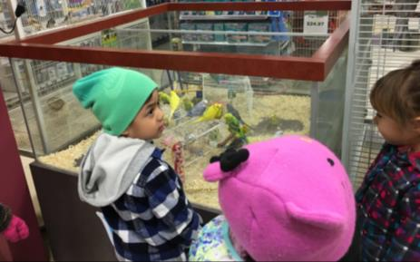
Birds, Birds, Birds and more Birds….. They were all very vocal and singing up a storm. Marley said that they looked just like Bat Girl the little bird that came to visit our classroom. The children commented on the many different colors the budgies came in. It was almost like a rainbow.

Slide 38
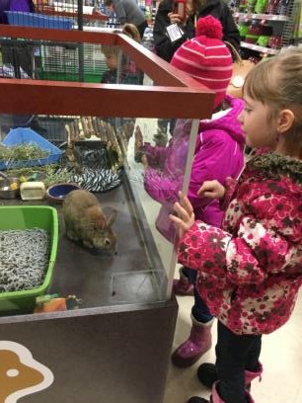
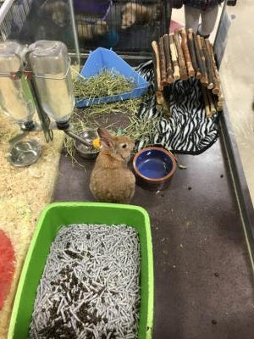
A student discovered the cute little bunny. The students thought he would make a great classroom pet as well. We wondered if he might possibly know the Easter Bunny. We also decided that those were not chocolate covered raisins in his cage!

Slide 39
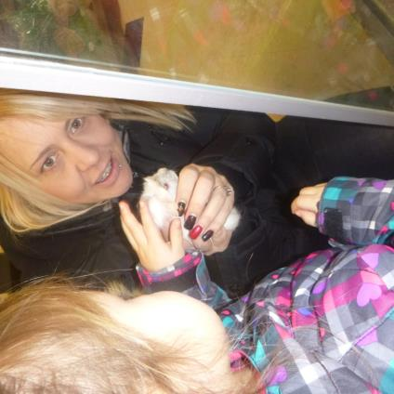
Next up…. rodents! One student was a little unsure of the rat. She didn’t think we should hold it. A mom held a cute little gerbil so the students could pet it. What a great opportunity to get to touch some of the pets.

Slide 40
Now these little guys were a huge hit. We were able to observe these little ferrets have a bath and play time!

Slide 41
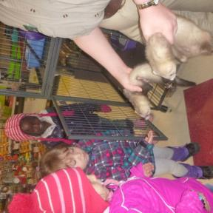
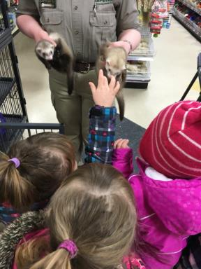
First the Petland worker took the ferrets out of their cage and then we tried to pet them. They were very wiggly and really wanted to get into their play area.

Slide 42
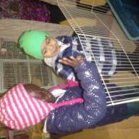
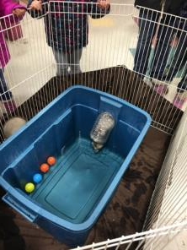
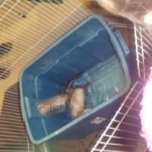
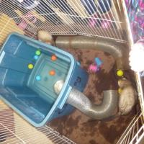
Let the fun and games begin! These little guys loved their bath and playtime. They climbed in and out of the tubes and chased each other around and around. We decided that they would not make a good classroom pet. Even one girl said they had “too much energy!”

Slide 43
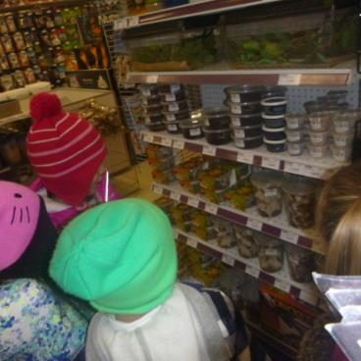
We also learned that some animals eat insects in order to survive. Although we thought it might be fun to have some of these insects as pets instead.

Slide 44
A student found a very big dog treat! It was almost as tall as she was!

Slide 45
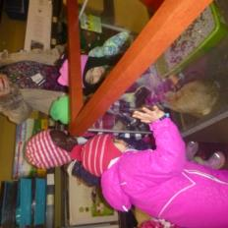
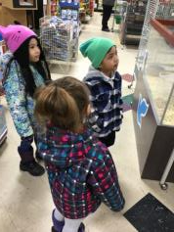
Wrapping it up
We had so much fun on our outing. The students were engaged from beginning to end. Many of their questions regarding pets were answered and they were able to experience some animals that they had never seen before.
We found out that the pet store does not sell giraffes or zebras but it does have a great selection of small pets and everything that you need to take care of them.
We are still talking about what kind of pet we should get for our classroom as a friend for our beta fish, Spidey.

Slide 46
Essential Learning Experiences
“Quality learning programs recognize children develop socially, emotionally, physically, intellectually, and spiritually. When children have opportunities to grow holistically in well prepared environments, children build relationships with their peers, adults, families and communities.” (Play and Exploration, p.9)
Intellectual Development Language and Emerging Literacy
As the children created their dramatic play scenarios they where engaged in conversation with one another. When they were conversing often it was sustained, lengthy, and frequently conveyed new ideas about a vet clinic, doctors, animals, pet stores, and money.
The children were consistently inquiring and asking questions of what they different medical devices and objects where used for by the doctors, they were also curious about what kinds of animals are pets.
The children had a tremendous amount of opportunity to learn new vocabulary while they explored. Some of the words that they learned were stethoscope, x-ray, veterinarian, blood pressure cuff, grooming, prescription and cash register.
As the children played I could tell that the children where using prior language experiences to enhance their play. They would often talk to do things to their animals like their caregivers to do them when they are sick, or what may have happened to them at the doctors office.
I witness the children use and read the books that were in the vet clinic to learn more about a veterinarian job, and about different pets. They would often tell the story in their own words!
The children loved to explore with print as they wrote down the pets diagnosis, and wrote prescriptions.

Slide 47
Essential Learning Experiences
Social Emotional Development
The children developed self-awareness during this project. They had the opportunity to pick what kind of animal they would like if they had a pet at their house. They had a variety of things to choose from when playing with the animals, and they had a large selection of animals to choose from.
The children began to develop lots of confidence and had lots of opportunity to try and experience new things.
Following the children’s lead throughout this project enforced to them that their ideas are valued and worthwhile. They felt a sense of belonging.
The children not only had they opportunity to express their emotions but they also incorporated emotions into their play; as they would say how their pets where feeling. For example: My doggie is sad he is sick. And they would also show empathy for one another and their animals when they weren’t feeling well.
Physical Development
The children where using their gross motor skills as they crawled around the classroom pretending to be different pets (most of the time kitties).
The children used their fine motor skills lots as they manipulated the different instruments in the classroom. They often had to squeeze, twist, pour, grasp the different medical tools, medication, and grooming tools. The children were also given the opportunity to print when they wrote out perceptions and diagnosis.
Spiritual Development
The children showed appreciation for the wonderful things in our environment that God has blessed us with.
We are blessed to have people care and look after our animals when they’re sick.

Slide 48
Cross-Curricular Learning
Religion
The children were thankful for the wonderful creatures God gave them.
Science
The children learned about different types of animals.
The children were given the opportunity to observe and discover with a variety of pets.
Social Studies
The children learned about different jobs, places and people that are in our community.
Doctors, vet and vet clinics, pet stores and pet groomers.
Health
The students learned to care for their pets and the importance of looking after them.
The students were re-enacting situations that happened when they were at the doctors. They learned that they doctors office is not a scary place rather they want to help us and keep us healthy.
Art
The children used their imaginations as they created lots of dramatic play.
The children drew and coloured different pets.
Language Arts
The children had lots of opportunity to use imaginary printing, as they would write out prescriptions and diagnosis.
The children would read the books about the animals to learn more about their pets.
Mathematics
The children learned about different price values and the value of money.
The children explored with numbers, and one-to-one correspondence. For example: The dog needs three needles, or two bones. Or that kitty costs two dollars and they would count out two coins.
The children would practice counting theirpets feet and comparing how many legs and toes the different animals had.

Slide 49
Teachers Reflection
We enjoyed following the children’s lead while doing this project with them. We often had to take a step back and put ourselves in their shoes. We would sit down at their level to get a deeper understanding of what was sparking their interest and making them want to touch and investigate. We had to take the time to reflect on what made them excited, curious, and where were their very inquisitive minds going and wanting to explore and learn more deeply about. When they were given the materials and environment they became more intrigued to learn new things. The foundation of our curriculum was created by valuing and considering the children’s ideas worthwhile. The children’s minds flourished, and the learning became exciting and joyful for both the students and we as teachers.
Throughout our projects our theme changed many times but in doing so we were able to see holistic growth among all the children. The children grew socially, spiritually, emotionally, physically and intellectually. The deep inquisitiveness, wonder and understanding of how the world works around them and how they fit into it was astonishing. Our learning went to new altitudes and it was exhilarating to see the sparkle in their eyes when they discovered something new. And the BEST part about this project was everyone had FUN!
“Play is the highest form of research” (Albert Einstein).

Slide 50
We are Thankful for God’s Creations
Day one brought heaven earth and light. It must have been so very bright! Day two God made the clear blue sky. A place for many birds to fly. Day three brought land apart from seas. With all the plants grass and trees. Day four shone forth moon, stars and sun. The work of God was not yet done. Day five we see the fish and birds. God did all of this with just His words. Day six God formed all beasts and man To finish His creation plan. Day seven was especially blessed, A day for worship and for rest.
Children are a gift from the LORD; they are a reward from him.
Psalm 127:3

Slide 51
“As adults, our familiarity with common materials may limit possibilities we see in them. Young children, on the other hand, are new to this world and still see its magic and wonder everywhere around them. They approach experiences with an open mind, unencumbered by frameworks and labels. Because they are in the process of exploring and constructing an understanding of their world, they notice details and try out a variety of operations and interactions with everything they encounter. If you take their point of view while looking for collections to offer, your planning and children’s exploration and learning will be more joyful” (Curtis and Carter).

Slide 52
Learning Story
Next is a learning story that we sent home with a child for the parents to respond and send back.

Slide 53
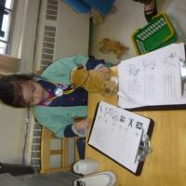
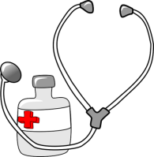
Dr. T.
Looking after the pets in the vet clinic.

Slide 54
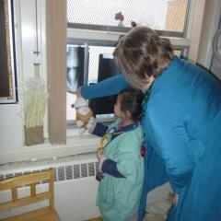
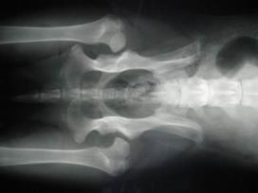
Mrs. W then showed the x-rays that were taped to the window.
“These show the bones of the puppy.” “This is the spine or backbone of the puppy and these are the legs.”
She then looked at her puppy and found the spine and legs.

Slide 55
Essential Learning Experience of One Child
The student showed empathy towards the sick puppy.
The student was able to manipulate all the medical
instruments properly and with great ease.
The student was able to read the chart and
apply the instructions to her puppy. She
is clearly showing signs of emerging
literacy.
The student was eager to learn about the x-rays and was so happy when her puppy was well again.
“The knowledge and skills that a child can develop interacting
with an adult or peer is greater that the child can gain alone.” Vygotsky

Slide 56
We know that children learn when they are interested in the topic and that learning is also based on previous experiences.
The student was obviously interested in the well being of pets and the fact that we provided the environment for her to explore further that interest increased her learning, compassion and knowledge of pet care and the tools used for their care.
The student was ‘playing vet’, but ultimately was learning as well. She showed great empathy and compassion when she said her puppy was not well. She also concluded her play by making sure that her patient had been well looked after. (Social/Emotional)
She had great control of the instruments used to care for her pet. She knew how each should be used and had no problem executing their purpose. She needed to use both large and small motor skills as well as coordination. (Physical)

Slide 57
The student followed the information provided for her on the sheet in the vet clinic. She then knew which instruments would be needed and what their intended use was. She would then check off each instruction as she completed them. She showed great knowledge of concepts and emerging literacy. (Intellectual)
Finally she grew in her development of awe and wonder. She was in awe when she realized that that x-rays showed her the inside of the dog. She also wondered how to make the puppy better and the steps that it might take. (Spiritual)
Teacher Reflection - I enjoyed being with this student during this learning experience. It showed me how competent and knowledgeable she is. She has obviously experienced going to the doctor and knows what each tool does and how they follow procedure. Maybe one day I will visit with her at her own vet clinic with my sick puppy.

