Slide 1
Farming
Kindergarten

Slide 2
Chicken Coop
This was the chicken coop I set up to gauge students interests. The students ran with this idea!

Slide 3
Making Nests
Students loved the chicken coop and decided the chickens needed nests and began creating nests for the chickens.

Slide 4
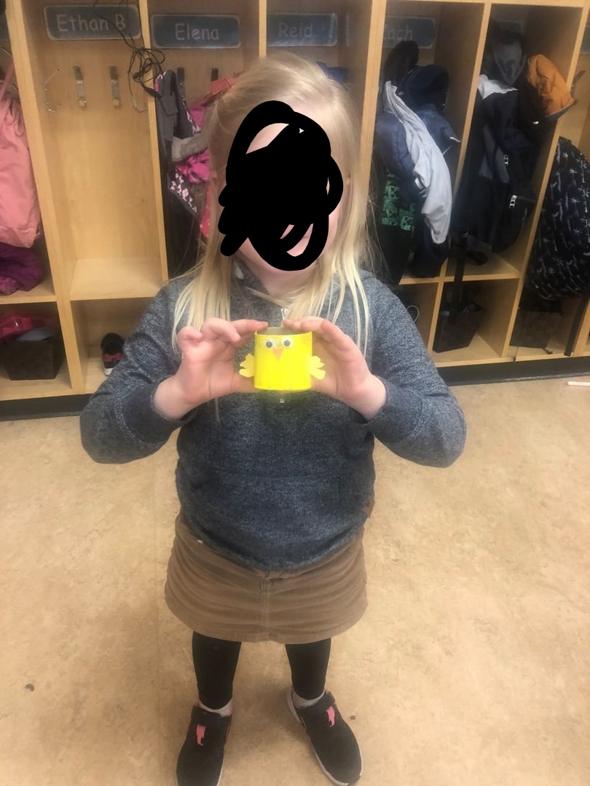
Making chicks
Students decided we needed baby chicks to go with the chickens so they got to work making chicks.

Slide 5
Sensory Bin
Next I added a sensory bin with grain, animals and tractors. This brought in the discussion of planting seeds and what seeds can be made of. In this case it is durum in the bin so it can be made into pasta.

Slide 6
Milk Cow
The third thing I added was a milk cow! The students loved this. This allowed students to explore cows and where milk comes from.

Slide 7
Adding spots
The students thought the cow needed more spots, so out came the markers!

Slide 8
Web
We learned what foods come from grain. We learned eggs come from chickens and that milk comes from cows.
We are still investigating further and students had some more questions.
What kinds of farms are there?
How do you plant bread?
How do you plant seeds?
How do farmers make cheese?
How do cows make milk?
Who makes lettuce?

Slide 9
Next Steps
Zoom call with a farmer.
Have a farmer bring a lamb into the school.
Planting seeds and learning to plant and care for plants.
Have a student share about his own chickens.

